Slide 1
Let’s not do another survey!
Program improvement evaluation techniques
California 4-H Association | February 2017
Kendra M. Lewis, Evaluation Coordinator

Slide 2
Objectives
Sharing fun and engaging ways to collect formative (program improvement) data!

Slide 3
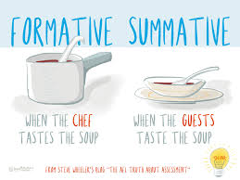

Slide 4
Common things we want to know
What did you like?
What would you change?
Did you have fun?

Slide 5
Other useful information
What worked and what didn’t?
What did you actually do?
What did the youth learn? What did they get out of the program?

Slide 6
Plus/Delta Sheets

Slide 7

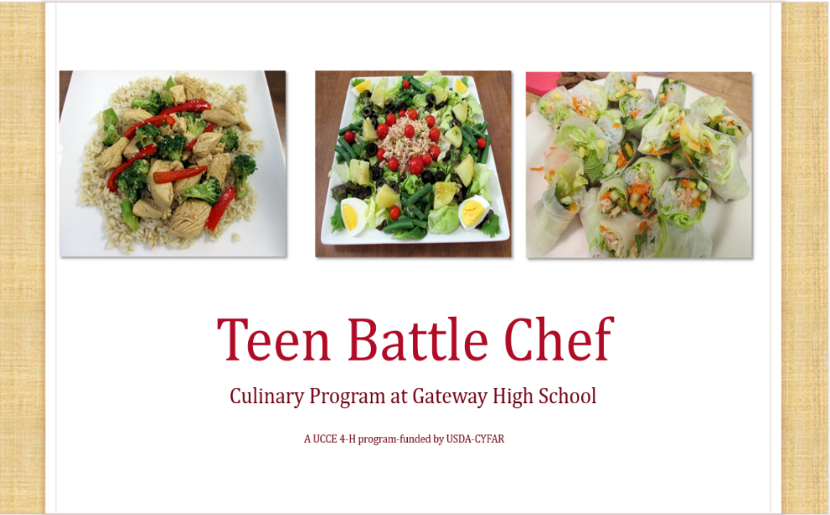
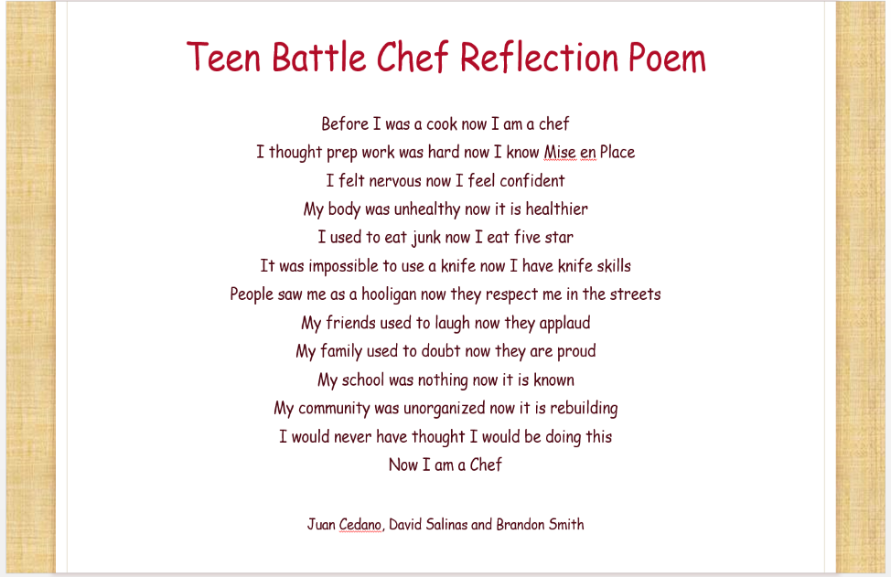
Journals, Presentations, Blog
Notes:
Cool Trick – Journals: At the start of a program, provide journals for all youth in the program and ask them to write something related to the program goals. Is one of the program’s goals to develop leadership skills? They can ask the youth to respond to this question: “In what ways are you a leader?” Is one of the goals to increase enjoyment of reading? “What do you like about reading?” Then, at the end of the program, youth can read what they wrote the first day and write “How would you answer that question differently, now?” or some other question to get them to reflect on how they’ve changed in the program.

Slide 8
Interviews/Focus Groups
I would tell them to participate in Thrive because it’s fun. They have an opportunity to learn things in this project that they can’t, that they’re probably not going to learn until they get into college
  What did you enjoy most about the Thrive program?
  What aspects of the program could be improved upon for the future?
  What would you tell other young people about Thrive?
I would tell [other youth] that they should join the project and that they should come into it with an open mind. Just interact with others and that you’ll automatically get something from it. Everyone can get anything from it
I thought that this year was, it, this year it seemed like the program took all of the suggestions from last year and made them

Slide 9
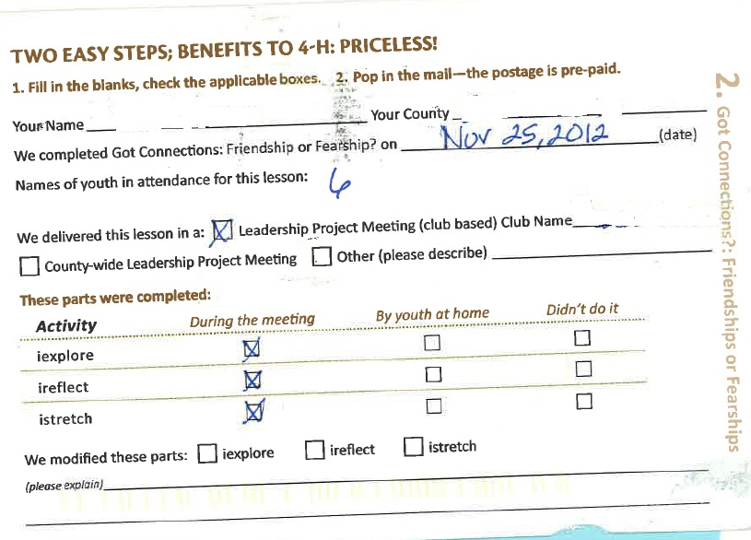
Postcards

Slide 10
Photo Voice
Uses photography for expression
Have clear prompts (3-5)
Have youth take photos that represent those prompts
Have time for youth to reflect on their photos and the photos of others
Share the results! Create a photo gallery, put them into a presentation or blog, write a report
http://aea365.org/blog/yfe-week-elizabeth-diluzio-and-miranda-yates-on-implementing-youth-photovoice-for-strategic-planning/

Slide 11
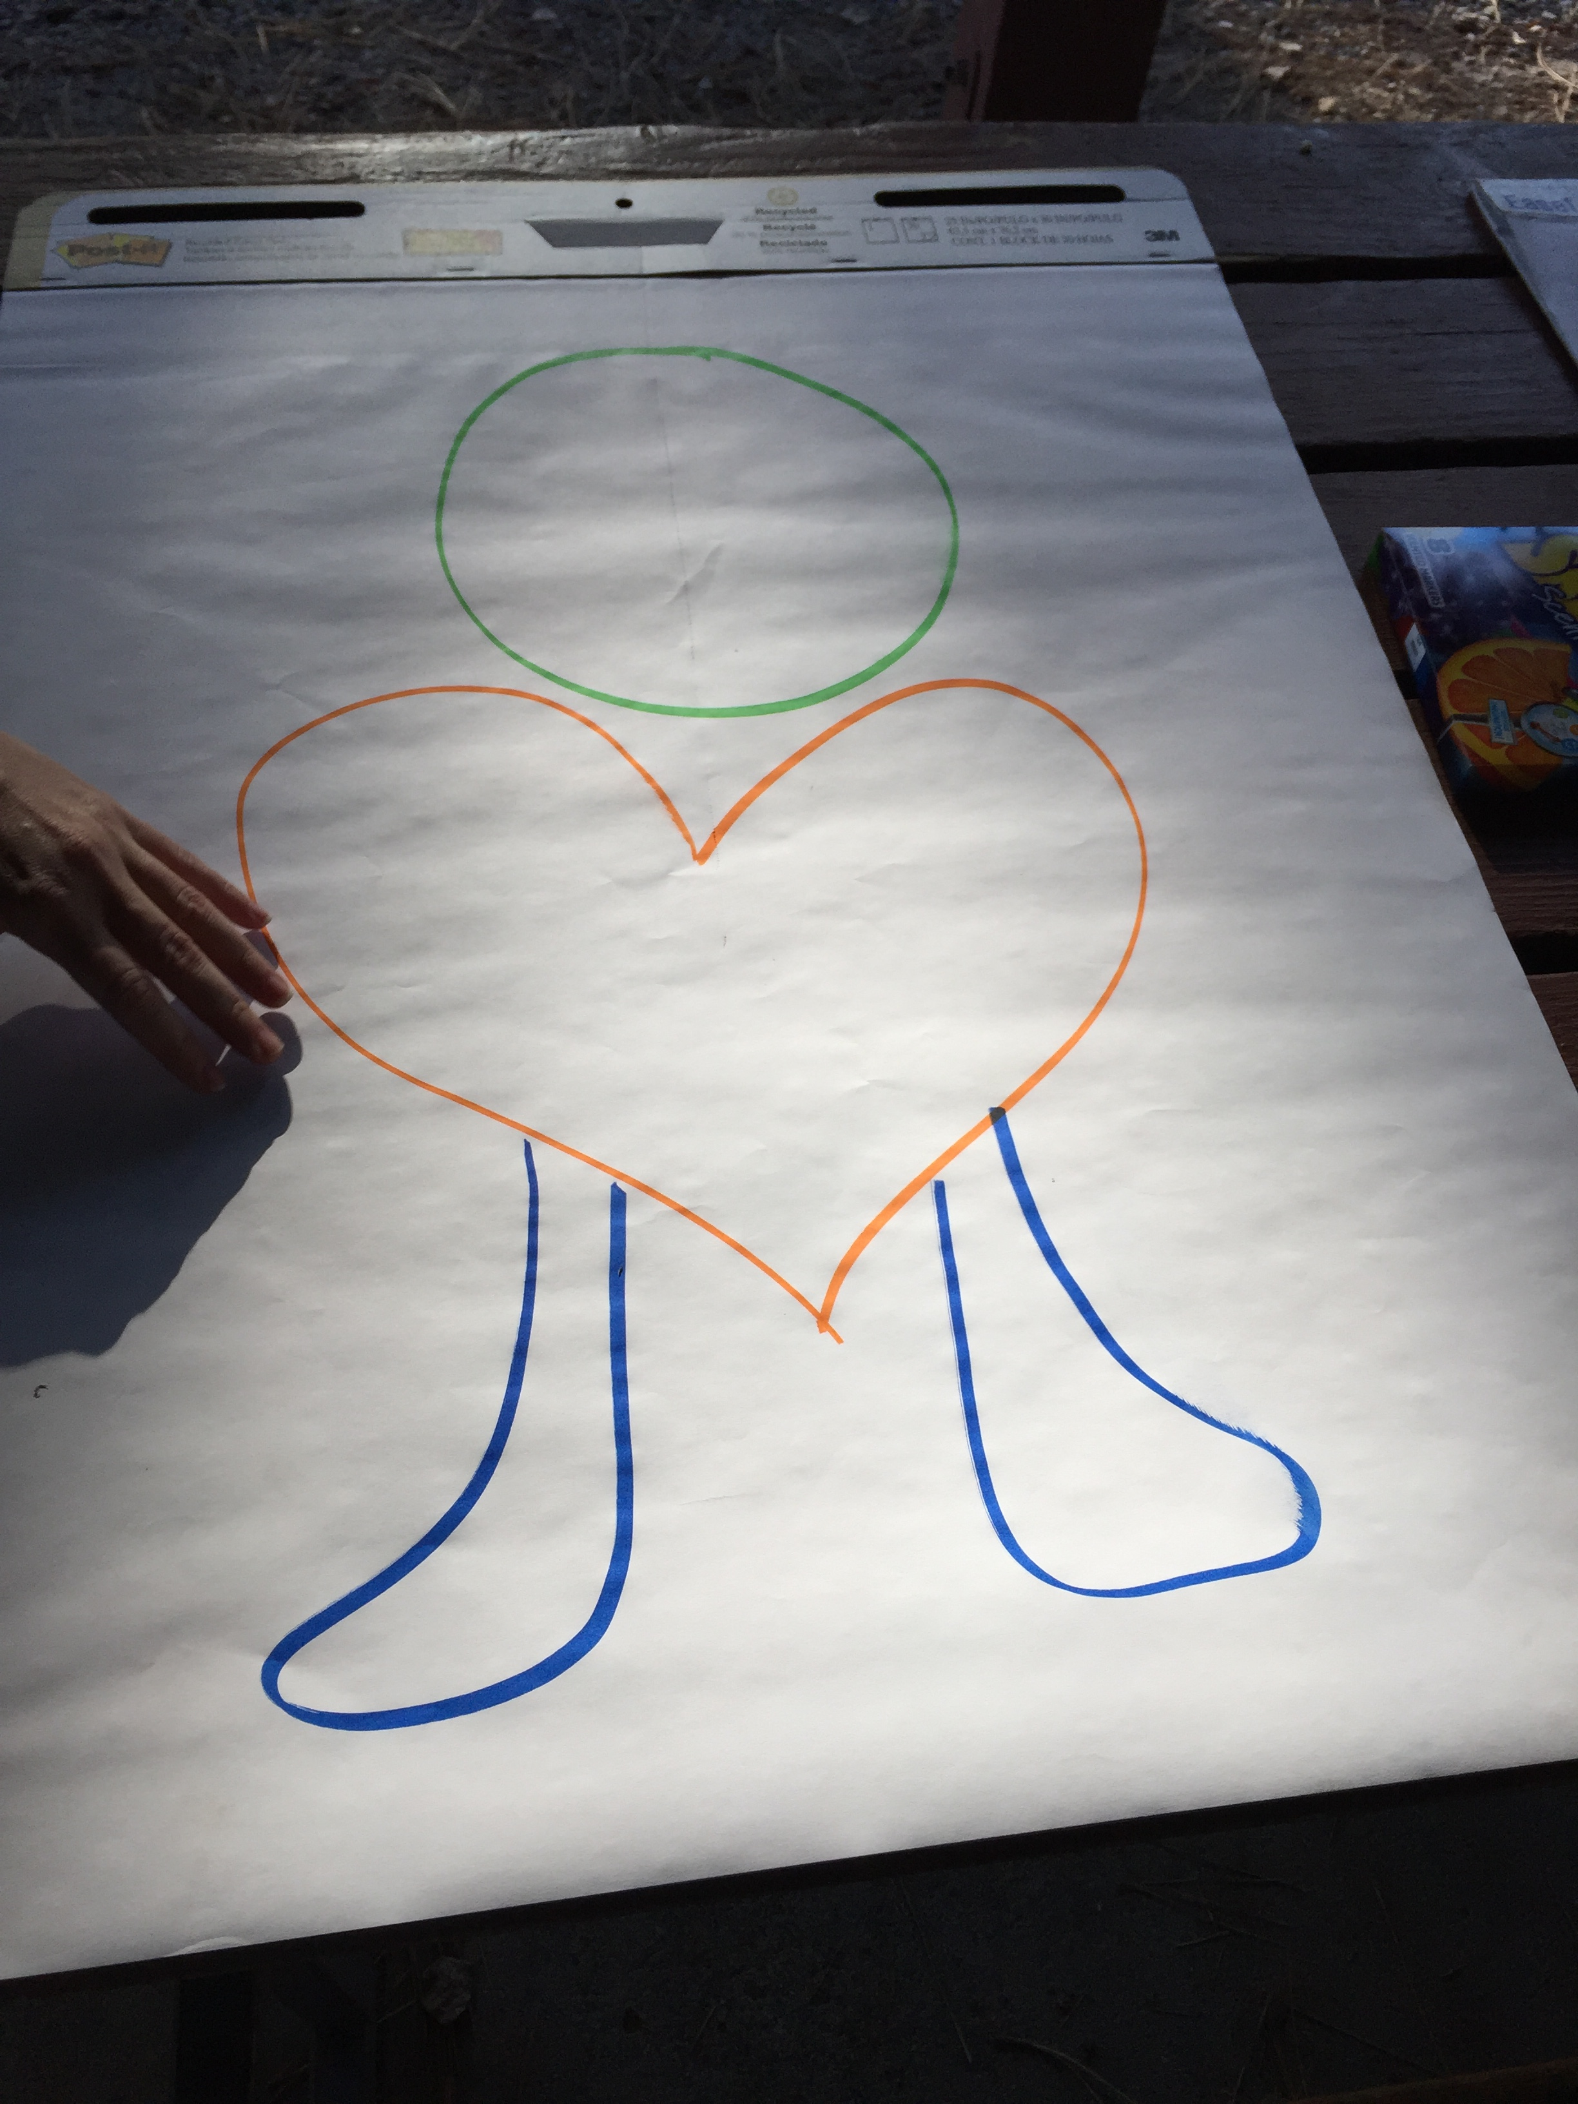
Evaluation Dude
Head: What did you learn?
Heart: How did you feel?
Feet: Action Steps/Plan

Slide 12
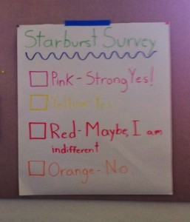
Candy Surveys
http://aea365.org/blog/yfe-week-jessica-manta-meyer-jocelyn-atkins-and-saili-willis-on-creative-ways-to-solicit-youth-feedback/
Notes:
Cool Trick – Candy surveys: Ask students to answer surveys questions by putting certain colors of candy in a cup then tally the candy colors to get your responses. Have the youth tally the results themselves. They can even make a bar chart on chart paper by taping the actual candy to the paper. The youth can then eat the candy after they’ve tallied the results.
Hot Tip – used wrapped candy! Starburst works
Recommend finding something healthy to do instead of candy!

Slide 13
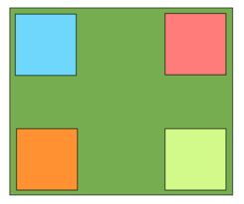
Four Corners
Notes:
Cool Trick – 4 Corners Activity: Youth leadership programs do this all the time. They ask youth to “take a stand” next to signs that are marked Strongly Agree, Agree, Disagree or Strongly Disagree in response to a statement like “youth should be able to vote at age 16.” Once the youth stand next to one of the signs, the group can talk out their different perspectives. Programs can also use this to collect both quantitative (how many stand where) and qualitative (what they say about why they are standing where they are) data.
--This can also be done in a line.

Slide 14

Example
Statement | Strongly agree | Agree | Neither agree nor disagree | Disagree | Strongly disagree
Youth treasurers should sign all checks written by the club.
The club’s general leader should write the monthly agenda.
Parents should be able to vote on club issues at monthly meetings.
Older teens in the club do not need to attend club meetings
Count the number of people standing in the different areas and record the numbers. You can also use this process to facilitate discussion about why people took various positions.

Slide 15
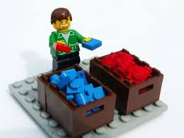
Image Sorting
Notes:
Museum wanted new galleries. After people went through the gallery, they were asked to sort photos of current gallery exhibits:
1. Really liked
2. Take or leave
3. Don’t like
After sorting, ask what they liked, asked what they didn’t like and why. Get some demographics
Then have a recording sheet to mark which they liked.
Advantages: fun, engaging, maybe better recall-have photos as a prompt. Give opinion in fun, easy way. Quicker, easy, tactile.
Other uses: photos of projects, ask them to pick what stands out to most.
Example 2:
Sort things (photos of manipulatives) that help them learn math.
Have done some in pairs, small groups. Drawing okay, but sorting might be more challenging
Seems to work more formative, more process. Less about the impact.

Slide 16
Games – Card Sort
Print brief explanations of program outcomes (or whatever you are seeking information about and wish people to rate or rank) on 3 x 5 cards. Make one set of cards for each participant. Or, let participants generate the items (e.g., benefits they gained from the program) and create one set of cards for each person.
Write the rating scale (excellent-poor) or ranks (1st, 2nd, 3rd…) on baskets placed on a table.
Ask participants to sort and put their cards into the appropriate basket.
You may wish to prioritize the cards in each basket.
This can be done individually or as small groups working together.
Simple key words or graphic images can be used to ease literacy requirements.

Slide 17
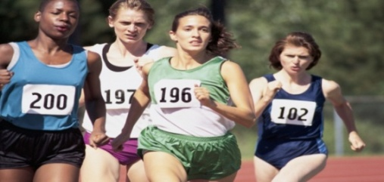
Action cards
Action cards are index cards
on which participants record steps, actions, and accomplishments during the course of a project or program. Individuals or groups write a short entry on each card - a few words or sentences. The cards help to monitor progress, critical incidents and accomplishments.
Youth can fill in the cards at regularly scheduled meetings or specified times. Information on the cards become data for later analysis.

Slide 18

Fun with stickers!
This idea may work well with young children. Count out a fixed number of stickers and place the same number in each of three cups (use any number of cups). Label each cup with “learned a lot”, “learned a little”, didn’t learn anything”, or whatever response options fit your question. Ask each youth to take a sticker from the cup that best answers the question you ask (your evaluation questions). Tally after each question. The youth get a fun sticker and you get evaluation data.

Slide 19

Other Ideas
Tweets
Time Capsule
Skits
Drawings
Videos
Storyboards
Collages
www.uwex.edu/ces/4h/evaluation/documents/CreativeMethods.ppt
Notes:
Cool Trick – 4 Corners Activity: Youth leadership programs do this all the time. They ask youth to “take a stand” next to signs that are marked Strongly Agree, Agree, Disagree or Strongly Disagree in response to a statement like “youth should be able to vote at age 16.” Once the youth stand next to one of the signs, the group can talk out their different perspectives. Programs can also use this to collect both quantitative (how many stand where) and qualitative (what they say about why they are standing where they are) data.
--This can also be done in a line.
Collage: have them create a collage about the program, activity. Alone or in groups
Tweets: make sure to create a hashtag and ask youth to use it so you can find them all later.
Same with pictures on Instagram,

Slide 20
Program Quality
Goals
  Assess the quality of our programming
  Are we providing our youth with safe, welcoming, engaging environments and programming?
  Set goals/make action plans to improving 4-H programming

Slide 21
Contents
Safety
Relationship Building
Youth Engagement
Community Involvement
Action Plan
Skill Building
Content
Teaching Methods
Action Plan

Slide 22
Pilot-testing
Project meetings and afterschool programs
Observations
Self-Assessment
Youth Perspectives
  Available in ORB in May 2017

Slide 23
Large events
Surveys might be easiest
Can have large print-outs to leave up
  Evaluation Dude
  Plus/Delta sheet
  Large signs with stickers
  Candy surveys

Slide 24


Slide 25
Ideas
http://aea365.org/blog/julie-carpineto-and-kelly-washburn-on-using-a-creative-evaluation-project-to-engage-youth/
http://aea365.org/blog/yfe-week-julie-poncelet-catherine-borgman-arboleda-and-jorge-arboleda-on-using-participatory-video-to-engage-youth-in-evaluation-in-a-creative-and-empowering-way/
http://aea365.org/blog/jan-noga-on-surveying-young-children-part-two-collecting-effective-and-usable-data/
http://aea365.org/blog/lori-peterson-on-conducting-focus-groups-with-high-school-students-with-disabilities/
http://aea365.org/blog/kimberly-kay-lopez-on-getting-creative-with-the-type-of-data-you-collect-and-use-for-evaluations/
https://www.edutopia.org/discussion/10-fun-filled-formative-assessment-ideas
https://globaldigitalcitizen.org/12-awesome-formative-assessment-examples

