Slide 1
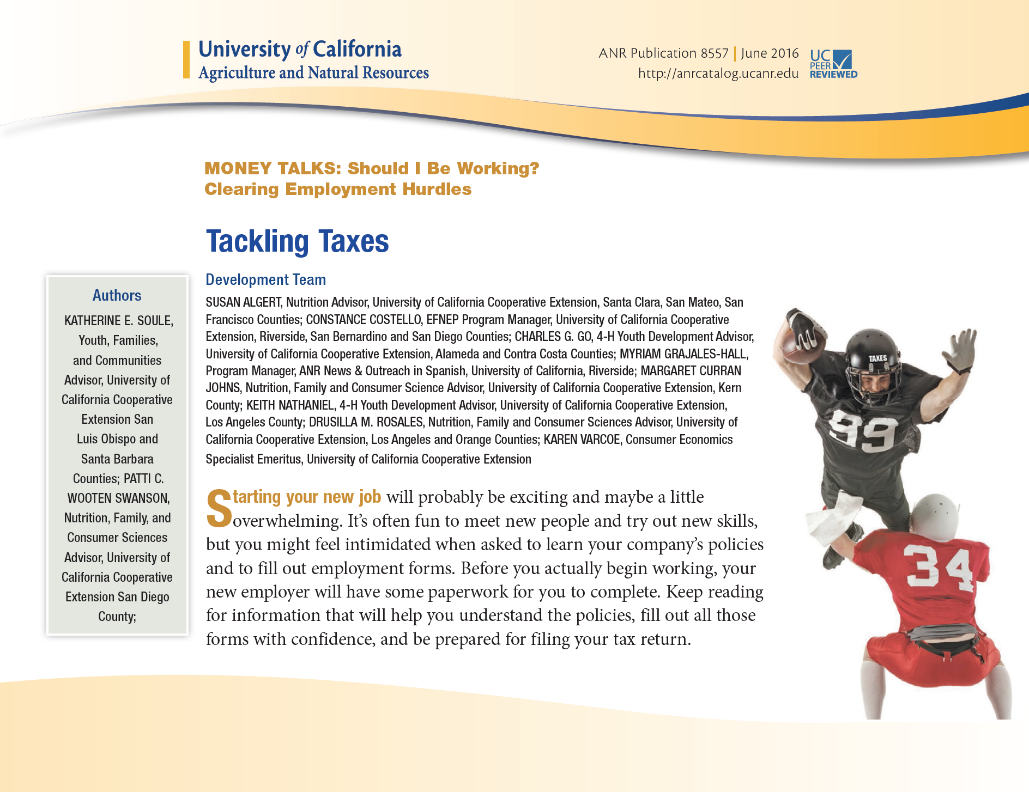
Money Talks: What Can it Do for You
Presented by:
Derrick Robinson
UC ANR, Youth Families & Communities
www.moneytalks.ucanr.edu

Slide 2
Money Talks: Introduction
Summary of Objectives
Available resources
How can you use Money Talks
Ways to get involved
Pilot test participation
Formative evaluation
Field Experiments
Are the resources meeting your needs

Slide 3
Money Talks: Youth Consumerism
How much do youth/young adults spend:
As a percentage of what they earn ____%
Weekly? Yearly?
Whose money is it? (Are they producing income or using someone else's?)
Youth/young adults & credit:
What percentage own credit cards?
What percentage make only the minimum payment?
What percentage of college students have credit cards?
What is the average credit card balance being held

Slide 4
Money Talks: Youth Consumerism
Teens spend:
98% of what they earn
$74 weekly (their own & others’ $$)
$175 billon yearly
Teens & credit:
10.3% own credit cards
15.7% make the minimum payment
78% of college students have credit cards
Average balance of $3,200

Slide 5
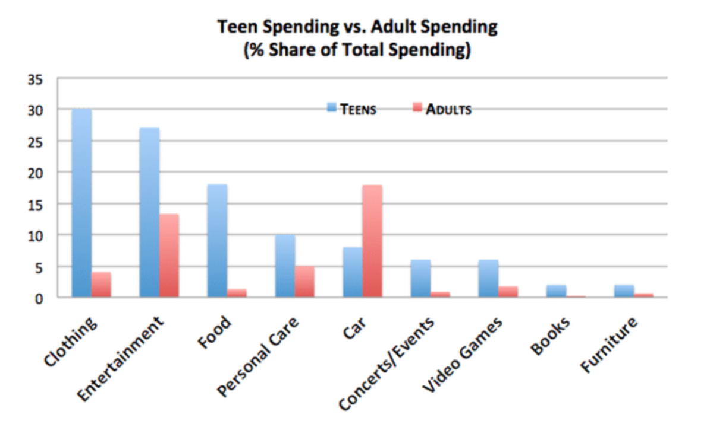
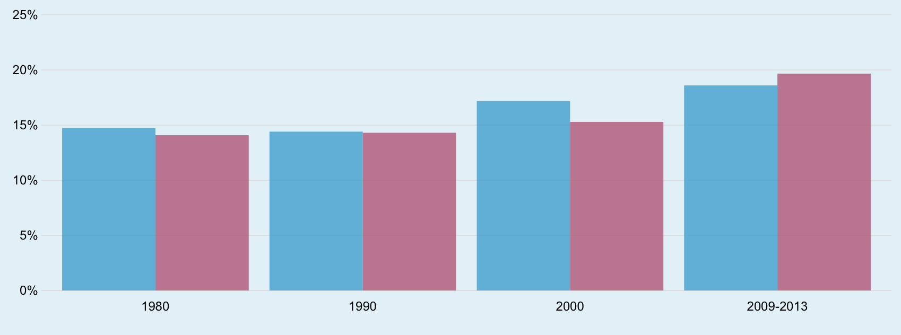
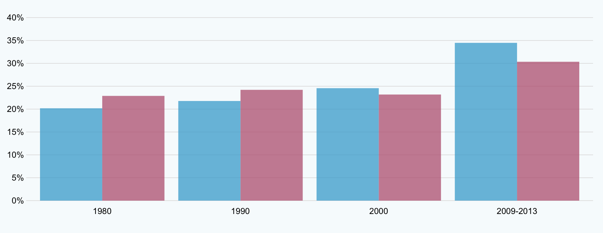
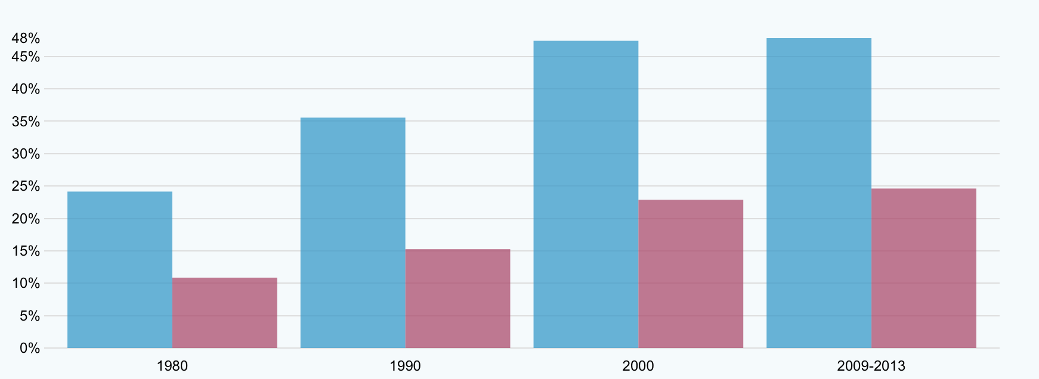
Money Talks: Why we are needed?
CA
USA
Piper Jaffray: 2014

Slide 6
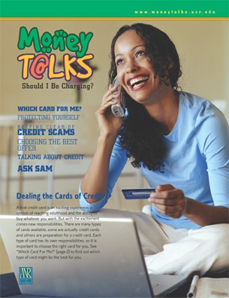
Money Talks: Curriculum
Created to appeal to teenagers as it increases financial literacy capacity and life skill development
Teen/Leader guides; Interactive games; Multimedia
Available free: www.moneytalks.ucanr.edu

Slide 7
Money Talks: Newest Resources
Tackling Taxes
Identity Theft
Living On My Own Series

Slide 8
Money Talks: Ways to Get Involved
Input to MT WG
Pilot testing curriculum is coming soon!
Pilot testing of new website
Formative Evaluation of curriculum in development
Read aloud methodology
Think aloud process

Slide 9
Money Talks: Ways to Get Involved
Input to MT WG
Field Experiments
Behavioral Experiments
Resource Development
Multimedia Resources
Print Resources
Interactive Resources
i.e.: Articulate

Slide 10
Money Talks: Budgeting Activity
Draw a playing card
This decides income
Gather in groups based on the suit of your card choice (try to limit your groups to 3-4)
Use the posters to fill out your budget forms
The posters have distributions of products and costs
After first round introduce economic shocks to households

Slide 11
Money Talks: Meeting your Needs
Are these resources matching the needs of your community?
How can we improve the delivery?

Slide 12
Money Talks: Ask Your Question
dearobinson@ucanr.edu

