Slide 1
Accessing and Navigating the UC Library
Kali Trzesniewski & Natalie Ramos

Slide 2
Objectives
Understand how to navigate through UC Davis online library
Resources on how to conduct basic literature review searches
How to access documents (e.g. journal articles, peer reviewed articles) from Google Scholar and using the VPN
Understanding the What Works Clearnghouse WWC organization
Intervention reports
Practice guides
Reviews of individual studies

Slide 3
Navigating UC Davis Online Library using psycINFOdatabase

Slide 4
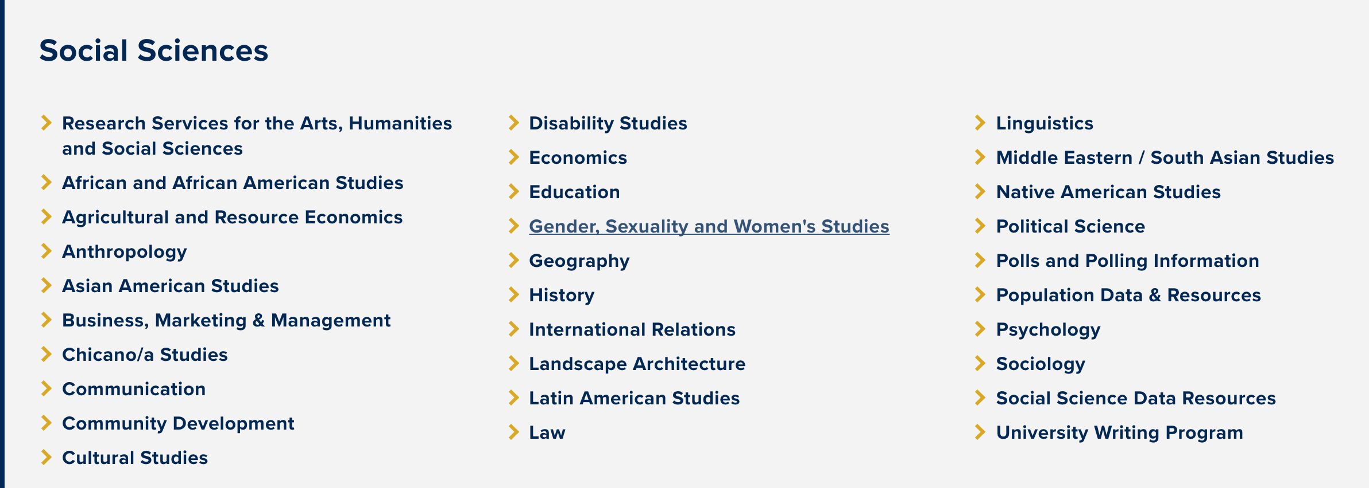
Subject Guides
Subject Guides list library resources by subject area. They are created and maintained by UC Davis subject librarians and organized around broad areas:
Agricultural and Environmental Sciences, Arts & Humanities, Biological Sciences, Engineering & Transportation, General & Multidisciplinary Sources, Government Information, Health Sciences, Physical Sciences, and Social Sciences.
Scroll down to Social Science

Slide 5
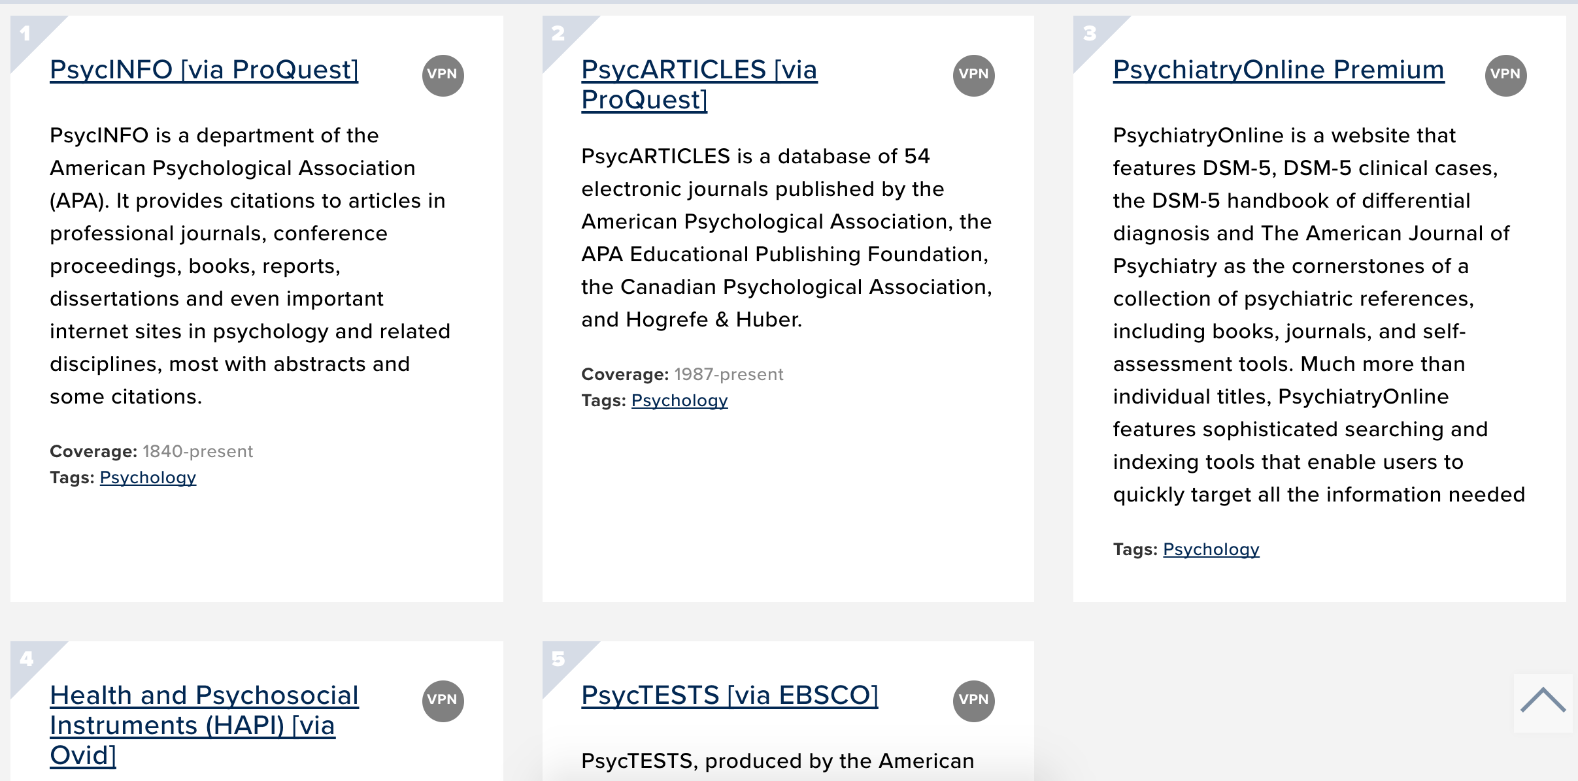
Psychology
Use the tools on this guide to get started with your research in psychology, human development and related fields

Slide 6
PsycINFO search page

Slide 7
1. Search by key words located “Anywhere” or specifically inside the title, abstract, etc.

Slide 8
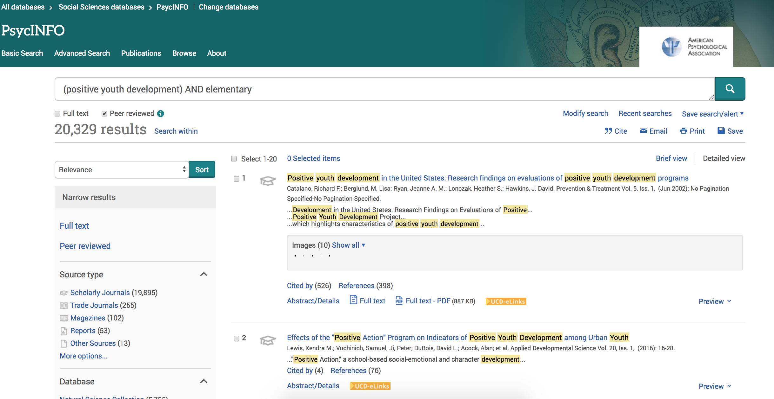
2. Narrow results by publication date, source, age group, record type..etc

Slide 9
Accessing Full Texts from PychINFO

Slide 10
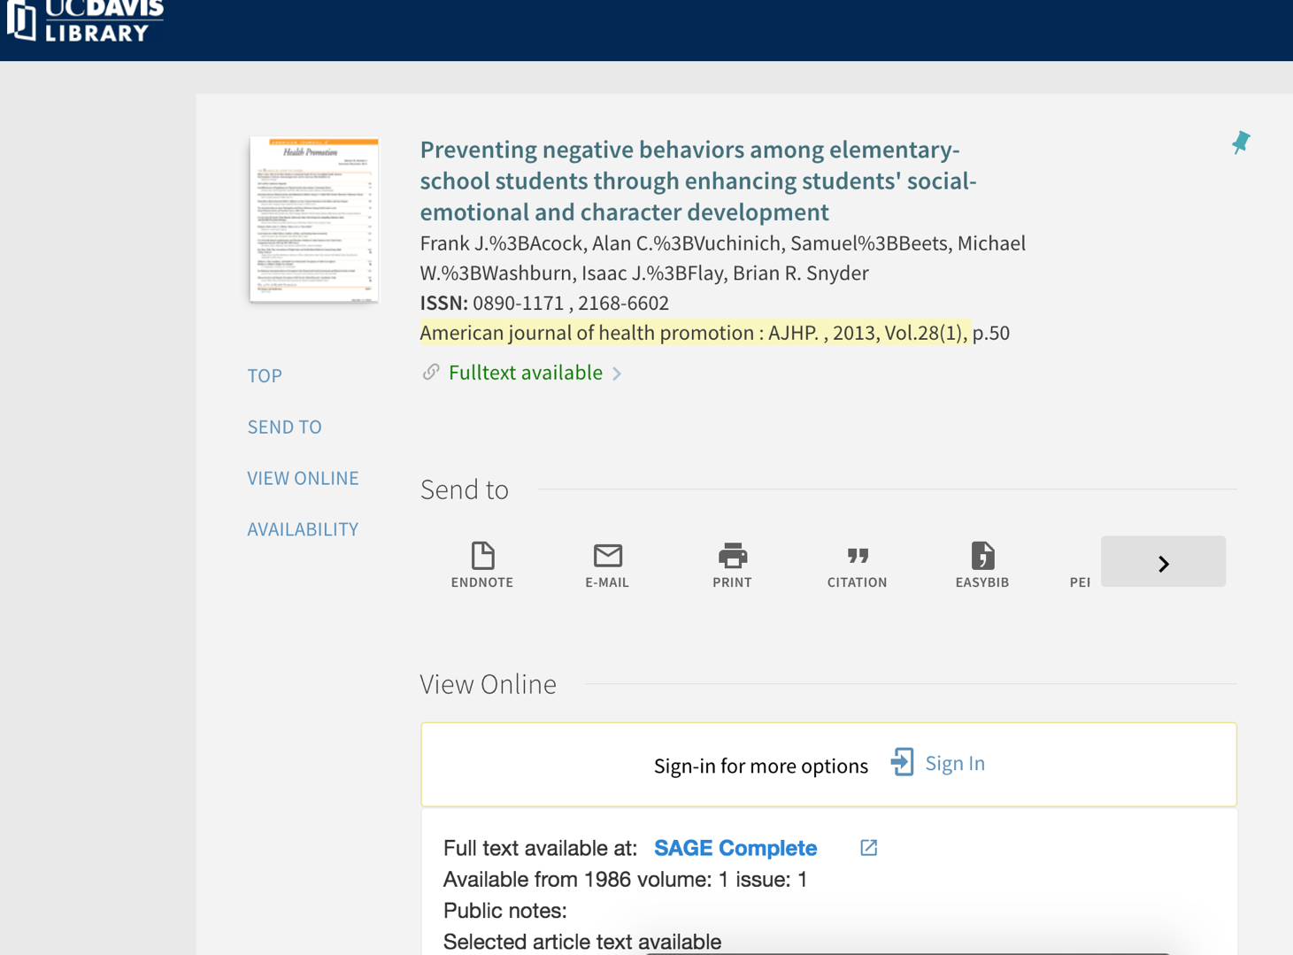
3. Click on Preview or the name of the peer reviewed paper for more details…
4. Locate “full text” options at the orange UCD/e-link

Slide 11
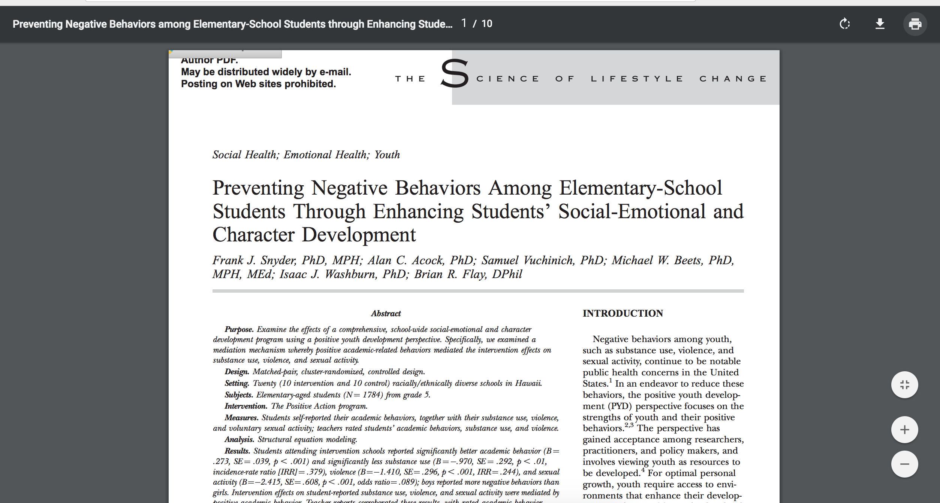
That will often lead you to the publisher website
Where you can download or print the full text PDF

Slide 13
ERIC search page

Slide 14
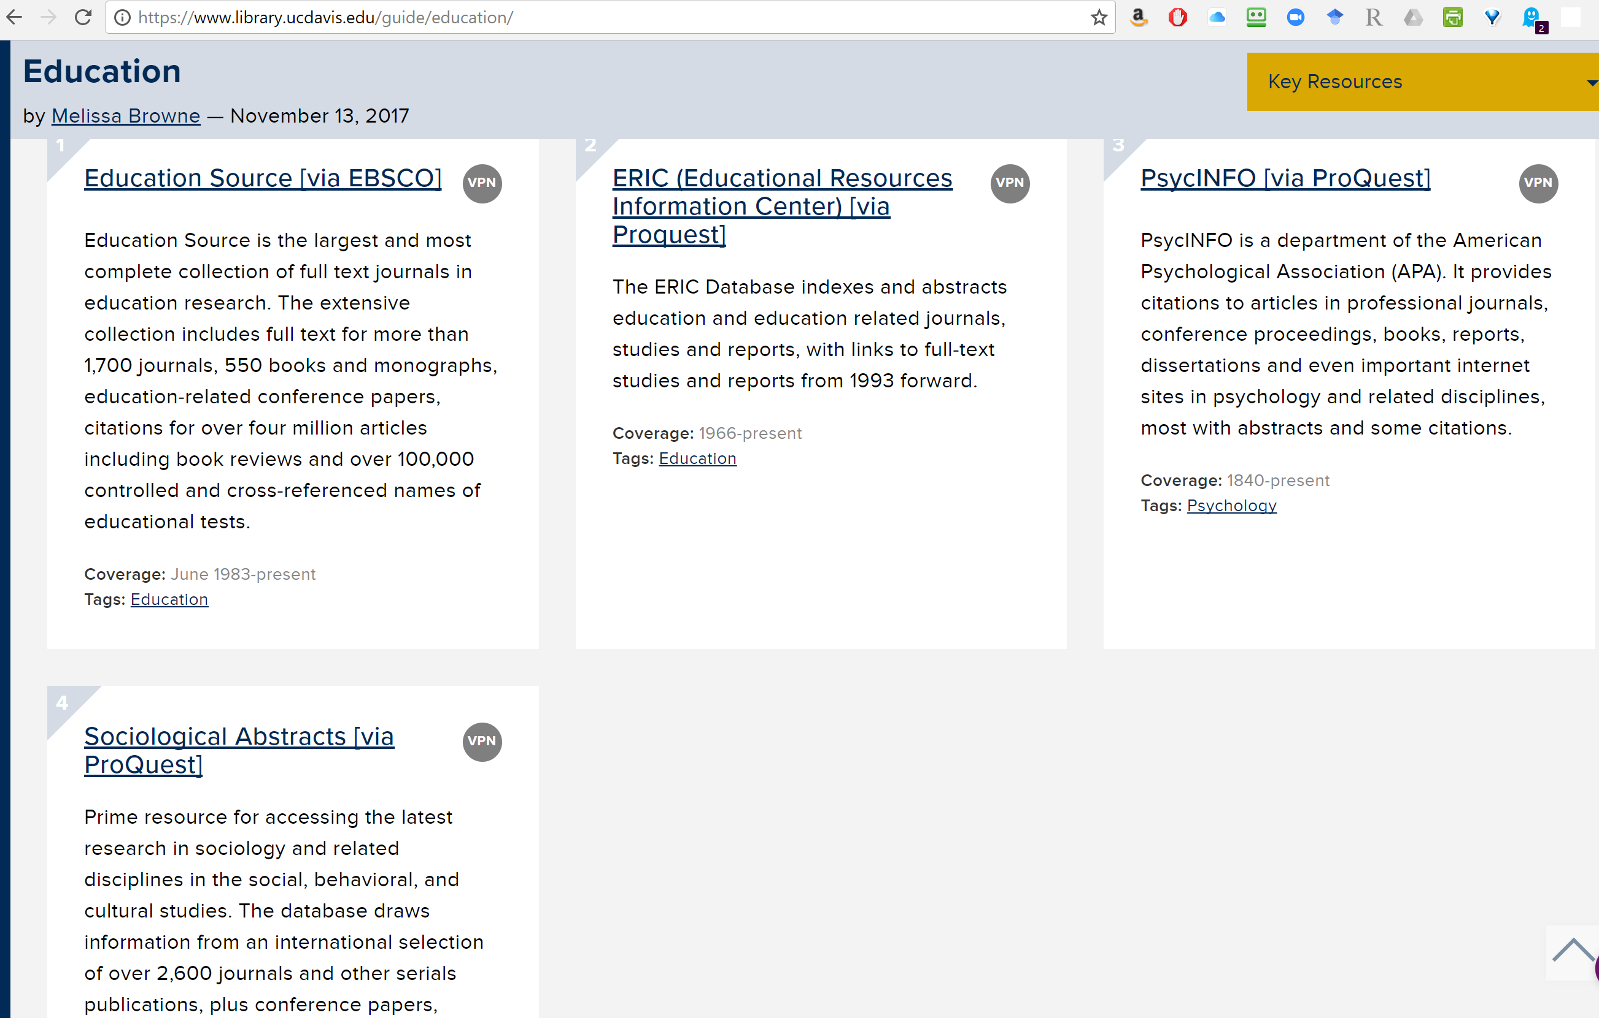

Slide 15
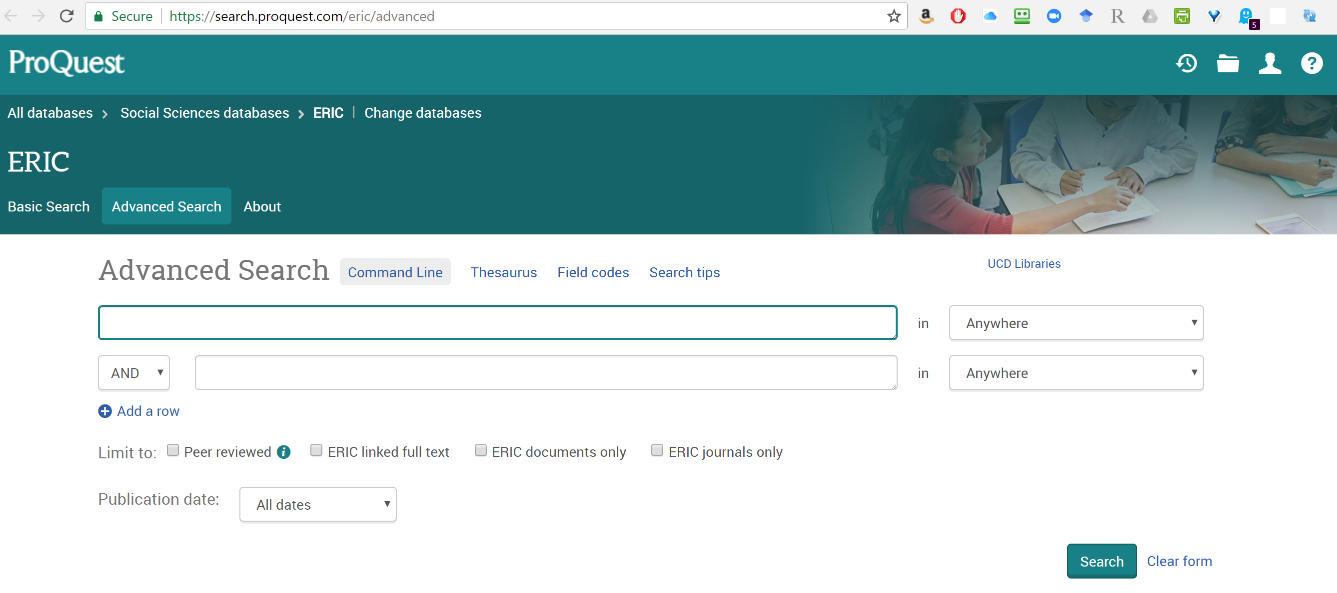

Slide 16
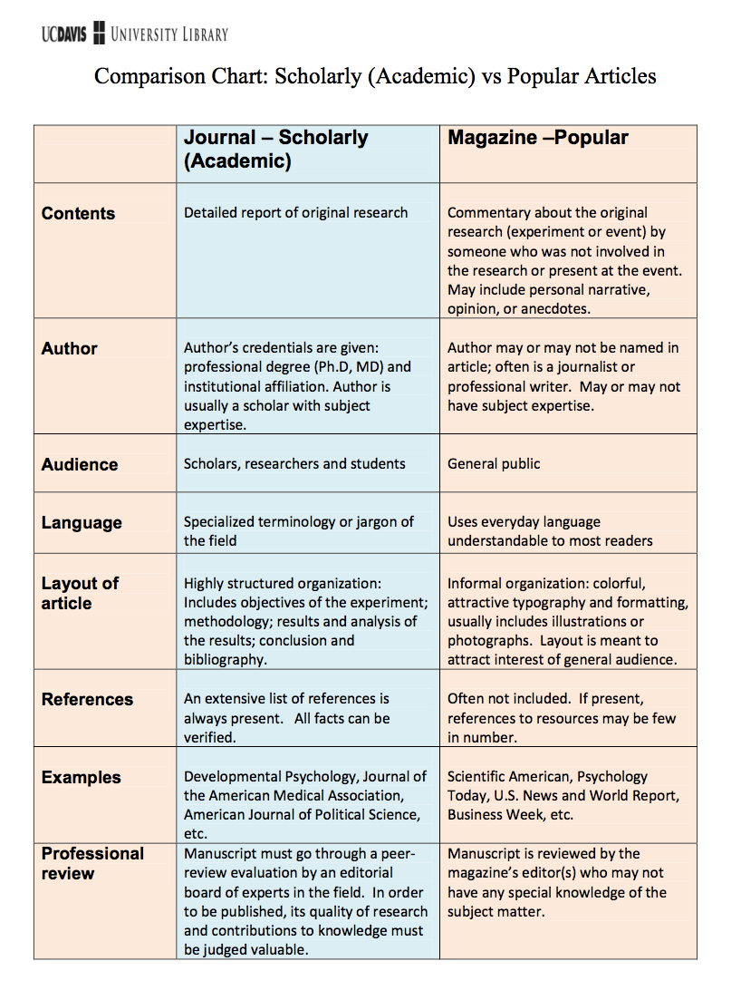
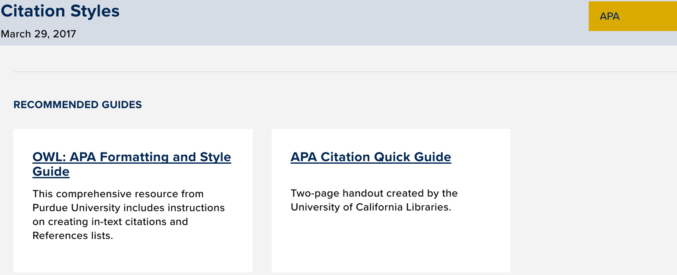
Guides and Tutorials on Conducting Research
Notes:
I inserted a hyperlink to the university website for quick access on their own guides/tutorials site for conducting research. There are many useful tips for navigating the library and pdfs on understanding topics like:
Scholarly vs. popular articles,
How to cite/avoid plagiarism

Slide 17
Current UC Davis students, faculty, and employees may access our licensed resources from off campus with their UCD LoginID. The UC Davis Library catalog, Melvyl catalog, and other free resources are open to all and do not require use of the VPN.
Using the VPN Client

Slide 18
Connecting from Off Campus
The VPN Client (Pulse Secure) needs to be downloaded and installed on your personal computer. Please use one of the links below for instructions on how to install, configure, and use the VPN Client. You only need to do this once: VPN Client for Desktops and Notebooks: Installation & Use Guide

Slide 19
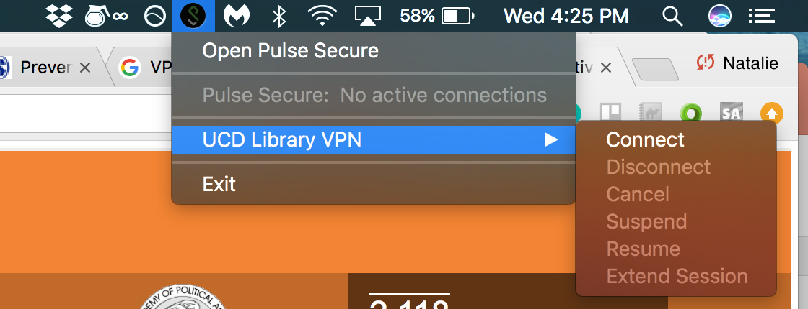
Connecting from Off Campus
2. Once on your navigation bar, the Pulse Secure connect using the VPN when off campus

Slide 20
Connecting from Off Campus
3. Your navigation bar Pulse Secure should look like this if it is connected and working:

Slide 21
Using Google Scholar and the VPN
Access to journal articles from Google Scholar with the VPN can bypass searching the library system
Download articles straight from publisher’s website

Slide 22
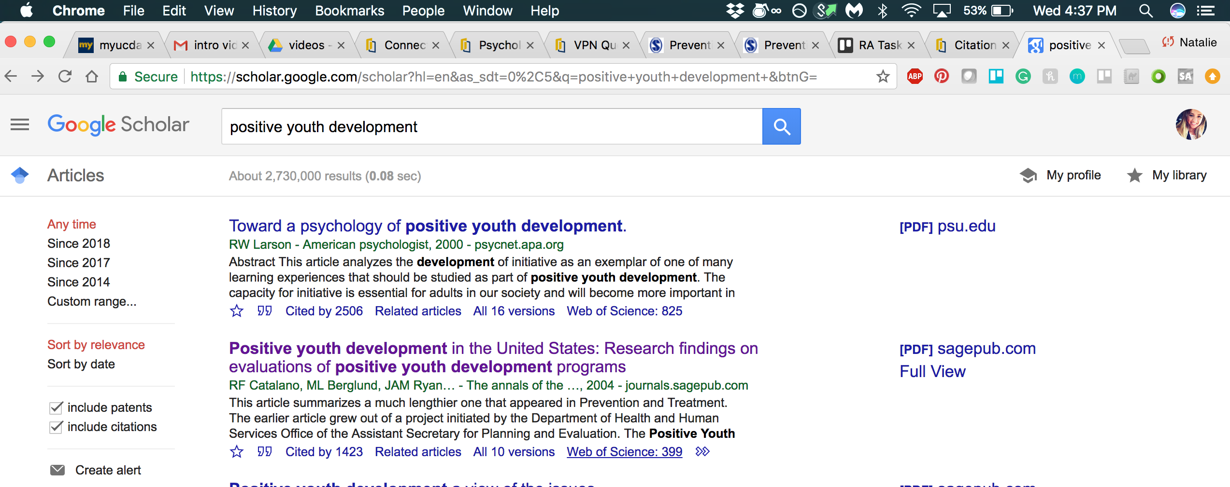
Using Google Scholar and the VPN
3. Access links to full texts easier

Slide 23
Notes:
The link: Using Google Scholar with VPN and UC elinks is a video tutorial I created on Zoom to help your staff see a visual of how I navigated and downloaded from google scholar. The UC elinks in orange would not have shown up if I wasn’t on the VPN.
Click this tutorial if there is time for it (its only 2 min or less)

Slide 24
Some notes about searches

Slide 25
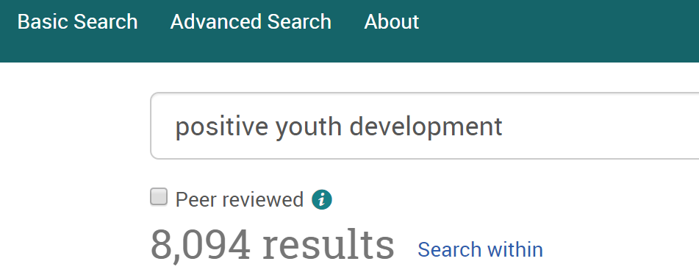

Slide 26
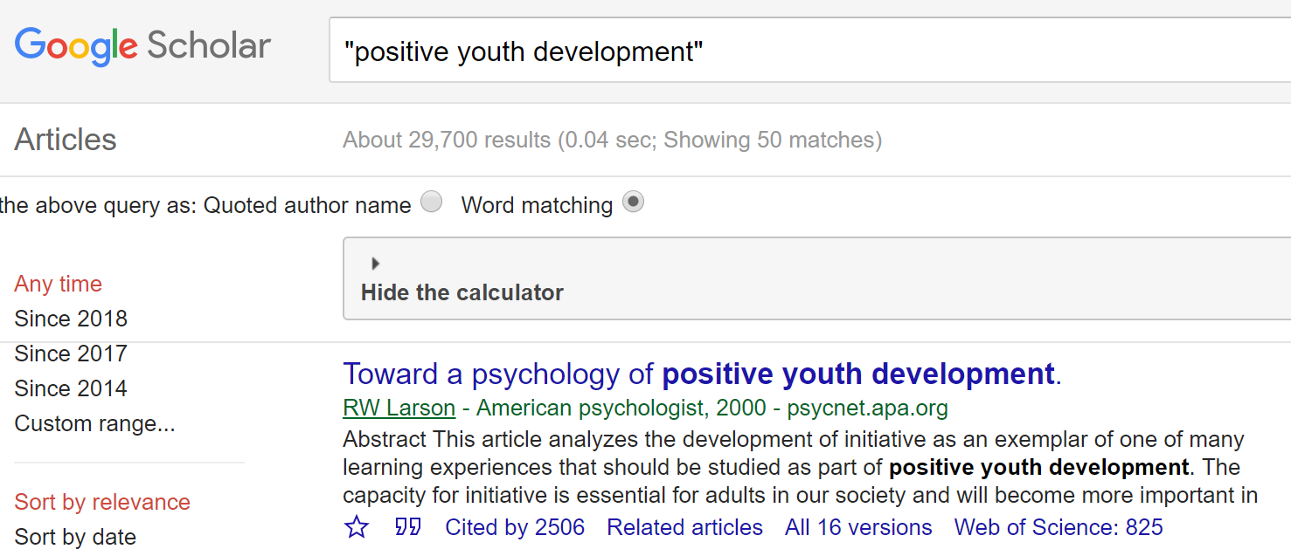

Slide 27
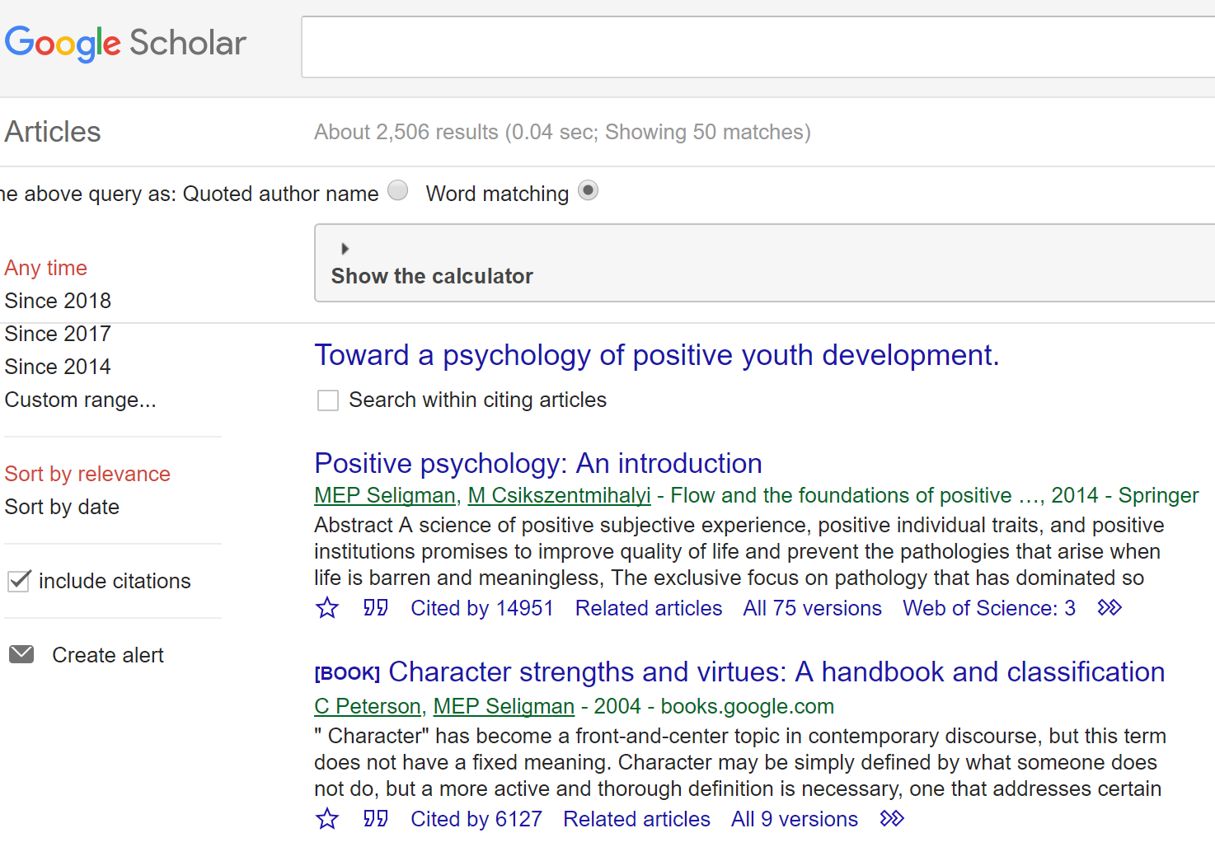

Slide 28
WELCOME TO THE WHAT WORKS CLEARINGHOUSE

Slide 29
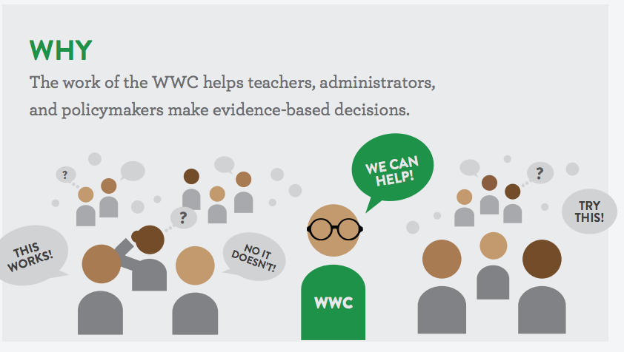
What is WWC?
The What Works Clearinghouse (WWC) reviews the existing research on different programs, products, practices, and policies in education.
Our goal is to provide educators with the information they need to make evidence-based decisions. We focus on the results from high-quality research to answer the question “What works in education?”

Slide 30
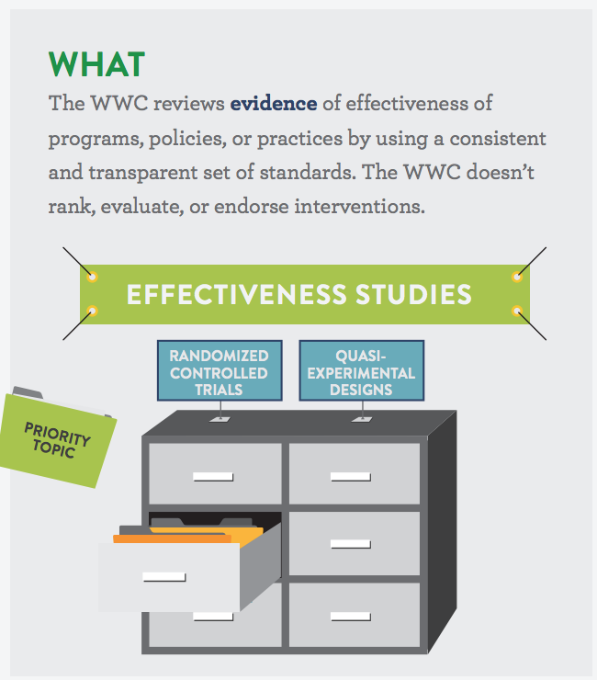
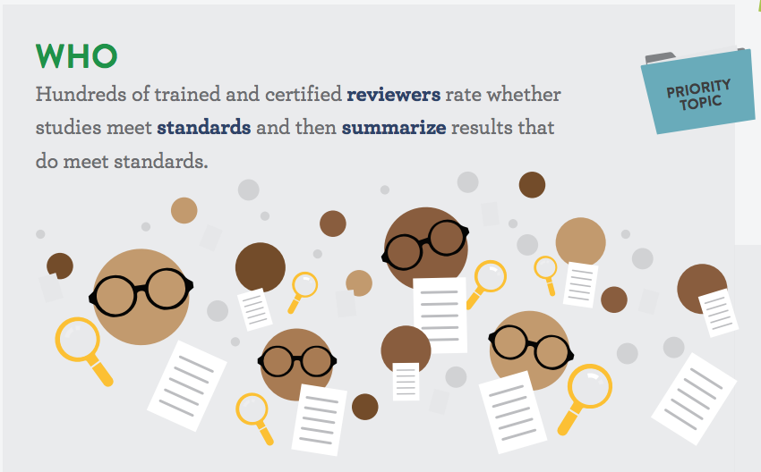
What We Do

Slide 31
About Quick Links
Intervention Report
A summary of findings of the highest-quality research on a given program, practice, or policy in education.
The WWC searches for all research studies on an intervention, reviews each against evidence standards, and summarizes the findings of those that meet standards.
A practice guide is a publication that presents recommendations for educators to address challenges in their classrooms and schools.
They are based on reviews of research, the experiences of practitioners, and the expert opinions of a panel of nationally recognized experts.
Use this search page to find individual studies that have been reviewed by the WWC. Select options from the filters, or enter author/title information into the search box. The resulting list of studies connects you to more information, including whether the study has been included in a WWC publication that summarizes evidence from more than one study.

Slide 32
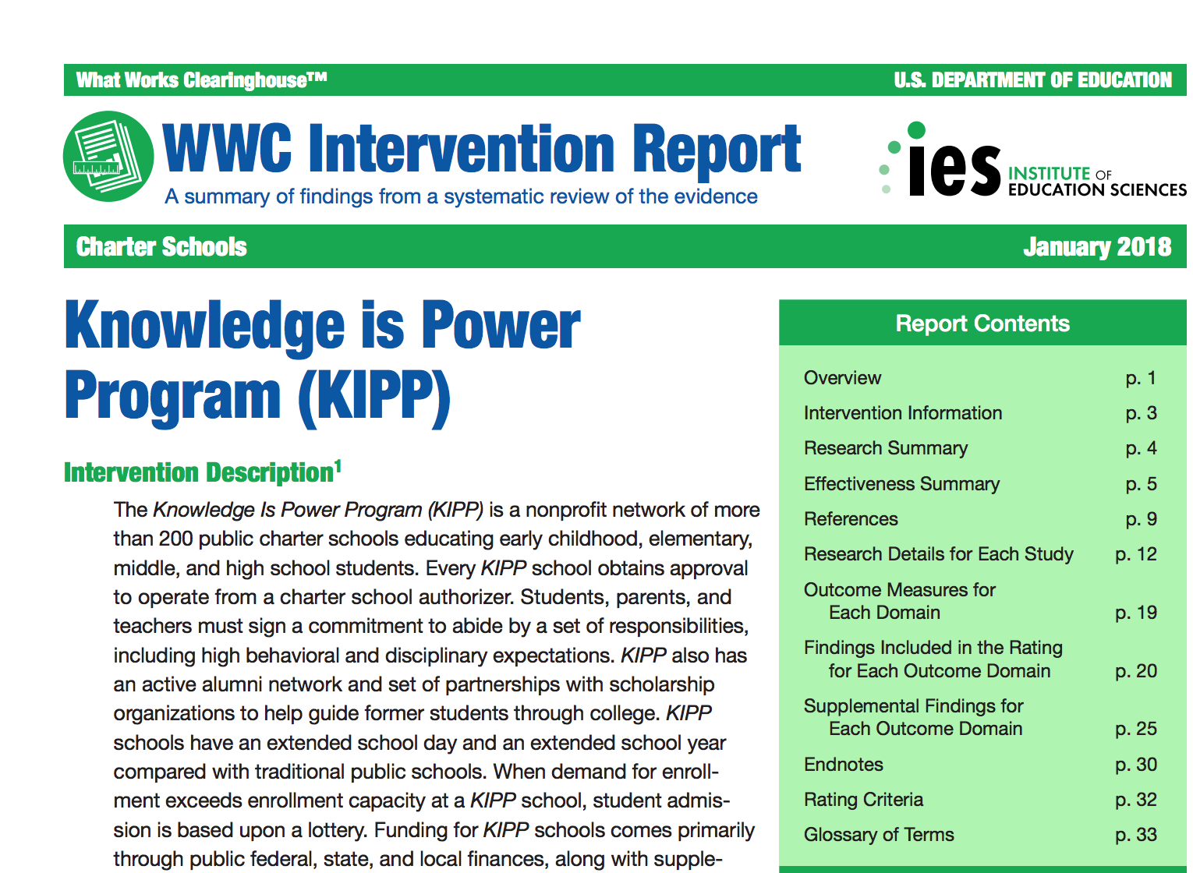
Intervention Reports
A summary of findings of the highest-quality research on a given program, practice, or policy in education.

Slide 33
View the Evidence Snapshot for details

Slide 34
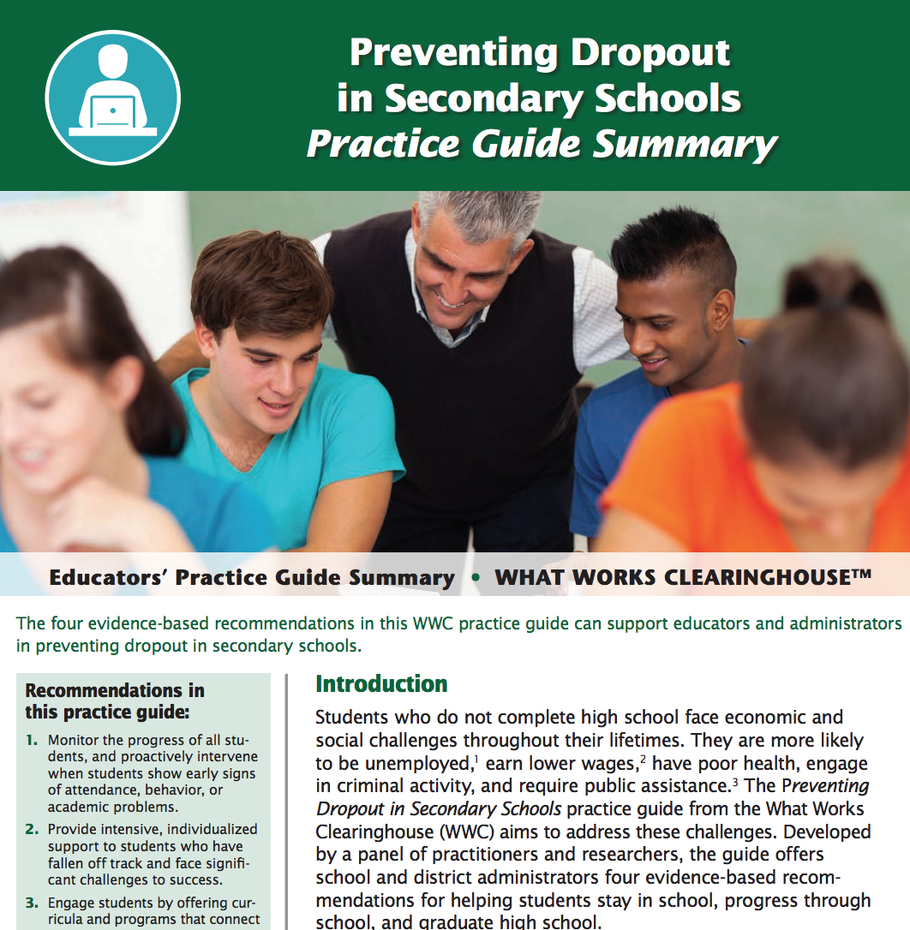
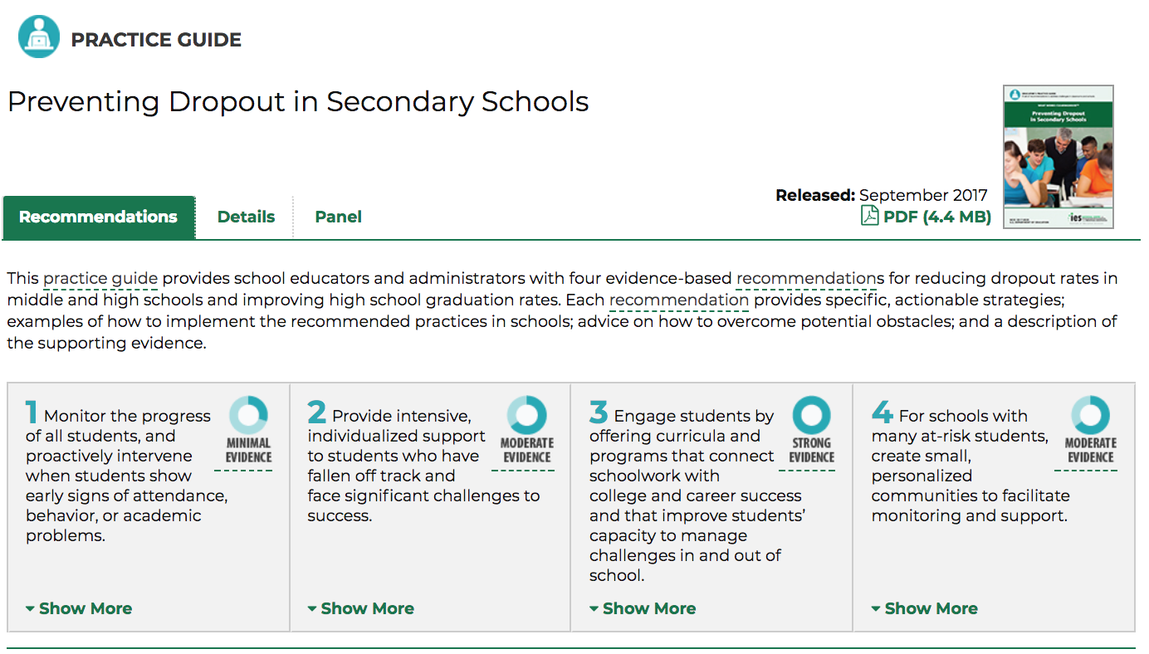
Practice Guides
publication that presents recommendations for educators to address challenges in their classrooms and schools.

Slide 35
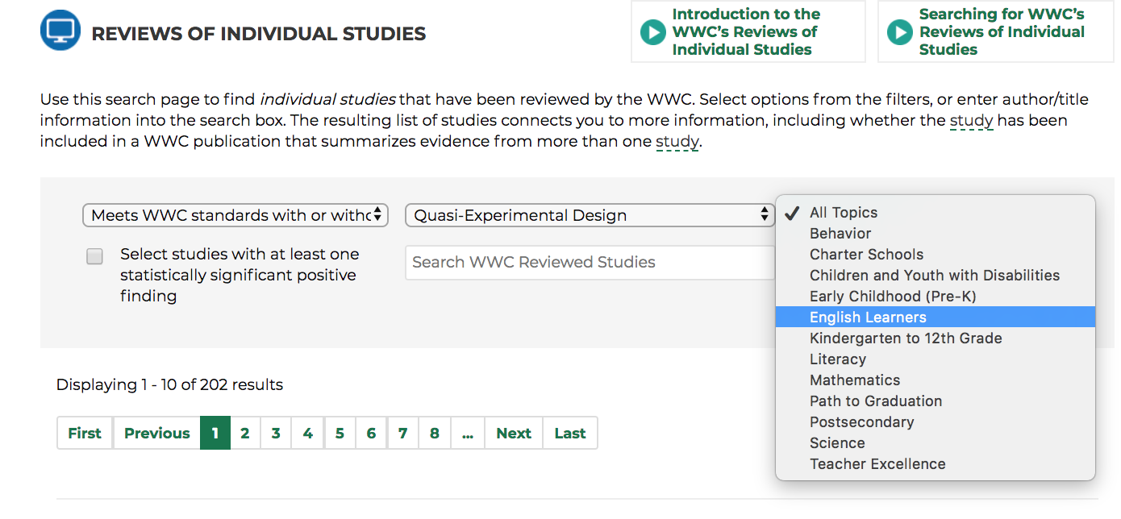
Reviews of Individual Studies
Select options from the filters, or enter author/title information into the search box

Slide 36
Individual Studies Review Video on WWC
Notes:
Included a hyperlink to a video on youtube about overview of WWC and their Individual studies page on the bottom right

