Slide 1
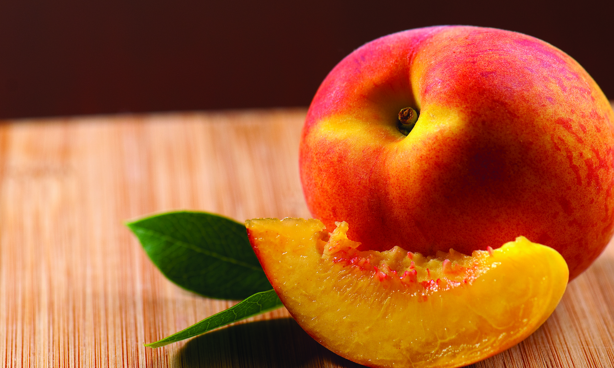
An Overview of Cling Peach Insect Pests and their Management
Kris E. Tollerup, UC Area Advisor, Kearney Agricultural Research and Extension Center

Slide 2
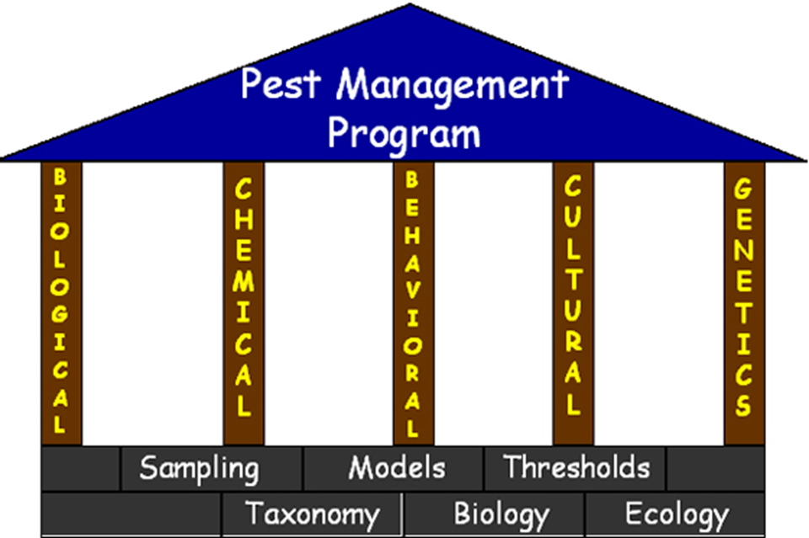
IPM
Based on scientific research.
Focuses on long-term prevention of pest and their damage through ecosystem management.
Monitoring.
Identification of pest/damage.
Combination of management practices
Biological, cultural, mechanical, chemical.

Slide 3
Monitoring
Why?
Identification of pest and associated damage.
Estimate population density of pest
Provides decision-making tool.
Some level of pest/damage is tolerated i.e. below on economic injury level
Pest and crop dependent.
Decrease as crop value increases/pesticides decrease.

Slide 4
Pesticide Information
Disclaimer: Labels often change and reflect the law how pesticide can be legally applied. The following information in this presentation is for the purpose of general education only and does not constitute an endorsement or recommendation for use.

Slide 5
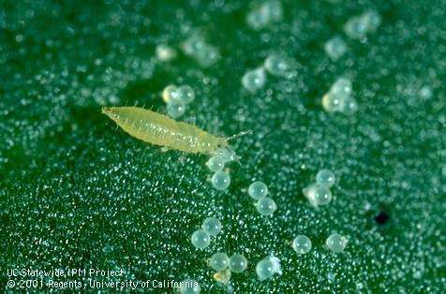
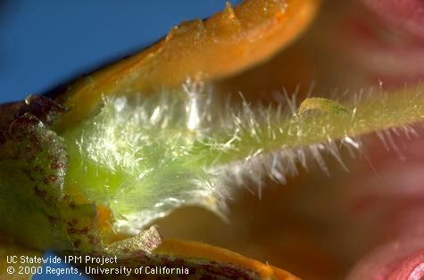
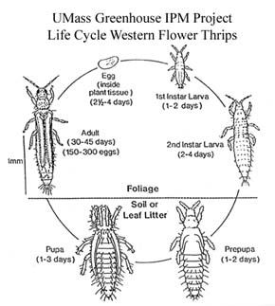
Thrips

Slide 6
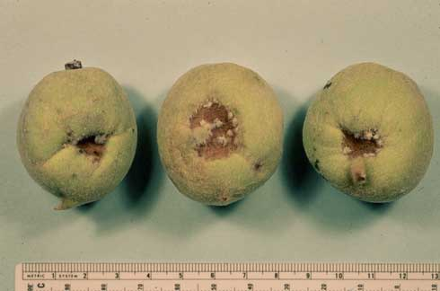
Damage
Damage by western flower thrips, Frankliniella occidentalis, on immature peaches.
Photo by Jack E. Dibble.

Slide 7
Monitoring and Management Options
Monitoring
Bloom
One blossom from 50 trees, dislodge thrips onto dark surface.
Dissect flowers to look for nymphs with hand lens.
Management
Adults 4 -5 blossoms of 50,
Nymphs 3 blossoms of 50
Apply treatment prior to calyx coming tight around developing fruit.
Two – three wks pre-harvest for colorful cultivars.

Slide 8
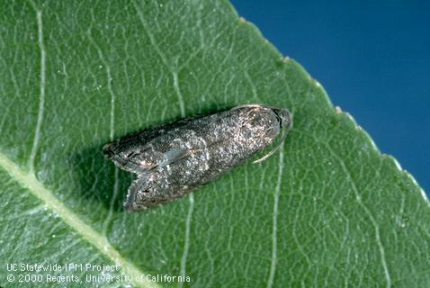
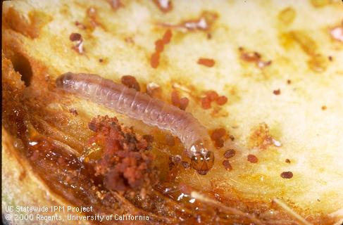
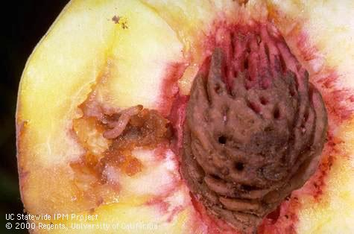
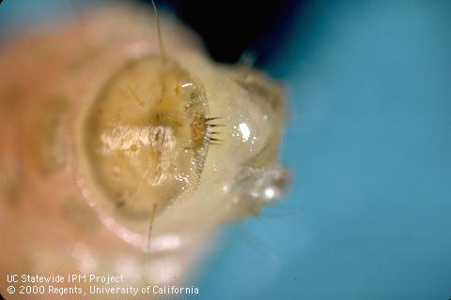
Oriental Fruit Moth

Slide 9
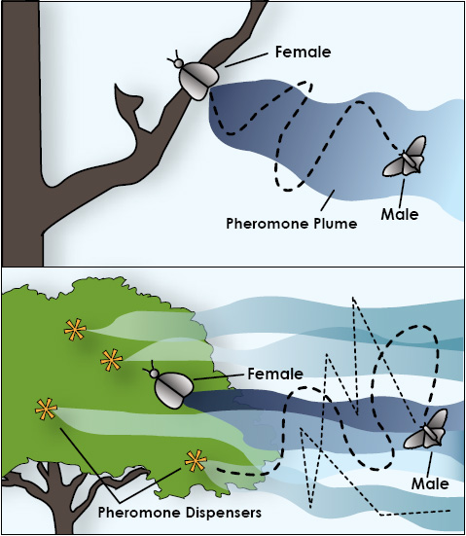
Management Options
Mating disruption
Monitoring
Place pheromone traps in orchard by Feb 15 (SJV), Feb 20 (SV).
Monitor for shoot strikes
Late-April, mid-June, and mid-July; and fruit damage *4 wks before harvest
Management
Most effective against 1st to 3rd generation.
Insecticide application may not be necessary.

Slide 10
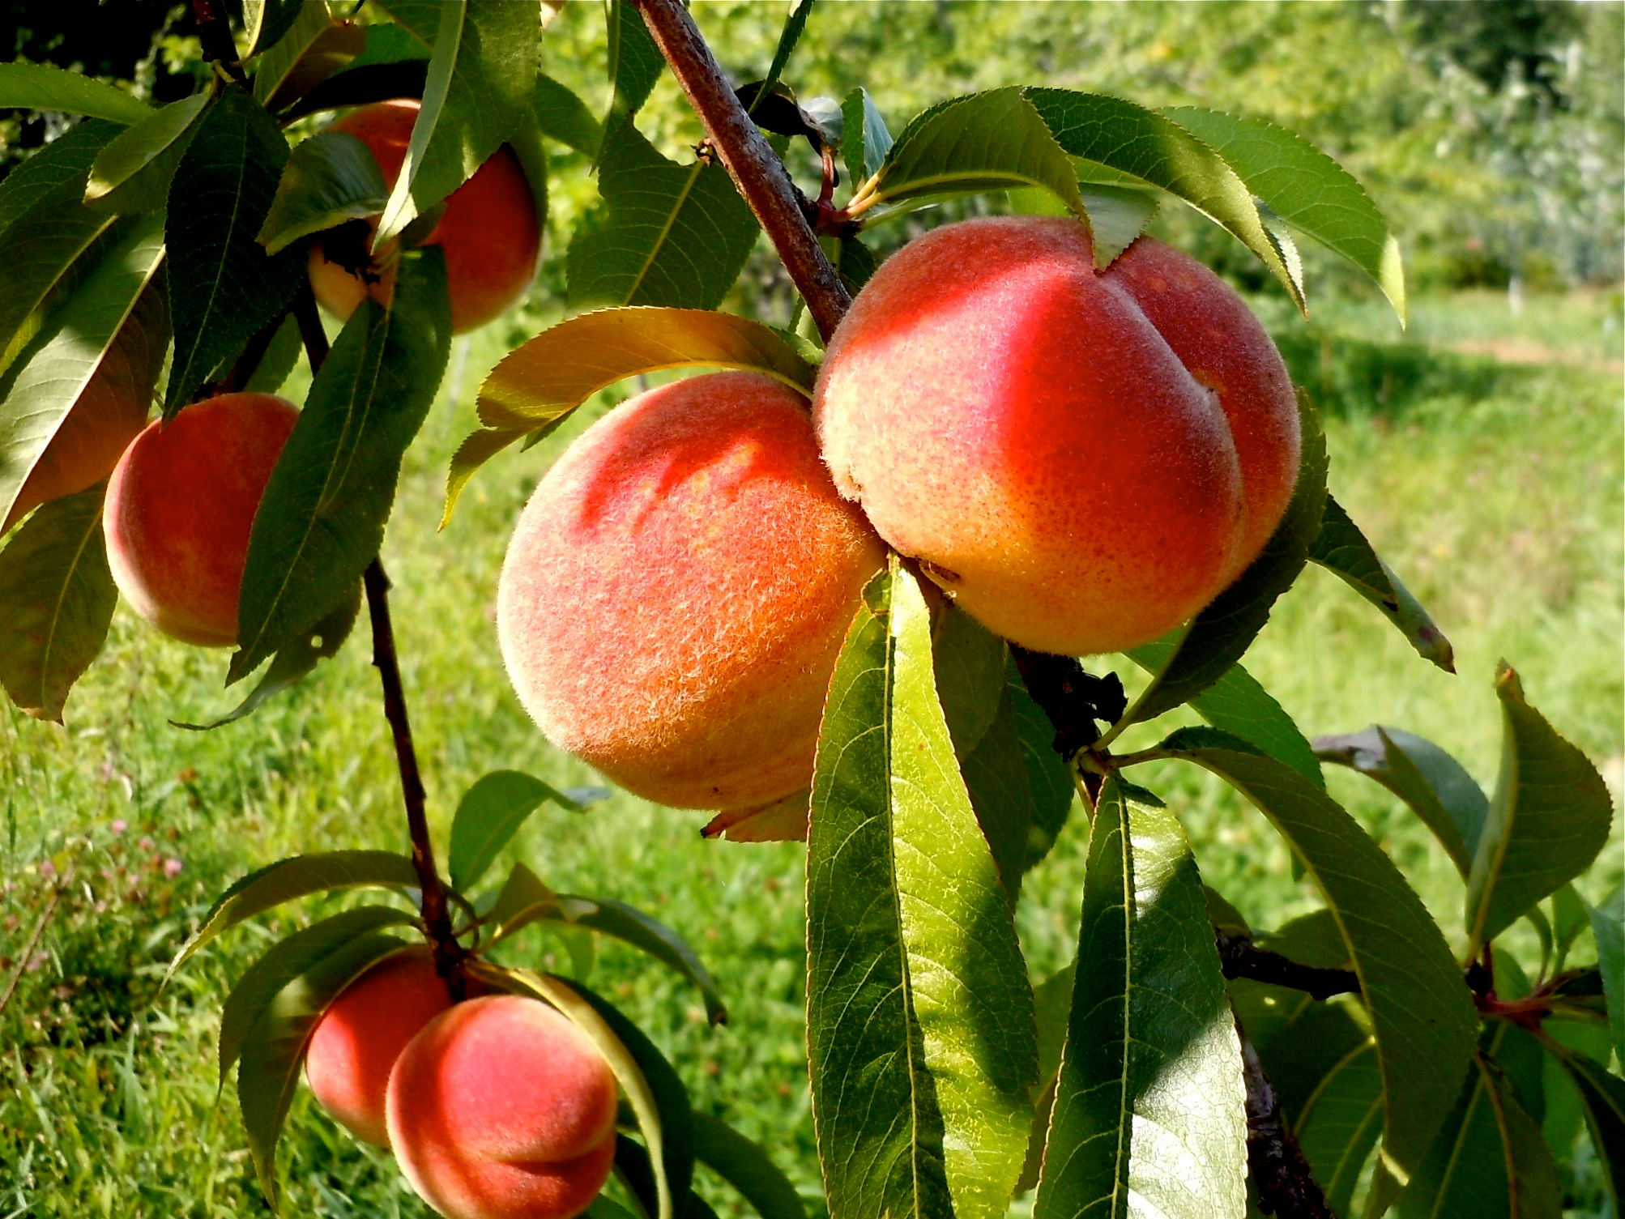
Management Options
Non mating disrupted
Monitoring
Place pheromone traps in orchard by Feb 15 (SJV), Feb 20 (SV).
Calculate DD at first capture.
2nd flight at 920 – 1,010 DD (800 DD).
Once 2nd has begun, calculate DD
Management
Altacor, Belt, or Intrepid apply at 400 DD.
Others, 500 – 600 DD.

Slide 11
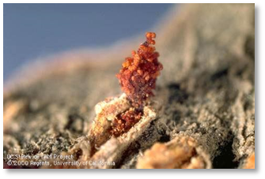
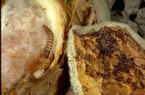
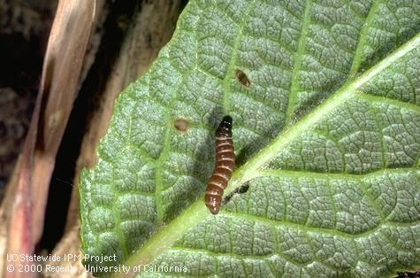
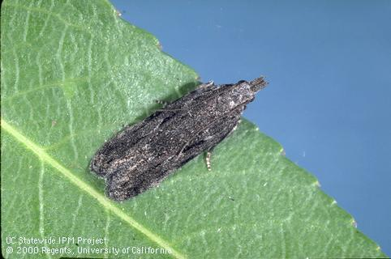
Peach Twig Borer

Slide 12
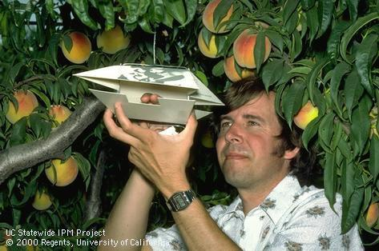
Monitoring
Spring
Shoot tip (early-season)
When shoots reach ~ 1” long monitor for wilted shoot tips and feeding at flower base. Slice into shoot strikes to determine PTB or OFM.
Threshold: ≥ 3 strikes per tree.
Pheromone traps (mid-March to April)
1 trap/40 acres, minimum 2/orchard
Biofix = first moth capture. Begin calculating DD.

Slide 13
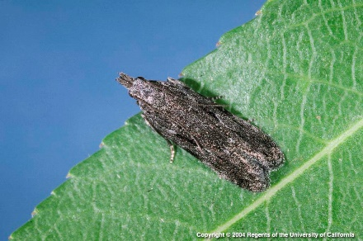
Management Options
Bt
Two applications, 300 -350 and 450 – 500.
Altacor, Belt, or Intrepid
One application, 300 DD
Others
Beginning of flight
400 DD for green fruit.
300 DD if fruit coloring

Slide 14
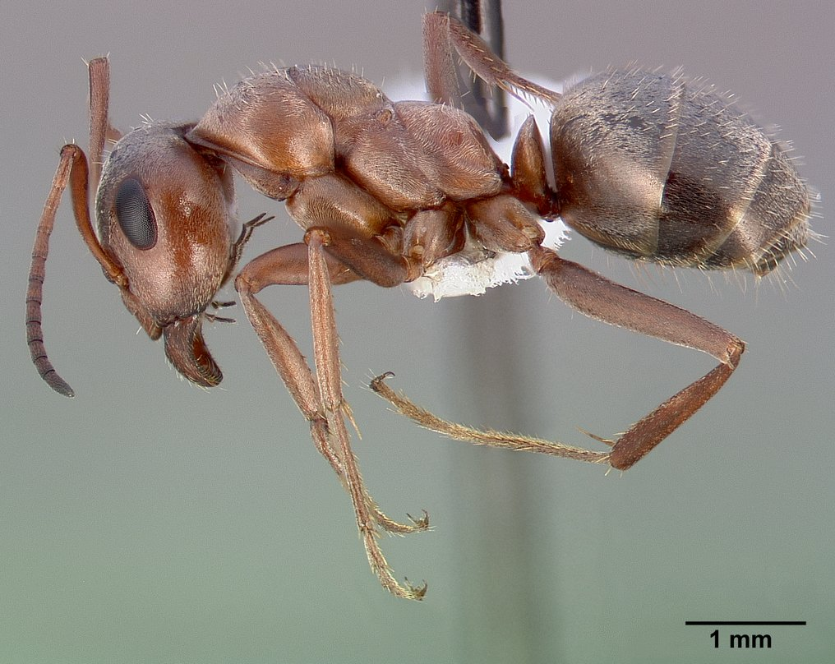
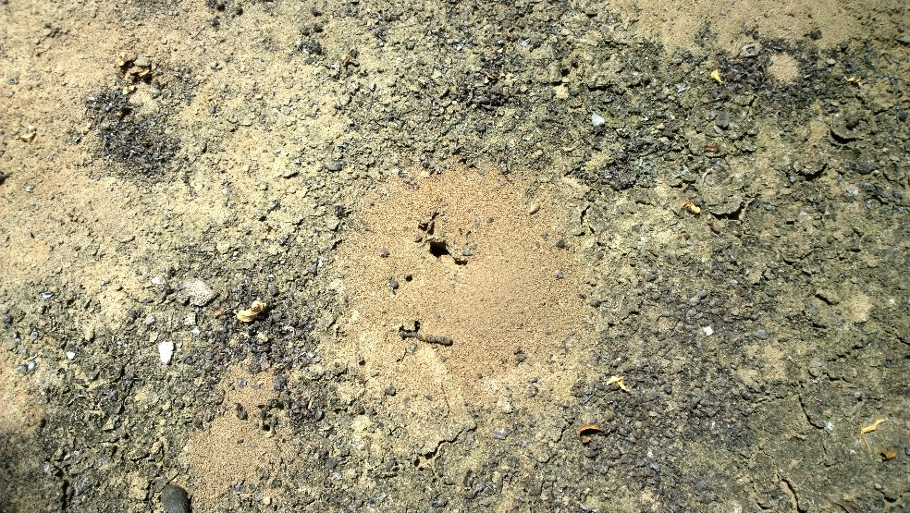
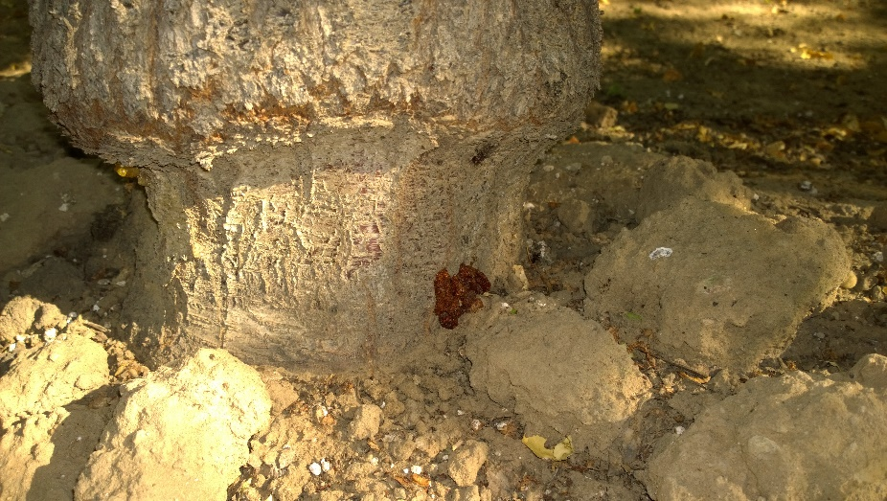
Native Gray ant, Formica aerate

Slide 15
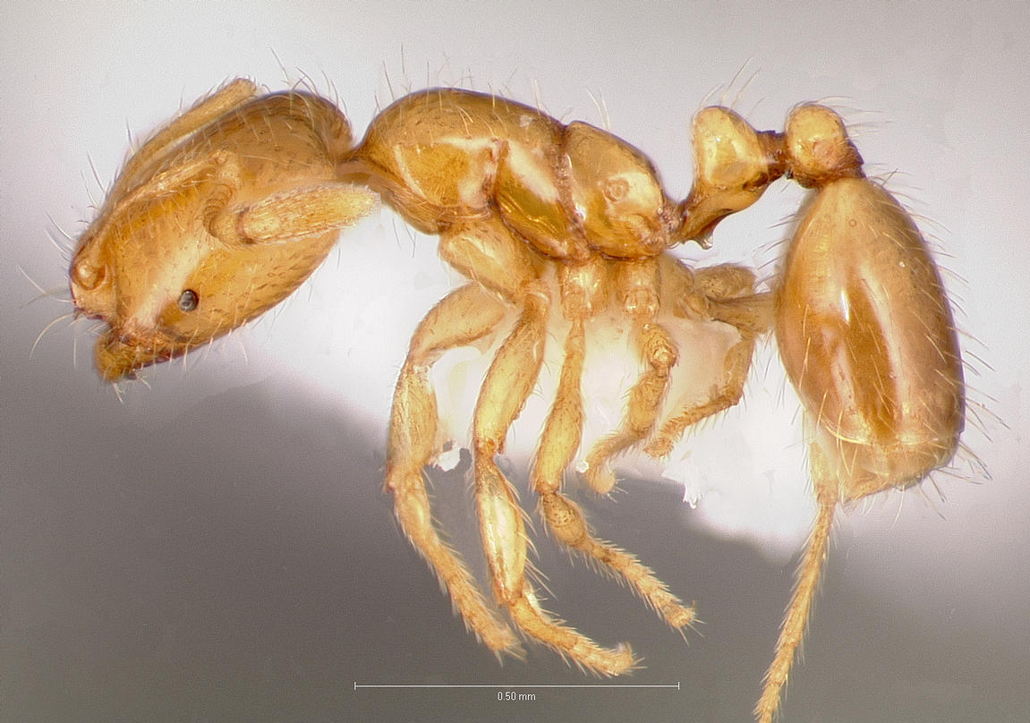
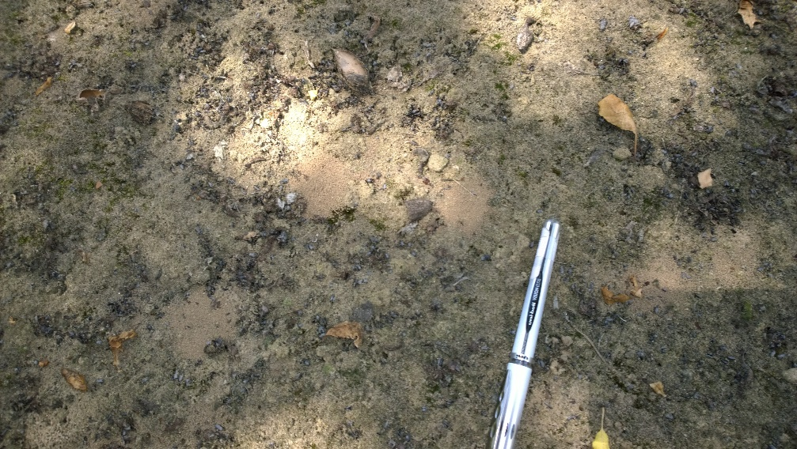
Thief Ant, Solenopsis molesta

Slide 16
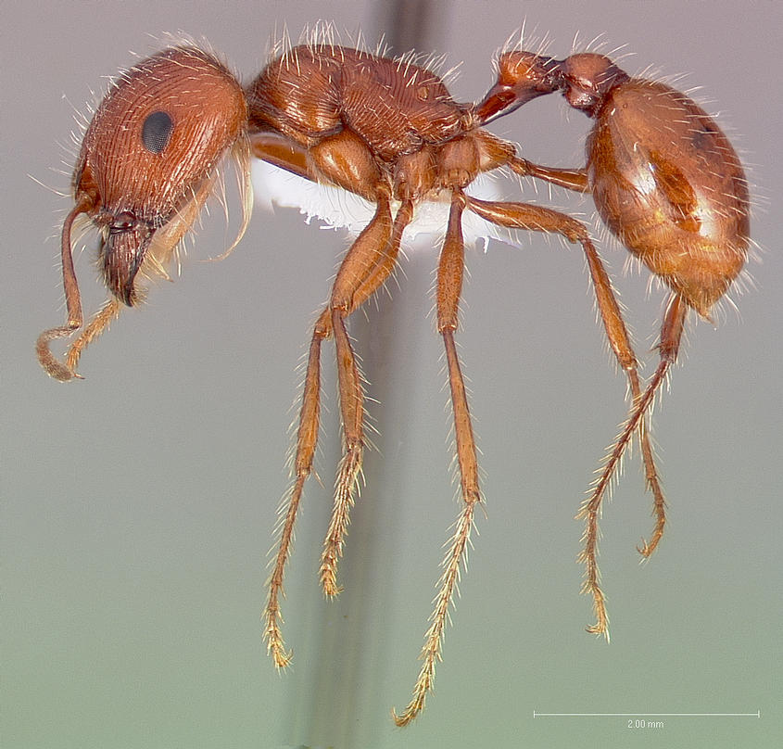
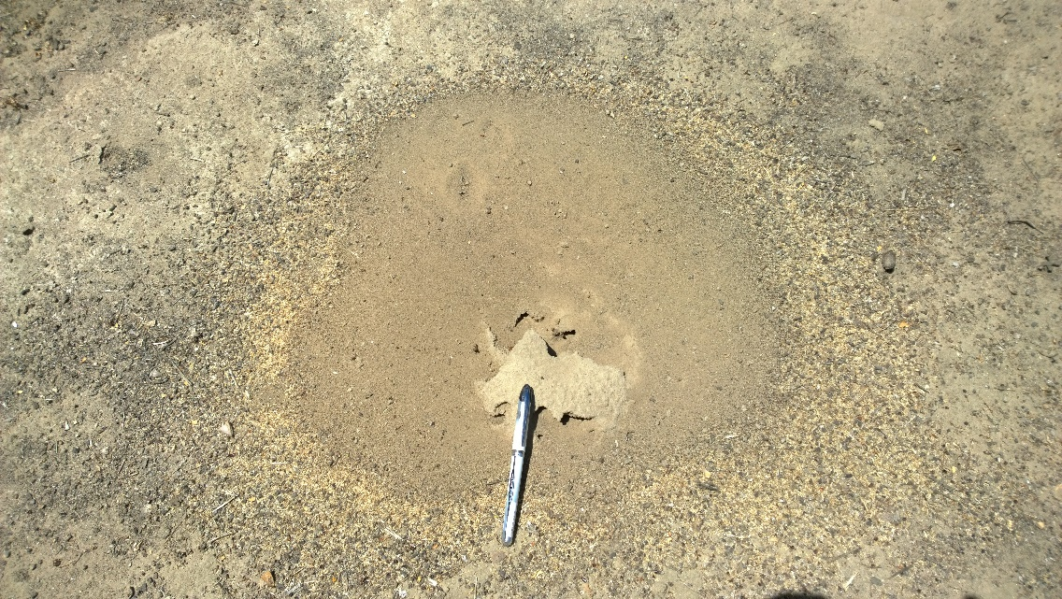
Harvester ant, Pogonmyrmex californicus

Slide 17
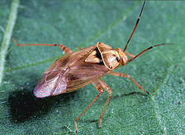
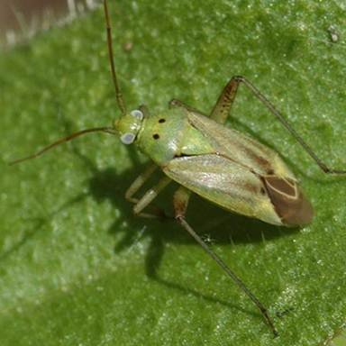
Other Hemipteran, Small Bugs
Small bugs.
Lygus, western tarnished plant bug.
Lygus hesperus and L. elisus.
Immigrate from grasslands.
Calocoris.
Calocoris norvegicus.
Commonly collected on weeds near orchards.

Slide 18
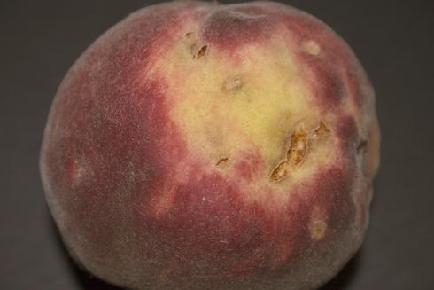
Damage
Plant bug feeding on peaches causes them to be misshapen.
Photo by Barbara L. Ohlendor

Slide 19
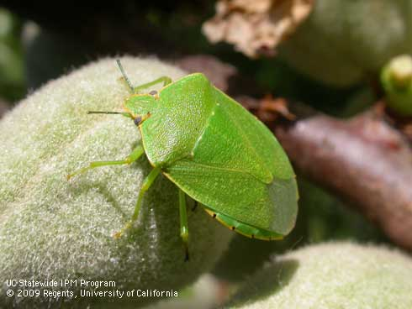
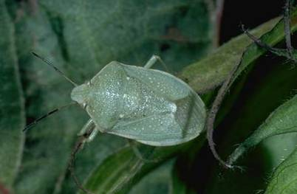
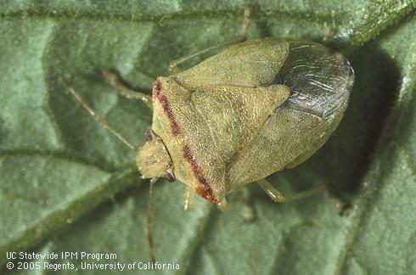
Hemipteran Pests, Stink Bugs
Large bugs.
Stink bugs spp.
Green, Chinavia hilaris (Say), syn. Acrosternum hilare.
Southern, Nezara viridula.
Red shouldered, Thyanta pallidovirens.
Uhler’s, Chlorochroa uhleri.

Slide 20
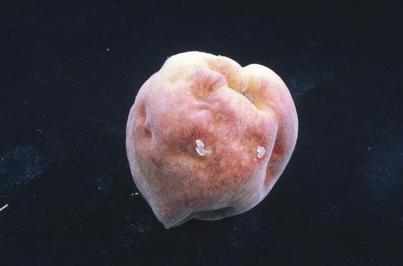
Damage
Stink bug feeding on developing peaches creates areas that cease to grow. At harvest these areas show up as irregular, depressed areas or dimples.
Photo by Walter J. Bentley.

Slide 21
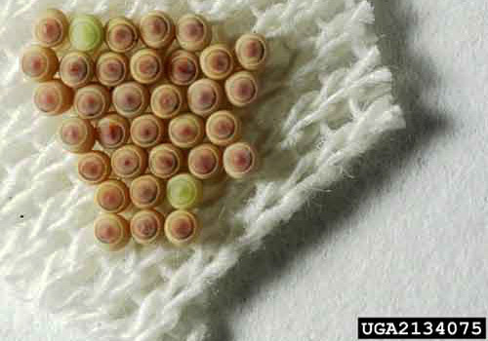
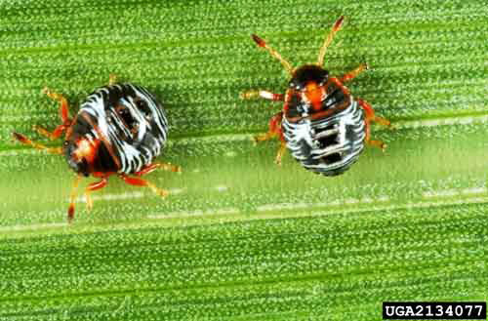
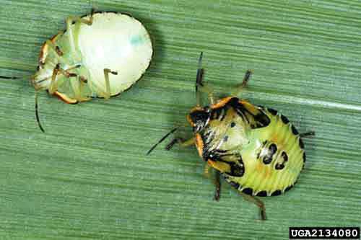
Hemipteran Pests, Stink Bugs
Two generations per year, adults present most of the year.
Five instar stages, vary in color making ID difficult.
Eggs laid in groups and barrel-shaped.

Slide 22
Monitoring and Management Options
Monitoring
March
Sweep net weeds: curly doc, Russian thistle.
Orchards with legume cover crops populations may be higher.
Early June
Examine fruit
Management
Prevent populations from moving into orchard
Avaunt, Seven, Asana.

Slide 23
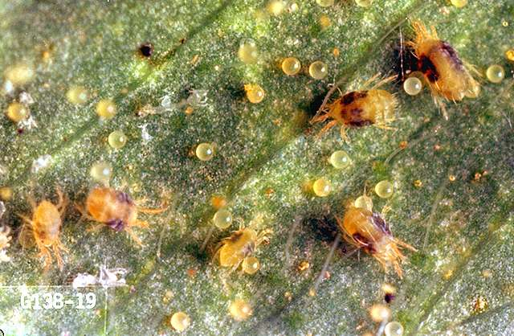
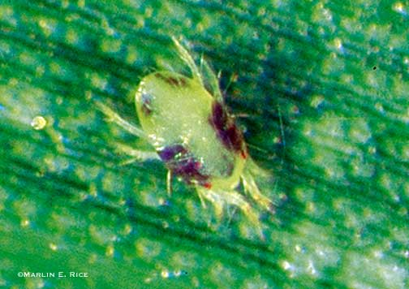
Spider Mites
Tetranychus spp.
Pacific spider mite
T. pacificus
Twospotted spider mite
T. urticae

Slide 24
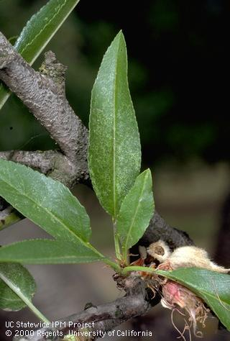
Damage
Feed using a stylophore
Punctures cells, mite sucks out content causing stippling
Browning of leaves
Defoliation
MAY: reduce fruit quality following year due to Reduced photosynthesis
Sunburn of wood
Plant stress due to evapotranspiration

Slide 25
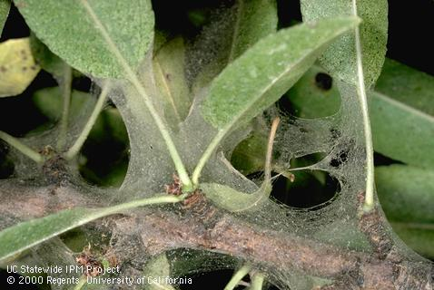
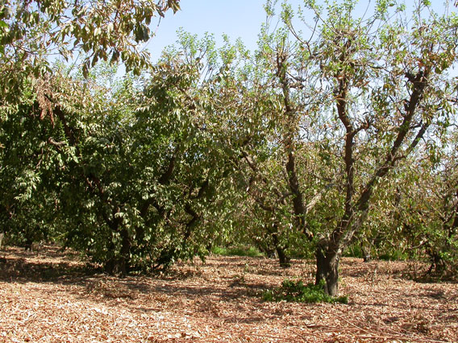

Slide 26
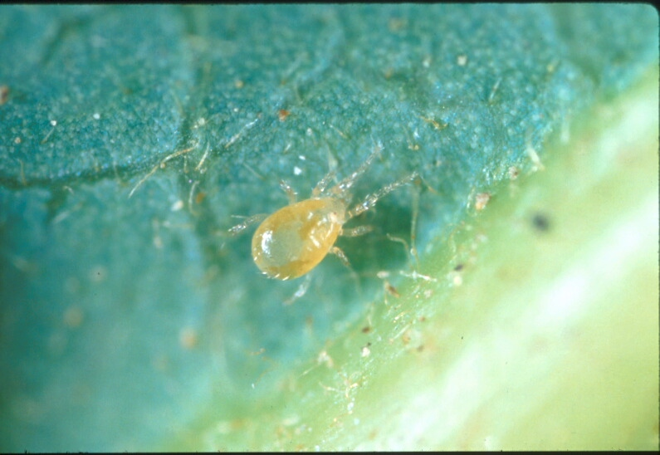
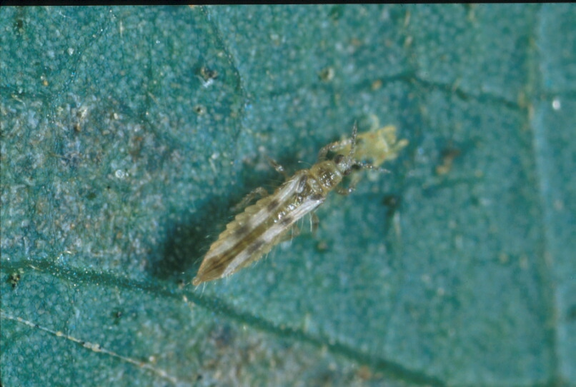
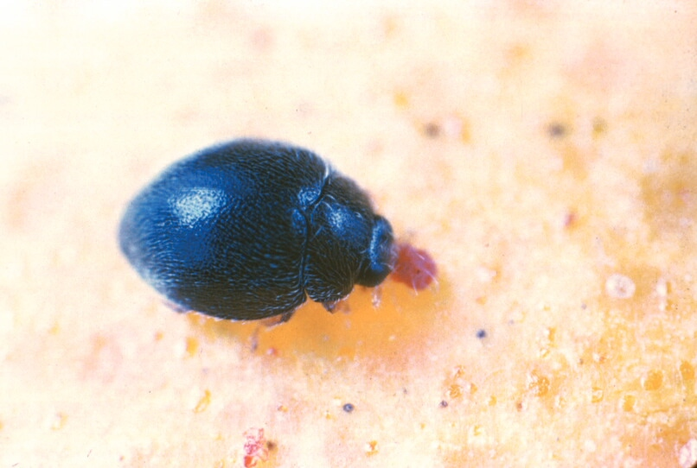
Natural Enemies
Predatory mites
Galendromus sp.
Neoseiulus spp.
Lacewing
Chrysoperla spp.
Sixspotted thrips
Scolothirps sp.
Spider mite destroyer
Stethorus spp.

Slide 27
Monitoring and Management Options
Monitoring (May - August)
40 ac block, 5 min search
Two –three leaves both sides on 10 trees noting presence / absence of mites and natural enemies.
Management
Cultural
Avoid stressing trees and keep dust to a minimum.
Chemical
Several options, consult UC IPM Guidelines.
Know what to expect after treatment

Slide 28
Any Questions?

