Slide 1
EatFit

Slide 2
Introduction
Eat Fit is designed to improve the eating and fitness choices of middle school adolescents. Lessons in this curriculum were carefully selected to include issues most important to this age group.

Slide 3
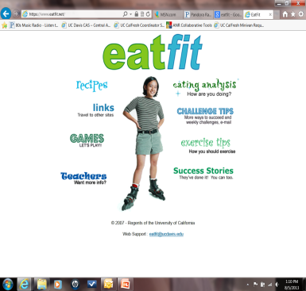
Program Components
Curriculum
Student workbook
A website with dietary analysis and goal setting program

Slide 4
Lessons in EatFit
EatFit Foundation
What Are You Eating?
Get Psyched for Fitness
Energy
EatFit @ Fast Food
Food Label Fax
Body Work
TV Training
Got Breakfast?

Slide 5
Lesson Plan
Overview-highlights main reason for lesson
Timeline-quick reference to show lesson flow
Objectives- what the students should learn from the lesson
Getting Ready- before class review and list of materials
Standards- list of standards met by curriculum
Questions- each lesson starts with a question for the students which becomes the focus.

Slide 6
Lessons continued
Goal tracking- feedback on progress toward goal
Opening Discussion- provides guidelines for engaging students
Activities- the focus of each lesson that reinforce the objectives
Closing Discussion- ties together all that was learned

Slide 7
Lessons continued
Take Home Activities- “homework”
Background Information- any additional information needed to teach the lesson
Lesson Enhancements- reinforcements of the goals
Recipes- kid tested and nutritionally approved
Standards
Workbook answer sheets

Slide 8
Tips for Implementing
Introduce each lesson by posting the lesson question.
Discuss goals on lessons days are not taught to keep students on track.
Hands-On real life problem-solving improves future ability.
Walk the Talk, students learn by observation. Choose healthy foods at snack and lunch.
Make it a Big Deal! Notify parents of their child’s success. Talk to the newspaper about what your class has achieved.

