Slide 1
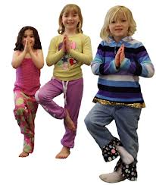
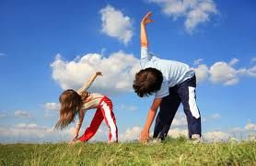
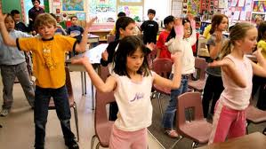
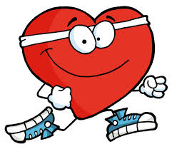
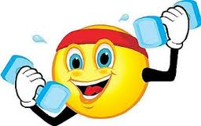

Getting your students active
Ideas for quick PA breaks
© University of California 2015

Slide 2
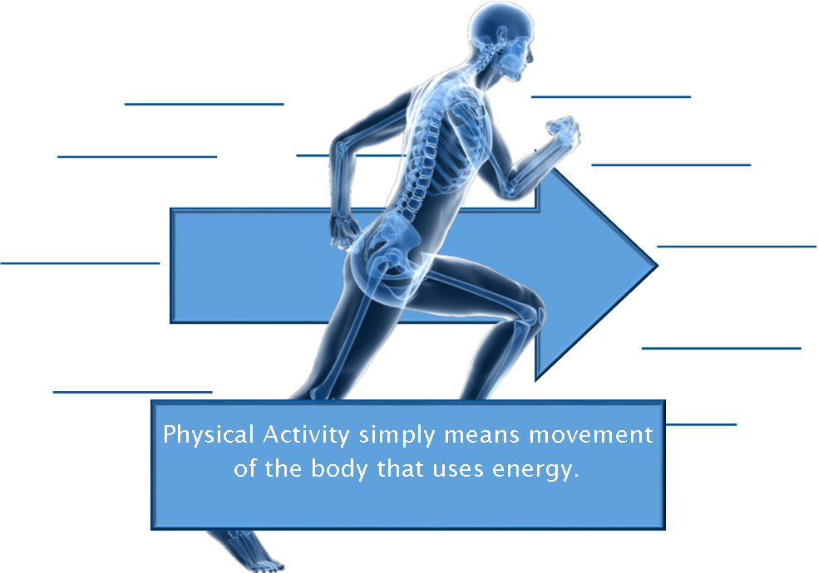
What is Physical Activity?
For health benefits, physical activity should be of moderate or vigorous intensity.

Slide 3
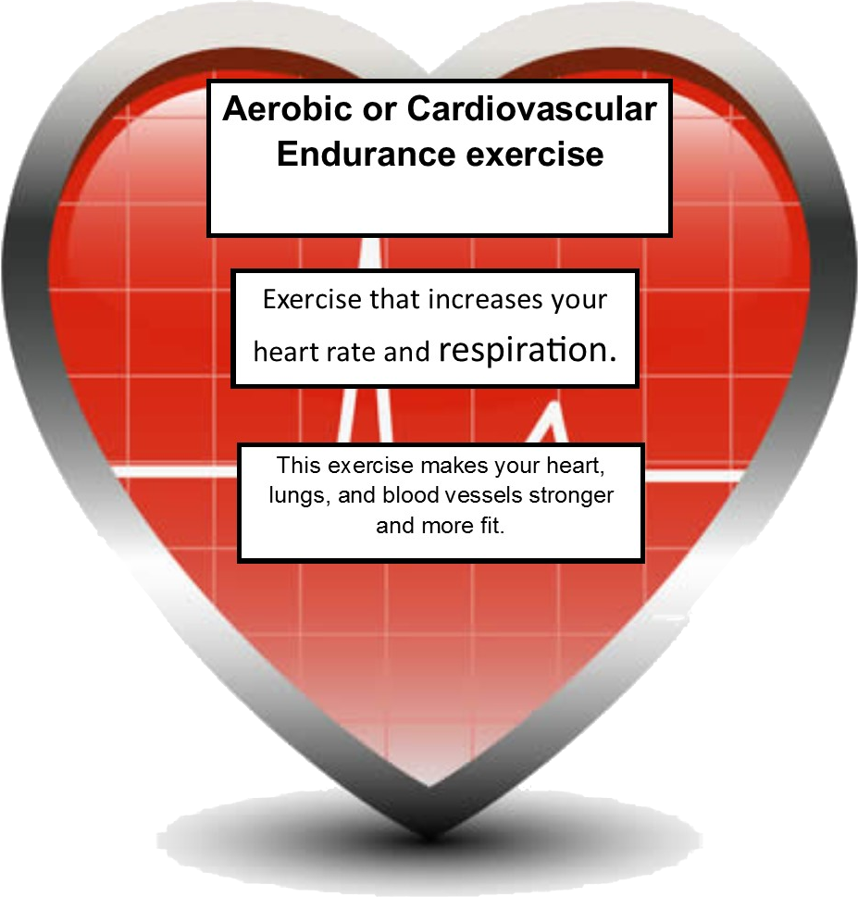
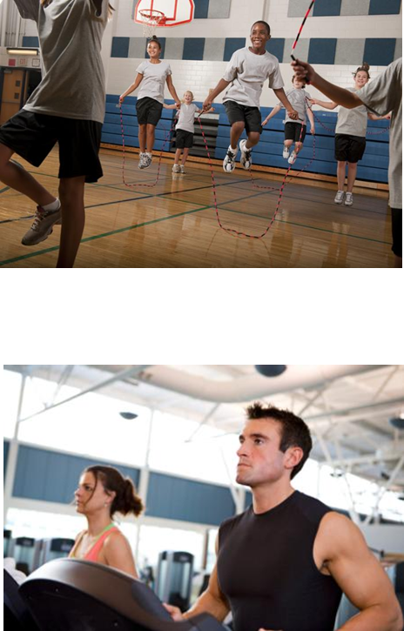
Types of Physical Activity
Examples: Running, Walking, Swimming, Biking, Jump Rope.

Slide 4
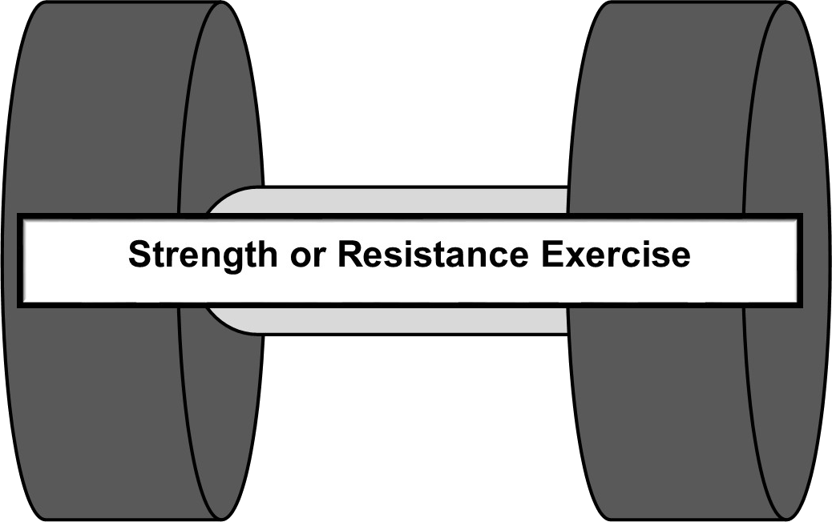
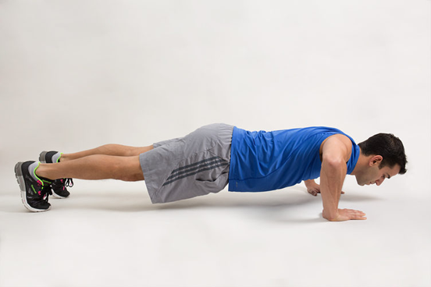
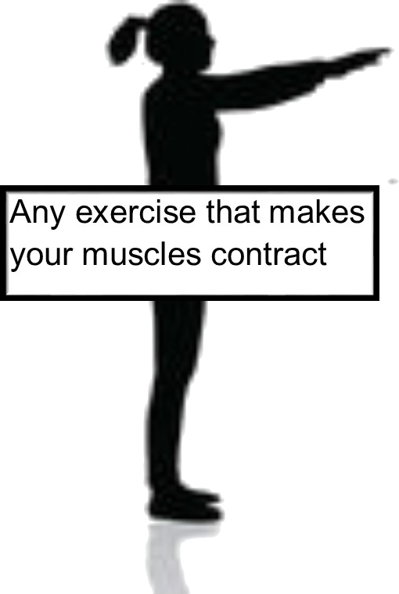
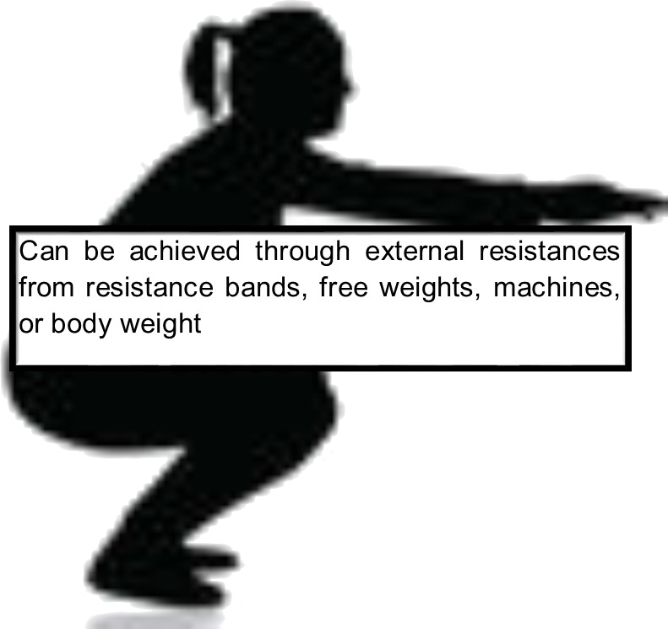
Types of Physical Activity

Slide 5
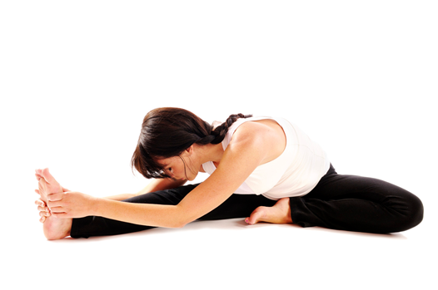
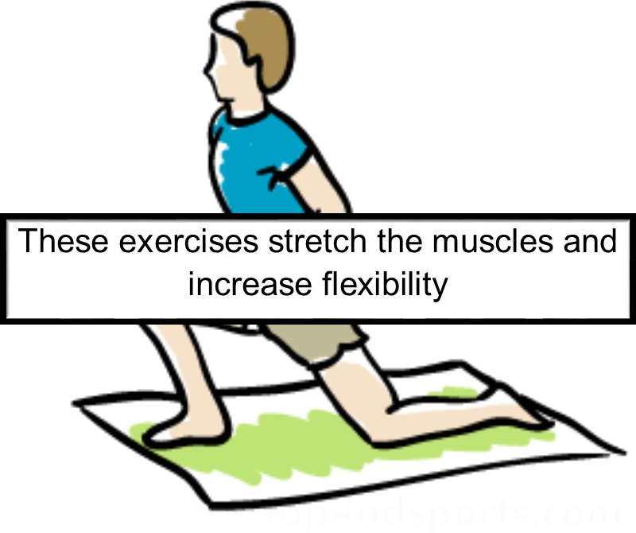
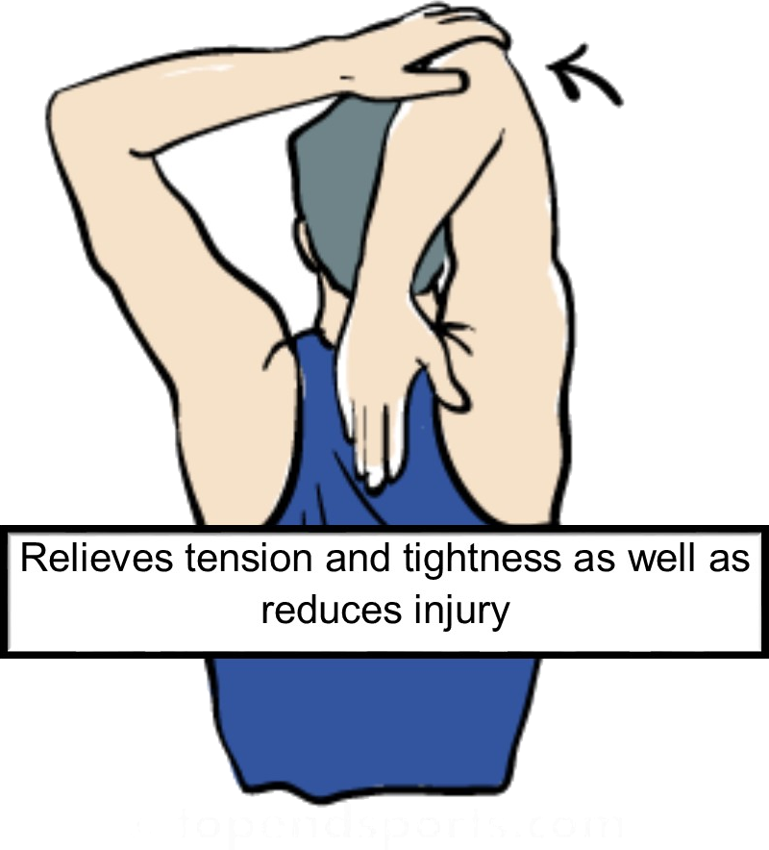
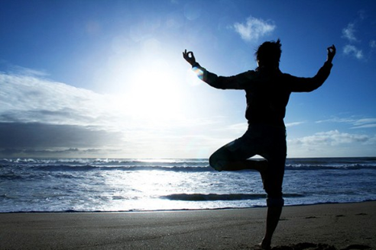
Types of Physical Activity
Flexibility Exercises

Slide 6
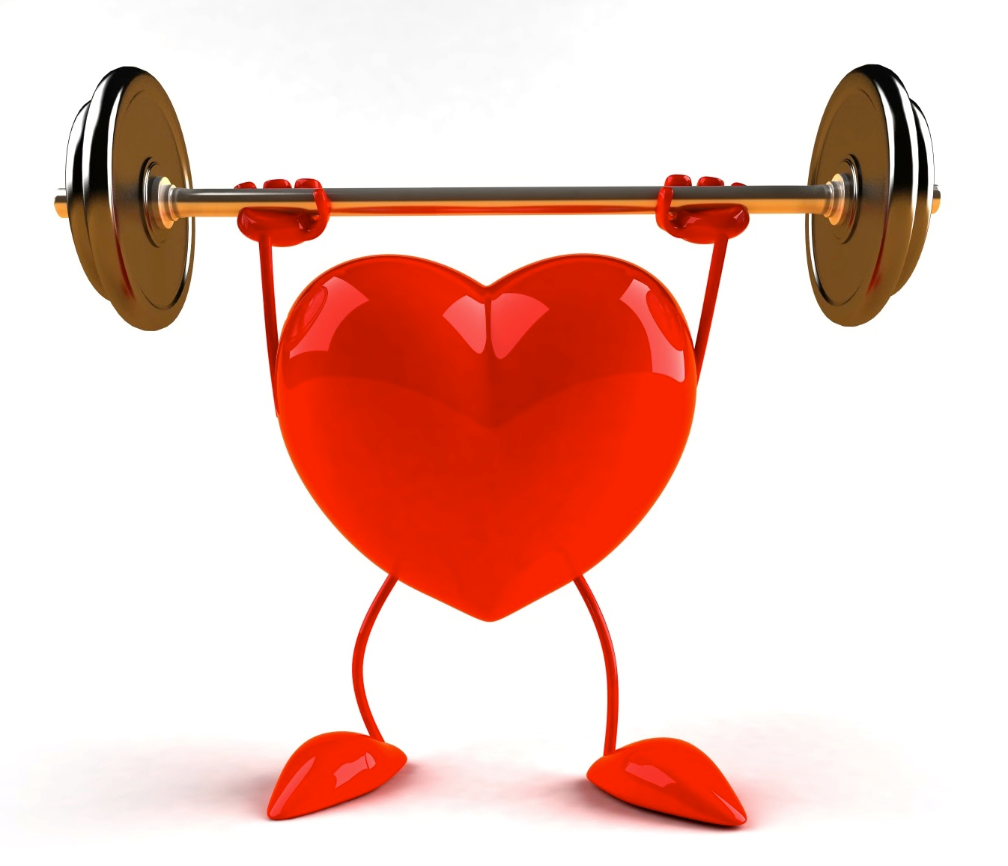
Why Is Physical Activity Important?
Regular physical activity can produce long term health benefits.
People of all ages, shapes, sizes, and abilities can benefit from being physically active.

Slide 7
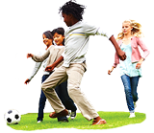
Why Is Physical Activity Important?
The more physical activity you do, the greater the health benefits.
Kids need 60 minutes a day of physical activity!

Slide 8
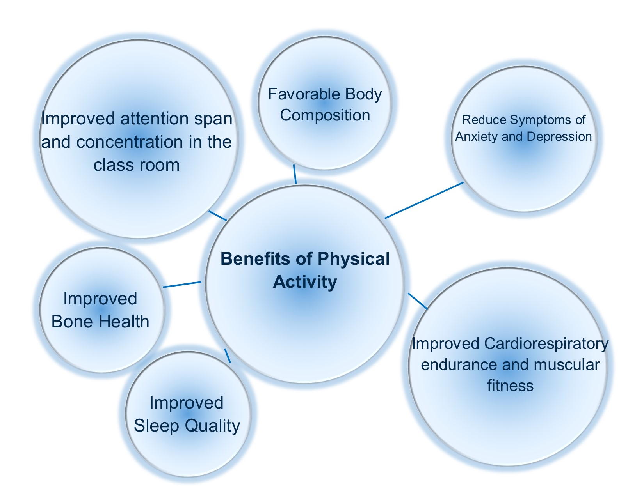
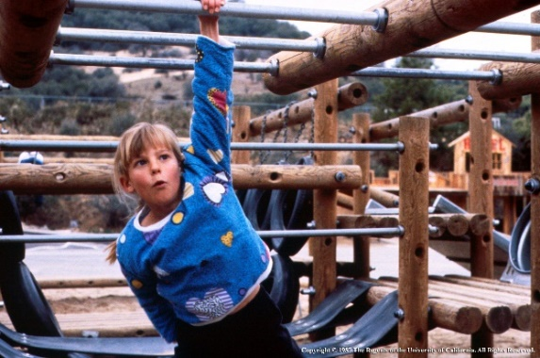
Why is Physical Activity Important?

Slide 9
What are some ways I can get my students moving?
Try to run in place for 2 minutes straight
Do some strength building exercises like lunges, squats, and push ups
Exercise to a workout video
Toss a beach ball around the class
Take a brain break and stretch for 5 minutes with your class
Have a dance off
Plant and care for a vegetable or flower garden
Use imagination: have students imitate sports movements or animals

Slide 10
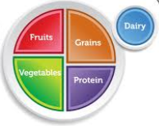
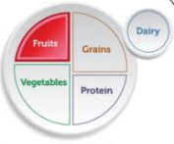
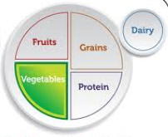
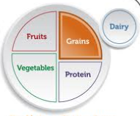
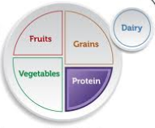
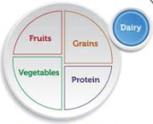
MyPlate Shaky
You put your fruit up (arms in the air) your put your fruits down(touch your toes) you put your fruits in(arms at waste level) and you mix them all around(mixing motion with arms) you do the MyPlate shaky(shaking hands in the air) and you turn yourself around, that’s what it’s all about! (clap)
You put your vegetables up your put your vegetables down you put your vegetables in and you mix them all around you do the MyPlate shaky and you turn yourself around, that’s what it’s all about!
You put your grains up your put your grains down you put your grains in and you mix them all around you do the MyPlate shaky and you turn yourself around, that’s what it’s all about!
You put your protein up your put your protein down you put your protein in and you mix them all around you do the MyPlate shaky and you turn yourself around, that’s what it’s all about!
You put your dairy up your put your dairy down you put your dairy in and you mix them all around you do the MyPlate shaky and you turn yourself around, that’s what it’s all about!
Do it Again! This time have students save their favorite food from each food group instead of the fruit, vegetable, etc. (i.e. apples, carrots, rice, chicken, yogurt)

Slide 11
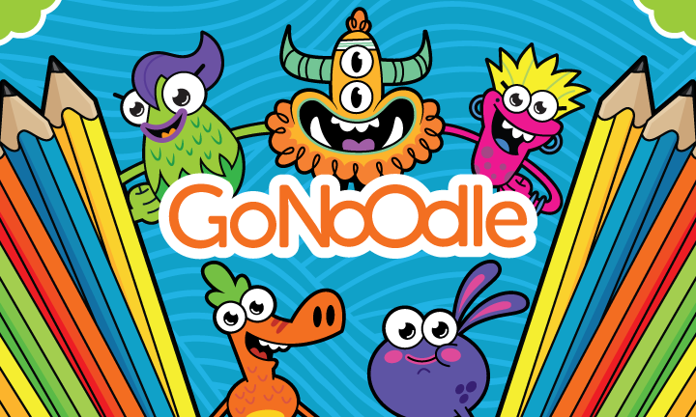
GoNoodle
Fun and interactive videos that promote physical activity.
Great for PA breaks.
https://www.gonoodle.com/

Slide 12

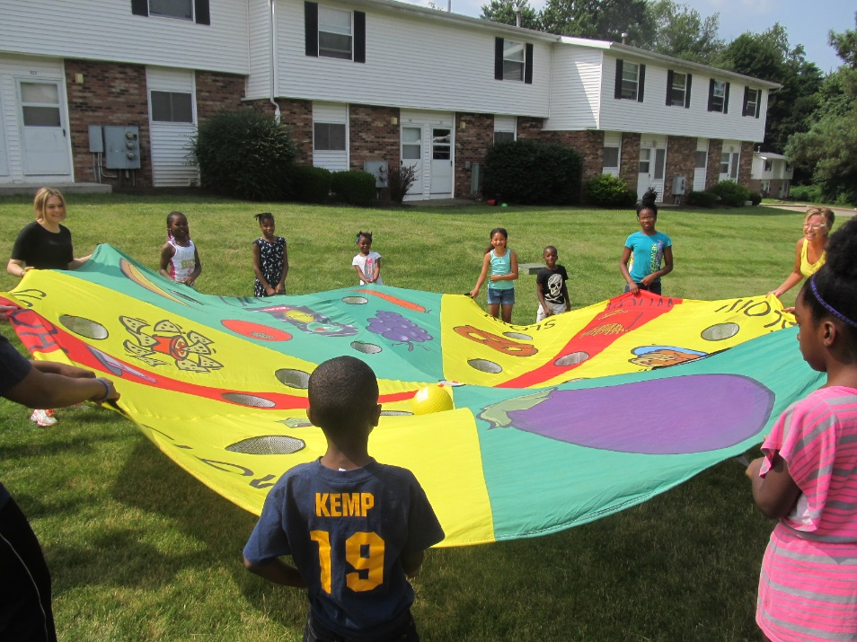
CATCH
The CATCH Program is a resource for bringing schools, families, and communities together to work toward creating a healthy school environment.
It is a Coordinated Program designed to promote physical activity, healthy food choices, and prevent tobacco use in elementary school aged children.

Slide 14
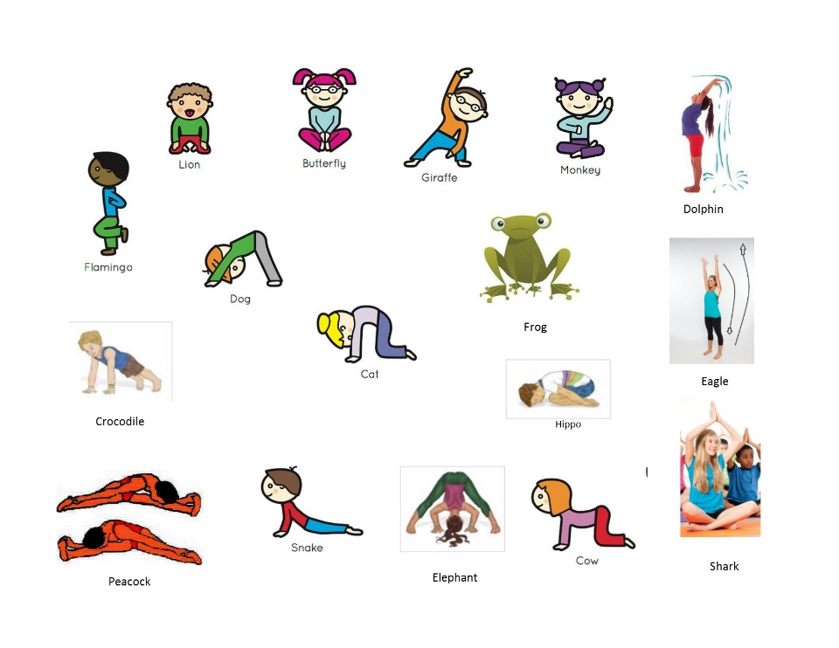
Fun and Interesting ways to do Physical Activity:
Animal Yoga:
Directions: Explain to students that yoga can help us increase our flexibility, strengthen our joints, give us better balance, increase concentration, help us focus and relax us. Tell the students to follow your directions and perform the movements slowly and controlled. Explain to the students that they will be doing yoga poses based on various animals. Select an animal pose. Together as a class slowly perform the pose and hold it for 10-30 seconds. Emphasize deep controlled breaths, in and out. Once the pose has been completed have the class make the noise the selected animal makes or do movements that the animal would do (e.g. scratch your head and jump like a monkey).
Repeat process as needed.
Review
  Why should we do yoga? Makes us flexible, prevents injury and calms us.
  Why is exercise important? Keeps us healthy and makes us strong.

Slide 15
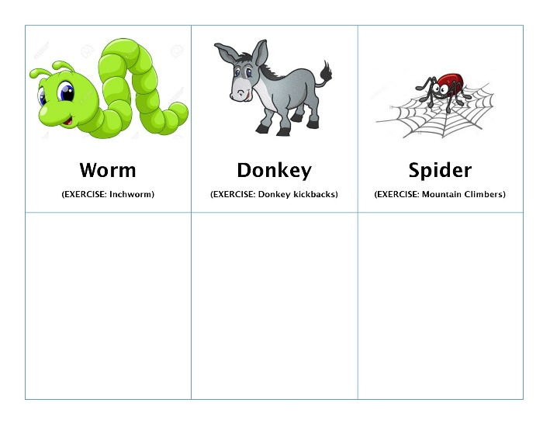
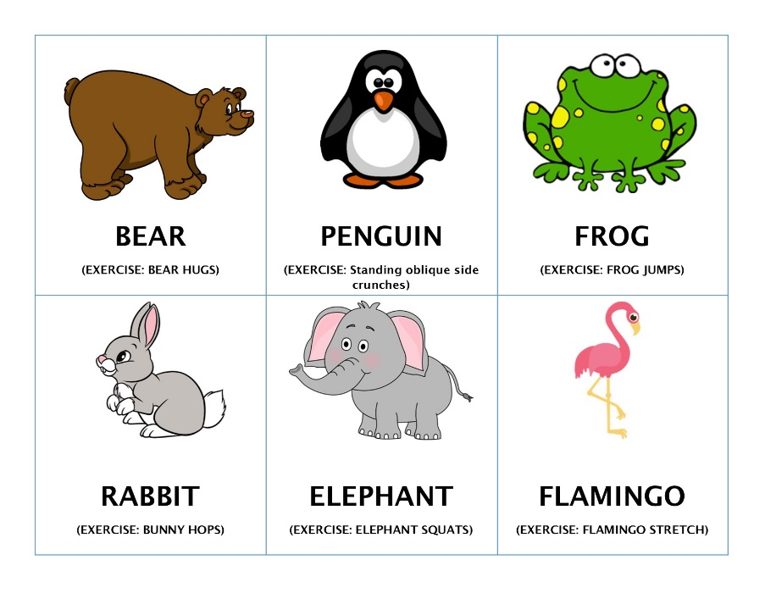
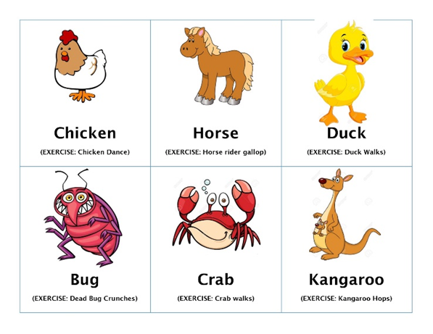
Fun and Interesting ways to do Physical Activity:
Animal Charades
Objective: One actor acts out selected animal in their own creative way to get their class to guess the animal
Directions:
Actor selects card and only shows educator, not the rest of the class.
After the animal is guessed correctly, educator will lead class in doing ~10 reps of the animal exercise (indicated in parentheses on animal card)
Play as many rounds as time allows, giving different students a chance to be the actor.
Review
  Why is exercise important? Keeps us healthy and makes us strong.

Slide 16
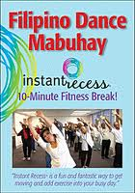
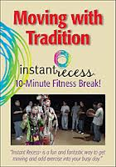
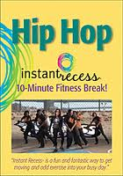
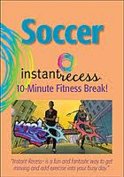
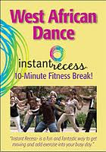
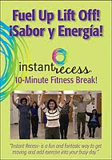

10-Minute Recess
Too Hot? Too Cold? Raining? Pop in a 10-Minute Recess DVD by Dr. Toni Yancey and get your students active. Purchase, youtube or ask your program representative to check out a copy.

