Slide 1
Gardening With Native Plants
UC Master Gardeners of Monterey & Santa Cruz
July 2019

Slide 2
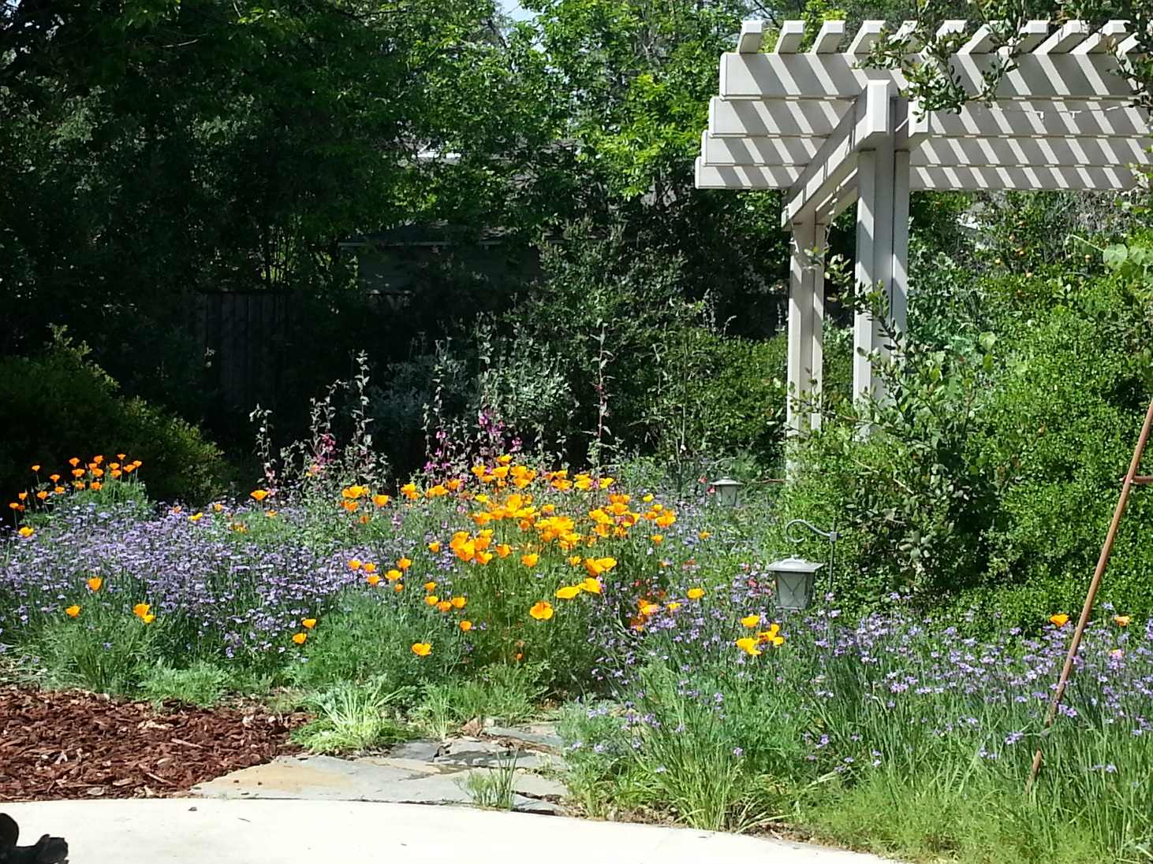
Gardening With Beautiful Native Plants
Notes:
Introduction. New class. Value feedback. Please complete the follow-up survey.
You will learn: Why do it, How do you do it, When do you do it, What to plant….

Slide 3
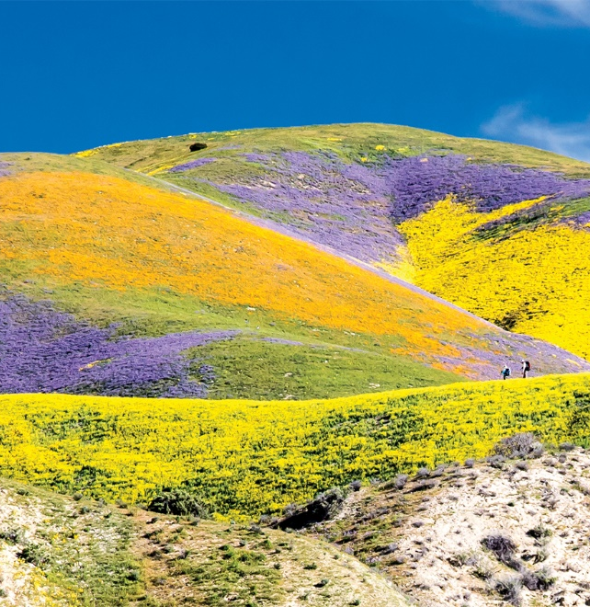
California is a Biodiversity Hotspot
California is considered one of 34 Global Biodiversity Hotspots. We have a large number of plants and animals that do not occur elsewhere in the world.
Our state has more plant species (7,000+) than any other state.
We have 1,600 species of bees. (4,000 bee species in entire U.S.)
Estimated 100,000 insects
650 bird, 220 mammal, 100 reptile, 75 amphibian, 70 freshwater fish and 100 marine fish and mammal species
Notes:
Designated in 1996. Over 2,000 plants are endemics. Another example of our biodiversity – number of bee species.

Slide 4
Habitat Loss and Biodiversity Initiative
Over 75% of native habitat has been lost in California
300 species are Federally listed as threatened and endangered.
The State Biodiversity Initiative was launched in 2018 to provide a roadmap and funding to protect our biodiversity.
http://opr.ca.gov/docs/20180907-CaliforniaBiodiversityActionPlan.pdf
Photos of Santa Cruz endangered species:
Yellow-billed cuckoo, Santa Cruz wallflower,
Ohlone tiger beetle, long-toed salamander
Notes:
Lost to large-scale agriculture, urbanization, roads and infrastructure and introduced non-native species.
Pictured are just a few of our county’s threatened and endangered species. Full list is on SC Library website. Snowy Plover.

Slide 5
Santa Cruz County Plants
Santa Cruz County has over 1,000 native species even though we are the second smallest county in the state (S.F. is the smallest).
There are many choices for gardeners.
Our urban landscapes are predominantly planted with nonnative species.
Some of those nonnatives are invasive species that have escaped into natural areas. (See flyer)
Pictured: Ribes sanguineum var. glutinosum Pink-flowering currant
Notes:
Important since planting species local to your community is best. We also have endemic species that don’t occur outside our county. Certain manzanitas and wildflowers and a kind of Ponderosa Pine. (Pinus ponderosa var. pacifica)

Slide 6
Many Benefits
Fewer Problems
Adapted to our soils
Adapted to dry summers
Adapted to fire
Attracts beneficial insects, pollinators and supports wildlife
Controls erosion
Few amendments or fertilizers needed
Once established, little watering
Fire rejuvenates many natives
Native wildlife and plants are closely connected
Extensive root systems hold soil
Notes:
We will explain in further detail why using your most local species will help you have the most success in gardening with natives. All of these benefits have to do with tens of thousands of years of the plants adaptation to the environment. It’s in their DNA.

Slide 7
Local Native Plants are Best Suited to Your Soil
Soils vary in pH, depth, texture and chemical composition. Some of our soils are unique.
More than 1,500 soil series are recognized in California.
Twenty-seven types of soil have been identified on UCSC campus alone.
Geologic events such as faulting and glaciation have influenced the mineral content of our soils.
Combinations of parent rock, organic matter, moisture levels, salinity and topography add to the mix.
If you are curious, you can access your soil data by entering your address at:
https://casoilresource.lawr.ucdavis.edu/gmap/
Notes:
Basically, all soils are not the same. In fact, we have some very unique soils in California. The soils at UCSC have been studied extensively.
An app was developed at UC Davis to help access soil data.

Slide 8
Example: Soil at UCMG Demo Garden – Watsonville Loam
Notes:
Where we are at, the soil is primarily Watsonville loam with some other types of soil in the mix. This is USDA soil data and this app was developed by the CA Soil Resources lab at UC Davis.
You do not need to know your soil type but it can be interesting to know it.

Slide 9
Winters are Wet, Summers are Dry
City of Santa Cruz Precipitation
Growing Season Oct-May
Notes:
The red line is our average rainfall. The green line is the rest of the country. Native plants are adapted to this rainfall pattern.
Sometimes called Mediterranean climate but also occurs in parts of Africa and Australia.

Slide 10
City of Santa Cruz Water Supply 2018/19 Native Plant Water Needs Match Supply
Notes:
The new water rates are being structured to promote conservation in the summer. This also helps us determine the best time to plant natives, when the rains return. January is a great month to plant. Steadier rainfall makes watering easier.

Slide 11
Native Plants and Fire- Recovery
Many native plants rapidly regenerate after a fire and their roots prevent erosion.
Native California Oaks are adapted to survive periodic burning and will recover if the cambium is intact.
The invasion of non-native grasses has increased the ignition, spread and severity of wildfires.
Eucalyptus trees have flammable resins, peeling bark and dead wood that cause fires to spread especially fast.
Our Riparian ecosystems act as moist buffers and don’t burn severely except when they are infested with weeds.
New Fire Recovery Guide:https://www.cnps.org/wp-content/uploads/2018/04/CNPS-fire-recovery-guide-LR-040618.pdf
Notes:
The catastrophic fires are causing us to rethink past practices such as fire suppression and increase our awareness of non-native grasses that have spread throughout our state. Burls on manzanitas, deep root systems, seeds that need fire to germinate.

Slide 12
Gardening for Wildlife is Important
There is a 40% loss of insects worldwide
Biodiversity increases the resilience of ecosystems
The health of planetary life depends on food webs, which depend on the health of interdependent species from fungi and microorganisms to plants, invertebrates, herbivores and carnivores
This Photo by Unknown Author is licensed under CC BY-SA-NC
Notes:
Every garden can make a difference.

Slide 13
Native Plants Support Wildlife
Native plants coevolved with native species and provide:
Nesting materials, cover and places to live
Food
Pollen
Nectar
Seeds and Nuts
Berries & Other Fruit
Foliage
Insects…
This Photo by Unknown Author is licensed under CC BY-SA
This Photo by Unknown Author is licensed under CC BY-SA
Notes:
There are many plants that we can’t eat. Our native wildlife needs our native plants. Those are the things they can eat. Poison oak has great wildlife value.
Probably the most well known example is the monarch butterfly’s need for the milkweed plant.

Slide 14
Native Plants Support Native Insects
Insects play a large role in transferring energy from plants to other animals.
An estimated 90% of insect herbivores are specialists needing particular host plants..
While Buddleia – butterfly bush, native to Asia produces nectar, not a single species of butterfly in North America can reproduce on it.(Tallamy 2007)
This Photo by Unknown Author is licensed under CC BY-SA
Notes:
Here is an example of a local butterfly that needs our help. Pictured: Smith’s Blue Butterfly.

Slide 15
Cal-IPC California Invasive Plant Council Helps Stop the Spread of Invasives
Notes:
The Buddleia plant is also on the watch list for becoming an invasive. It is already invasive in the Pacific Northwest.

Slide 16
Birds Rely on Insects
96% of terrestrial birds of North America raise their young on insects
Caterpillars and other insects are fatty, high protein foods needed in large quantities
A mother bird may need 400 insects a day to feed her nestlings
Notes:
Without large numbers of insects, bird populations suffer.

Slide 17
Native Plants Support Our Native Bees
Findings from the Berkeley survey of plants in front yards (2003)
1,000 different plants recorded
950 non-native, 50 native
Non-native plants attracted 8% of bees
Native plants attracted 80% of bees
One small urban garden can attract 40-50 species of bees if planted with native “bee plants”
Notes:
A lot of focus has been on Colony Collapse Disorder which only affects a handful of non-native bees. More recent research on our native bees, is highlighting their importance in pollinating our crops.

Slide 18
Oaks are “Super Plants”
Coast Live Oak Quercus agrifolia
One of the most important wildlife plants
Easy to grow
Can reach 40’ in 20 years

Slide 19
Coast Live Oak Acorns
From little acorns, mighty oaks grow.
Tens of thousands of acres of oaks have been lost to agricultural conversion, fires and urbanization.
There are 9 species of oaks in Santa Cruz County.
Oaks sequester more carbon than other urban trees.
Re-Oaking programs are now a statewide effort.
Notes:
You can collect acorns for free and plant them if you have room for an oak tree.
Instructions for acorn planting.

Slide 20
Calscape.org Restore Nature One Garden at a Time
Launched in 2016, Calscape is an online tool that lets you identify the plants that are native to where you live.
Developed through a strategic partnership with the California Native Plant Society (CNPS) and the Jepson Herbarium at U.C. Berkeley
Maps are based on over 2 million GPS field observations
Notes:
This is the first tool of this kind.

Slide 21
Calscape – It’s easy to find your most local plants
Notes:
399 Plants. Can export to an excel spread sheet. Allows you to save plant lists. The Planting Guide.

Slide 22
Plants are sorted into useful categories

Slide 23
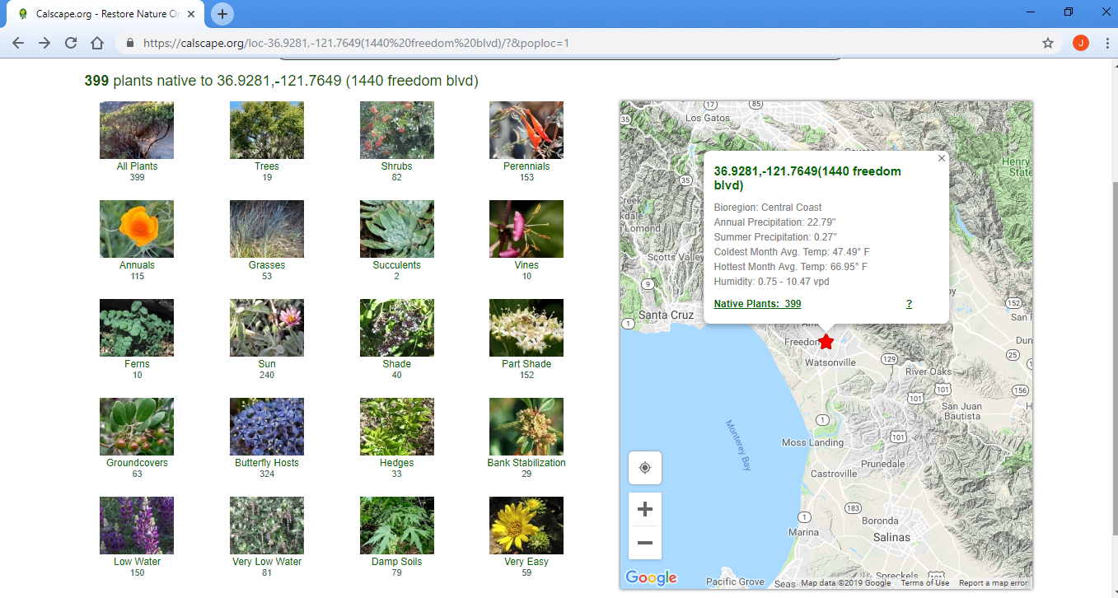

Slide 24
Very Easy Plants – Toughest & Most Reliable
Notes:
Adaptable to a wider range of soils, topographies and amounts of water.

Slide 25
Calscape – Information on Individual Plants
Notes:
Participants should have this as a handout. There is a wealth of well-researched information on each plant.

Slide 26
Landscaping information and Nursery Availability
Notes:
Suggestions for companion plants, watering needs, etc.
Click “Show all” for Butterflies

Slide 27
Sourcing Plants What’s Available? Saving Money
Native plant nurseries, local growers
Local nurseries – most have a Native plant section or can order plants for you
Plant Sales – CNPS, Cabrillo College (Annually on Mother’s Day weekend), UC Master Gardeners Fall Fest and Smart Gardening Fair
Seeds
Bulbs
Propagating your own plants
Mail-order sources
Notes:
Locating plants can be an adventure. Might want to have a shopping list with 2nd and 3rd options.

Slide 28
Short Lists of Easy, Reliable and Beautiful Native Plants for Santa Cruz County
Perennials
Shrubs
Groundcovers
Annual Wildflowers
Container Plants
Non-local Favorites
Notes:
Everyone should have handouts with these lists. They are not comprehensive. Around 10 suggestions each to fit on a page. Ideas to get you started.

Slide 29
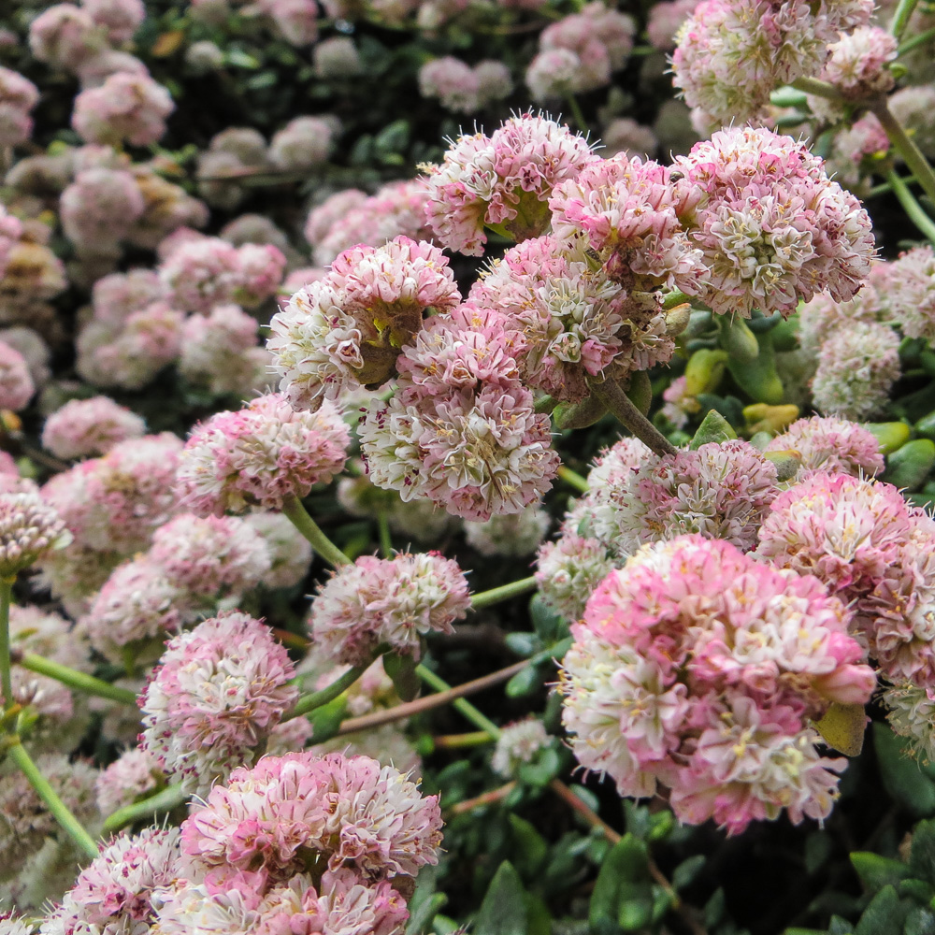
Coast Buckwheat
Eriogonum latifolium
This Photo by Unknown Author is licensed under CC BY-NC-ND
Notes:
On Perennial list: Buckwheats – one of the largest genera of California plants with over 125 species. The blooms will turn and earthy color as they fade. Can also be used as a groundcover.

Slide 30
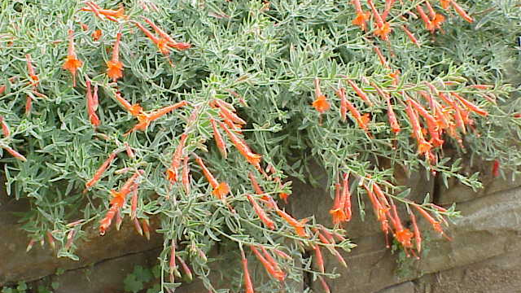
California Fuschia
Epilobium canum
This Photo by Unknown Author is licensed under CC BY-SA
Notes:
On Perennial list: A favorite hummingbird plant. One of the few natives blooming in summer to fall.

Slide 31
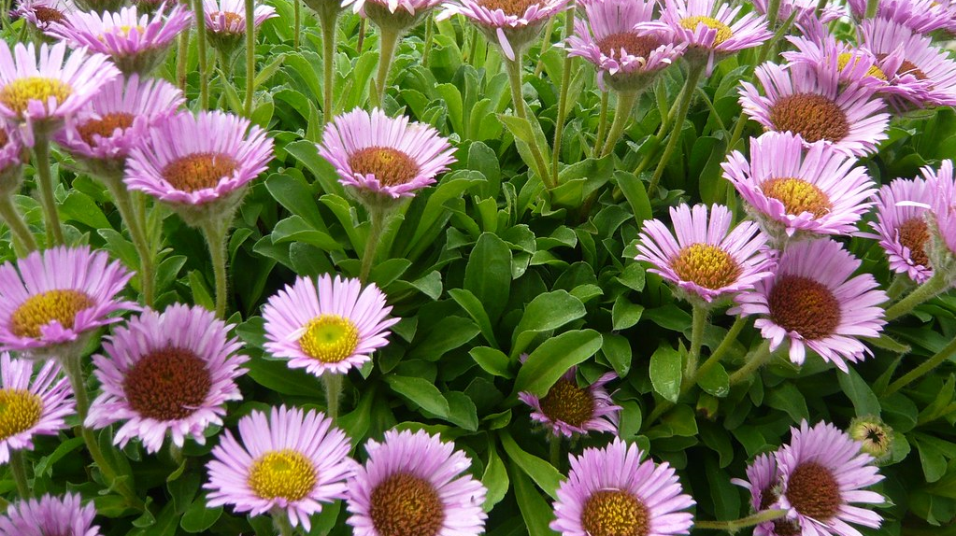
Seaside Daisy
Erigeron glaucus
This Photo by Unknown Author is licensed under CC BY-SA-NC
Notes:
On groundcover list. Also has a long bloom time. Does not have to be used as a groundcover. Nice in a pot.

Slide 32
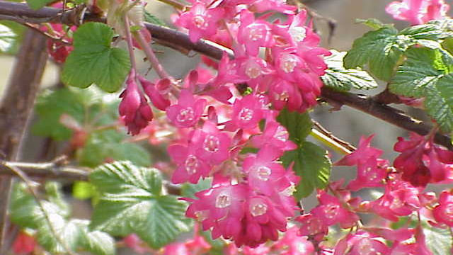
Blood Currant
Ribes sanguineum
This Photo by Unknown Author is licensed under CC BY-SA
Notes:
A very showy shrub.

Slide 33
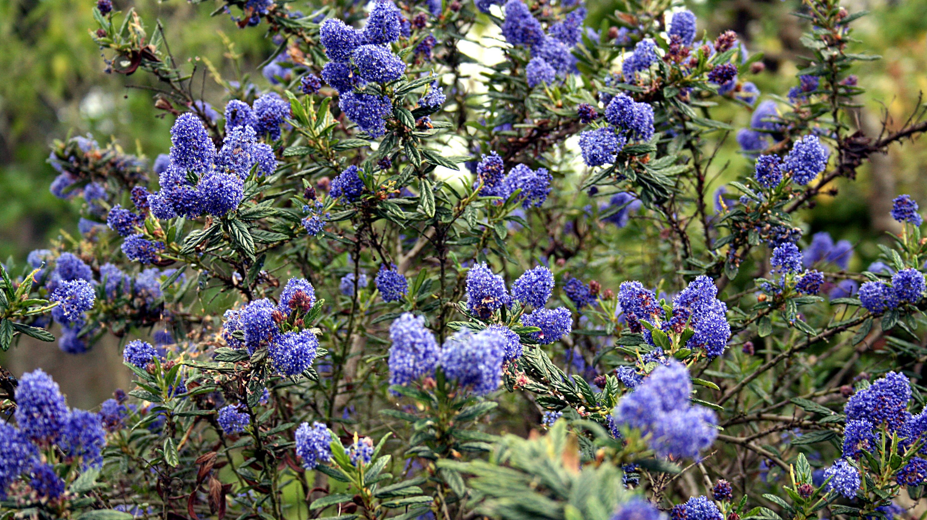
Blueblossom
Ceanothus thyrsiflorus
This Photo by Unknown Author is licensed under CC BY-SA
Notes:
On Shrub list:
California ceanothus are so popular in Great Britain. Another “Super Plant” supporting over 90 butterflies and moths.

Slide 34
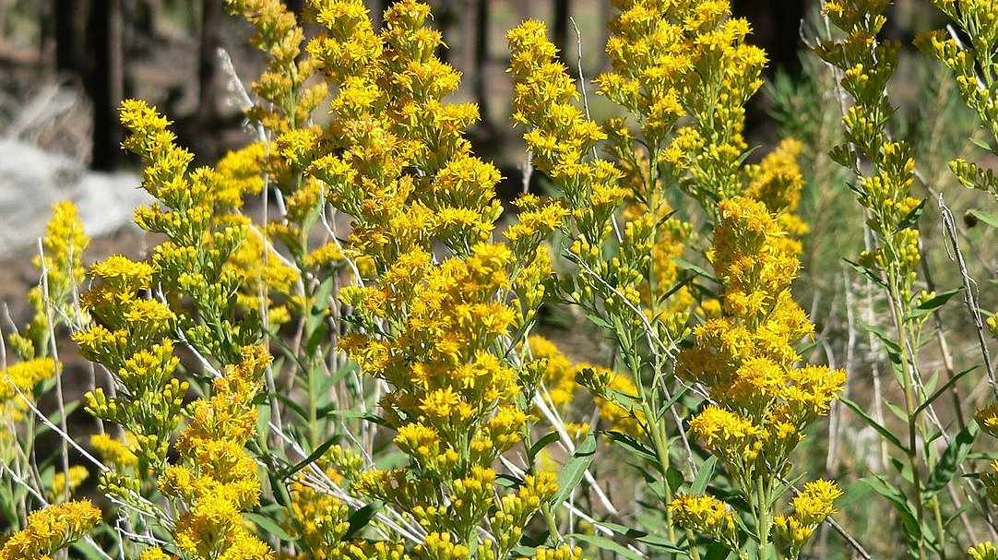
California Goldenrod
Solidago velutina
This Photo by Unknown Author is licensed under CC BY-SA
Notes:
On Containers list: Another late blooming perennial that will help to extend bloom in the garden. It is in a raised garden box in the Demo Garden.
However, we can also appreciate seasonal dormancy. All the plants on this list are great in the garden.

Slide 35
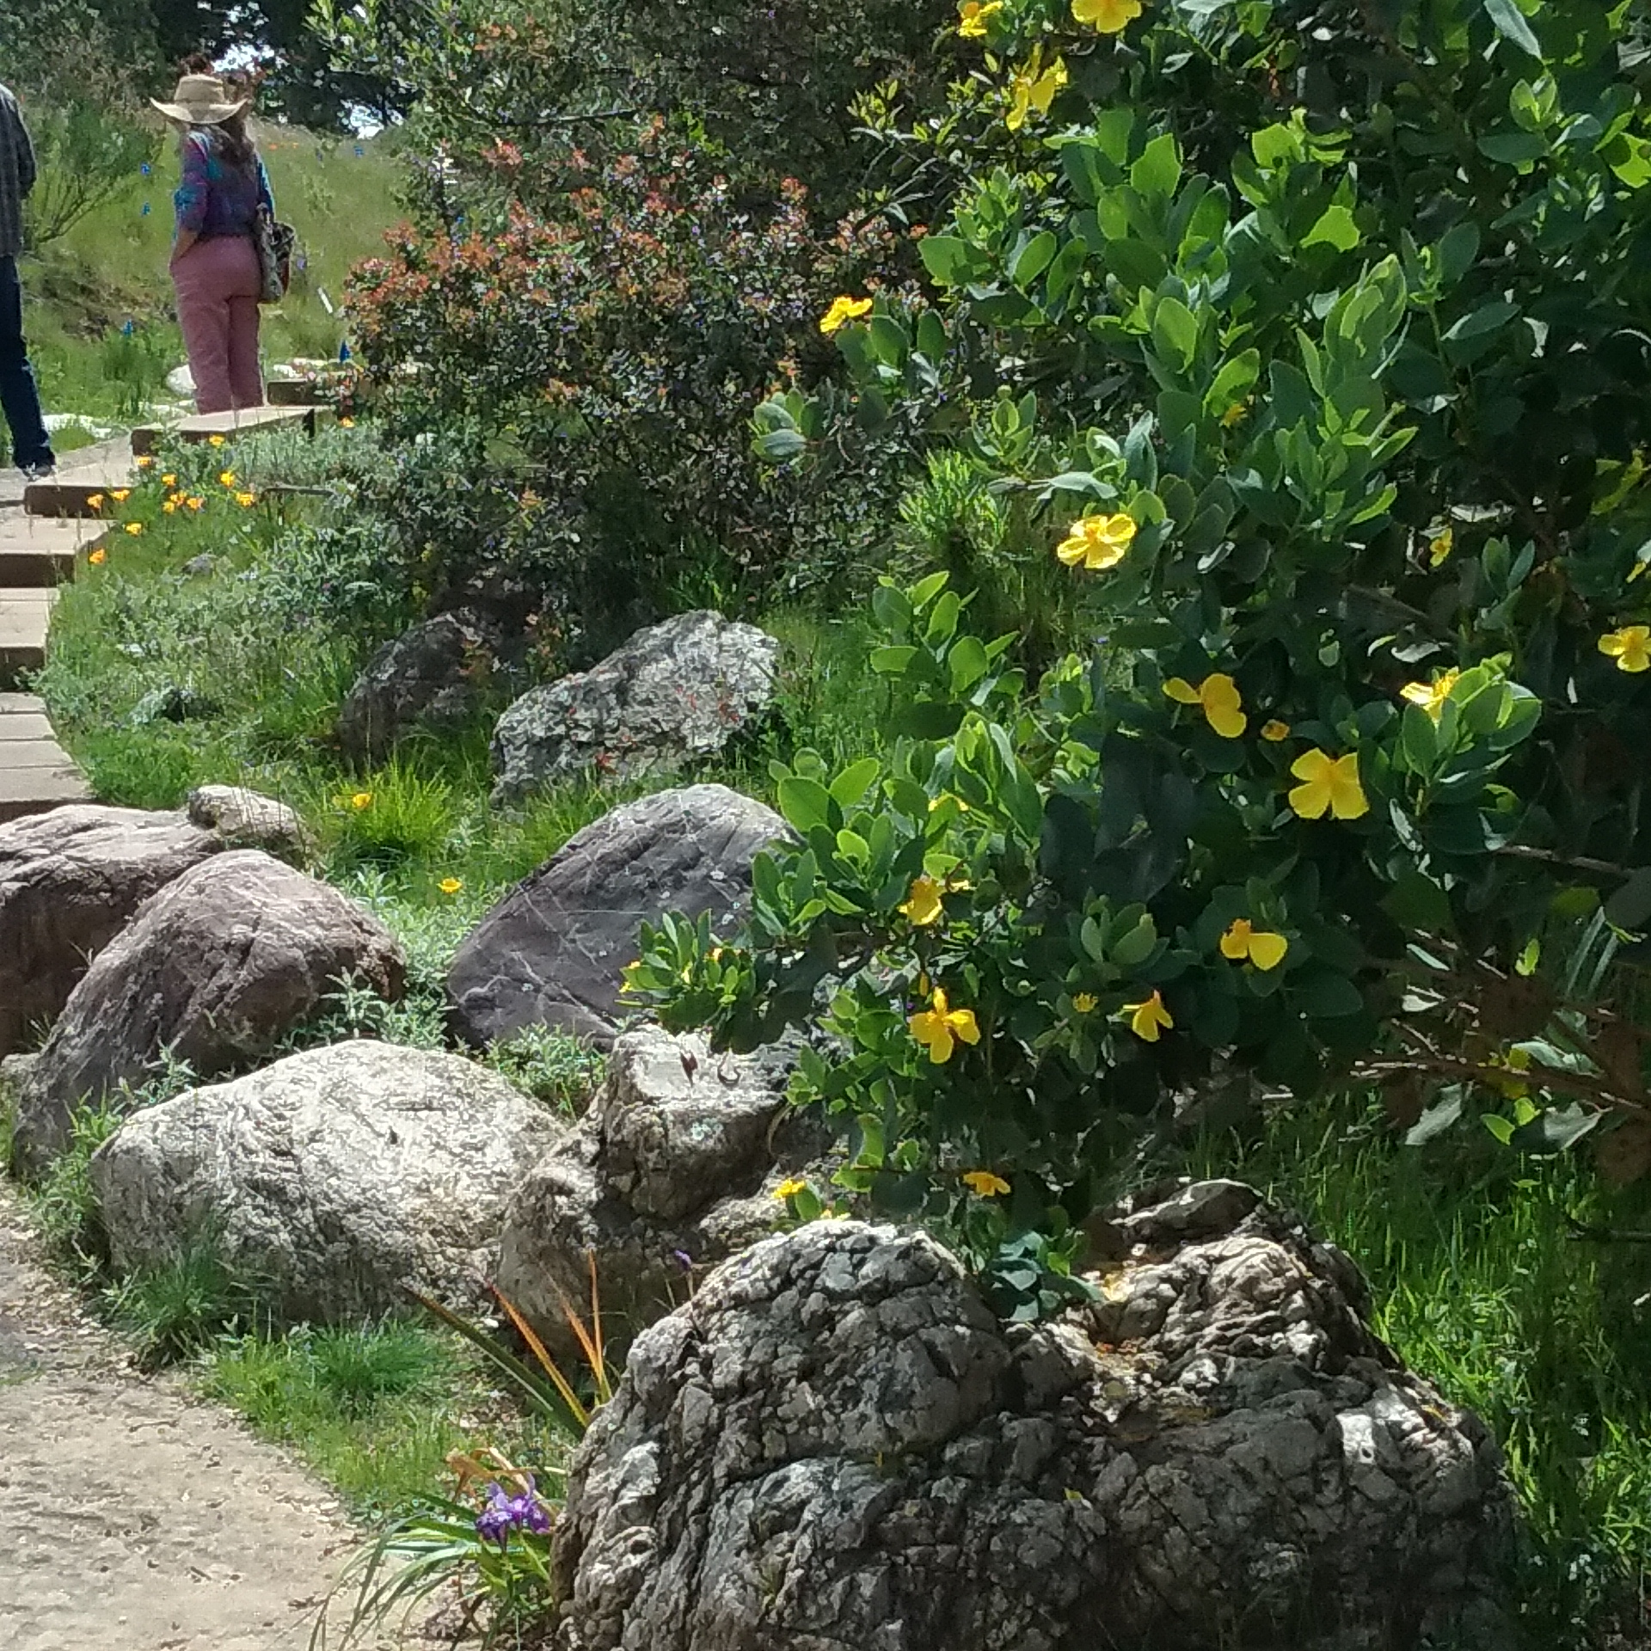
Island Bush Poppy
Dendromecon harfordii
Notes:
On Non-Local list: An outstanding “non-local” native shrub. Stays in bloom ¾ of the year.

Slide 36
A Blood Currant in a Pot
Plants in containers will need more watering.
Some native plants have even been used for bonsai.
Nice to enjoy scented species up close.
Great for bulbs that are summer dormant.
`
Notes:
If you will be sowing wildflower seed, think about sowing some seed in a pot so that you can identify what the seedlings look like. This is useful when weeding.

Slide 37
Things to Consider When Selecting Specific Plants for Your Garden
Microclimates on your property:
Topography – slopes, trenches
Existing trees and shrubs to be retained
Existing irrigation and hardscape
Nearby natural features – beach, creek, forest, cliffs, bluffs etc.
Size considerations. Many choices for tiny areas to large landscapes.
Year-round color, texture, scent, uses (erosion control, herbal, edible, wildlife, screening, espalier, children, etc.)
Ease of maintenance and availability……

Slide 38
A Garden Near West Cliff Drive
Includes a profusion of perennial and annual flowers
Coyote bush pruned to take on a beautiful form
Highly aromatic Cleveland sage and Woolly blue curls
Plants in containers to meet their specific needs
K. Laird Garden
Photo by Anandi Paganini

Slide 39
Notes:
Another part of the garden.

Slide 40
Special Considerations if you live in the Wildlife Urban Interface
Maintain the biological integrity of wild populations of native plants by avoiding species that might cross-pollinate with them.
Eliminate invasive species
Reduce fuel loads
Photo of Master Gardener Karen Cozza’s garden by Kevin Lohman

Slide 41
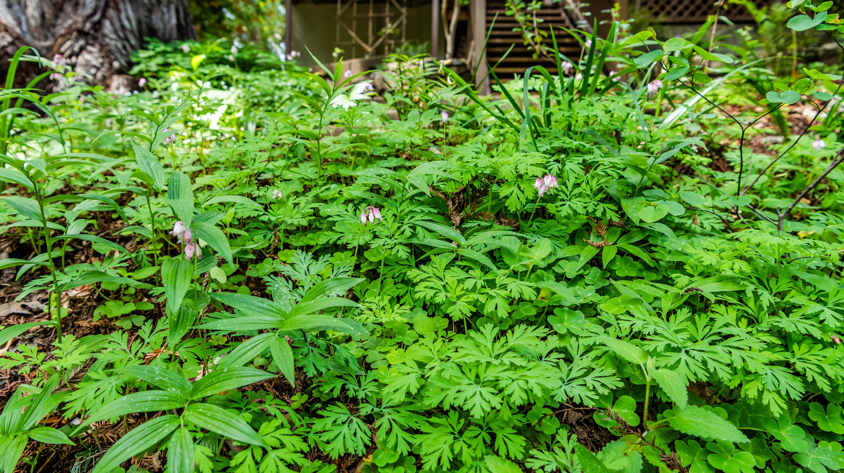
Notes:
Bleeding Hearts, Solomon’s Seal, Irises, and Wild Ginger are a few of the native plants in this woodland garden.

Slide 42
Weed Eradication Before Planting
Invasive weeds can outcompete your plants for resources
Identify your weeds to determine optimal methods of removal
Perennial weeds are more difficult to eradicate
Weeds produce a lot of seed
Weed seeds persist for many years
Remove weeds before they set seed
Sheet mulching can help suppress weeds
Once established, many native plants will help suppress weeds
http://ipm.ucanr.edu/PMG/menu.weeds.html
https://www.cal-ipc.org/wp-content/uploads/2017/03/TheTopOffenders_20171114.pdf
Notes:
Pass around Worst Weeds in County handout. UC ANR Weed cards. Example: Oxalis pes caprae

Slide 43
Planting
Planting in late fall to winter is best.
Calscape planting guide https://calscape.org/planting-guide.php
Space plants for future growth.
Spaces can be filled with wildflowers, bunchgrasses, stones or even art!
Mulch to maintain moisture and suppress weeds.
Photo by Kevin Lohman
Notes:
Lawn was removed at the Santa Cruz Natural History Museum and this photo was taken only one year later.
Garden includes: Coast Buckwheat, Seaside Daisy, Self-Heal, Horkelia, Poppies, Yarrow and native bunchgrasses.

Slide 44
Watering to Establish Plants – Sleep, Creep then Leap!
More extensive root growth occurs while plants are becoming established (great erosion control)
Watering is needed to establish roots and during periods of drought
In general, watering will taper off to once a month
As a rule of thumb, plants are established if they have doubled or tripled in size or lived through 2 or 3 summers
Drawing: Typical root system of a perennial native grass.
Courtesy: Hastings Natural History Reserve – UC Natural Reserve System
Notes:
Many native plants have far more extensive root systems. It may seem like there isn’t a lot going on above ground, but a lot is going on underground.
Patience.

Slide 45
Group Plants in Hydrozones
Plants native to moist canyons and shady streams are water-needy.
Plants of scrub or chaparral communities need a lot less water.
Other plants fall somewhere in the middle.
You may have 3 hydrozones on your property.
Photo by Kevin Lohman
Notes:
It is a misconception that all native plants need little or no water. The Redwoods would not survive in the Mojave Desert.
Summer drought tolerance, not year-round drought tolerance.

Slide 46
Careful Watering in Summer
Native plants adapted to hot and dry soils are sensitive to fungi and bacteria that become active in warm, wet soils.
New plantings are establishing the root systems needed to survive drought.
Summer watering can be a balancing act but is fairly easy with our cool coastal climate.
Water during cool periods.
“Very Easy” plants can take summer watering
Notes:
Helpful to let the plants dry out a bit between waterings. Roots should not be constantly wet.

Slide 47
No Garden is No Maintenance That Would be No Fun!
Mulching
Weeding
Pruning
Seed sowing
Transplanting
Coppicing
Harvesting bulbs
Native American techniques for plant cultivation included all the above methods to ensure good supplies of the plants they depended upon.
Notes:
Pass out fragaria vesca runners. Check for pruning info.

Slide 48
Public Places to View Native Gardens in Santa Cruz County From the westside to the east
Seymour Marine Discovery Center – UCSC
Natural Bridges State Beach Visitor Center
UCSC Arboretum and UCSC Farm
Bay Street Reservoir – corner of Cardiff and Iowa next to the 7 Eleven
Henry Cowell State Park Visitor Center
Land Trust of Santa Cruz County – Water St.
Santa Cruz Museum of Natural History
Seabright Beach
Sunset Beach
UC Cooperative Center and UC Master Gardener Demonstration Garden in Watsonville

Slide 49
Internet Resources
Calscape https://calscape.org/
Calflora https://www.calflora.org/
UC Master Gardeners of Monterey Bay- Local Resourceshttp://mbmg.ucanr.edu/Read_An_Article/Local_Resources/
California Native Plant Society https://www.cnps.org/
Best Plants, Best Practices. Info on planting for beneficial insects. https://www.calflora.org/bpbp/insects.html
Tilden Botanic Garden https:https://www.ebparks.org/parks/tilden/botanic_garden.htm
Weed Gallery and Key to Identifying Weeds http://ipm.ucanr.edu/PMG/menu.weeds.html
California Native Grasslands Association: https://cnga.org/

Slide 50
Helpful Books
California Native Plants for the Garden by Bornstein, Fross & O’Brien. Cachuma Press 2005.
Designing California Native Gardens by Keator, Middlebrook. University of California Press 2007.
California Native Gardening by Helen Popper. University of California Press 2012.
Growing California Native Plants 2nd Edition by Schmidt. University of California Press 2012
Wild Suburbia: Learning to Garden with Native Plants by Eisenstein. Heyday 2016
California Bees and Blooms by Frankie, Thorp, Coville, Ertter. Heyday 2014.

Slide 51
Additional References
Anderson, M. Kat 2005’s Tending the Wild: Native American Knowledge and the Management of California’s Natural Resources. Berkeley and Los Angeles: University of California Press.
Haff, T., Brown, M., Tyler, W. 2008. The Natural History of the UC Santa Cruz Campus. Santa Cruz: Environmental Studies Department University of Santa Cruz.
Neubauer, D. 2013. Annotated Checklist of the Vascular Plants of Santa Cruz County, California 2nd Edition. Santa Cruz: California Native Plant Society Santa Cruz Chapter.
Ornduff, R., Faber, P., Keeler-Wolf, T. 2003. Introduction to California Plant Life Revised Edition. Berkeley and Los Angeles: University of California Press.
Tallamy, D.W., 2012. Bringing Nature Home – How You Can Sustain Wildlife with Native Plants. Portland, Oregon Timber Press.
Sources of plant photos and gardens include Calflora, CalPhotos and independent photographers who have agreed to share their images.

Slide 52
Notes:
Notes:
“So we can better serve our communities and improve the content and value of our program’s events and workshops, please be on the look-out for an email to access our online survey. The survey typically takes less than 10 minutes to complete. We are so grateful for your support of the UC Master Gardener Program”.

