Slide 1
NPI Brown Bag Seminar Series
Building on low-income consumer perspectives and practices to inform healthy retail interventions
Sridharshi Hewawitharana
Research Data Analyst, Nutrition Policy Institute
Thursday, November 21st, 2019
http://npi.ucanr.edu • Twitter @UCNPI

Slide 7
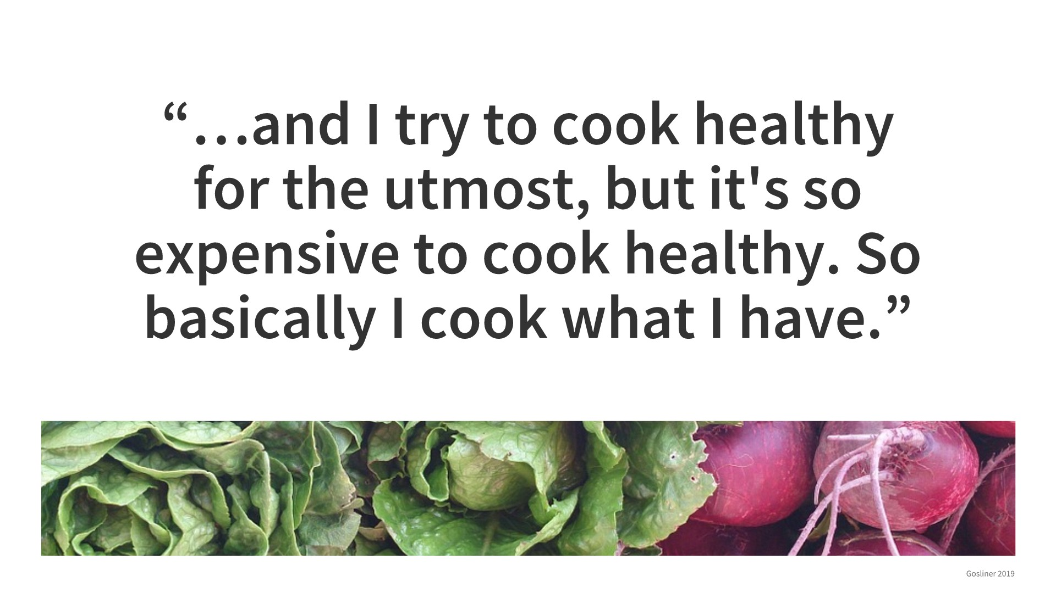

Slide 8
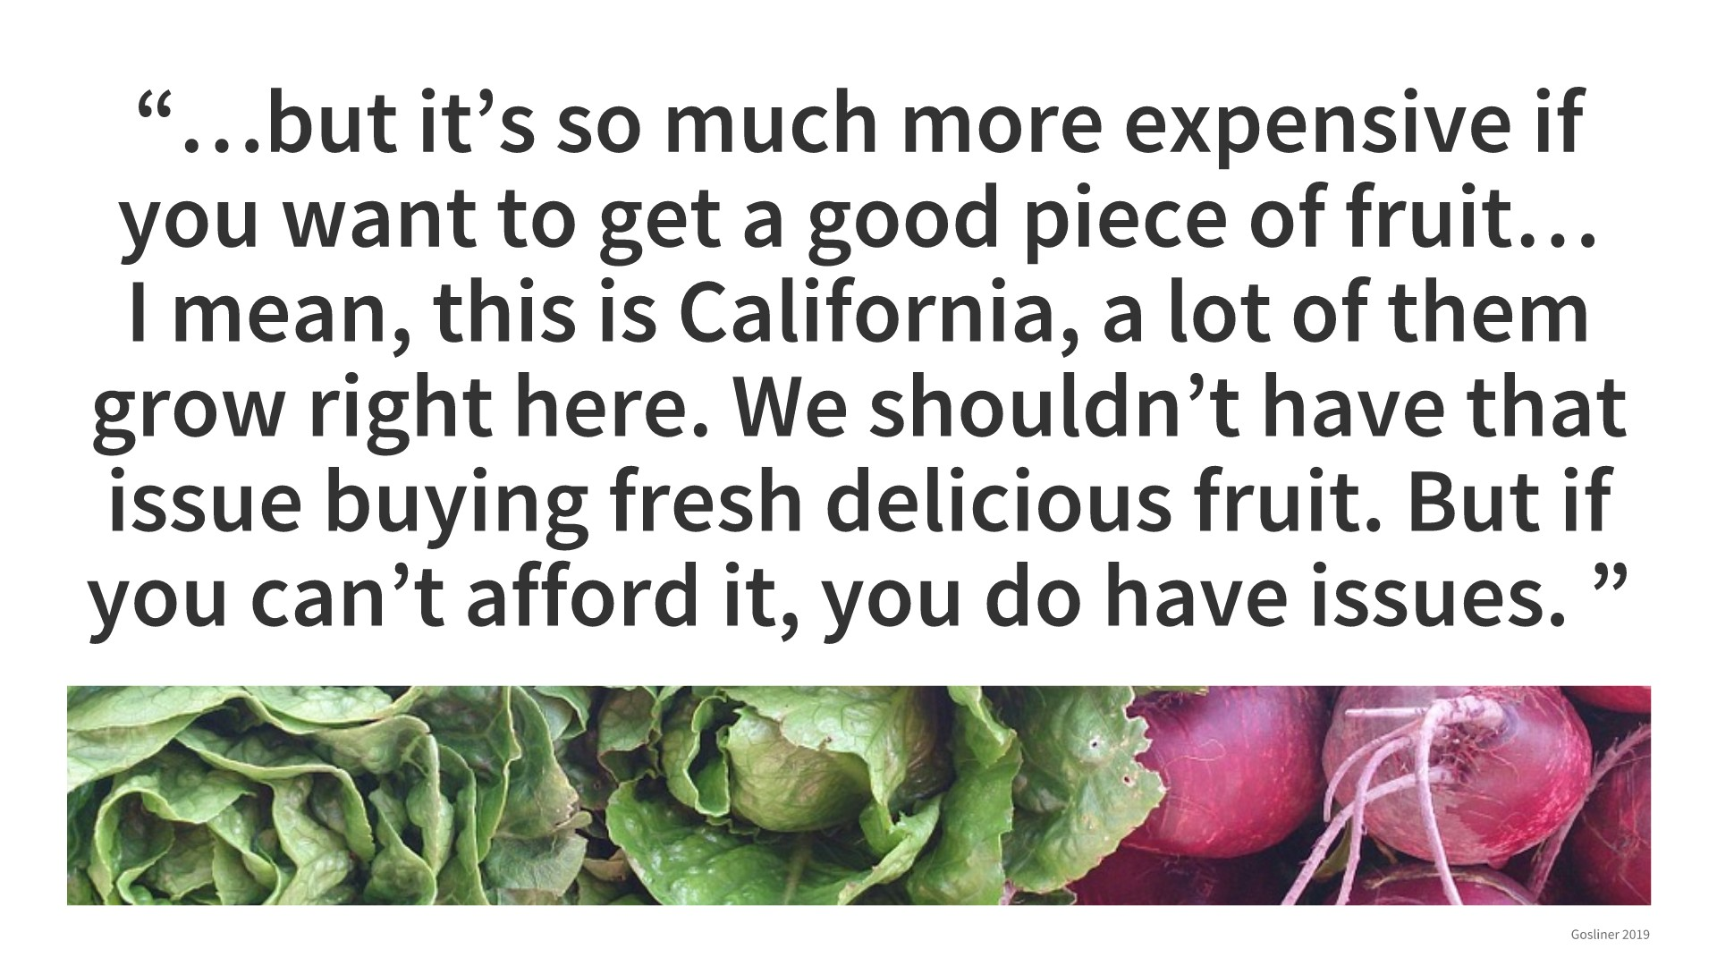

Slide 11
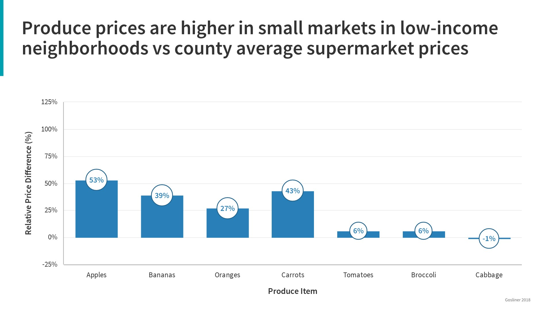

Slide 21
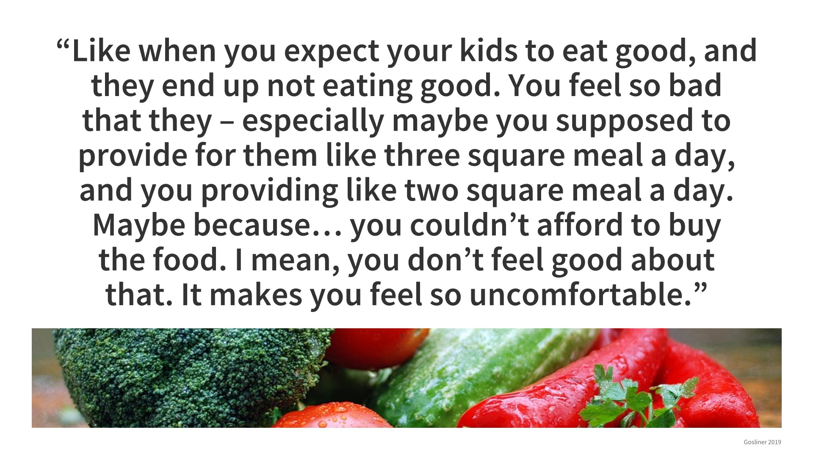

Slide 28
