Slide 1
Creating Meaningful Dialogue
Focused Conversations
Presented by
Lauren Snowden
Statewide Training Coordinator
UC Master Gardener Program
Notes:
The Focused Conversation method is a structured process that helps a large or small groups navigate a conversation together.

Slide 2
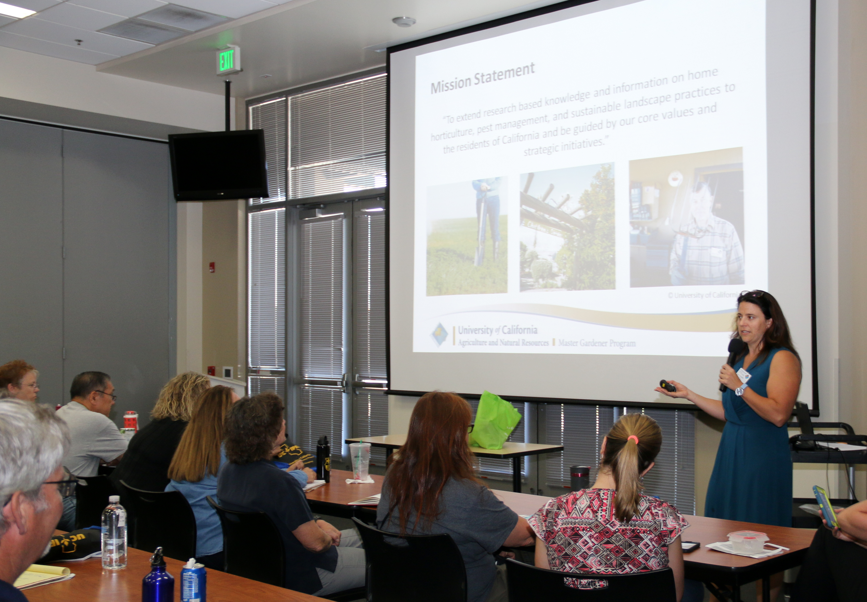
Focused Conversations
Create meaningful dialog
Broaden a group’s perspective
Elicit clear ideas and conclusions
Allow the entire group to participate
Notes:
It starts with a topic beginning with things that can be observed (facts/data) and gets all voices in the room to share simple observations.
It brings out information tied to individual experiences to enrich the data to be considered.
The group is then asked to contemplate this information, to draw forth meaning, consider options, possibilities and questions.
A last stage is to decide what action / conclusion to make - whether as individuals or as a group.
The process is intentional in seeking full participation from everyone and makes space for everyone at the table to be included and their ideas considered.
This is a great tool for groups that are quiet or don’t know each other. This can also be effective for large groups and one on one conversations.

Slide 3
Four Levels of Questions (ORID)
Decisional
Objective
Senses
What?
Reflective
Heart
Gut
Interpretive
Head
So what?
Action
Now what?
Notes:
The acronym “ORID” is derived from the first letters of the four stages of questioning:
• Objective
• Reflective
• Interpretative
• Decision
People often evaluate experiences quickly and superficially, or allow discussions to meander.
This framework enables detailed reflection and learning, and helps groups get to the heart of the matter efficiently.
The method structures the debriefing process and prompts recall so that a group can broaden their perspectives of an experience, develop a shared understanding of the experience, and formulate a common strategy.
Emotional or intuitive responses are important data but frequently are not acknowledged. When taken into consideration in decision making, they strengthen and support the decision. Ignored, they often jeopardize the decision.

Slide 4
Your job as facilitator
Prepare question in advance
Ask open ended, specific question
Ask one question at a time
Allow time to answer
Rephrase the answer
Correct misconceptions
Maintain objectivity
Say thank you
Record observations / ideas / input if needed
Encourage people to participate
Notes:
If you are a facilitator running a meeting or training and would like to have a focused conversation here is an outline of your role.
SIDE NOTE: The facilitator may want to explain the purpose and outline the stages, both to help participants stay on task and learn a process they too can use.
A facilitator prepares, then asks questions in a specific order to which group members respond.
Ideally, questions are prepared in advance and relevant to the experience
open-ended and specific
You ask only one question at a time, don’t rephrase the question.
Silence is ok, give them time to answer, let the question marinate.
Correct misconceptions but do not add your own observations.
Rephrase the person contribution so others can hear
Say thank you
The facilitator may record ideas on flip charts to keep track of them. The facilitator may wish to summarize ideas or ask for clarification.
Encourage participation from as many people as possible) and guides participants back on task if they skip a stage.

Slide 5
How to encourage participation
Phrases to use
Tell me more
What else?
Anything else?
Anymore observations?
Would anyone like to add something more?
Notes:
Encouraging participation can be difficult but here are a few phrases that allow the conversation to be open while inviting people to participate.

Slide 6
What?
See, hear, taste, feel, smell
Objective
What happened during this activity?
What words or phrases stood out for you?
What do you recall?
What words, sounds, or images stood out for you?
What did you notice?
Notes:
The first level is Objective…the What?
The purpose of this level is to examine the data.
Identify factual information.
Questions that fit in this section are…

Slide 7
Gut
Emotions, memories, associations
Reflective
What was a high point for you? - What was a low point?
What worked for you? -What didn’t work?
What was most exciting? -What drained your energy?
Where was it easy? -Where was it hard?
What surprised you or encouraged you?
Notes:
The second level is Reflective…the Gut
The purpose of this level is to encourage participants to make connections.
To encourage free flow of ideas and imagination.
Questions that fit in this section are…

Slide 8
So What?
Meaning, value, relevance
Interpretive
What is a key insight from this exercise?
What did you learn from this?
What is the importance of this?
What questions does this raise for you?
What does this mean?
Notes:
The third level is Interpretive… so What?
The purpose of this level is to identify patterns and determine their significance or meaning
To articulate underlying insights. Sometimes referred to as the AH HA question
Questions that fit in this section are…

Slide 9
Now What?
Resolution, opinion, do something
Decisional
What will you do differently when you return to work?
What actions does this trigger for you?
What will you do with this tomorrow?
What does this mean for your future?
What applications or action ideas has this triggered for you?
Notes:
The forth level is Decisional… Now What?
The purpose of this level is to propose next steps.
To develop an action plan.
To make decisions.
To experience “Coming Together”
Questions that fit in this section are…

Slide 10
Four Levels of Questions
Decisional
Objective
Senses
What?
Reflective
Heart
Gut
Interpretive
Head
So what?
Action
Now what?
Notes:
The first level is Objective…the What?
The purpose of this level is to examine the data.
Identify factual information.
The second level is Reflective…the Gut
The purpose of this level is to encourage participants to make connections.
To encourage free flow of ideas and imagination.
The third level is Interpretive… so What?
The purpose of this level is to identify patterns and determine their significance or meaning
To articulate underlying insights. Sometimes referred to as the AH HA question
The forth level is Decisional… Now What?
The purpose of this level is to propose next steps.
To develop an action plan.
To make decisions.
To experience “Coming Together”

Slide 11
What
Gut
See, hear, taste, feel smell
Emotions, memories, associations
So What
Now What
Meaning, value, relevance
Resolution, opinion, do something
Notes:
You can do this activity with a large group by having them fold a piece of paper into fours and have them draw an eye, heart, brain and a clapboard.
Ask the questions you have prepared one at a time, allow people time to their answers down. Do this for all four questions.
After they are done you can go through the questions and answers verbally or have them break up into small groups and share with each other.
You can also do this verbally with a large group and utilize your screen to lead the group through the conversation. My next slide is a good example of this.

Slide 12
Advisory Comm. Meeting
SITUATION: Reviewed and discussed annual reports of other programs, we are looking to create our own.
What stood out to you about the examples we reviewed?
What feels most challenging?
What more do we need to know or further explore?
What direction are we heading in?

Slide 13
Training about Zoom
SITUATION: A group of five people have just received a ten minute training on the different ways to schedule a zoom meeting.
What do you recall about scheduling a zoom meeting?
What was easy or what was hard?
What did you learn from this?
What will you do differently now when scheduling Zoom?

Slide 14
Conversation with an employee
SITUATION: Reviewing accomplishments with an employee
Tell me about what you’ve done in the last year?
What were some high points or low points?
What was most meaningful to you?
What would you like to change in the coming year?

Slide 15
Practice
Notes:
PRACTICE
Give example with Melissa about podcast.
Although best practice is to create questions before hand, this technique can be used when you are having trouble having a deeper conversation with someone or trying to get participation.

Slide 16
Your job as facilitator
How to encourage participation
Ask one questions at a time
Allow time to answer
Rephrase the answer
Correct misconceptions
Maintain objectivity
Say thank you
Encourage people to participate
Phrases to use
Tell me more
What else?
Anything else?
Anymore observations
Would anyone like to add something more?
Notes:
Ask one question at a time, doesn’t keep rephrasing the questions
Allow time to answer, let the question marinate
Rephrase the person contribution so others can hear
Say thank you

Slide 17
What do you notice about this new form?
Who was present at the meeting? Who spoke?
What scenes do you remember?
What facts do we know about this situation?
What caught your attention about ______________?
Where are you confident?
Where is more work needed?
What gives you courage?
What seems the most critical?
What are you most doubtful about?
What was inspiring?
What color would you add? Why?
What parts reminded you of your own ___________________?
What is the importance of this?
What new vantage point has this given us?
What difference will it make?
What would you say lies underneath these issues?
How has this been beneficial to you personally?
What are we really committed to?
Then, what are the first steps we need to take?
What is the resolve of this group?
How would you articulate our consensus?
What will you do differently?
What name will you give to ourtime together?
Notes:
Here are a few phrases to help you see what type of questions fit into the four areas.

Slide 18
Thank you for your time
Feedback Survey
http://ucanr.edu/survey/survey.cfm?surveynumber=27522
Questions?
Next WebANR June 20
Storytelling for Presentations and Speeches
Session are recorded and archived on the
ANR Learning & Development Website
Notes:
https://ucanr.edu/sites/Professional_Development/Monthly_WebANRs/

Slide 19
Train the Trainer Certificate Series
Fundamentals for Trainers
Trainer as Facilitator
Icebreakers, Energizers and Activities to Make Learning Stick
Culturally Inclusive Training
https://hr.ucdavis.edu/departments/learning-dev/certificate/train-trainer
Notes:
I learned about this and several other training and meeting facilitation techniques through the Train the Trainer Certificate Series through the UC Davis Staff Development.
This Certificate Series is designed for UC Davis subject matter experts.
The four-course series will explore how to:
Design and present interactive, engaging training
Manage the differences between presentation and facilitation
Incorporate effective ice breakers and activities
Ensure your course is culturally inclusive
https://hr.ucdavis.edu/departments/learning-dev/certificate/train-trainer

