Slide 1
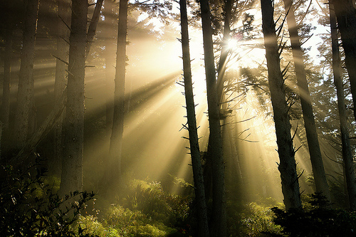
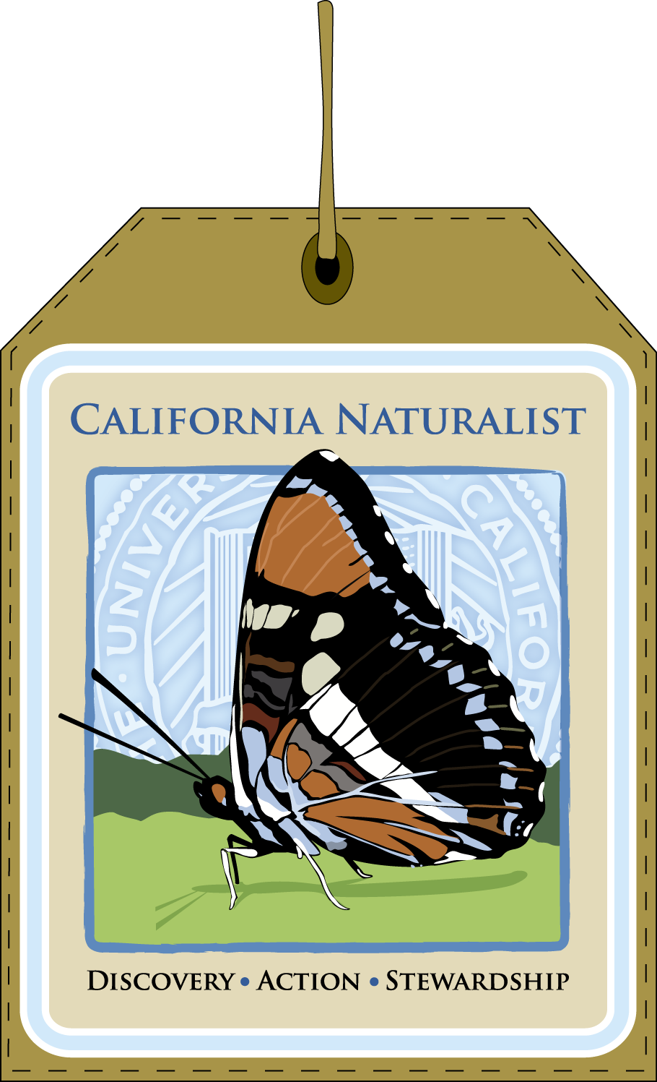


uc california naturalist
Chapter 1
Introduction to the CA Naturalist Program
California’s Biodiversity in Context
The Role of Naturalists

Slide 2
uc california naturalist
healing ourselves and the natural world
Discovery
Action
Stewardship

Slide 3
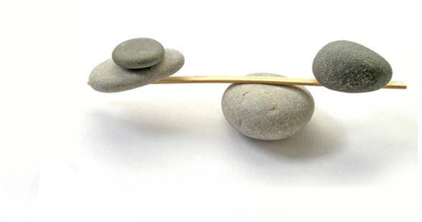
Introduction to the CA Naturalist Program
  a vibrant human society needs a healthy natural world, just as a healthy natural world needs a vibrant human society
Notes:
http://davepatania.files.wordpress.com/2010/02/stones.jpg

Slide 4
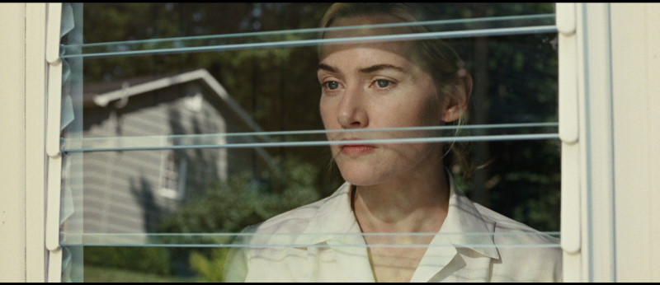
reconnecting with nature can bring us great satisfaction and happiness

Slide 5
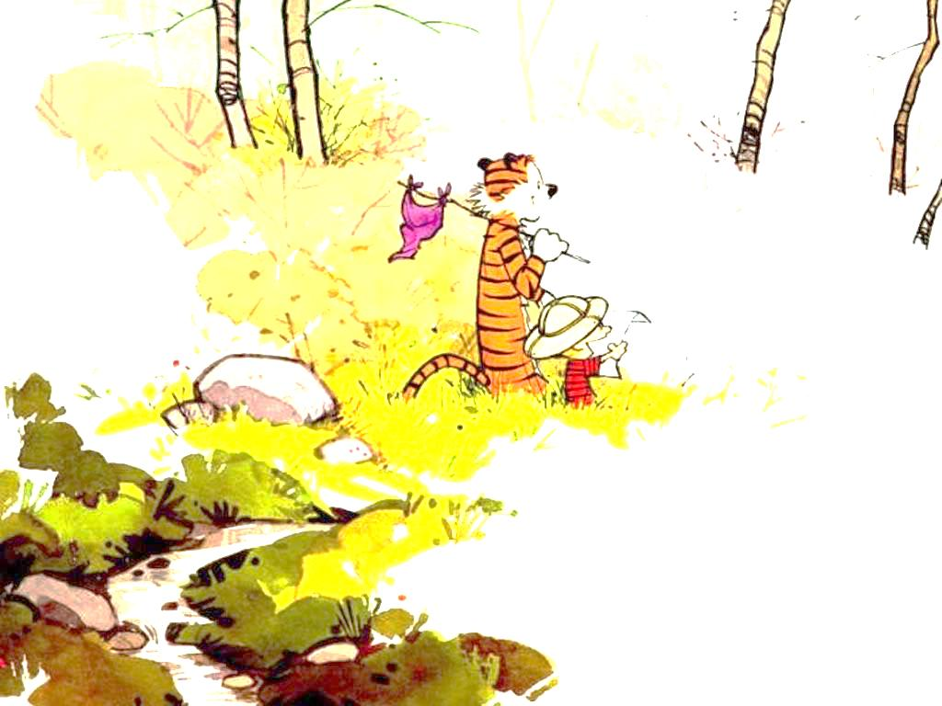
becoming a naturalist is good for your health
  spending time out of the office
  taking in scenes of natural beauty
  hiking
  sketching what you see
  spending time with friends
  collecting insects
  collecting plants
  discovering new species
  making great memories
  just having fun like when you were a kid!

Slide 6
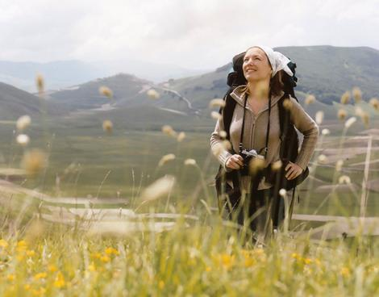
becoming a naturalist offers a chance to explore nature and deepen your understanding of how she works

Slide 7
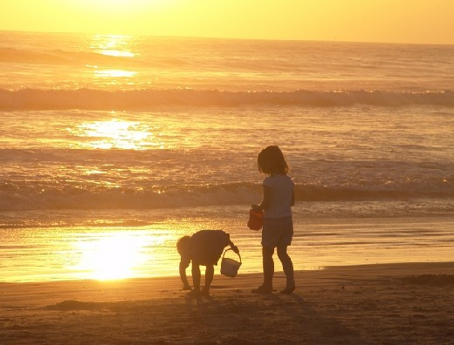
by joining the UC California Naturalist Community, you will be working with an interdisciplinary team of both amateurs and professionals to protect the planetary ecosystem functions which make life on Earth possible

Slide 8
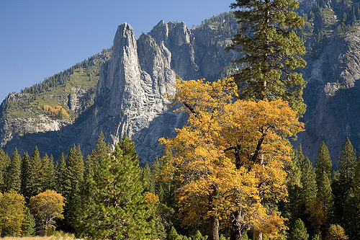
why California?
  breathtaking diversity of plants, animals and natural landscapes
  Mediterranean climate
  because its our home

Slide 9
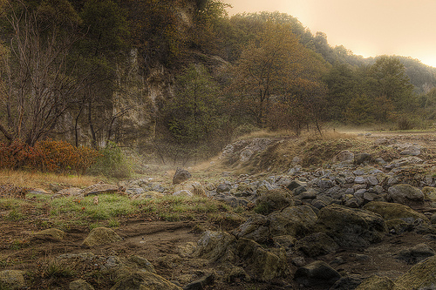
UC California Naturalist program goals
    foster a committed corps of volunteer naturalists and citizen scientists trained and ready to take an active role in natural resource conservation, education, and restoration
  provide training, in collaboration with local sponsoring institutions, for adult environmental stewards through an adaptable outdoor and in class curriculum that can be as easily applied in a variety of settings
engage adults in interactive learning that provides them with scientific literacy and critical thinking skills
  a science curriculum
  hands-on learning
  communication training
  community service

Slide 10
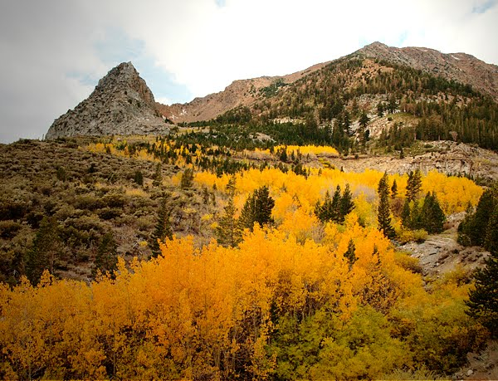

there are Master Naturalist type programs in 26 other states, but this is the first such program for California that will engage adults including teachers, docents, land stewards, and nature enthusiasts in service learning and participatory research

Slide 11
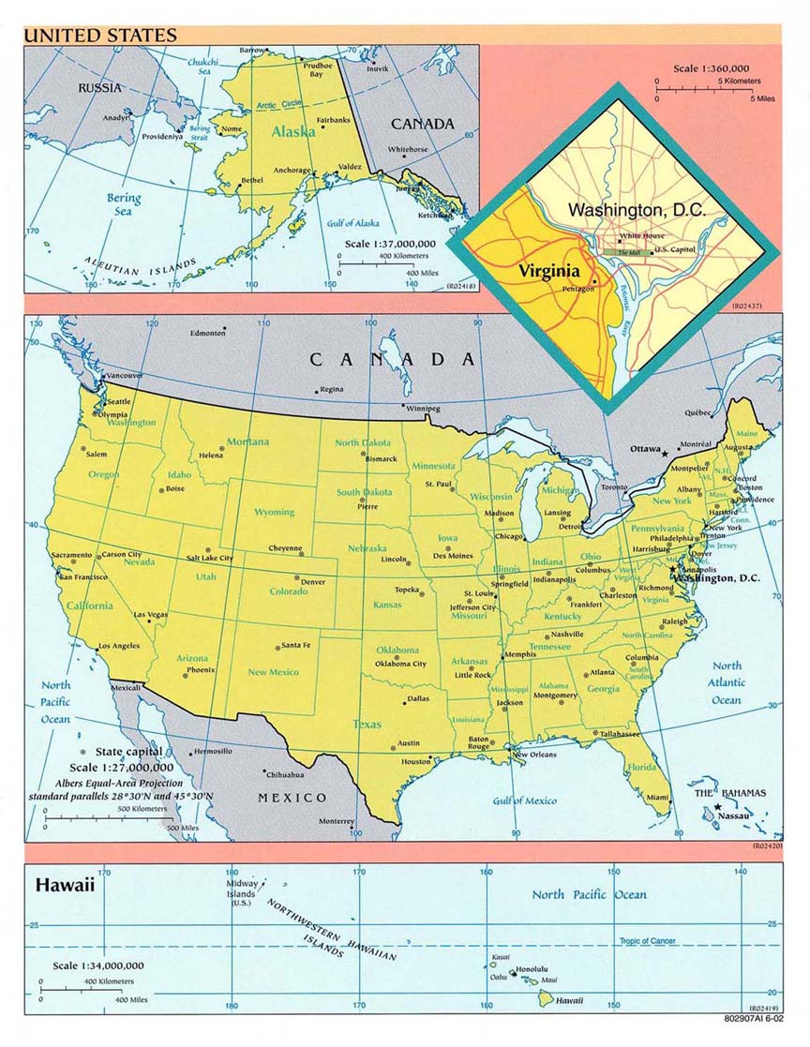
Statewide Naturalist Programs

Slide 12
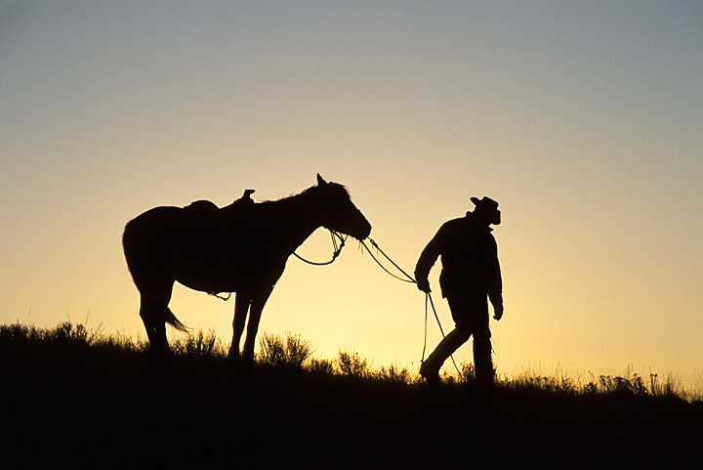
Texas Naturalist
  2,751 volunteers trained
  reached 530,845 people
  impacted 75,000 acres habitat
  192,606 hours of service = $3.38 million in ‘03-’04

Slide 13
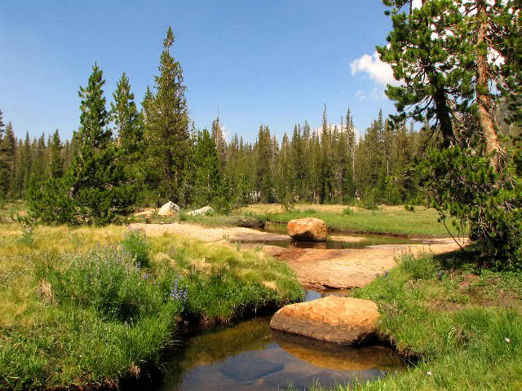
we cannot protect and restore California’s unique ecology without an environmentally literate, engaged public
  environmental literacy
  scientific and social understanding
  interpretive skills
  involved in collaborative conservation

Slide 14
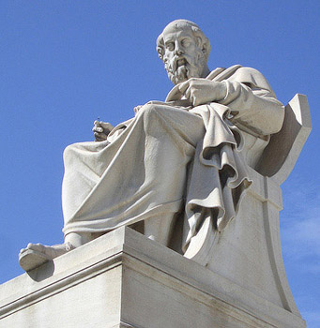

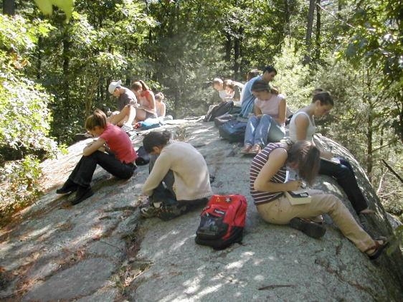
what naturalists will gain
  advance scientific literacy
    knowledge
    perceptions
    changes in behavior
  credibility
relationship with the UC
  resources (museums, field stations…)
  communication with scientists
  research updates
local community of naturalists
  relationship with fellow naturalists in the area
  increased networking in field of interest
  work together to improve local environment
  being a part of a corps of informed citizens across the State and Nation

Slide 15
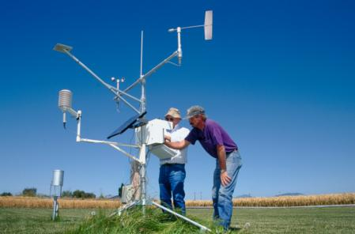
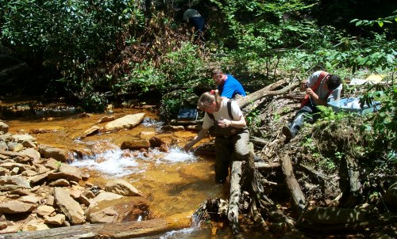
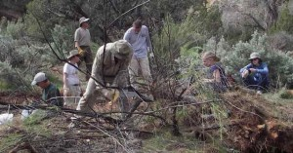
web portal
  course and advanced training opportunities
    estuarine
    coastal
    desert
    etc
  volunteer opportunities
  citizen science opportunities
  annual conferences
  environmental science content relevant to California

Slide 16
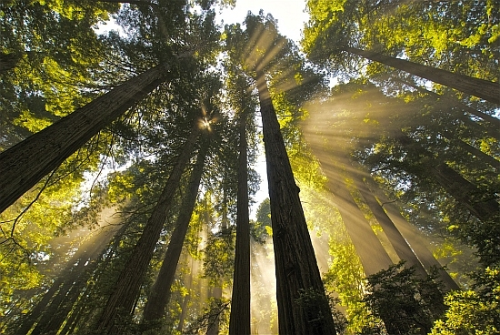
Certificate of Completion
Local partner delivers the class
Train-the-Trainer workshop
for local partners
California Naturalist program: Handbook, website portal, database, instructor support materials, slideshows, promotional material

Slide 17
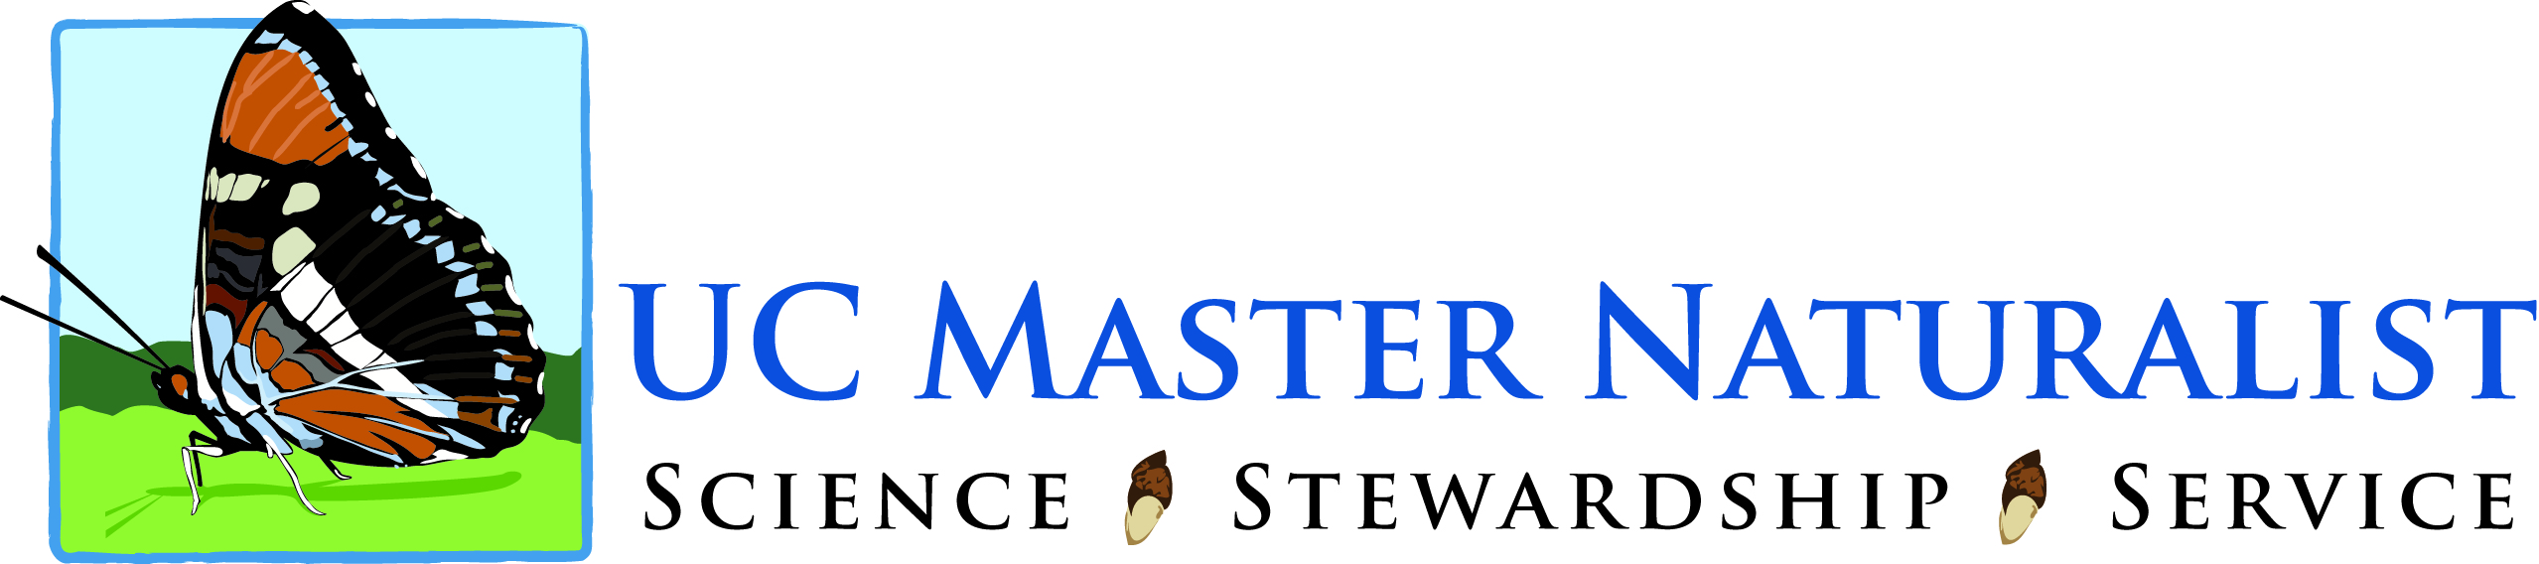
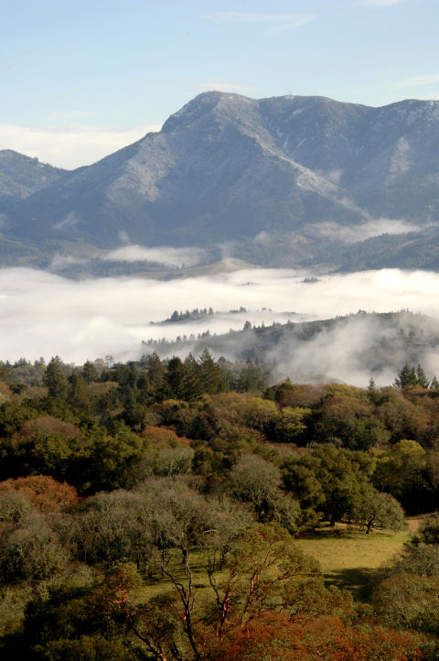
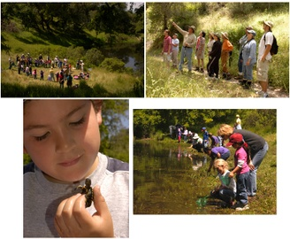
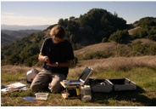
outreach
citizen science
Pepperwood preserve
participants

Slide 18
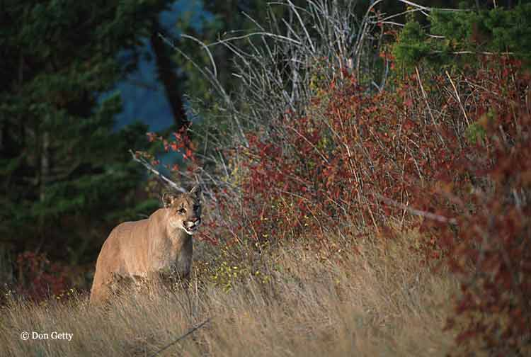
curriculum
  statewide framework
  7 bio-region modules planned
  regional issue sidebars
  the UC California Naturalist Handbook 2011 draft
    by Greg de Nevers, Deborah Stanger Edelman, and Adina Merenlender
  lecture slides
    by Sube Caohuu
Table of Contents
  Acknowledgements
  Chapter 1 Introduction to Becoming a California Naturalist
  Chapter 2 Geology, Soils, and Climate
  Chapter 3 Water
  Chapter 4 Interpretation, Communication, and Citizen Science
  Chapter 5 plants
  Chapter 6 Forests and Woodland Resources
  Chapter 7 Wildlife
  Chapter 8 Energy and Global Environmental Challenges
  Glossary

Slide 19
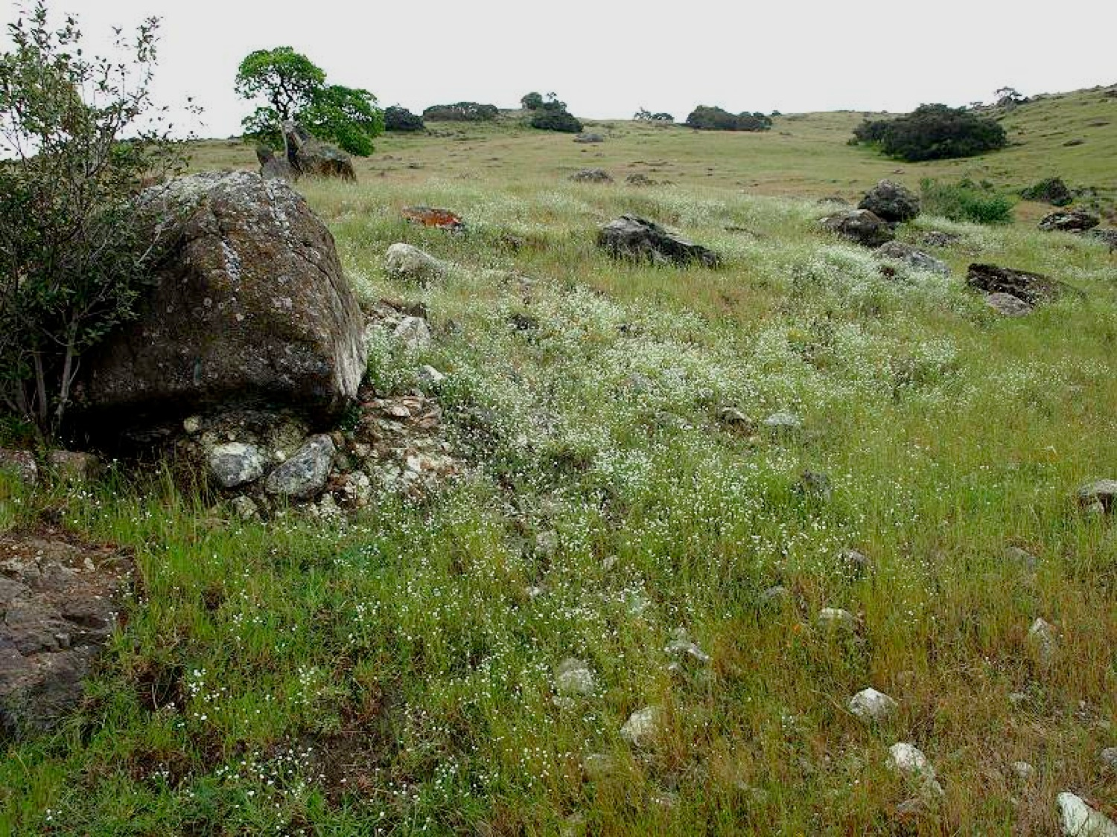
next step
  publish curriculum
  conduct train-the-trainer workshops
  develop regional modules
  marine module
  more classes
  citizen science portal
  encourage underserved adults to participate

Slide 20
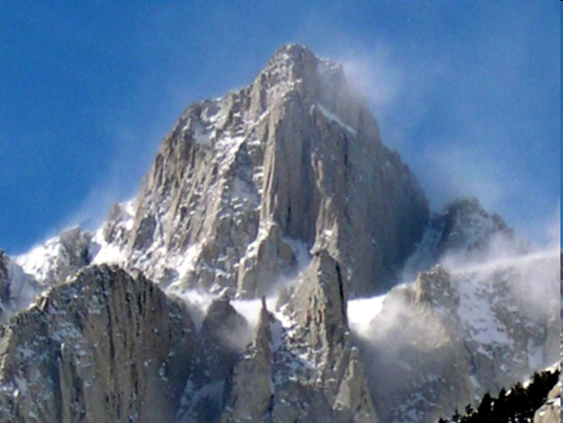
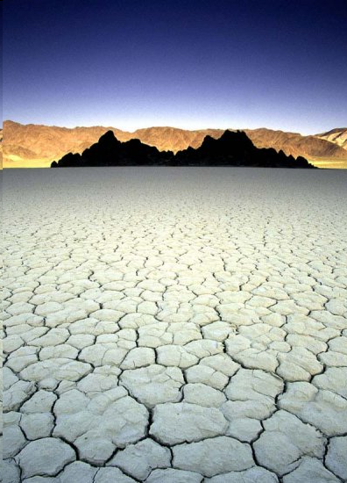
Mt Whitney
California’s Biodiversity in Context
  CA is a state of extremes
Death Valley
Mt Whitney and Badwater in Death Valley are the highest and lowest points in the contiguous 48 states, respectively
85 miles
Notes:
http://www.google.com/imgres?imgurl=http://www.pfint.com/pics/peaks/RussellWhitneyMuir/wHITNEY.jpg&imgrefurl=http://www.pfint.com/pics/peaks/RussellWhitneyMuir/RussellWhitneyMuir.htm&usg=__Nk9rUs2nDMQGql_u1_YGhdddqcg=&h=488&w=650&sz=98&hl=en&start=34&sig2=OAQcKRyWDFnTsFeQViLoow&zoom=1&tbnid=7pL7jzGNN-USdM:&tbnh=161&tbnw=205&ei=S8r3TeOoII6-sAPrk4jNBw&prev=/search%3Fq%3Dmt%2Bwhitney%26hl%3Den%26client%3Dfirefox-a%26hs%3DSXb%26sa%3DX%26rls%3Dorg.mozilla:en-US:official%26biw%3D1064%26bih%3D865%26tbm%3Disch&itbs=1&iact=hc&vpx=764&vpy=416&dur=250&hovh=194&hovw=259&tx=176&ty=116&page=3&ndsp=16&ved=1t:429,r:3,s:34&biw=1064&bih=865
http://www.google.com/imgres?imgurl=http://www.pfint.com/pics/peaks/RussellWhitneyMuir/wHITNEY.jpg&imgrefurl=http://www.pfint.com/pics/peaks/RussellWhitneyMuir/RussellWhitneyMuir.htm&usg=__Nk9rUs2nDMQGql_u1_YGhdddqcg=&h=488&w=650&sz=98&hl=en&start=34&sig2=OAQcKRyWDFnTsFeQViLoow&zoom=1&tbnid=7pL7jzGNN-USdM:&tbnh=161&tbnw=205&ei=S8r3TeOoII6-sAPrk4jNBw&prev=/search%3Fq%3Dmt%2Bwhitney%26hl%3Den%26client%3Dfirefox-a%26hs%3DSXb%26sa%3DX%26rls%3Dorg.mozilla:en-US:official%26biw%3D1064%26bih%3D865%26tbm%3Disch&itbs=1&iact=hc&vpx=764&vpy=416&dur=250&hovh=194&hovw=259&tx=176&ty=116&page=3&ndsp=16&ved=1t:429,r:3,s:34&biw=1064&bih=865
http://www.google.com/imgres?imgurl=http://surfwithberserk.com/img/nature/death_valley/7.jpg&imgrefurl=http://surfwithberserk.com/death-valley&h=550&w=396&sz=55&tbnid=y23mVp_mN6eEeM:&tbnh=90&tbnw=65&prev=/search%3Fq%3Ddeath%2Bvalley%26tbm%3Disch%26tbo%3Du&zoom=1&q=death+valley&usg=__aGUzz5aLuVMgPJegQGEr6Vx4QqE=&sa=X&ei=P8z3TaOVGoygsQOT2qHUDA&ved=0CDAQ9QEwAQ&dur=301

Slide 21
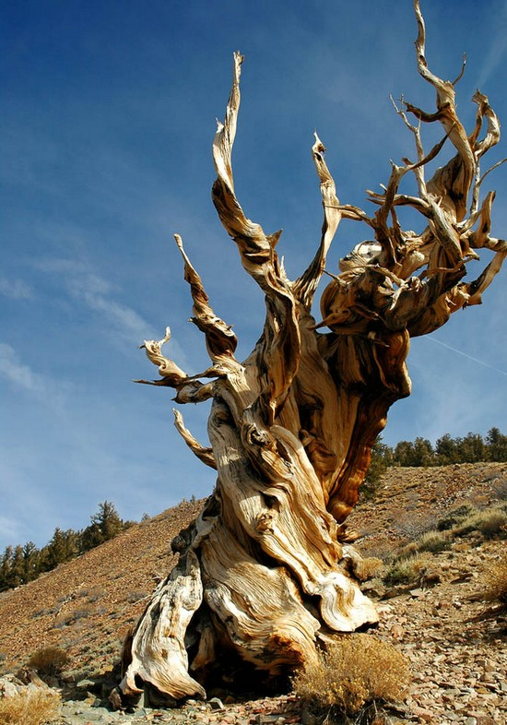
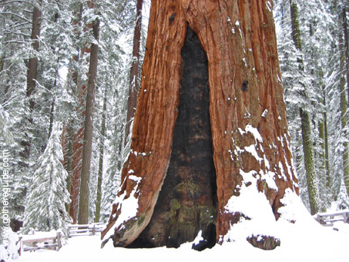
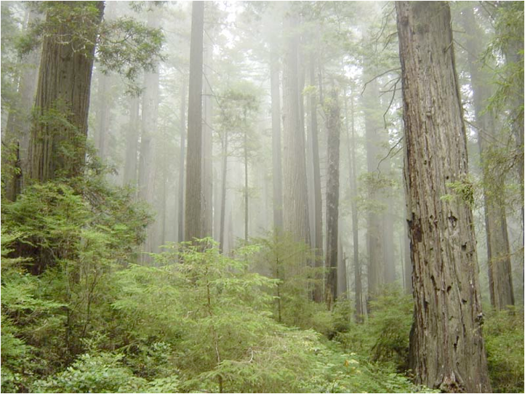
oldest
  Methuselah, a Great Basin Bristlecone Pine is the White Mountains of CA is the oldest living tree in the Western Hemisphere at nearly 5,000 yrs old
  largest
    the General Sherman Tree, a Giant Sequoia, is the largest tree (by volume) in the world
  tallest
    the Coastal redwoods are the tallest trees in the world
Notes:
http://www.trcross.com/Redwoods/images/10_Foggy_Redwoods.jpg

Slide 22
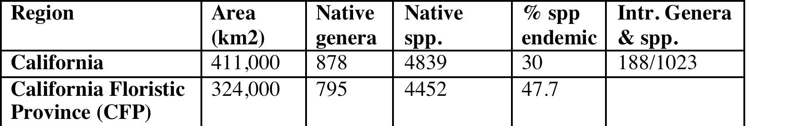
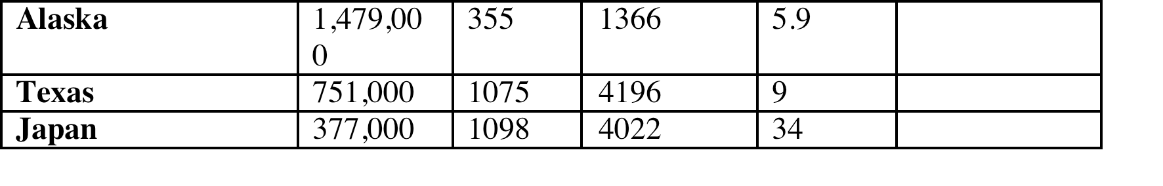
California is one of Earth's 25 biodiversity hotspots
  30,000 species of insects
  63 species of freshwater fish
  46 species of amphibians
  96 species of reptiles
  563 species of birds
  190 species of mammals
  more than 8,000 species of plants, many of which are found only in CA
California has the largest number of endemic species out of all 50 states
  geographic range: area within which a given species may be found
      geographic range is not static, as plants and animals are constantly probing the boundaries of their range
  endemic species are naturally and exclusively restricted to a particular locality or region
Numbers of vascular plant taxa (sensu Ornduff et al.; circa 2005)

Slide 23
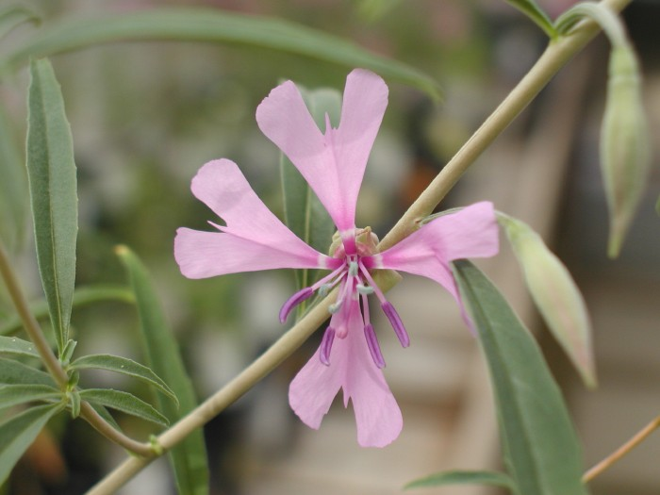
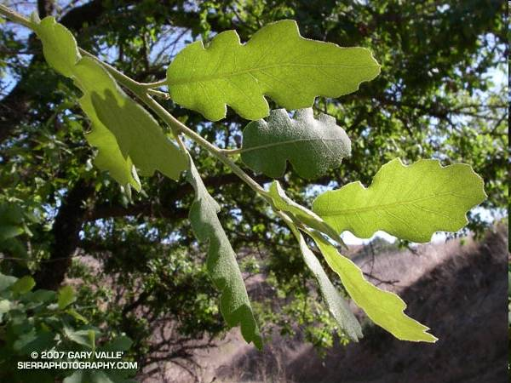
ex. of CA endemics
  Clarkia xantiana
Blue oak
Notes:
http://calphotos.berkeley.edu/cgi/img_query?enlarge=0000+0000+0109+0483
http://www.google.com/imgres?imgurl=http://www.photographyontherun.com/content/binary/BlueOak8782b.jpg&imgrefurl=http://www.photographyontherun.com/AhmansonBlueOak.aspx&h=450&w=600&sz=80&tbnid=ohx8w1Gl2bxXxM:&tbnh=90&tbnw=120&prev=/search%3Fq%3Dblue%2Boak%26tbm%3Disch%26tbo%3Du&zoom=1&q=blue+oak&usg=__pKnyykE8BFRwUI2Q05XnzDhYS0g=&sa=X&ei=AtH3TZG5DI_AsAOPn9XVDA&ved=0CGAQ9QEwBw&dur=323

Slide 24
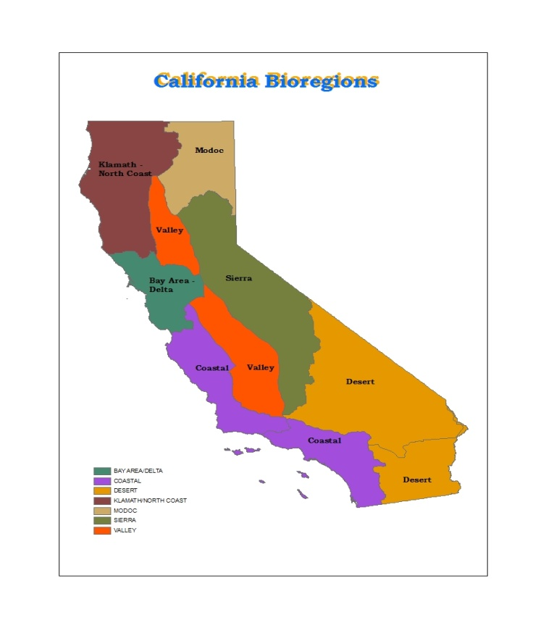
California has 10 distinct bioregions
  most other states have relatively homogenous ecosystems
reasons why California have such high levels of species diversity, endemism, and habitat diversity
  varied topography
    mountains, valleys, and deserts form geographic barriers which effectively isolate natural communities and promote higher rates of speciation
    the North Coast Range blocks the flow of air from Pacific into the Central Valley
    this the first place where oceanic wind can enter the Central Valley
      brings moisture and lowers temperature into valley
    the South Coast Range also blocks Pacific winds from entering

Slide 25
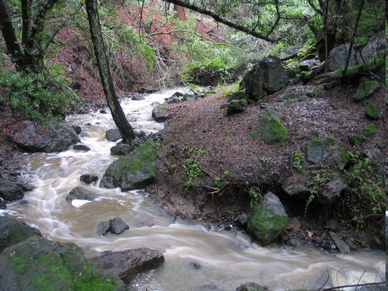
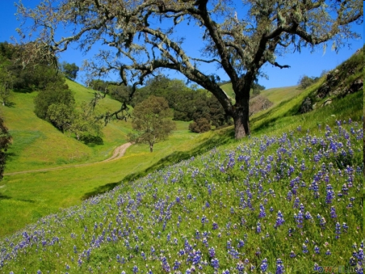
at 6pm, July:
55 degrees
relative humidity 80%
30 miles
30 miles
82 degrees
relative humidity 17%

Slide 26
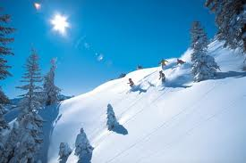
aspect
  the direction a hill faces
  in the Northern Hemisphere, the sun shines from the south
    North facing slopes are cooler
    South facing slopes are hotter
North-facing
South-facing
slope
  a measure of steepness
    most hills vary between 15% and 30% slope
plant communities will differ depending on where on the slope a plant occurs
  soil at the bottom of the hill tends to be richer and softer because it has collected soils washed off the hills by landslides and streams
  soil on the slopes tends to be shallower and rockier

Slide 27
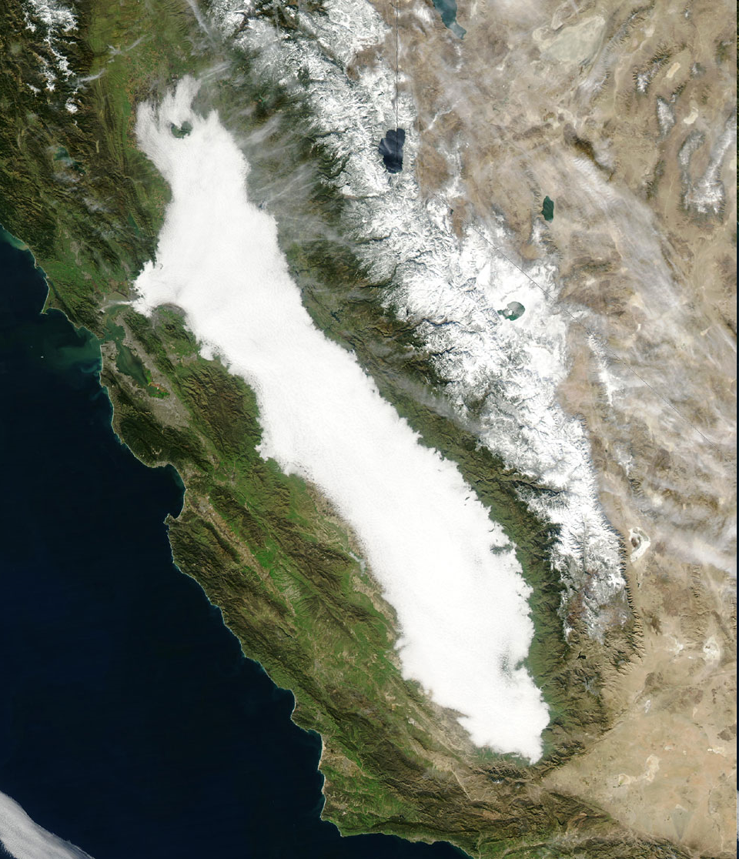
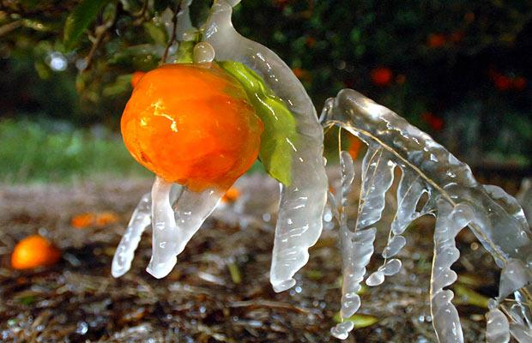
Tule fog
  during the day, warm air moves up and over valley walls
  at night, cool air flows down the valley walls and pools at the bottom
  Tule fog forms when cold mountain air flows down the sides of the Central Valley and fills it to the "brim"
it is not the averages but the extremes of temperature and rainfall which determine a species' geographic range
  citrus growers push the limits of temperature tolerance in the trees they cultivate, and periodically they pay the price in form of a cold snap that wipes out their entire crop

Slide 28
precipitation
3. once the cloud reaches a sufficiently high altitude, it begins to "drop" it's water
ffffffffff
fff
2. the temperature of the cloud drops with increasing altitude, as well as it's water carrying capacity
1. warm moist clouds are pushed up the mountain by coastal winds

Slide 29
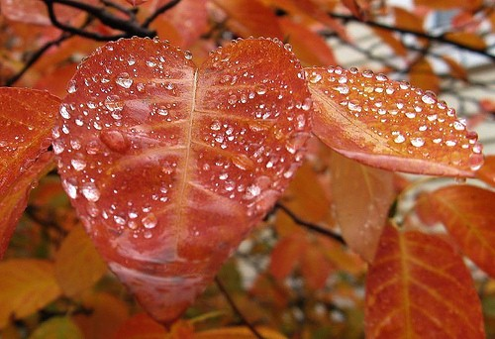
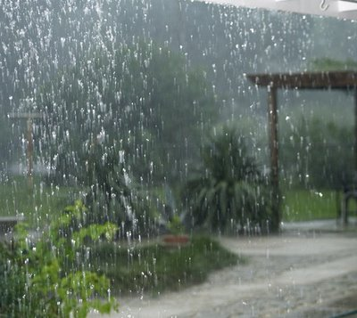
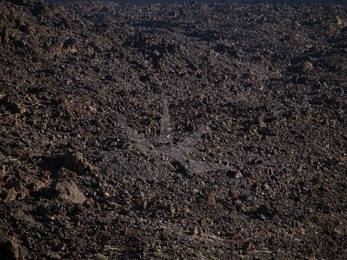
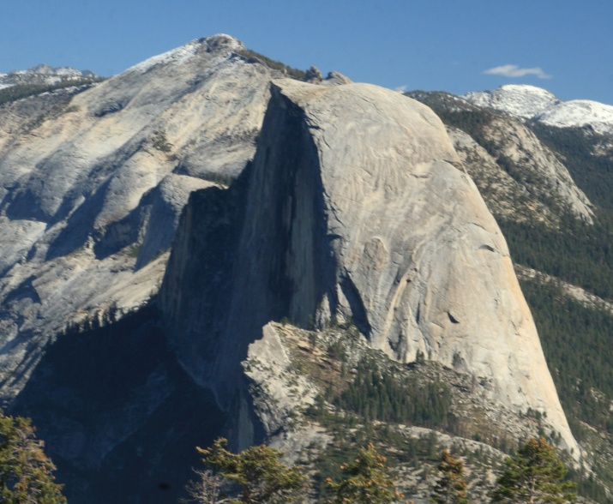
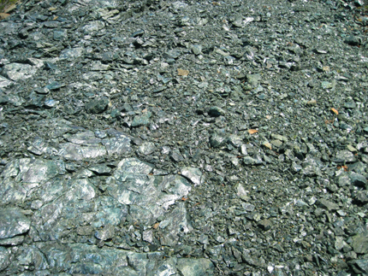
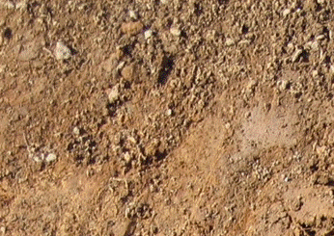
extent of orographic precipitation varies with elevation and size of the mountain range
  clouds passing over low topography San Francisco only produce 20 inches of annual rainfall
  the same clouds passing over Mount Tamalpais on the other hand are driven up 2,000 or more feet and consequently Kentfield has 60 inches of annual rainfall
  naturally, plant communities that grow in these two areas can be quite different
@vijayal
soil diversity also contributes to California's high biodiversity
  soils have different chemical compositions and physical structures depending on their parent materials and how and where they were formed
soil type shapes the composition of plant communities
  ex. serpentine soils are conducive to the growth of leather oak

Slide 30
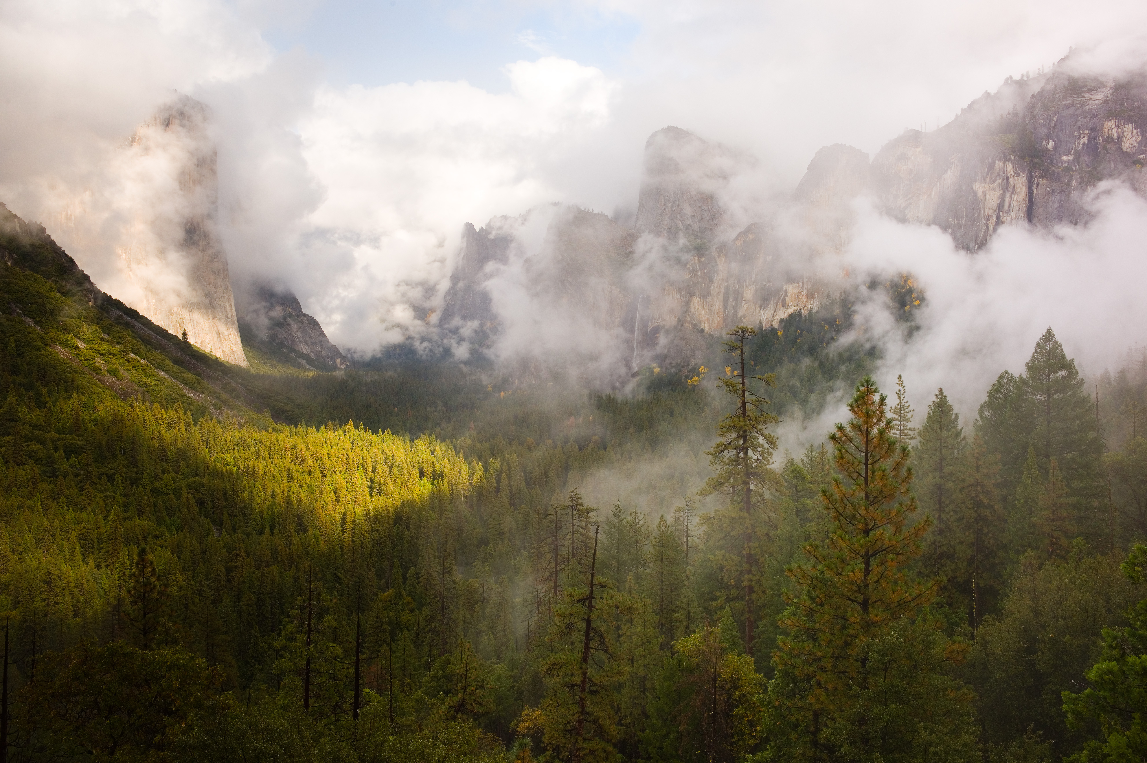
varied topography
+
varied soil
wind
aspect
position on slope
temperature
rainfall
biodiversity

Slide 31
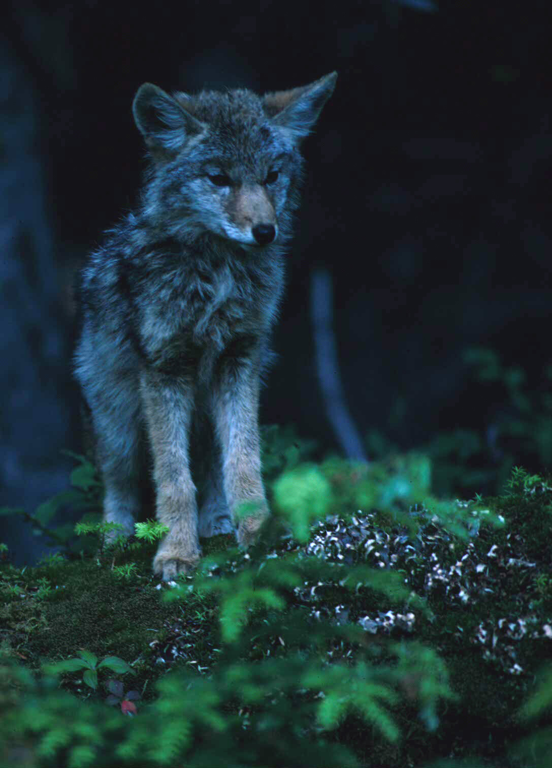
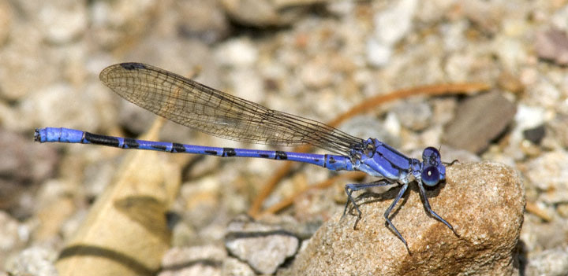
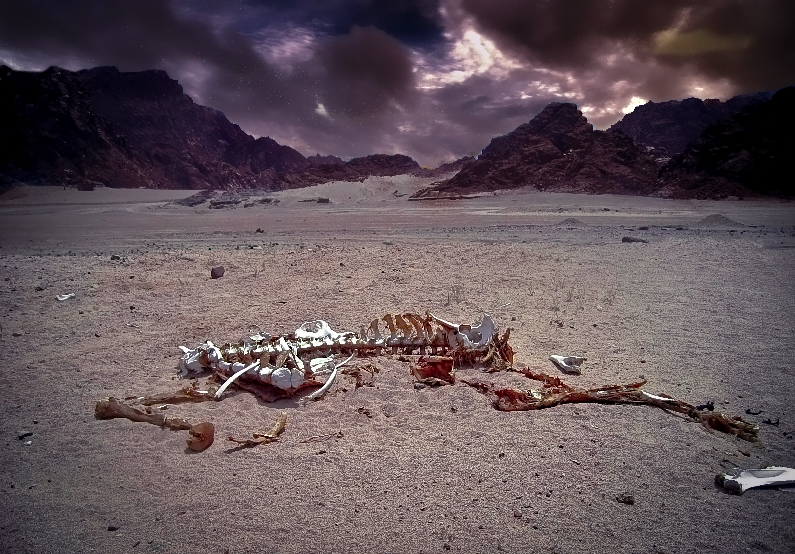
the biodiversity crisis
  biodiversity at all scales of life is currently being threatened
    genes
    species
    natural ecological processes
    evolutionary processes
    ecosystems
the current rate of species extinction exceeds the background extinction rate prior to the emergence of modern humanity
if the current rate of biodiversity loss continues, we will experience the most extreme mass extinction event since the K-T extinction event that ended the age of the dinosaurs

Slide 32



land use change is the primary driver of habitat loss and ecosystem degradation-it greatly exacerbates most of the other threats to the environment
  accelerated rates of land use change can be attributed to geometric growth of human population, which has increased six-fold since the 1800s
overall, the human footprint is detectable across 83 percent of the land area in the world, excluding Antarctica
synergistic effects between habitat loss, habitat fragmentation, and climate change can compound the effects of habitat loss on biodiversity

Slide 33


researchers are figuring out whether or not species will be able to shift their distributions or evolve new adaptations fast enough to accommodate global warming
  numerous studies such as the UC Berkeley Grinnell Project have documented the historical movement of species in response to climate change
the continuing loss of species and degradation of ecosystems threatens our economy and sciences
  many of our medicines and advances in agriculture and public health depend upon the study of wild species and their habitats
  we have categorized and named less than 1% of all Earth's biodiversity, and of that 1%, we have only ventured beyond a superficial description of anatomy into biochemistry and genetics in a handful of these

Slide 34

the continuing loss of species and degradation of ecosystems threatens the integrity of vital ecosystem functions which make all life on this planet possible
  air quality maintenance
  soil production
  nutrient cycling
  climate moderation
  pollination
  detoxification
  control of parasites and disease

Slide 35

The Role of Naturalists
"To be a Naturalist is better than to be a King."
Charles William Beebe, Journal, 31 December, 1893
Jane Goodall

Slide 36


what a naturalist does
  observes the natural world
  reports back to his/her fellow humans
  works with others to patch these observations into an understanding of the world
    this is where knowledge originally comes from
humans have always been naturalists by necessity: we have had to observe, measure, speculate and communicate about the world in order to survive

Slide 37



why be a naturalist?
  become a generalist with knowledge of the system as a whole
  during the 18th and19th centuries, before formal fields of ecology, entomology, geology, and zoology emerged, only naturalists had command of these disciplines
their collected specimens were instrumental to the creation of most natural history museums, including the California Academy of Sciences
today, naturalists can contribute to science through their observations of rare or even new species
  there are only so many scientists in California- more eyes and ears are needed in the field if we are to fully discover and explore all of our state's biodiversity

Slide 38

naturalists form the link between the everyday and the academic

Slide 39


exemplary naturalists
  Charles Darwin (1809-1882)
    articulated evolution, the greatest and most elegant explanatory theory of the biological sciences ever yet proposed
John Muir (1838-1914)
  wrote brilliant essays that changed our views on nature and deeply inspired readership to protect the environment
  possessed the two key qualities vital to any naturalist
    the power of careful observation
    the ability to communicate and inspire others
pushed for the designation of Yosemite Valley, Sequoia & Kings Canyon, Grand Canyon, Mt Rainier as national parks
founded the Sierra Club
through nothing but keen observation ability and logic, discovered that Yosemite had been borne of glacial carving

Slide 40


becoming a naturalist
  practice observing the world around you with all your senses
record your observations in a naturalist journal
  a tool to sharpen your skills of observation and interpretation
  a way of spending some time to imbue value into your experiences
  it doesn’t matter if others have found what you are now just finding for your own, what matters is that the experience is new to you!
  a resource for other naturalists who may wish to build on your discoveries

Slide 41


Grinnell Method used by UC Berkeley students and professional naturalists for over a century
  field notebook
    this is what you actually take to the field to record your observations
    record detailed observations
    put up an "Observation checklist" on the first or last page that you routinely refer to
field journal
  a place to rewrite your field observations in a format that is easy for you and others to read
  each field day ought to have a separate journal entry with written descriptions, a species account and a catalog of collected specimens

Slide 42

written description
  this is a general account of the day's events
  begin each page with the location of that entry and underline it with a wavy line
  write in full sentences to tell a full story of what you observed
  only write on one side of the sheet, and use the opposite side for sketches, maps, or photos (taped onto the paper)
  underline species names, using straight lines for scientific names and wavy lines for common names
species account
  this is an account of specific natural observations of interests
  title the page with the name of the species (scientific name)
catalog
  this is a record of any specimens that you collect
  title each page "Catalog"
  label or tag each specimen you collect

Slide 43


learn how to properly name and classify what you find
  necessary in order to communicate clearly
  Carl Linnaeus (1707-1778), hierarchichal classification
    each species is assigned a binomial
      first word designates the genus
        things in same genus share recent common ancestor
      2nd word designates the species
Canis Lupus
Canis Domestica
Hierarchical classification
Kingdom: Animalia
Phylum: Chordata
Class: Mammalia
Order: Carnivora
Family: Canidae
Genus: Canis
Species: domestica

