Slide 1
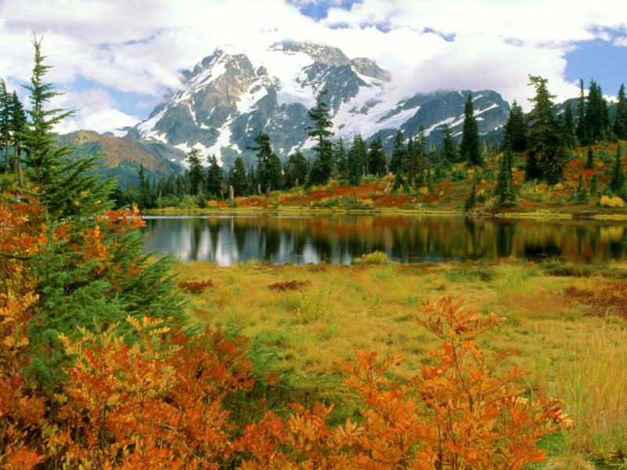

  Chapter 2
  Landforms
  Geological History of California
  California's Climate
  Diversity of California Microclimates
  Soil Structure and Nutrient Cycles
  Decomposition
  Mycorrhizal Relationships
  Mining in California

Slide 2

Land Forms
  California is like a bathtub
    mountain ranges
    flat valley
Klamaths and Siskiou Mountains
Cascade Ranges
Sierra Nevada
North Coast Ranges
San Francisco Bay
Central Valley (or Great Valley)
South Coast Ranges
Transverse Range
Peninsular Range
Mojave Desert
Colorado Desert
Notes:
http://www.saulsteinbergfoundation.org/gallery/gallery_girlbath.jpg

Slide 3
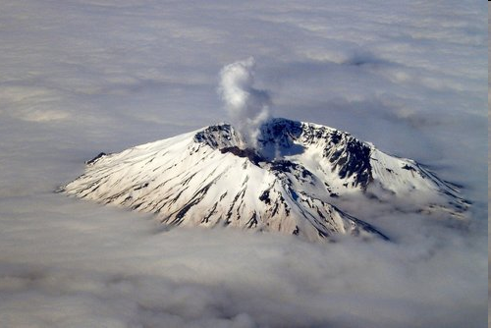
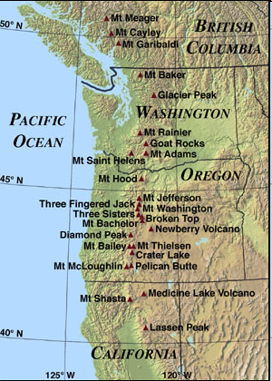
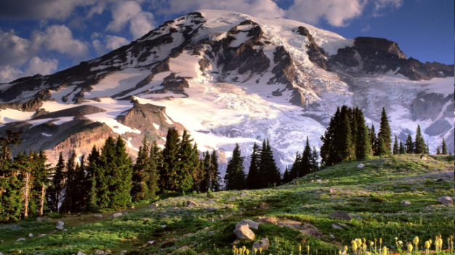
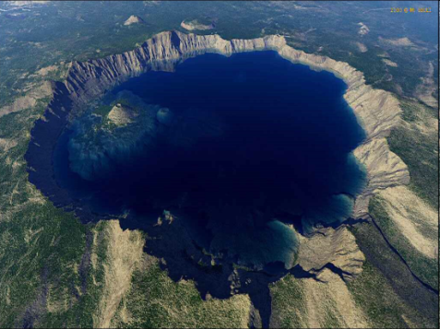
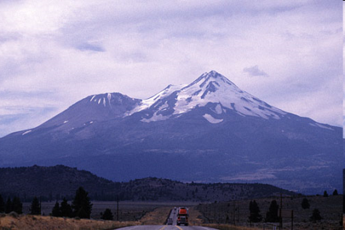
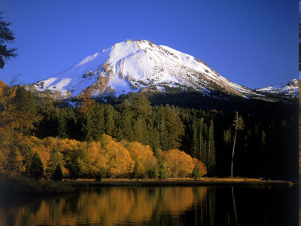
the Cascade Ranges actually run from California up through Oregon, Washington, and southern British Columbia
    North-South trending mountain
Notes:
http://www.stanford.edu/~thelero/images/photography/Mount%20Rainier.jpg
http://www.fatpacking.com/images/CLNP/CraterLakeAerial.jpg
http://fpnetwork.ucdavis.edu/redding/images/lassenlake.jpg
http://cache2.allpostersimages.com/p/LRG/26/2680/2CIUD00Z/posters/corwin-jim-mt-lassen-and-manzanita-lake-california.jpg

Slide 4
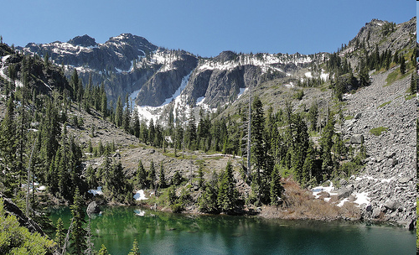
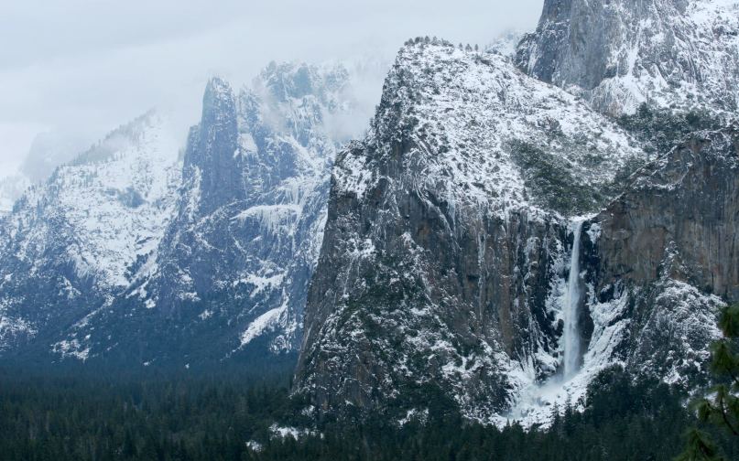
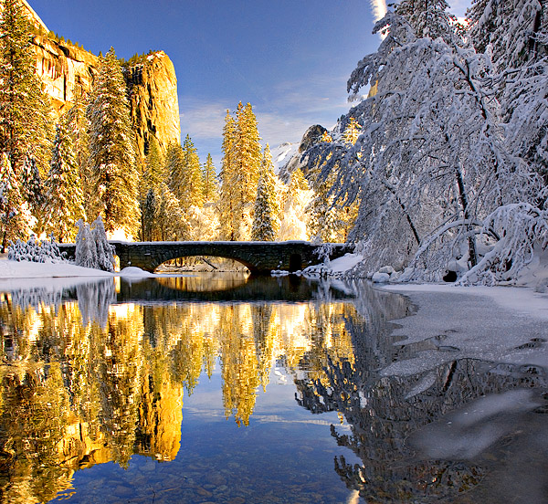
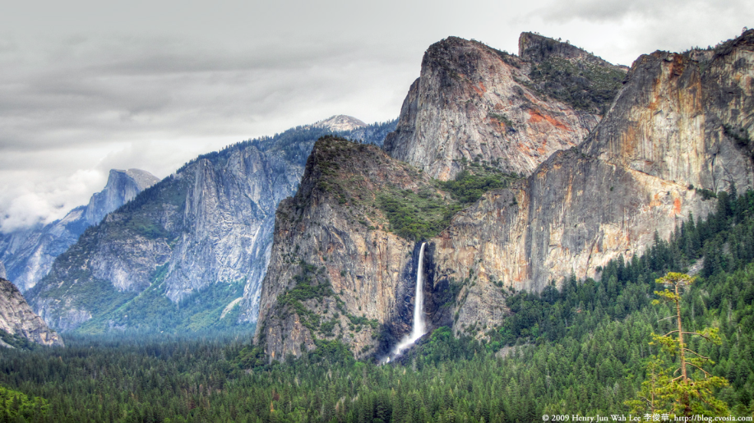
Klamath and Siskiou Mountains
  link the Coast Ranges to the Sierra-Cascade axis in the North
Maryann Huang 2010
Sierra Nevada
  North-South trending
  part of Sierra-Cascade axis
  far higher in elevation than the Coast Ranges

Slide 5
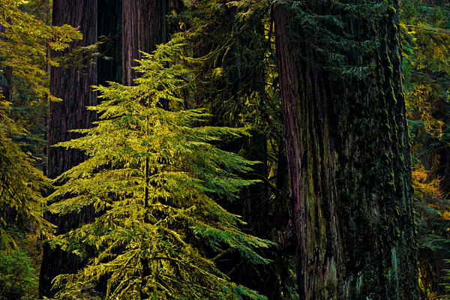
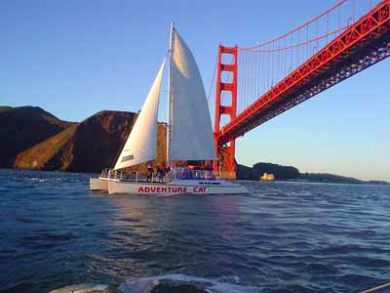
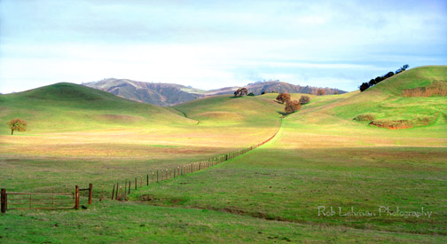
North Coast Range
    North-South trending
San Francisco Bay
Central Valley

Slide 6
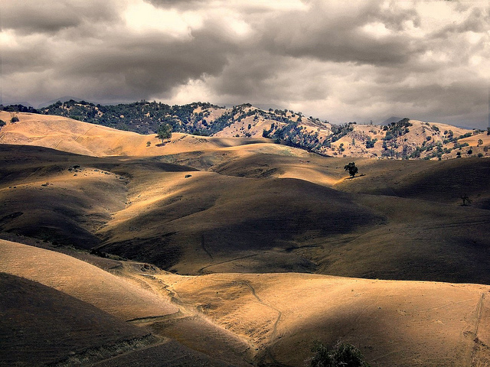
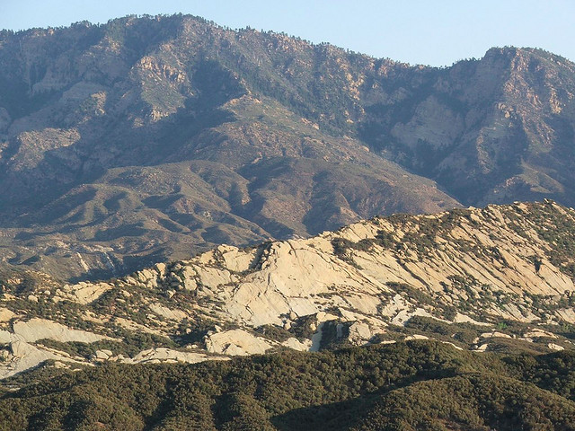
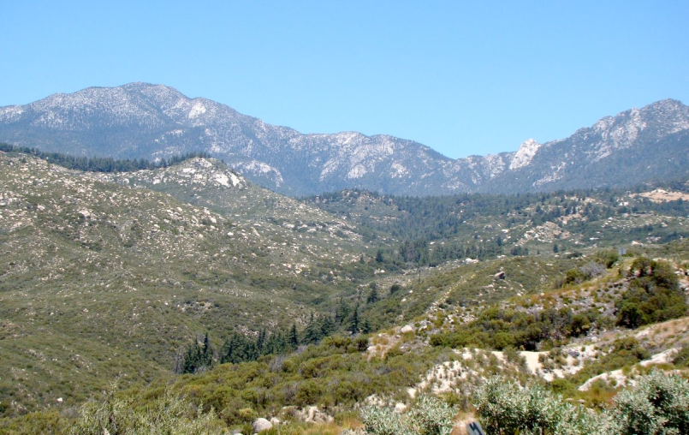
South Coast Ranges
  North-South trending
@brian romans
Transverse Range
  links Coast Ranges to Sierra-Cascade axis in the South
@brian romans
Peninsular Range

Slide 7
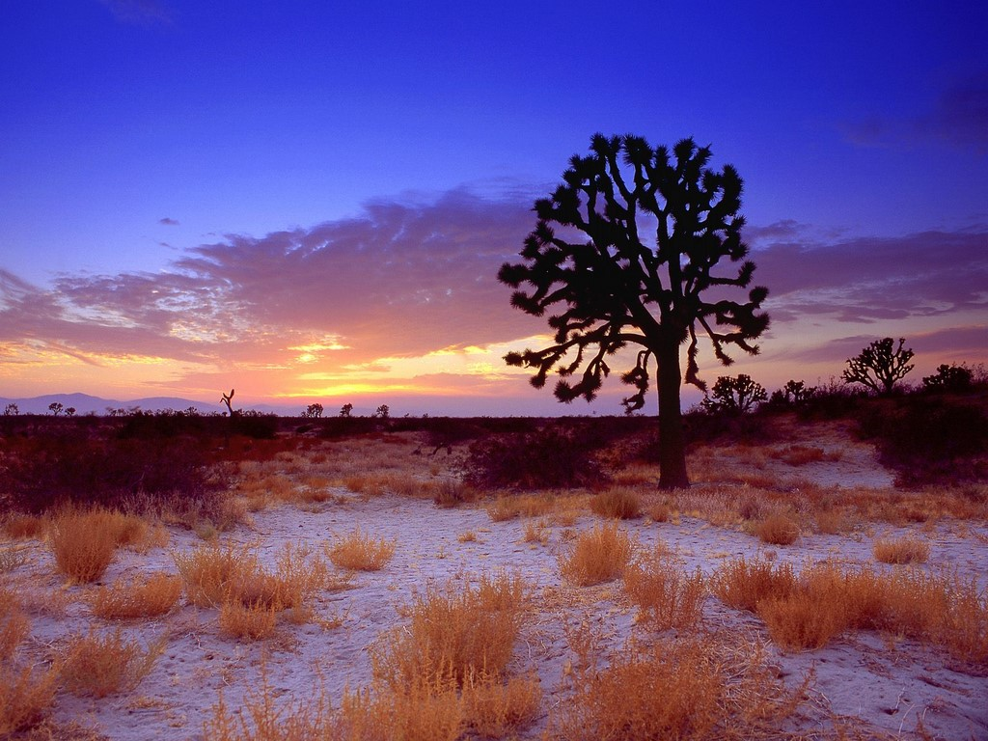
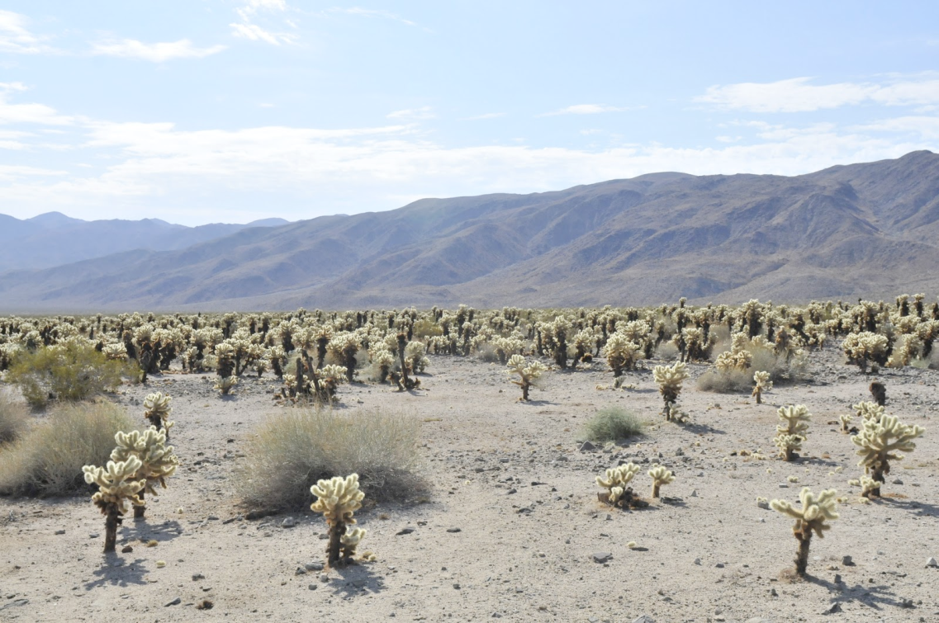
Mojave Desert
Colorado Desert

Slide 8
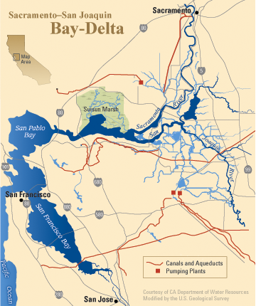
the Sierra-Cascade axis can be thought of as CA's spine/backbone
"trans-montane"
"cis-montane"
rivers flowing down the west slopes of the Sierra Nevada converge in the Central Valley into the Sacramento and San Joaquin Rivers and then exit out the SF Bay
other miscellaneous land forms
  Sutter Butte
    remnants of a volcano that erupted 3 million years ago
  Farallon Islands
  Channel Islands
Notes:
http://blog.gmedical.com/Portals/61098/images/SutterButtes-resized-600.jpg

Slide 9
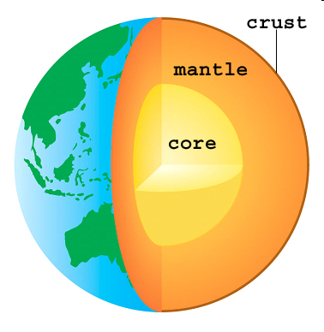
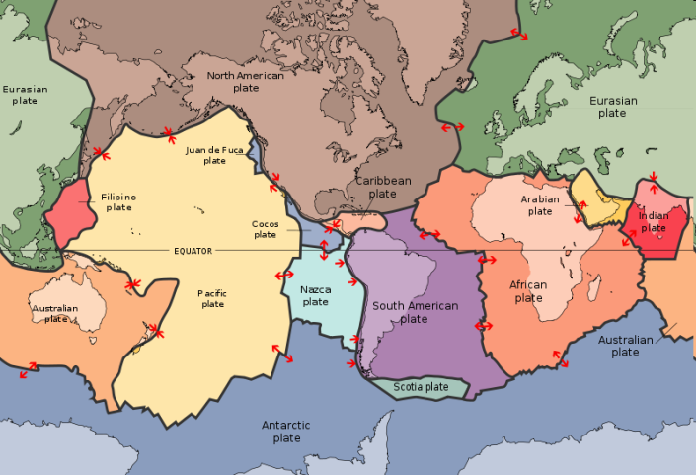
Geologic History of California
  Plate Tectonic Theory
    Earth’s composition
      semisolid core
      fluid mantle that moves very slowly
      thin crust made of separate pieces (tectonic plates) that float over the mantle
the plates float atop the fluid mantle like cereal bits floating in milk
ways the plates can interact
  divergence
    creates an opening for molten material to ooze out, resulting in an elevated area called a spreading center

Slide 10
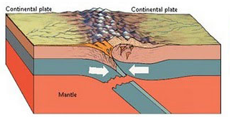
convergence
  between oceanic plate and continental plate
    oceanic plate, being more dense, will slide under the continental plate and sink into the mantle
    responsible for formation of the Sierra Nevada, Klamath Mountains and Peninsular Ranges
between continental plate and continental plate
  being roughly the same density, these plates will just push into each other like two blobs of Play-Doh to form mountains
  such processes formed the European Alps, Appalachian and Himalayan Mountains

Slide 11
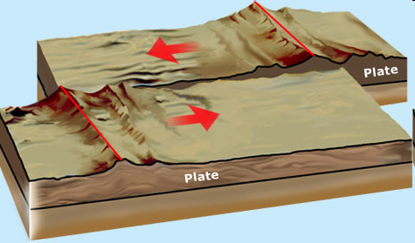
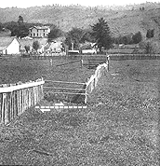
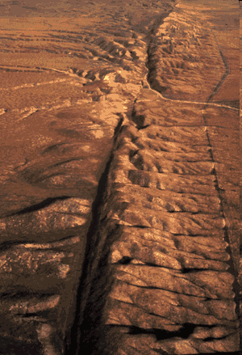
transform
  responsible for continuing deposition of sediment in the Central Valley
  responsible for volcanic activity in northern CA and eastern Sierra
the right-lateral motion along the 800 mile San Andreas is the primary cause of California's earthquakes and has offset rock assemblages, streams, and other objects on both sides of the fault by hundred of miles
Carrizo Plains, Central CA
San Andreas Fault
1906 earthquake
Notes:
http://www.platetectonics.com/book/images/Transformfaults.gif
http://pubs.usgs.gov/gip/dynamic/graphics/San_Andreas.gif

Slide 12
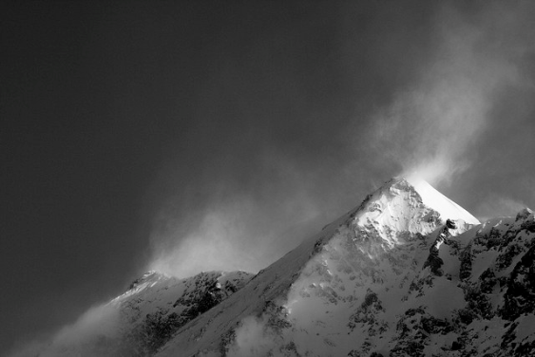
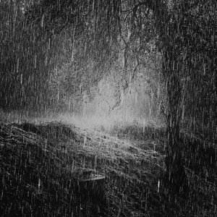
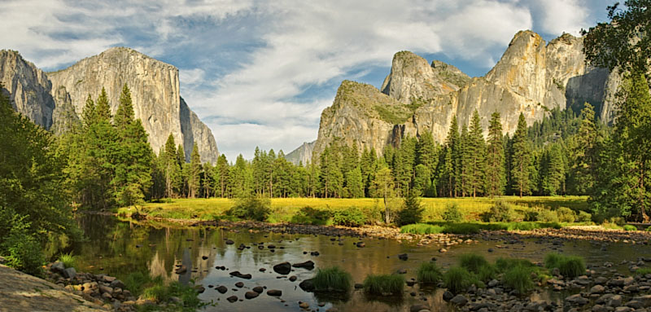
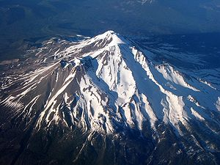
erosion
  wind
  rain
  snow
  freezing thawing
  glacial carving
  while we often think of mountains of as being stupendously old, they must constantly grow to avoid being flattened by erosion
    Mt. Shasta is only 12,000 years old

Slide 13
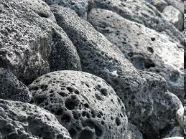
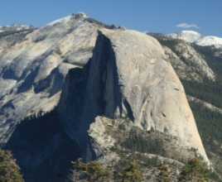
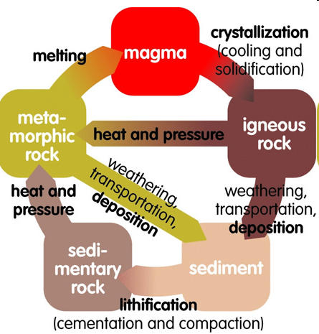
rocks in California
  the movement of plates influences the kinds of rocks found throughout the state
  in CA, Mt Lassen is a convenient place marker for the dividing line between volcanic rocks to the north and granite rocks to the south
Volcanic rock
Granite
rock cycle
Notes:
http://t3.gstatic.com/images?q=tbn:ANd9GcScptloNsRUwLiG9ebZ6l1a0szISEg74WieWqLr9B7V3rYmA_Of&t=1

Slide 14
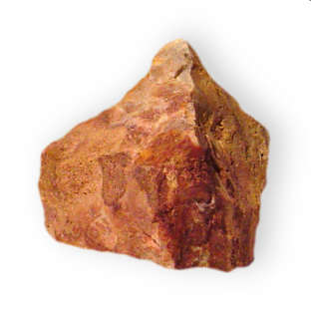
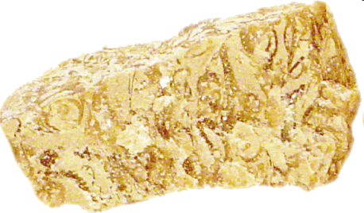
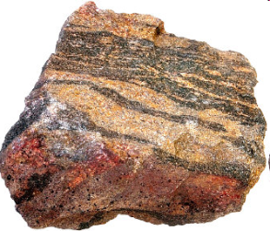
types of rocks in California
  igneous
    formed from the cooling of molten material (magma) in a process called crystallization
sedimentary
  formed by the gradual accumulation and cementation of rock debris (usually from mountains) and frequently occurring under water
metamorphic
  formed when igneous or sedimentary rock have been subducted deep into the earth, but instead of simply melting, undergo structural change due to extreme pressures and temperatures
Notes:
http://t3.gstatic.com/images?q=tbn:ANd9GcScptloNsRUwLiG9ebZ6l1a0szISEg74WieWqLr9B7V3rYmA_Of&t=1

Slide 15
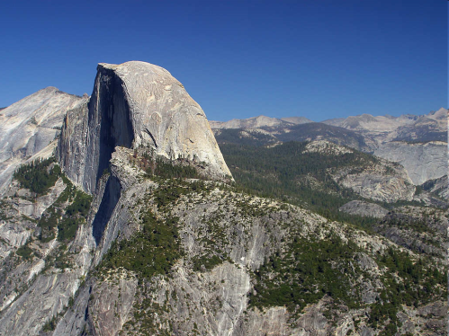
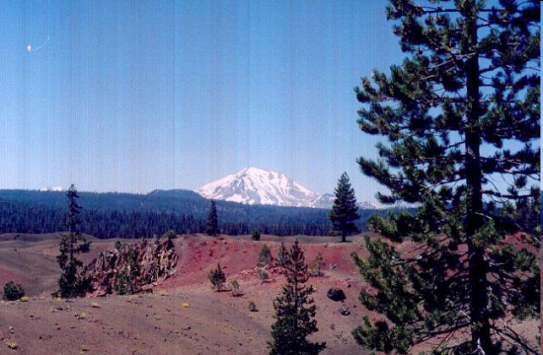
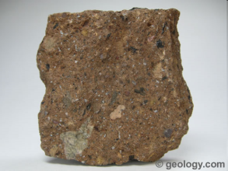
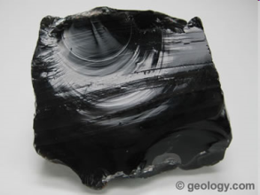
common types of igneous rock in CA
  granite
    coarse grained, light colored
    forms high peaks of Sierra Nevada and Yosemite
basalt
  fine grained, black to rust colored
  common to volcanic areas like Modoc Plateau, Mt Lassen
volcanic rock
  tuff is light colored, low density
  obsidian is black and glassy rock
  common to Cascade Ranges volcanoes and eastern Sierra
tuff
obsidian
Notes:
http://www.platetectonics.com/book/images/Transformfaults.gif
http://pubs.usgs.gov/gip/dynamic/graphics/San_Andreas.gif

Slide 16
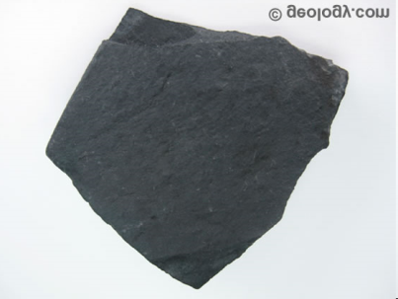
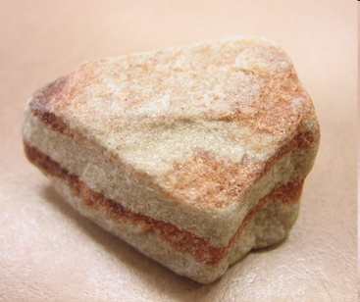
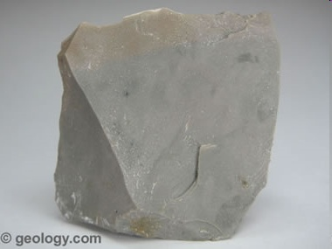
common types of sedimentary rock in CA
  shale
    extremely fine grained rock
    forms in calm environments
    common in Coast Ranges and foothills of Sierra Nevada
  sandstone
    medium grained rock
    found in near-shore marine environments
    common in Central Valley and desert provinces
chert
  chemical sedimentary rock composed of layers of microscopic shells
  commonly rust colored
  common in Coast Ranges and foothills of Sierra Nevada
Notes:
http://www.platetectonics.com/book/images/Transformfaults.gif
http://pubs.usgs.gov/gip/dynamic/graphics/San_Andreas.gif

Slide 17
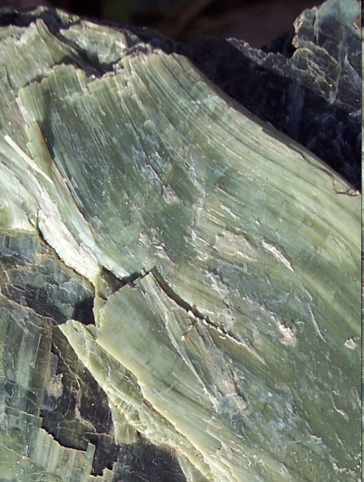
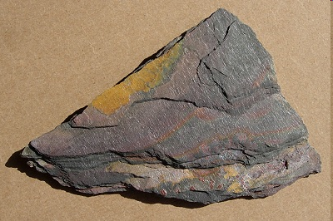
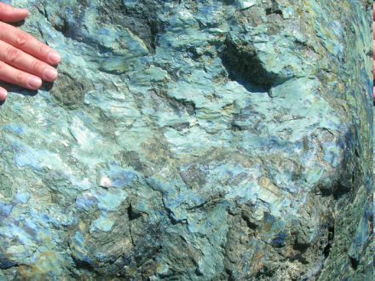
common types of metamorphic rock in CA
  serpentine
    our proud state rock
    green to black color
    waxy and extremely soft
    common in the Coast Ranges and Sierra Nevada foothills
  slate
    fine grained foliated rock
    common in Sierra Nevada foothills
  schist
    fine grained, foliated rock
    common in Sierra Nevada foothills
Notes:
http://www.platetectonics.com/book/images/Transformfaults.gif
http://pubs.usgs.gov/gip/dynamic/graphics/San_Andreas.gif

Slide 18
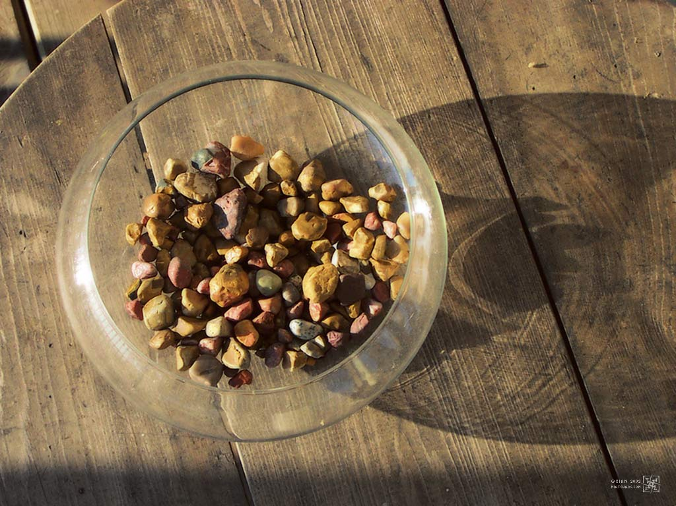
rocks falling into bowl
  sedimentary rocks and debris made from the erosion of Coast Ranges and Sierra Nevada have covered the Central Valley in layers of sedimentation up to 20,000 meters in thickness
  contributes to the richness of soil in Central Valley
Notes:
http://static.mintchaos.com/wallpaper_download/bowl_of_rocks/bowl_of_rocks_1024.jpg

Slide 19
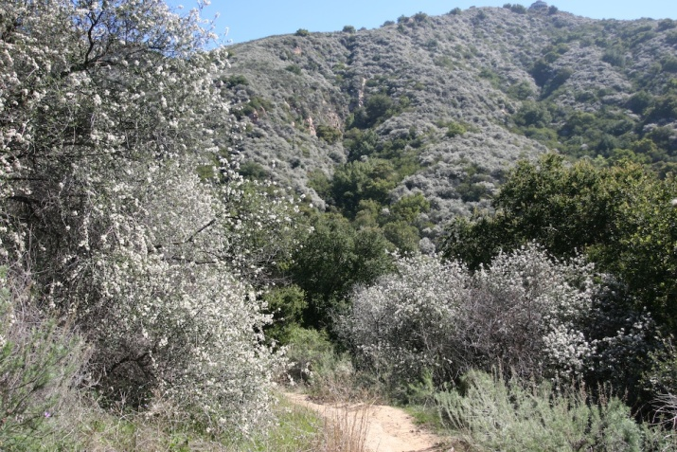
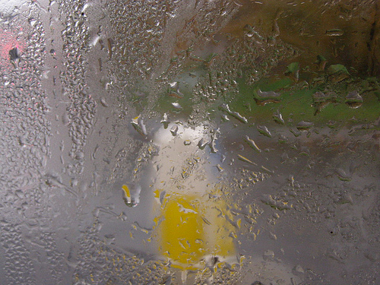
California's Climate
  California is one of only five regions in the world with a Mediterranean climate
    all the areas with Mediterranean climate occur on the western edges of the continents
      the earth spins in one direction, and the atmosphere above remains relatively still (wind)
hot, dry summers (May to October)
cool, wet winters (November to April)

Slide 20
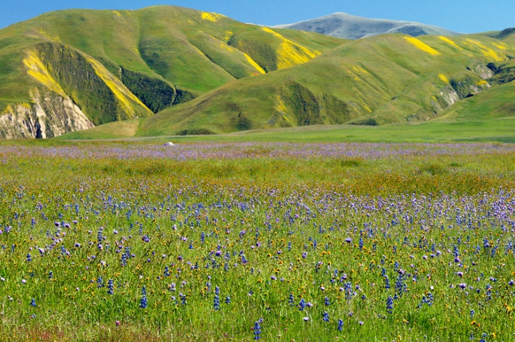


3. California's Climate
California’s seasons
  spring occurs in November
periods of animal dormancy occur in the heat of summer
  amphibians and small mammals estivate during this timeer months
some species never lose their leaves
  Sequoia sempervirens (evergreen)
Notes:
http://www.republicdomain.com/photos/bulkupload//wallpapers55/Yosemite-Meadows.jpg

Slide 21

Diversity of California Microclimates
  coastal winds drive clouds over mountains to produce rain
1. Moist clouds blown inland from Pacific winds are driven up in elevation by the Coast Ranges until they have been wrought of a portion of their moisture
3. The clouds begin to regain their moisture as they rise up the Sierra. By the time they reach mid elevation, they have enough moisture to rain again
4. Having spent all their moisture at mid-elevation, the now dry clouds continue their eastward journey….
2. The clouds descend into the valley, where they increase in temperature

Slide 22




  the western slopes of the Coast Ranges and Sierra experience dramatically higher rainfall than the eastern slopes
Notes:
http://www.republicdomain.com/photos/bulkupload//wallpapers55/Yosemite-Meadows.jpg

Slide 23

precipitation trends
    increases along coast
    increases northwards
    increases with increasing mountain elevation
Notes:
http://www.republicdomain.com/photos/bulkupload//wallpapers55/Yosemite-Meadows.jpg

Slide 24


Soil Structure and Nutrients
  the parent rock of a soil determines its chemistry and thus how it will affect various plant species
    promotion of growth
    inhibition of growth
      ex. when salt is leeched out of the rocks in a mountain range and ends up in basins, a salt lake forms that is toxic to most plants
serpentine soil
  characterized by low concentrations of calcium (which plants absolutely need) and excessive concentrations of magnesium
  many generalist plants are excluded from serpentine soil
  calcium and magnesium are chemically very similar so generalist plants don't bother to distinguish between the two and consume themselves to death
  specialists have come to inhabit this niche
Notes:
http://www.republicdomain.com/photos/bulkupload//wallpapers55/Yosemite-Meadows.jpg

Slide 25


nitrogen fixation
  Nitrogen is present in limited quantities in most soils, but generally not enough to allow for luxuriant growth
  some plants have found ways to extract nitrogen from the air and thus obtain some degree of independence from their soils
  these plants have nodules in their roots that are perfect habitats for specialist bacteria that eat atmospheric oxygen
  when the bacteria complete their life span and die, they decompose in the nodule and release nitrogen to the plant
  when these plants die, they decompose and release the nitrogen into the soil
  ex. Ceanothus
Notes:
http://www.republicdomain.com/photos/bulkupload//wallpapers55/Yosemite-Meadows.jpg

Slide 26

Soil Structure and Nutrient Cycling
"Outside of a few infalling meteors and outflying spaceships, the Earth is a closed chemical system."
William H. Schlesinger
Notes:
http://www.republicdomain.com/photos/bulkupload//wallpapers55/Yosemite-Meadows.jpg

Slide 27



materials cycling through the Earth's systems go in and out of biotic and abiotic stages
  living things grow, reproduce, die, decompose, and become part of other living things
non-living things accumulate, break down, are utilized by or stored in other organisms, get excreted and redeposited, get reformed or reused
nutrients remain in different reservoirs or states for different residence times
  carbon remains in plants for 5 years on average
  carbon found in rocks remains locked there for millions of years
Notes:
http://www.republicdomain.com/photos/bulkupload//wallpapers55/Yosemite-Meadows.jpg

Slide 28


tampering with the Nitrogen Cycle, as with any other natural cycle, induces a chain reaction of problems
  Nitrogen is important for agriculture because its often a limiting factor for plant growth
  farmers often apply large amounts of nitrogen in the form of nitrate to yield crops
this however, puts into the nitrogen cycle far more nitrogen than the plants can possibly absorb
this excess nitrate becomes a source of pollution in streams and rivers and other bodies of water
polluted water bodies may experience explosions in growth of phytoplankton, which often chokes off water oxygen levels and suffocates local fish populations
Notes:
http://www.republicdomain.com/photos/bulkupload//wallpapers55/Yosemite-Meadows.jpg

Slide 29



Decomposition
Everything in the biosphere can be and is used again
  raccoon falls from a tree and dies on impact
within a few hours
  bacteria break into its cells to eat up nutrients
  coyotes, foxes and vultures rip open and devour the best parts of the carcass
  flies begin laying eggs on the carcass
after 8-20 hours
  the maggots hatch and begin cleaning up all the easily available soft tissue
Notes:
http://www.republicdomain.com/photos/bulkupload//wallpapers55/Yosemite-Meadows.jpg

Slide 30



now there is just a pile of hair, skin and bones left
  beetles that specialize in hair or skin now arrive to deposit their eggs
after 3-6 months, the bones are finally bare and clean
  mice seeking calcium will now gnaw on the bones
decomposition is essential for continuing the circle of life
Notes:
http://www.republicdomain.com/photos/bulkupload//wallpapers55/Yosemite-Meadows.jpg

Slide 31



Mycorrhizal Relationships
  mycorrhizal fungi
    elongate, tubular string-like cells called hyphae
hyphae form white filamentous mats called mycelium, which constitutes the actual body of the organism
the mushroom is the reproductive body part
Notes:
http://www.republicdomain.com/photos/bulkupload//wallpapers55/Yosemite-Meadows.jpg

Slide 32



mycorrhizal fungi and trees share a symbiotic relationship
  hyphae wrap around or penetrate the roots of trees
  the tree and fungus then exchange products
tree gives the fungus products of its photosynthesis (sugars)
fungus gives the tree water and mineral nutrients like nitrogen and phosphorus
the mushroom hyphae are far finer in diameter than tree roots and can thus extract more water and nutrients from the soil than the roots can
  this symbiosis is so successful that about 80% of species of trees worldwide use it
Arbutus
Notes:
http://www.republicdomain.com/photos/bulkupload//wallpapers55/Yosemite-Meadows.jpg

Slide 33



mycorrhizal fungi also have a symbiotic relationship with orchids
  orchids make the smallest seeds of any flowering plan, with each pod containing up to 25,000 seeds
this extreme reduction in size could only have been achieved by leaving out the "essential" element of a seed: food for the embryo
the fungus helps out by supplying food to the seedlings
Notes:
http://www.republicdomain.com/photos/bulkupload//wallpapers55/Yosemite-Meadows.jpg

Slide 34



Mining in California
California's forays in mining did not end with the Gold Rush, but continue on till this very day
  ranked second in the U.S. non-fuel mineral production
these industrial minerals form the backbone of modern society, yet at the same time, their harvesting imposes severe burdens on the environment
even historic mines continue to have environmental impacts
  mercury used in gold mining during the Gold Rush continues to be a continual source of pollution and toxic conditions for fish, wildlife, and our drinking water.
  Iron Mountain Mine had uncontrolled acid drainage making it the largest source of surface water pollution in the US before it was shut down in 1963

