Slide 1
UC Path Network
October 24, 2018
Zoom meeting ID: 815-160-2829
John Fox Executive Director, Human Resources
Dave Krause Manager, Web Development and Applications Programming
Emily LaRue Assistant Director, Business Operations Center

Slide 2
Today’s Topics
Overview of UC Path changes
Multi-factor Authentication
Impact on Business Operations Center (BOC)

Slide 3
UC ANR UC Path – Implementing Positive Changes
Employee Self Service
Supervisor Access to Information
New ways to access systems
Support from UC Path Center
New Staff Recruitment System
Automated routing for approvals
Web-based Performance Appraisals
2018
2019
2020

Slide 4
Multi-factor Authentication
Accessing online systems is changing
Dave Krause Manager of Web Development and Applications Programming
New ways to access systems
ucanr.edu/mfa
ucpath.ucanr.edu
Notes:
Title slide. No notes.
>>>Next slide>>>

Slide 5
Topics covered
New ways to access systems
What is MFA?
Benefits
Enrollment
Related changes
ucanr.edu/mfa
ucpath.ucanr.edu
Notes:
Today we will provide an introduction to multi-factor authentication or MFA.
You may have already heard about and will hear more about in the coming months (and from multiple sources).
We’ll review how it works, why it’s important and what you need to do to participate.
We will also briefly touch on changes in our systems related to MFA.
>>>Next slide>>>

Slide 6
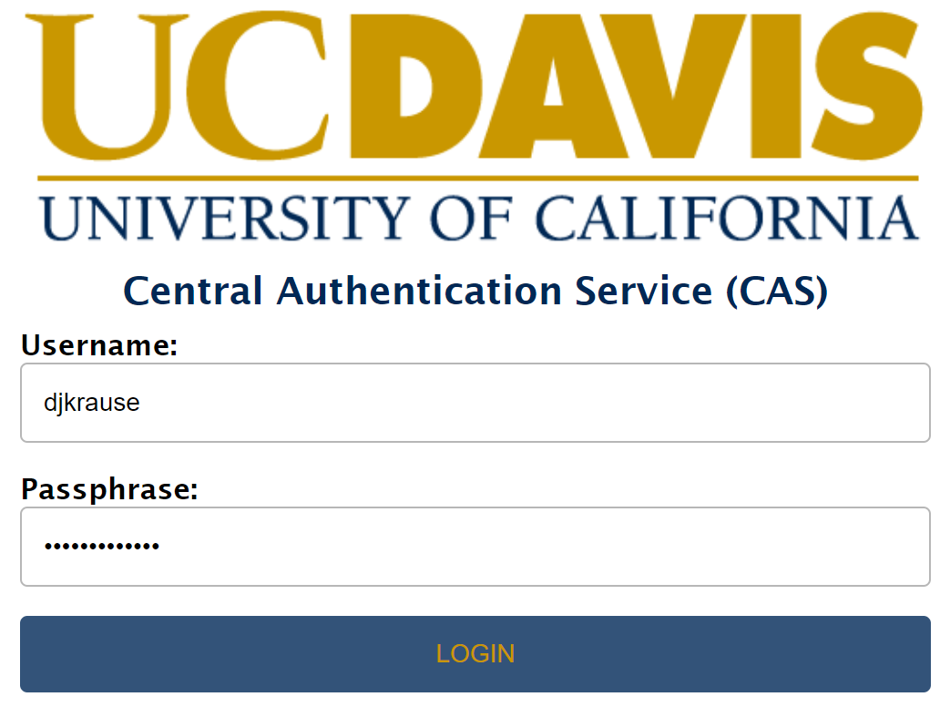
ucanr.edu/mfa
ucpath.ucanr.edu
Notes:
Imagine you need to use an online system that is operated by UC Davis for us, like Time reporting system (TRS), KFS or AggieTravel.
You will no doubt recognize this login form where you enter your UC Davis credentials, assuming you have them.
Historically, once your credentials are “authenticated” against a database hosted by UC Davis, you are redirected to the system and off you go.
>>>Next slide>>>

Slide 7
ucanr.edu/mfa
ucpath.ucanr.edu
Notes:
Now there will be another step to going on to that system.
A tool called “Duo” has been added to the login process which will ask you for a second form of authentication.
You’ll here more about Duo in a moment.
>>>Next slide>>>

Slide 8
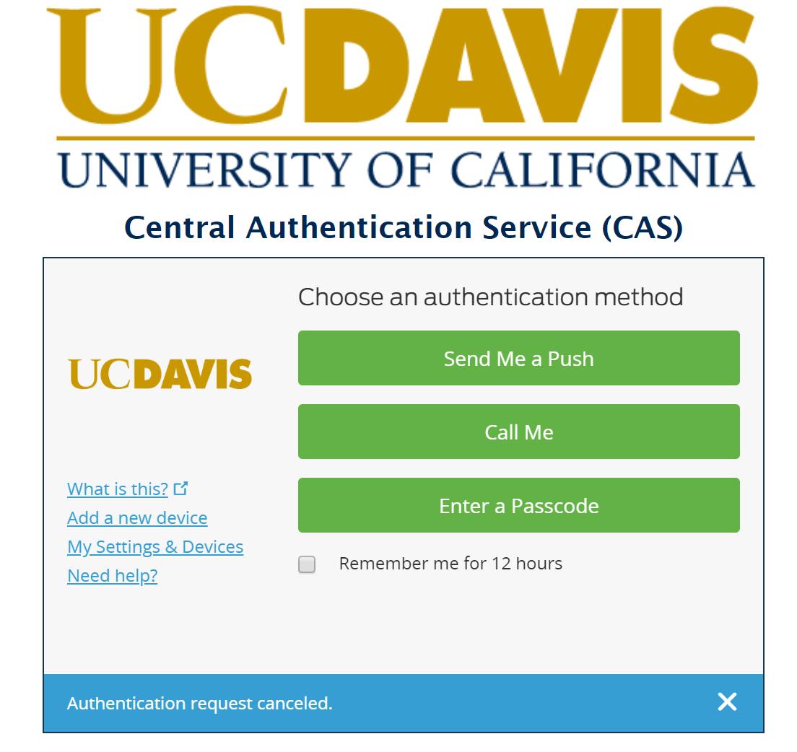
ucanr.edu/mfa
ucpath.ucanr.edu
Notes:
Duo seamlessly adds this second form of authentication right in the login form.
There are steps you will need to take to initially set up Duo, which we will cover in a moment.
For this example, I have preset Duo to send the second authentication to my phone as a “push notification.” Duo will also happily call you or send you a code to use instead.
If you are unaware, a push notification is a mobile phone alert which can appear while the phone is still in locked mode.
>>>Next slide>>>

Slide 9
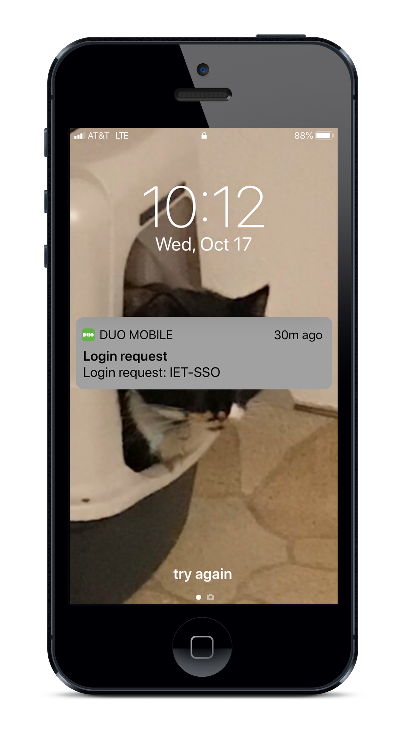
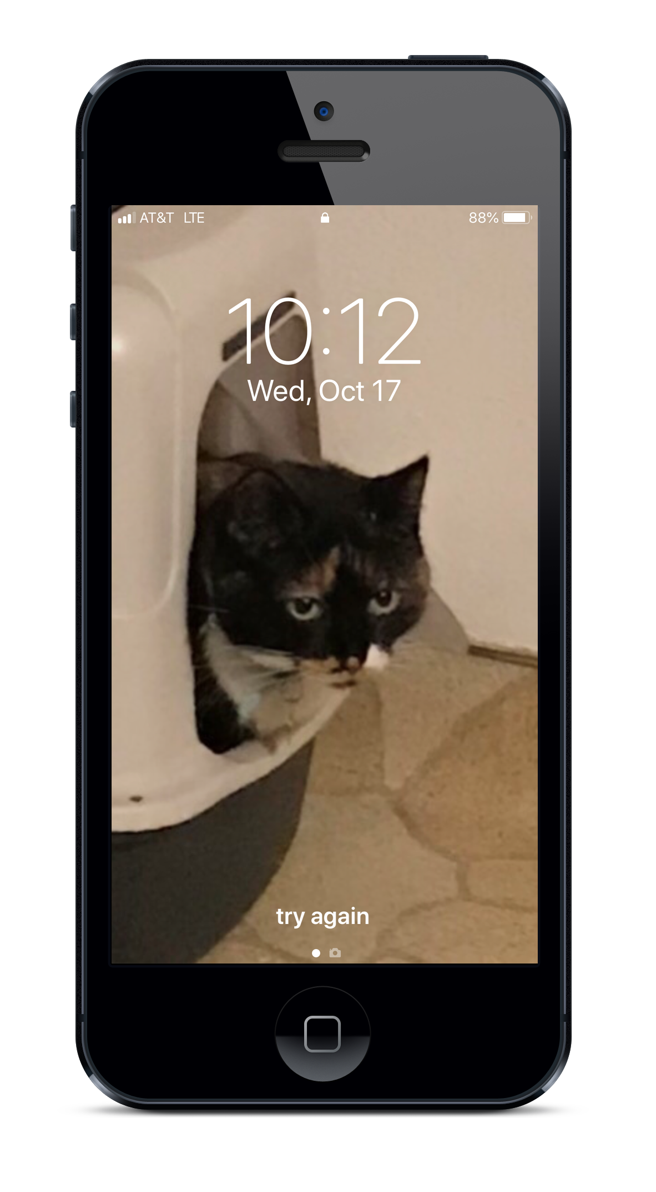
ucanr.edu/mfa
ucpath.ucanr.edu
Notes:
This is what the push notification looks like on my iPhone 7.
I can press down on the notification to access my phone and complete the Duo process.
>>>Next slide>>>

Slide 10
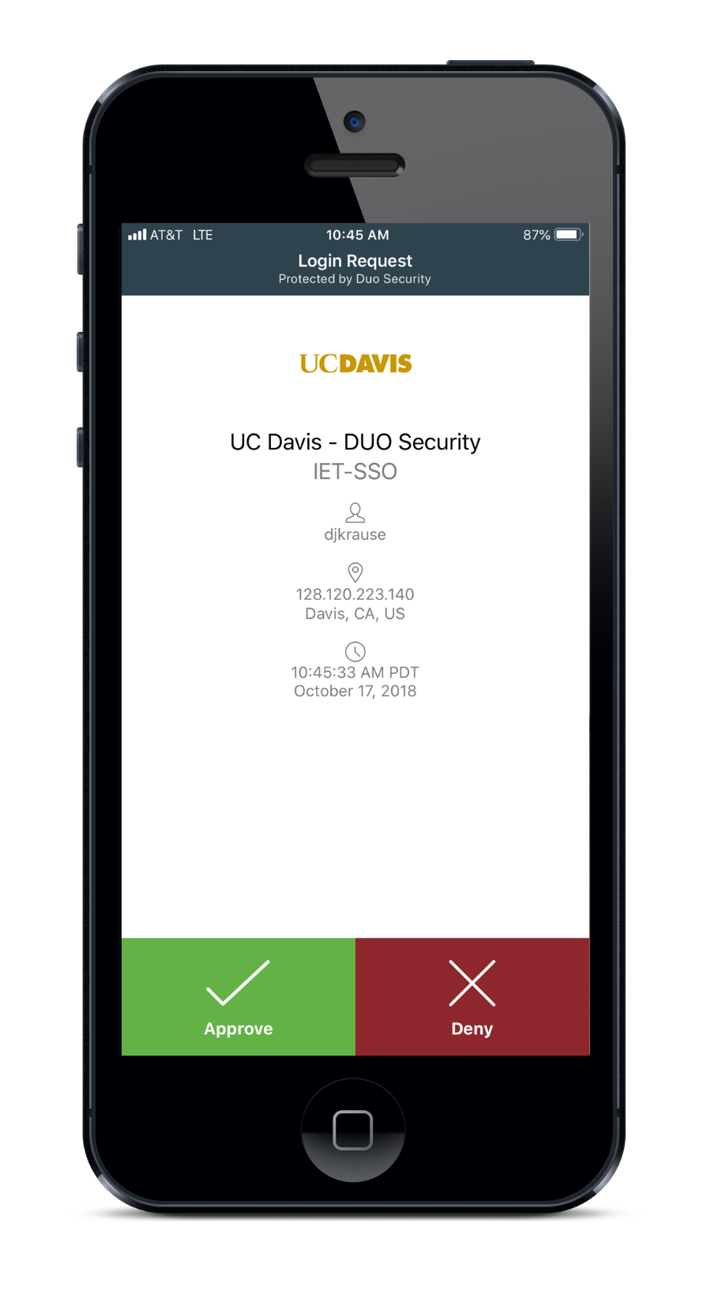
ucanr.edu/mfa
ucpath.ucanr.edu
Notes:
When I press the push notification and unlock my phone, I go right to the Duo app to verify my access.
Once I click “approve,” the website immediately accepts the second authentication and I’m done. I can close my phone.
>>>Next slide>>>

Slide 11
Benefits of Duo
New ways to access systems
Account and data protection
Protection for UC ANR
Flexible and simple solution
ucanr.edu/mfa
ucpath.ucanr.edu
Notes:
MFA protects you from having your access hijacked via phishing or some other account theft.
Hackers will not have the second form of authentication to complete the process.
It protects ANR from having our systems and websites compromised by a hacked account.
Duo is simple to set up and use and offers several ways to authenticate.
>>>Next slide>>>

Slide 12
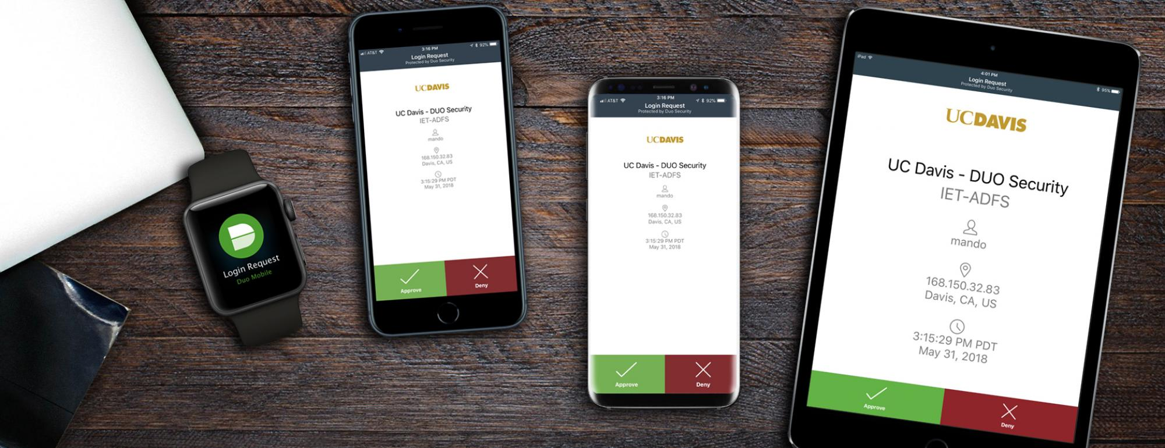
ucanr.edu/mfa
ucpath.ucanr.edu
Notes:
Mobile phones, tablets, and Apple watch are among the devices supported by Duo. And it doesn’t take up much space on your device.
You can host multiple Duo access needs in one app. For example, you only need one Duo app to manage your access for UC Davis, UCOP and anyone else who uses Duo.
As previously mentioned, Duo will call you or send you a code or use your landline to authenticate in the way which works best for you.
Also, physical tokens which connect directly to your computers will be available for purchase soon.
And if you lose or forget your device or token, you can quickly set up Duo on an alternate device or token, or request assistance from IT.
>>>Next slide>>>

Slide 13
All UC locations will be rolling out Duo
Use of Duo will be required
ucanr.edu/mfa
ucpath.ucanr.edu
Notes:
If you use systems at UCOP, you may have already set up Duo.
UC Davis is mandating use of Duo in the coming months.
Other locations will follow.
>>>Next slide>>>

Slide 14
Enrollment
New ways to access systems
Enrollment is open
Detailed FAQs online
Assistance available
ucanr.edu/mfa
ucpath.ucanr.edu
Notes:
We are now inviting all UC ANR employees who use UC Davis systems to enroll in Duo via a smartphone or tablet. Yes, you can do this right now! Systems like:
Aggie Travel
Aggie Buy
Time reporting system (TRS)
KFS
Be sure you use a device that is with you when you work!
Go to ucanr.edu/mfa for details on enrollment and to find additional assistance setting it up.
>>>Next slide>>>

Slide 15
Related changes
New ways to access systems
UC ANR login
UC ANR Duo
ucanr.edu/mfa
ucpath.ucanr.edu
Notes:
UC ANR login will change to a new identity management system. This should be a seamless change, allowing you to login to the ANR Portal and other tools with the same password you use now. The key changes are:
Use of login ID instead of email address, similar to UC Davis CAS.
No more use of UC Trust to access UC ANR systems if you are an ANR employee.
Volunteers, affiliates and collaborators will have unchanged access.
UC ANR will be rolling out Duo for our identity management system next year.
>>>Next slide>>>

Slide 16
Impacts of UCPATH to the BOC
Physical location of ANR’s UC Path Payroll Team
Work assignments and responsibilities
Impacts of being a Business Unit
Systems and processes

Slide 17
What can we expect to be different?
Personnel action entry functions will be performed by ANR HR or UC Path Central Team
New hires, terminations, pay changes
One ANR BOC Payroll unit located in Davis
Payroll Manager
3 staff members
New terms, different processes, changed appearance
Routing of forms and documentation
For the first several weeks, EVERYTHING will seem different!

Slide 18
What can we expect to be the same?
Payroll (time and leave reporting) processing
Timely submission for all organizational units
Time Reporting System review and corrections as needed
Service level
ANR UCPATH Hypercare Team – Group devoted to resolution of ANR employee issues
Processing of financial transactions
BOCK - UCCE (Gifts excluded)
BOCD – Statewide programs, RECs and administrative units
For the first several weeks, NOTHING will seem the same!

Slide 19
ANR as a Business Unit
Impacts on BOC
Increases ANR’s visibility as equivalent to the 10 other campuses
ANR’s responsibility for compliance and accountability takes on even greater importance!
Audits
Reporting
Serve as ANR’s central payroll unit
Dependence on UC Davis very different

Slide 20
Your Action List as Network Representative
Use the Talking Points to tell your colleagues about how the BOC will be different in UCPATH
Tell your colleagues about what will be the same AND different about the BOC
Start thinking about what you do in your offices that may need to be done differently
Post questions you or your colleagues have about UCPATH on the website [address] or send the ANR PATH team an email [address]

Slide 21
November UC Path Network Webinar
Wednesday, November 28, 2018
11am-12pm
Zoom information:
https://ucanr.zoom.us/j/8151602829
Phone: +1 408 638 0968 (US Toll)
Meeting ID: 815-160-2829

