Slide 1
UC ANR UCPath Network
June 26, 2019
John Fox, Human Resources
Sally Harmsworth, Business Operations Center

Slide 2

Agenda
Today’s Agenda
New TRS Approval Deadlines
Position Management – Changes Starting in July
Readiness Sessions
Recruitment and Pre-Hire Processes – Training Plan
UCPath website: Videos and Other Resources

Slide 3
Implementing Positive Changes…
May
New TRS approval deadlines
July
Position Management (Approval to initiate a recruitment)
New online form replaces SPR
Aug
Readiness Sessions with UCCE offices and RECs to be scheduled
Sept
Zoom training on changes to Recruitment and Pre-Hire processes

Slide 4
TRS approval deadlines for Bi-weekly Paid
Old Timing
Deadline for supervisor TRS approval had been 5pm on Wednesday following the end of a pay period
Late timesheets could be manually added up to 5pm on Friday
New Timing
Deadline for supervisor TRS approval is 10am on Monday following the end of the pay period
No opportunity for late submission
Notes:
John review agenda and meeting logistics

Slide 5
*If the employee works on the last Saturday of the biweekly pay period, they should submit their TRS timesheet at the end of their work day on Saturday.

Slide 6


2019 Bi-Weekly Timesheet Schedule
Pay Period End Date (Saturday) | Employee Submits Timesheet | Supervisor Approves Timesheet (by Monday 10am) | Timesheet Pay Compute | Pay Date
06/29/19 | 06/29/19 | 07/01/19 | 07/03/19 | 07/10/19
07/13/19 | 07/13/19 | 07/15/19 | 07/19/19 | 07/24/19
07/27/19 | 07/27/19 | 07/29/19 | 08/02/19 | 08/07/19
08/10/19 | 08/10/19 | 08/12/19 | 08/16/19 | 08/21/19
08/24/19 | 08/24/19 | 08/26/19 | 08/29/19 | 09/04/19
09/07/19 | 09/07/19 | 09/09/19 | 09/13/19 | 09/18/19
09/21/19 | 09/21/19 | 09/23/19 | 09/24/19 | 10/02/19
10/05/19 | 10/05/19 | 10/07/19 | 10/09/19 | 10/16/19
10/19/19 | 10/19/19 | 10/21/19 | 10/23/19 | 10/30/19
11/02/19 | 11/02/19 | 11/05/19 | 11/07/19 | 11/13/19
11/16/19 | 11/16/19 | 11/18/19 | 11/20/19 | 11/27/19
11/30/19 | 11/30/19 | 12/02/19 | 12/04/19 | 12/11/19
12/14/19 | 12/14/19 | 12/16/19 | 12/18/19 | 12/23/19
12/28/19 | 12/28/19 | 12/30/19 | 12/31/20 | 01/08/20
First UCPath bi-weekly pay period

Slide 7
TRS approval deadlines: outreach plan
BOC Payroll sends reminders to TRS approvers each bi-weekly pay period
Payroll calendar to be posted on BOC and UCPath websites
Developing flier for local distribution
Notes:
John review agenda and meeting logistics

Slide 8

Position Management Training
Zoom sessions June 18 and June 19
Understand the new Position Management form and process (SPR replacement).
Have a clear understanding of the handoff and workflow of the position creation process.
Understand creating new positions and updating existing positions prior to UC Path Go-live.

Slide 9
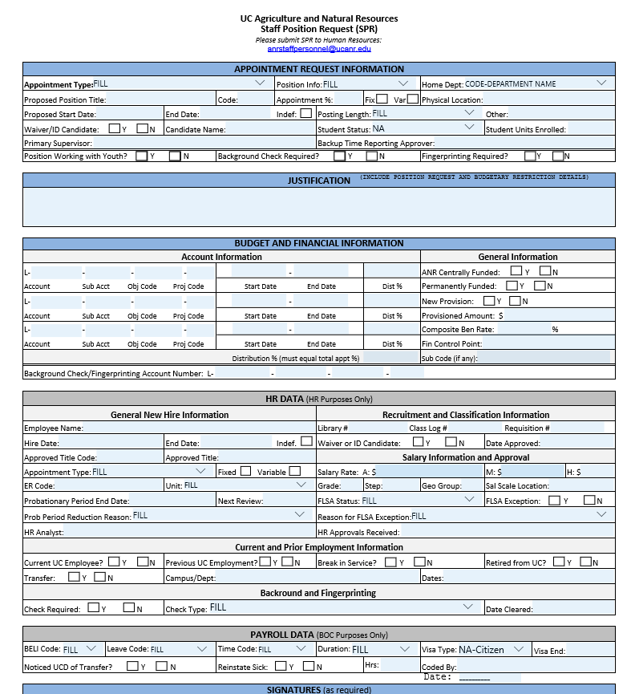
Staff Position Request Form (SPR)
Effective July 1, 2019, the SPR is going away!

Slide 10
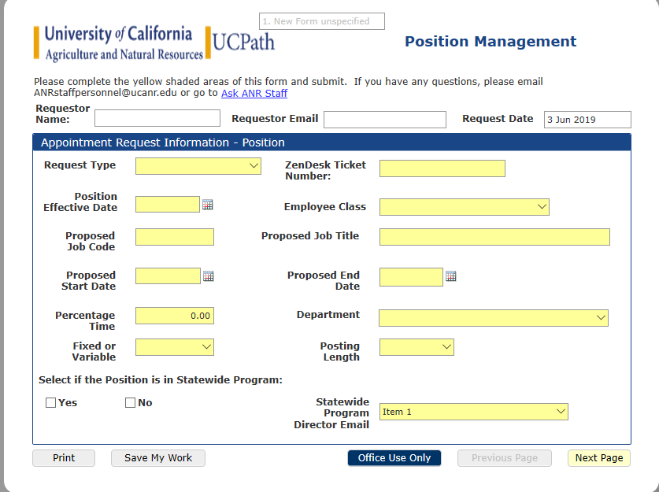
NEW: Position Management Form
Highlights
Online form (PerfectForms)
Automated workflow
Highlights required fields; provides appropriate dropdowns for information; smart form.
Notes:
Automated Workflow: Position management form will be completely electronic. Once the form is initiated and submitted by the supervisor or person initiating on the supervisors behalf it will begin the automated routing process.

Slide 11

Position Management: Next Steps
Begin using new online form July 1, 2019
  SPR will no longer be accepted
Additional Zoom session to be scheduled in July (date TBA)
Zoom recording to be posted on ANR websites, along with FAQs and checklist
  ANR UCPath Training Resources
  HR Staff Recruitment

Slide 12
Readiness Sessions
UCPath team (BOC, HR) to schedule small, interactive sessions with UCCEs, RECs, statewide programs and admin units to review UCPath changes
One hour sessions, including time for questions and discussion
Target audience: Directors, Office Managers, Business Managers, Supervisors, and anyone else who is interested
Target timing: between late July and the end of August
  UCPath team will contact Network members to schedule
Notes:
John review agenda and meeting logistics

Slide 13
Staff Recruitment and New Hire Processes
TAM replacing CATS as staff recruitment application
Improved tools for new hire process (forms, I-9, etc.)
90-minute Zoom sessions, to be repeated and recorded
Target audience: Office Managers, Business Managers, Supervisors, and anyone else involved in hiring staff
Target timing: September (dates to be announced)
Notes:
John review agenda and meeting logistics

Slide 14
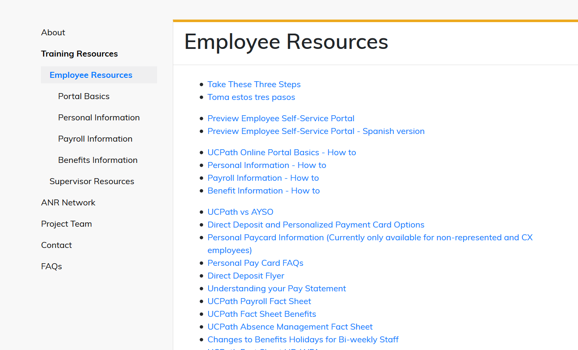
Training Resources on the Website
ucpath.ucanr.edu/Training_Resources/Employee_Training_Courses/

Slide 15
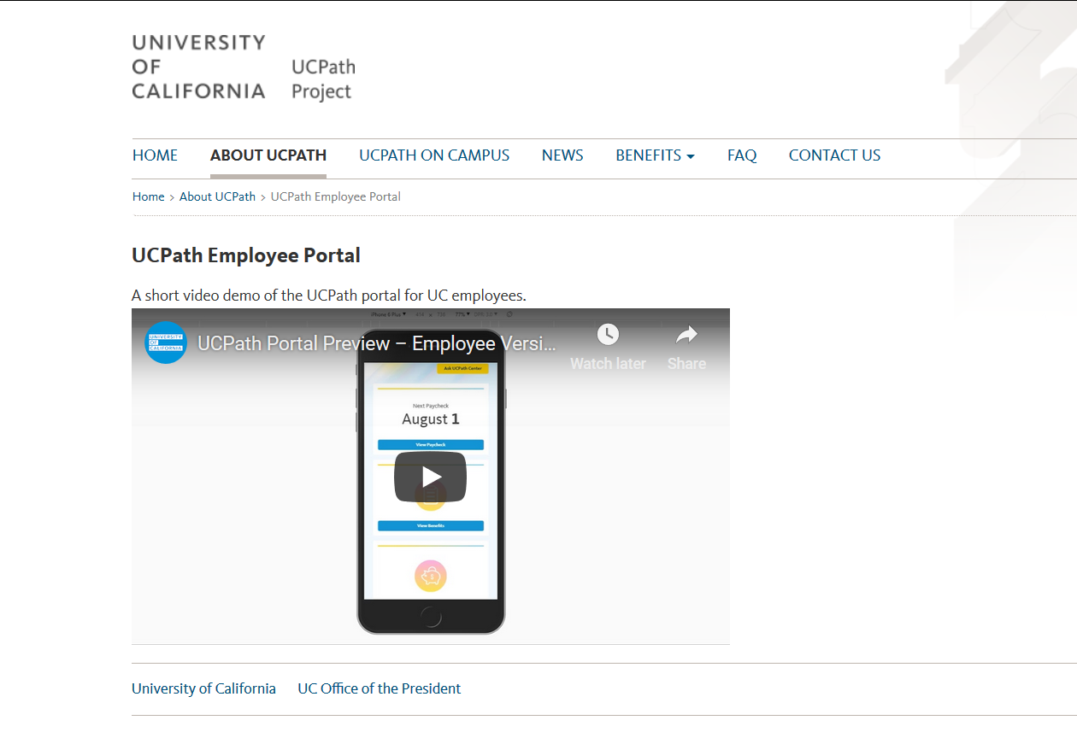

Slide 16
Action Items for UCPath Network
Be sure bi-weekly paid employees are aware of new TRS approval deadlines
Schedule a Readiness Session with the UCPath team
If you missed it, view the Position Management Zoom webinar
  New steps for hiring managers and their designees beginning in July
Notes:
John review agenda and meeting logistics

Slide 17

Questions about UC Path?
Email ucpath@ucanr.edu or visit ucpath.ucanr.edu

