Slide 1
2015/16 Staff Performance Appraisals and Merit-based Salary Program
ANR Town Hall
July 29, 2016
Dial-in for audio
866-740-1260
Access code: 7520495

Slide 2
Agenda
Introduction and Background
Changes During This Transition Year
ANR Performance Standards
Calibration Review
The Goal: Consistency in Performance Ratings
Performance Discussions
Merit-based Salary Program – Eligibility and Timing
Planning for 2017
Tools and Resources

Slide 3
Background: Merit-based Pay Program
President Napolitano announced a merit-based pay program last year, with any salary increases based on the individual’s performance and contribution.
The implementation of this salary program is another step toward consistent delivery of UC pay programs that reward individuals for their performance and contribution.
3
Notes:
The merit-based approach is consistent with feedback from staff in the most recent Engagement Survey. Employee feedback urged us to make pay for performance a more prominent feature in our salary programs and consistent with best practices.
With proper distribution of performance ratings, managers can differentiate merit awards increases and appropriately recognize the strongest contributors, while still providing a good increase to solid performers.
Recognizing and rewarding individual outstanding performance and differentiating pay practices based on employee’s accomplishments will help motivate people to achieve superior results.
This is not a new concept at UC, but it’s been a number of years since the UC budget situation allowed locations to plan for merit-based salary programs.

Slide 4
Transition Year
Webinars for all ANR supervisors in April and May
Division-wide standards for performance ratings
Performance ratings changing from a 4-point scale to a 5-point scale
New top-level rating for “Exceptional Performance”
ANR-wide calibration process to review appraisals and overall ratings for consistency
4

Slide 5
ANR Performance Standards
Common descriptions for each job element in the Performance Appraisal Form
To be used as the basis for performance discussions and ratings
http://ucanr.edu/sites/ANRSPU/Supervisor_Resources/Performance_Management/
5

Slide 6
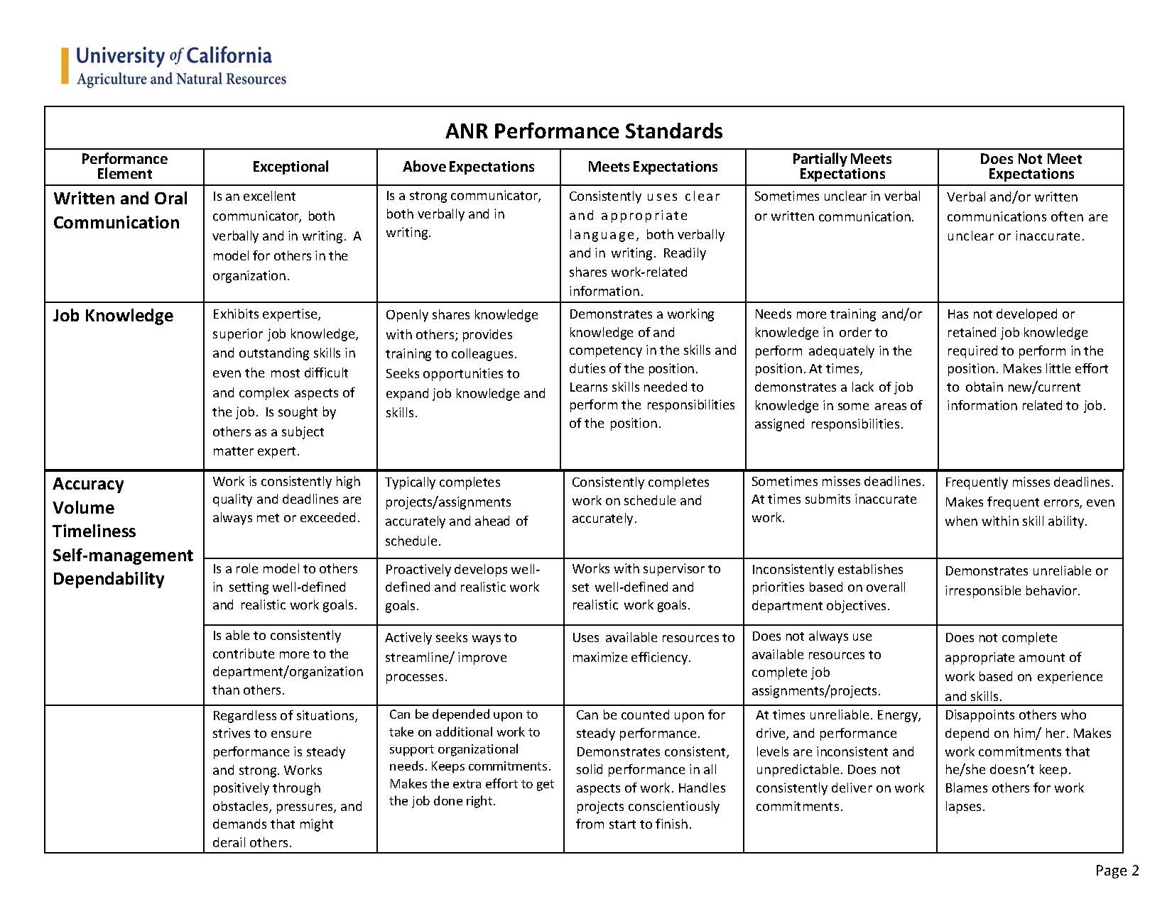
ANR Performance Standards
6

Slide 7
Exceptional Performance
Baseline
Compliant with UC policy in performance of job duties. Up-to-date on mandatory trainings.
Not subject to a disciplinary action during review period.
Achievement of Goals
Work consistently exceeds quality, quanity, and timing for performance goals established by the employee and supervisor during the review period.
Job Competencies
Above expectations or higher on each performance element/job competency based on Performance Standards.
If the employee supervises others, this includes performance as a people manager.
Transformative
In addition to exceeding performance goals, the organization is fundamentally better as a result of the employee’s contributions.
Or, the employee overcame significant obstacles during review period.
The individual is a role model for others in ANR.
In current role during the entire review period
7

Slide 8
Calibration Review
Second-level supervisors and Unit Heads actively engaged to promote consistent ratings based on ANR Performance Standards
By June 30, HR received overall ratings for all staff, with sign-off from second-level supervisors
HR collected and reviewed appraisals for employees with a PROPOSED OVERALL RATING of “Exceptional”, “Does Not Meet” or “Partially Meets Expectations”
In some cases, HR asked supervisors for clarification and directed that performance ratings change to be consistent with division-wide standards
8

Slide 9
The overarching goal of the program is to have consistent ratings across ANR

Slide 10
Performance Discussions
Aug 1 – Aug 31: Supervisor meets with employee to discuss and finalize performance appraisal, including goals for next review period.
By August 31: Final written performance appraisals are due to Human Resources.
10

Slide 11
Manager’s Role
Set expectations
Give employees the insight needed to achieve key outcomes
Hold employees accountable
Enable meaningful performance conversations
Support employees’ development plans
Connect performance management with pay for performance
Employee’s Role
Understand what performance management and pay for performance means
Participate actively in the ongoing process
Discuss performance expectations
Own their performance
Ask for performance feedback
Human Resources
Act as an objective 3rd party
Support managers and employees in understanding performance management and differentiated pay for relative performance
Provide tools, training, and coaching.
11

Slide 12
Merit-Based Salary Program Eligibility Criteria
ANR employees paid through UC Davis
Policy covered (non-represented) Staff employees (MSP, PSS)
Regular/Career status
Employees in Contract Appointments for at least 6 months as of July 1, 2016
On active payroll through the end of August 2016
Employees on Leave without Pay, if otherwise eligible, will be eligible for an increase upon return to active pay status.
12

Slide 13
Merit-Based Salary Program Timing
 | Bi-weekly Paid Employees | Monthly Paid Employees
Effective date | June 19, 2016 | July 1, 2016
Salary adjustment first reflected in paycheck | September 7, 2016 (pay period ending August 27) | September 1, 2016 (August pay)
Retroactive salary adjustment included in paycheck | By October 5, 2016 | By October 1, 2016
13

Slide 14
Employee Groups Not Included in Staff Merit-Based Salary Program
Probationary career employees, hired on or after Jan 1, 2016
Limited-term employees
Per Diem employees
Employees in Contract Appointments for less than 6 months as of July 1, 2016
Exclusively-represented (union) staff
Academic appointees
14

Slide 15
Planning for 2017
New Timing: the next review period will run from July 1, 2016 to March 31, 2017
Supervisors and employees should set goals based on a nine-month review period
In future years the annual review cycle will be April 1 to March 31
We are planning for merit-based staff salary program again in 2017/2018
15

Slide 16
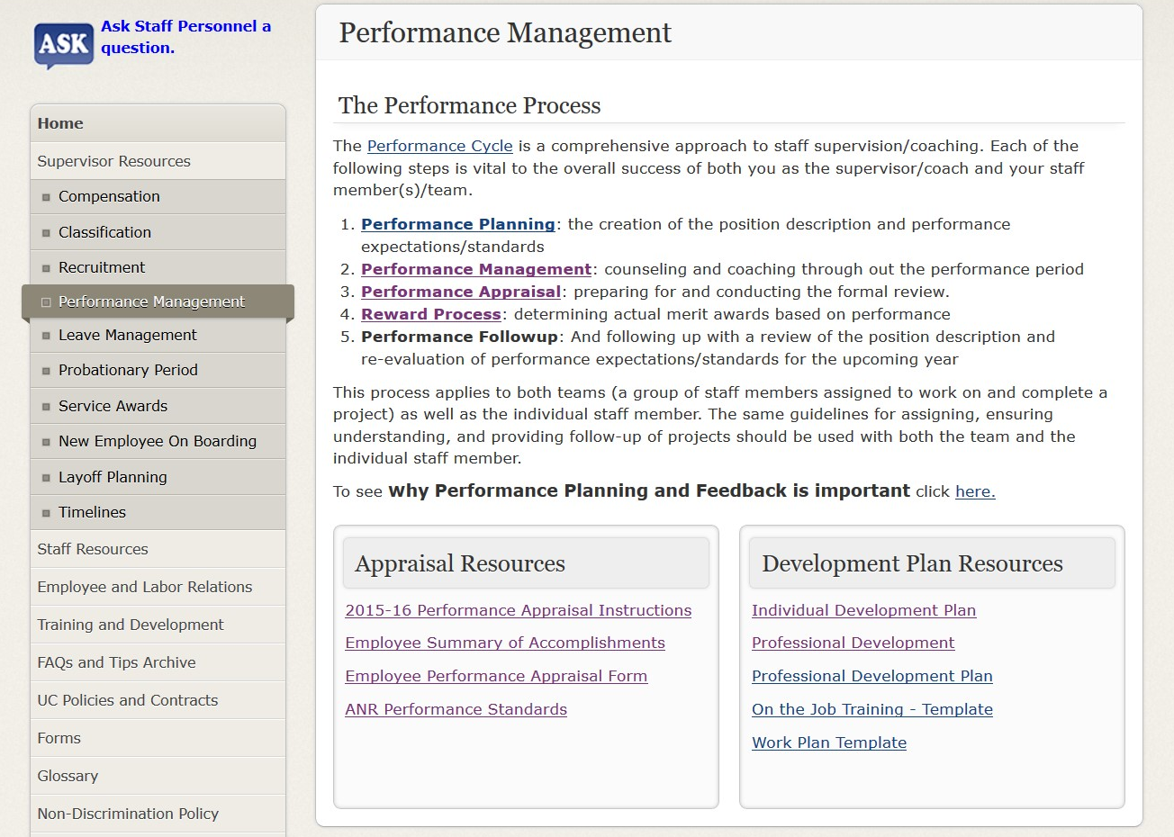
http://ucanr.edu/sites/ANRSPU/Supervisor_Resources/Performance_Management/
16

Slide 17
UC Performance Management Series
Available at the UC Learning Center
Performance Management Overview (25 min)
Setting Expectations & Individual Performance Goals (60 min)
Giving and Receiving Feedback (45 min)
Engaging and Developing Employees (30 min)
Conducting Performance Appraisals (30 min)
Motivating, Recognizing, and Rewarding Employees (30 min)
Coaching for Performance and Development (30 min)
Managing Corrective Action (35 min)
Developed by system-wide UC Human Resources

Slide 18
Questions and Comments?
Mary Roberts at maroberts@ucanr.edu
John Fox at jsafox@ucanr.edu
18

