Slide 1
Annual Evaluation Training
Fall 2016

Slide 2
ACADEMIC HUMAN RESOURCES
Tina Jordan
Academic Human Resources Manager
Karen Ellsworth, Analyst
Soo Hsieh, Analyst
Kim Ingram, Analyst
For specific unit responsibilities, please visit our website at: http://ucanr.edu/academicpersonnel

Slide 3
Presenters
Chris Greer Vice Provost of Cooperative Extension
Assistance from the AAC Personnel Committee

Slide 4
Conference Call Agreements
When asking questions, state your name first.
Put your cell phones on vibrate.
Mute phone until you want to speak.
Press *6 to mute and *7 to unmute.
One person speak at a time.

Slide 5
Desired Outcomes
Increased understanding of the elements of the Annual Evaluation (AE/Goals).
Knowledge of how the AE supports the thematic Merit/Promotion Dossier (PR).
Understanding that we have a shared responsibility for the success of AE as a performance evaluation tool.
Understanding of the importance of annual goals and frequent check-ins between academics and supervisor(s) to avoid surprises at merit/promotion time.

Slide 6
Agenda
Process Guide
Benefits of Annual Evaluations
Recent Changes
General Directions
Guidance
The AE Template
“Themes” and Examples
Tips for Writing Your AE
Guidance for Supervisor
Guidance for online AE Verification for Academics
Timeline
Questions

Slide 7
Process Guide
AE – Academic → CD/Supervisor/REC Director – No higher level review
AE – County Director → Vice Provost of CE
Academics affiliated with statewide programs (YFC, MG, NPI and/or IPM) may receive input from the appropriate director.

Slide 8
Benefits of the Annual Evaluation
Creates a transparent system where academics know clearly what is expected of them throughout the performance cycle not just at the end of two or three years.
Provides opportunity to “shift gears” to meet emerging priorities.
Provides a context for academic’s work within the strategic vision and/or other identified program priorities for the coming year.
Positions academics for writing their Program Review.

Slide 9
Recent Changes to the AE
Academics who have been appointed more than 6 months will use the full template for their Annual Evaluation (Sections A, B and C).
Academics who have served less than 6 months will use the abbreviated template for their Annual Evaluation (Sections A and C).
Academics who begin after the fiscal review period ending September 30th will be assigned goals only.
All CE advisors are required to enter data into CASA.
All documents related to the AE must be uploaded as pdfs.
Reminder: AE/goals due February 1, 2017, same date as merits and promotions.

Slide 10
General Directions
For a Full Annual Evaluation, include work from:
October 1, 2015 through September 30, 2016.
In completing an Abbreviated AE, include work from:
Start date through September 30, 2016.
Section A: Program Summary Narrative limited to 6 pages.
Bibliography: You are only required to include only those publications developed during the period under review and not previously reported.
Sabbatical Leave – upload sabbatical report completed during the review period if applicable.

Slide 11
AE Template & Guidelines
Templates and Guidelines will be available on your Academic Online Program Review page (top right). When you “click” the AE link, it takes you to the Academic Personnel Annual Evaluation information found at:
http://ucanr.edu/aeguidelines (or go directly to this link for all annual evaluation templates and guidelines).
There are two Annual Evaluation templates for all academic titles. If you have served longer than 6 months – use the full template (sections A-C). If you have served less than 6 months – use the abbreviated template.
Abbreviated Template only utilizes Section A (program summary narrative -work performed to date) & Section C (goals).
If you began after September 30th – use Section C- goals only.
The Full AE Template can also be generated when you use DANRIS-X retrieval (CE Advisors only).

Slide 12
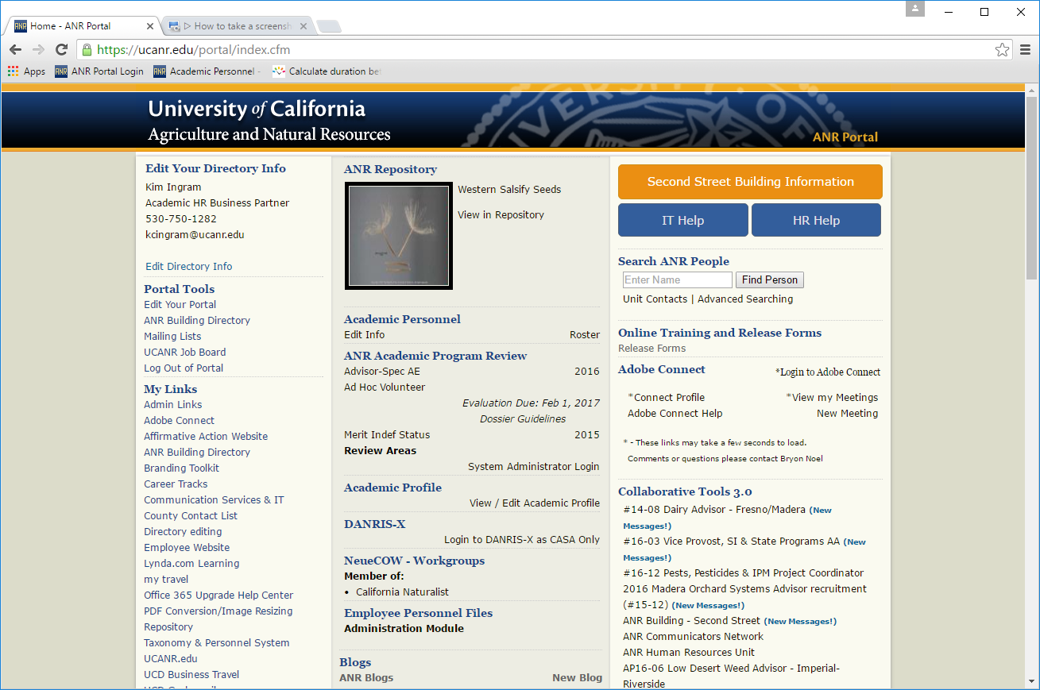

Slide 13
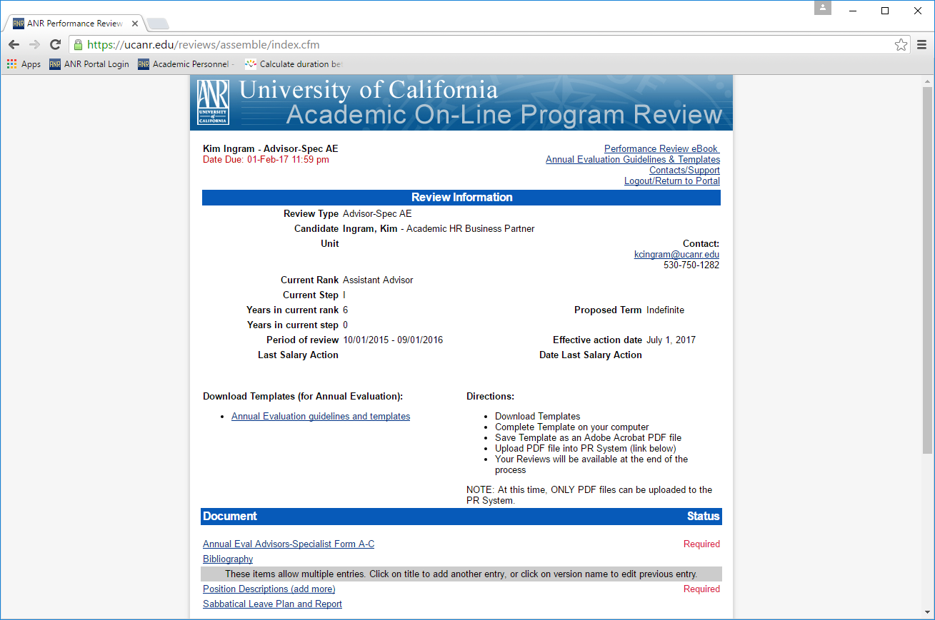

Slide 14
Position Description Discussion
Name, Position Title, Effective Date
Purpose and Clientele
Academic Program Major Responsibilities
Administrative Duties (Program Leadership & Business Operations Duties)
Leadership
Administration
Budget
Local Delivery of Statewide Programs
Interpersonal Relationships
Academic, Research and Administrative Staff
Affirmative Action
Relationships
Qualifications
For the template go to http://ucanr.edu/academicpersonnel
The position description is required as part of the Annual Evaluation Process.

Slide 15
Annual Evaluation Template
Section A – Self Assessment
Program Summary Narrative Section A – 6 Page Limit
Statement of Assignment (you can retrieve this information from DANRIS-X (Advisors/CE Specialists).
Changes in responsibilities (if applicable).
Programmatic Assignment of FTE - ANR knowledge area (FTE).
Extending Knowledge and Information/Applied Research and Creative Activity – describe major themes and goals of programs and the accomplishments and evidence of impact in past year.
Professional Competence and Activity/University and Public Service: 1-2 paragraph summary further supported by tables in Section B.
Affirmative Action: 1-2 paragraphs highlighting specific efforts and accomplishments.

Slide 16
Program Summary Narrative
In General
Describe major themes and goals of your programs.
Describe your accomplishments in meeting last year’s goals.
Refer to your Project Summary and Extension Activities tables while writing this section. You do not need to duplicate the information included in your tables.
Organize your program descriptions by themes.

Slide 17
Program Summary Narrative-Emphasis
CE Advisors and CE Specialists:
Research, extension and creative activity
Performance in extending knowledge and information.
Performance in applied research and creative activity.
Academic Coordinators:
Coordination of academic programs
Academic Administrators:
Administrative experiences
Professional Researchers:
Independent research program/creative work
Specialists:
Research in a specialized area
Project Scientist:
Research/creative work

Slide 18
Section B
(to be completed as part of a full annual evaluation)
This section only includes tables. Fill in the “blanks” as applicable.
Project Summary Table
Extension Activities Table
Professional Competence & Activities Table
University & Public Service Table
Bibliography (Peer reviewed and non-peer reviewed publications developed during the year in review)
DANRIS-X AE retrieval populates most of these tables (for CE Advisors only)
Imports all relevant information that you entered into DANRIS-X
Link to the retrieval is in your portal or accessed from DANRIS-X Data Recap
Downloads AE template as a easily editable Word Document
DANRIS X (2015 Annual Report & CASA) closes October 28th @ midnight; 2016 AE retrieval will be available Nov. 2
Complete Guidelines at: http://ucanr.edu/annualevaluation

Slide 19
Section C - Goals (6 page limit)
Goals for Coming Year:
October 1, 2016-September 30, 2017:
Projects you intend to accomplish in the coming year, anticipated collaborators and anticipated outcomes.
What needs to be accomplished to advance
Barriers/ Obstacles in Accomplishing your Goals
Complete Guidelines at: http://ucanr.edu/annualevaluation

Slide 20
DANRIS-X AE Retrieval
Available November 2rd
Enter your information into CE Advisor DANRIS X 2015 Annual Report & CASA by Oct. 28th
Imports all relevant information that you entered into DANRIS-X into the AE template
Link to the retrieval is in your portal or accessed from DANRIS-X Data Recap
Downloads AE template as a easily editable Word Document to be uploaded to PR page
For Help Contact:
Chris Hanson: Christopher.Hanson@ucop.edu; 510-987-0628
Katherine Webb-Martinez: Katherine.Webb-Martinez@ucop.edu; 510-987-0029
DANRIS X Website: http://ucanr.edu/Danris-X

Slide 21
Section D
(Supervisor Evaluation)
Supervisors provide the academic an evaluation appraisal of Sections A, B, C (full evaluation), A, C (abbreviated) or C (goals):
Indicate areas the Academic is meeting expectations for his/her level in each of the advancement criteria.
Indicate areas of concern and suggestions for improvement.
Goals: Approve or make recommendations for revising goals.
Make recommendation for progress in terms of balance and productivity for rank and step and progress toward advancement.
Complete Guidelines at: http://ucanr.edu/annualevaluation

Slide 22
Organizing your Work into Themes
List all of your projects/programs first, and then group projects that target the same issue together. Each of these groups is a theme. You can look at these closely and identify the common goals, accomplishments and impacts.
You might use initiatives from the Strategic Vision (or challenges described in the Vision) for your themes, or refer to the Statewide Program, the Program Teams and/or workgroups you are affiliated with.

Slide 23
Theme Examples – Agricultural
My research and extension program is based on the major theme of interactions between plants and microorganisms. Because of my interest, training and experience with plant pathology, I focused my activities on three areas of plant-microbe interactions:
Pathogens of plants (summary of 16 projects)
Microbial ecology in strawberry (summary of 7 projects)
Foodborne pathogens and ecology of E. coli. (summary of 2 projects)
Sustainability and Viability of Agriculture:
Sustainable Food Systems
Science and Agriculture Literacy
Organic Crop Production
Ag Productivity, Efficiency and Sustainability
Waste Management

Slide 24
2 Separate Theme Examples 4-H YDA
Healthy Families and Communities Initiative (Advisor 1)
Promote Positive Youth Development
Support Adolescent Leadership Development
Volunteer Development
Increase Science Literacy Among Youth
Healthy Families and Communities Initiative (Advisor 2)
Life Skills
Adolescent Development
Extension Education
Science, Engineering and Technology
Administrative Leadership

Slide 25
Theme Examples - NFCS Advisor
I expanded the scope of my activities in research, extension, and creative activity while at the same time ensuring I was strategically positioning my administrative and programmatic efforts in ways that integrated the local county needs with the UC ANR Strategic Vision: human nutritional status, child obesity, food safety, and food security.
Healthy Families and Communities Initiative
Prevention of Childhood Obesity
Health Promotion
Consumer Food Safety
Food Security
Administrative Leadership

Slide 26
Theme Examples – Natural Resources
Sustainable Ecosystems Initiative
Sustainable Natural Ecosystems
Sustainable Natural Resources
Water Quality, Quantity and Security
Water Conservation and Irrigation Quality
Example of a more narrowly focused Natural Resources Theme(s)
Landscape Management
Wildland/Urban Interface
Wildfire Education

Slide 27
Tips for Writing your AE
Make sure you highlight your activities that support UC ANR visibility and effectiveness such as:
Successful collaborations (Internal and external).
Mentoring of colleagues (formal and informal).
Efforts to strengthen the UC ANR network (formerly called the “continuum”).
Multi-county and/or multi-program assignments.
Leadership roles and advocacy efforts.
Highlight innovative extension methods.
Only list activities and accomplishments in one place in the document (i.e. list on one table)

Slide 28
Guidance to Supervisors
Use the AE/Goals as formal feedback. Give it the same consideration you would give a PR.
Provide mentoring as a supervisor, and seek additional input, as necessary/appropriate with AHR input.
IMPORTANT - Review AE/Goals and meet early with academics.
This is especially critical for academics in the term review process and/or anyone that has not met expectations in the past.

Slide 29
Guidance to Supervisors
When writing your recommendation:
Prepare your letter with care – be clear, concise and constructive.
Evaluate academic against their position description and academic criteria for the given rank and step.
Discuss your evaluation with the academic.
Inform academic of your recommendation in writing before you upload it.

Slide 30
Guidance to Supervisors
Navigating towards positive change(s).
Developing shared goals.
Updating PDs, as needed.
Establishing periodic check-ins throughout the year, as needed.

Slide 31
Guidance to Academics
Uploading AE Verification Online
Academic checks the box on PR page if you have met with supervisor, discussed AE and goals (date will be displayed indicating you have done this)
Or there is the option for loading a: Divergent File/additional comments/disagreement with Supervisor comments
2 week deadline imposed for uploading this document after supervisor deadline has passed (Academic due date is April 3rd)
2 day grace period for Academic to delete/edit/reload divergent document
Email automatically sent to supervisor notifying them of document to review after expiration of grace period

Slide 32
Deadlines
Deadlines
Deadlines
Deadlines

Slide 33
Annual Evaluation Timeline: check dates
Steps | Due Date | Action
Annual Evaluation/Abbreviated AE/Goals Preparation For Full AE: Period October 1, 2015 - September 30, 2016 For abbreviated AE: Period as indicated through September 30, 2016 | February 1, 2017 | Completion and submission of Sections A,B,C of AE as applicable
Review of AE by Supervisor | March 20, 2017 | Supervisor meets with Academic and completes Section D

Slide 34
Desired Outcomes – AE Training
Did this training increase your understanding of the elements of the Annual Evaluation (AE)?
Did this training increase your knowledge of how the AE supports the thematic Merit/Promotion Dossier (PR)?
Did this training increase your understanding that we have a shared responsibility for the success of the AE as a performance evaluation tool?
Did this training increase your understanding of the importance of annual goals and frequent check-ins between academics and supervisor(s) to avoid surprises at merit/promotion time?

Slide 35
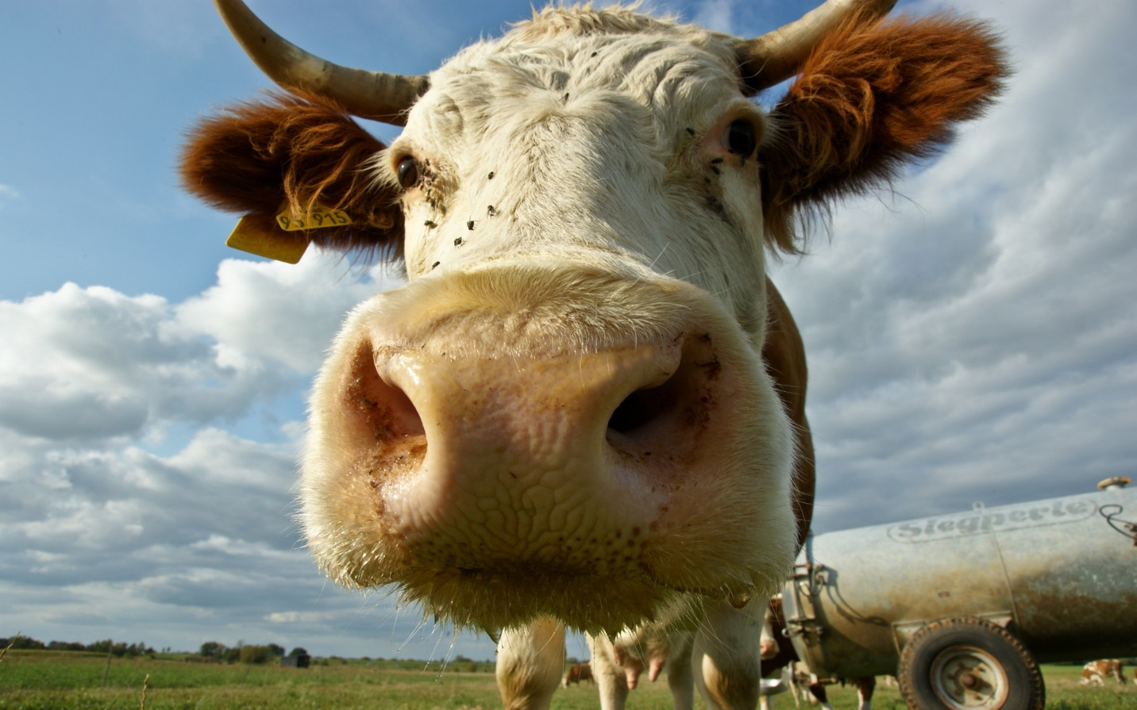
Questions??

