Slide 1
Training for NPI Academics
Fall 2016

Slide 2
ACADEMIC HUMAN RESOURCES
Tina Jordan
Academic Human Resources Manager
Karen Ellsworth, Analyst
Soo Hsieh, Analyst
Kim Ingram, Analyst
LeChe McGill, Analyst
For specific unit responsibilities, please visit our website at: http://ucanr.edu/academicpersonnel

Slide 3
Desired Outcomes
Increased understanding of the elements of the Annual Evaluation (AE/Goals).
Knowledge of how the AE supports the thematic Merit/Promotion Dossier (PR).
Understanding that we have a shared responsibility for the success of AE as a performance evaluation tool.
Understanding of the importance of annual goals and frequent check-ins between academics and supervisor(s) to avoid surprises at merit/promotion time.
(continued next slide)

Slide 4
Desired Outcomes (continued)
Increased understanding of the components of the Program Review for each title series
Utilizing the 13/24 month option
Criteria for an acceleration
Reappointment guidelines submitted to Academic HR

Slide 5
Agenda
Process Guide
Benefits of Annual Evaluations
Recent Changes to the AE
General Directions
Guidance
The AE Template
“Themes” and Examples
Tips for Writing Your AE
Guidance for Supervisor
Guidance for online AE Verification for Academics
Timeline
Merit and Promotion Criteria for each title series
Acceleration Criteria
Reappointment Requirements
Questions

Slide 6
Annual Evaluations (AE)

Slide 7
Process Guide
Annual Evaluation – Academic → Supervisor/
No higher level review
Academics affiliated with a statewide program (such as NPI) may receive input from the appropriate statewide director.

Slide 8
Benefits of the Annual Evaluation
Creates a transparent system where academics know clearly what is expected of them throughout the performance cycle not just at the end of two or three years.
Provides opportunity to “shift gears” to meet emerging priorities.
Provides a context for academic’s work within the strategic vision and/or other identified program priorities for the coming year.
Positions academics for writing their Program Review.

Slide 9
Recent Changes to the AE
Academics who have been appointed more than 6 months will use the full template for their Annual Evaluation (Sections A, B and C).
Academics who have served less than 6 months will use the abbreviated template for their Annual Evaluation (Sections A and C).
Academics who begin after the fiscal review period ending September 30th will be assigned goals only.
All documents related to the AE must be uploaded as pdfs.
Reminder: AE/goals due February 1, 2017, (same date as merits and promotions).

Slide 10
General Directions
For a Full Annual Evaluation, include work from:
October 1, 2015 through September 30, 2016.
In completing an Abbreviated AE, include work from:
Start date through September 30, 2016.
Section A: Program Summary Narrative limited to 6 pages.
Bibliography: You are only required to include only those publications developed during the period under review and not previously reported.

Slide 11
AE Template & Guidelines
Templates and Guidelines will be available on your Academic Online Program Review page (top right). When you “click” the AE link, it takes you to the Academic Personnel Annual Evaluation information found at:
http://ucanr.edu/aeguidelines (or go directly to this link for all annual evaluation templates and guidelines).
There are two AE templates for all academic titles. If you have served longer than 6 months – use the full template (sections A-C). If you have served less than 6 months – use the abbreviated template.
Abbreviated Template only utilizes Section A (program summary narrative -work performed to date) & Section C (goals).
If you began after September 30th – use Section C- goals only.

Slide 12
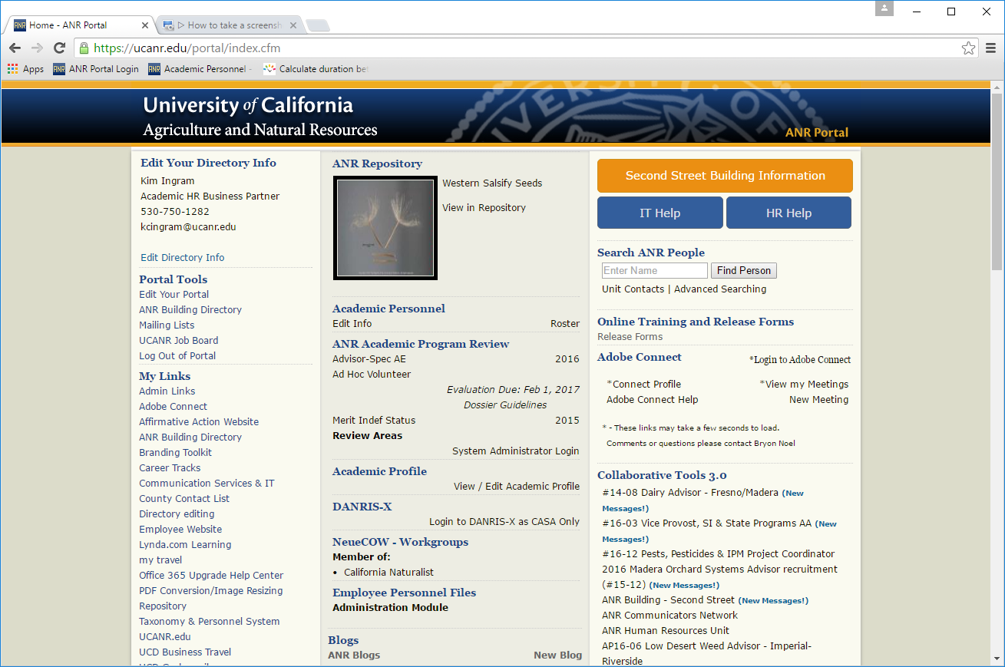

Slide 13
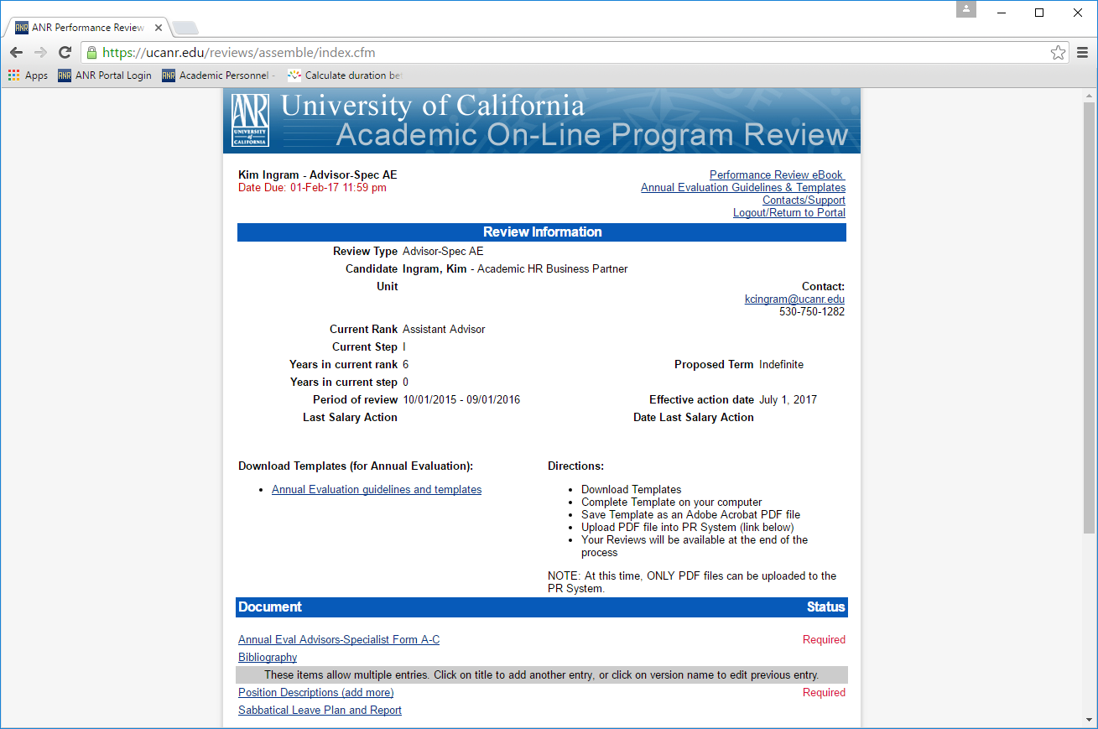

Slide 14
Position Description Discussion
Name, Position Title, Effective Date
Purpose
Academic Program Major Responsibilities
Administrative Duties if applicable (Program Leadership & Business Operations Duties)
Leadership
Administration
Budget
Local Delivery of Statewide Programs
Interpersonal Relationships
Academic, Research and Administrative Staff
Affirmative Action
Relationships
Qualifications
For the template go to http://ucanr.edu/academicpersonnel
The position description is required as part of the Annual Evaluation Process.

Slide 15
Annual Evaluation Template
Section A – Self Assessment
Program Summary Narrative Section A – 6 Page Limit
Statement of Assignment
Changes in responsibilities (if applicable).
Programmatic Assignment of FTE - ANR knowledge area (FTE).
Academic Coordinators: Emphasize your coordination of academic programs.
Professional Researchers: Emphasize your independent research program/creative work.
Project Scientists: Emphasize your research/creative work.
Research Specialists: Emphasize your performance in research in specialized areas.
Professional Competence and Activity/University and Public Service: 1-2 paragraph summary further supported by tables in Section B (if applicable)
Affirmative Action: 1-2 paragraphs highlighting specific efforts and accomplishments.

Slide 16
Program Summary Narrative
In General
Describe major themes and goals of your programs.
Describe your accomplishments in meeting last year’s goals.
Refer to documenting lists and tables in Section B while writing this section. You do not need to duplicate the information included in your tables.
Organize your program descriptions by themes.

Slide 17
Section B
(to be completed as part of a full annual evaluation)
This section only includes tables. Fill in the “blanks” as applicable.
Project Summary Table
Extension Activities Table (optional)
Professional Competence & Activities Table
Not required for Assistant Rank in Research Specialist series
University & Public Service Table
Not required for Assistant Rank in Professional Researcher series
Encouraged but not required for Project Scientists
Bibliography (Peer reviewed and non-peer reviewed publications developed during the year in review)
Complete Guidelines at: http://ucanr.edu/annualevaluation

Slide 18
Section C - Goals (6 page limit)
Goals for Coming Year:
October 1, 2016-September 30, 2017:
Projects you intend to accomplish in the coming year, anticipated collaborators and anticipated outcomes.
What needs to be accomplished to advance
Barriers/ Obstacles in Accomplishing your Goals
Complete Guidelines at: http://ucanr.edu/annualevaluation

Slide 19
Section D
(Supervisor Evaluation)
Supervisors provide the academic an evaluation appraisal of Sections A, B, C (full evaluation), A, C (abbreviated) or C (goals):
Indicate areas the Academic is meeting expectations for his/her level in each of the advancement criteria.
Indicate areas of concern and suggestions for improvement.
Goals: Approve or make recommendations for revising goals.
Make recommendation for progress in terms of balance and productivity for rank and step and progress toward advancement.
Complete Guidelines at: http://ucanr.edu/annualevaluation

Slide 20
Organizing your Work into Themes
List all of your projects/programs first, and then group projects that target the same issue together. Each of these groups is a theme. You can look at these closely and identify the common goals, accomplishments and impacts.
You might use initiatives from the Strategic Vision (or challenges described in the Vision) for your themes, or refer to the Statewide Program, the Program Teams and/or workgroups you are affiliated with.

Slide 21
2 Separate Theme Examples 4-H YDA
Healthy Families and Communities Initiative (Advisor 1)
Promote Positive Youth Development
Support Adolescent Leadership Development
Volunteer Development
Increase Science Literacy Among Youth
Healthy Families and Communities Initiative (Advisor 2)
Life Skills
Adolescent Development
Extension Education
Science, Engineering and Technology
Administrative Leadership

Slide 22
Theme Examples - NFCS Advisor
I expanded the scope of my activities in research, extension, and creative activity while at the same time ensuring I was strategically positioning my administrative and programmatic efforts in ways that integrated the local county needs with the UC ANR Strategic Vision: human nutritional status, child obesity, food safety, and food security.
Healthy Families and Communities Initiative
Prevention of Childhood Obesity
Health Promotion
Consumer Food Safety
Food Security
Administrative Leadership

Slide 23
Tips for Writing your AE
Make sure you highlight your activities that support UC ANR visibility and effectiveness such as:
Successful collaborations (Internal and external).
Mentoring of colleagues (formal and informal).
Efforts to strengthen the UC ANR network (formerly called the “continuum”).
Leadership roles and advocacy efforts.
Highlight innovative extension methods (if applicable).
Only list activities and accomplishments in one place in the document (i.e. list on one table)

Slide 24
Guidance to Supervisors
Use the AE/Goals as formal feedback. Give it the same consideration you would give a Program Review.
Provide mentoring as a supervisor, and seek additional input, as necessary/appropriate with Academic HR input.
IMPORTANT - Review AE/Goals and meet early with academics.
This is especially critical for academics who have term end dates and/or anyone that has not met expectations in the past.

Slide 25
Guidance to Supervisors
When writing your recommendation:
Prepare your letter with care – be clear, concise and constructive.
Evaluate academic against their position description and academic criteria for the given rank and step.
Discuss your evaluation with the academic.
Inform academic of your recommendation in writing before you upload it.

Slide 26
Guidance to Supervisors
Navigating towards positive change(s).
Developing shared goals.
Updating Position Descriptions is the responsibility of the academic. However, please work with the academic to update their PD if there are changes in their responsibilities and/or reporting authority.
Establishing periodic check-ins throughout the year, as needed.

Slide 27
Guidance to Academics
Uploading AE Verification Online
Academic checks the box on PR page if you have met with supervisor, discussed AE and goals (date will be displayed indicating you have done this)
Or there is the option for loading a: Divergent File/additional comments/disagreement with Supervisor comments
2 week deadline imposed for uploading this document after supervisor deadline has passed (Academic due date is April 3rd)
2 day grace period for Academic to delete/edit/reload divergent document
Email automatically sent to supervisor notifying them of document to review after expiration of grace period

Slide 28
Deadlines
Deadlines
Deadlines
Deadlines

Slide 29
Annual Evaluation Timeline: check dates
Steps | Due Date | Action
Annual Evaluation/Abbreviated AE/Goals Preparation For Full AE: Period October 1, 2015 - September 30, 2016 For abbreviated AE: Period as indicated through September 30, 2016 | February 1, 2017 | Completion and submission of Sections A,B,C of AE as applicable
Review of AE by Supervisor | March 20, 2017 | Supervisor meets with Academic and sumits Section D

Slide 30
Merit/Promotion Criteria

Slide 31
13 & 24 Month Option for Academics in their first term (Quick Snapshot)
With supervisor approval, an academic in their first term has the option to submit a PR packet for advancement after either 13 months of continuous employment (for those in two year terms, or 24 months (for those in three year terms).
Advantage: You advance one year earlier, and advance your term
Disadvantage: If you receive a negative outcome, you are not automatically guaranteed your term will be renewed. By choosing this option, your original term end date is not retained.
This is not an acceleration!

Slide 32
Merit for Academic Coordinators
Upload by February 1, 2017
Program Summary Narrative (6 page maximum)
Documents 3 criteria and Affirmative Action
Professional Competence Table since last successful salary action
University and Public Service Table since last successful salary action
Project Summary since last successful salary action
Extension Activity Table since last successful salary action (if applicable)
AE Goals for the coming year (section C of AE form)
Position Description for review period covered
Workplan if you have less than 100% appointment

Slide 33
Merit/Promotion for Professional Researchers & Project Scientists
Upload by February 1, 2017
Program Summary Narrative (6 page maximum for Merits, 10 page maximum for Promotion)
Documents criteria (Prof Research: Quality of research and creative work, professional competence, and University/ & public service; Project Sci: Significant/original/creative contributions, and professional competency) and Affirmative Action
Professional Competence Table since last successful salary action
University & Public Service Table since last successful salary action (except Asst. Rank in the Professional Research and Project Scientist series)
Bibliography since last successful salary action (merit) or Bibliography from entire career, highlight publications in present rank (Promotion, Step VI, Above Scale (AS). Annotate your role on multi-authored publications since last successful salary action
(3) Publication examples with summary (Promotion, Step VI, AS)
Letters of Evaluation (maximum of 6); (Promotion, Step VI, AS). You should input your list of names under the tab “references” in your PR document by January 17, 2017.
Project Summary Table since last successful salary action
AE Goals for the coming year (section C of AE form)
Position Description for period covered
Workplan if you have less than 100% appointment

Slide 34
Merit/Promotion for Research Specialists
Upload by February 1, 2017
Program Summary Narrative (6 page maximum for Merits, 10 page maximum for Promotion)
Documents criteria (Performance in research, professional competency, and University & public service) and Affirmative Action
Professional Competence Table since last successful salary action (except Assistant Rank)
University & Public Service Table since last successful salary action
Bibliography since last successful salary action (Merit)or Bibliography from entire career, highlight publications in present rank (Promotion, Above Scale (AS). Annotate your role on multi-authored publications since last successful salary action
(3) Publication examples with summary (Promotion, AS)
Letters of Evaluation (maximum of 6); (Promotion, AS) You should input your list of names under the tab “references” in your PR document by January 17, 2017.
Project Summary Table
AE Goals for the coming year (section C of AE form)
Position Description for period covered
Workplan if you have less than 100% appointment

Slide 35
Acceleration Criteria
Accelerated PR dossiers are prepared by candidates seeking an advancement that occur earlier than a normal review cycle. An acceleration represents exemplary efforts beyond what is typically accomplished. The dossier must clearly demonstrate evidence of exceptional achievement in at least one of the academic criteria:
Academic Coordinators
1) Administrative Performance/Programs Experience
2) Professional Competence and Professional Activity;
3) University and Public Service;
Research Specialist
1) Research in specialized area
2) Professional Competence and Professional Activity (optional for Assistant level)
3) University and Public Service
Professional Research
Independent Research Program/Creative Work
University Service (not required for Assistant Rank)
Professional Competence (Continued next slide)

Slide 36
Acceleration Criteria (continued)
Project Scientist
Research/creative work
Professional Competence
University Service (not required, however depends upon position description)
Additionally, productivity and progress in all two or three (as applicable) academic criteria should be greater than would normally be expected for the individual’s rank and step. An acceleration may be a merit or a promotion. Only Academics that have successfully completed their first term are eligible to seek an acceleration.

Slide 37
Accelerated Merit for All Academics
Upload by February 1, 2017
Acceleration Statement (1 page maximum)
Program Summary Narrative (6 page maximum)
(*except Professional Research & Project Scientist Step VI, AS, or Research Specialist AS)
Professional Competence Table since last successful salary action
Except Assistant Rank in the Research Specialist series
University and Public Service Table since last successful salary action
Except Professional Researcher Assistant Rank, and Project Scientist
Project Summary Table since last successful salary action
Extension Activity Table since last successful salary action (optional)
*Professional Research & Project Scientist Step VI, AS, or Research Specialist AS merits are allocated 10 pages for their program summary narrative as these are career reviews.
(continued next slide)

Slide 38
Accelerated Merit for All Academics (continued)
Bibliography since last successful salary action (except Academic Coordinators (optional). Annotate your role on multi-authored publications since last successful salary action
3 publications samples with summary
Letters of Evaluation (maximum of 6)
AE Goals for the coming year (section C of AE form)
Position Description for review period covered

Slide 39
Accelerated Promotion for All Academics (except Academic Coordinators)
Upload by February 1, 2017
Acceleration Statement (1 page maximum)
Program Summary Narrative (10 page maximum)
*Professional Competence Table since last successful salary action
*University and Public Service Table since last successful salary action
Project Summary Table since last successful salary action
Extension Activity Table since last successful salary action (optional)
Bibliography for “years” in the present rank (i.e. you are an Assistant and promoting to Associate). You must include all publications created when you held the Assistant rank. Annotate your role on multi- authored publications since last salary action.
*Professional Research Assistant Rank and Project Scientist are not required to submit University and Public Service; Research Specialist Assistant Rank are not required to submit Professional Competence
(continued next slide)

Slide 40
Accelerated Promotion for All Academics (except Academic Coordinators) (continued)
3 publications samples with summary
Letters of Evaluation (maximum of 6)
AE Goals for the coming year (section C of AE form)
Position Description for review period covered

Slide 41
Re-Appointment

Slide 42
Requirements for Re-Appointment
Fund verification form completed (utilizing most up to date salary scale)
Performance Evaluations:
Academic: for period since last Annual Evaluation
Supervisor: stating that the academic exceeds, meets or does not meet expectations.
Workplan for any academic working part time (less than 100% FTE)
If you anticipate any changes in funding that may lead to less than your stated FTE, it may trigger consequences in the reduction of work hours. Please plan ahead.

Slide 43
Desired Outcomes
Did this training increase your understanding of the elements of the Annual Evaluation (AE)?
Did this training increase your knowledge of how the AE supports the thematic Merit/Promotion Dossier (PR)?
Did this training increase your understanding that we have a shared responsibility for the success of the AE as a performance evaluation tool?
Did this training increase your understanding of the importance of annual goals and frequent check-ins between academics and supervisor(s) to avoid surprises at merit/promotion time?

Slide 44
Desired Outcomes
Did this training increase your understanding of the elements of the Program Review for your specific title series?
Did this training increase your understanding of the 13/24 month option available to those in their first term?
Did this training increase your knowledge of the necessary requirements to seek an acceleration?
Did this training clarify what is needed for a re-appointment?

Slide 45
Questions??

