Slide 1
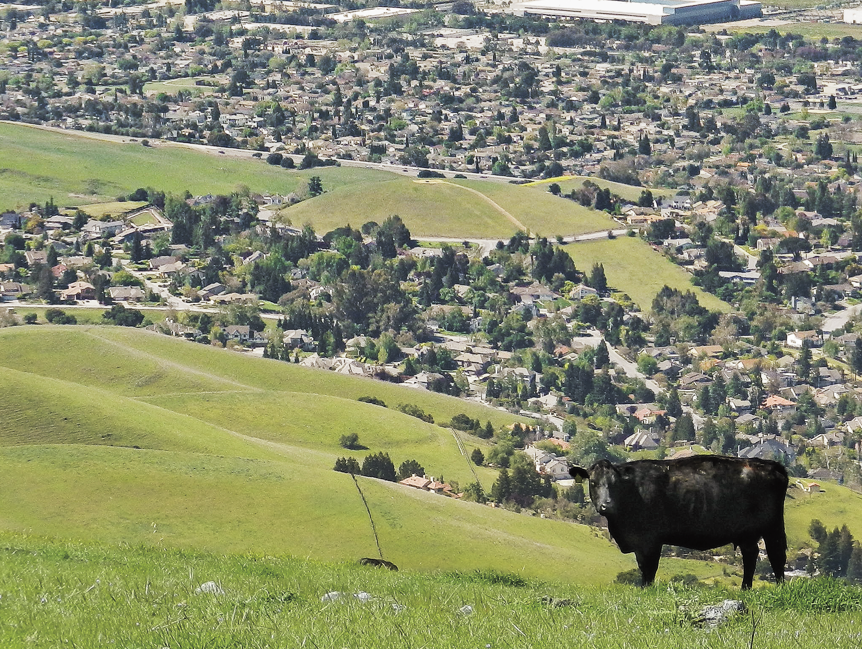
(Partial) Introduction to
Project Board
UC ANR Affirmative Action Office
Notes:
Hello, everyone and welcome to this not quite full introduction to Project Board.
This presentation will be dealing mainly with the Affirmative Action or Civil Rights reporting requirements of Project Board, although we will also cover many other aspects of your contact reporting responsibilities.

Slide 2

Topics & Outcomes
Participants will have an understanding of . . .
What is Affirmative Action?
  → Goals of Affirmative Action
Civil Rights: Why & Wherefore
What is Program Compliance?
Who is Your Potential Clientele?
→ What is Project Board Civil Rights reporting?
→ Why do we collect racial data?
→ What is All Reasonable Effort?
→ What is parity of participation?
Notes:
Here are our goals for today’s presentation. At the end you should have a clear idea of what Affirmative Action is and what the goals of Affirmative Action are here in ANR.
We will discuss why there is a civil rights reporting component within Project Board and the requirements of it. We will touch on the components of program compliance and briefly look at determining who your potential clientele should be.
We have over thirty slides to get through . . . seems like a lot, but compared to plowing forty acres with a mule, it’s not so bad.

Slide 3
Overview of Affirmative Action
Established by the federal government in 1965 through an executive order signed by President Lyndon Johnson
Designed to eliminate the present effects of past discrimination, such as the underrepresentation of minorities and women; and, in addition, to encourage the employment of veterans and persons with disabilities.
Valuing inclusion and diversity to guide educational programming for our clientele.
Implement the ANR Core Values as an expression
of support for the goals of Affirmative Action.
Notes:
Let’s start with a quick overview of Affirmative Action.
Affirmative Action is an outgrowth of the Civil Rights Act of 1964. It was established in 1965 by an executive order signed by President Lyndon Johnson.
It was designed to eliminate the present effects of past discrimination against minorities and women. Later, it was expanded to encourage the employment of both veterans and persons with disabilities.
Today we look at Affirmative Action as the valuing of inclusion and diversity – and using these values as a guide to our educational programming for our clientele.
We will see in a later slide how the goals of Affirmative Action have informed even our UC ANR Core Values as well as the ANR Strategic Plan. You should see this as indicative of the high status with which UC and UC ANR holds the principles of non-discrimination, the prevention of all forms of harassment (including sexual harassment) and the ideals of affirmative action – both in our CE programs and in the workplace.

Slide 4

National Institute of Food and Agriculture (NIFA)
The Food, Conservation, and Energy Act of 2008 (the 2008 Farm Bill) authorized the creation of NIFA.
NIFA provides leadership and funding for programs that advance agriculture-related sciences through partnerships with the Land-Grant University System and their extension programs.
NIFA is a federal agency within the United States Department of Agriculture (USDA) — is part of USDA’s Research, Education, and Economics (REE) mission area. The agency administers federal funding to address the agricultural issues impacting people’s daily lives and the nation’s future.
Notes:
When we’re talking about Project Board, we are talking, in part, about the UC ANR’s web-based contact reporting system. We have a contact reporting system because the USDA a long while ago had requested each land grant university create such a system.
Now which agency is really monitoring our contact reporting? It’s NIFA. The National Institute of Food and Agriculture. Here are some bullet points that explain what NIFA is and what it does.
1) The Food, Conservation, and Energy Act of 2008 (the 2008 Farm Bill) authorized the creation of NIFA.
2) NIFA provides leadership and funding for programs that advance agriculture-related sciences through partnerships with the Land-Grant University System and their extension programs.
3) NIFA is a federal agency within the United States Department of Agriculture (USDA) — is part of USDA’s Research, Education, and Economics (REE) mission area. The agency administers federal funding to address the agricultural issues impacting people’s daily lives and the nation’s future.

Slide 5

Program Access (Barriers)
NIFA CIVIL RIGHTS REVIEW AREAS OF CONCERN/INTERESTS
Quantity and quality in the collection and reporting of Extension and Research program and workforce race/ethnicity and gender data.
Racial/ethnic and gender composition of academic workforce, staff workforce: any employees, volunteers that support Extension and Research.
Identifying potential workforce and program audiences.
Racial/ethnic and gender composition of committees and councils.
National Origin discrimination and Limited English Proficiency
Accessibility to the disabled and public notification for accommodation.
Notes:
What is NIFA interested in when they come here to give UC ANR a civil rights audit?
Here are some bullet points of their areas of interest. You see in the first bullet that they are not interested ONLY in the actual Cooperative Extension (CE) programs . . . they are ALSO interested in the diversity of the ANR workforce – both academic AND staff.
In short, they are interested in Equal Opportunity both in program access and in the area of employment. Note the bullet points that touch on not only race but national origin, and the disabled, as well.
1) Quantity and quality in the collection and reporting of Extension and Research program and workforce race/ethnicity and gender data.
2) Racial/ethnic and gender composition of academic workforce, staff workforce: any employees, volunteers that support Extension and Research.
3) Identifying potential workforce and program audiences.
4) Racial/ethnic and gender composition of committees and councils.
5) National Origin discrimination and Limited English Proficiency
6) Accessibility to the disabled and public notification for accommodation.

Slide 6
CODE OF FEDERAL REGULATIONS (CFR)
7 CFR part 15 —Nondiscrimination on the basis of race, color, or national origin.
7 CFR part 15, Subpart A —“Nondiscrimination in Federally-Assisted Programs of the USDA—Effectuation of Title VI of the Civil Rights Act of 1964”
7 CFR part 15a.1 —“The purpose of this part is to effectuate Title IX of the Education Amendments of 1972, Discrimination on the basis of Sex in any education program or activity receiving federal financial assistance…”
7 CFR part 15b—Nondiscrimination on the basis of HANDICAP in program or activities receiving federal financial assistance 7 CFR 15B.1 “The purpose of this part is to implement section 504 of the Rehabilitation Act of 1973 …{Also ADA Amendments Act of 2008}
45 CFR PART 90– Nondiscrimination on the basis of AGE in programs or activities receiving federal financial assistance (Health and Human Services)
28 CFR §42.104 (b)- A recipient may not on the ground of race, color or national origin.. “deny a person the opportunity to participate as a member of a planning or advisory body which is an integral part of the program.”
Notes:
Here is a list of the CFRs, the Codes of Federal Regulations, that outlaw particular discriminatory practices within any agency receiving federal money. There is one more CFR for us to look at on the next slide.
1) 7 CFR part 15 —Nondiscrimination on the basis of race, color, or national origin.
2) 7 CFR part 15, subpart A —“Nondiscrimination in Federally-Assisted Programs of the USDA—Effectuation of Title VI of the Civil Rights Act of 1964”
3) 7 CFR part 15a.1 —“The purpose of this part is to effectuate Title IX of the Education Amendments of 1972, Discrimination on the basis of Sex in any education program or activity receiving federal financial assistance…”
4) 7 CFR part 15b—Nondiscrimination on the basis of HANDICAP in program or activities receiving federal financial assistance 7 CFR 15B.1 “The purpose of this part is to implement section 504 of the Rehabilitation Act of 1973 …{Also ADA Amendments Act of 2008}
5) 45 CFR PART 90– Nondiscrimination on the basis of AGE in programs or activities receiving federal financial assistance (Health and Human Services)
6) 28 CFR Section 42.104 (b)- A recipient may not on the ground of race, color or national origin.. “deny a person the opportunity to participate as a member of a planning or advisory body which is an integral part of the program.”

Slide 7
CODE OF FEDERAL REGULATIONS (CFR)
(cont.)
7 CFR, Subpart A § 15.5, (b) “Each recipient (primary and other recipients) shall keep such records and submit to the Agency timely, complete, and accurate compliance reports at such times, and in such form and containing such information, as the Agency may determine to be necessary to ascertain whether the recipient has complied or is complying …”
“…have available for the Agency racial and ethnic data showing the extent to which members of minority groups are beneficiaries of federally assisted programs.” (Also reference USDA DR-4300-005)
Notes:
This CFR is of particular interest. It outlines why we collect clientele contact data. We do so in order to document “the extent to which members of minority groups are beneficiaries of federally assisted programs.”
1) 7 CFR, Subpart A Section 15.5, (b) “Each recipient (primary and other recipients) shall keep such records and submit to the Agency timely, complete, and accurate compliance reports at such times, and in such form and containing such information, as the Agency may determine to be necessary to ascertain whether the recipient has complied or is complying …”
“…have available for the Agency racial and ethnic data showing the extent to which members of minority groups are beneficiaries of federally assisted programs.” (Also reference USDA DR-4300-005)

Slide 8
Goals of Affirmative Action
To assure nondiscrimination and equal opportunity in hiring practices and in the workplace
To expand access to people from traditionally underrepresented groups with outreach activities
Promote nondiscrimination and valuing of differences among staff and clientele
Value inclusiveness and diversity
Notes:
Let’s look at the Goals of Affirmative Action in your academic role.
As an academic you will assure nondiscrimination and equal opportunity in your program outreach and activities.
You will expand access to people from underrepresented groups with your outreach activities. Suggested methods of outreach will be reviewed in upcoming slides.
As an academic you will promote nondiscrimination in your program planning, outreach and program activities in ways that will be inclusive, and that will value differences among your clientele.
Your commitment to nondiscrimination and inclusion will allow you to reflect the ANR Core Values in your work with clientele as well as your interactions with the staff in your workplace. We’ll take a look at the ANR Core Values in our next slide.

Slide 9
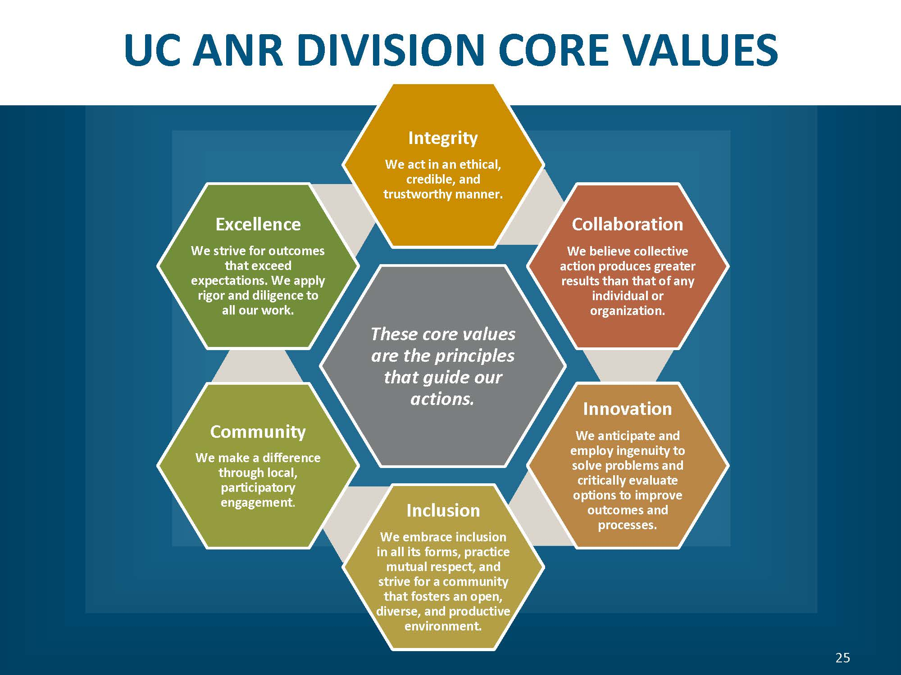

Goals of Affirmative Action
To assure nondiscrimination and equal opportunity
To expand access to people from traditionally underrepresented groups with outreach activities
Promote nondiscrimination and valuing of differences among staff and clientele
Value inclusiveness and diversity.
Notes:
Here’s the graphic representation of the ANR Core Values.
These core values are the principles that guide our actions.
The ANR Core Values embrace not only inclusion but also integrity (we act in an ethical, credible, and trustworthy manner), collaboration (we believe collective action produces greater results than that of any individual or organization), excellence (we strive for outcomes that exceed expectations. We apply rigor and diligence to all our work), innovation (we anticipate and employ ingenuity to solve problems and critically evaluate options to improve outcomes and processes) and community development (we make a difference through local, participatory engagement).

Slide 10

ANR’s Strategic Plan –
Public Value Statements
UC ANR: Promoting economic prosperity in California
UC ANR: Developing a qualified workforce for California
UC ANR: Safeguarding abundant and healthy food for all Californians
UC ANR: Protecting California’s natural resources
UC ANR: Building climate-resilient communities and ecosystems
UC ANR: Promoting healthy people and communities
7. UC ANR: Developing an inclusive and equitable society
Notes:
The ANR Public Value Statements derive from the ANR Strategic Plan and are short statements that articulate both the value and the goals of our work in Cooperative Extension. Number 7, in particular, addresses indirectly the intent behind the Civil Rights Act of 1964 . . . to have an equitable and inclusive society is to eliminate the present effects of past discrimination against minorities and women. The Civil Rights Reporting component in Project Board, by our embracing of non-discrimination and inclusion, is one small step that UCANR takes toward that goal.
ANR Public Value Statements: 1) Promoting economic prosperity in California; 2) UCANR: Developing a qualified workforce for California; 3) Safeguarding abundant and healthy food for all Californians; 4) UCANR: Protecting California’s natural resources; 5) Building climate-resilient communities and ecosystems; 6) UCANR: Promoting healthy people and communities 7) Developing an inclusive and equitable society.

Slide 11
Assure Nondiscrimination with
Federal and/or California Laws
—discrimination prohibited on the basis of:
Race/Ethnicity
Color
Gender (sex/gender identity)
Medical Condition
Disability (physical or mental)
Religion
National Origin
Ancestry
Age
Sexual Orientation
Pregnancy
Marital or Parental Status
Veterans
Genetic Information
Notes:
What overview of Affirmative Action or Civil Rights compliance is complete without a list of the protected categories? This slide presents the protected categories.
The Federal and California laws prohibit discrimination in extending your program and in hiring practices on the basis of any of these categories . . .
Race/Ethnicity Ancestry
Sexual Orientation Age
Pregnancy Marital or Parental Status
Veterans Genetic Information
Color Gender (sex/gender identity)
Medical Condition Disability (physical or mental)
Religion National Origin
Veterans Genetic information

Slide 12

Project Board’s Civil Rights Reporting Why & Wherefore
Notes:
Now we will look at why we do civil rights reporting.

Slide 13
Why do Civil Rights Reporting?
The following USDA requirement receives its scope, in part, from Code of Federal Regulations, Title 7: Agriculture, Subtitle A: Office of the Secretary of Agriculture, Part 15A
“Each agency that administers programs . . . will develop a system for establishing base data that identifies eligible populations and measures delivery of program benefits in order that the quantity and quality of benefits and services delivered to minority individuals can be documented and compared to benefits delivered to nonminority individuals . . .”
Ultimately, Project Board’s Civil Rights component is the documentation that ANR executes its CE mission with equality. . .that the “quantity and quality of benefits and services” is the same for both people of color and whites.
Notes:
We touched on this topic in an earlier slide. We do civil rights reporting in order to document “the extent to which members of minority groups are beneficiaries of federally assisted programs.”
The language in this slide is from an earlier reg and succinctly re-states this requirement. We identify a clientele, we establish a baseline for that clientele group, then we report the contacts made against that baseline because attendance/contacts allows – maybe not a perfect – but at least some sort of measure that the delivery of program benefits and services to minorities is equal to the benefits being delivered to nonminority individuals. (Hence the importance of sign-in sheets – which we will talk about in a future slide.)
Then in the red font there at the bottom of the slide, I restate this requirement once again . . . because it’s important.
Ultimately, Project Board’s Civil Rights component is the documentation that ANR executes its CE mission with equality. . .that the “quantity and quality of benefits and services” is the same for both people of color and whites.

Slide 14
Why Do We Have to Collect Racial Data?
California courts have held that the collection of racial data to monitor for non-discrimination does NOT violate state law prohibiting the consideration of race, sex, or ethnicity in areas of public employment, public contracting, and public education.
In order to comply with the USDA requirement that the “. . . quantity and quality of benefits and services” is the same for both people of color and whites.
Notes:
Once more: why do we collect racial data?
Because, for one, it’s O.K. to do in California if it is being done to monitor for non-discrimination – which is exactly what we are doing in Project Board.
1) California courts have held that the collection of racial data to monitor for non-discrimination does NOT violate state law prohibiting the consideration of race, sex, or ethnicity in areas of public employment, public contracting, and public education.
2) In order to comply with the USDA requirement that the “. . . quantity and quality of benefits and services” is the same for both people of color and whites.

Slide 15
Why Do We Report Contacts?
Compliance with Federal and State Civil Rights Laws
Promote nondiscrimination and the valuing of differences among clientele
To move toward compliance by parity in program participation
What is Program Compliance?
Program Compliance or compliance with federal requirements is achieved
when 1) clientele contacts are in “Parity”; but if parity is not achieved, then 2) through establishing All Reasonable Effort (more on this later).
Notes:
O.K. we’re going to hammer away at this a little more:
Why do we have to report contacts? To comply with federal and state laws, to promote nondiscrimination and the valuing of differences among clientele and to measure our progress toward achieving full parity of participation.
Now let’s look at how program compliance is achieved.
A program can be in compliance in two ways. 1) your clientele contacts are in full parity (more on that later); OR, 2) you establish All Reasonable Effort (ARE) if you are not in parity (we’ll discuss this later, as well).

Slide 16
What is Parity?
Parity or ‘parity of participation’ is defined by the USDA as when the percentage of each minority group making up your actual contacts comes to within 80% of their percentage in the baseline. For example, if Hispanics make up 10% of your potential or baseline, then Hispanics should make up at least 8% of your actual contacts in order for your program to be in parity for Hispanics.
What is All Reasonable Effort?
All Reasonable Effort (ARE) is the utilization of at least three of four specific outreach methods (i.e. 1-Mass Media; 2-Newsletter/flyers; 3-Personal letters/emails; 4-Personal invitations) in order to expand access and move toward or maintain parity of participation.
Notes:
Here’s the definition of Parity. If your actual contacts come to within 80% of their percentage in the baseline, then your program is in parity. It has achieved parity of participation. We see an hypothetical example for Hispanics in this slide illustrating this point.
For example, if Hispanics make up 10% of your potential or baseline, then Hispanics should make up at least 8% of your actual contacts in order for your program to be in parity for Hispanics.
You establish All Reasonable Effort (ARE) by utilizing (at least one time) at least three of four specific outreach methods. (And there is no substitution allowed, you must use at least three of these four specific methods. You are free to use other methods not listed but in order to establish compliance by ARE you must use at least three of these four specific outreach methods.) Mass Media / Newsletter or flyers / personal letters or personal emails to specific individuals / personal invitations – either face-to-face or by phone.

Slide 17
Who is Your Potential Clientele?
Your PVA & PD should provide key information on who your position is intended to serve. Then work with your county director and program colleagues to fine tune this and discover additional groups who may also become potential clientele
Learn about the demographics of your clientele group(s) by viewing US Census, Ag Census, Ag Commissioner’s Report, local data and local knowledge
  Ask who would be interested in or benefit from your educational program
  Consider the geographic area of your potential audience/clientele
Work with collaborators, agencies and stakeholders who represent and serve those protected classes/groups
Notes:
How do you identify your potential clientele?
Your PVA & PD (Position Description) should state who your position is intended to serve. That’s your starting point. Then, working with colleagues in the similar program areas and/or your County Director, you can fine-tune that to discover additional groups who could also benefit from your program. Once you define you clientele group or groups, then the fun begins.
As an academic it is important that you find the demographic breakdown of your clientele groups in your county or geographical area. Some programs can use the US Census. If you are in an agricultural program area you may want to check the Ag Census and Ag Commissioner’s Report. Feel free to use local data and local knowledge from individuals who have lived or worked in the area for a period of time – but remember to document any sources you use.
As an academic you should ask yourself who are those individuals who would be interested in or benefit from my educational program.
Another great source is the collaborators, stakeholders or even individuals from other agencies who serve or represent the protected or underrepresented groups you are trying to reach.
If you are unfamiliar with them, learn about the diverse cultures within the geographical area where you work.

Slide 18
Your AA Responsibilities…
Establishing Your Baseline
Define potential audience for each program
  Ask who are those individuals who would be interested in or benefit from your educational program
Learn about the demographics of your county by viewing US Census, Ag Census, Ag Commissioners Report, local data, and local knowledge
Work with partners and stakeholders who represent and serve those protected classes
  Where they live and work
  Their values and beliefs
  Their cultures.
Notes:
As an ANR Cooperative Extension Advisor, probably your chief – or at least pretty high up there – Affirmative Action responsibility is finding your baseline data.
We cannot determine if you’ve achieved parity if we cannot compare your actual contacts to a baseline. As important as establishing a baseline is, it is also important to get a good demographic breakdown of audience participants in any events you may hold. These make up your actual contacts and it’s vital to get a breakdown of race, gender and ethnicity of your audiences. If you have a formal sit-down event, you can have sign-in sheets that offer people an opportunity to self-identify their race, ethnicity and gender. If you’re having an open-house sort of thing with people flowing in and out throughout the day this is far more challenging. Even with a sit-down event people are free to decline to state but in both instances, (sit-down, formal or in-and-out open house-style) the USDA has stated that visual identification of audience make-up is fine. I’ll talk more about this important topic in a later slide.
Establishing your baseline: Ask who are those individuals who would be interested in or benefit from your educational program.
Learn about the demographics of your county by viewing US Census, Ag Census, Ag Commissioners Report, local data, and local knowledge.
Work with partners and stakeholders who represent and serve those protected classes 1) where they work; 2) their values and beliefs; 3) their cultures

Slide 19
Your AA Responsibilities cont.
All reasonable efforts to reach individuals who are representative of the cultures and ethnicities, genders and ages of your county/area
Move from ARE toward parity in program participation
Partner with groups, agencies and organizations to reach protected audiences you want to reach
Include people from protected groups on program planning committees, on survey lists and on research projects
Keep mailing and e-mail lists
Make personal contacts within protected or under-represented groups
Conduct meetings/trainings in facilities welcoming and accessible.
Notes:
Take a minute to read over these additional bullet points concerning your Affirmative Action responsibilities.
1) All reasonable efforts to reach individuals who are representative of the cultures and ethnicities, genders and ages of your county/area
2) Move from ARE toward parity in program participation
3) Partner with groups, agencies and organizations to reach protected audiences you want to reach
4) Include people from protected groups on program planning committees, on survey lists and on research projects
5) Keep mailing and e-mail lists
6) Make personal contacts within protected or under-represented groups
7) Conduct meetings/trainings in facilities welcoming and accessible.

Slide 20
Youth Development & NFCS Programs
and Project Board
4-H Advisors are NOT required to enter club or group Youth enrollments as contacts in Project Board.
NFCS Advisors in EFNEP are not required to enter their adult and/or youth participants as contacts in Project Board.
NFCS Advisors in UC CalFresh are required to enter their enrollees as contacts into Project Board.
All other NFCS programs ARE required to enter their contact numbers into Project Board.
Notes:
O.K. if you’re not a Youth Development or an NFCS Advisor these next few slides, for you, will be in the neighborhood of “getting into the weeds” of Project Board but I am asking your forbearance – it’s only for two slides, I promise.
If you are a 4-H Advisor, you are not required to enter youth enrollments as contacts into Project Board.
If you are an NFCS advisor in UC CalFresh or EFNEP and you’ve been an advisor for awhile who has already been entering your adult and/or youth participants in as contacts and are comfortable with your baseline, you may continue to do so.
However, all other NFCS advisors with programs NOT in UC CalFresh or EFNEP are required to enter their contacts into Project Board.

Slide 21
Youth Development & NFCS Programs
and Project Board cont.
NFCS Advisors in UC CalFresh or EFNEP who are not comfortable with their baseline data the State YFC Office and ANR AA will take your participation data, establish a standardized baseline and determine the compliance status of your program for you. Your county will be notified concerning the compliance status of your program.
All 4-H Advisors and NFCS Advisors are required to
e n t e r t h e i r O u t r e a c h (ARE) i n t o Project Board.
Notes:
If you are a newer NFCS advisor in UC CalFresh or EFNEP who is not comfortable with your baseline data, the Statewide YFC Office and the ANR AA Office will take your participation data, establish a standardized baseline and determine the compliance status of your program for you. Your county will be notified concerning the compliance status of your program.
4-H youth enrollments and UC CalFresh and EFNEP enrollments are all collected in systems outside of Project Board – and we are trying hard not to duplicate efforts.
However, these other systems are not collecting outreach data at all. Therefore, all 4-H advisors and all NFCS advisors are required to input their outreach into Project Board!

Slide 22
What is ARE Activity?
ARE is the things you do to encourage people to participate in your program. It is not synonymous with program delivery methods.
ARE can be targeted to reach underserved clientele in order to expand access.
ARE Efforts Compliment Good Extension Programs
Consider . . .
Press releases in local publications
Holding meetings in places people are comfortable going to
Identifying possible barriers to participation and seeking ways
to remove them
Find groups to co-sponsor meetings
Notes:
So to be clear that we’re all on the same page, let’s review, “What is ARE Activity?”
It’s what you do to encourage people to participate in your program. It is NOT synonymous with program delivery. You can also target your ARE to reach specific segments of your clientele baseline in order to expand access.
Good ARE efforts could or should include sending press releases to local publications, holding meetings in place were all people can feel comfortable; if you can identify barriers to participation, try and find ways to remove them; seek out other groups to co-sponsor meetings with as an aid to reaching wider segments of your clientele.
A R E Efforts Compliment Good Extension Programs
Consider . . .
Press releases in local publications
Holding meetings in places people are comfortable going to
Identifying possible barriers to participation and seeking ways to remove them
Find groups to co-sponsor meetings

Slide 23

Why Do We Care About
Affirmative Action?
Promote nondiscrimination and the valuing of differences among clientele.
To promote equality and equal opportunity.
To promote the widest adoption of best practices to the widest possible audience.
Note, affirmative action is a verb. You are reporting efforts!
Notes:
Why do we do ARE and why do we care about Affirmative Action?
To promote nondiscrimination and the valuing of differences among clientele.
We do it because we care about equality and equal opportunity.
This last bullet, to me, is Cooperative Extension in a nutshell: to promote the widest adoption of best practices to the widest possible audience. Therefore, we don’t want to leave anybody out.
Remember: affirmative action is a verb. You are reporting efforts.

Slide 24
Project Board and Your PR Connection
Your clientele will be the focus of your research and extension program.
Demonstrating extension efforts and impacts to your clientele groups is key to being successful in your merits and promotions.
To start, your PVA and PD should provide key information on what clientele groups your position is intended to serve – but usually only in broad, industry-wide terms. You should fine tune this information to discover additional groups (i.e. special niche or auxiliary industries) whose members could also benefit from your program.
PR Reviewers look to your position description, program summary narrative, and extension tables to determine if your program is serving your defined clientele.
Notes:
I’ll give you a couple minutes to read this slide. We’ve covered some this material in earlier slides but it’s good to go over it again as it relates directly with your PR – which ties in directly with establishing your baselines, which relates to determining your clientele group or groups . . .
Your clientele will be the focus of your research and extension program.
1) Demonstrating extension efforts and impacts to your clientele groups is key to being successful in your merits and promotions.
2) To start, your PVA and PD should provide key information on what clientele groups your position is intended to serve – but usually only in broad, industry-wide terms. You should fine tune this information to discover additional groups (i.e. special niche or auxiliary industries) whose members could also benefit from your program.
3) PR Reviewers look to your position description, program summary narrative, and extension tables to determine if your program is serving your defined clientele.

Slide 25
AA Documentation
Promotional material and program outreach
  News releases, radio spots, newsletters, flyers, other mass media
  Nondiscrimination statement on promotional materials
  Accommodation statement or icon
  Keep notes that demonstrate your outreach to underrepresented individuals/groups
Mailing lists
  Keep mailing and e-mail lists up to date
  Notation about race, ethnicity, gender
  Update frequently (12-18 months)
Assurance of Nondiscrimination Forms
Meeting sign-in sheets/documentation.
Notes:
O.K., we’re getting close to the end now. This next series of slides have to do with Frequently Asked Questions. For instance: the ANR AA Office is often asked what Affirmative Action Documentation should I keep?
You should keep for a period of three years, any documentation regarding any outreach or promotional activity that you did. Such as any PSAs or news releases sent to mass media outlets such as radio or television stations or newspapers. If you program cooperates with any non-governmental agency , for instance, if you use meeting space at, say, the Elks’ Club, you should have on file a signed Assurance of Nondiscrimination form from the Elks’ Club which states that they do not discriminate in their membership practices. These Assurance of Nondiscrimination letters should be updated every two years. (If you have any questions concerning the Assurance of Nondiscrimination letter, please contact the ANR Affirmative Action Office.)
Any outreach activities toward underrepresented groups that you do that is not related to mass media, keep some kind of documentation of such activity on file for three years. Keep snail mail and/ or email lists on file. Keep any Sign-in Sheets or other documentation you may have regarding audience attendance, also for three years. All this documentation can be kept in hard copy and filed in your office or as electronic copies and kept on your office computer.
Let’s talk a little more about Promotional activities in mass media:
On a case-by-case basis, other media including certain social media outlets such as blogs and Facebook posts may be considered as “mass media” and documentation about these should also be kept for three years.
Keep samples of any newsletters and flyers you send out for three years.
While we’re speaking of promotional and outreach materials -- you should include the nondiscrimination statement on any newsletters or flyers. The appropriate statement can be found on the ANR Affirmative Action website under the resource sidebar, or call the AA Office.
You should also include in these materials a solicitation for accommodation statement asking participants to contact you or your County Office if they need special accommodations. You can also use the wheelchair icon shown in an earlier slide. This icon indicates that your program or activity is accessible to individuals with disabilities – assuming your facilities actually are accessible, of course.
Your snail mail mailing list and/or your email mailing list should be updated regularly and as outlined in the third bullet under mailing lists it should be done every 12-18 months. It is important that you discuss with your county director the mailing or email list updating process used in your county or MCP unit.
Your mailing lists (snail or email) need to note the individuals’ race, ethnicity and gender, if possible. Your meeting sign-in sheets should offer people the opportunity to self-identify their gender, race and ethnicity. Self-identification is voluntary. No individual participating in UCCE programs is required to identify their gender, race/ethnicity in order to participate. We need the information in order to document for the federal government that ANR is supplying the benefits and services of CE to everyone who is interested without regard to their race or gender. If participants decline to self-identify, ANR still has a legal obligation to document that our CE programs are not discriminating. The USDA has o.k.’d the use of visual identification of audience make-up with regard to gender, race and ethnicity if we first offer an opportunity to self-identify and audience members subsequently decline to state. Take a head count of the audience. If fewer people self-identify than you have in your headcount, the USDA asks you to visually identify the race, gender and ethnic makeup of the rest of the audience. If half your audience declines to self-identify, you are asked to visually identify – yes, to guess – the makeup of the other half of the audience to the best of your ability. Why? I’m sure they’d love to take our word

Slide 26
FAQs
Are Cooperative Extension Academics required to conduct an Affirmative Action Program?
  Yes, the UCCE Academic is required to have AA as part of their program development/plans.
  AA was established by the federal government in 1965 and all agencies that receive federal funding, such as UCCE, are required to have in place an affirmative action plan that includes non-discrimination in hiring practices and equal access to programs.
Notes:
that we are not discriminating, but they’d rather see something on paper showing it. Even if it’s just a guess. Yes, some program clientele groups may have very, very few minorities in the potential. We understand this we’re just asking for your best guess about those who decline to self-identify. And we’re only asking you to do this on a total audience basis. We are not asking you to go back through the sign-in sheet and assign a race to those who did not self-identify. We are NOT asking you to do that. If 20 people attend your event and only 5 self-identify and they all self-identify as “white”, you have 15 other people to classify. If you think 3 of those people were African American, 2 probably Hispanic, and the rest (10 – to make up a total of 20) were probably white – that’s how you would describe the audience: 15 whites (5 self-identified); 3 African Americans; 2 Hispanics = 20. It is only a guess and it pertains only to that single event at that particular time. You are not “assigning” an official racial designation or gender to any particular person in any “official” way – none of this is going to appear on anyone’s “permanent record” – you’re just guessing about the racial makeup of your total audience at that time and place. Regarding “open house” type of events where people are coming and going, you can use visual identification only if you first offer people an opportunity to self-identify. Use your judgement; it may be too awkward or inconvenient to ask people during an open-house to self-identify. If that is the case, taking a rough head-count of all who dropped by can be used as personal efforts in ARE – where demographic information is not required – rather than as clientele contacts in the educational, programmatic sense. If you do give open-house participants an opportunity to self-identify and they decline to state, you may use visual identification and count those with whom you’ve had a significant educational exchange as clientele contacts. Again, please keep your sign-in sheets and/or estimates of open-house participants for a period of three years. I’ve expended a lot of effort on sign-in sheets because it’s important. If you have any questions, feel free to contact the Affirmative Action Office.
O.K., we have a few more frequently asked question slides:
Are Cooperative Extension Academics required to implement principals of Affirmative Action in their program?
Yes.
As a reminder Affirmative Action has federal civil rights law behind it and all agencies like UCCE that receive federal funding are required to maintain active nondiscrimination policies and practices in hiring and in access to educational activities.

Slide 27
FAQs
Must My CE Program be in Parity?
  Your program must meet Civil Rights Compliance
  Compliance can be met by achieving Parity or by All Reasonable Effort (ARE). The long term goal is to have your CE program in compliance through Parity
  Your program establishes ARE when you use at least 3 of 4 specific outreach activities to reach protected groups
    All available mass media
    Newsletters, promotional materials
    Personal letters/email/invitations
    Personal invitation (e.g. face-to-face).
Notes:
Must My CE Program be in Parity?
Your program must meet Civil Rights Compliance
Compliance can be met by Parity or by All Reasonable Effort (ARE). Your long term goal is to have your CE program in compliance through Parity and/or to maintain that parity.
If you are meeting compliance through ARE you must complete at least 3 of 4 specific outreach activities to reach underrepresented groups.
Those include:
Use all available mass media such as radio, TV, and newspaper.
The use of Newsletters (snail or email copy) and promotional materials or flyers to all your potential clientele.
Make contacts to underrepresented individuals through Personal letters or personal emails inviting them to participate in your programs, meetings, trainings, research and other UCCE activities.
And the fourth method is Personal invitation which is normally face-to-face but can also be done over the phone. The goal here is to inform clientele of your program and invite them to participate.

Slide 28
FAQs
How Do I Identify my Potential Clientele?
  Start with you PD, then consult your CD/Supervisor and other advisors in similar programs to discover additional clientele groups
  Ask: Who has interest in my program and who will benefit?
  Don’t forget the underrepresented or protected categories
  Learn about the demographics of your county/area by viewing data such as the US Census, Ag Census, local data and talking to knowledgeable individuals
  Get out and network
  Send a survey to potential clientele to see who is interested.
Notes:
How do you as an academic identify your Potential Clientele?
Your PVA and PD should provide key information on what clientele groups your position is intended to serve – but usually only in broad, industry-wide terms. You should fine tune this information to discover additional groups (i.e. special niche or auxiliary industries) whose members could also benefit from your program. You can consult with your County Director or colleagues in your program area in other counties for ideas.
Ask yourself Who has interest in and could benefit from my program?
Think about who in those underrepresented or protected categories would be interested in your program.
It is your responsibility as an academic to learn about the demographics of your clientele groups in your county/area by consulting whatever data you can find (i.e US Census, Ag Census, etc.)
We encourage you to get out and network with your colleagues, and other agency personnel who serve the underrepresented individuals you are trying to reach.

Slide 29
FAQs
Am I Limited to One Clientele Group?
  No, you are not limited to one clientele group, but you have to have at least one clientele group. However, if your clientele group is predominantly white and/or male, ANR strongly encourages you to identify an additional clientele group that may capture underrepresented peoples who are involved in some way with your program area but whom you may not have thought of as a distinct clientele group before. Assuming such a group of people exists, capturing them in another clientele group will help you more accurately reflect the demographics of your geographic area and increase the reach of your programmatic efforts and potentially help more people.
  Examples of Clientele Groups:
    Example: All owners, operators, managers of __ commodity
    Example: All PCAs
    Example: Agencies and organizations that work in__ commodity arena
    Example: Farm labors
Notes:
Am I Limited to One Clientele Group?
No, you are not limited to one clientele group.
You are required to have at least one clientele group. However, keep in mind that if your primary clientele group is predominantly white and/or male, ANR strongly encourages you to identify an additional clientele group that may capture underrepresented peoples who are involved in some way with your program area, perhaps in some niche industry, but whom you may not have thought of as a distinct clientele group before. Assuming such a group of people exists, capturing them in another clientele group will help you more accurately reflect the demographics of your geographic area and increase the reach of your programmatic efforts and potentially help more people.
Examples of Clientele Groups:
1) Example: All owners, operators, managers of __ commodity
2) Example: All PCAs
3) Example: Agencies and organizations that work in__ commodity arena
4) Example: Farm labors

Slide 30
FAQs
Do I need to input contact data into Project Board?
  YES. A few exceptions include programs, as listed below, that collect data in other systems:
  4-H Advisors are NOT required to enter club or group youth enrollments as contacts in Project Board.
  NFCS Advisors in UC CalFresh or EFNEP who have been entering adult and/or youth participants as contacts in Project Board (and are comfortable with their baseline data) may continue to do so. Those who have not been entering into Project Board or are not comfortable with their baseline the YFC statewide office and AA office will take your participant data, establish a standardized baseline and determine compliance status.
  All other NFCS programs not in CalFresh or EFNEP DO require their contact numbers to be entered in Project Board.
  All 4-H and NFCS Advisors are required to enter their ARE into Project Board.
  IPM Regional/County Advisors are required to enter contact and ARE numbers in Project Board.
Notes:
Do I Need to Input contacts into Project Board?
YES. Extension activities that include direct clientele contact and programmatic outreach (i.e. ARE activity) must be put into Project Board. There are some exceptions for certain programs that are required to collect contact data in outside systems . . . such as . . .
4-H Advisors are NOT required to enter club or group youth enrollments as contacts in Project Board.
NFCS Advisors in UC CalFresh or EFNEP who have been entering adult and/or youth participants as contacts (and are comfortable with their baseline data) may continue to enter these contacts. Those who have not been entering such contacts or are not comfortable with their baseline the YFC statewide office and AA office will take your participant data and establish a standardized baseline.
All other NFCS programs DO require their contact numbers entered in Project Board.
All 4-H and NFCS Advisors are required to enter their ARE activities into Project Board.
IMP Regional/County Advisors are required to enter contact numbers and ARE into Project Board.

Slide 31

Evaluation
County Director/MCP Director annually communicate with their advisors about their contact reporting in Project Board.
Measurable Goals: establish measurable goals such as moving toward full parity in your program.
AA Office annually reviews Project Board reports and monitors progress toward compliance/parity. Also, supplies compliance status of programs of advisors up for Merit/ Promotion to ANR Administrators.
Advisors should be comfortable defending their choice of clientele group(s) and the source of their baseline data should there be a federal audit.
Notes:
O.K., we’re almost at the end!
What’s measured gets done. (Or so it is said.) As part of the ANR evaluation process, your supervisor should meet with you annually and go over your contact reporting. A goal that any advisor can have is to either move their program into full parity or to maintain parity.
The ANR AA Office annually reviews contact and ARE activity and compiles a compliance history for each advisor. Are you in compliance by ARE or by parity? Or are you out of compliance? This information is supplied to ANR administration for all advisors going forward for Merit/ Promotion.
As a side note: Any advisor should be comfortable defending their choice of clientele group(s) and the source of their baseline.

Slide 32

The End
Notes:
We thank you for taking this training.

Slide 33
Questions? Contact . . .
David White
dewhite@ucanr.edu
530-750-1286
Affirmative Action Compliance & Title IX Officer
Project Board Affirmative Action policies and requirements and Title IX Investigator
Notes:
If you have any questions concerning your Affirmative Action or Civil Rights obligations, feel free to contact me, David White, the ANR Affirmative Action Analyst and Title IX Investigator
Thank you again for taking this training.

