Slide 1

Landscape trees & climate change: selection and management
With slides from
Dr. Larry Costello
UCCE emeritus
Dr. Joe McBride
Professor, UCB
Drs. Oki and Fujino
UC Davis
Igor Laćan
Urban Forestry Advisor
UCCE San Mateo/San Francisco
ilacan@ucanr.edu
510 684 4323

Slide 2
outline
We are discussing ornamental trees in residential landscapes;
NOT wildlands forests, timber plantations, agriculture, orchards!
Street trees & climate change study: what we learned from space-for-time substitution
…what do the study results suggest for individual landscapes
…and how to establish your trees and maintain them during the drought

Slide 3
basic ideas
warmer climate = challenge to trees and to management |  | but we still will be able to grow trees
mortality is unfortunate but normal |  | not an excuse for not (re)planting!
manage the factor(s) in tree loss (those that you can manage) |  | species selection? site conditions? management?
droughts will recur, perhaps more frequently |  | help your trees survive!

Slide 4
outline
We are discussing ornamental trees in residential landscapes;
NOT wildlands forests, timber plantations, agriculture, orchards!
Street trees & climate change study: what we can learn from space-for-time substitution
…what do the study results suggest for individual landscapes
…and how to establish your trees and maintain them during the drought

Slide 5
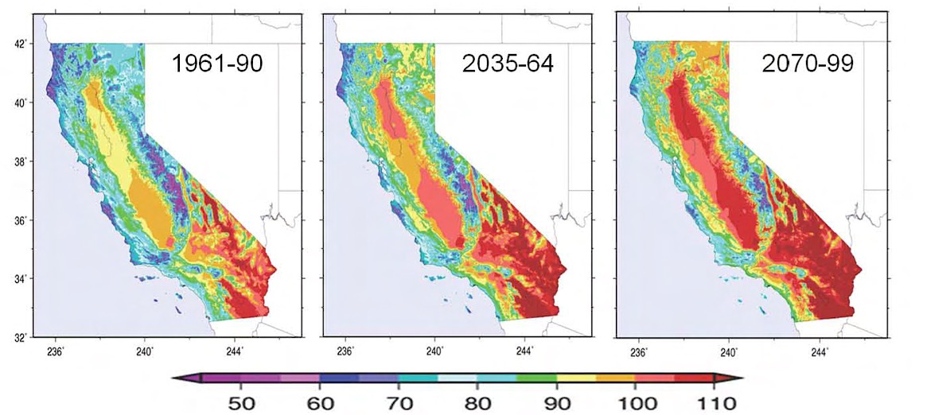
Temperature Patterns & Planning for the Future:
Street Trees and California’s Changing Climate
University Avenue, Palo Alto, CA
Joe R. McBride and Igor Lacan
Department of Landscape Architecture and Environmental Planning
and
University of California Cooperative Extension
University of California

Slide 6
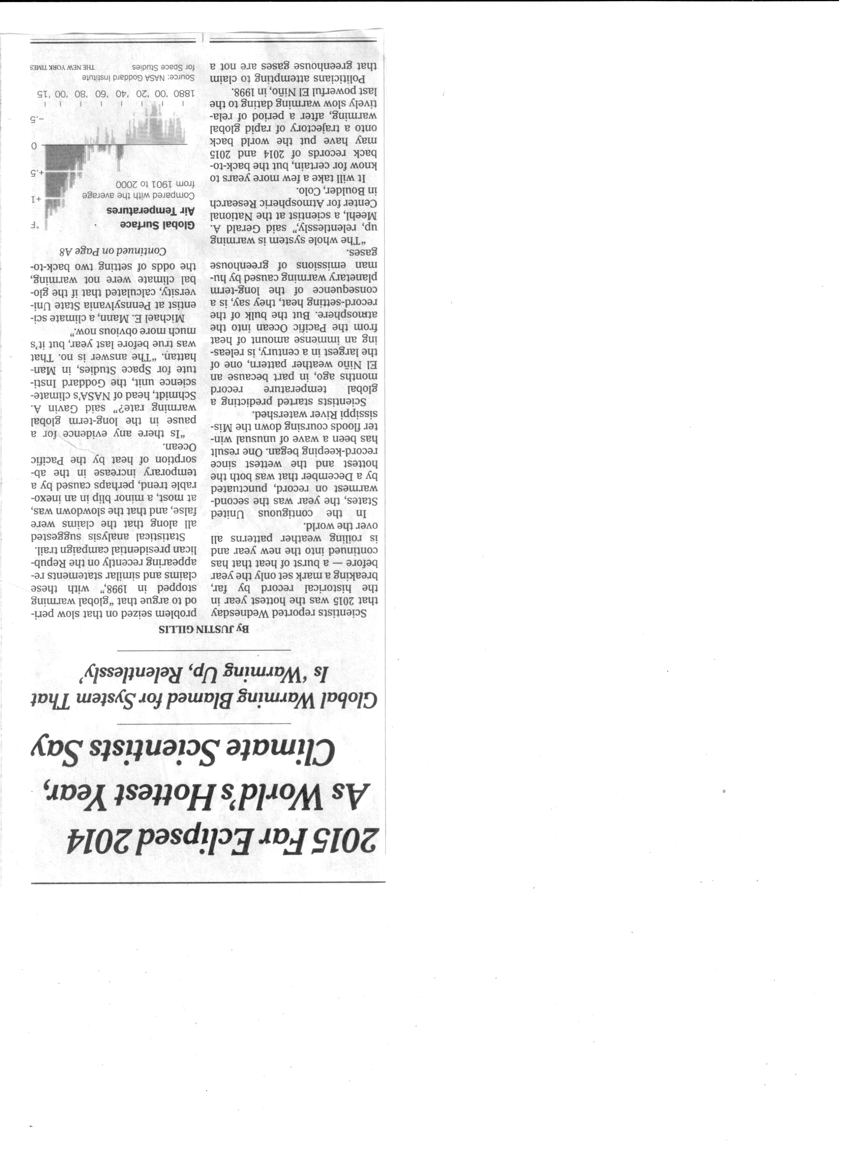
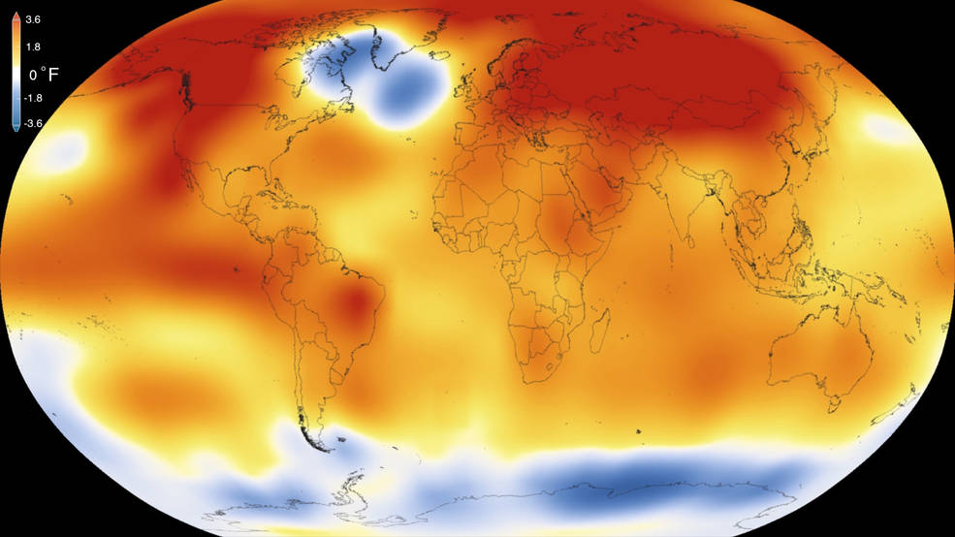
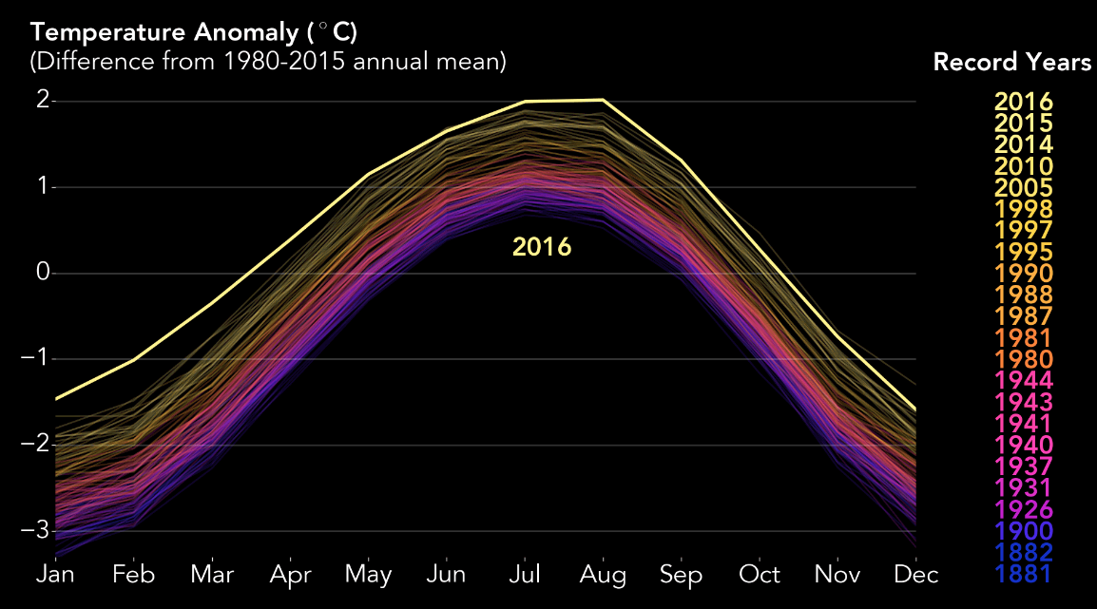
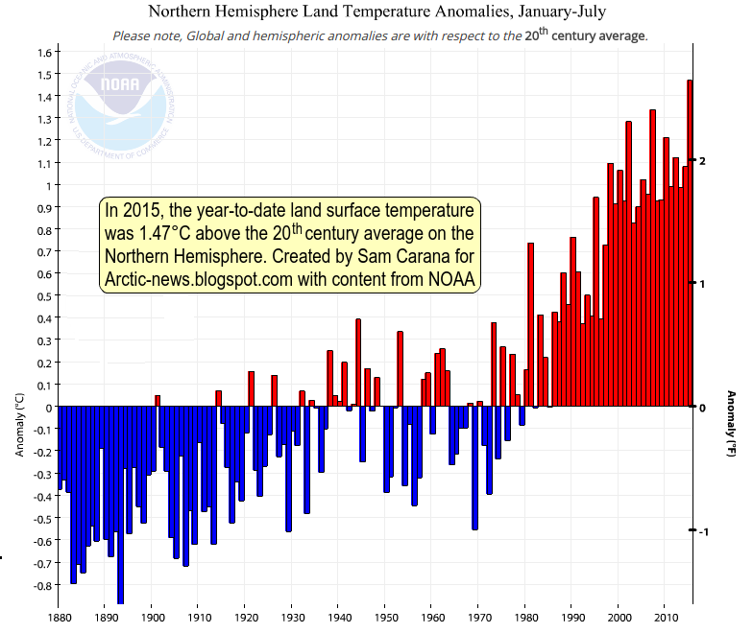
From: New York Times, Jan. 21, 2016

Slide 7
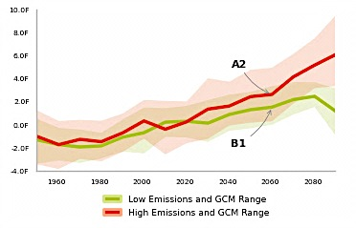
Problem Facing California’ Urban Forests
Increasing Temperature
from: Cal-adapt.org
Palo Alto, CA
July Ave. Max. Temperature (ºF)
Historic Predicted
78º 86º

Slide 8
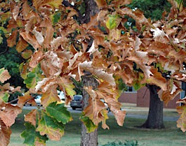
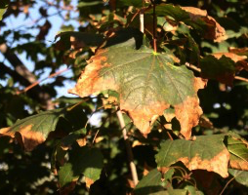
Heat Injury
Oak Maple
from: Michigan State University Extension (msue.anr.msu.edu)

Slide 9
Objective
To identify tree species in California cities that are
not expected to survive as the climate becomes warmer.

Slide 10
Method
Compare tree species composition
of “example” cities in each climatic zones of California
to the species composition
of cities that are currently as warm as the
example cities will be in 2100 (“warm cities”).
If any “example” city tree species
is currently absent from the “warm” city,
we shall conclude that it will not survive in the
“example” city as the climate becomes warmer.

Slide 11
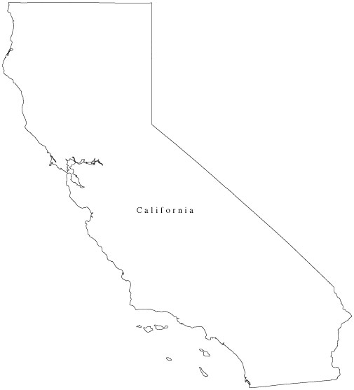
Example: Eureka
“substituting space for time”
Temperature ºF
Current Ave. Predicted Ave.
July Max. Temp. July Max.
Eureka 62 70
Berkeley 70
•
Eureka
•
Berkeley

Slide 12
Urban Forest Composition
A B C D
D C B A
Eureka Berkeley
“Example” city for Zone 1 “Warm” city
Conclusion: Street trees in Eureka will survive and perform well as the temperature becomes warmer.

Slide 13
Example: Fresno
“substituting space for time”
Temperature ºF
Current Ave. Predicted Ave.
July Max. Temp. July Max. Fresno 95 108
El Centro 106
•
Eureka
•
Berkeley
•
Fresno
•
El Centro

Slide 14
Urban Forest Composition
A B C D
C
A
Fresno El Centro
Example city for Zone 13 “Warm” city
Conclusion: Two of the common street trees in Fresno (B, D) will
not survive as the temperature becomes warmer.

Slide 15
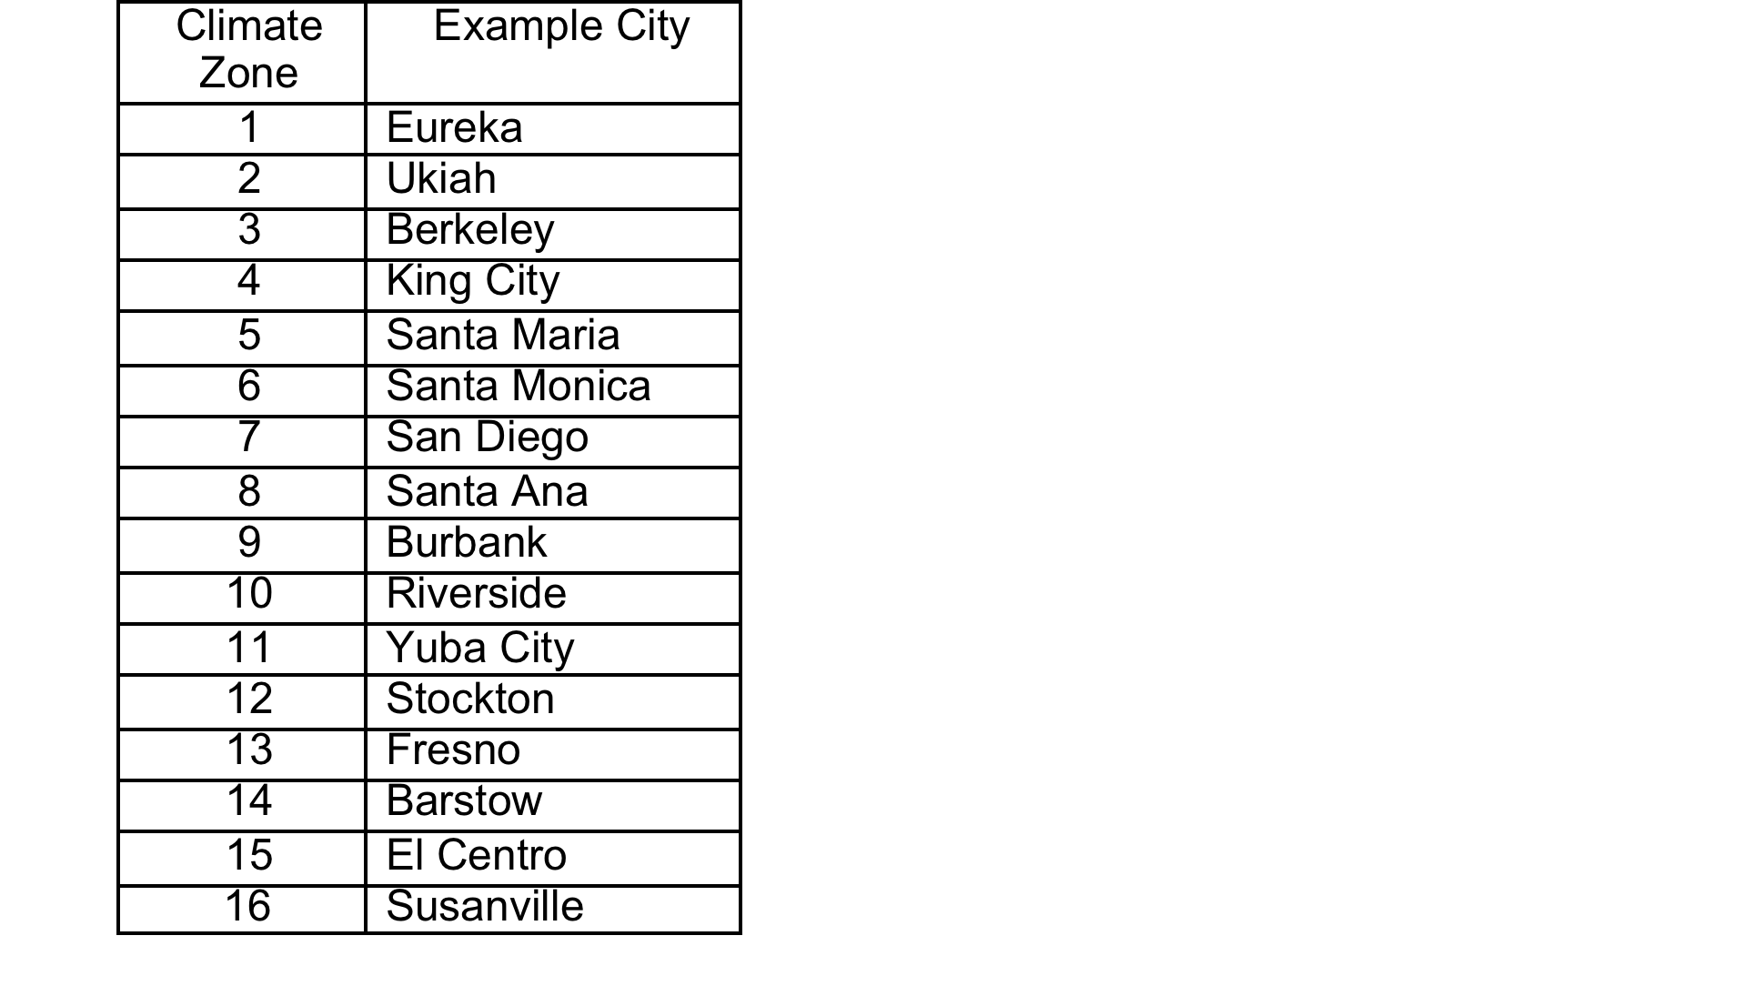
Cities Selected as Example Cities

Slide 16
Historic and Predicted July Average Maximum Temperatures
from: http://cal-adapt.org/temperature/annual/

Slide 17
Example City and “Warm” Cities

Slide 18
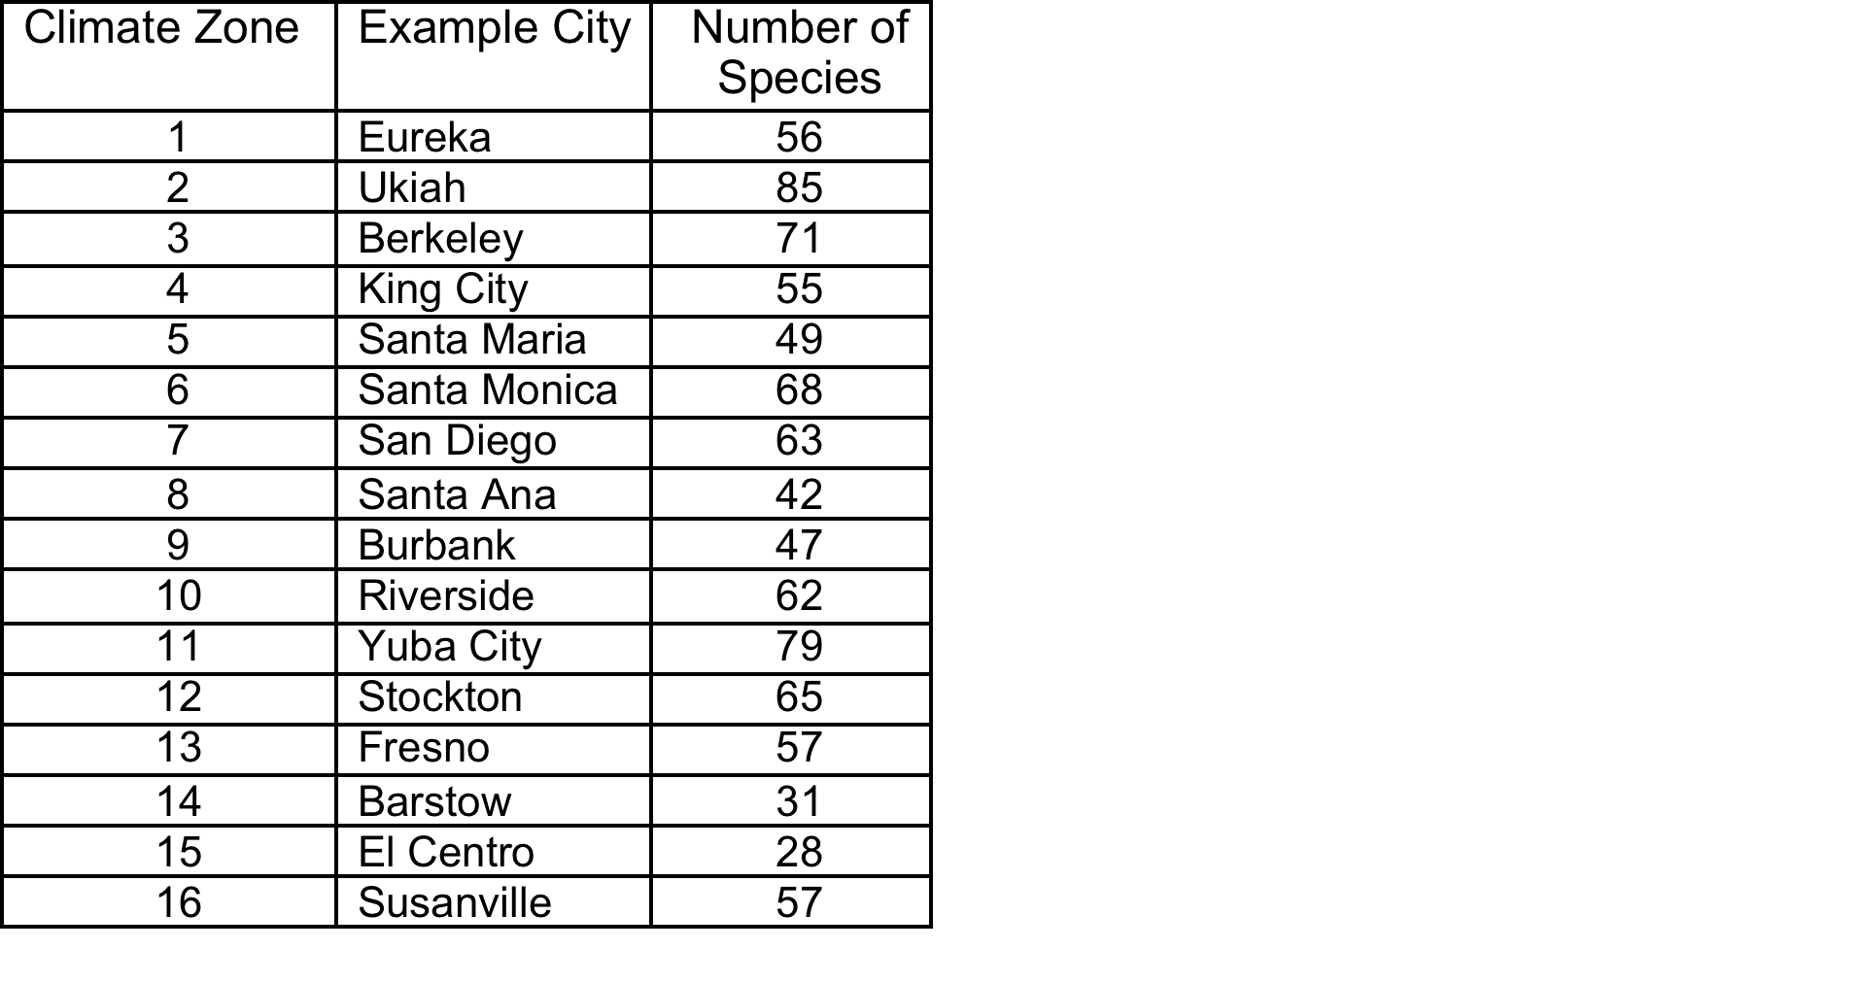
Number of Tree Species

Slide 19
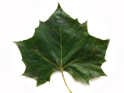
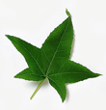




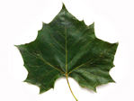



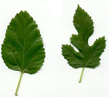
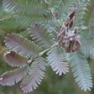

Most Common Species in the Example Cities
1
2
3
4
Purple Leaf Plum London Plane Tree Sweetgum London Plane Tree
5
6
7
8
Southern Magnolia Moreton Bay Fig Mexican Fan Palm London Plane Tree
9
10
11
12
Crape Myrtle Mexican Fan Palm Redwood London Plane Tree
13
14
15
15
16
Crape Myrtle White Mulberry Silver Wattle Siberian Elm

Slide 20
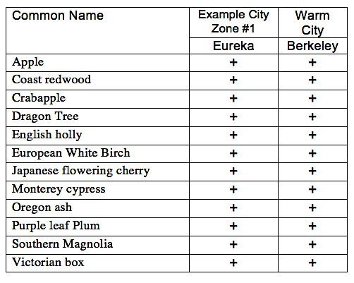
Common Eureka Street Trees and their Occurrence in Berkeley

Slide 21
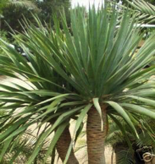
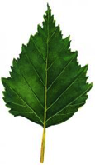
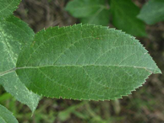
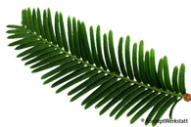
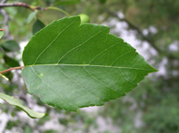
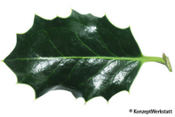
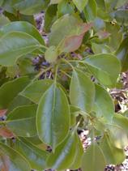
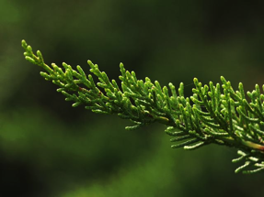
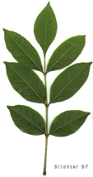
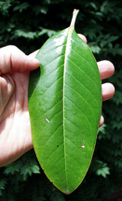
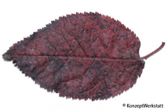
The common street trees in Eureka will survive and perform well as the climate becomes warmer
Conclusion
Apple Redwood Crab Apple Dragon Tree English Holly European White Birch
Japanese Flowering Monterey Cypress Oregon Ash Purple Leaf Southern
Plum Magnolia

Slide 22
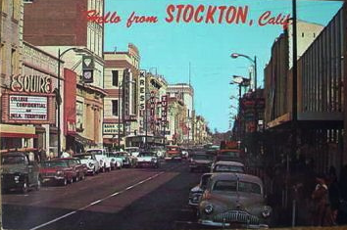
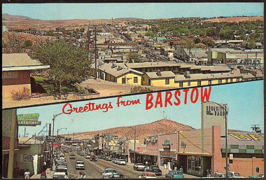
Climate Zone 12
Example City = Stockton; “Warm” City = Barstow
July Average Max. Temp (ºF)
City Historic Predicted
Stockton 90.4 101.7
Barstow 99.5 112.5

Slide 23
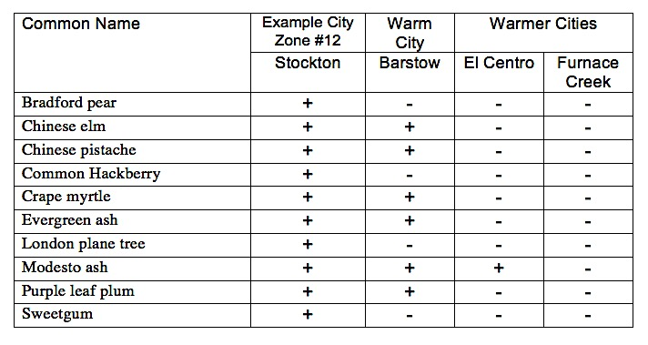
Common Stockton street trees and their occurrence in Barstow and warmer cities

Slide 24
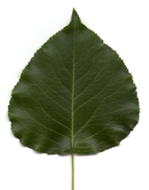
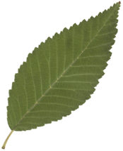
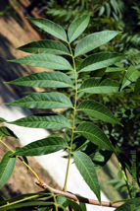
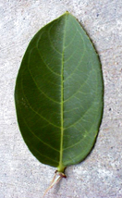
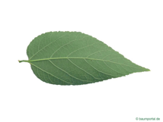
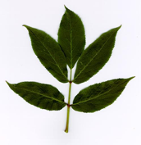


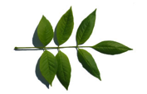

Four of the common street trees in Stockton will not survive as the climate becomes warmer
Conclusion
Bradford Pear Chinese Elm Chinese Pistache Common Hackberry Crape Myrtle
Evergreen Ash London Plane Tree Modesto Ash Purple leaf plum Sweetgum

Slide 25
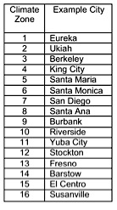
16
Climate zones where some commonly used street trees are not expected to survive
as a result of increasing temperature
11
12
16
16
13
14
10
15
15
14

Slide 26
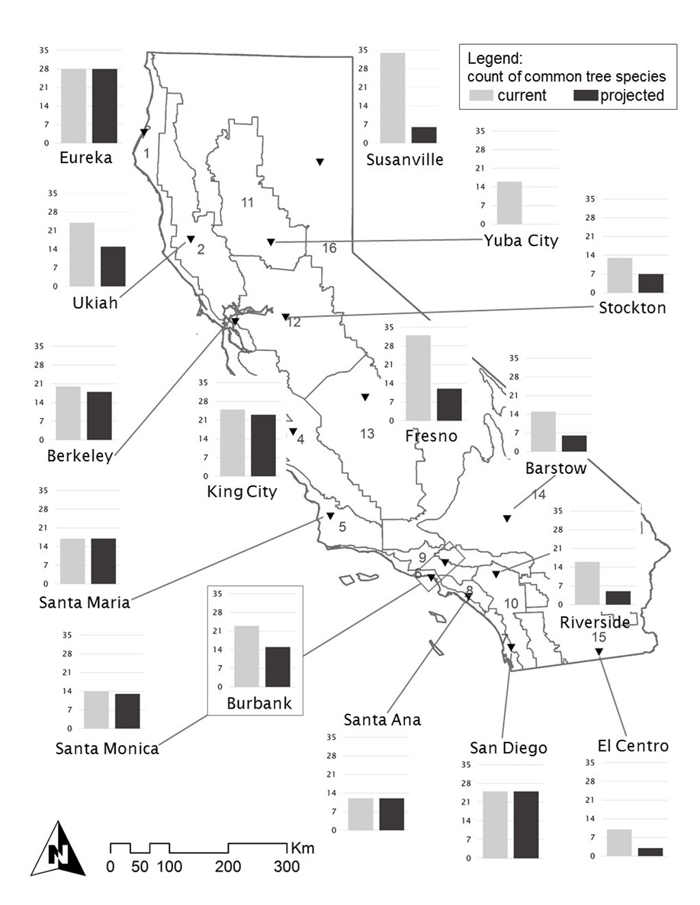
results

Slide 27
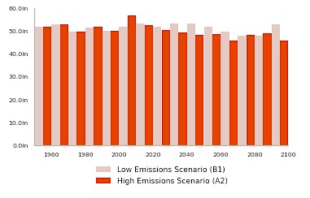
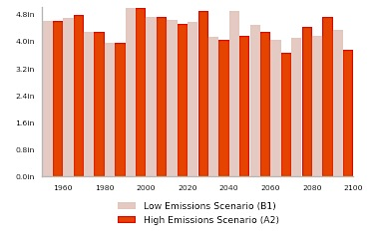
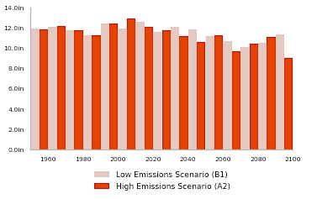
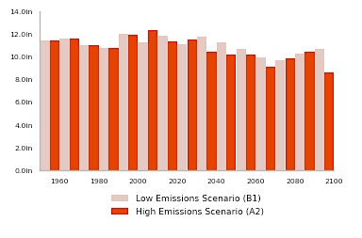
Change in Precipitation
Eureka Barstow
51” 45”
4.3” 3.8”
Stockton Fresno
11” 8.8”
10.9” 9.0”
from: Cal-adapt.org

Slide 28
Common Street Tree Species - Stockton
Bradford Pear Chinese Elm Chinese Pistache Common Hackberry Crape Myrtle
IR¹: M M/L M/L M/L M/L
DT²: M-D DT DT DT DT
Evergreen Ash London Plane Tree Modesto Ash Purple-leaf Plum Sweetgum
IR¹: M M/H M M M
DT²: M-D W-D M-D M W-D
¹ Irrigation Requirement: M/H = medium to high, M = medium, M/L = medium to low
² Soil Moisture Tolerance or Drought Tolerance: M-D = moist to dry soil, W-D = wet to dry, M = moist soil, DT = drought
tolerant

Slide 29
Street Tree Species not in “Warm’ or Warmer” Cities
Bradford Pear Chinese Elm Chinese Pistache Common Hackberry Crape Myrtle
IR¹: M M/L M/L M/L M/L
DT²: M-D DT DT DT DT
Evergreen Ash London Plane Tree Modesto Ash Purple-leaf Plum Sweetgum
IR¹: M M/H M M M
DT²: M-D W-D M-D M W-D
¹ Irrigation Requirement: M/H = medium to high, M = medium, M/L = medium to low
² Soil Moisture Tolerance or Drought Tolerance: M-D = moist to dry soil, W-D = wet to dry, M = moist soil, DT = drought
tolerant

Slide 30
Irrigation Requirement and Drought Tolerance
Bradford Pear Chinese Elm Chinese Pistache Common Hackberry Crape Myrtle
IR¹: M M/L M/L M/L M/L
DT²: M-D DT DT DT DT
Evergreen Ash London Plane Tree Modesto Ash Purple-leaf Plum Sweetgum
IR¹: M M/H M M M
DT²: M-D W-D M-D M W-D
¹ Irrigation Requirement: M/H = medium to high, M = medium, M/L = medium to low
² Soil Moisture Tolerance or Drought Tolerance: M-D = moist to dry soil, W-D = wet to dry, M = moist soil, DT = drought tolerant

Slide 31
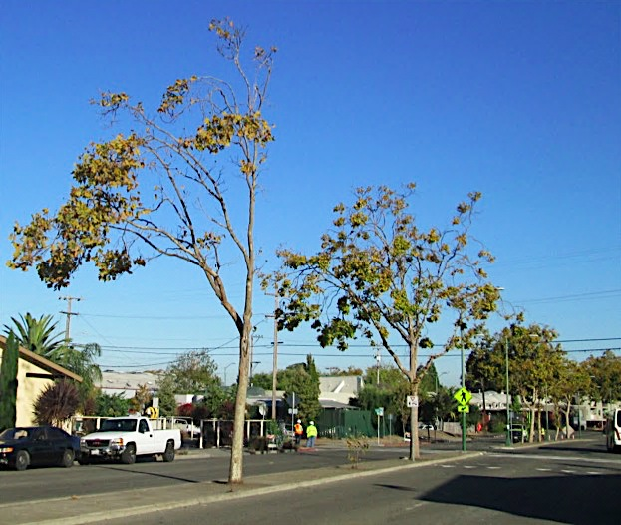
Consequence of Climate Change:
Some currently used trees will not survive or not perform well

Slide 32
outline
We are discussing ornamental trees in residential landscapes;
NOT wildlands forests, timber plantations, agriculture, orchards!
Street trees & climate change study: what we can learn from space-for-time substitution
…what do the study results suggest for individual landscapes
…and how to establish your trees and maintain them during the drought

Slide 33
warmer, maybe drier on average… so…
assess your tree’s environment → |  | ~ reflective surfaces? Paving? ~ sandy/rocky soils? slope? ~ etc. (you know this!)
evaluate your tree’s climate envelope → |  | ~ is it “at the edge” now? ~ our study ~ SelecTree
consider the major landscape pests → |  | ~ UC IPM website ~ Pest Vulnerability Matrix (PVM)
understand and meet your tree’s water needs → |  | ~ WUCOLS ~ calculate! ~ apply properly

Slide 34
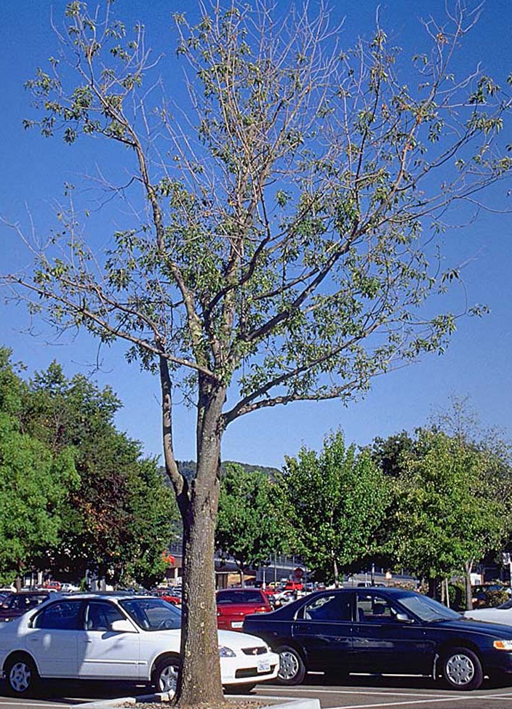
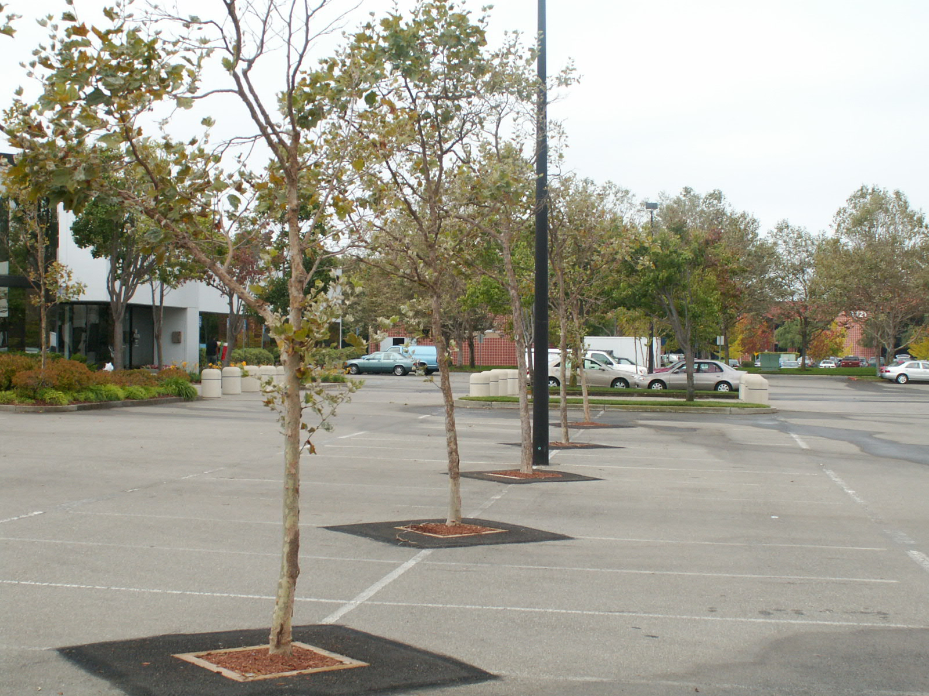
Landscape Situations that favor Water Deficits…
yes, I know your landscape probably differs from these…

Slide 35
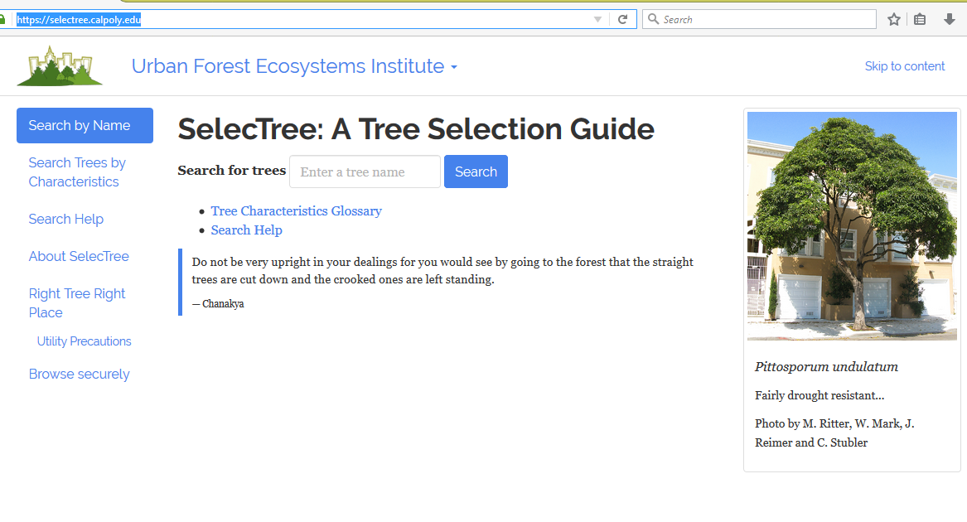
https://selectree.calpoly.edu/
~ you can search for a species by desired characteristics!

Slide 36
Species not expected to perform well – based on “warm” or “warmer” city

Slide 37
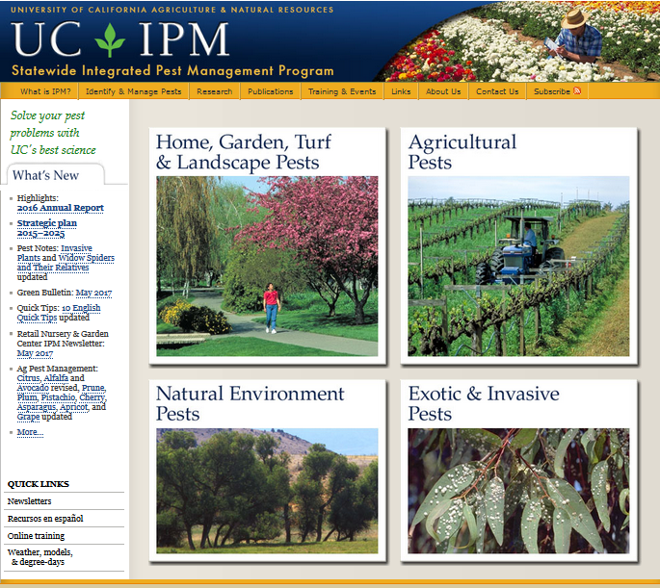
http://ipm.ucanr.edu/

Slide 38
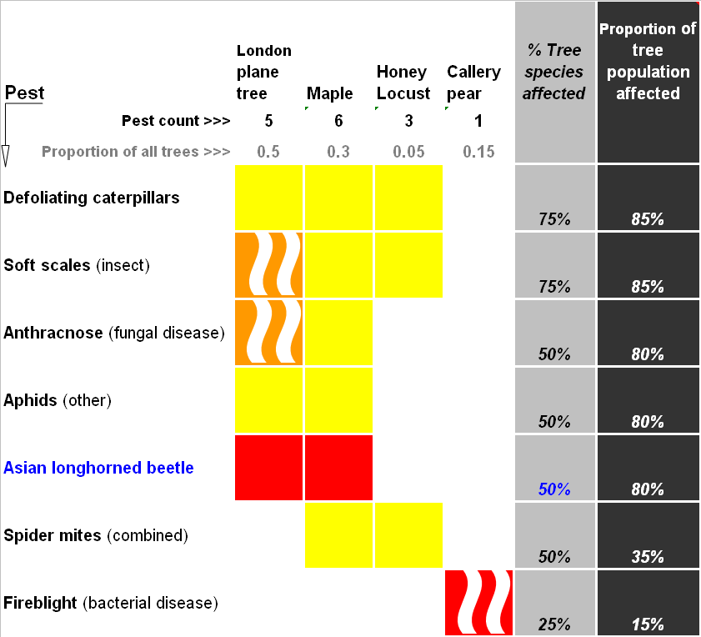


PVM

Slide 39
outline
We are discussing ornamental trees in residential landscapes;
NOT wildlands forests, timber plantations, agriculture, orchards!
Street trees & climate change study: what we can learn from space-for-time substitution
…what do the study results suggest for individual landscapes
…and how to establish your trees and maintain them during the drought

Slide 40


Young trees: Lack of water = quick death
←Problem: what does “Deep watering” mean here?
(how much can it hold?)
“Crispy critters” → (Larry Costello)

Slide 41

Young tree solutions
How much?
Amazingly little: 5-10 gal
How often?
Frequently! (X times/WEEK)
Who?
Residents
NGOs
Partners (schools, churches, business)

Slide 42

Mature trees: Functional irrigation approach,
or refilling the “water reservoir”
(Nelda Matheny and Larry Costello)
1 in on 1 ft² = 0.62 gal.
Soil water reservoir capacity: 2 elements Volume → area*depth, or inches water/foot depth Texture → available water → loam > clay > sand

Slide 43

Soil water reservoir: Where are the roots?

Slide 44
Functional irrigation approach for mature trees: estimating the size of the “water reservoir”
1 in on 1 sq ft = 0.62 gal.
Soil water reservoir capacity: 2 elements Volume → area*depth, or inches water/foot depth Texture → water stored→ clay > loam >> sand water available → sand > loam > clay)

Slide 45

Available water in soils (inches water/foot of soil depth)

Slide 46



Slide 47


Mature tree solutions
How much?
Substantial: 100 to 100s of gal.
Oki/Fujino RSIC→
and
TRIC ↓
How often?
Seldom! (X times/SUMMER)
Who?
Residents
Municipalities
Partners (schools, churches, business)
Notes:
All stakeholders should start doing this – we have so far been sending the wrong message, “the trees will be fine” or “the trees are not really important”

Slide 48


Mature tree solutions: ccuh.ucdavis.edu
The challenge:
How to apply water
too much, too little
without runoff
↑RSIC
and
← TRIC

Slide 49

Fujino/Oki TRIC Calculator
Example:
silty
clay

Slide 50


Compare my trees’ water use to other species:
ucanr.edu/sites/Wucols

Slide 51


WUCOLS categories

Slide 52


ucanr.edu/sites/UrbanHort

Slide 53
basic ideas
warmer climate = challenge to trees and to management |  | but we still will be able to grow trees
mortality is unfortunate but normal |  | not an excuse for not (re)planting!
What are the factor(s) in tree loss (which you can manage?) |  | species selection? site conditions? management?
droughts will recur, perhaps more frequently |  | help your trees survive!

Slide 54

Urban Ecology and Natural Resources: Introduction
Thank you!
Igor Laćan
ilacan@ucanr.edu
Igor Laćan
ilacan@ucanr.edu
510 684 4323

