Slide 1
May 2020 Update
SO MUCH GOOD NEWS!

Slide 2
VIRTUALOGY 2020
CONTESTS HAVE ENDED
LOTS OF ENTRIES!
RESULTS ARE BEING POSTED

Slide 3
VIRTUALOGY 2020
Special thanks to
Maryam Handley – Event Chair; Building Competitions
Marcie DeWolf – Large Livestock Competitions
Max Horan – Small Animal Competitions
Virtual events committee
Judges and evaluators
Results are being tabulated for so many amazing entries!
Check here for results:
Building entries – by end of this week
http://www.oc4h.org/events/Imaginology/
Livestock entries – posted
Small animal http://www.oc4h.org/events/Imaginology/
Large livestock https://www.virtualogy2020.com/

Slide 4
VIRTUAL FASHION REVUE 2020
ENTRIES BEING ACCEPTED UNTIL MAY 29

Slide 5
Virtual Fashion Revue 2020
Entries in these categories
BOX CHALLENGE
CONSUMER SCIENCE
COSPLAY
TRADITIONAL
VINTAGE
Entry deadline is this Friday May 29
Evaluations on Saturday June 6

Slide 6
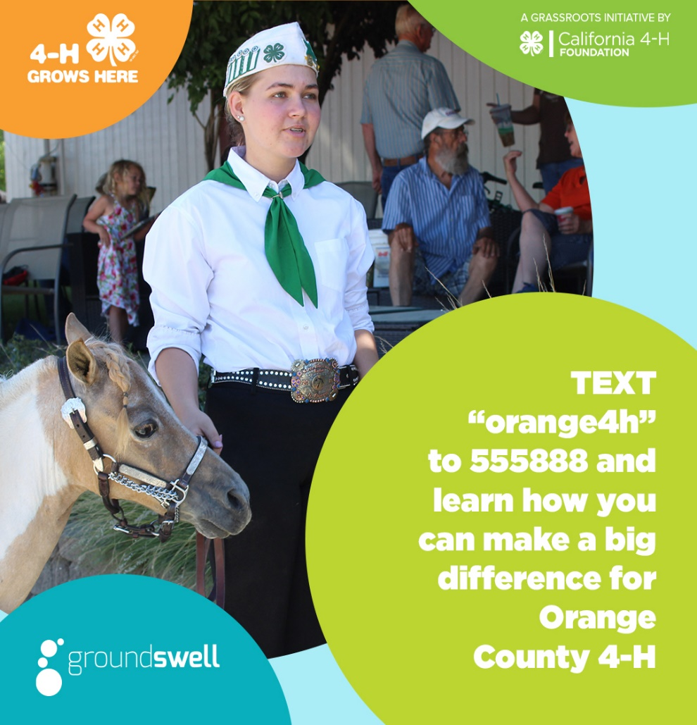
CA 4-H DEBIT CARD ROLLOUT
RESERVE YOUR CARD TODAY!
ENCOURAGE FRIENDS & FAMILY TO RESERVE A CARD!
CLUB COMPETITION – PRIZE – MOST SIGN-UPS BY JUNE 15!
Goal – 100 entries by June 15!

Slide 7
County Council Document Review
By-laws, constitution & organization chart
Revision & update completed – see website for links
Public review from today to June 22
Voting for approval via survey link June 15 to 22
Results of voting and approval of documents at council meeting on June 23

Slide 8
#BigDigDay – June 5
LIKE GIVING TUESDAY
MAJOR DONATION CAMPAIGN FOR UCANR & 4-H

Slide 9
CA 4-H Virtual Summer Camps
Three weeklong virtual summer camps
Volunteers needed

Slide 10
Virtual Summer Camps
Are you bummed that summer camps got canceled?
Enjoy three weeklong virtual summer camps with fun and engaging activities that won’t all involve a screen!
STEM, art, mindfulness, healthy living, coding, citizen science
Recreation and fun & games just like at camp
Virtual campfires to meet up with new friends and showcase your camp accomplishments
Minimal materials required
Watch for signups!

Slide 11
Virtual Summer Camps 2020
Are you bummed because you were planning to volunteer for camps?
Adult and teen volunteers are needed!
Sign up here: VOLUNTEER SIGN-UP SURVEY

Slide 12
CLUB LEADER MEET-UPS ENDING THE PROGRAM YEAR 2019-2020 GEARING UP FOR THE NEW YEAR 2020-2021
BEST TIME TO MEET?
BEST DAY TO MEET?

Slide 13
Info for Club Leaders – PY 2019-2020
Make arrangements for end-of-year paperwork
Outreach Documentation Form DUE July 31
http://4h.ucanr.edu/files/167457.pdf
Financial Reporting Forms DUE Aug 15
http://4h.ucanr.edu/files/14647.pdf
Hold elections for next year’s executive board
It’s OK to have a few open spots – can fill them after new registrations
Don’t forget about Teen Council reps
Have some fun – have a “Zoom party” to close out the year!
Guidelines for Adult Volunteers and virtual meetings
https://ucanr.edu/sites/ca4H/files/324210.pdf

Slide 14
Info for Club Leaders – PY 2020-2021
Start planning for next year!
Look for an email with a link to update club information – leader, project leader, exec board
Leadership Forums – club officers (Aug 22); CCLs (Aug 25); Project Leaders (Sept 10, 12, 14)
Club Budgets DUE September 30 or sooner
Some clubs need to update bank accounts/signer information
Calendar update: https://ucanr.edu/sites/oc4h/files/325700.pdf
Currently, phase 2 allows for meetings in person of no more than 10 people with strict requirements for personal safety. When will we move to phase 3 and beyond????
SCREC is still closed. Starting June 1 limited opening, even I won’t be working at the office yet!
Hopeful to hold a fall recognition event in October IN PERSON!

Slide 15
ORB to sunset this Dec 31!
IMMEDIATE ACTION REQUIRED!

Slide 16
SUNSETTING OF ORB
ORB will no longer be available after December 31, 2020
Action you need to take:
Download all files from previous record books by June 30, 2020
NOTE: Tech support for old files will end on this date!!
Complete and download all files from current year (2019-20) record books by December 31, 2020
NOTE: Tech support for current year files will be available until Dec 31 but after this date there will be absolutely no access to ORB starting Jan 1, 2021
Record Books will be made using paper forms for the upcoming program year 2020-2021
Watch for details regarding record book assistance and training
Deadlines for submitting 2019-20 record books will be announced soon

Slide 17
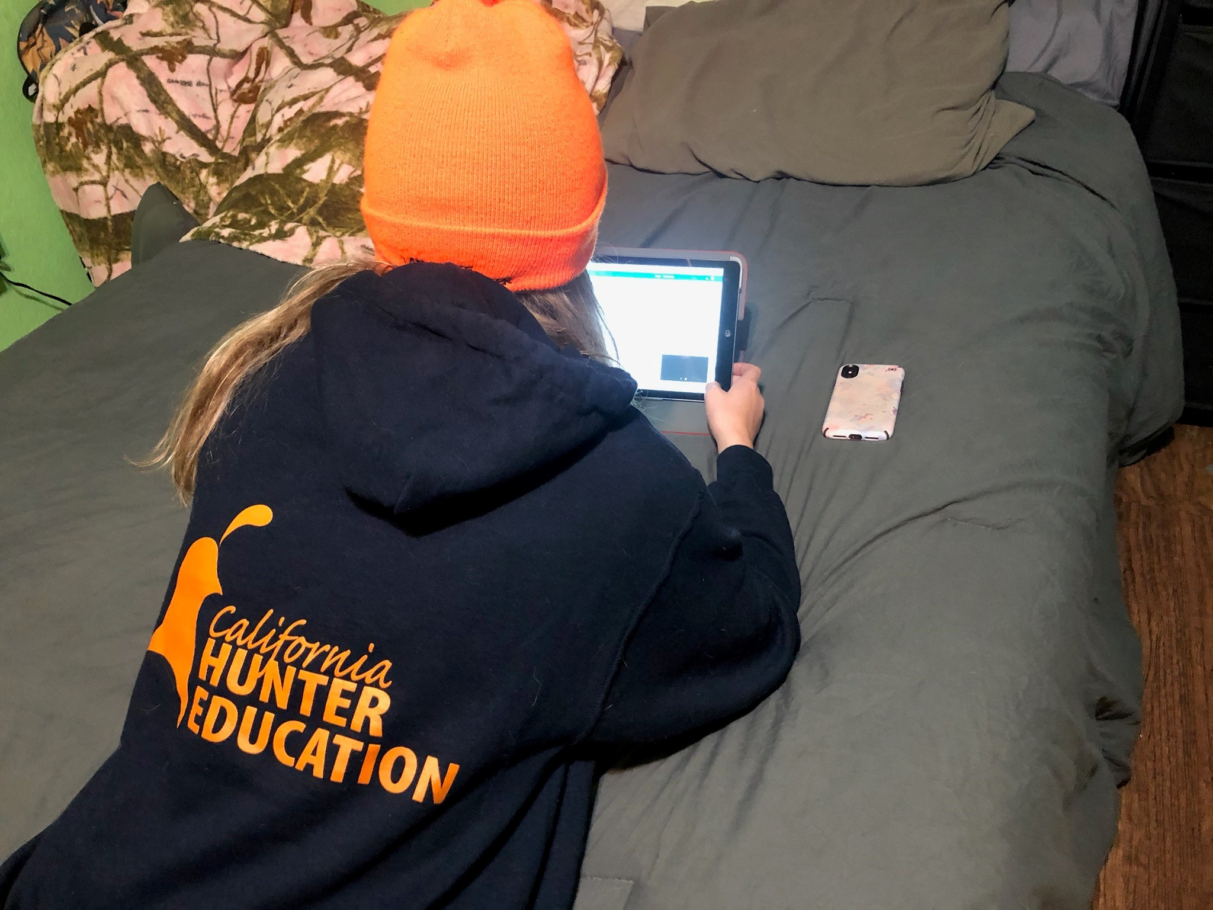
Online Hunter Safety Course
one-time only certification that is needed if someone wants to hunt in CA
can be taken at any age
course is usually only offered in person, so now is a really good time to take it
can be put in the record book
costs $25, only offered until the end of May
Thanks to Allison Kari for finding this resource!
https://cdfgnews.wordpress.com/2020/05/19/california-temporarily-authorizes-completion-of-hunter-education-courses-online/

Slide 18
SCREC OPEN HOUSE BECOMES
http://ceorange.ucanr.edu/avocadofestival
4-H WILL BE HELPING OUT – WATCH FOR DETAILS!

Slide 19
CONGRATULATIONS!
2020 GRADS!
OC 4-H Wishes you the best of luck!

Slide 20
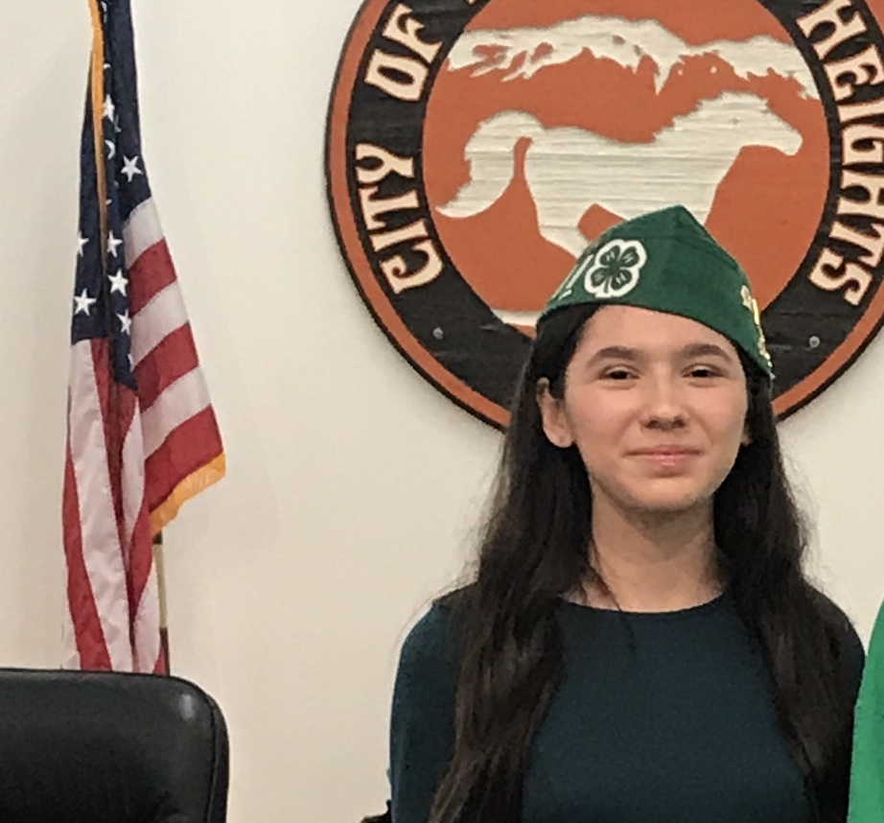
CONGRATULATIONS!!
LAUREN REYES
4-H CA STATE AMBASSADOR
2020-2021
The 4-H State California Ambassador position is one of the highest service opportunities that is recognized by the University of California 4-H Youth Development Program. California State Ambassadors help shape the CA 4-H program. They promote 4-H, plan state-wide events, teach at events across the state, and more. Overall, California State Ambassadors are the youth advocates for the California 4-H Program.

