Slide 1
Ergonomics
Malendia Maccree, Safety Specialist
UC – ANR Risk and safety Services

Slide 2
Ergonomics
“An applied science concerned with designing and arranging things people use so that the people and things interact most efficiently and safely” (Merriam-Webster)
Assessment – Quantitative or qualitative, in-person evaluation, phone interview, online survey, photos and video
Intervention – Recommendations for equipment, exercises, workflow optimization
Evaluation – Was the intervention effective? What next?

Slide 3
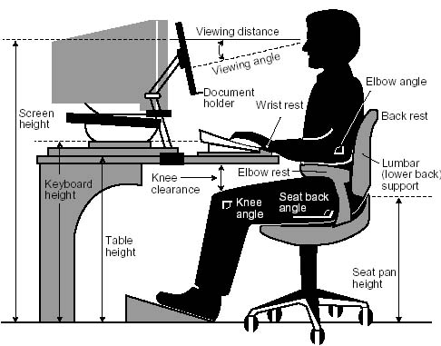
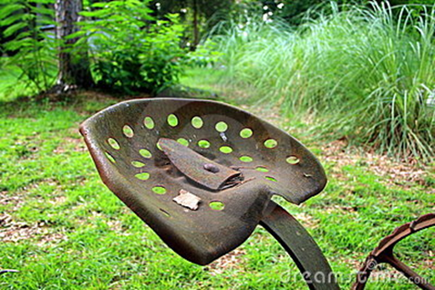
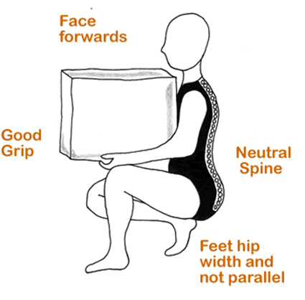
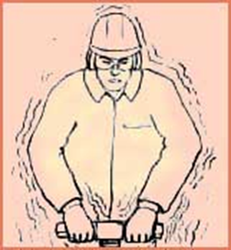
Ergonomics
Office ergonomics:
Desk and chair
Computer equipment
Document handling
Outside of the office:
Lifting
Repetitive tasks
Use of hand tools
Vehicles
Vibration
Notes:
Ergonomics is defined in many ways, I look at it broadly as how humans interact with their environment and equipment. Ergonomic studies can be applied to any type of work humans perform: playing a musical instrument, sitting at a desk, working in a greenhouse.
Office ergonomics tends to focus on the user at their workstation. Perhaps you are all familiar with these type of diagrams. Many many measurements and angles… Office ergonomics tends to focus on anthopometric analyses of seated positions and keyboard use. It is useful to remember that these measures and angles are guides and ranges, not positions that every human must maintain throughout their workday. While some basic concrete guide is useful, one pitfall of anthropometric analyses is that they do not account for all the factors that influence human posture and movement. Let’s take a few minutes to look at the entire range of human activities which could (and should) occur during office work.

Slide 4
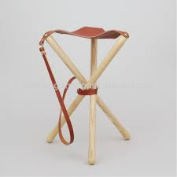
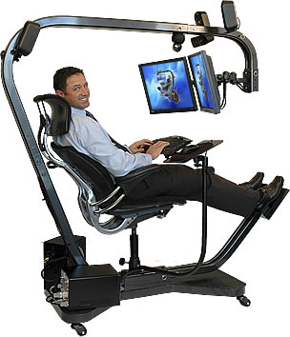
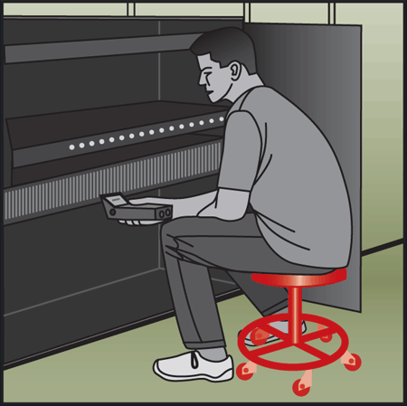
Sitting – Benefits and Challenges
Benefits:
Uses less energy
Allows for fine motor skills and mental focus
Less stressful than crouching, kneeling, or stooping
Challenges:
Seating surface influences posture and circulation
Over-relaxation
Static postures
Notes:
First we have sitting. Your Chair is not your enemy—sitting has some important benefits. However, many people fall into static or overrelaxed postures which can lead to discomfort.

Slide 5
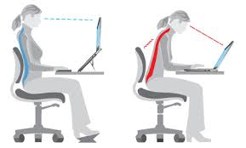
Sitting Posture

Slide 6
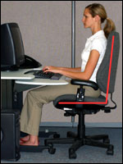
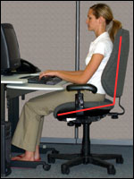
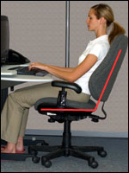
Sitting – What to do…
Pay attention to your breath
Be aware of habitual postures
Keep both feet on the floor (or footrest)
Maintain balance and open angles
Move/adjust your chair throughout the day
Take regular breaks to stand and move around
At the computer….
Look up and away from your computer screen (20-20-20)
Stretch and relax your arms and hands every 30 – 60 min
Notes:
Here are some ways in which you can make the most of sitting and combat the sources of discomfort.
Many people don’t notice their breath, but it is a key in assessing your physical and mental state. Have you stopped breathing or are you breathing shallowly—these are cues that you need to adjust your body or your mind to a new task or interrupt your current pattern.
Open angles are very important—these pictures are guides. Whenever an angle becomes less than 90 degrees pay attention and try to adjust your position to open the angle more.
Another sign that you need to shifty your position is when you find that don’t have both feet on the floor. Move and adjust your chair throughout the day. Get to know your chair and how to adjust it.
Don’t forget you eyes. Remember to follow the 20-20-20 guide to avoid eye strain and work you eye muscles. Every 20 minutes look 20 feet away for twenty seconds. Also let go of your mouse when you’re not using it. If you can’t get up from your chair, try reaching up to the ceiling and strestchign your spine. Reach your feet out in front of you.

Slide 7
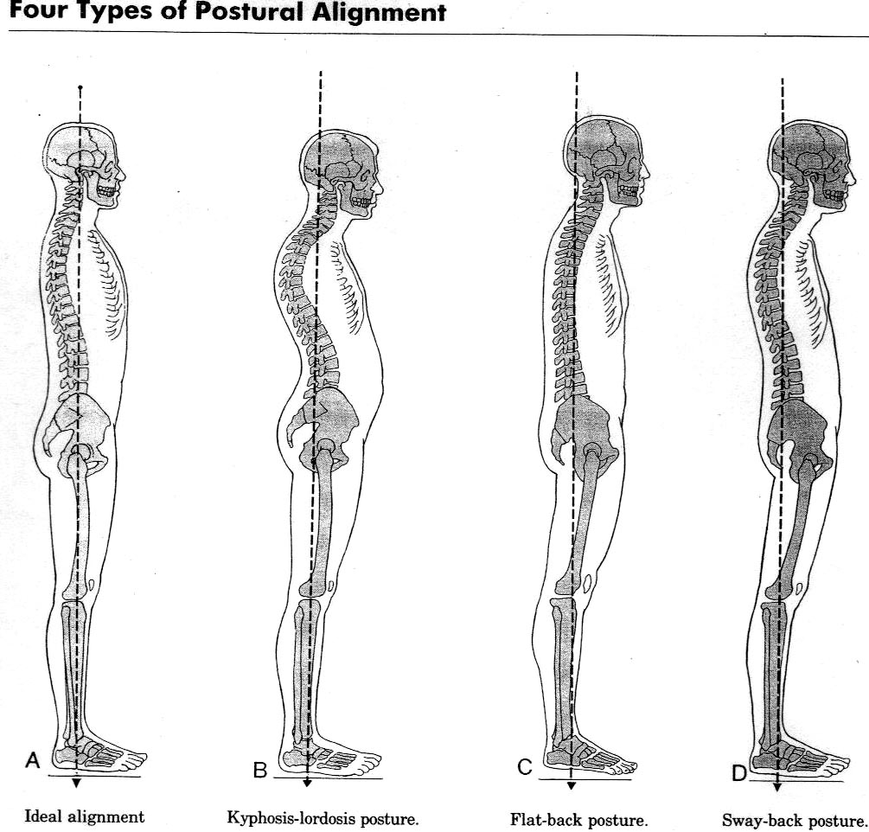
Standing – Benefits and Challenges
Benefits:
Allows for more movement and weight shift
Maintains active muscle engagement
Challenges:
Pressure on feet, shoes matter
Uses more energy than sitting
Notes:
The latest and most popular intervention in office ergonomics is now the sit-stand desk. I too once thought that a sit-stand desk was eth answer to all of my woes and pains. I thought that since I used to work labs and greenhouses that my transition to a sitting job was the cause of my pain. I purchased a really great sit-stand desk for use at my home. What I quickly realized was that standing in one place wasn’t much better than sitting. In fact it took more energy and detracted from my concentration and ability to perform some tasks. Proper standing also requires good posture. As standing takes more energy than sitting, it is easy to get fatigued and slip into poor posture habits while standing.

Slide 8
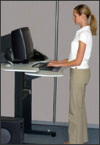
Standing – What to do…
Sit down periodically
Wear supportive shoes
Maintain balanced and relaxed legs
Maintain pelvis in neutral position
Explore weight shifts, knee bends, and foot position
At the computer…
Look up and away from your monitor (20-20-20)
Stretch and relax your arms and hands every 30 – 60 min
Notes:
Standing continuously can be very tiring. Take regular breaks to sit down.
The position of your pelvis is also very important to maintaining a neutral relaxed back. Explore knee bends and weight shifts but make user you don’t linger for long period of time with all of your weight on one lag.
Wear good shoes—your shoes are now serving the role your chair would have. They can define your posture and also save you feet from pain. Anti-fatigue mats can be used, but these interfere with chair use at sit stand stations.
Also, the guides for your eyes and arms still apply to standing work.

Slide 9
Keyboarding

Slide 10
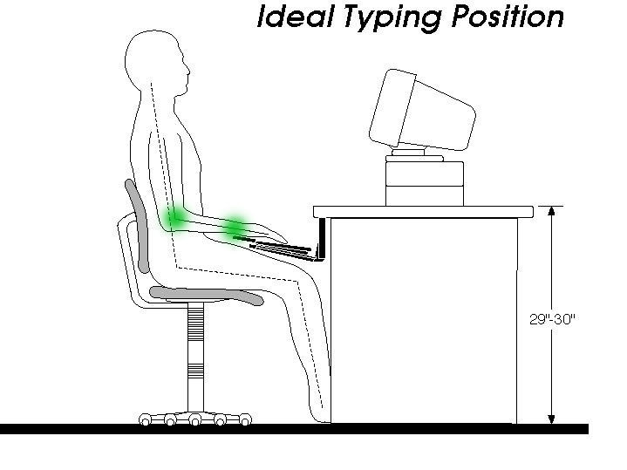
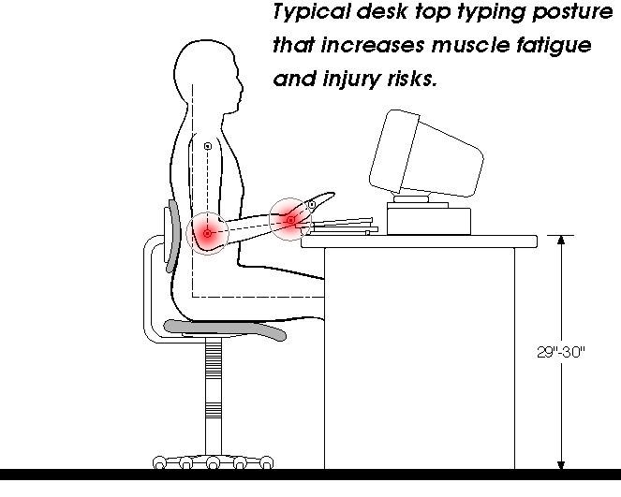
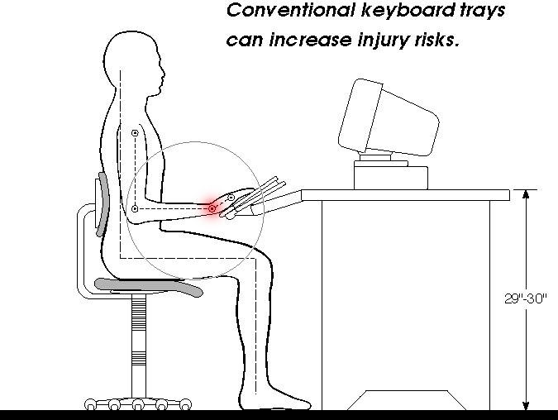
Keyboarding

Slide 11
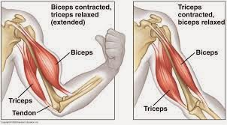
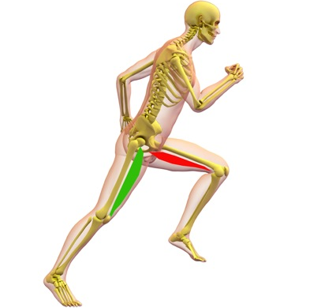
Moving – Benefits and Challenges
Benefits:
It’s what your body is ‘built’ for!
Cardiovascular fitness
Muscle tone and bone density
Mental focus/emotional resilience
Challenges:
Repetitive motion stress
Disruption (time and motion)
Mobility issues
Notes:
Regardless of how good your working posture is, working in the same posture or sitting still for prolonged periods is not healthy. Our bodies are built to move! Each bone has a complicated set of muscles attached. The large muscles take turns as antagonist and agonist—we are each a beautifully complex and unique push-pull machine. Even the action of breathing in and out creates movement in our spine and helps circulate your spinal fluid to refresh your nervous system.

Slide 12
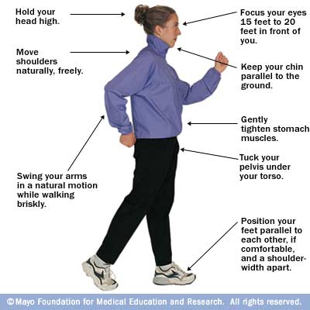
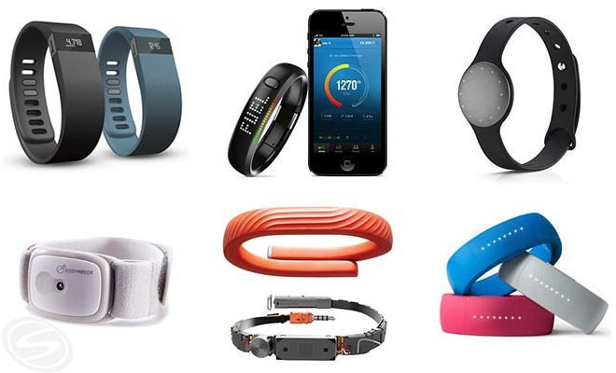
Moving – What to do…
Walking
Hold your head up
Wear supportive shoes
Maintain pelvis in neutral position
Maintain forward momentum with arms
Use activity trackers or cell phone apps
Notes:
Here are some helpful tools to get you moving.
First of all-be gentle. You don’t need to start a rigorous exercise program and even activities like yoga can be strenuous. Exercises like tai chi and chi gung are gentle enough for everyone and they will build strength and balance.
Use your arms for forward momentum—try not to cross you body with them but swing them forward and backward at the sides of your body.
You can use high tech gadgets or download software on to your cell phone and computer. Or try the low tech motivator—a large bottle of water on your desk. If you set the goal of drinking a bottle of water each day, you’ll also be compelled to leave you desk throughout the day for a nice walk.
Be creative and explore—enjoy conversations with friends or just enjoy fresh air and focusing your eyes on three dimensional objects for a change.

Slide 13
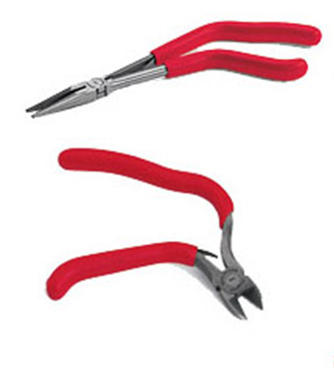
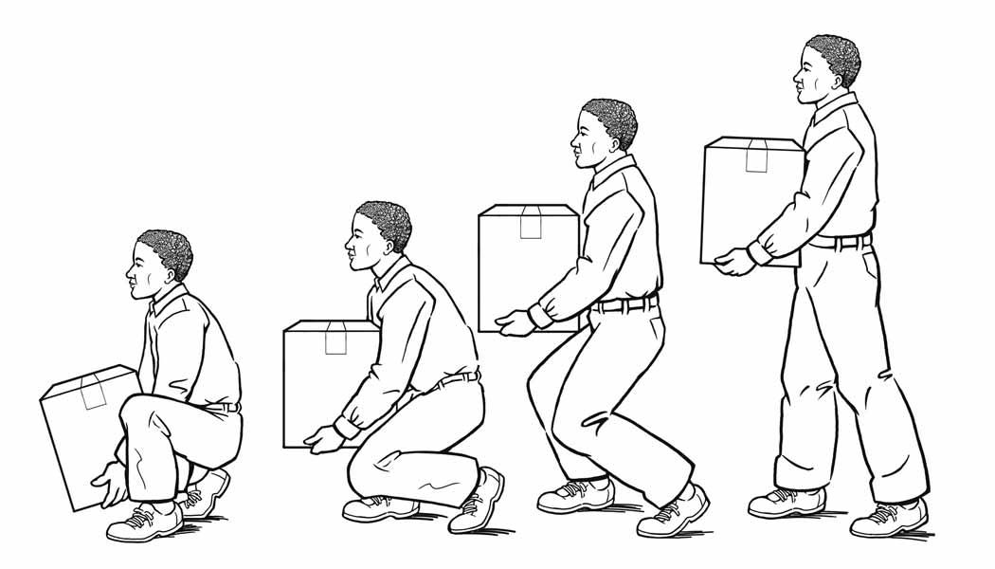
Moving – What to do…
Lifting
Have a plan before you pick it up!
Keep load close to body
Maintain natural back curve, avoid twisting
Engage your core – energize your belly
Use your legs, not your back, to lift things
Hand tools and task work
Avoid prolonged contact with hard surfaces
Use bent handles instead of bent wrists
Keep hands relaxed to avoid excessive gripping force
Notes:
Here are some helpful tools to get you moving.
First of all-be gentle. You don’t need to start a rigorous exercise program and even activities like yoga can be strenuous. Exercises like tai chi and chi gung are gentle enough for everyone and they will build strength and balance.
Use your arms for forward momentum—try not to cross you body with them but swing them forward and backward at the sides of your body.
You can use high tech gadgets or download software on to your cell phone and computer. Or try the low tech motivator—a large bottle of water on your desk. If you set the goal of drinking a bottle of water each day, you’ll also be compelled to leave you desk throughout the day for a nice walk.
Be creative and explore—enjoy conversations with friends or just enjoy fresh air and focusing your eyes on three dimensional objects for a change.

Slide 14
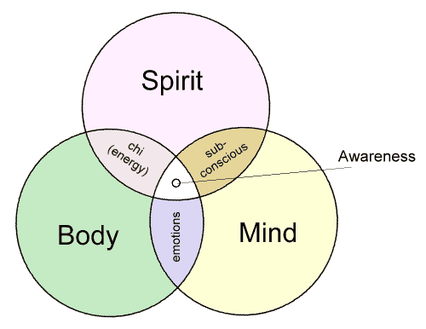
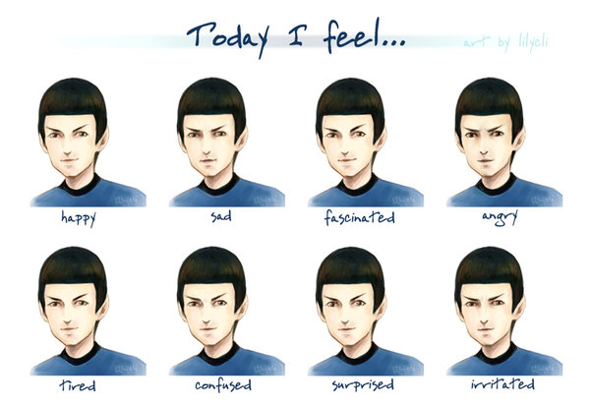
Awareness and Wellness
Check out March 2015 Safety Spotlight for tips and tools http://ucanr.edu/sites/ucehs/files/207901.pdf
Nurture yourself - prioritize healthy eating, sleeping, and rest
Consider mental or emotional triggers/associations
Pay attention to your patterns and habits (mental and physical)
Seek new experiences (new perspectives support new habits)
Notes:
Assessments is the first step and where others can help you the most, but the real work—what makes a difference is the work which only you can do. Your awareness is key to a successful ergonomic intervention.
Before you decide to change your external reality, take inventory and focus your attention on your internal reality. It’s very important that you explore and develop your own awareness of your body as well as how your thoughts and emotions affect your body. We are not Spock.
Use tools to help in monitoring your physical habits. Keep journals or stay mindful of thoughts and emotions that help or hinder your progress towards achieving comfort at your workstation. Awareness is sometimes referred to as the intersection of the mind, body, and spirit. Assessment is not the time to critique your self or determine how you measure up against a standard—think of it as an open inquiry into your being. What is?

Slide 15
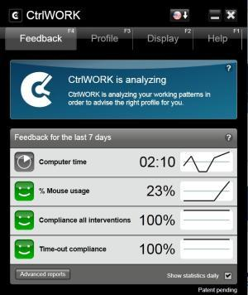
Tools and Resources
Online tools & guides:
UC-ANR website: http://safety.ucanr.edu/Safety_Training_Resources/Ergonomic_Training/
Computer workstation: https://www.osha.gov/SLTC/etools/computerworkstations/positions.html
Farm ergonomics: http://ohioline.osu.edu/aex-fact/pdf/AEX_981_6_10.pdf
NIOSH hand tool selection guide: http://www.cdc.gov/niosh/docs/2004-164/pdfs/2004-164.pdf
CalOSHA publications and posters: http://www.dir.ca.gov/dosh/puborder.asp
Contact UC-ANR EHS:
http://safety.ucanr.edu/Safety_Training_Resources/Ergonomic_Training/Ergonomic_Assessment/
Malendia Maccree: mmmaccree@ucanr.edu (530) 219-3732
Notes:
The key to comfort in your work station is to figure out what is the right range for you and your activities. This happy place is unique for every individual.
An important first step is to assess your current postures, activities, and sensations. To help with this first step we have tools available on our website.
Our ergonomics website is where you can sign up for online assessments, helpful tools and access ANR SafetyNotes on special topics in ergonomics. I have also included the OSHA ergonomics website because it is a very good simple guide which includes more than one type of seating posture. If you find that you need more guidance and help than what you can find on your own, please feel free to contact us and request help.

