Slide 1
2016 Ergonomic Program Updates and Training
UC ANR All Staff Meeting - July 21, 2016
Malendia Maccree, CIH
UC ANR Environmental Health and Safety
mmmaccree@ucanr.edu (530)219-3732

Slide 2
Ergonomics Topics
Be Smart About Safety (BSAS) funding for ergonomic equipment
Online ergonomic evaluations and tools
Desk height adjustments
Ergonomic injury prevention

Slide 3
Requesting Be Smart About Safety (BSAS) Funds
Requester(s) completes the online ergonomic assessment.
Submit a Be Smart About Safety (BSAS) funding request and office ergonomic equipment request form
Office Ergonomic Equipment is eligible for 50% funding by BSAS, with the other 50% from local department funds.
The requested equipment must be indicated by the results of the ergonomic assessment(s)
Risk & Safety Services will review the BSAS application and if approved, provide the account number for the 50% funding.
Requester or department makes the purchase and directs the expense to 50% BSAS account, 50% other local account(s).
Requester or department makes arrangement for installation of equipment.

Slide 4
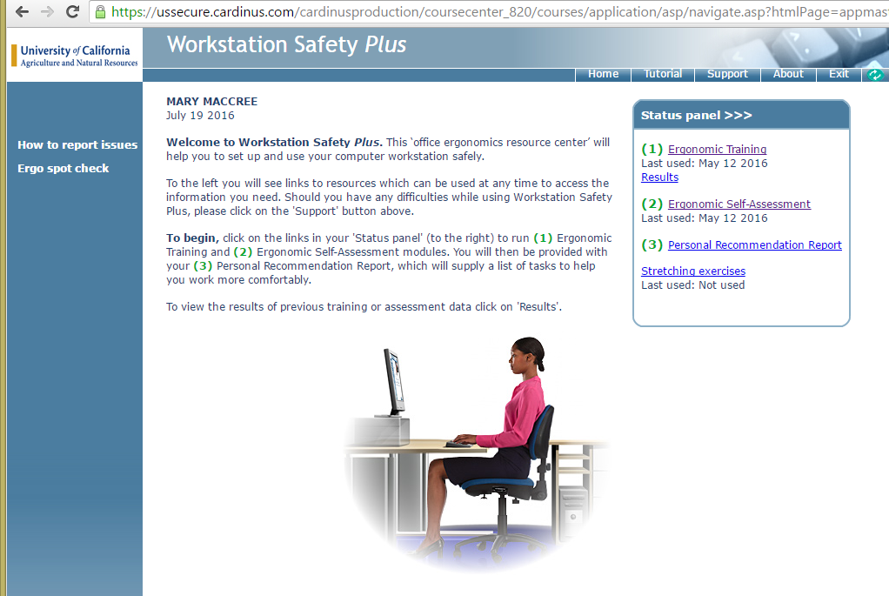
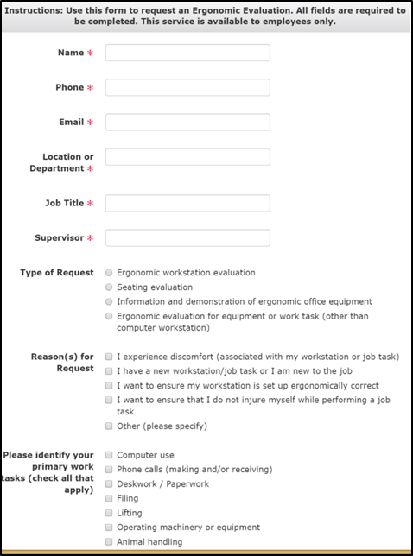
Requesting Be Smart About Safety (BSAS) Funds
Ergonomic assessment website: http://safety.ucanr.edu/Training/Ergonomic_Training/Ergonomic_Assessment/
Online ergonomic assessment software
Website request form

Slide 5
Be Smart About Safety (BSAS) Website http://safety.ucanr.edu/Programs/BSAS/
BSAS funding request form: http://safety.ucanr.edu/files/178981.pdf
BSAS ergonomic equipment form: http://safety.ucanr.edu/files/178982.pdf

Slide 6
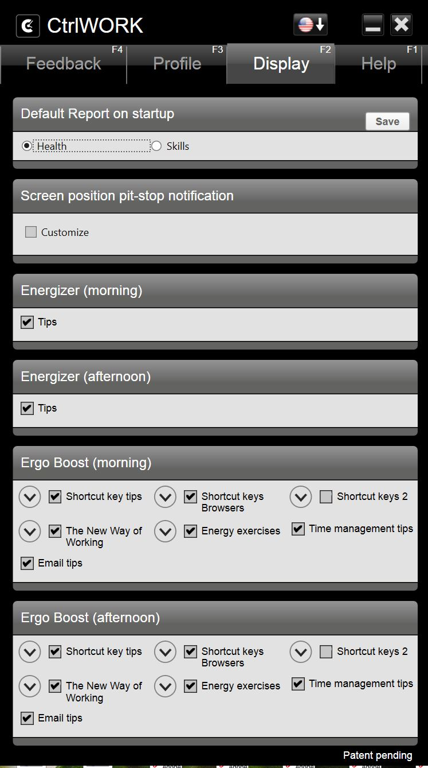
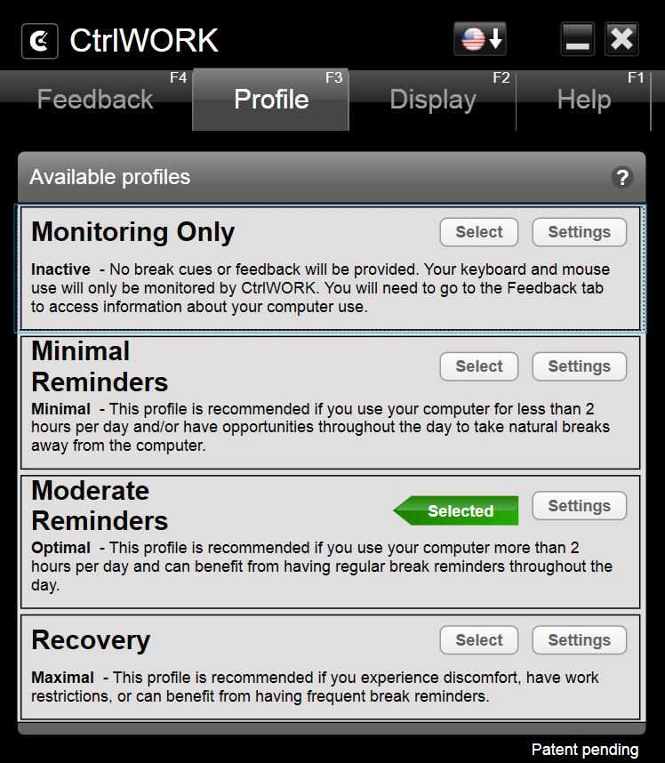
CtrlWORK Software for Ergo Breaks
Visit EHS website or contact Malendia for a download link
Customize settings for type, amount, and frequency of desktop reminders

Slide 7
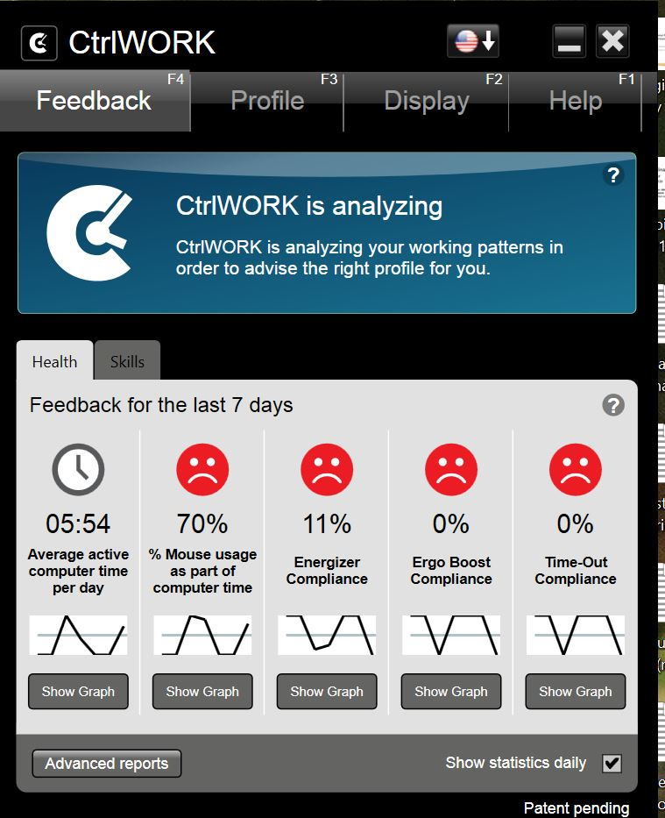
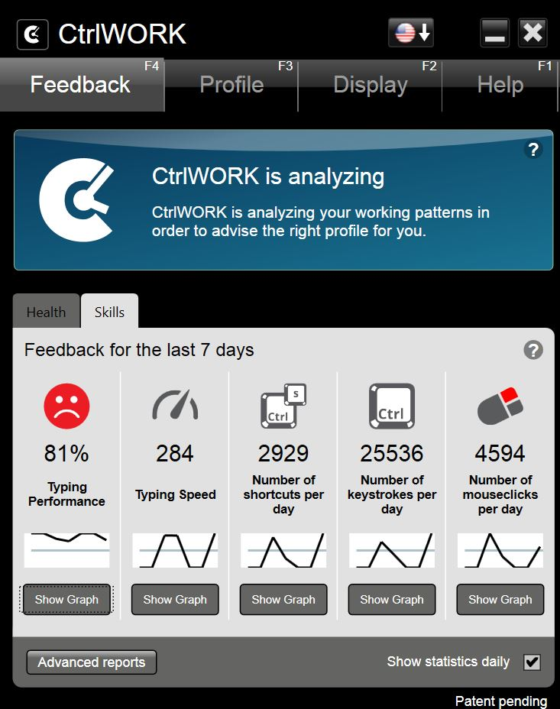
CtrlWORK Software for Ergo Breaks
Visit EHS website or contact Malendia for a download link
Monitor your computer use with daily and weekly statistics

Slide 8
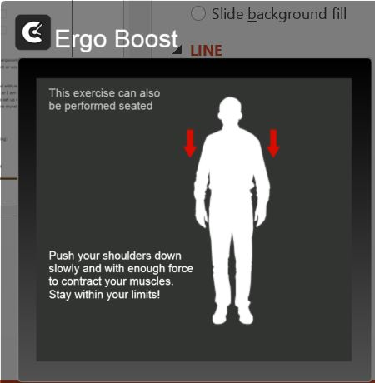
CtrlWORK Software for Ergo Breaks
Visit EHS website or contact Malendia for a download link
Reminders throughout the day:
Ergo Boost Exercises
Shortcut keystrokes
Eye exercises
Hand stretches
Time-out breaks
Productivity tips

Slide 9
Desk Height Adjustment
Departments will now request desk height alterations directly from UCD special services
The Process:
Determine the desired height for the desktop surface
Measure old desk
Request ergonomic evaluation
Request desk height adjustment on UCD Buy website
Special services will contact customer to arrange for service

Slide 10
Desk Height Adjustment
Cost is lower if multiple orders can be grouped together
Each trip to our building = 2 workers for 1hr travel/set-up
Each adjustment requires 2 workers for at least 30 min
Typical cost of a single cubicle desk height adjustment: $95
Desk must be cleared of all items (including your computer)
Furniture repairs or defects should be reported to facilities
Desk hazards and ergonomic issues should be reported to EHS
Facilities and EHS provide advising for furniture purchases

Slide 11
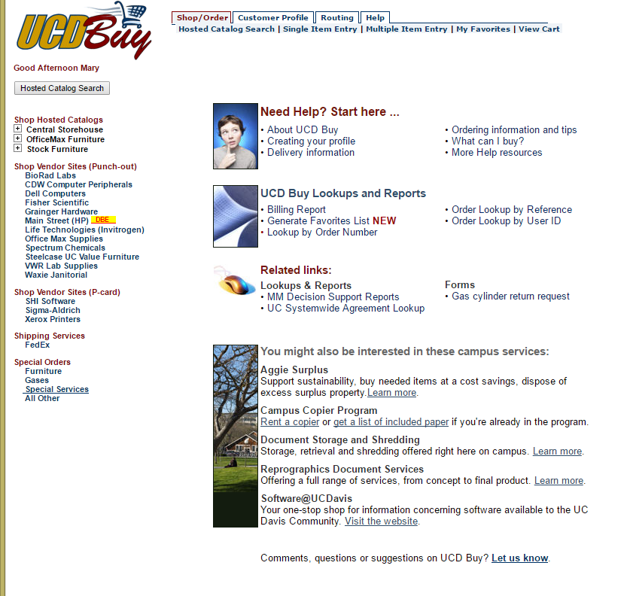
Desk Height Adjustment
UCD Buy Special Services

Slide 12
Signs of Ergonomic Stress
Tingling, numbness, or loss of sensation in hands
Swelling, inflammation, or stiffness in joints
Pain: sharp, dull, or burning sensation
Clumsiness / loss of coordination
Discomfort or tightness in the muscles
Weakness
Cold hands
Exposure to Risk
Occasional Discomfort
Frequent Pain

Slide 13
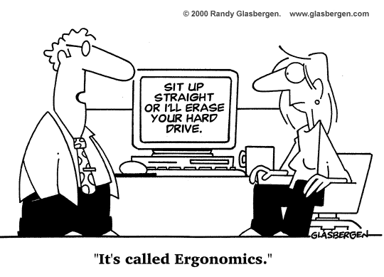
Causes of Ergonomic Stress
Repetitive motion
Awkward or sustained postures
Contact pressure
Forceful exertion or strain
Exposure to vibration
Exposure to heat or cold

Slide 14
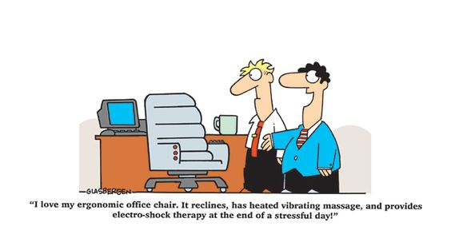
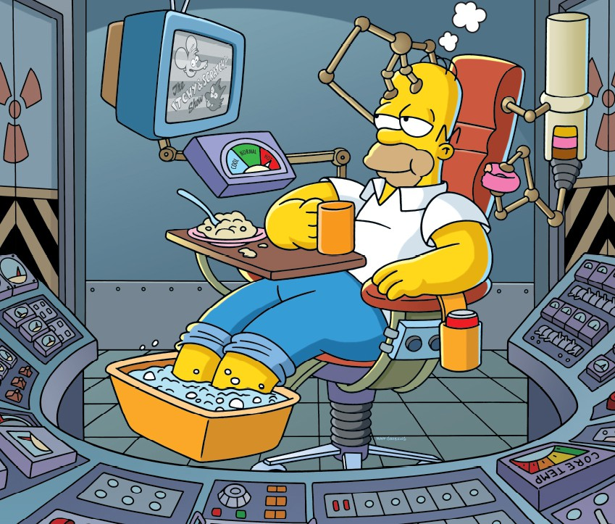
Preventing Ergonomic Injuries
Pay attention to postures
Pay attention to discomfort
Vary work tasks and seating position throughout the day
Get enough activity and rest… away from your desk!

Slide 15
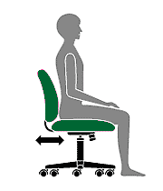
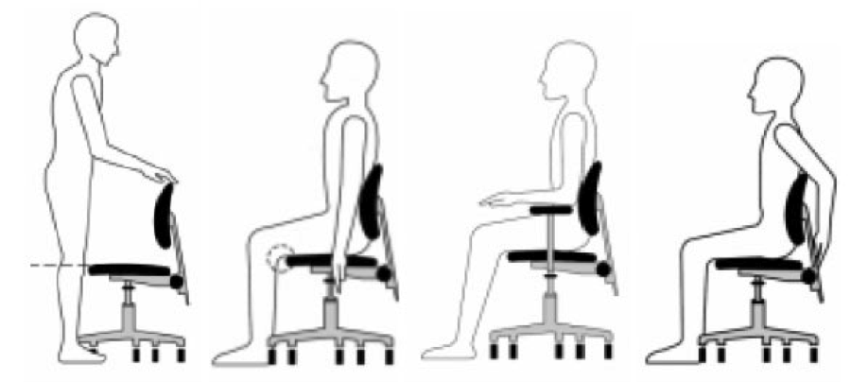
Legs and Hips
Feet should be well supported (either by the floor or a footrest)
The angle at hips and knees should be >90°
Back should be well supported by your chair
Notes:
http://ergonomics.ucr.edu/docs/pdf/Ergonomics%20Handout.pdf

Slide 16
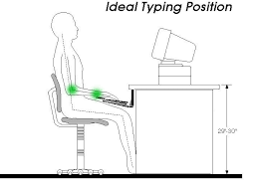
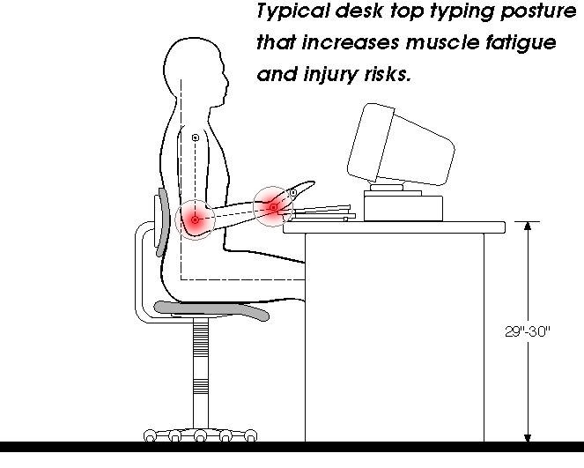
Arms
Upper arms should remain close to your body and RELAXED
Elbow angle should be 90 or greater
Forearms should be parallel with the ground or angled slightly downward
Notes:
http://ergonomics.ucr.edu/docs/pdf/Ergonomics%20Handout.pdf

Slide 17
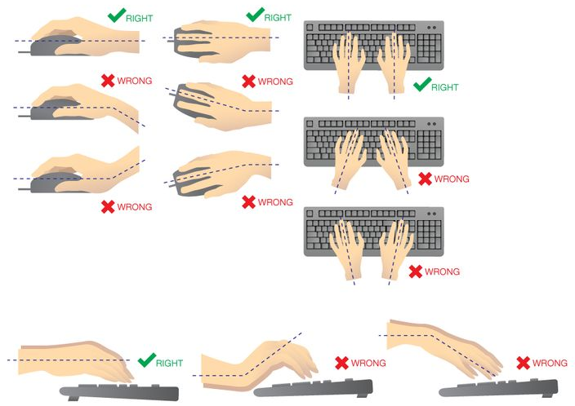
Wrists
Wrists should remain in a neutral position
Avoid resting wrists on surfaces while typing/mousing
Notes:
http://ergonomics.ucr.edu/docs/pdf/Ergonomics%20Handout.pdf

Slide 18
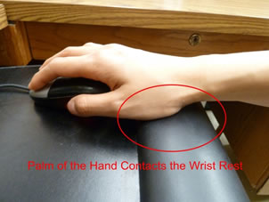
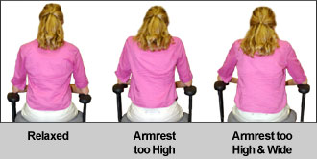
Just Resting?
Wrist and arm rests are not there to hold your body parts up
Wrist pads can immobilize the wrist or increase pressure on wrist
Rest arms and wrists between typing strokes
Try resting the palm of hand on a pad instead of the wrist
Notes:
http://ergonomics.ucr.edu/docs/pdf/Ergonomics%20Handout.pdf

Slide 19
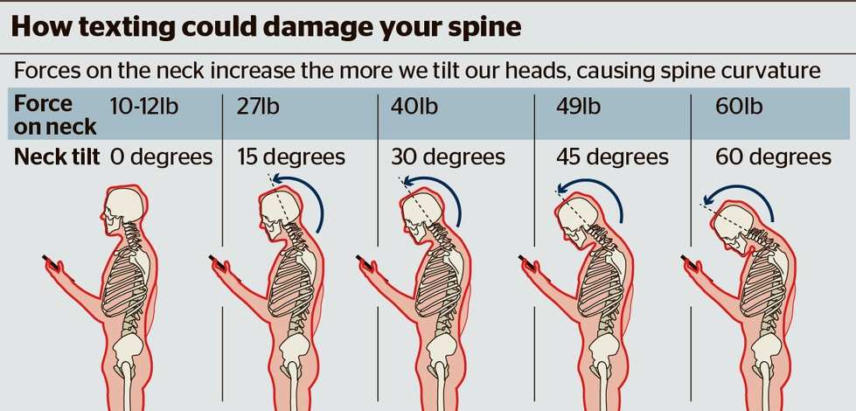
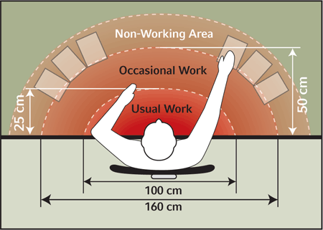
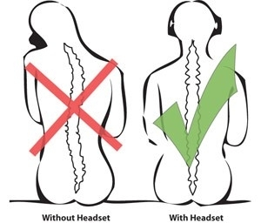
Head, Neck, and Shoulders
Your head and neck should remain upright
Your upper arms should remain close to your body and relaxed
Notes:
http://ergonomics.ucr.edu/docs/pdf/Ergonomics%20Handout.pdf
Every inch forward head posture increases weight on spine by 10 pounds

Slide 20
How much activity does an adult need?
2 hours and 30 minutes (150 minutes) of moderate-intensity aerobic activity (i.e., brisk walking) every week and muscle-strengthening activities on 2 or more days a week that work all major muscle groups (legs, hips, back, abdomen, chest, shoulders, and arms).
OR
1 hour and 15 minutes (75 minutes) of vigorous-intensity aerobic activity (i.e., jogging or running) every week and muscle-strengthening activities on 2 or more days a week that work all major muscle groups (legs, hips, back, abdomen, chest, shoulders, and arms).
OR
An equivalent mix of moderate- and vigorous-intensity aerobic activity and muscle-strengthening activities on 2 or more days a week that work all major muscle groups (legs, hips, back, abdomen, chest, shoulders, and arms).
http://www.cdc.gov/physicalactivity/basics/
Notes:
Aerobic physical activity. Activity in which the body's large muscles move in a rhythmic manner for a sustained period of time. Aerobic activity, also called endurance activity, improves cardiorespiratory fitness. Examples include walking, running, and swimming, and bicycling.
Light: Walking slowly, Sitting using computer, Standing light work (cooking, washing dishes), Fishing sitting, Playing most instruments
Moderate: Walking briskly (3 miles per hour or faster, but not race-walking), Water aerobics, Bicycling slower than 10 miles per hour, Tennis (doubles), Ballroom dancing, General gardening
Vigorous: Hiking, Jogging at 6 mph, Shoveling, Carrying heavy loads, Bicycling fast (14-16 mph), Basketball game, Soccer game, Tennis singles, Swing, Jazz or HipHop dancing.
For moderate-intensity physical activity, a person's target heart rate should be 50 to 70% of his or her maximum heart rate.
For vigorous-intensity physical activity, a person's target heart rate should be 70 to 85% of his or her maximum heart rate. Max heart rate = 220 – age
Muscle-strengthening activity (strength training, resistance training, or muscular strength and endurance exercises). Physical activity, including exercise that increases skeletal muscle strength, power, endurance, and mass. Exercises that involve using your muscles to lift, push or pick up very heavy items produce muscular strength. Those same exercises done with less weight for longer periods of time will produce muscular endurance.

Slide 21
How much activity does an adult need?
10 minutes at a time is fine…
10-minute activities performed 2-3 times per day will add up to about 140 – 210 minutes per week
150 minutes each week = 2 ½ hours…. about the same amount of time you might spend watching a movie.
It's about what works best for you, as long as you're doing physical activity at a moderate or vigorous effort for at least 10 minutes at a time.
http://www.cdc.gov/physicalactivity/basics/

Slide 22
How much rest does an adult need?
Age | Recommended Amount of Sleep
Newborns | 16–18 hours a day
Preschool-aged children | 11–12 hours a day
School-aged children | At least 10 hours a day
Teens | 9–10 hours a day
Adults (including the elderly) | 7–8 hours a day
Insufficient sleep is linked to:
Increased risk for diabetes, stroke, heart disease, and hypertension
Increased risk for obesity and difficulty maintaining healthy weight
Poor performance, mistakes, and accidents during the day
(Institute of Medicine (US) Committee on Sleep Medicine and Research, 2006)
Notes:
Institute of Medicine (US) Committee on Sleep Medicine and Research; Colten HR, Altevogt BM, editors. Sleep Disorders and Sleep Deprivation: An Unmet Public Health Problem. Washington (DC): National Academies Press (US); 2006. 3, Extent and Health Consequences of Chronic Sleep Loss and Sleep Disorders. Available from: http://www.ncbi.nlm.nih.gov/books/NBK19961/

Slide 23
Ergonomic Resources
http://safety.ucanr.edu/Training/Ergonomic_Training/Ergonomic_Resources/
SafetyNote #10 "Safe Lifting Practices"
SafetyNote #28 "Computer Workstation"
SafetyNote #69 "Continuous Standing Practices"
UCD SafetyNet #17 "Personal Computer Workstation Checklist"
UCD SafetyNet #29 "Back Belts"
UCD SafetyNet #41 "Protect Your Wrists and Hands from Repetitive Motion Injury"
UCD SafetyNet #46 "Lifting"
UCD SafetyNet #96 "Keyboard and Mouse Use“
Recommended ergonomic equipment:
http://safety.ucanr.edu/Training/Ergonomic_Training/Equipment_Catalog/

Slide 24
Ergonomic Resources
http://safety.ucanr.edu/Training/Ergonomic_Training/

Slide 25
Questions??
Safety presentation that are shared in our building all-staff meeting are also made available on our website:
http://safety.ucanr.edu/Training/Presentations/Staff_Meetings/

