Slide 1
Sierra Foothills
Research and Extension Center
Compost application field day
November 14, 2018

Slide 2
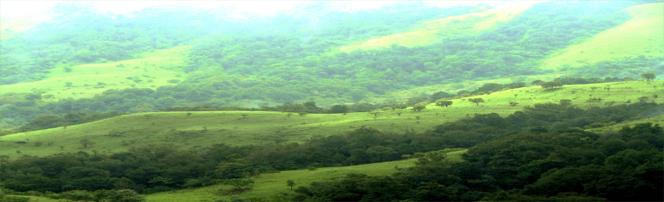
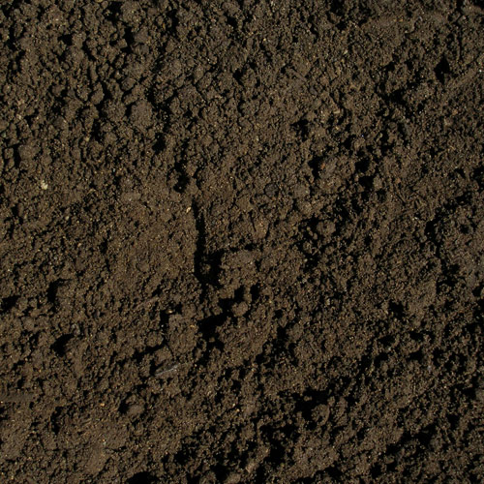
Atmosphere carbon
760 Pg
Photosynthesis
Vegetation carbon
610 Pg
Microbe respiration
Plant/tissue death
Soil carbon
2000 Pg
(or more)
Notes:
CO BENEFITS

Slide 3
Managing soils for increased carbon content has many co-benefits:
Fertility
Water holding capacity
Soil stability
Sustainability
Productivity

Slide 4
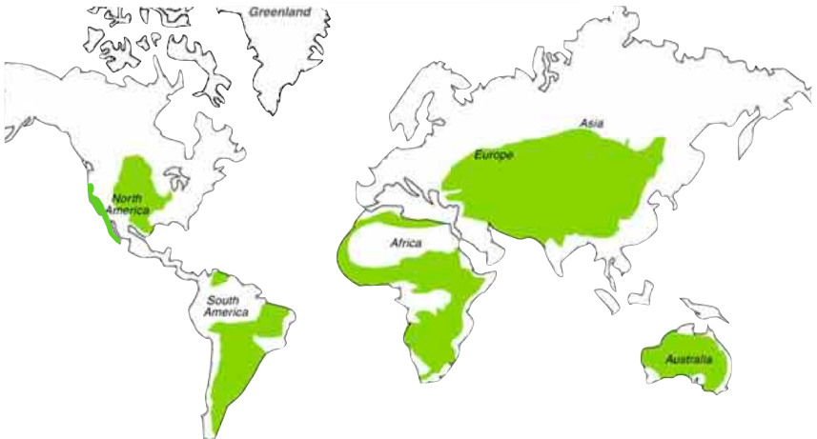
Grasslands hold considerable potential for soil C sequestration
The majority of grasslands are degraded
23 million hectares in California (40% of the land area)
30% of US land area
30% of global land surface area
Notes:
CA rangelands roughly store about 1-2 Pg C in the top meter;

Slide 5
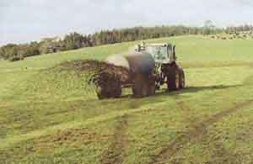
Amendments of livestock manure increased soil carbon by 50 Mg C ha⁻¹ in the top meter of soil
300
200
Soil Carbon (Mg C ha⁻¹)
100
0
Not amended
Amended
Analysis of 35 fields (1050 samples) from Marin and Sonoma Counties
From Silver et al. In prep
Notes:
50 Mg C = 183 Mg CO2e; over 10,000 ha that is almost 2 million MT

Slide 6
Livestock manure is a large source of greenhouse gases
U.S. Methane Emissions (MMT CO₂e)
U.S. Nitrous Oxide Emissions (MMT CO₂e)
x10
U.S. EPA EPA 430-R-15-004 2013; Owen and Silver 2015 Global Change Biology
Notes:
Note composting has lower emissions

Slide 7
From 2012 to 2100, manure applications led to a large net source (positive values) to the atmosphere
2
1
Source
Climate impact (Mg CO₂e ha⁻¹ y⁻¹)
0
Grazed
Sink
Grazed and manured
-1
Soil C
Net Balance
Methane
Nitrous oxide
Owen et al. 2015, Global Change Biology

Slide 8
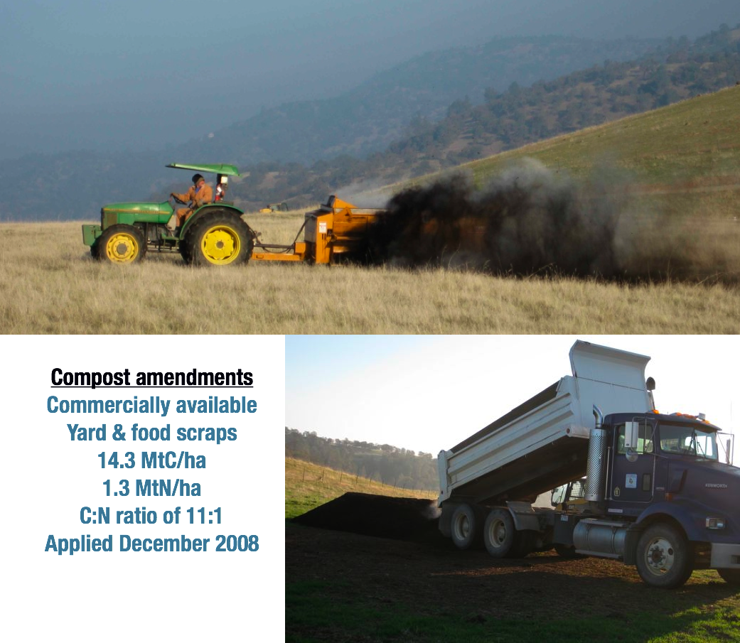
Composted organic matter
has much lower emissions
One time application
Did not increase field nitrous oxide and methane emissions
Created a slow release organic fertilizer

Slide 9
Net primary production (a.k.a. forage production) increased every year following a one time compost application
control
compost
Aboveground Net Primary Production (g m⁻²)
2009 2010 2011 2012
Year
Ryals and Silver 2013 Ecological Applications, Silver et al. in prep.

Slide 10
Compost amendments also significantly increased
soil carbon pools
Soil organic carbon (g m⁻²)
Ryals et al. 2014 Soil Biology and Biochemistry; Silver et al. in prep

Slide 11
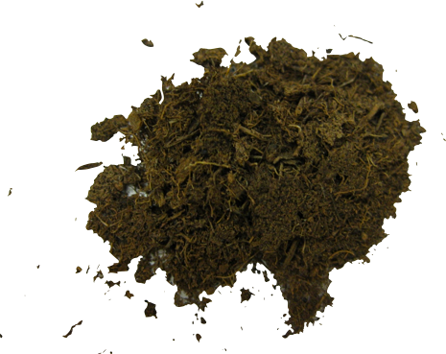
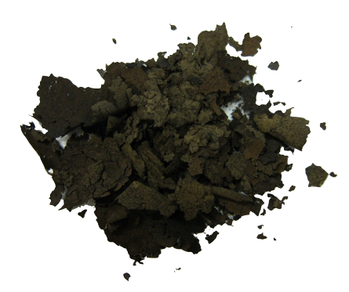
Carbon sequestered in soil:
3 Mg C/ha over three years

Slide 12
Using half of California’s grasslands
At a rate of 0.5 Mg C ha⁻¹ y⁻¹
= 21 MMT CO₂e y⁻¹
Livestock (enteric fermentation)
~ 12 MMT CO₂e y⁻¹
Commercial/residential
~ 43 MMT CO₂e y⁻¹
Electrical generation (in state)
~50 MMT CO₂e y⁻¹
Units:
Mg = Metric ton
MMT= Million metric tons CO₂e = CO₂ equivalents
Emissions data: CA GHG Inventory 2013
Notes:
There is considerable potential to offset some of California’s energy use with soil C sequestration

Slide 13
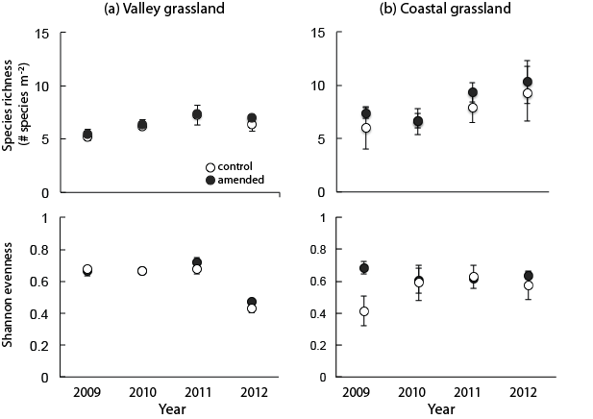
There were no significant changes in diversity
Ryals et al. 2016 Ecosphere

Slide 14
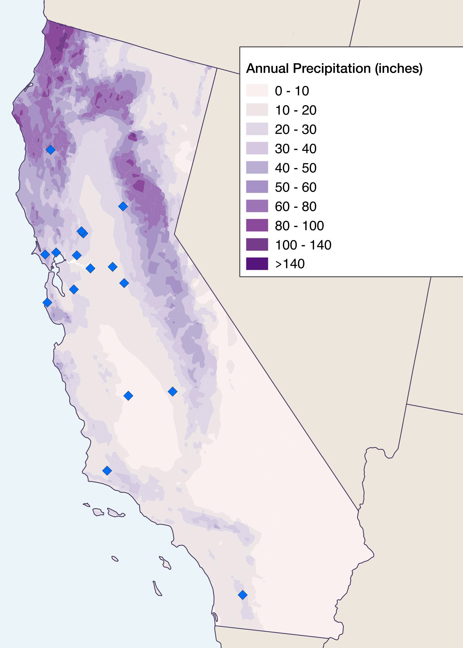
Scaling up: testing the impacts of compost across California rangelands
What is the impact of predicted climate changes on rangeland carbon dynamics with and without compost amendments?
Mendocino County
SFREC
Marin County
Solano
San Joaquin
Tulare
Santa Barbara County
San Diego County

Slide 15
Healthy Soils Project
Compare and contrast different types of compost for:
Forage production and species
Soil carbon sequestration
Soil moisture dynamics
Greenhouse gas emissions

Slide 16
USDA Drought Project
Determine the effects of drought on:
Forage production and species
Soil carbon sequestration
Soil moisture dynamics
Greenhouse gas emissions
And interactions with nitrogen fertilization

