Slide 1
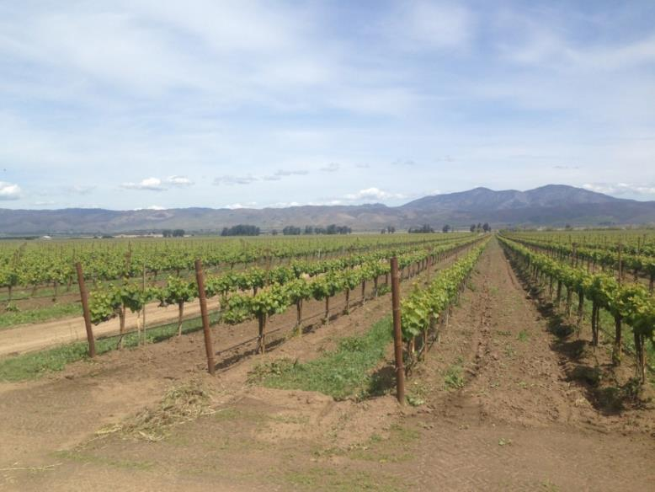
2019 Compliance Issues & Regulatory Updates
Monterey County
Monterey County Agricultural Commissioner’s Office
Notes:
Introduction: Good morning everyone, Introduce self, today we will be reviewing some of the most common violations we have found throughout the year, as well as some recent regulatory updates to be aware of.

Slide 2
2019 Violations Summary & Regulatory Update
2019 Season violation trends
Pesticide Investigations
Apiary Update – BeeWhere
Pesticide Use Near Schools Regulation
Paraquat dichloride

Slide 3
Violations Found
  Field Worker Safety Inspections (FWSI)
  Record Inspections
  Fumigation Use Monitoring Inspections (FUMI)
  Pesticide Use Monitoring Inspections (PUMIs)
Notes:
We are going to cover common violations found during fieldworker safety inspections, record inspections which some of you may know as headquarters audits, fumigation use monitoring inspections and pesticide use monitoring inspections.

Slide 4
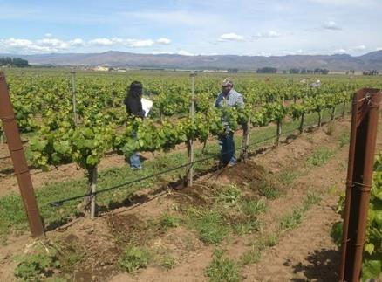
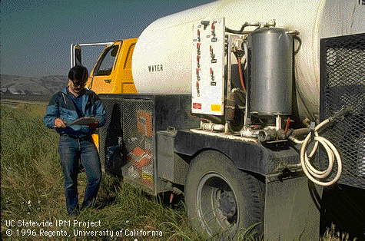
Violation Summary
2019
January – December
1032 Pre-Application Inspections
119 Fieldworker Safety Inspections
158 Records Inspections
1783 Total Inspections
889 non-compliances
Notes:
During 2019, our office conducted: 1032 pre-application site evaluation inspections, 119 fieldworker safety inspections, 158 records inspections. For a total of 1783 inspections across all inspection types and 889 non-compliances were documented.

Slide 5
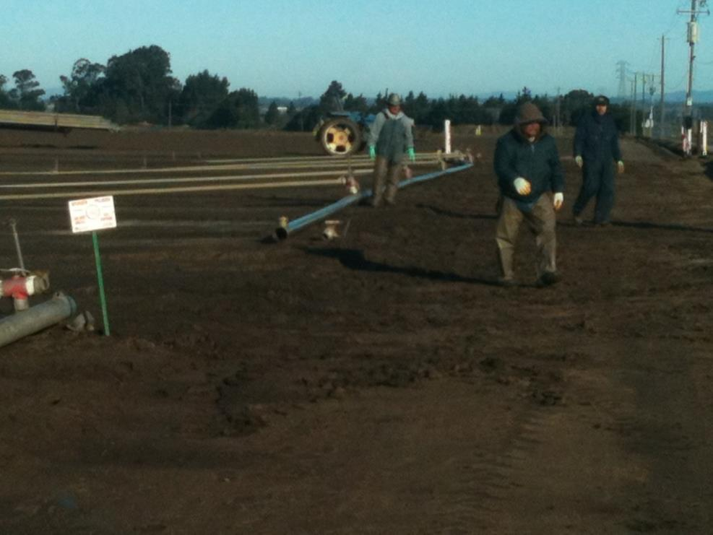
2019 FWSI Violations
Notes:
We will begin with common violations during fieldworker safety inspections.
Can anybody tell me what is wrong with this picture?
There are Irrigators in an area where pesticide applications have occurred, and the signs are still posted, which indicate that the restricted entry interval has not passed. Please remember no one should be inside a posted field without wearing all required PPE as stated on the label for early entry.

Slide 6
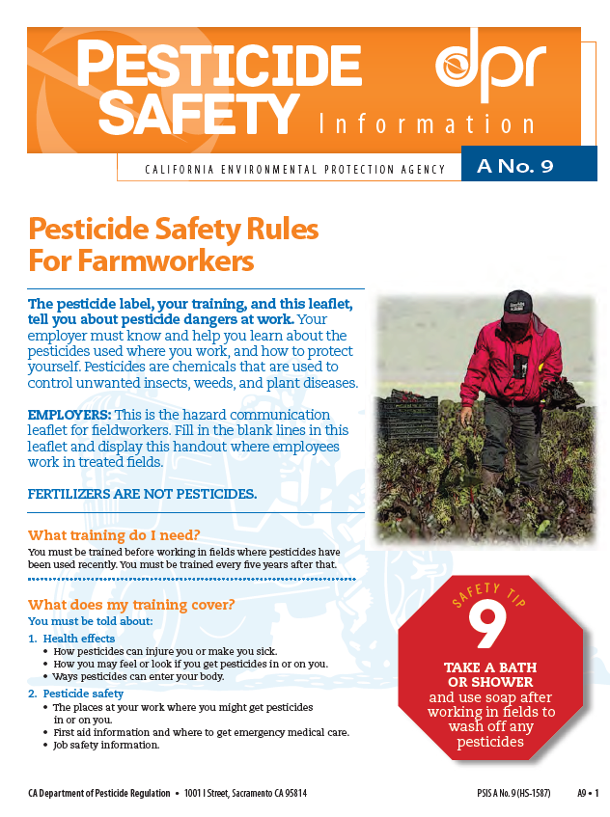
2019 FWSI Violations
Hazard Communication for Fieldworkers (A-9)
Locations to be filled in:
Emergency medical care location
Pesticide application records
Safety training records location
County Agricultural Commissioner address and number
Requirements:
Required for fieldworkers
Spanish copy if fieldworkers not fluent with English
Notes:
A very common violation is issues with the Hazard Communication for Fieldworkers (A-9) Form
This form provides fieldworkers with pesticide safety information. It is required when fieldworkers are working in any field treated with pesticides. Examples of fieldworkers are: irrigators, weeding/thinning crews and harvesters.
It must be displayed at a central location on the ranch. Often times it is posted on a board in a spot where workers begin their workday. Sometimes it is kept in the supervisors truck or a crews bus in a binder with other important documents. If kept in a vehicle, its important to remember the form must stay on site while the fieldworkers are working in the field. A common violation is the supervisor had to leave and the form is in the truck with them.
There are four places on the form to fill in; the location of emergency medical care, pesticide application records, location of training records, and the local county agricultural commissioners office.
This is the English A-9 form for pesticide handlers in agricultural settings. A Spanish form must also be present if fieldworkers are not fluent in English.
========================================================================
The A-9 form must also be posted at permanent decontamination facilities and decontamination facilities servicing 11 or more handlers. A good example of a facility servicing 11 or more handlers are the portable restrooms as seen on the right of this slide.
Remember any changes to the emergency medical care must be updated on all A-9 forms within 24 hours of the change.

Slide 7
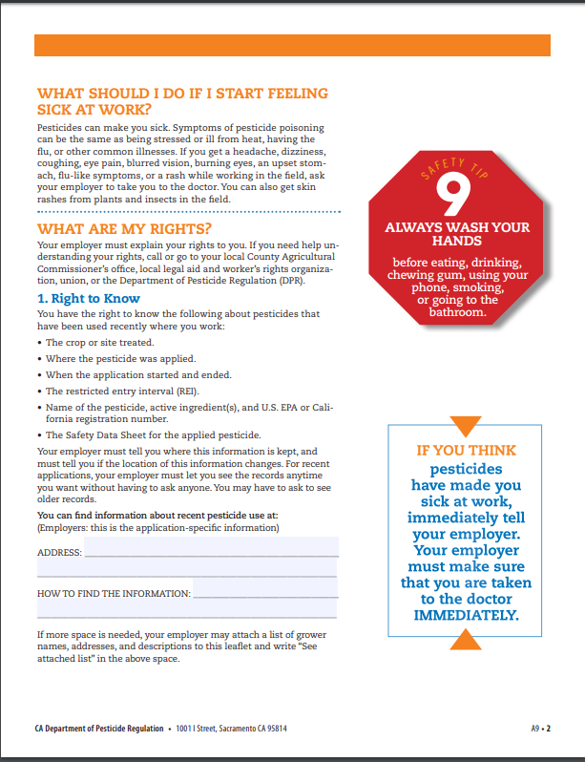
2019 FWSI Violations
?
132 Sun Rd,
Somewhere CA 93657
Notes:
Here is an example of the A-9 Form that is checked for completion during an inspection. As you can see the address is filled in, but the how to find the information box is not filled in. For example this can say “in red binder next to front office desk” or any other descriptive location for the information. Other violations occur when the location changes, the inspector is unable to easily find the documentation at the location listed or the application information is missing. This information must be available unimpeded to any employee seeking the information, it cannot be located somewhere they are not allowed to access.

Slide 8
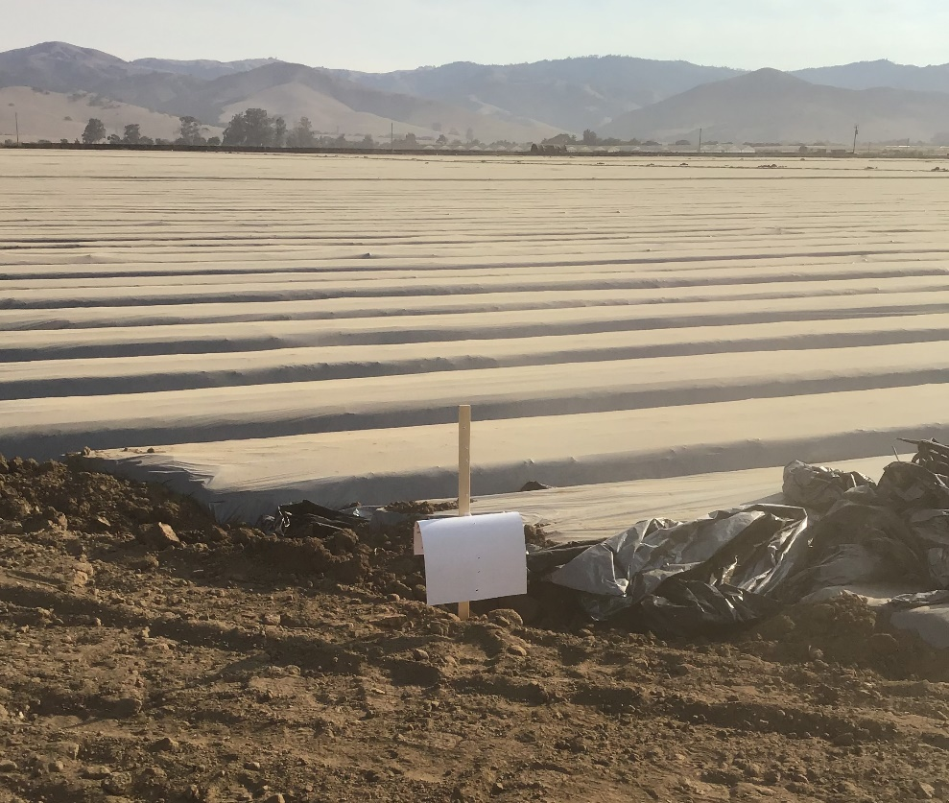
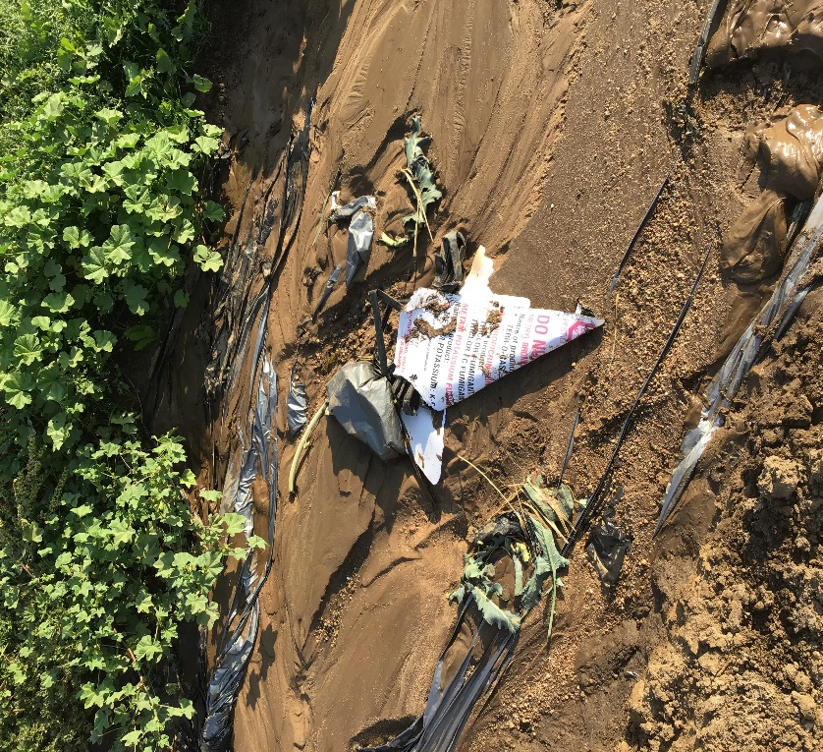
2019 FUMI Violations
Signs must be readable, and the skull and crossbones symbol is clearly visible . . . from a distance of 25 feet.
Notes:
Another common issue was with posting signs. Posting signs must remain legible throughout the duration of the buffer zone period and reentry interval. Signs need to remain legible for the entirety of the active buffer zone and reentry period. Although commonly posted by Pest Control Businesses, ultimately the grower is responsible for posting and maintaining signs. We do not want to see signs like shown in the picture which are unreadable or destroyed.

Slide 9
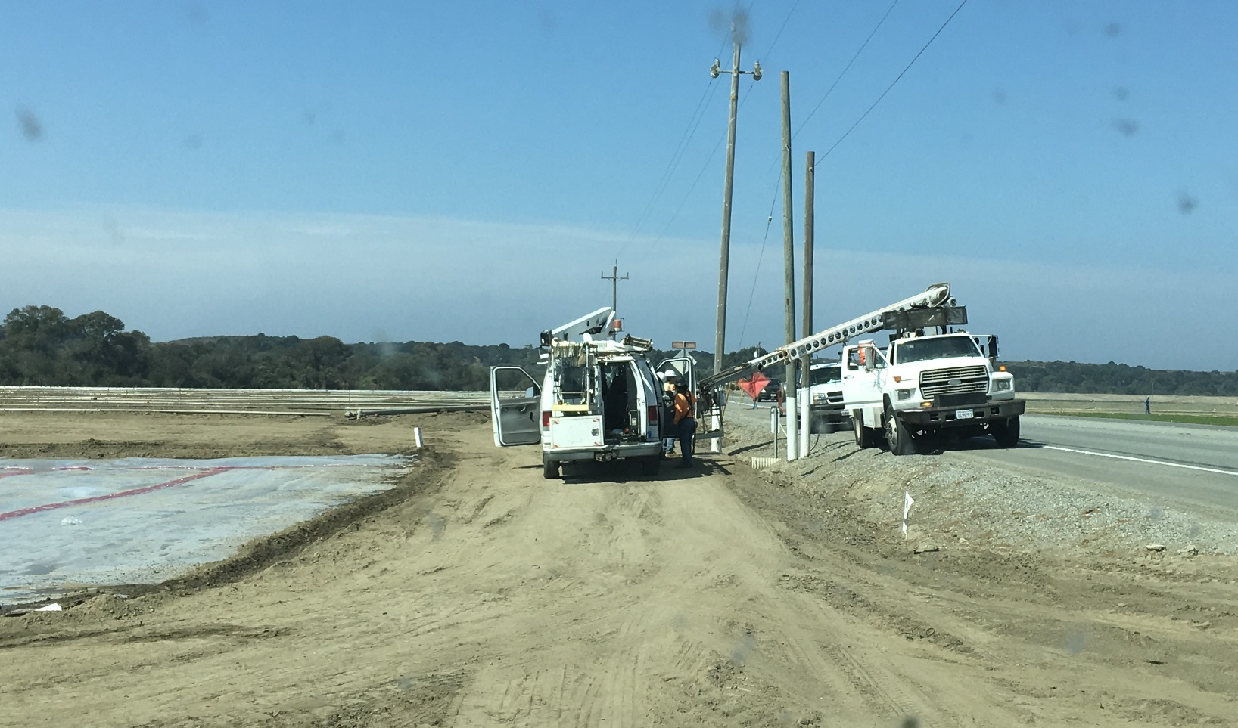
2019 FUMI Violations
Notes:
This picture shows a good example of a buffer zone violation. A telecom company has pulled into an active buffer zone and parked to begin work, this would result in a violation. Buffer zones need to be monitored to keep unaware people out. The above statement is pulled directly from the encroachment agreement signed prior to a fumigation. Remember you are responsible for keeping people out of the buffer zone even if it is your neighbor performing the fumigation!

Slide 10
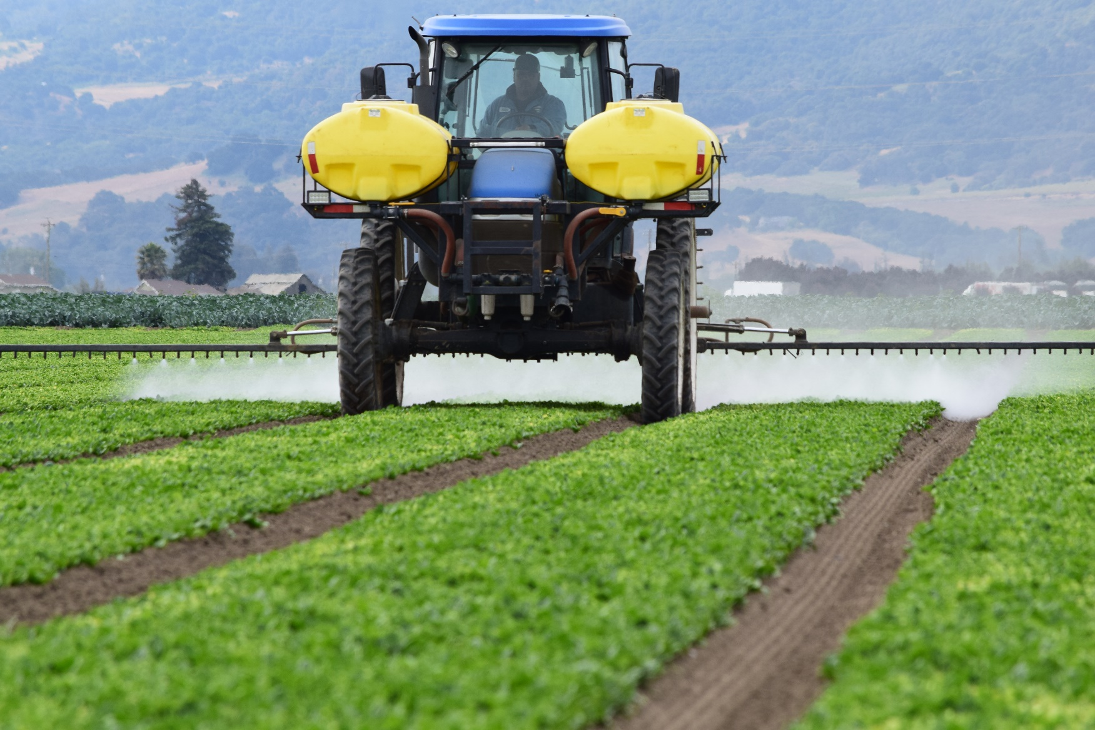
2019 PUMI Violations
Notes:
Next we will cover common violations found during a pesticide use monitoring inspection.

Slide 11
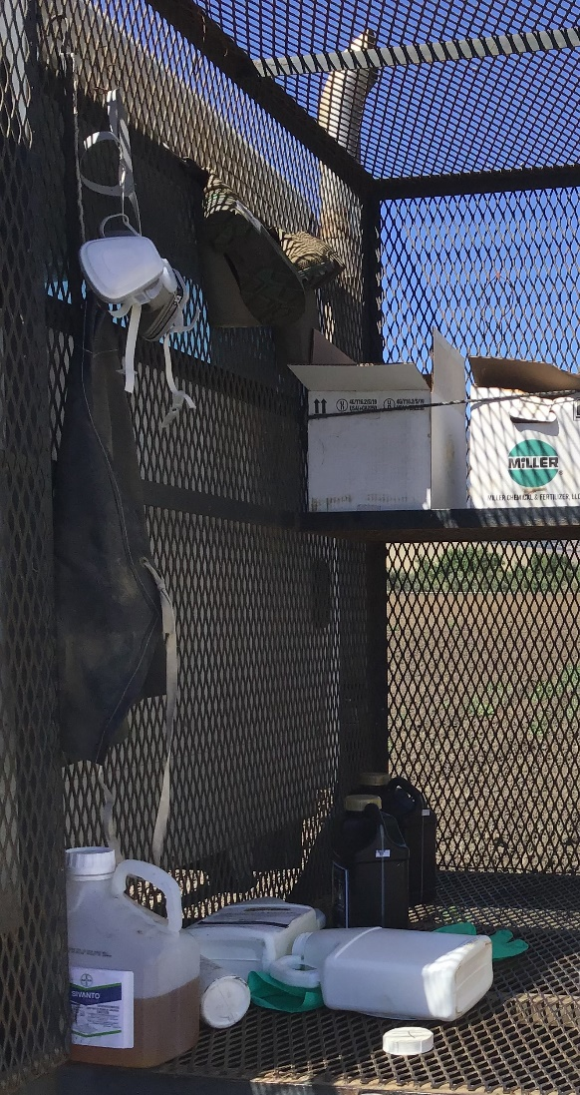
2019 PUMI Violations
Personal Protective Equipment (PPE)
Employer must provide PPE.
PPE must be kept separate from personal clothing and in a pesticide free area.
Notes:
Employer must provide all personal protective equipment (PPE) required by label, regulation and permit conditions, provide for its daily inspection and cleaning, and repair or replace any worn, damaged or heavily contaminated PPE. Employer must assure that all clean PPE is kept separate from personal clothing and in a clean and pesticide-free designated place. A violation would be clean coveralls stored next to pesticide containers or contaminated PPE not kept separate from clean PPE. This picture shows an example of a violation due to PPE being stored inside the pesticide cage on a nurse rig.
RESPIRATOR NOTES…
When using respirators there must be a written respiratory protection program, as well as medical evaluation conducted prior to use, and an annual fit test record. These documents must be kept for 3 years.
Common violations found were:
No written respiratory protection program
Missing medical evaluation or fit test completed before receiving a medical evaluation.
Missing fit test records
Please remember, records shall be maintained while the employee is required to use respiratory protection and for three years after the end of employment conditions requiring respiratory protection, and shall be available for inspection by the employee, Director or Commissioner.

Slide 12
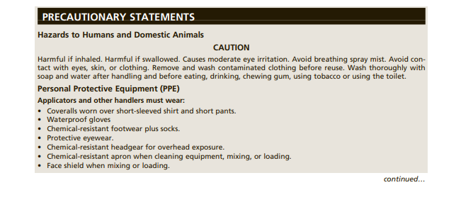
2019 PUMI Violations
PPE required for different activities while using this pesticide are located on the label of each pesticide.
Notes:
Here is an example precautionary statement taken from a pesticide label showing all the required PPE to be worn while using this material. As you can see this label allows for a broad choice of PPE with vague statements such as “waterproof glove” not chemical resistant. as well as simply “protective eyewear”.

Slide 13
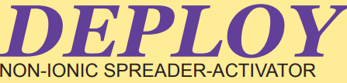
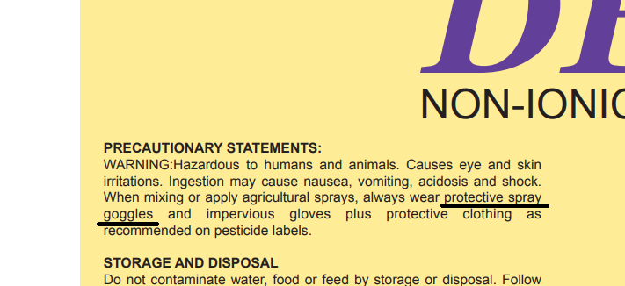
2019 PUMI Violations
The highest requirement PPE from any pesticide in a tank mix must be followed.
Notes:
This label shows the importance of reading each PPE requirement on each pesticide label in a tank mix, this label requires specifically “protective spray goggles”, therefore safety glasses would not meet this requirement resulting in a violation. Remember the highest PPE requirement of labels in a tank mix must be followed.

Slide 14
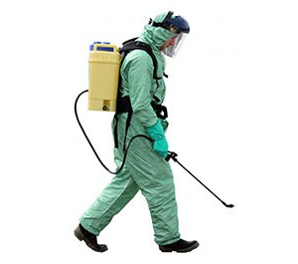
2019 PUMI Violations
California regulations on PPE (other than pesticide label)
Notes:
Besides what the pesticide label says, state regulations require that employees wear eyewear and gloves when mixing, loading or applying pesticides by hand and ground rig, or when exposed to application equipment that contains or is contaminated with pesticide. Also, state regulations require applicators to wear coveralls when applying WARNING or DANGER chemicals.
Reading the label for required PPE is good, but we need to be aware of these additional regulations. For example: If using a hand pump sprayer to apply a pesticide, eye wear and gloves would be required even if the pesticide label did not require them.

Slide 15

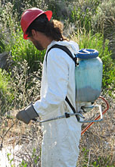

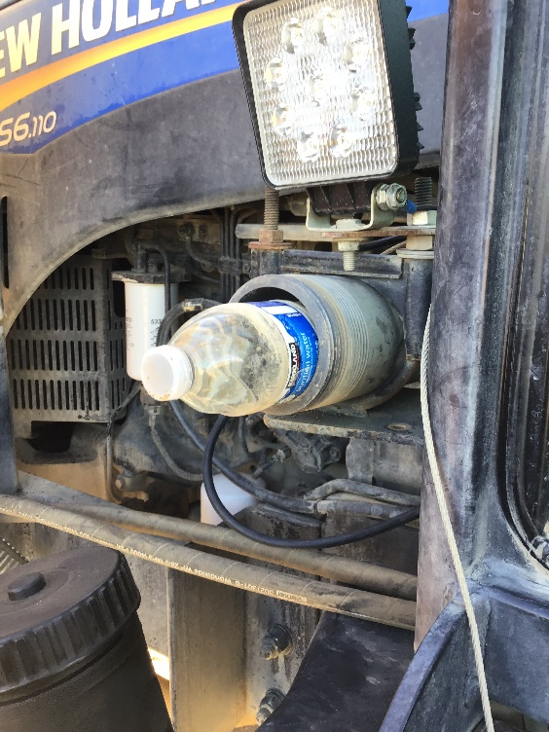

2019 PUMI Violations
Eyewash not immediately available
16 oz
Notes:
In most situations if the pesticide label requires the use of protective eyewear, emergency eye wash solution of 16oz must be immediately available. This eye wash solution can be as simple as a 16oz water bottle on the application tractor or carried on the handler. Violations occur when the pesticide applicator either did not have the eyewash immediately available, did not have 16 oz available, or did not have the eyewash at all. For instance, an inspection could find that the handler had left the 16oz water bottle in the truck and had no replacement on the tractor, since the eyewash is not immediately available it would be a violation.

Slide 16
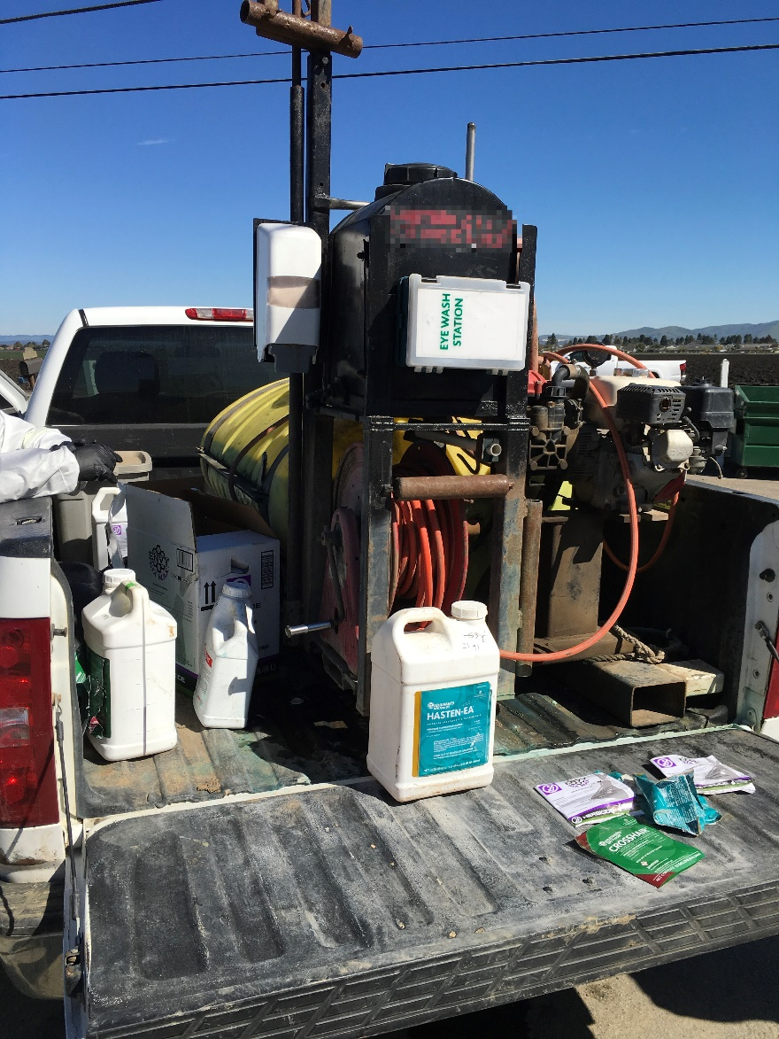

2019 PUMI Violations
Items missing from the decontamination facility site
Must include: soap, single use towels, sufficient water, and a pair of clean overalls
Notes:
Missing decontamination supplies are another common issue. The decontamination facility site must include sufficient soap, single use towels, water and a pair of clean coveralls. Many of the growers who received violations were due to them not having single use towels or an extra pair of clean coveralls available. It is important to remember that coveralls need to be available, even if the pesticide label doesn’t require it as PPE. The coveralls are not a second set of clothes, they are for emergency use after water and soap have been used. Please remember that the eye wash and decontamination are separate requirements and decontamination water is not a substitute for the 16oz eye wash.
Next, I’ll be discussing what triggers an investigation by our office, as well as explaining the different types and approaches to these investigations.

Slide 17
What triggers an
Investigation?
Sources of Pesticide Episodes Complaints from:
    Public
    Grower
    Pest Control Business
    Farm Labor Contractor
    Field Worker
    DPR Worker Health & Safety Report
    Doctor’s Illness Report
Notes:
Our office initiates an investigation into a suspected pesticide exposure event when we become aware such a thing may have occurred.
There are many potential sources including (read the list)
Other sources exist as well.

Slide 18
Types of Episodes
Investigated
Human Effects - Pesticide exposure and illness
Property Damage - Property damage or loss due to contamination (plant damage, crop loss)
Environmental Effects - damage to the environment: fish or wildlife kills, lake or stream contamination, ground water contamination, soil contamination and air pollution.
Antimicrobial – household bleach, medical sterilant, institutional decontaminant
Other - Bee kills, domestic animal poisoning, residues causing crop loss – inability to market commodities
Notes:
There are several types of investigations we work on. (read slide)

Slide 19
Types of Investigations
General Investigation includes:
One in which there are fewer than Five people experiencing symptoms of pesticide exposure.
Notes:
A “general investigation” includes (read slide)
Some stats.
Since 2016 we have completed.
10 priority investigations
67 non-priority
*non-priority include human effect agricultural, human effect antimicrobial, environmental, property loss,
Currently we have ongoing.
5 priority investigations
8 human effect agricultural
5 human effect antimicrobial

Slide 20
Types of Investigations
Priority Investigation includes:
  Death
  Serious illness or injury requiring hospitalization of One or more persons
  Five or more people experience symptoms
  CAC will immediately notify DPR
Notes:
Some types of investigations are given the designation “priority”
These include pesticide episodes that caused (read slide)

Slide 21
Approach to
Drift Investigation
Sample Collection with DPR approval
Interviews with all persons involved
Label review for violations
Review of weather data
  wind speed
  wind direction
Notes:
We do conduct investigations of apparent pesticide drifts from the application site to offsite locations.
These include complaints of pesticides moving onto vehicles traveling on roads adjacent to the application site, or onto a person or persons not involved in the application of the pesticide
Examples include fieldworkers, residents, pedestrians and others
In those cases, once we learn enough to initiate the investigation, we follow protocol outlined by DPR
Our approach to drift investigations includes, but is not limited to, (read slide)
If prompted:
Weather data = Dept of Water Resources’ CIMIS= California Irrigation Management Information System

Slide 22
Approach to
Drift Investigation
Review of lab analysis report from DPR
Investigation review and write-up
If violations are found
  Decision report
  Compliance or enforcement action such as ACP
  Formal Referral to District Attorney
Notes:
In addition we (read slide)

Slide 23
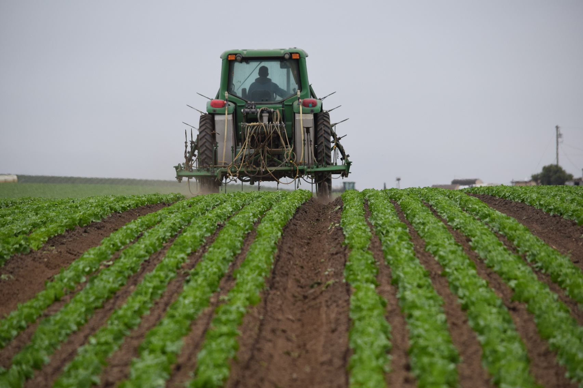
Regulatory Updates
Notes:
Next we will be discussing new regulatory updates as well as reminders about some existing regulations.

Slide 24

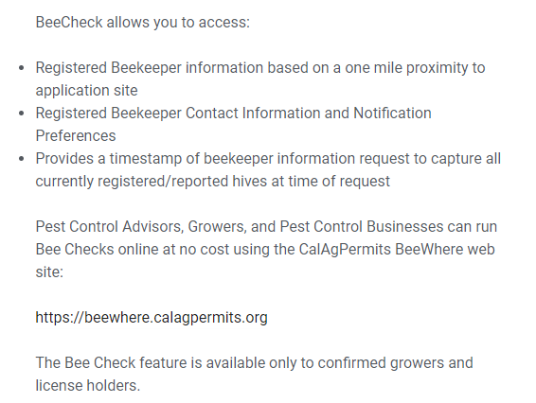
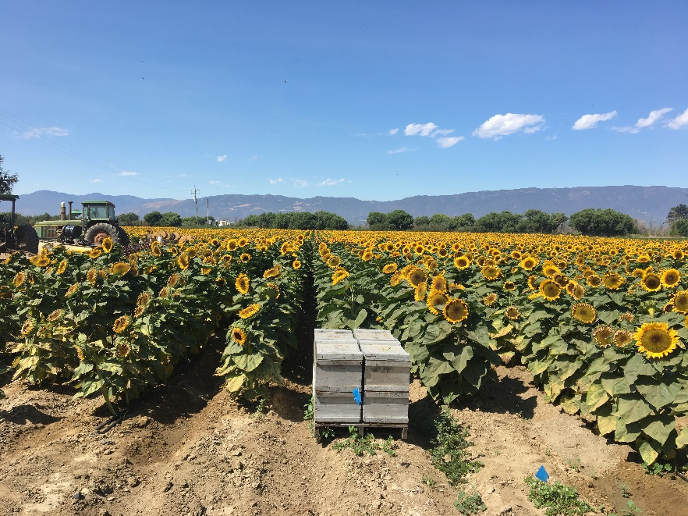
Apiary Update
Notes:
Bee where is a website designed to simplify the process of checking for any bee hives within 1 mile of a proposed application site. PCA’s Growers and Pest Control Businesses can login into the site to perform a BeeCheck as well as send the notification to any beekeeper who has requested notice. Advance notice of applications is now mandatory if any bee keeper with hives within 1 mile of the application site has requested notification of pesticides hazardous to bee health occurring nearby.
Advanced notice is mandatory under 3 CCR § 6654(a):
“Each person intending to apply any pesticide toxic to bees to a blossoming plant shall, prior to the application, inquire of the commissioner, or of a notification service designated by the commissioner, whether any beekeeper with apiaries within one mile of the application site has requested notice of such application.“

Slide 25
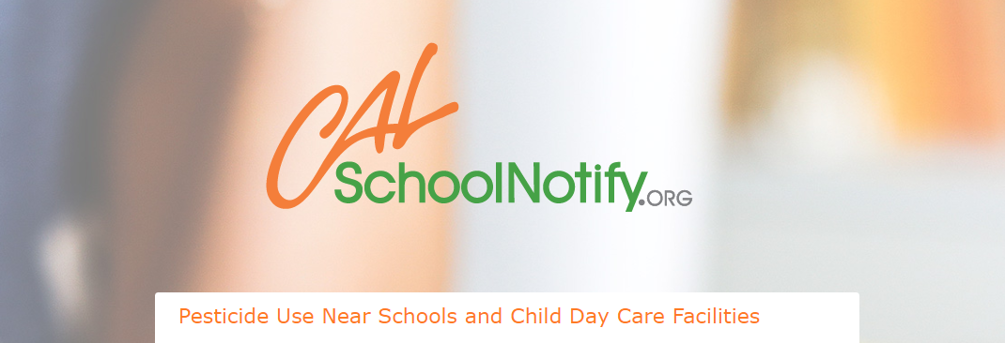
School Notification Reminder
The notification period runs from July 1 through June 30 of the next calendar year, and growers must submit the notifications by April 30 for the next notification period.
Growers must also notify school sites at least 48 hours prior to using an active ingredient that is not currently listed on the notification, and within 30 days after acquiring a new site.
Notes:
School notifications for the July 1 2020 through June 30, 2021 period will need to be completed by April 30, 2020. Any new material you plan to use need to be listed on this notification 48 hours prior to use, as well as within 30 days taking control of a new site. If you take control of new ground in the spring within a school site notification boundary, you will need to submit the notification within the initial 30 days of taking control of that ground and prior to any pesticide use.

Slide 26
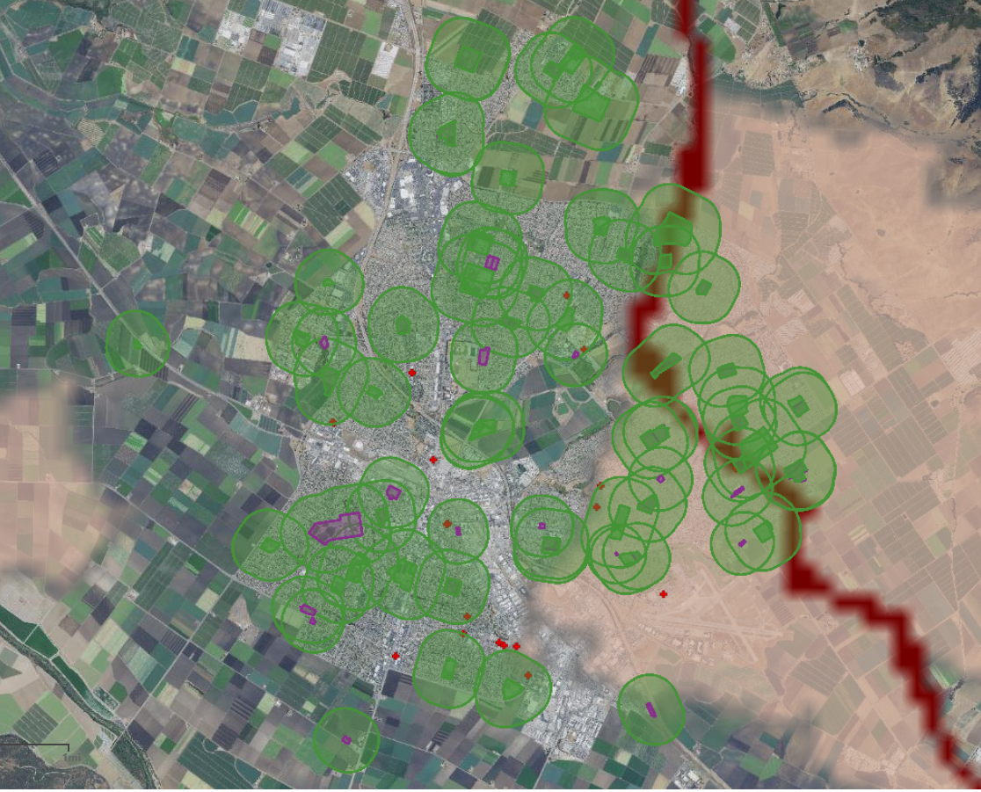
School Notification Reminder
106 growers required to generate 322 notifications for 2019
Notes:
This slide show the number of notifications generated this year, with 106 growers generating 322 notifications to 120 schools and childcare facilities. As you can see with this snapshot of Salinas some sites may have multiple facilities ¼ mile buffers overlapping.

Slide 27
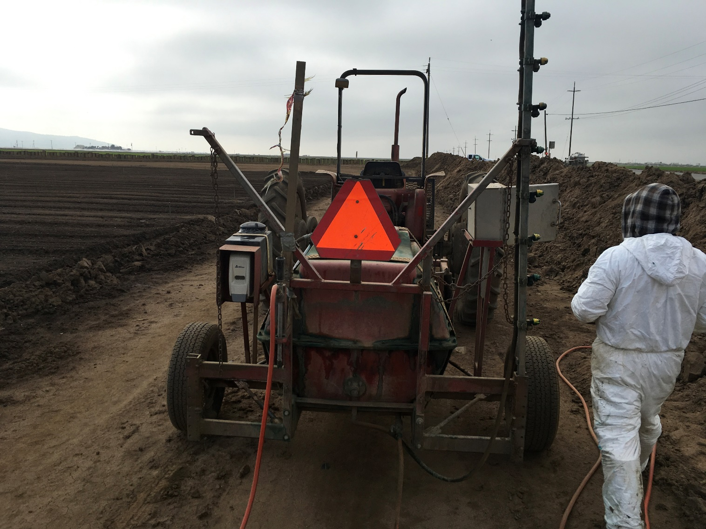
2019 Paraquat updates
Notes:
Next there have been significant changes to the labels of all paraquat herbicides. New labels now have additional restrictions due to the risks associated with handling this material including sickness from dermal exposure and fatalities from ingestion.
A single sip of paraquat can be fatal. Since 2000, accidental ingestion of paraquat has caused 17 deaths nationwide.
Paraquat being transferred to drinking bottles was the most common cause.
In addition to deaths by accidental ingestion, three deaths and many severe injuries were caused by the pesticide getting onto the skin or into the eyes of those working with it.

Slide 28
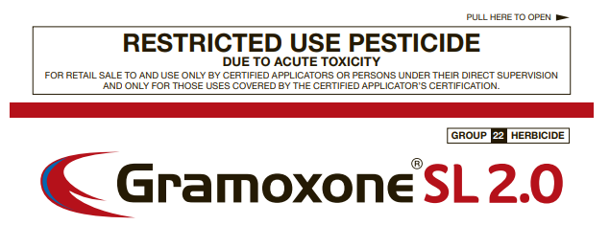
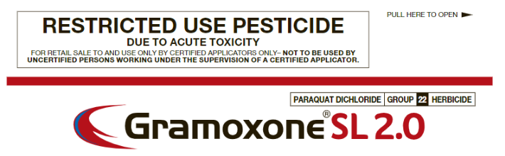
2019 Paraquat updates
Old Label
New Label
Notes:
Use of paraquat now requires each applicator to be a certified applicator, this can be either PAC, QAC or QAL. CLICK THE BUTTON Handlers can no longer be trained by a certified applicator, but must be certified themselves to handle or apply this material. Growers and their employees may obtain private applicator certificates issued by our office after passing the exam, to use this material. Pest control businesses will need their employees to obtain either QAC with Category D or QAL with Category D from the Department of Pesticide Regulation to continue to apply this material.

Slide 29
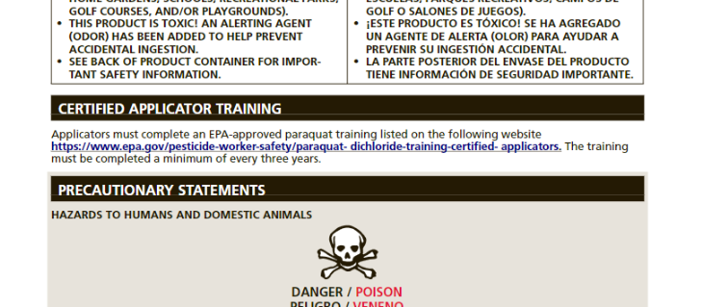
2019 Paraquat updates
Additional web based training must be completed by handlers prior to use.
Website for additional training is located on the product label.
Training certificate is good for 3 years.
Notes:
Additional training is required by certified applicators prior to use of paraquat. The website to receive this training is located on the new product labels and needs to completed for each handler prior to use. With this information in mind we suggest you evaluate your herbicide programs to comply with these requirements or search for any alternatives that may suit your needs. Please feel free to contact us if you have any questions about these new requirements.

Slide 30
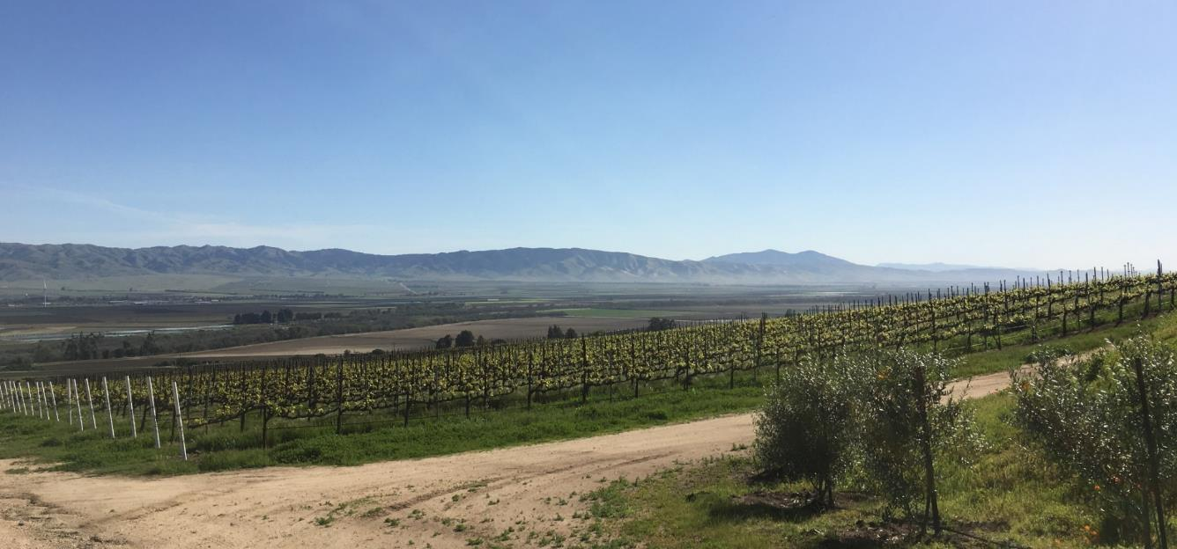
Questions?
1428 Abbott St., Salinas, CA 93901  PUE Office Duty (831) 759-7340
Notes:
With that said are there any questions?

