Slide 1
Fumigant Application Technologies and Compliance with Current Regulations
Methyl Bromide
1,3-Dichloropropene
Chloropicrin
Mike Stanghellini
TriCal, Inc.
April 2015

Slide 2
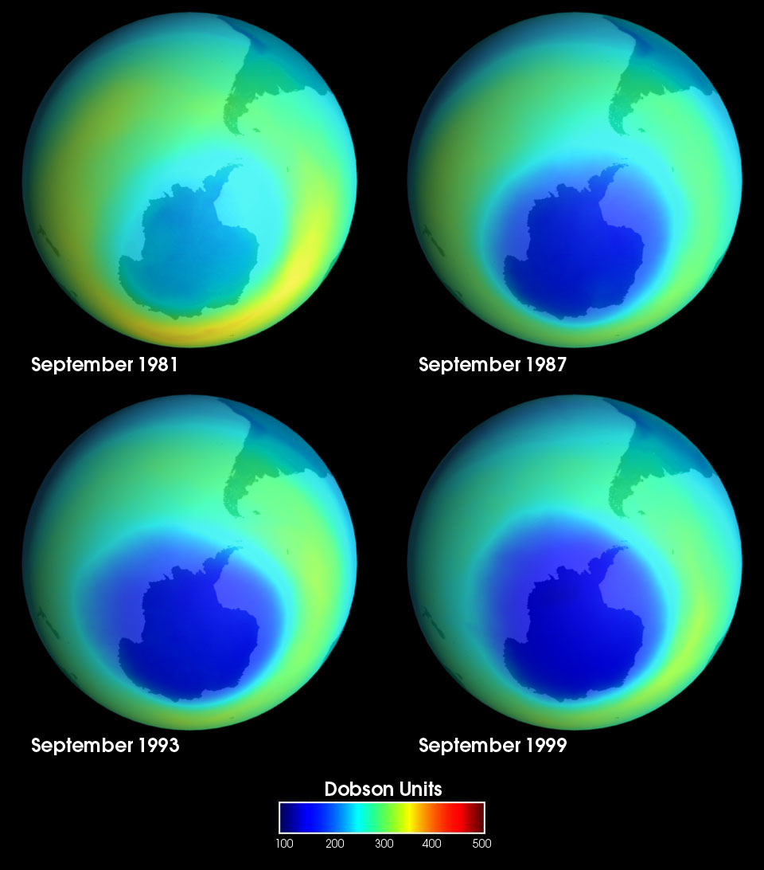
Methyl Bromide
Montreal Protocol:
International ban on substances that deplete the Ozone Layer
Elimination / Phase-Out of:
Refrigerants, insulating foams, and solvents
Chlorofluorocarbons (CFCs)
Hydrofluorocarbons (HFCs)
Halons (fire extinguishers) and others
Methyl Bromide:
Quarantine/Pre-Shipment (QPS) is exempt
Crop, Post-Harvest, and Structural Use Phase-Out
Developed Countries: phase-out by 2005
Critical Use Exemptions post-2005
Developing Countries: phase-out by 2015
Developing Critical Use Exemptions

Slide 3
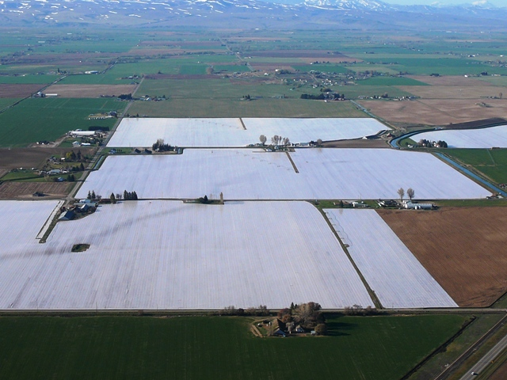
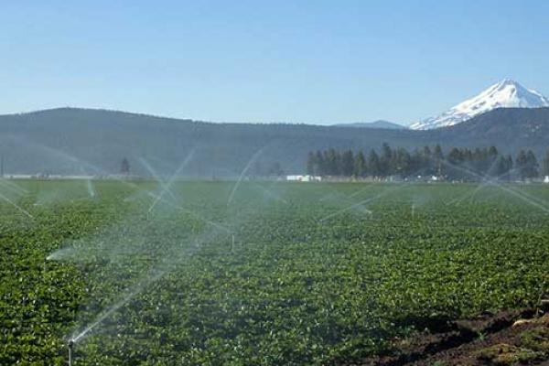
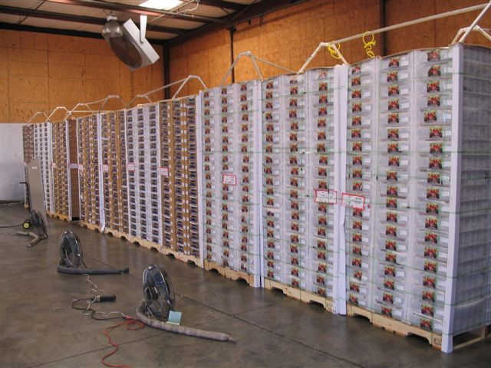
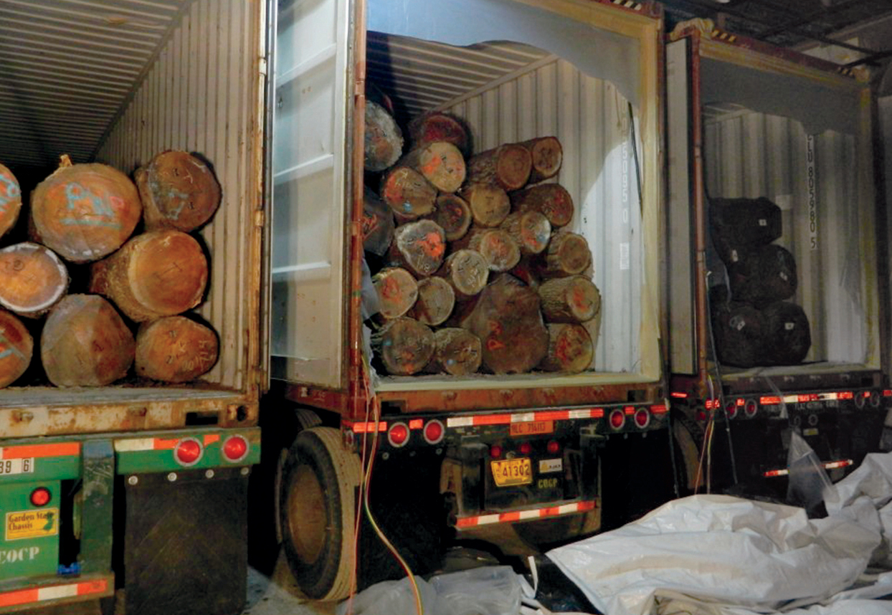
Quarantine/Pre-Shipment (QPS) treatments are exempt
Strawberry and Other Nursery Crops
USDA-APHIS (e.g., Pale Cyst Nematodes)
Fruit Import (e.g., Chilean Grapes)
Oak Log Export

Slide 4
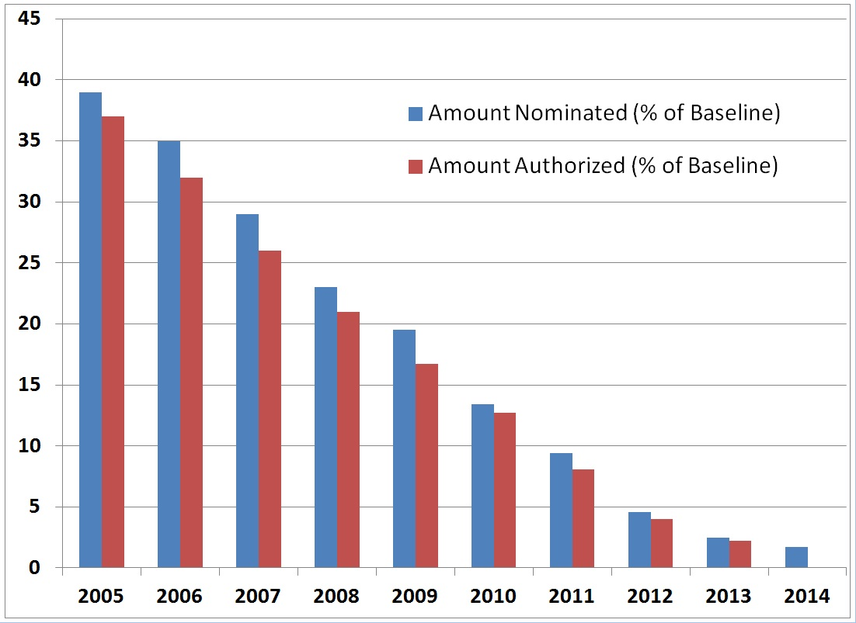
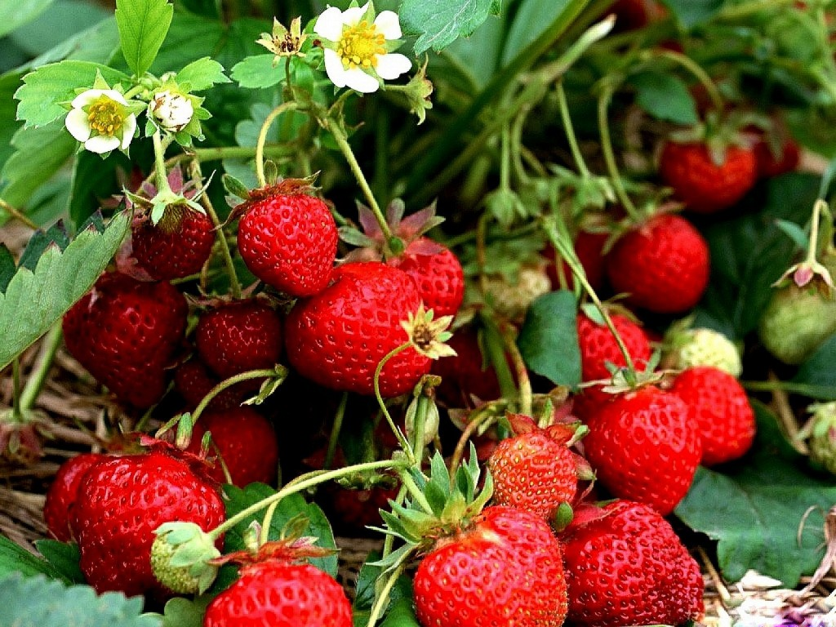
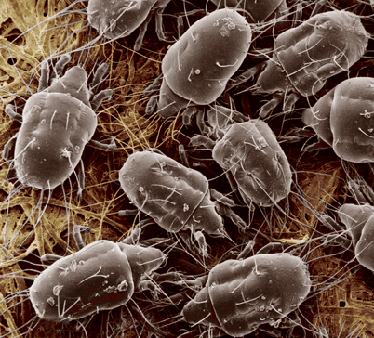
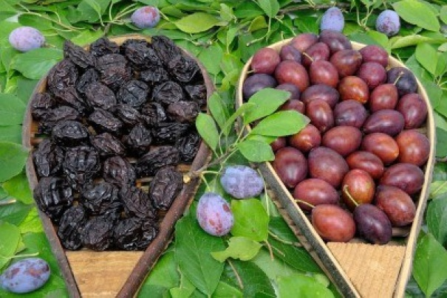
10⁺ Years of Critical Use Exemptions (CUE)
US Methyl Bromide Nominations and Approvals
% of Baseline (~56 million lbs)
1.5%
0.9%
0 ?
2015 2016 2017

Slide 5
For non-quarantine uses, current federal MB labels restrict use of MB to crops that have current CUE
Crop | Actual Status for 2014
Eggplant | Lost CUE
Cucurbits | Lost CUE
Forest Seedlings, Orchard Seedlings, Strawberry Nurseries | Lost CUE (but covered under CDFA Nematode-Free Certification Program)
Ornamentals | Lost CUE
Orchard Replant | Lost CUE
Peppers | Lost CUE
Strawberry Fruit (2015-2016) | CUE
Sweet Potato Slips | Lost CUE
Tomato (fresh market) | Lost CUE
Some sectors have reapplied for CUE.
CA cut flowers, CA orchard replant, Golf Courses

Slide 6
USEPA Soil Fumigant Re-Registration: MB, Pic, MITC Generators
Approximately 15 years of data generation, reviews and dialog with USEPA
○ = was under development ● = was adopted completely
Risk Mitigation Measure | Phase I (2010) | Phase II (2012)
Restricted Use | ● | ●
Use site limitations | ● | ●
Rate reductions | ● | ●
Good Agricultural Practices | ● | ●
New handler protections | ● | ●
Tarp cutting and removal restrictions | ● | ●
Extended worker reentry restrictions | ● | ●
Training information for workers | ● | ●
Fumigant Management Plans | ● | ●
First responder and community outreach | ○ | ●
Applicator training | ○ | ●
Compliance assistance and assurance measures | ○ | ●
Restrictions on applications near sensitive areas | ○ | ●
Buffer zones; Credits; Posting; Overlap Prohibitions | ○ | ●
Emergency preparedness measures | ○ | ●

Slide 7
USEPA’s Registration Review started September 2013.
Opportunity for refinements to labels.
Can we streamline the FMPs?
Can newer (post-2009) emissions data reduce the federal buffer zones?
Runs through ~2019
MB, Pic, MITC, and will also include 1,3-D (RED completed in 1998)

Slide 8
CDPR
Chloropicrin Risk Mitigation Program
VOC Regulations
Telone Township Caps

Slide 9
Chloropicrin Mitigation in California Timeline
July 2008 USEPA finalized the Re-Registration Eligibility Decision (Pic, MB, MITC)
Feb 2010 DPR completed the Risk Characterization Document
Dec 2010 DPR issues Risk Management Directive (endpoint = 73 ppb, same as EPA)
Jan 2011 Chloropicrin designated a Toxic Air Contaminant (triggers Risk Mitigation)
Dec 2012 Federal (Phase II) Labels go into effect
May 2013 DPR issued Proposed Mitigation Measures (Acute Exposure to Bystanders/Residents)
Jan 2015 DPR issues Final Chloropicrin Mitigation Measures (Bystanders/Residents)
DPR proposal for worker exposure changes has not yet been released
May 2015 Negotiate California-specific labels with DPR and USEPA
2016 New CA labels go into effect

Slide 10
DPR changes affect:
Buffer Zones
Buffer Credits
Approved Tarps
Minimum Buffer Zones
Acreage Limits
Overlapping Buffer Zones
Emergency Preparedness and Response
Emergency Response Plan
Notice of Intent Requirements
Tarp Cutting Requirements
Tree Hole Fumigation
Fumigation Time Restrictions

Slide 11
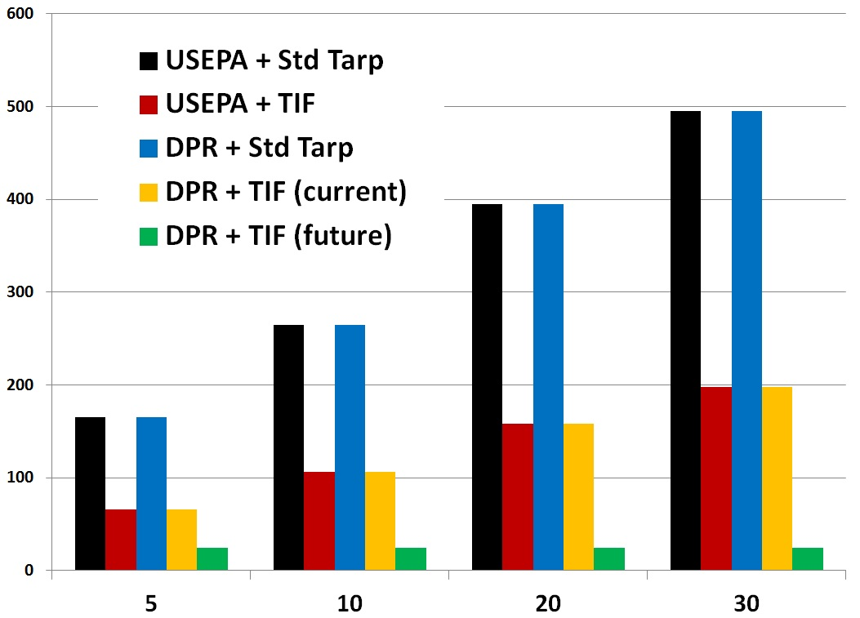
Buffer Zone Distance (feet) for 300 lbs chloropicrin/acre
Tarped Broadcast
Buffer Zone (feet)
Application Block Size (acres)

Slide 12
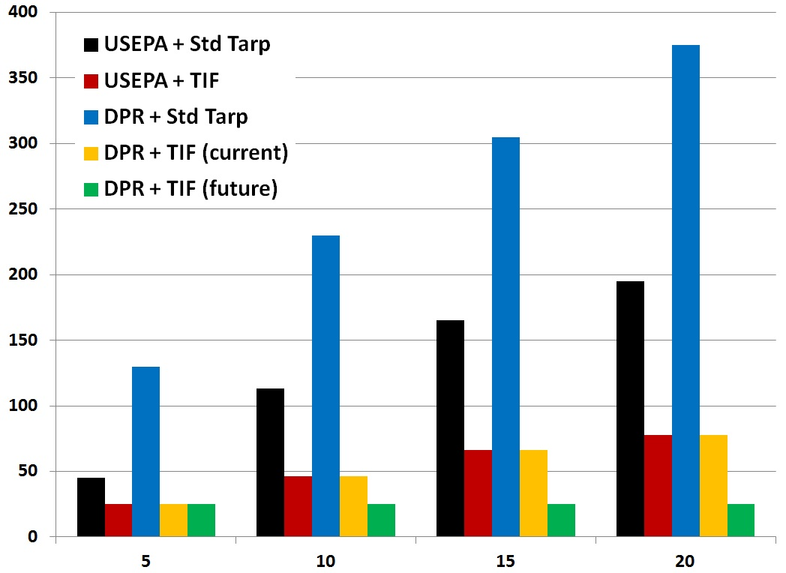
Buffer Zone Distance (feet) for 225 lbs chloropicrin/acre
Tarped Drip
Buffer Zone (feet)
Application Block Size (acres)

Slide 13
Approved Buffer Zone Reduction Credits:
USEPA vs. DPR
Credit | USEPA | DPR
1-2% organic matter | 10% | 0%
2-3% organic matter | 20% | 0%
>3% organic matter | 30% | 0%
Water Seals | 15% | 0%
Degradation Accelerants | 15% | 0%
Metalized Tarp | 20% | 0%
VIF Tarp | 40% | 0%
TIF Tarp | 60% | 60%
Additive Totals | 80% max credit | 60% max credit

Slide 14
DPR is refining the list of TIF-qualified (60% buffer credit list).
Films behave differently in the presence of high relative humidity
Film Composition | Ambient %RH | High %RH | Fold Increase
Polyethylene (LDPE) | 2.2710 | 2.6259 | No real change
Polyethylene (HDPE) | 0.7104 | 0.7754 | No real change
Nylon-1 | 0.0011 | 0.1563 | 142
Nylon-2 | 0.0001 | 0.3877 | 3,877
Nylon-3 | 0.0001 | 0.9499 | 9,499
EVOH-1 | 0.0001 | 0.0038 | 38
EVOH-2 | 0.0001 | 0.0006 | 6
The nylon films on USEPA’s 60% buffer credit list will likely not qualify for DPR’s “TIF” list. These nylon films would be treated the same as polyethylene.

Slide 15
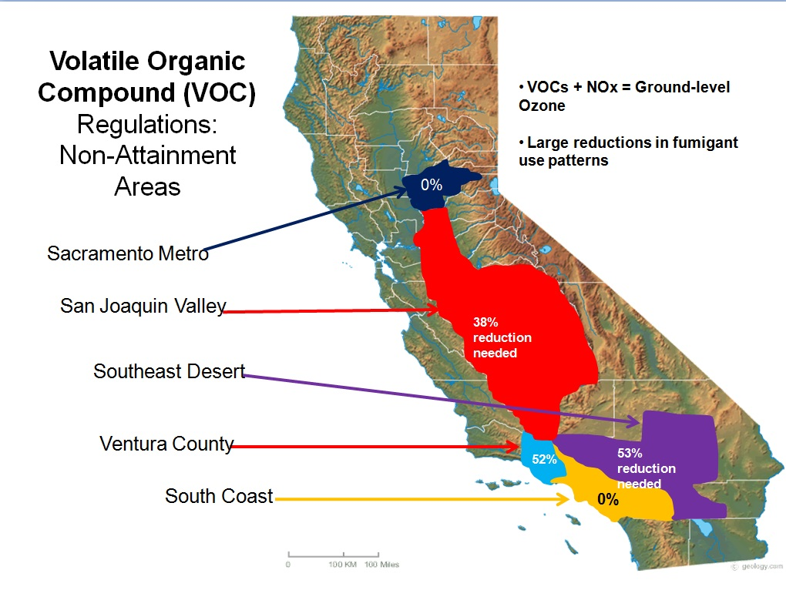
VOC Regulations
VOCs + NOx = ground-level ozone (smog)
DPR imposed rules on fumigant use:
When, what methods, etc.
2013 changes for broadcast TIF
2014 changes for non-tarped Pic
2015 changes for drip TIF (in progress)

Slide 16
DPR’s VOC Emissions Ratings – 2013 changes for tarps
(% emitted = affects method options, rates, and timing)
Fumigant | Application Method | Standard Tarp | TIF
Chloropicrin | Shallow or Deep Broadcast | 44% | 7%
 | Drip | 12% | 7%
1,3-D | Shallow Broadcast | 65% | 10%
 | Deep Broadcast | 26% | 10%
 | Drip | 29% | Data in progress
*Prohibited during May-October (Poly tarp)
* Approved year-around (Standard Film)
* Approved year-round (TIF)

Slide 17
R9W
R8W
R7W
R6W
R5W
R4W
R3W
R2W
R1W
R1E
R2E
R3E
R4E
R5E
R6E
R7E
R8E
R9E
10E
11E
12E
13E
14E
R15E
R16E
R17E
R18E
R19E
R20E
R21E
R22E
R23E
R24E
R25E
R26E
R27E
28
29
30
31
32E
33
34
35
36
37
> 90,250
Telone Township Caps
Early 2014, DPR eliminated
Cap Exceptions
Townships with ‘banked’ lbs can
still use 180,000 adjusted lbs
No other changes for non-tarped
Affects sweet potatoes, carrots
TIF changes: Tarped markets should be able to navigate current and future Township Cap issues
52,000-90,249
13,001-51,999
<13,000
Sacramento
Merced
Salinas
Fresno
Bakersfield
Santa Maria
Ventura
Brawley
Ave 1,3-D Use since 1995 by Township

Slide 18
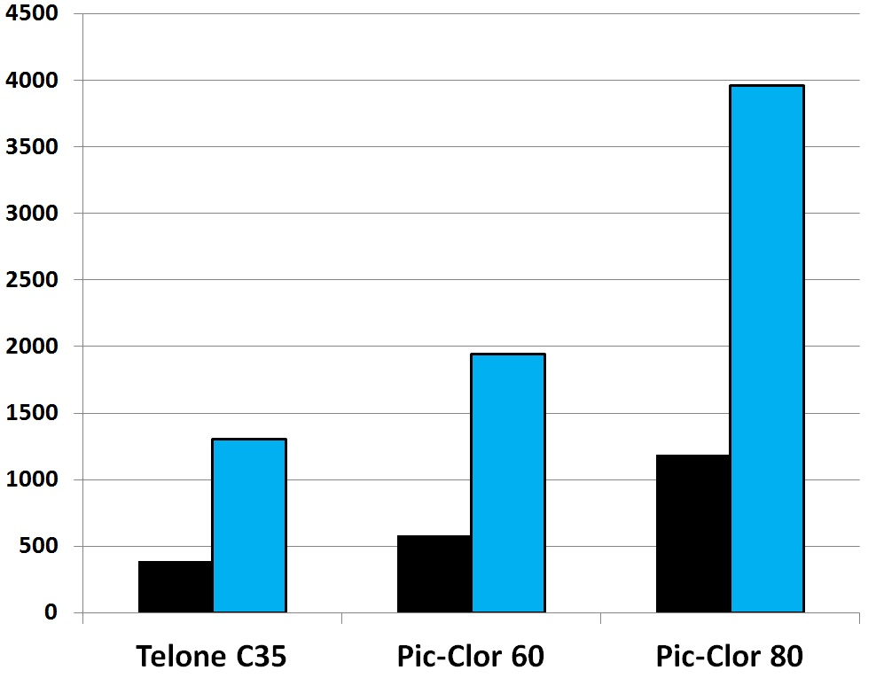
Telone Township Caps: Tarped Shank (drip data pending)
(allowed 90,250 “adjusted” lbs 1,3-D per 6x6 mile area per year)
Old Application Factor = 1.0 (any tarp)
TIF Application Factor = 0.3
Example rate: 33 gpa
TIF allows 3.3X increase in treatable acres
TIF + new formulation allows 6.6X increase
Default for Telone Cap issues: Tri-Clor
Treatable acres with per Township per Year

Slide 19
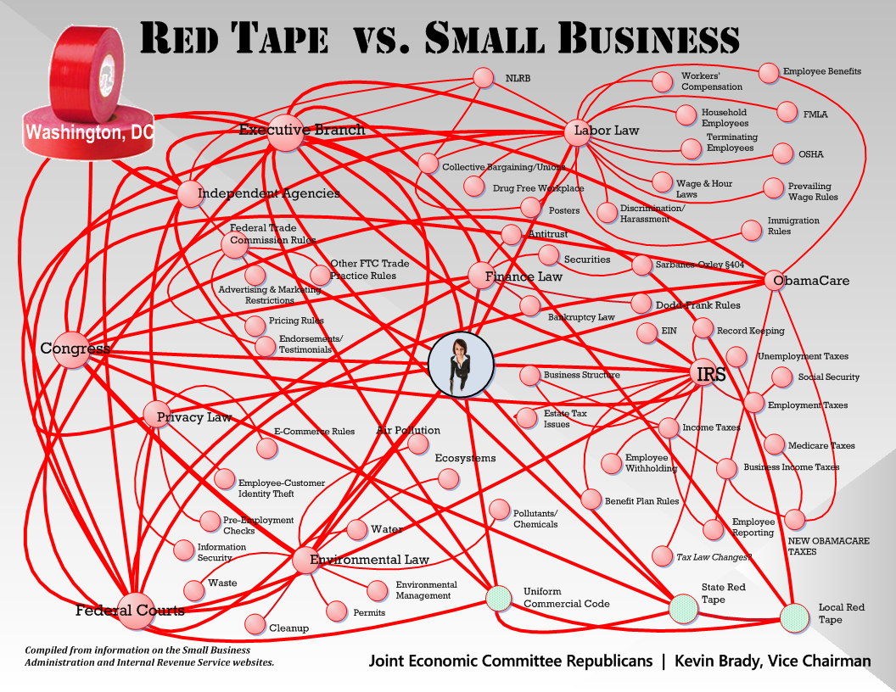
Regulatory Update
Ag
USEPA
AG
DPR

