Slide 1
Improving Irrigation and Nutrient Management in Ventura County Strawberry
Andre Biscaro,
Univ. of Calif. Cooperative Extension, Ventura County

Slide 2
Assessment of CropManage’s Water and Nitrogen Fertilizer Recommendations
(Validation studies – Year 2)
Andre Biscaro,
Univ. of Calif. Cooperative Extension, Ventura County
Michael Cahn, Oleg Daugovish, Nathan Bradford
Univ. of Calif. Cooperative Extension
Tim Hartz,
UC Davis

Slide 3
Objective
Assess CropManage’s water and nitrogen fertilizer recommendations
*Strawberry (2) and celery (1)

Slide 4
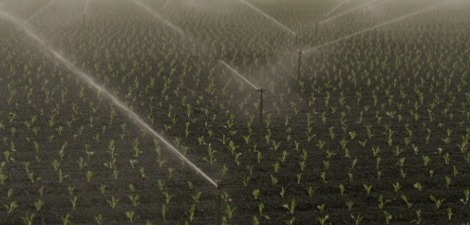
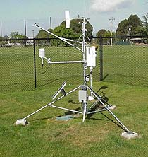
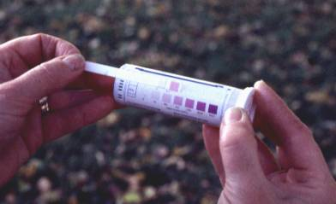
cropmanage.ucanr.edu
Soil and Ranch
Water
Recommendation
Crop ET model
Database driven web application
N fertilizer Recommendation
CIMIS ETo
Crop N model
Soil nitrate test
Notes:
Assist growers in making decisions on irrigation and nitrogen fertilizer management

Slide 5
How is N fertilizer rate determined?
Fertilizer N = Crop N uptake – Soil N
Soil N:
– Quick Test
Crop uptake???

Slide 6
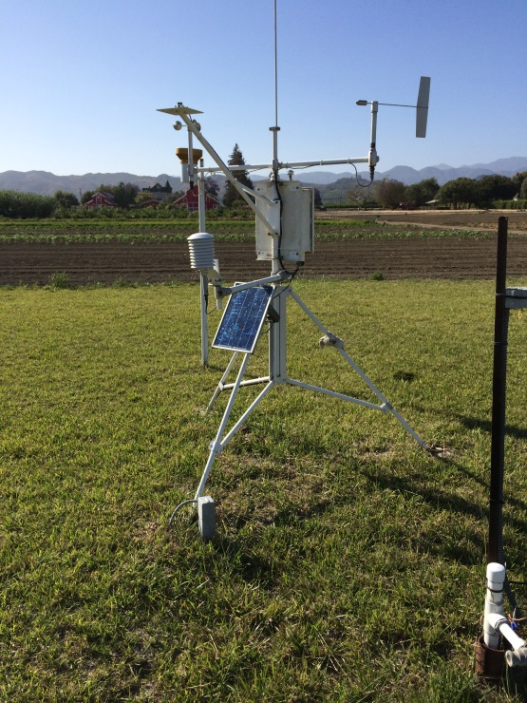
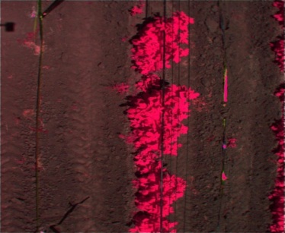
How Much Water?
ETo
Kc
x
Water
recommendation
Irrigation system application rate
Irrigation system application uniformity (DU)
Leaching fraction (water salinity)

Slide 7
Previous Year Measurements
2014/15 season:
6 strawberry fields (2 varieties)
2 celery fields
3 raspberry fields
4 sampling locations per field
Monthly:
Aboveground biomass and nutrient content (NPK)
Canopy cover (%)
Root depth
Soil mineral nitrogen
Yield and fertilizer records from participating growers
Notes:
weekly measurements of onion canopy coverage (%) collected with infra-red photos. The photos will be analyzed with PixelWrench II software to determine the percentage of canopy coverage

Slide 8
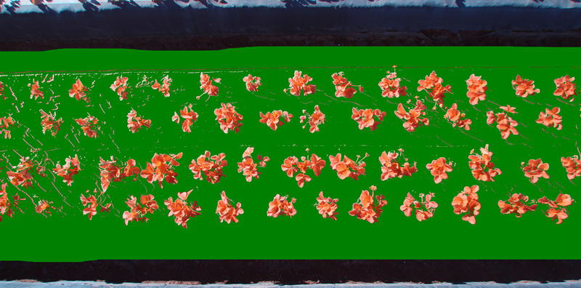
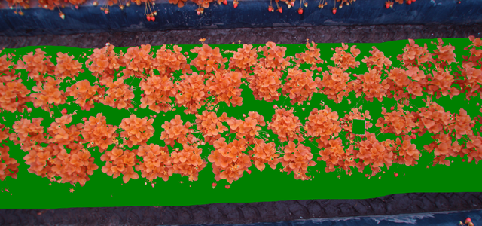
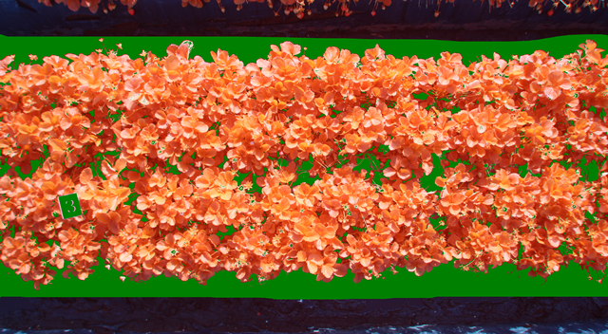
Canopy Cover
20%
20, 60 and 80%
60%
80%

Slide 9
Canopy Cover

Slide 10
Root Depth

Slide 11
Aboveground Biomass N

Slide 12
Nitrogen Uptake

Slide 13
Canopy Cover
Notes:
Both curves (N uptake and canopy) are sigmoidal. The N uptake equation is 3 parameters and the canopy curve is 2 parameters

Slide 14
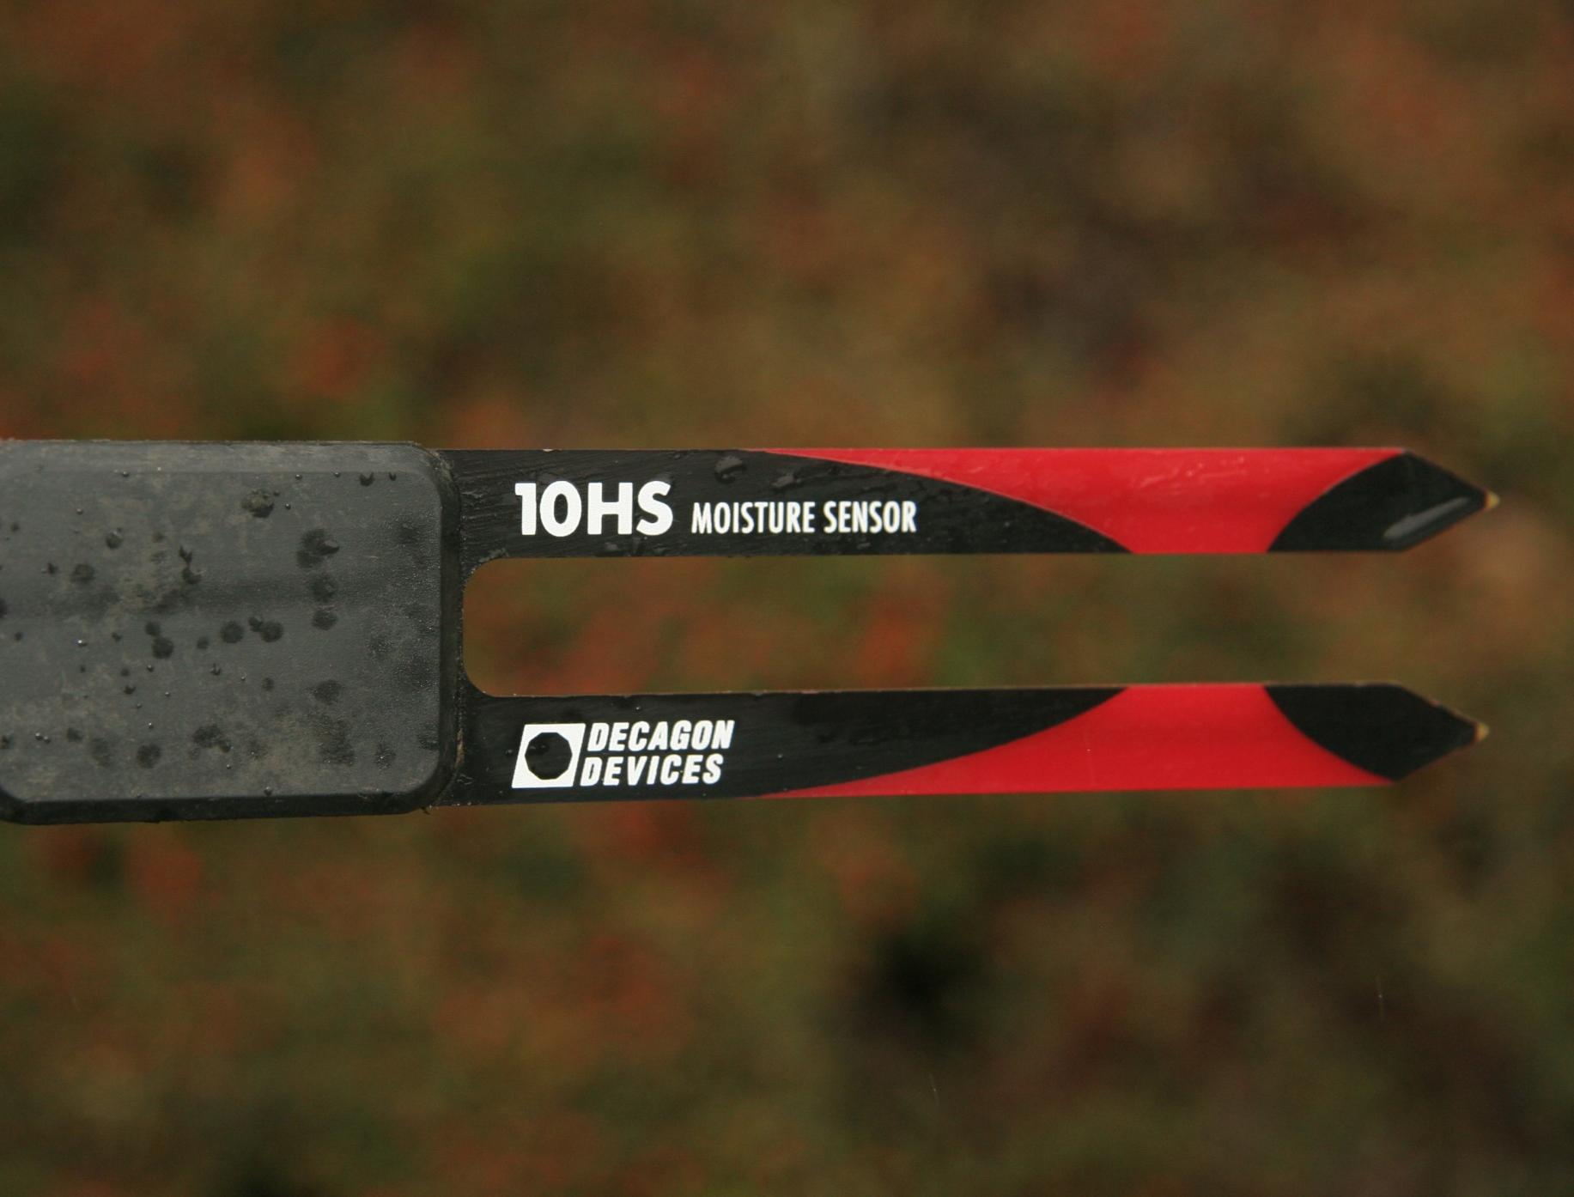
cropmanage.ucanr.edu
Soil and Ranch
Water
Recommendation
Crop ET model
Database driven web application
N fertilizer Recommendation
CIMIS ETo
Crop N model
Soil nitrate test
Field sensors
Notes:
Assist growers in making decisions on irrigation and nitrogen fertilizer management

Slide 15
Study 1, Strawberry

Slide 16
Design
 | CM | na | na | D | na | D | CM | na
plot # | 102 |  |  | 402 |  | 602 | 702
 | D |  |  | CM |  | CM | D
plot # | 101 |  |  | 401 |  | 601 | 701
 |  |  |  | Road
Planting date: October 17th
68” bed
3 tapes
Fruit yield est.: 71,333 lbs/A
Oct – March: same water and N fert.

Slide 17
Canopy Cover (%)

Slide 18
Canopy Cover (%)

Slide 19
Drip Irrigation (Feb-Jun, Weekly Total)
AF
D | CM
2.1 | 2.4

Slide 20
Water use - summary
 | D | CM
 | --- in ---
Drip Oct-Feb | 12.8 | 12.8
Drip Mar-Jun | 12.6 | 15.5
Total (in) | 25.4 | 28.3
AF | 2.1 | 2.4
Rain = 6in

Slide 21
Recommended vs Applied Water
(CM treatment)

Slide 22
Soil Moisture (cb)

Slide 23
Nitrogen Fertilizer Application (Lbs/A)

Slide 24
 | ----- lbs N/A ----
 | N Recommended | CM Applied | D Applied
Oct - Mar | ? | 27 | 27
9-Mar | 22 | 7 | 2
18-Mar | 14 | 10 | 2
25-Mar | 9 | 6 | 1
1-Apr | 8 | 2 | 5
6-Apr | 17 | 6 | 2
11-Apr | 19 | 9 | 2
19-Apr | 19 | 10 | 2
29-Apr | 14 | 10 | 3
3-May | 14 | 14 | 3
11-May | 12 | 12 | 4
20-May | 9 | 9 | 3
25-May | 8 | 8 | 0
 | 164 | 103 | 29
Total | ? | 130 | 56

Slide 25
Soil NO₃-N (ppm)

Slide 26
Marketable Yield

Slide 27
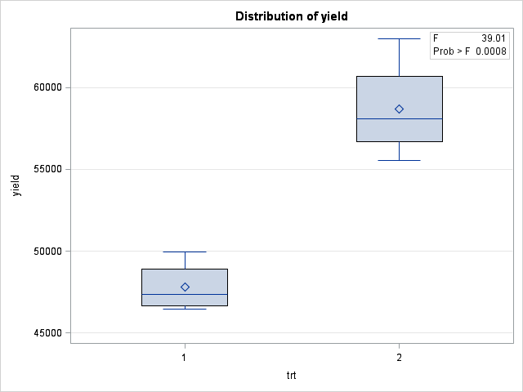

Slide 28
Results
 | D | CM
Total yield (lbs/A) | 48,364(a) | 59,171(b)
Cull (Avg %) | 28 | 27
Albino (%) | 2 | 1
Water use (AF) | 2.1 | 2.4
N fertilizer use (lbs N /A) | *56 | 130
Veg biomass at harvest (g/plant) | 542 | 1,047
*pending confirmation

Slide 29
Field Day

Slide 30
Strawberry Study 2

Slide 31
14 acres each
*Cultivar not studied the year before

Slide 32
Canopy Cover (%)

Slide 33
Irrigation (April – May)

Slide 34
Soil Moisture, CM

Slide 35
Mortality
- 50ft bed, 10 beds
 | GS | CM
15-Apr | 30 | 25
7-Jun | 56 | 39

Slide 36
 |  | Trays
 |  | CM | Control
17-Apr |  | 1,590 | 1,435
24-Apr |  | 1,770 | 1,733
1-May |  | 1,680 | 1,797
5-May |  | 1,478 | 1,034
8-May |  | 2,246 | 2,460
15-May |  | 2,586 | 2,633
 | Total | 11,350 | 11,092
 | Total N Fert (lbs/A)
GS | 100
CM | 65
(Mar – Jun)
35% less N fertilizer

Slide 37
Summary
Study # | Crop | Yield relative to grower standard | Water use relative to grower standard | Fertilizer (lbs N/A) use relative to grower standard
1 | Strawberry | 22% higher | 14% higher | At least 34% higher
2 | Strawberry | 2% higher* | Same | 35 % lower
3 | Celery | 5% higher* | Same | 24% lower
*not statistically significant

Slide 38
Final Thoughts
CropManage showed to be efficient in guiding irrigation and N fertilization
Algorithms for water and N need improvement/fine-tuning = more research
Although not perfect, it’s a more comprehensive approach than usual fertilization “program” and fixed irrigation schedule

Slide 39
Questions/comments?

