Slide 1
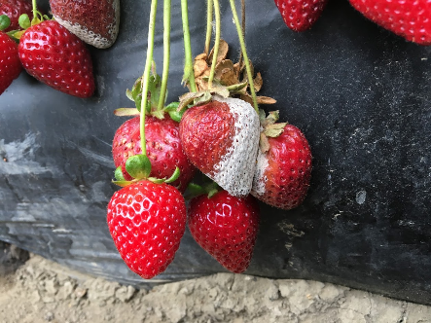
Resistance of Botrytis Gray Mold to Multiple Fungicides
Scott Cosseboom
M.S. Student

Slide 2
Introduction
My Research
Isolates collected from the major strawberry growing areas of California
Tested for resistance to active ingredients in: Topsin, Rovral, Elevate, Switch, Pristine, Luna Sensation/Tranquility, Fontelis, Kenja
Did not test Captan or Thiram
Notes:
1) Talk about what previous research shows

Slide 3
Background
Eastern U.S.
High levels of resistance to important fungicides for Botrytis gray mold control in strawberries
Resistance increasing from year to year
Isolates resistant to multiple modes of action
California
Mercier (2010) and Pokorny (2016) - Fresno State
Adaskaveg and Gubler (2005) - UC
Notes:
How the botrytis pressure is different for the east vs west. E.g. rain, season length, we have powdery more but chemicals also selection pressure botrytis. Fresno showed there is resistance in California. Adaskaveg and Gubler showed resistance can change within a season.

Slide 4
Product registered for Botrytis | Active ingredient(s) |  | FRAC code(s)
Topsin | thiophanate-methyl |  | 1
Rovral | iprodione |  | 2
Fontelis | penthiopyrad |  | 7
Kenja 400 | isofetamid |  | 7
Luna Sensation | fluopyram | trifloxystrobin | 7 | 11
Luna Tranquility | fluopyram | pyrimethanil | 7 | 9
Pristine | boscalid | pyraclostrobin | 7 | 11
Merivon | fluxapyroxad | pyraclostrobin | 7 | 11
Scala | pyrimethanil |  | 9
Switch | cyprodinil | fludioxonil | 9 | 12
PH-D | polyoxin-D |  | 19
Elevate | fenhexamid |  | 17
Notes:
I tested PH-d but am not sharing the results, should I include it here?

Slide 5
Product registered for Botrytis | Active ingredient(s) |  | FRAC code(s)
Topsin | thiophanate-methyl |  | 1
Rovral | iprodione |  | 2
Fontelis | penthiopyrad |  | 7
Kenja 400 | isofetamid |  | 7
Luna Sensation | fluopyram | trifloxystrobin | 7 | 11
Luna Tranquility | fluopyram | pyrimethanil | 7 | 9
Pristine | boscalid | pyraclostrobin | 7 | 11
Merivon | fluxapyroxad | pyraclostrobin | 7 | 11
Scala | pyrimethanil |  | 9
Switch | cyprodinil | fludioxonil | 9 | 12
PH-D | polyoxin-D |  | 19
Elevate | fenhexamid |  | 17
Notes:
Explain FRAC
Explain FRAC 7s

Slide 6
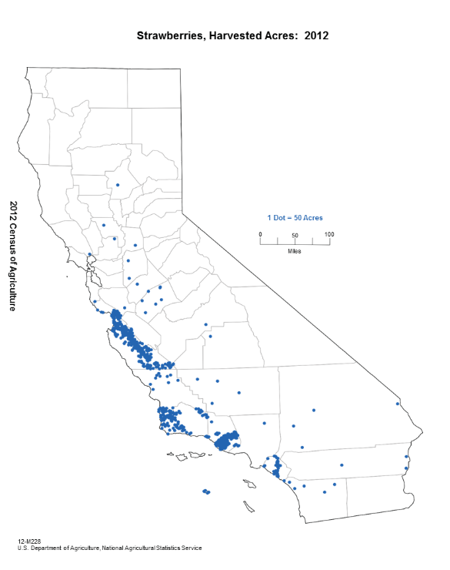
Notes:
WENT TO AT LEAST 10 ranches per region, 13 in Oxnard, Maybe just do a map with the sampling sites, and not with pesticide use info

Slide 7
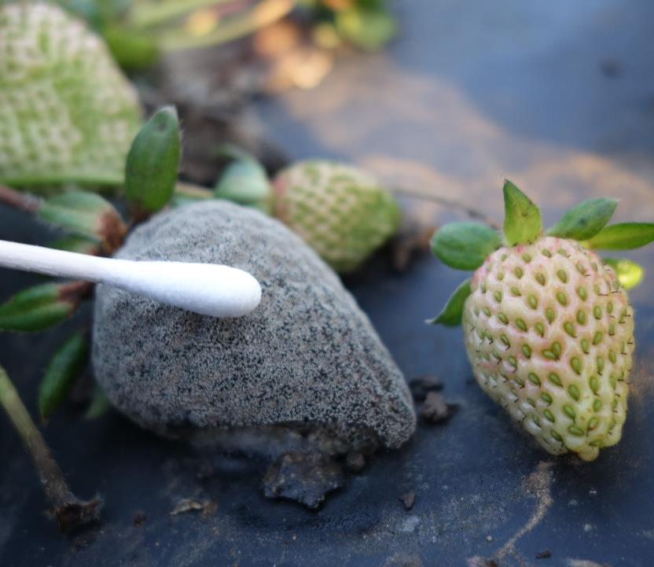
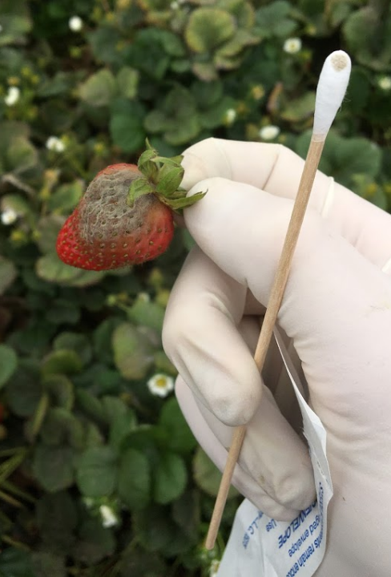
Notes:
Collected ten isolates per ranch

Slide 8
Sample 1
Sample 2
Sample 3
Sample 4
Sample 5
Sample 6
No fungicide
Active Ingredient 1
Active ingredient 2
Active ingredient 3

Slide 9
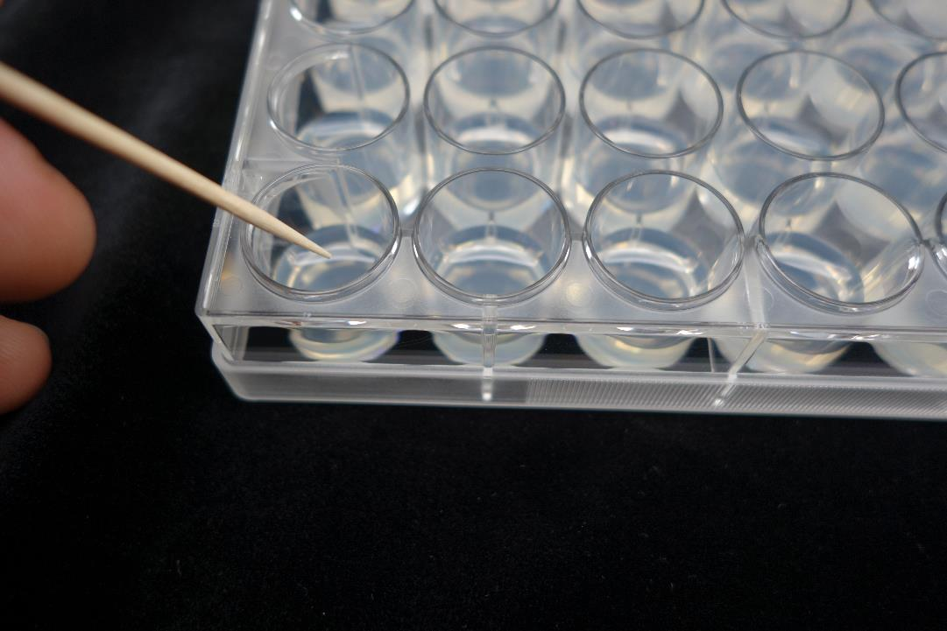

Slide 10
Penthiopyrad
Experimental
No fungicide
Fludioxonil
Fenhexamid
Isofetamid
Experimental
Cyprodinil
Iprodione
T-methyl
Fluopyram
Boscalid
Isolate 1
Isolate 2
Isolate 3
Isolate 4
Isolate 5
Isolate 6

Slide 11
Oxnard
Data from 13 fields (250 isolates)
Thiophanate-
methyl
(Topsin)
Iprodione
(Rovral)
Boscalid
(Pristine)
Fluopyram
(Luna*)
Penthiopyrad
(Fontelis)
Isofetamid
(Kenja)
Cyprodinil
(Switch)
Pyraclostrobin
(Pristine)
Fludioxonil
(Switch)
Fenhexamid
(Elevate)
*Fluopyram is in the products Luna Sensation and Luna Tranquility. They contain other active ingredients besides fluopyram.
Notes:
N = ?, Remove pyraclostrobin?

Slide 12
Early Season
Notes:
Delete superscripts from graph

Slide 13
How do resistant individuals “overwinter” or get introduced year to year?
Spreads between adjacent successive plantings
Weeds and neighboring crops
Fruit mummies, dead plant tissue
Transplants
Notes:
1) Fall Plant to summer plant
2) Sclerotia and resting mycelium
3) Broad host range
4)

Slide 14
Spray Program Matters
Use many FRAC codes
Spraying for powdery mildew can affect the Botrytis population
Save most effective fungicides for peak fruit production or rain event
Use multi-site active fungicides alone or tank mixed
Notes:
1) Pay attention to FRAC code not trade name
3) Even if not visibly present – exerts a selection pressure
4)
5) Captan and Thiram
5)

Slide 15
Trade name | Active ingredient(s) | FRAC |  |  | Disease | GM | PM
Topsin | Thiophanate-methyl | 1 |  |  | GM, PM | +++ | +++
Rovral | Iprodione | 2 |  |  | GM | +++ | NL
Bumper/Tilt | Propiconazole | 3 |  |  | PM | NL | ++++
Mettle | Tetraconazole | 3 |  |  | PM | NL | ++++
Procure | Triflumizole | 3 |  |  | PM | NL | ++++
Rally | Myclobutanil | 3 |  |  | PM | NL | ++++
Rhyme | Flutriafol | 3 |  |  | PM | NL | ND
Fontelis | Penthiopyrad | 7 |  |  | GM, PM | ++++ | +++
Kenja 400 | Isofetamid | 7 |  |  | GM, PM | ND | ND
Luna Tranquility | Fluopyram + pyrimethanil | 7 | 9 |  | GM, PM | ND | ND
Luna Sensation | Fluopyram + trifloxystrobin | 7 | 11 |  | GM, PM | ND | ND
Merivon | Fluxapyroxad + pyraclostrobin | 7 | 11 |  | GM, PM | ++++ | +++
Pristine | Boscalid + pyraclostrobin | 7 | 11 |  | GM, PM | ++++ | +++
Scala | Pyrimethanil | 9 |  |  | GM | ++ | NL
Switch | Cyprodinil + fludioxonil | 9 | 12 |  | GM, PM | ++++ | −
Abound/Quadris | Azoxystrobin | 11 |  |  | PM | NL | +++
Cabrio | Pyraclostrobin | 11 |  |  | PM | NL | +++
Evito | Fluoxastrobin | 11 |  |  | PM | NL | +++
Flint | Trifloxystrobin | 11 |  |  | PM | NL | +++
Quintec | Quinoxyfen | 13 |  |  | PM | NL | ++++
Elevate | Fenhexamid | 17 |  |  | GM | ++++ | NL
Ph-D | Polyoxin-D | 19 |  |  | GM, PM | ++ | +++
Torino | Cyflufenamid | U6 |  |  | PM | NL | ++++
Sulfur | Sulfur (multi-site) | M2 |  |  | PM | NL | +++
Thiram | Thiram (multi–site) | M3 |  |  | GM | ++ | NL
Captan | Captan (multi-site) | M4 |  |  | GM | +++ | NL

Slide 16
Acknowledgements
Funding
CDFA Specialty Crop Block Grant Program
California Strawberry Commission
Special Thanks
Cooperating growers
Mark Edsall

