Slide 1

Drosophila & Corn Earworm Management
Anna D. Howell - UCCE Ventura Co.
Frank Zalom – UC Davis
Mark Bolda – UCCE Santa Cruz Co.

Slide 2
Here is (one of) the news reports that led to millions of servings of processed strawberries being cancelled.
A processor’s label is shown in this video, but we want everyone to know all processors are affected when effective controls for pests are not in place.
  http://wate.com/2017/02/28/bount-county-high-school-student-finds-worm-in-cafeteria-fruit-cup/

Slide 3
10.2% of last year’s pack was contaminated
3 orders have been cancelled so far this year, resulting in 1 million lbs of product.
USDA is considering holding off on developing products with strawberries

Slide 4
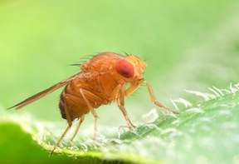
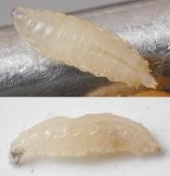
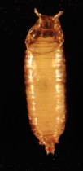
Drosophila spp. ‘Vinegar flies’
Adults- yellow brown with dark markings and red eyes
  ~1/8” length
Larvae- grow up to 3/16”
  white and legless
Pupae-amber ~1/8” have two breathing ‘horns’

Slide 5
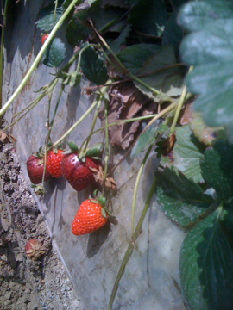
Drosophila spp. ‘Vinegar flies’ in general
Always present
  Abandoned fields, neighboring berries
Attack over ripe or unharvested fruit
A processing concern

Slide 6
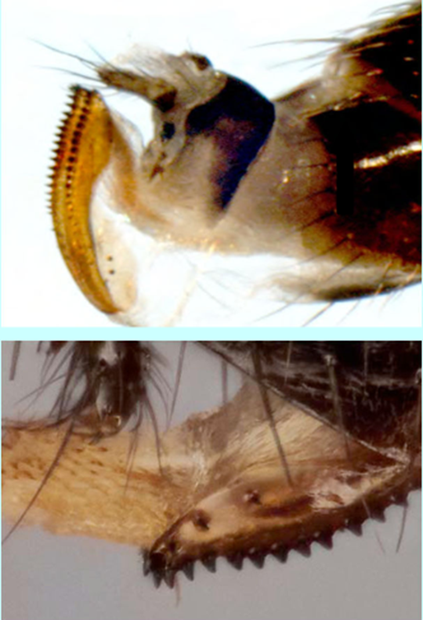
Spotted Wing Drosophila (Drosophila suzukii)
Female has a serrated ovipositor
  attacks ripening fruit, not just damaged
Can also cause secondary infections

Slide 7
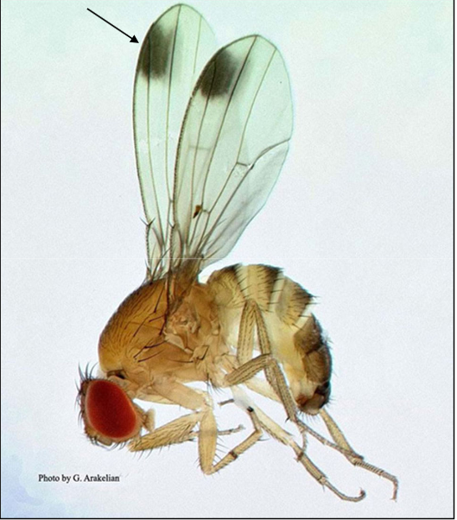

Slide 8
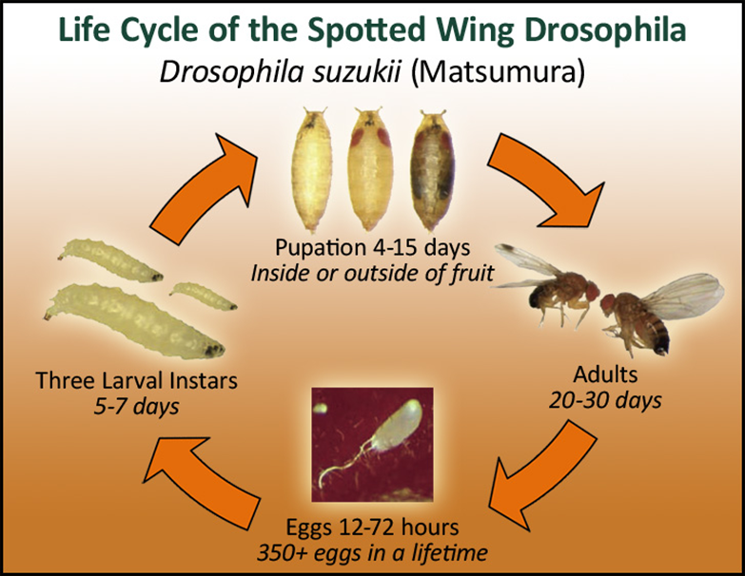
Most active at 60-80 ᵒF
Activity decreases ≥86 ᵒF
10 + generations per year

Slide 9
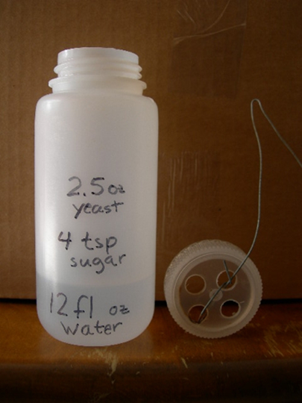
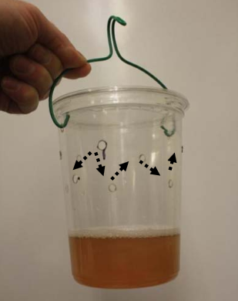
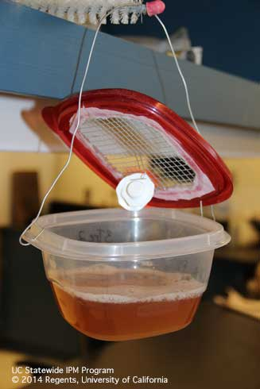
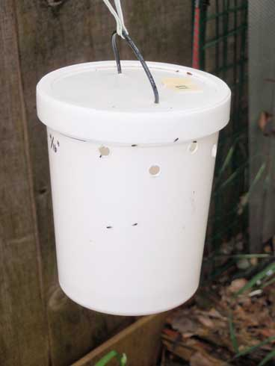
Monitoring
Bait
  Summertime: Yeast + Sugar + Water
  Winter: Apple cider vinegar
Check traps weekly

Slide 10
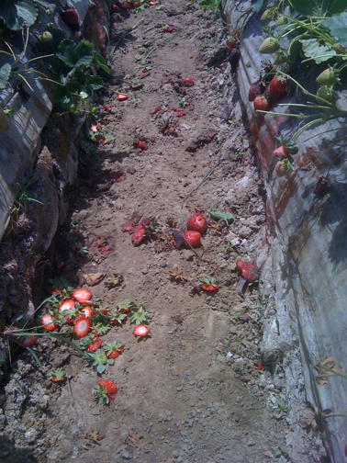
Cultural prevention
Sanitation
Remove mature,
overripe, and culled fruit
Remove abandoned fields
Shorten harvest intervals
Photo: Dr. Frank Zalom

Slide 11
Chemical Sprays
Organophosphates
Malathion
Pyrethrioids*
Danitol, Brigade, Bifenture
Spinosyns
Entrust, Success, Radiant
* Using pyrethroids can exacerbate Lygus resistance
Always consult the label

Slide 12
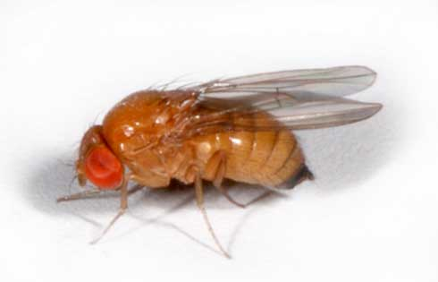
Keys to Successful Management
Sanitation- remove old/overripe fruit
  Eliminate alternative habitat (parts of a field no longer used)
  Decrease harvest intervals for processing crop
Monitoring & trapping to quickly detect infestations
Use of sprays or baits to suppress fly populations
**SANITATION IS KEY!**

Slide 13
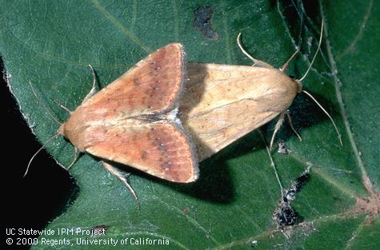
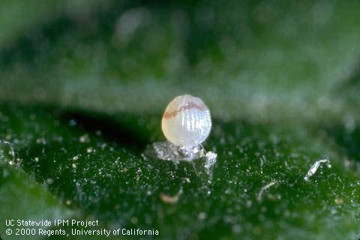
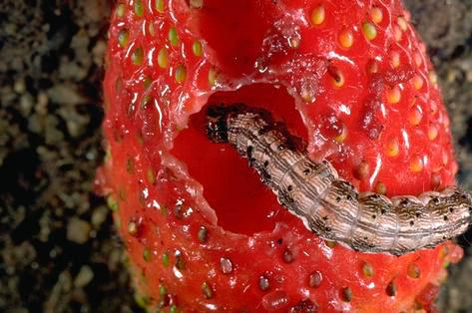
Corn Earworm
Adults- Grayish-brown
  ~1.5” wingspan
  Flight: March - April
Eggs laid singly under young leaves
Larvae burrow into fruit

Slide 14
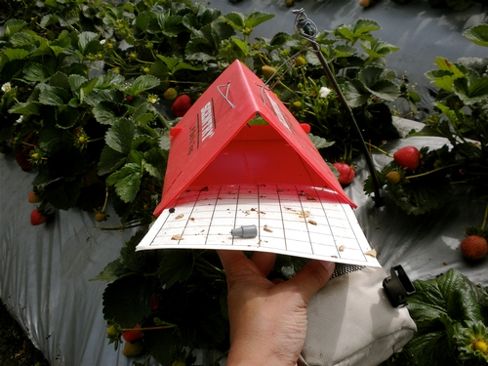
Monitoring
Several traps with CEW pheromone lure can be used (Texas, wing, delta)
  Start monitoring late Feb.
Place traps upwind
Also survey plants for eggs

Slide 15
Management
When to treat: 10+ moths/week in traps
Frequency of treatment will depend on the insecticide selected & infestation level
  Insecticides most effective against early instars

Slide 16
Chemical Sprays
Conventional
Brigade, Radiant, Assail, Coragen, Danitol, Intrepid
Organic
Entrust, Success, Bt,
**Rotate sprays of chemicals with different IRAC categories to manage resistance**

