Slide 1
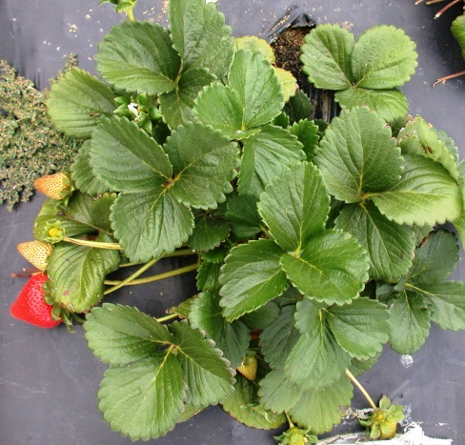
Update on Ventura County Soil Disinfestation Trials
Oleg Daugovish, Anna Howell, Bill Rutan, Steve Koike (UC-ANR), Joji Muramoto and Carol Shennan (UCSC), Tom Gordon (UC-Davis), Ruijun Qin (USDA), Husein Ajwa, J. Gerik , S. Gao (USDA, B. Hansen, UC –Davis)

Slide 2
Anthracnose management guidelines
Colletotrichum acutatum was
never recovered from soil, infected runners, or crowns that had been fumigated with
methyl bromide-chloropicrin
(Gubler et al., 1988).

Slide 3
Macrophomina phaseolina
survival in infested crowns after 200 lbs/a InLine
Drip lines
6 in
70%
0
19%
12 in
0
0
44%
Survival = viable Macrophomina sclerotia in crown tissue post fumigation

Slide 4
Colletorichum acutatum
survival in infested crowns after 200 lbs/a Pic
Drip lines
6 in
0
0
12 in
3%
0

Slide 5
NON-FUMIGATED SOIL
In non-fumigated soil C. acutatum was recovered in 80% of the buried crowns after 6 months
The fungus was able to survive in
buried strawberry tissue for 9 months (Eastburn and Gubler, 1990).
What is the probability of new transplant infection
from old C. acutatum containing residue?

Slide 6
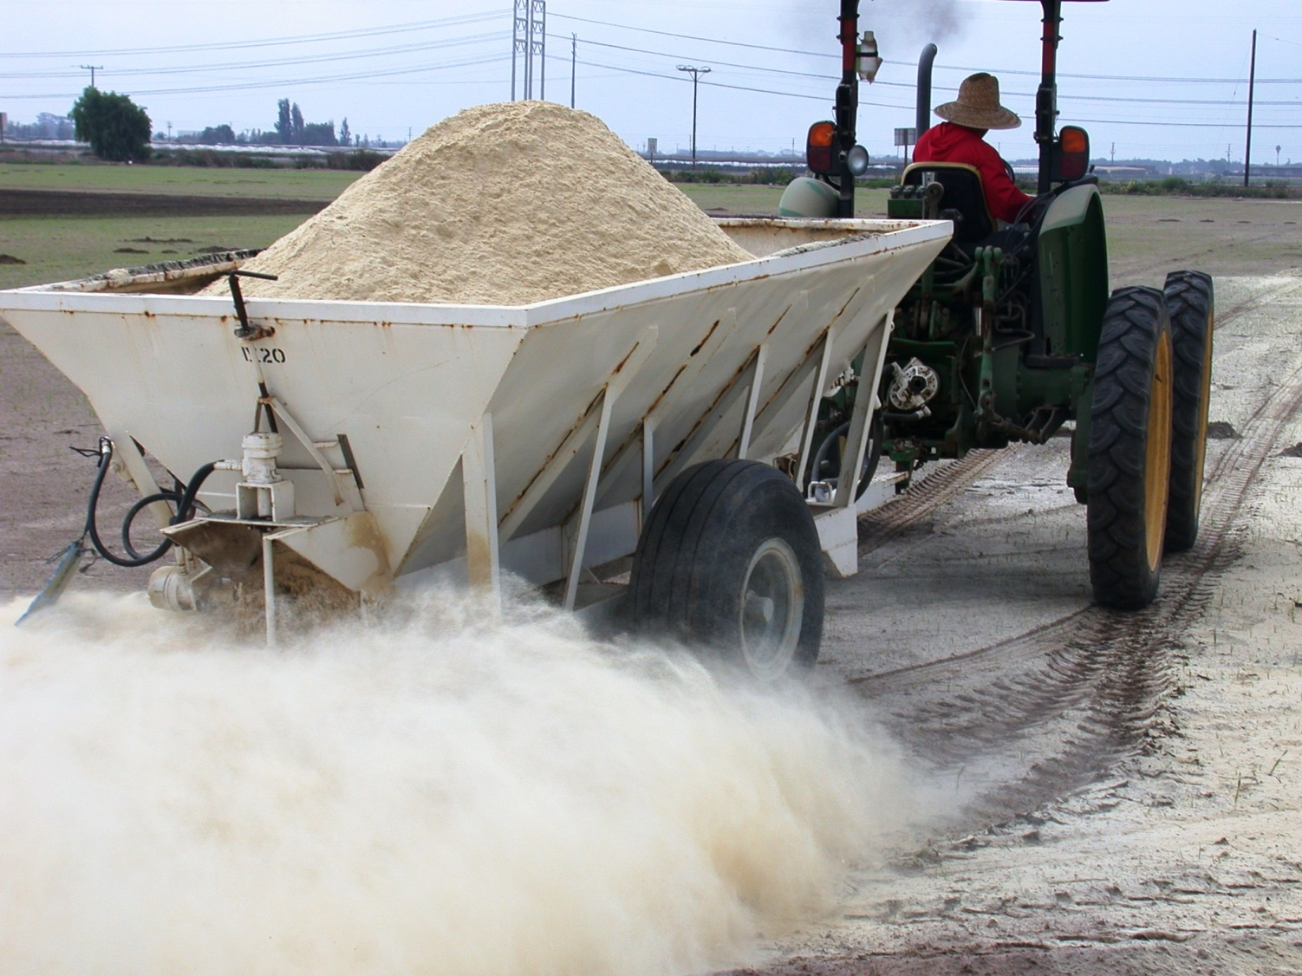
ASD: looking for Rice bran alternatives

Slide 7
Yield: Rice vs Untreated

Slide 8
Yield: Rice with or w/o irrigation

Slide 9
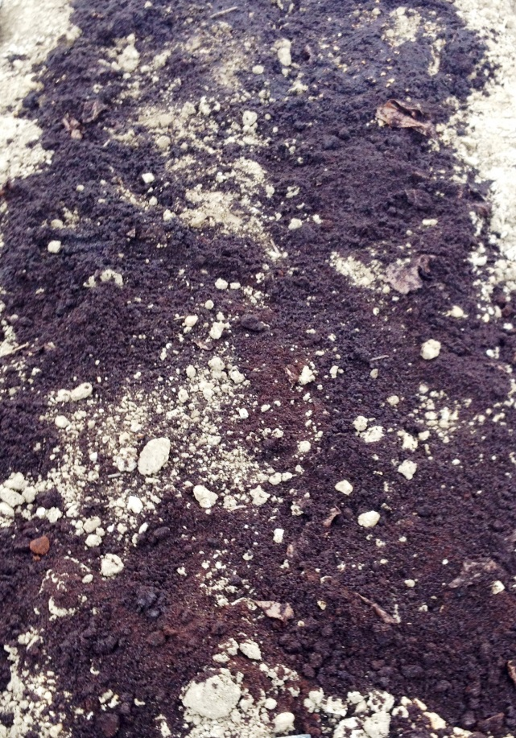
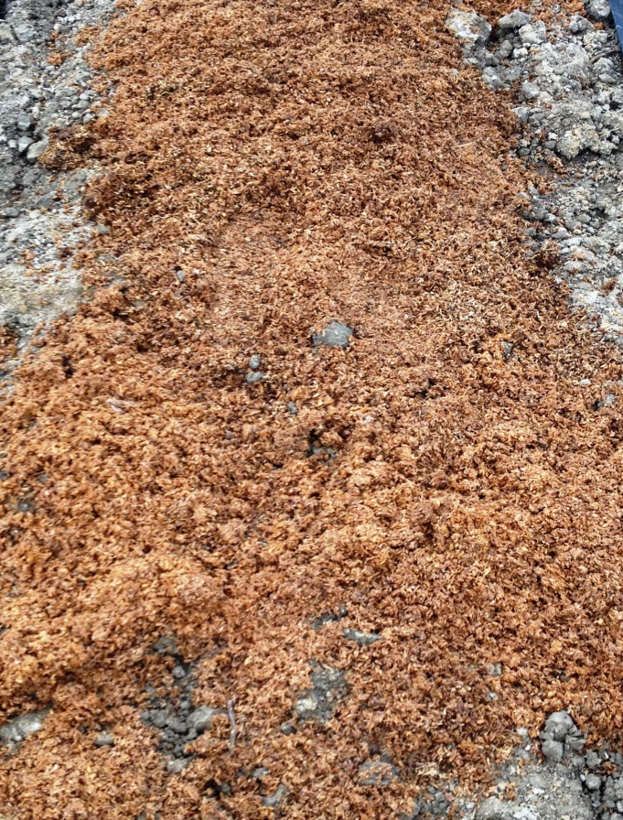
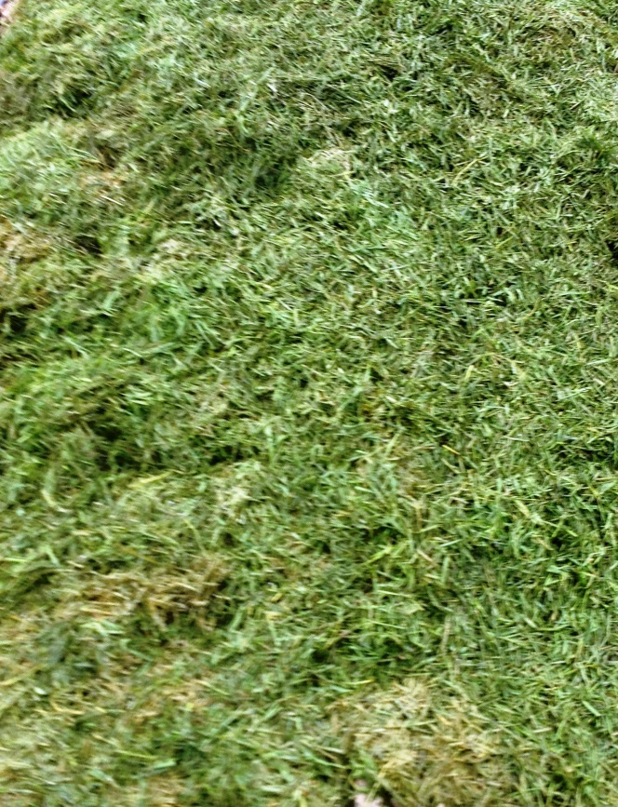
C-sources:
favorable C/N ratio, local, available, cheap
Coffee grounds
Spent grain
Grass clippings

Slide 10
Marketable yield: Dec-March

Slide 11
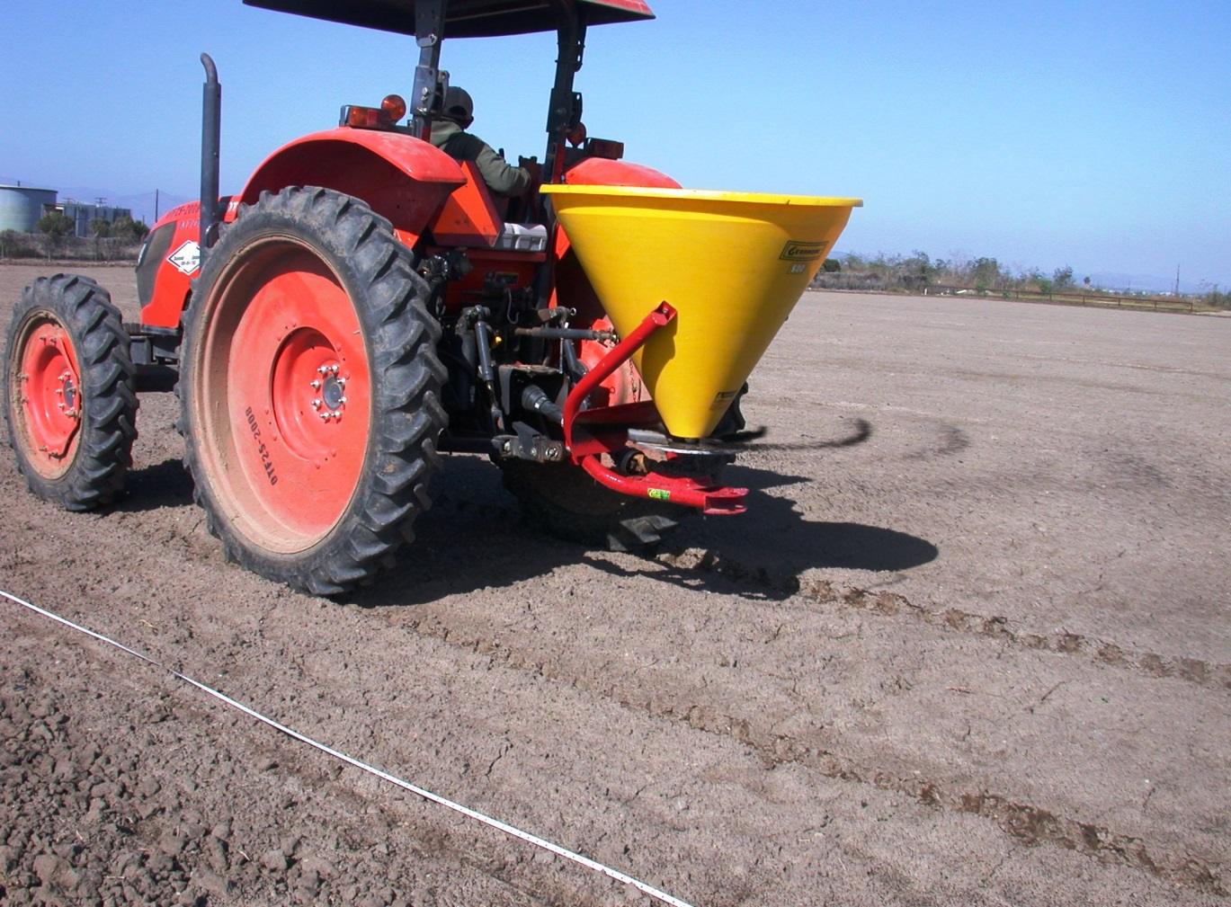
Roasting facility
for Starbucks
= coffee grounds
< 15 miles from
application sites
Free + free delivery
15-20 cu yards
available weekly
Can be stored at field site
Easy to apply

Slide 12
ANAEROBIC CONDITIONS

Slide 14
2015-16: NO₃-N at 0 -12”
Untreated check beds received 500 lbs/A of 18-6-8 pre-plant

Slide 15
NO₃-N at 0 -12”
2015-16
Untreated check beds in 2015 received 500 lbs/A of 18-6-8 pre-plant

Slide 16
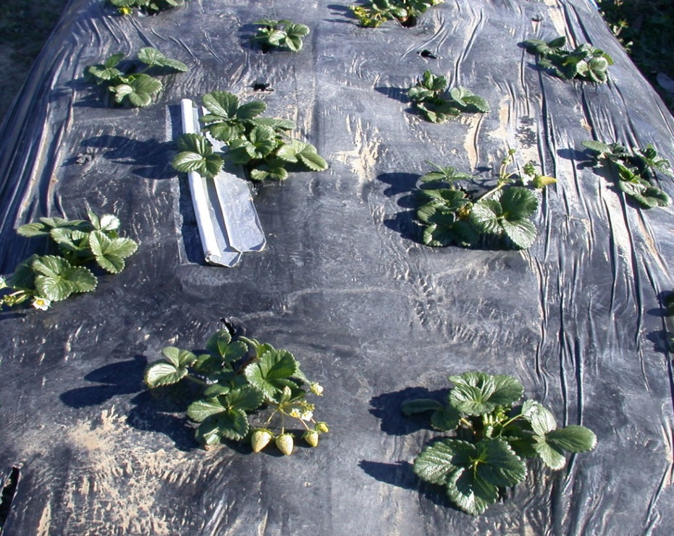
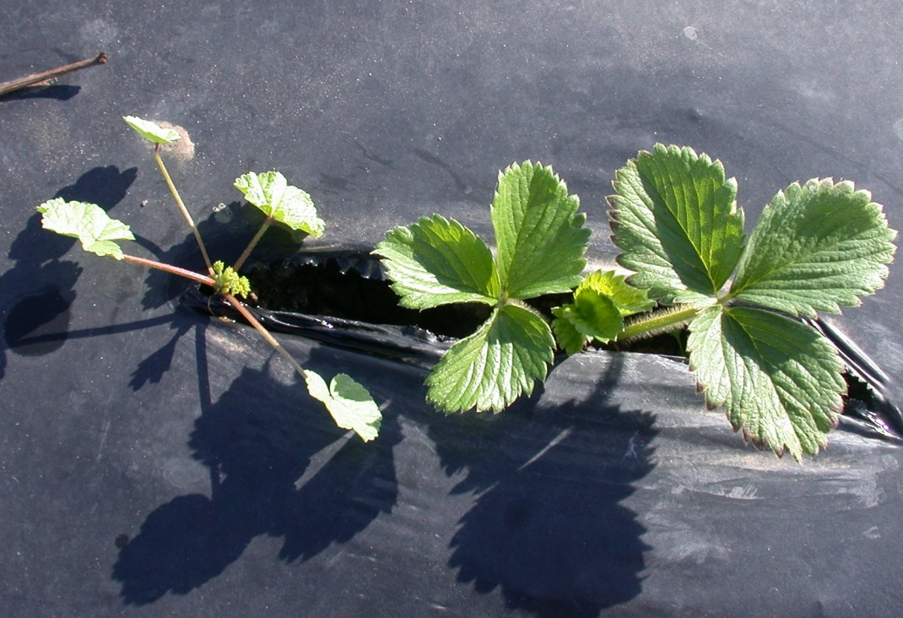
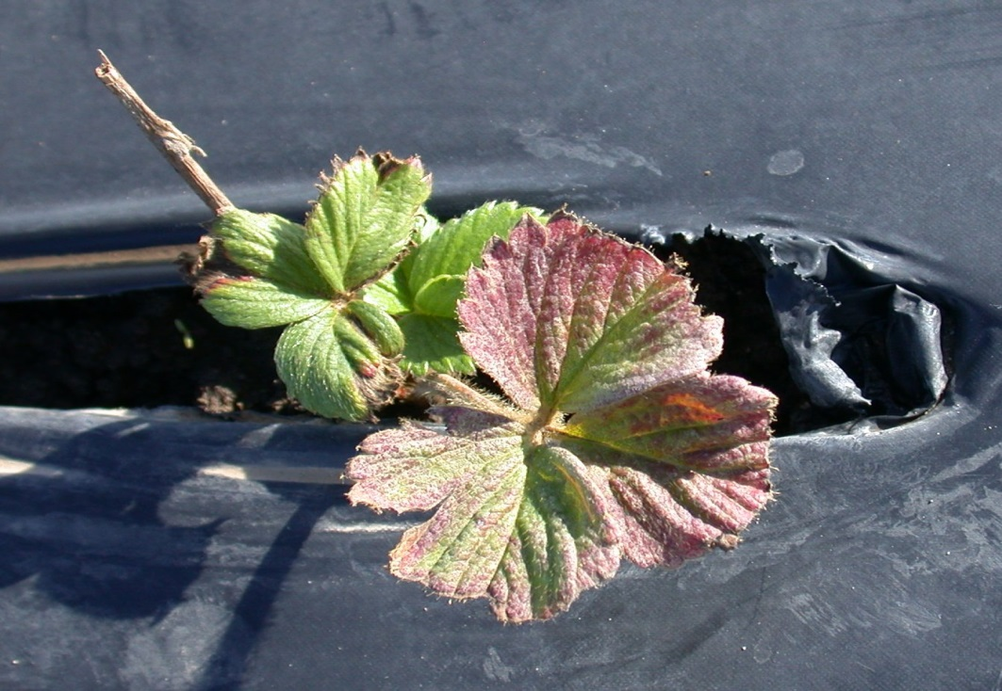
Nov 13, 2015
Untreated
Coffee grounds
Nov 13, 2016

Slide 17
Coffee grounds (as applied)
 | Peet’s | Starbucks
Total N, % | 2.4 | 0.9
Total C, % | 54.1 | 22
C:N ratio | 22:1 | 24:1
Total P₂O₅ , % | 0.1 | 0.1
Total K₂0, % | 0.26 | 0.23
EC, dS/m | 3.5 | 3.1
pH | 6.1 | 5.6
Ash % | 2.5 | 8.4
Moisture% | 63 | 24

Slide 18
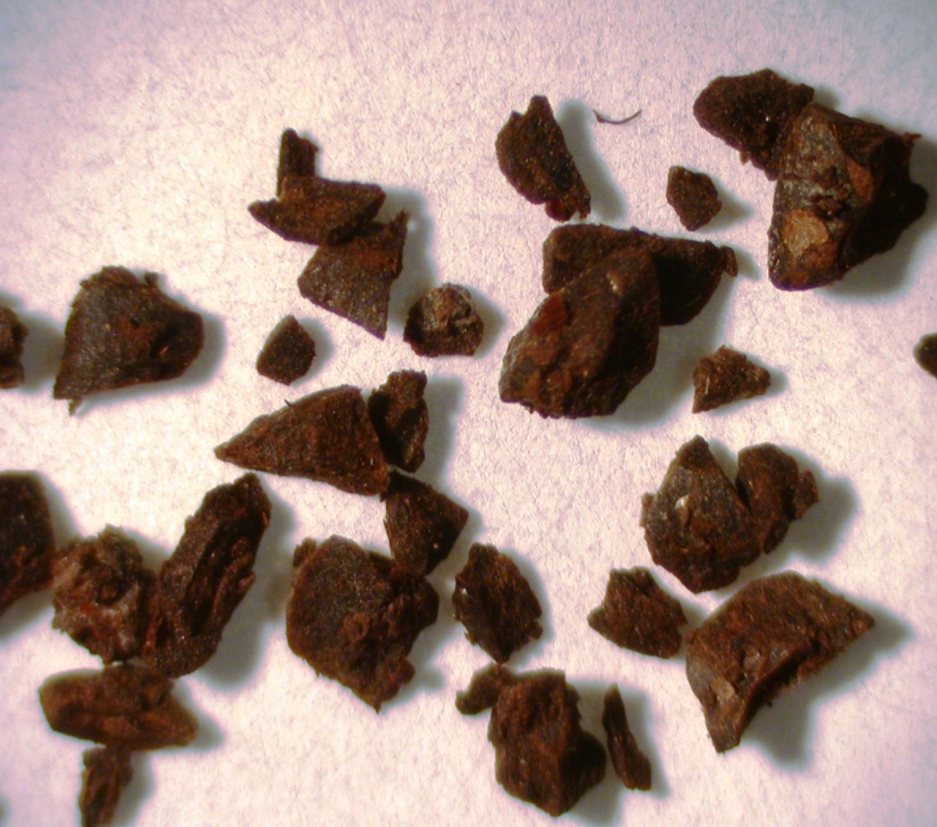
Pete’s
Starbucks

Slide 19
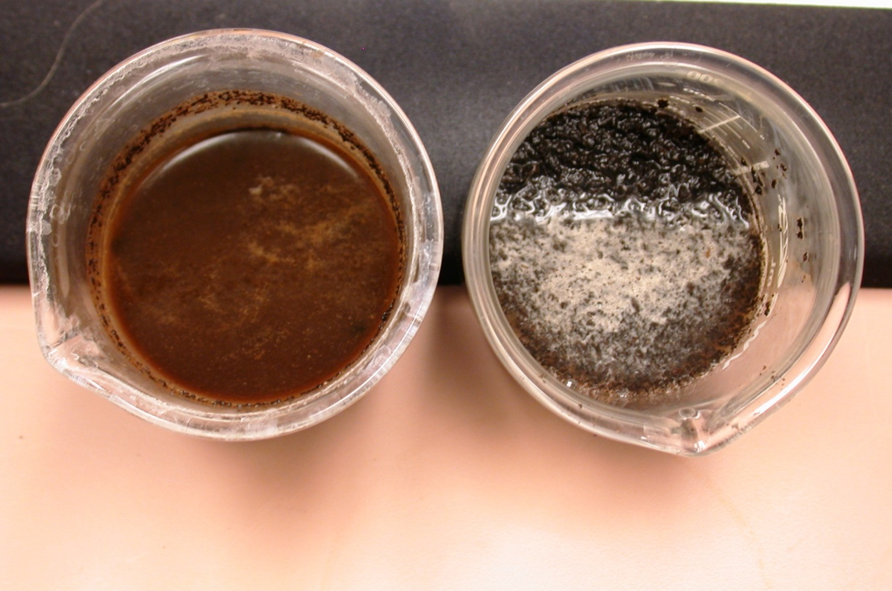
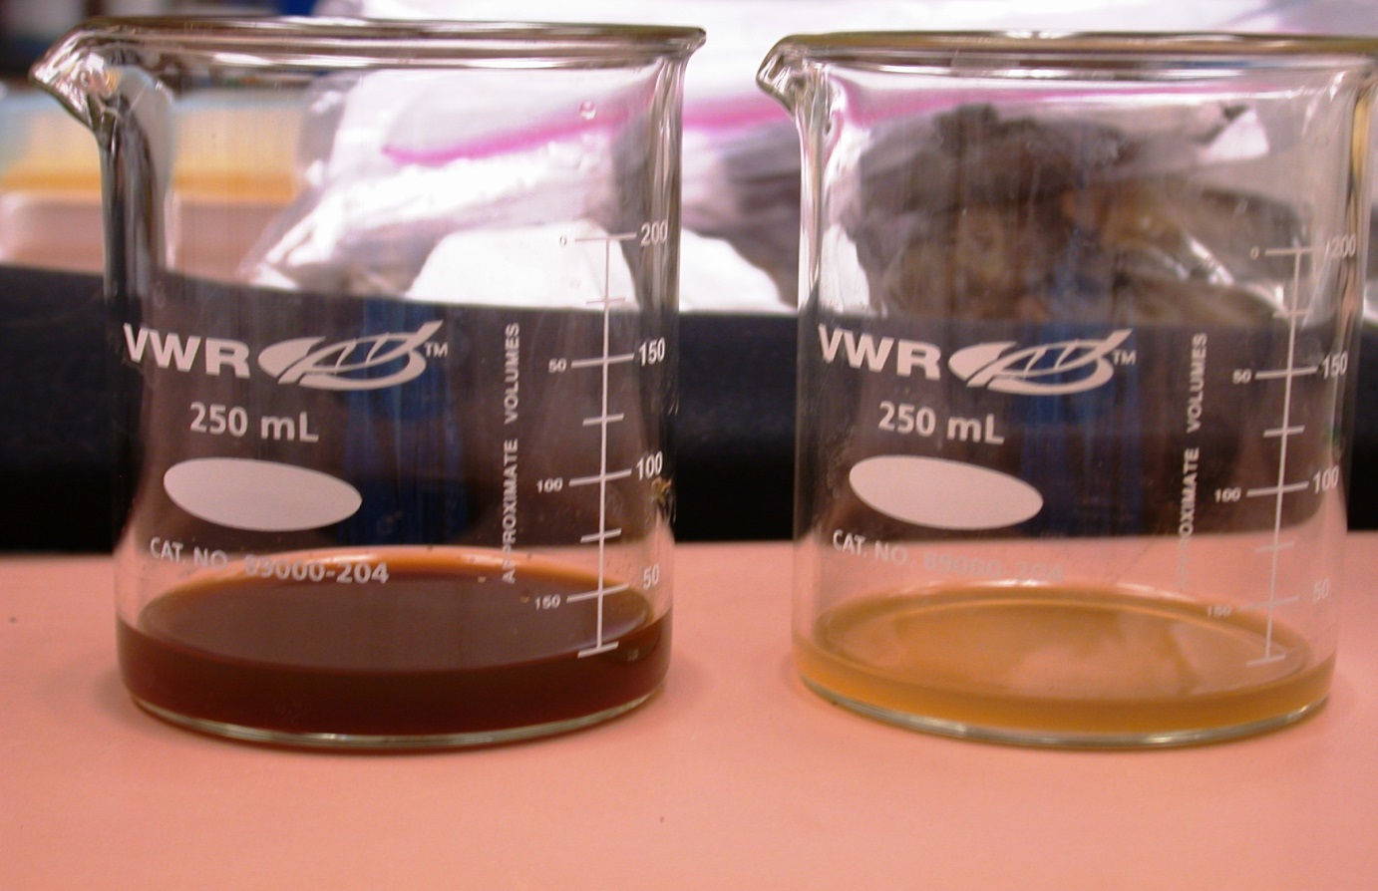
Pete’s
Starbucks
60% less

Slide 20
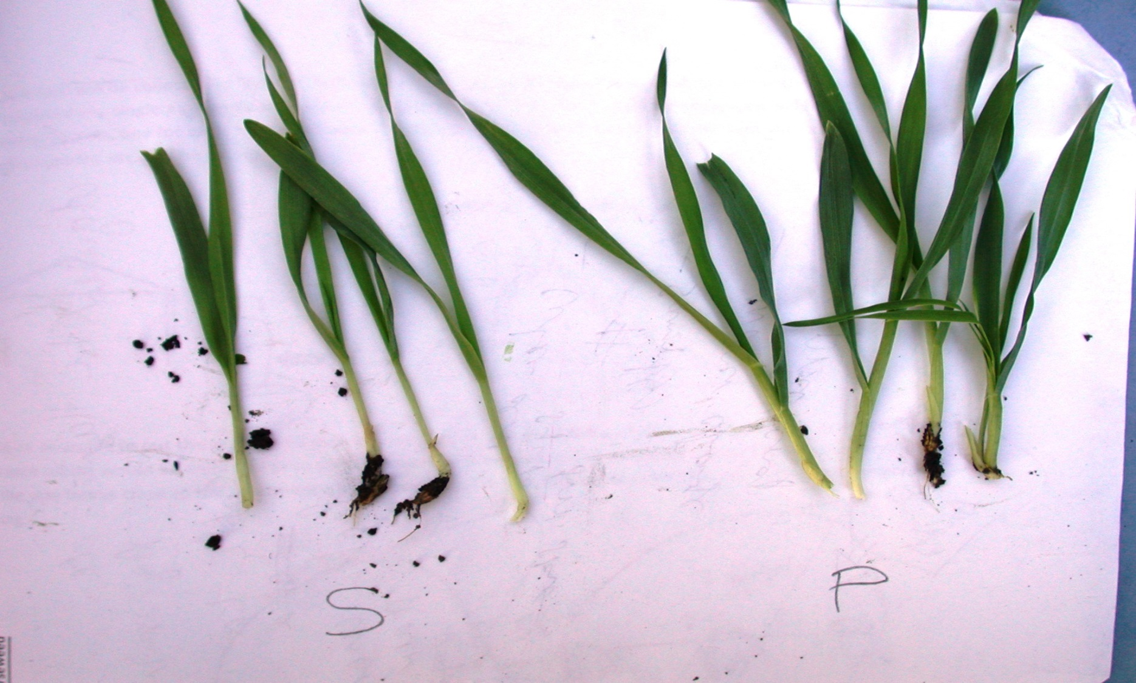
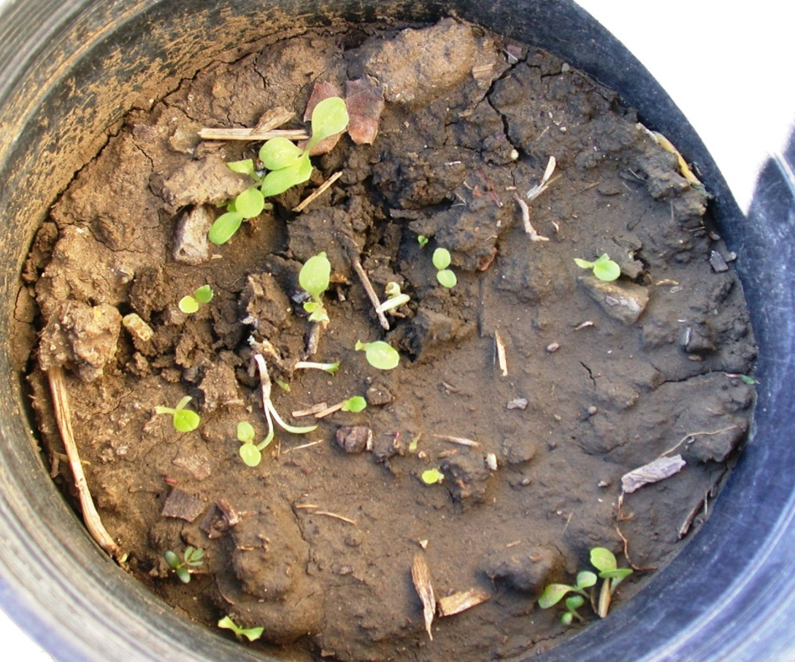
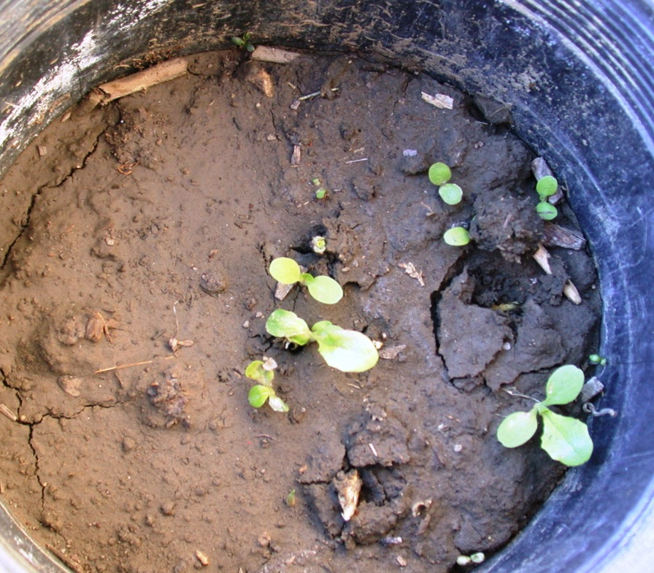
barley
lettuce

Slide 21
Continuation of soil disinfestation work
C-sources that are cheap, abundant, local and WORK
Since we don’t eradicate the problems:
- intergrade ASD with other strategies (rotation, fumigation, steam, varieties)
- Site-specific management

Slide 22
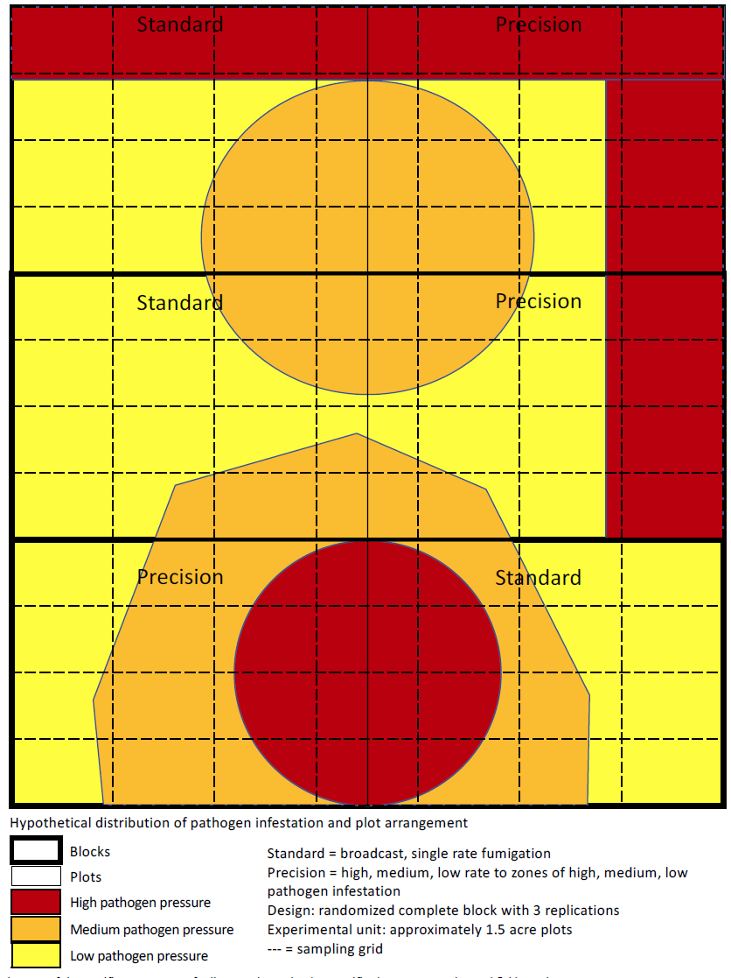
Mapping pathogen density in soil using rapid diagnostic tools Applying variable rate flat fumigation accordingly

Slide 23
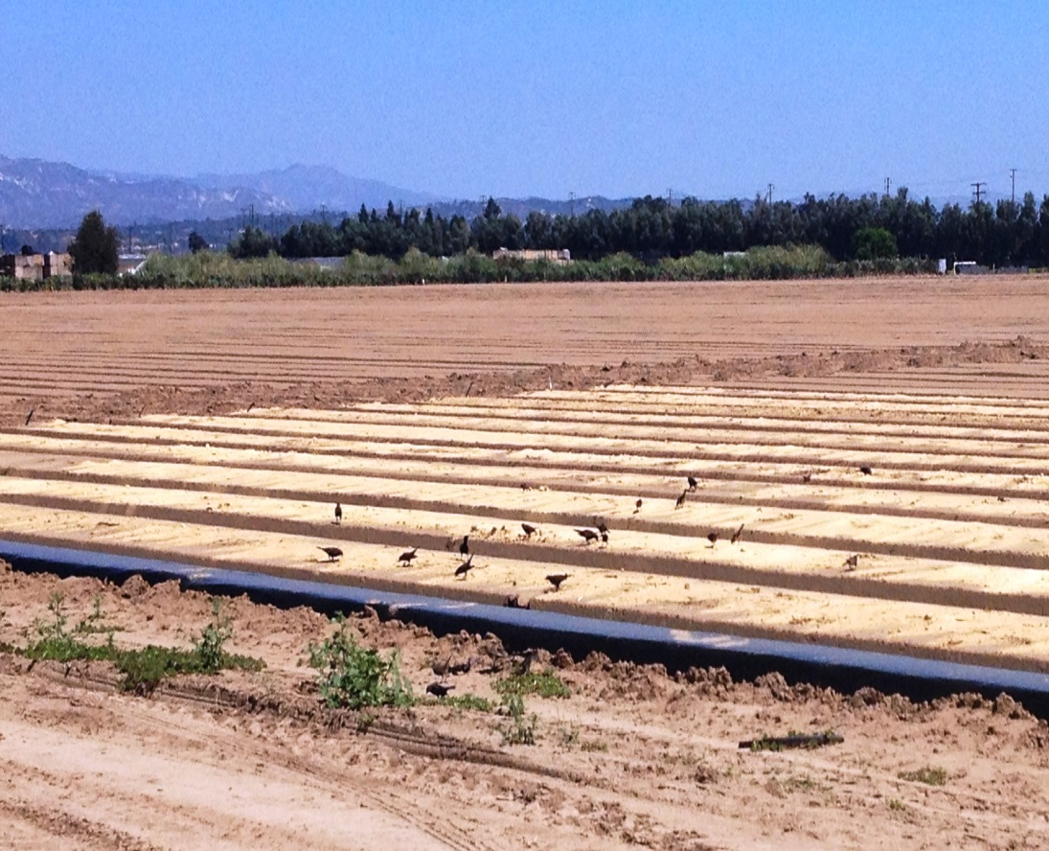
Acknowledgements:
Jose Romero and Hector Gutierrez
UC Hansen staff
UCCE Master Gardeners
CSC
Solimar Farms
Farm Fuel

