Slide 1
Pest Management Discussion
Caneberries, 2014
Mark Bolda
UC Cooperative Extension
Santa Cruz County

Slide 2
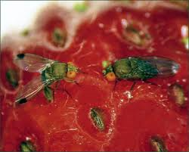
Spotted Wing Drosophila

Slide 3
Keys to Successful Management of the Spotted Wing Drosophila (SWD) on the Central Coast
Monitoring and trapping to quickly detect infestations.
Use of sprays or baits to suppress fly populations.
Use of enhanced sanitation to reduce numbers of flies remaining in the field.
Area wide management.

Slide 4
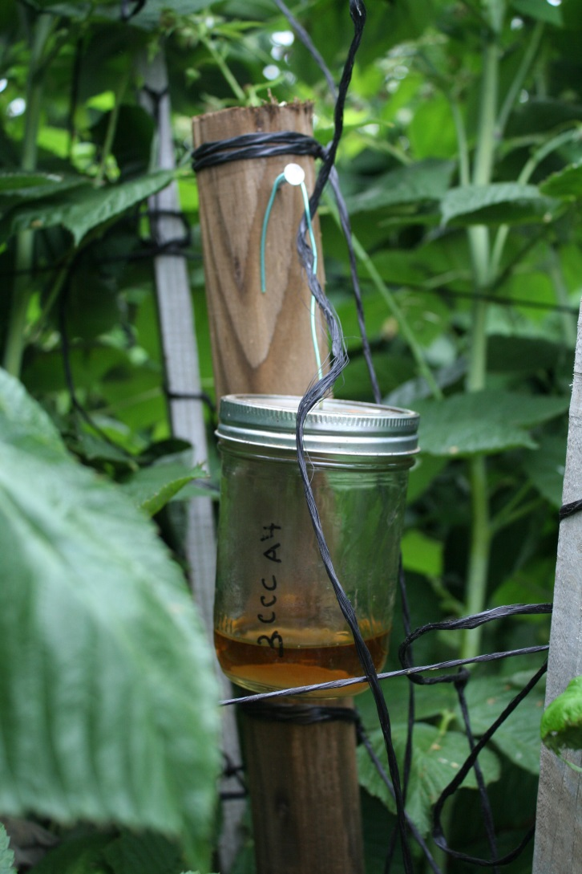
Standard Trap

Slide 5
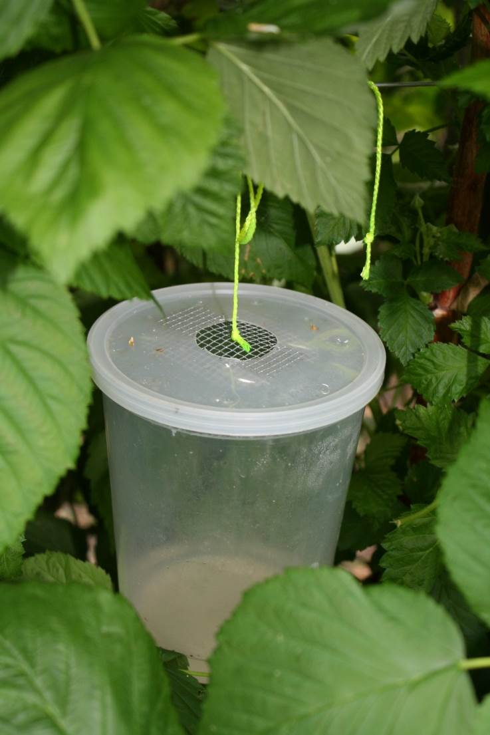
Modified trap, plastic.

Slide 6
Bait
Yeast, sugar and water in summertime.
* 0.25 oz yeast (one package) + 4 oz sugar + 12 fl oz water
Apple cider vinegar in the wintertime.

Slide 7
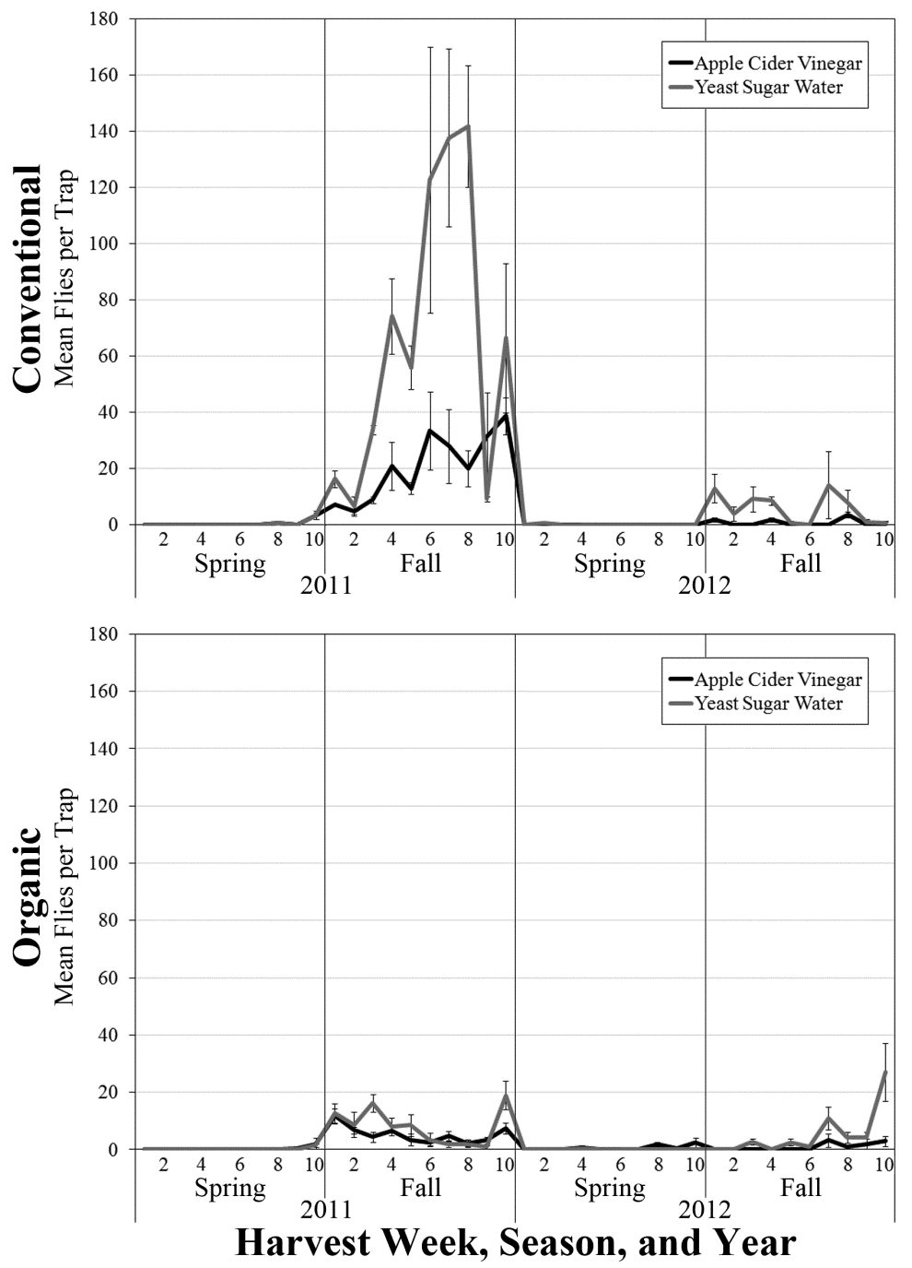
First 10 weeks of harvest
Variety S810.5
Low to no adult
captures in spring
YSW tends to capture
more flies
N = 4 traps of each lure for each site
Notes:
Remember that 1st 10 weeks of spring harvest are not consecutive with 1st 10 weeks of fall harvest when reading this graph. Just one variety on this the one that was present for all harvests in both years.

Slide 8
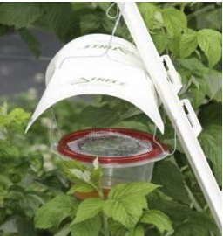
Is it the trap – Spring 2012 comparison.
‘Haviland’ trap with ACV + soap
Lee et al. 2012 trapping study ‘higher capturing’ trap
Notes:
Trapped for 10 weeks in early spring.

Slide 9
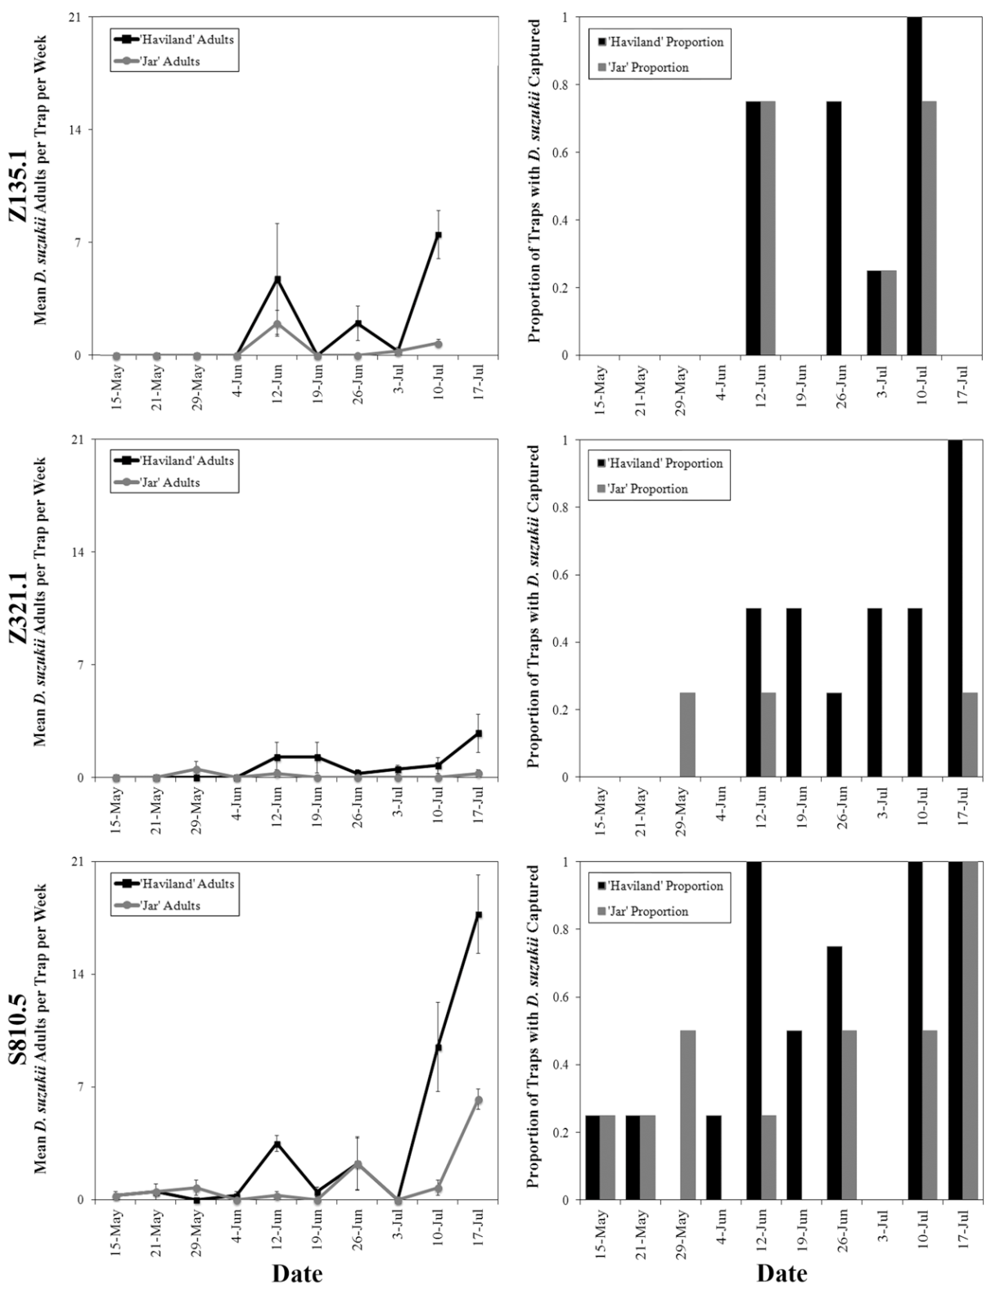
Trap comparison
Neither trap captures many flies in early spring
Proportion capturing also similar in early spring

Slide 10
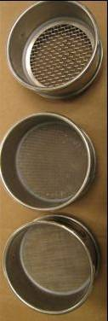
Weekly larval sampling
Collect fruit when available
Float out with salt water
Filter through fine sieves
Count larvae under microscope

Slide 11
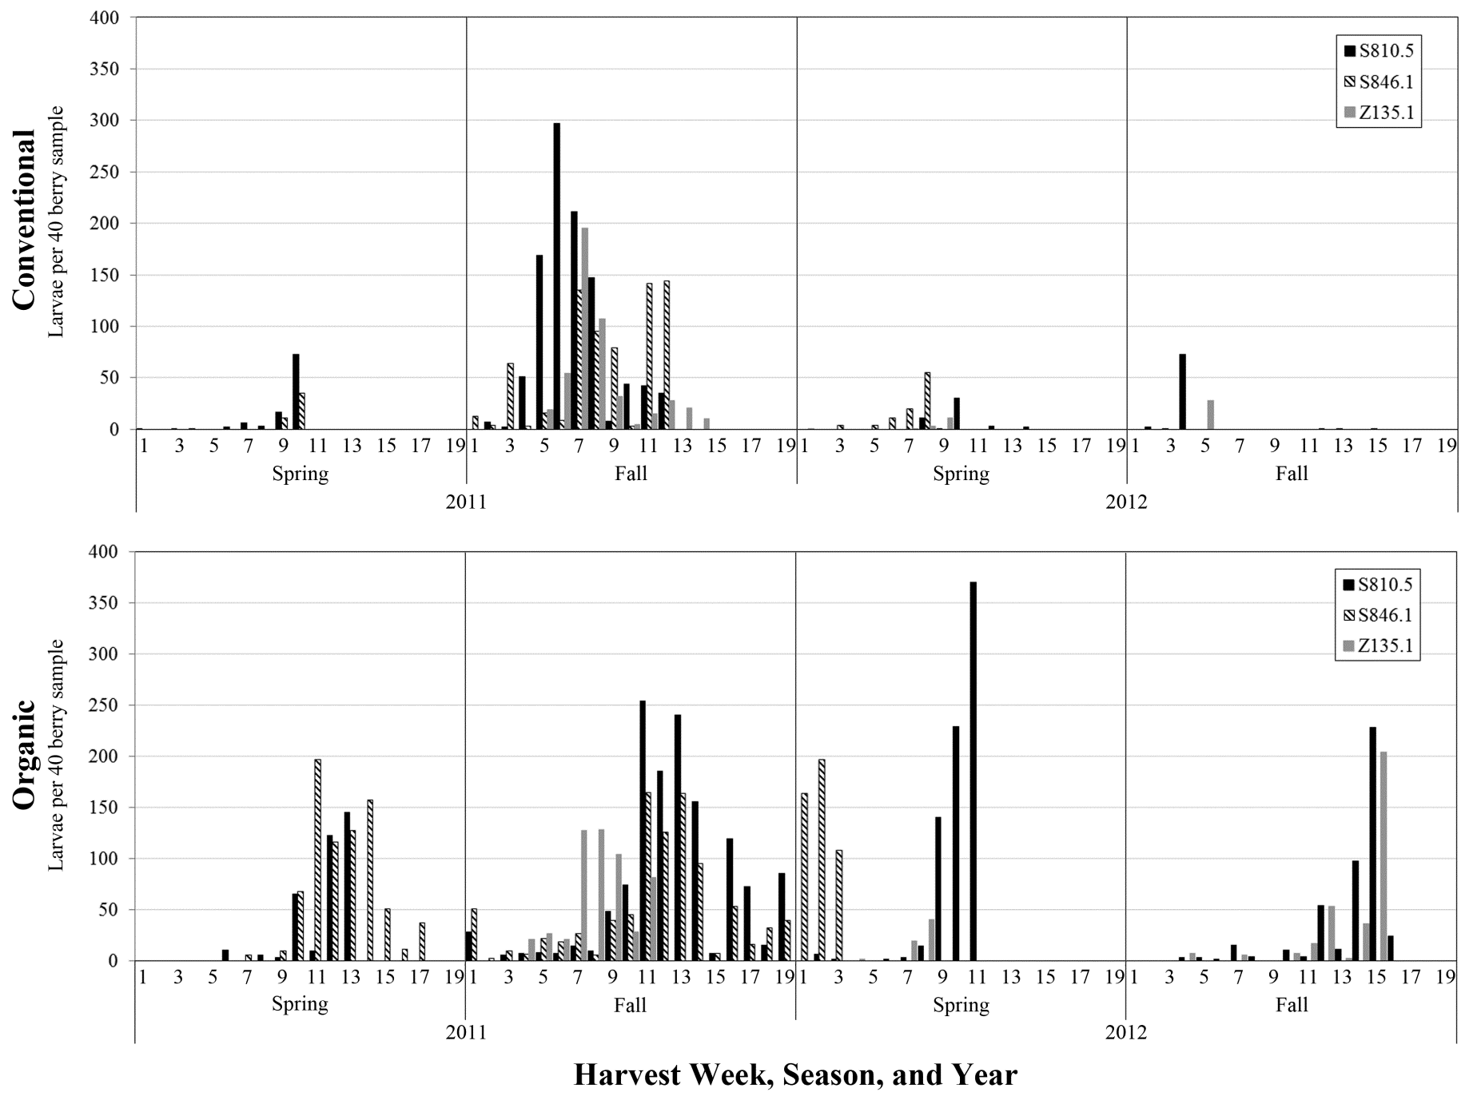
Larval counts for 3 varieties
Notes:
Larvae occurring in 1st 10 weeks of harvest for S810.5 and other varieties at both sites and years. All 3 varieties that were replicated at least 3 harvests are included on this.

Slide 12
Chemical Sprays for Spotted Wing Drosophila Management
Work well
Malathion, Mustang and Delegate
Work OK
Entrust, Pyganic
Don’t work
Actara, Altacor, oils and everything else.

Slide 13
No Baits.

Slide 14
Sanitation
Dirty= throw cull fruit on ground
Clean= remove cull fruit from field
Each treatment 3 hoops; 3 replications
Sampling done for marketable and unmarketable fruit
Weekly Trap counts
Fruit Samples:
Collected 20 berries of each marketable and non-marketable fruit
Vacuum sample when fruit was collected
Clean
Dirty
Clean
Dirty
Clean
Dirty

Slide 15
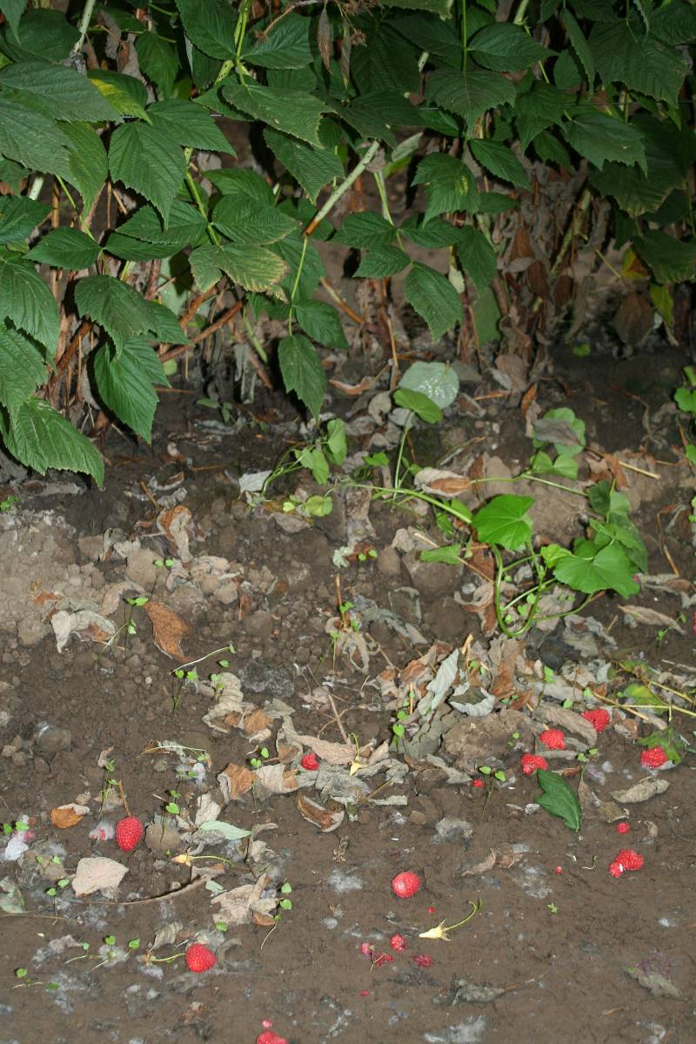
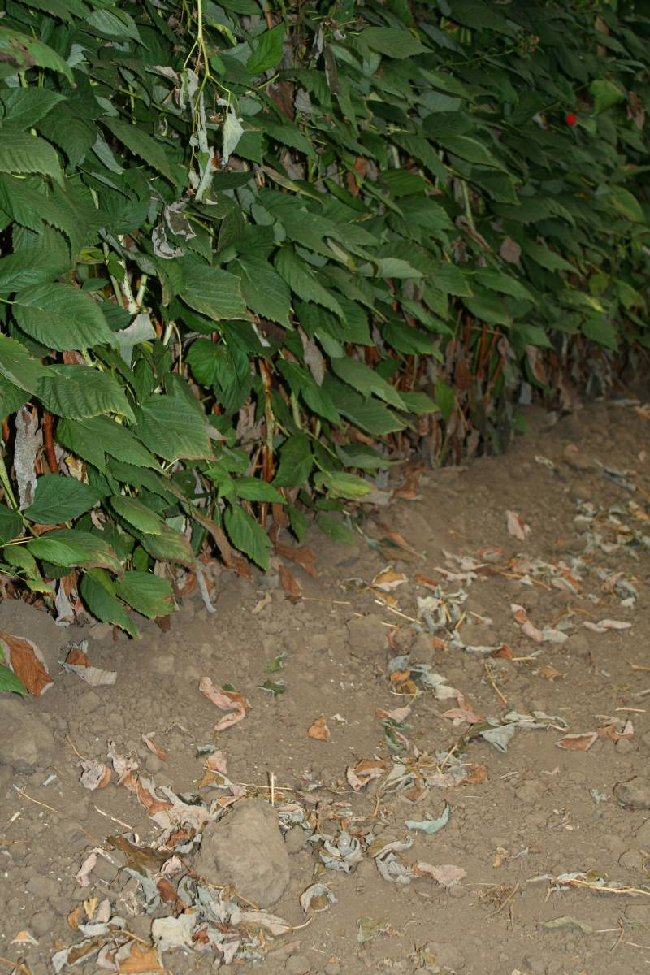

Slide 16
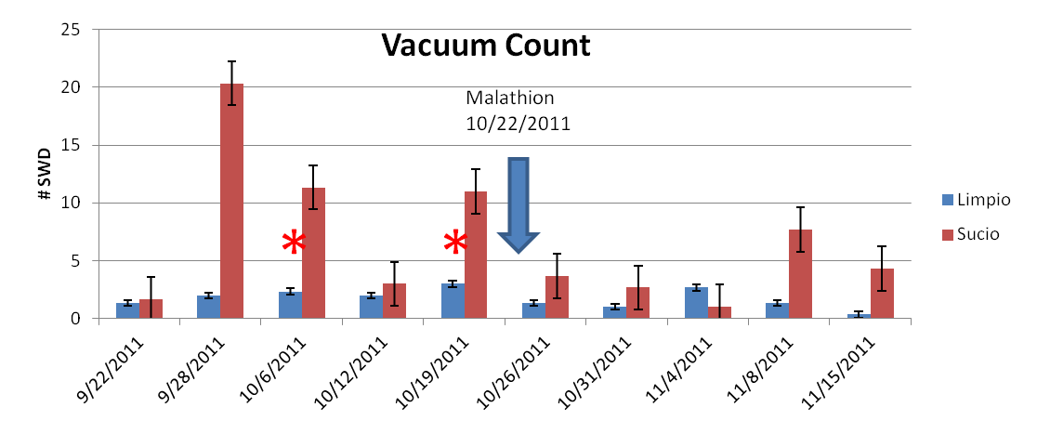
Sanitation Trial

Slide 17
Areawide Management Comments
Industry is de-facto in an areawide commitment, flies in 2013 were lower than any other year since the initial invasion.

Slide 18
Keys to Successful Management of the Spotted Wing Drosophila (SWD) on the Central Coast
Trapping to detect infestations.
Use of sprays to suppress fly populations.
Use of enhanced sanitation to reduce numbers of flies remaining in the field.
Area wide management.

Slide 19
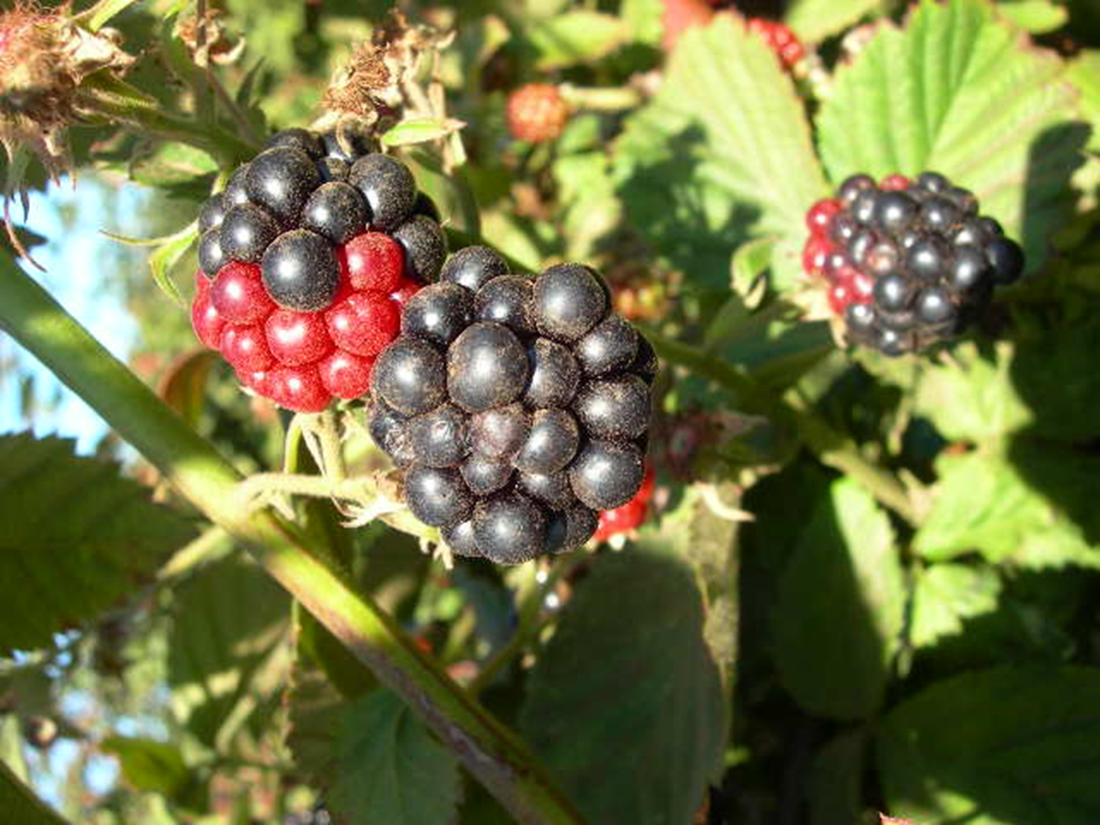
Redberry Mite

Slide 20
Recommendations for Redberry Mite Management
Three to four applications of 2% concentrations of Golden Pest Spray oil in at least 50 gallons water carrier begun at 25-50% flowering + first green fruit.

Slide 21
Caution about using oils
Golden Pest Spray oil applied every two weeks starting in April through the season for control of mites and mildew on strawberry.

Slide 22
Oil for Control of Mildew in Organic Strawberries
Golden Pest Spray Oil (GPSO) at 0.5% and 1.0%
 |  | Yield 6/18/2007 Mkt Box/A |  | Yield 9/6/2007 Mkt Box/A |  | Yield Mkt Box/A Total
1 | Untreated control | 749.7 | d | 3076.9 | a | 3826.6 | c
2 | GPSO @1% | 1395 | c | 3126.0 | a | 4521.8 | b
3 | GPSO @ 0.5% | 1987 | b | 3298.6 | a | 5286.4 | a
4 | Grower rotation | 2647 | a | 2957.4 | a | 5604.5 | a

Slide 23
A Caution About Using Oils
Six total applications in fall 2005 for yellow rust in raspberry, beginning August 12 and ending November 1.

Slide 24
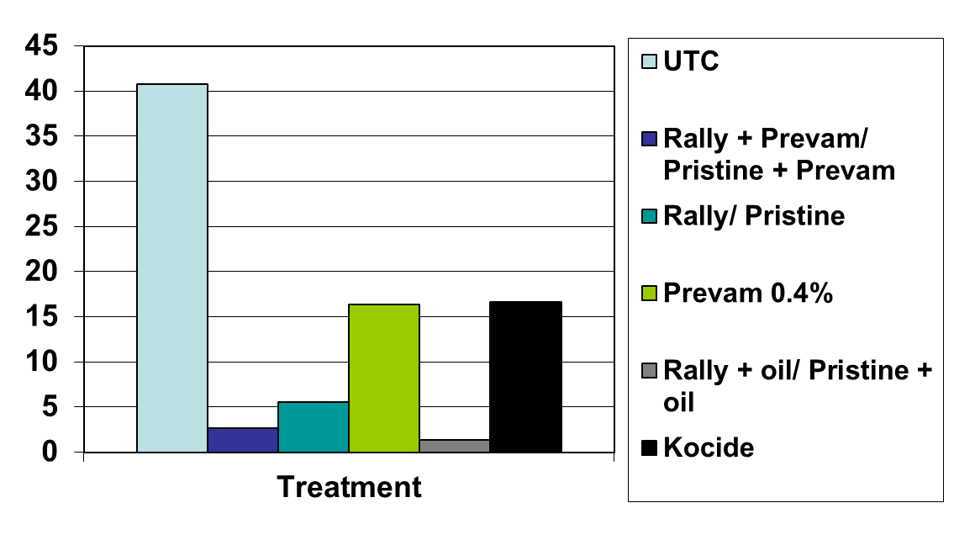
Control of Rust in Red Raspberry
(Fall 2005)
a
c c b c b
Average Leaf Infestation (%)

Slide 25
Control of Rust in Red Raspberry
Total Yield of Marketable Fruit
Fall 2005
Fruit Weight in Grams

Slide 26
Control of Rust in Red Raspberry
Yield of Marketable Fruit
November 2005
b ab a ab ab ab
Grams marketable fruit harvested

Slide 27
Marketable Fruit Weight in Grams
September 2005
a b b b b b

Slide 28
Redberry mite management
Three to four applications of 2% concentrations of Golden Pest Spray oil in at least 50 gallons water carrier begun at 25-50% flowering + first green fruit.

