Slide 1
Towards control of Fusarium wilt of celery, caused by F. oxysporum f. sp. apii race 4, with resistant germplasm
Lynn Epstein
Department of Plant Pathology
UC Davis
lepstein@ucdavis.edu
530-754-7916
Sukhwinder Kaur
Oleg Daugovish, UCCE, Ventura Co.
Peter Henry, formerly UCD Plant Pathology
Richard Hurstak, Crop Sciences Services
Allen van Deynze, Plant Science, UCD
Notes:
Hello. This is Lynn Epstein, Professor Emeritus, of the Dept. of Plant Pathology at UC Davis. I’m sorry that I’m not in person with you, but I am glad that I have the opportunity to tell you about our work on introgression of genes for resistance to Fusarium oxysporum f. sp. apii race 4 into a celery breeding line.
Much of the work that I’ll talk about today was done by Dr. Sukhwinder Kaur in our lab. We have had a number of excellent collaborators on this project over the years including Oleg, who I hope all of you know, and Peter Henry, who’s now at the USDA in Salinas. This work was supported by the CCRAB (Calfiornia Celery Research Advisory Board, the University of California, and the Hansen Trust.

Slide 2
Today
A brief introduction to celery & Fusarium oxysporum f. sp. apii (Foa) races 4 and 2
Our program for introgression of disease resistance to Foa race 4 into celery germplasm

Slide 3
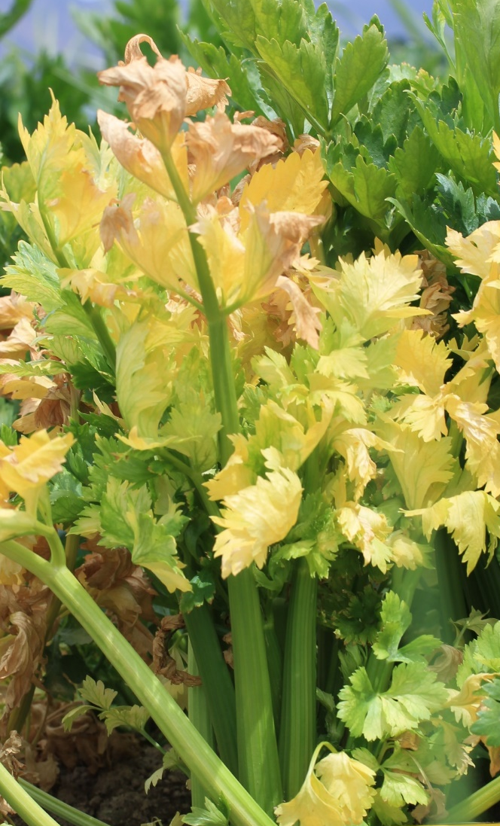
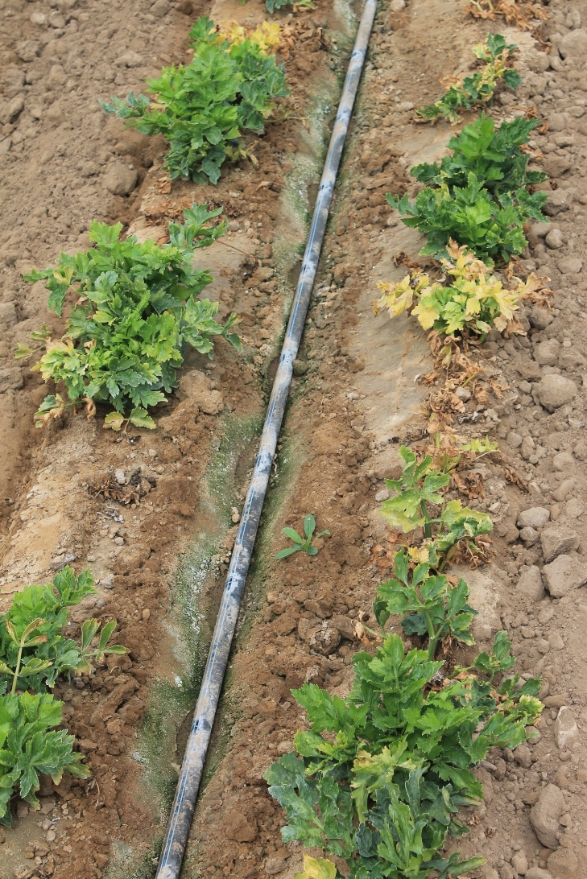
A)
B)
Fusarium oxysporum f. sp. apii (Foa) race 2
Appeared in ca. 1959
Causes the disease “Fusarium yellows in celery”
The pathogen first spread in California & then to other states in the U.S.
Foa race 2 an be controlled with resistance, e.g., cv. Challenger
C)
D)
Foa race 4
Appeared in ca. 2011 (in Ventura Co.). Recently, also in parts of Monterey Co.
Causes the disease “Fusarium wilt of celery”
Foa race 4 is relatively unrelated to Foa race 2
Foa race 4 is more virulent than Foa race 2
Notes:
I’ll focus on race 4 but I’ll also mention the historic work on race 2…also causes stunting. “The pathogen first spread in California (I guess mostly from field to field on unwashed harvesting equipment that carries soil and plant debris from an infested field to a previously uninfested field). After its spread in CA, race 2 appeared in other states & in Canada (I guess from seed that was grown in infested fields, and then the dust from those fields contained inoculum that was present in some seed batches; there is no evidence of infected plant to seed transmission in celery, but certainly bits of infested dirt in seed batches could contain the pathogen….Anyway, as I’ll explain later, race 2 can currently be controlled with resistant cultivars such as Challenger or CG390. Foa race 4…

Slide 4
A)
B)
Celery responds to infection with either Foa race 4
or race 2 by producing an orangish to brownish
pigment in the vascular parenchyma cells
C)
D)
Notes:
In some respects, celery to either race 4 or race 2

Slide 5
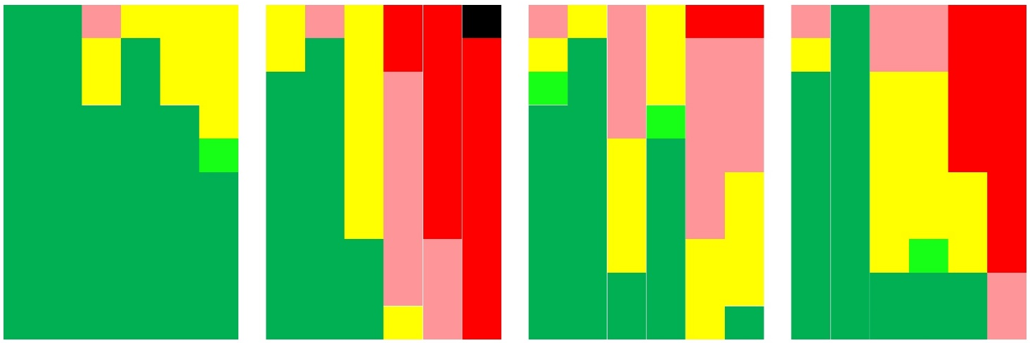
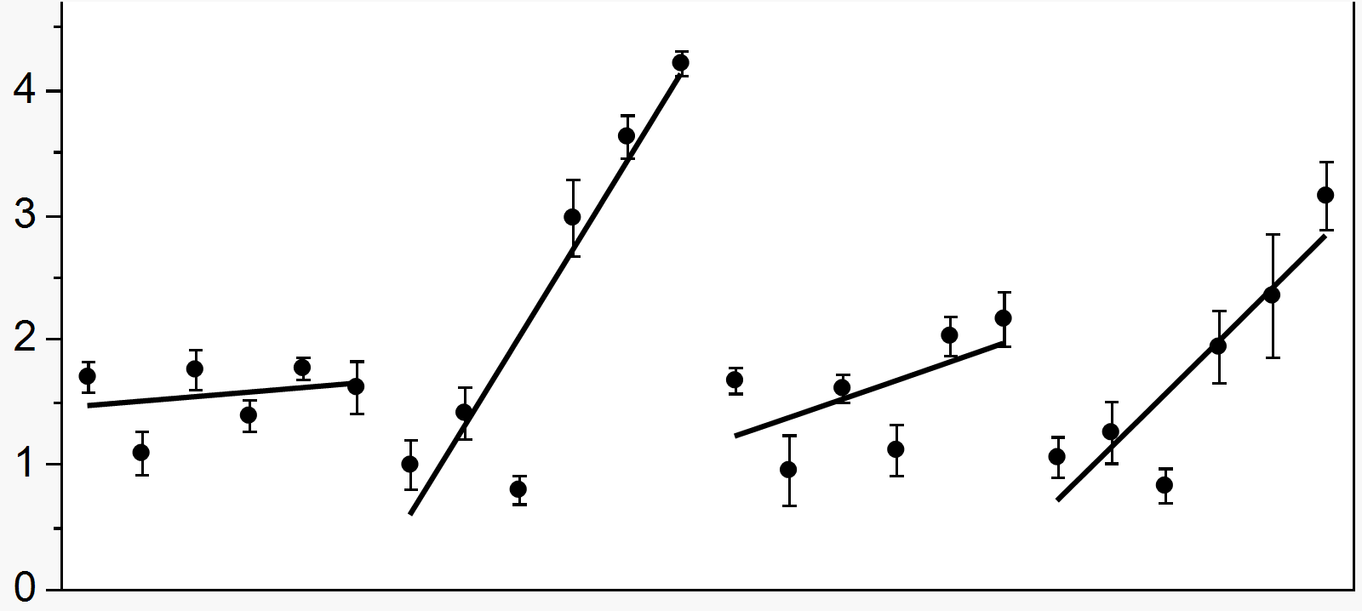
Differences between Foa races 2 and 4:
Race 4 is particularly virulent at temperatures greater than 72 ºF
A
Challenger
Sonora
100-
Race 2
Race 4
Race 2
Race 4
Severity
ratings
80-
5
Symptoms
4
60-
Plants with the indicated
disease severity, %
3
40-
2
20-
1
0-
0
16
20
24
16
20
24
16
20
24
16
20
24
Temperature, ⁰C
Challenger
Sonora
B
Race 4
Race 2
Race 4
Race 2
-1000
Fungal growth
in crowns
Log (fg Foa race 2 or 4
per ng celery DNA)
-100
No. Foa cells per 1,000 celery cells
-10
-1
C
0
Extent of stunting
in celery
Reduction in plant height, %
Kaur et al.
2022
Temperature, ⁰C
Temperatures from 61 ºF to 79 ºF
Notes:
LE: replace w F axis

Slide 6
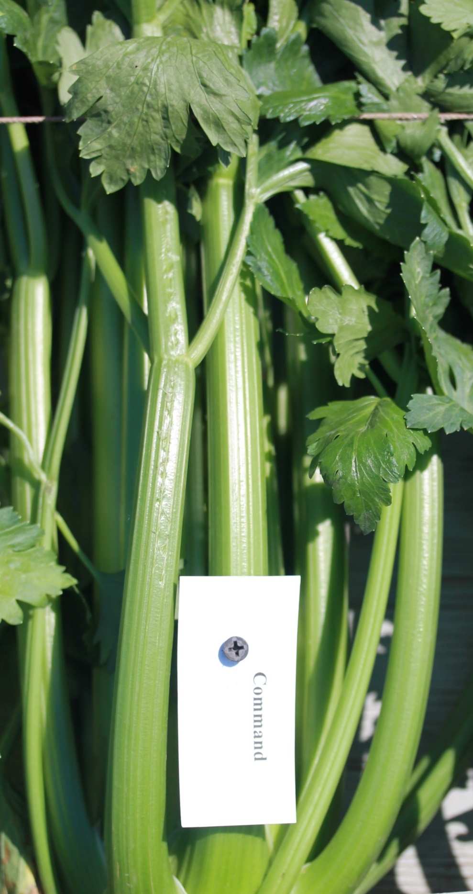
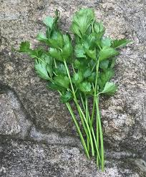
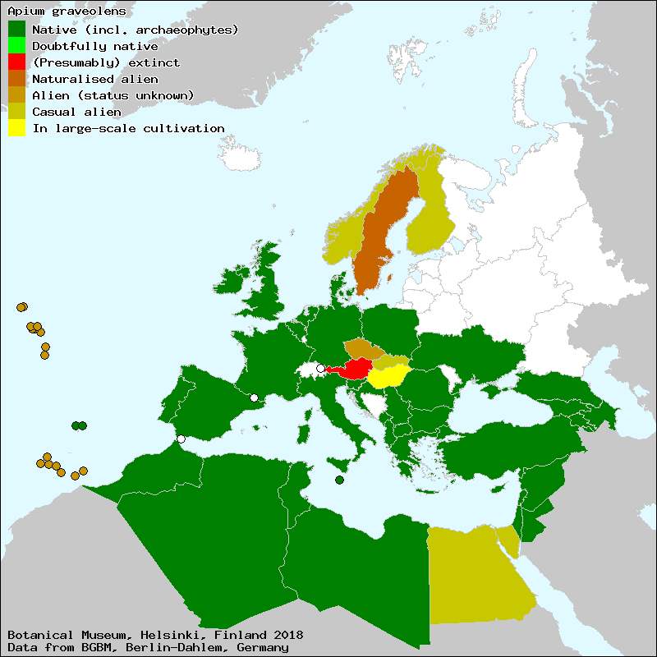
Celery: Apium
graveolens var.
dulce
Celeriac: A.
graveolens var.
rapaceum
Cutting celery/smallage: A.
graveolens var.
secalinum
Wild Progenitor: Apium
graveolens var. graveolens (may also be used for seed for spice)
https://www.gardenersworld.com/plants/apium-graveolens-var-rapaceum/
Notes:
The most common strategy for finding genes for resistance to a pathogen is to see if any sexually-compatible relatives have genes for resistance. The wild plant that was domesticated into celery is called Apium graveolens var. graveolens. The wild species was actually domesticated into three plants…

Slide 7
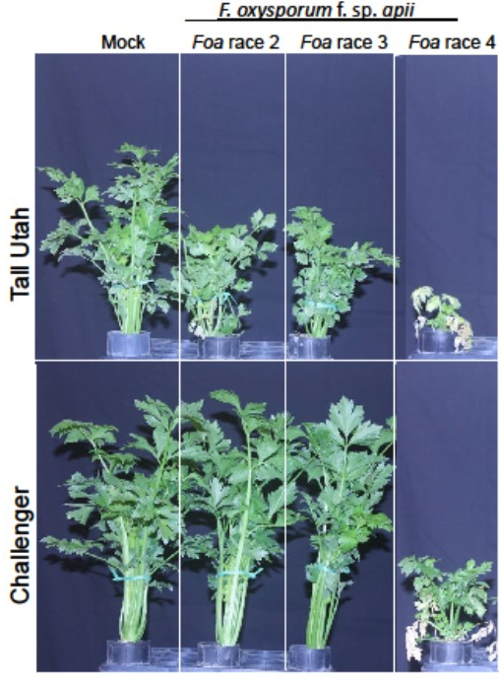
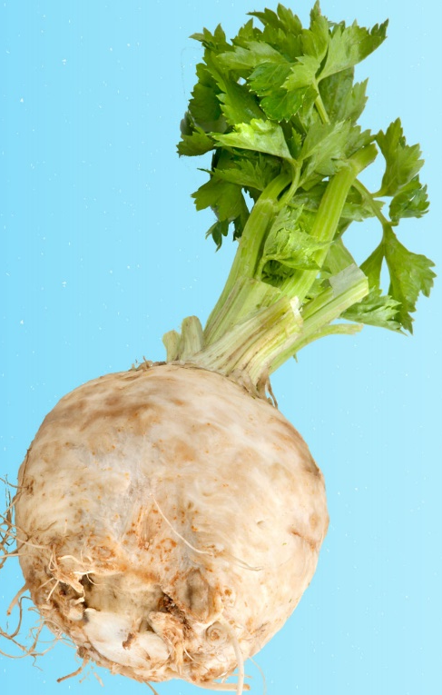
Breeding for Foa
race 2 resistance
Celeriac X
Henry et al. 2020
Notes:
The Tall Utah cultivars were introduced starting in the 1950’s. There are actually many variations of Tall Utah cultivars, but they’re basically all susceptible to race 2 (and also race 3, which has never been important. Back in the 1980’s researchers at UC Davis crossed a celeriac with a Tall Uah. This germplasm was developed in the private sector into the cultivar Challenger, which is resistant to race 2 (and race 3). But both Challenger & Tall Utah are susceptible to race 4.

Slide 8
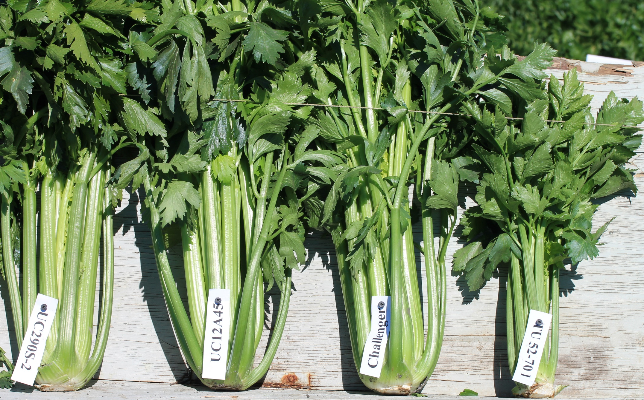
Some cultivars from the CCRAB trial in Camarillo, CA in Nov. 2013 in soil with F. oxysporum f. sp. apii race 2
Two of the Fusarium-tolerant varieties that were bred by the UC Davis Breeding Program: UC390S-2 & UC12A45
A commercial, Fusarium-resistant variety developed using material from the UC Davis Breeding Program
Fusarium-susceptible
Tall Utah 52-70 Improved
Notes:
The slide is from a 2013 CCRAB trial in Salinas, in race 2-infested soil. You can see the impact of race 2 on Tall Utah, compared with Challenger, and some other UC Davis lines with the same resistance genes that are in Challenger.

Slide 9
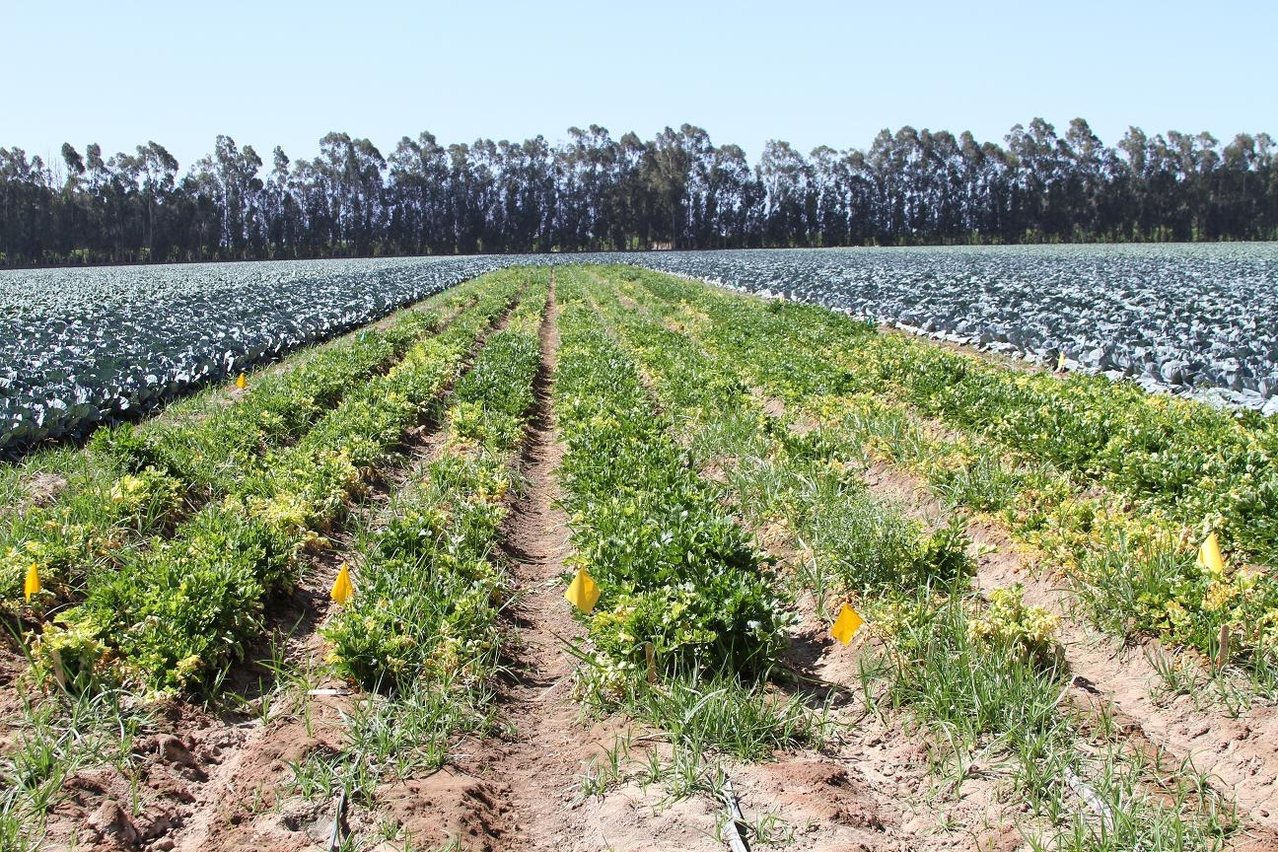
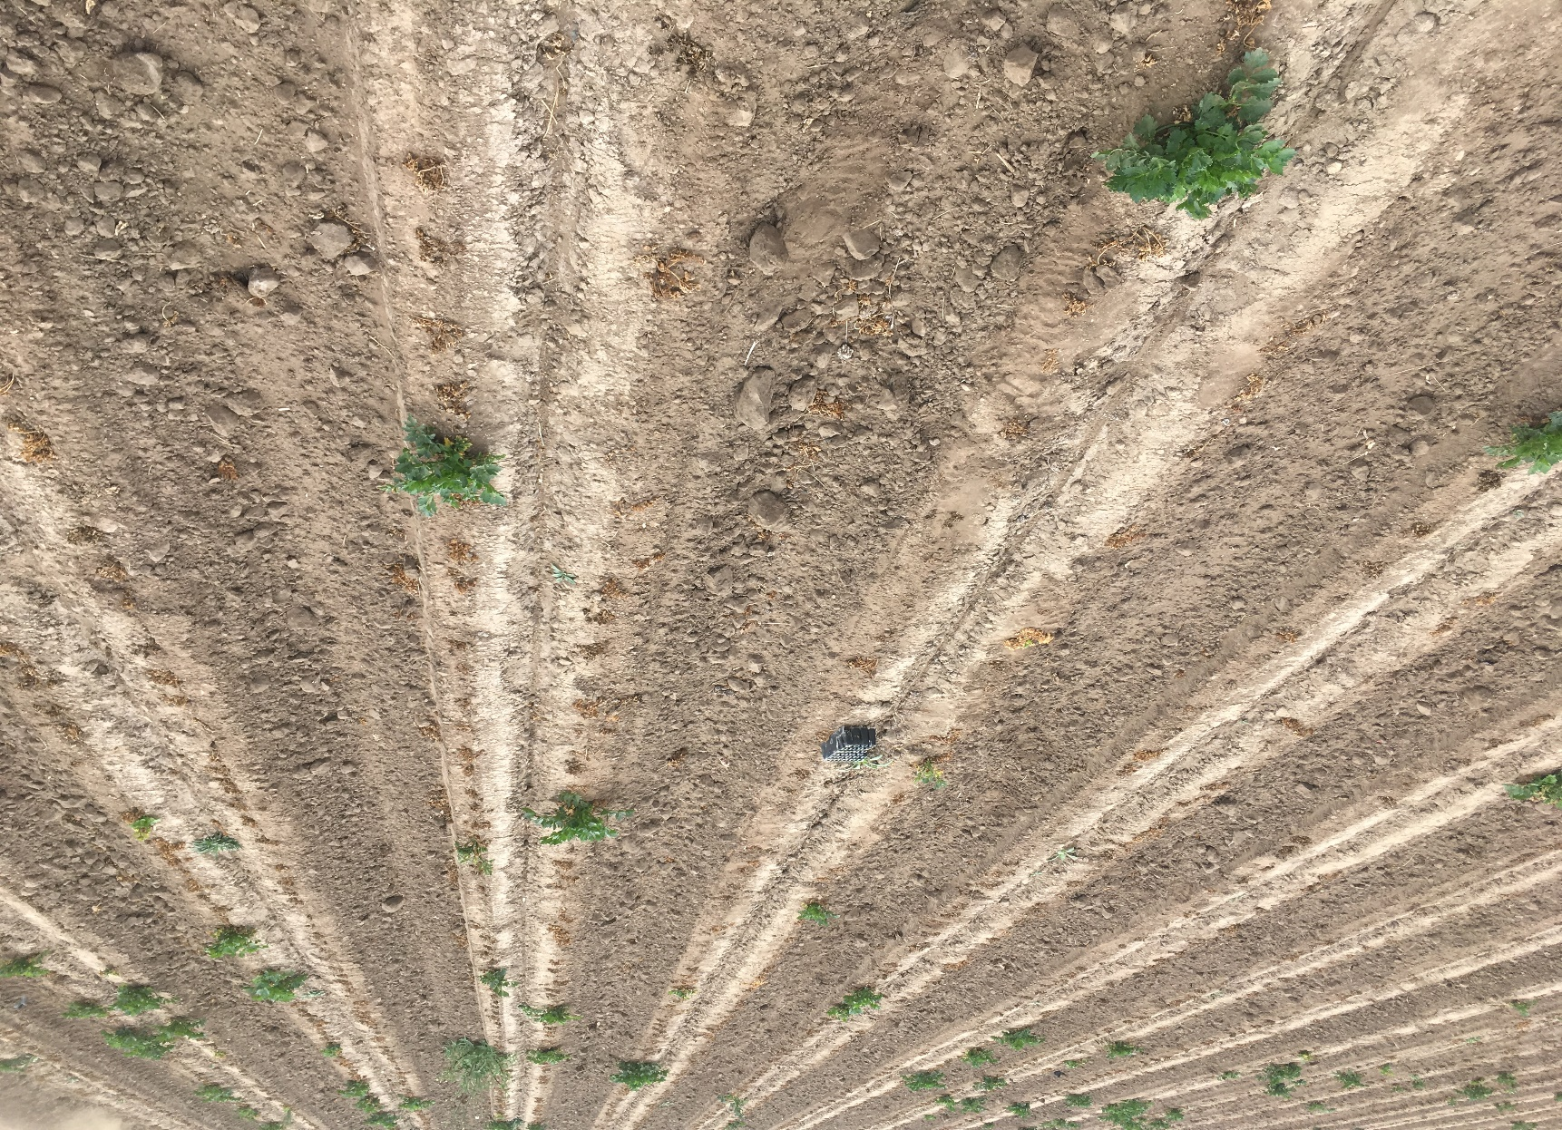
Camarillo, Celery Research Advisory Board trial, 28 May 2013
Results: We identified a new race (“race 4”) of Fusarium oxysporum f. sp. apii that is highly virulent on all tested celery cultivars (with some resistance in Rijk Zwaan’s Earthrace RZ F1)
Notes:
This is a picture from a CCRAB trial in 2013 in Camarillo (often called Oxnard) in Ventura Co.. Nothing in the trial was resistant, and it was the first evidence that there was a new pathogen.

Slide 10
Parents of F₁ in
Foa race 4-infested soil
Resistant
Susceptible
A0134, =PI 181714
cv. Challenger
“Celeriac”
cv. Challenger
Notes:
The most common strategy for finding genes for resistance to a pathogen is to see if any typically R4 inoc 2 parents of F1-A0134 celeriacL Challenger Rno2
[In 76-crosses, Challenger female
In 77-crosses, A0134 female]

Slide 11
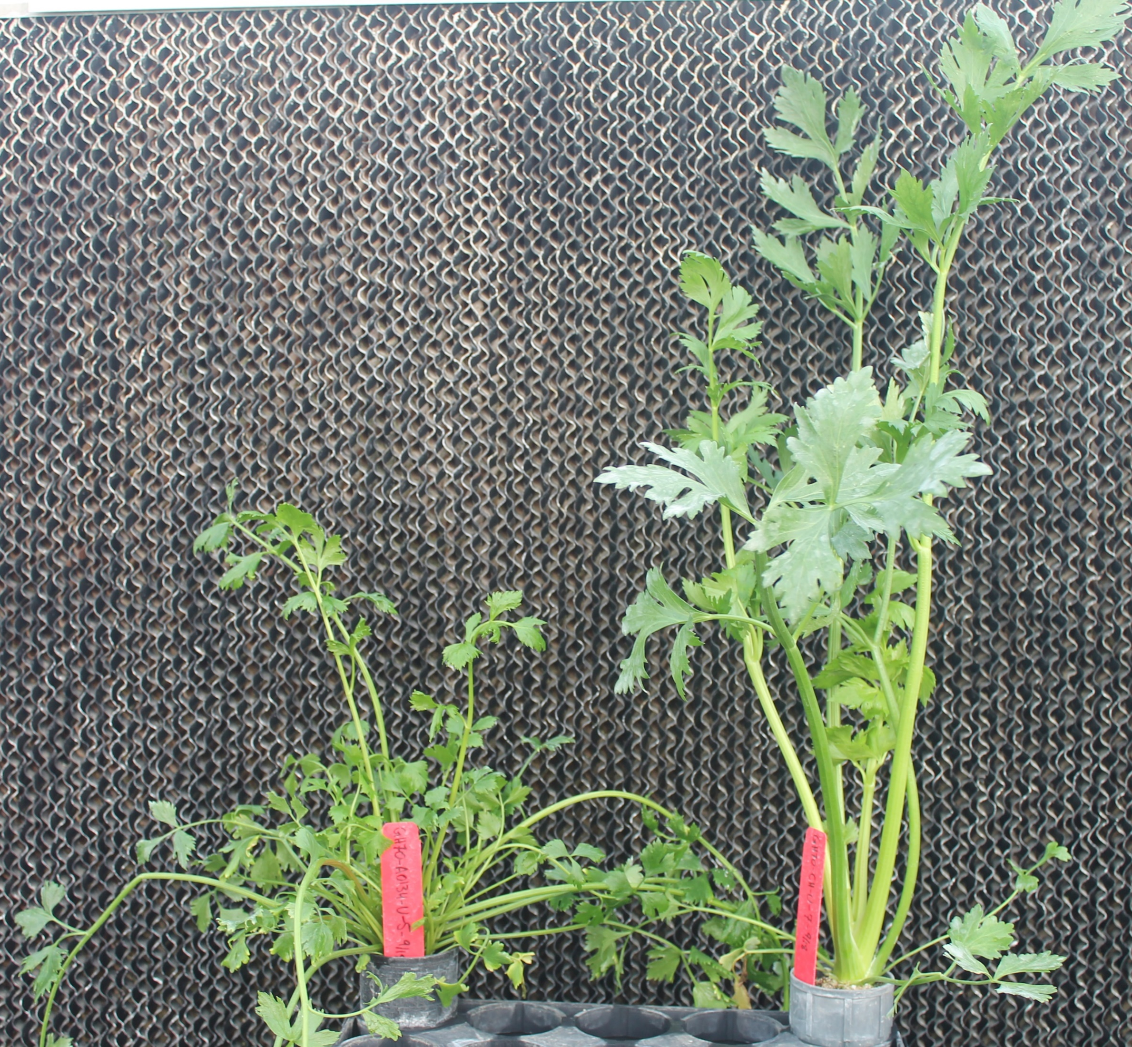
Parents of F₁
Uninfested soil
“Celeriac”A0134
cv. Challenger
Notes:
2 parents of F1-A0134 celeriacL Challenger Rno3 both U

Slide 12
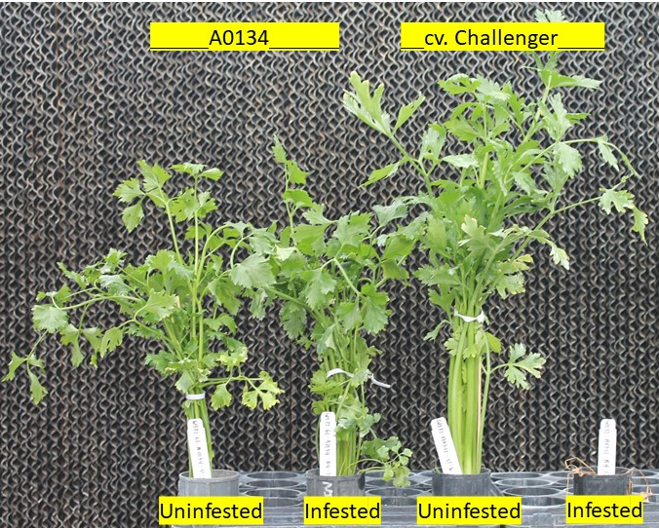
Parents of F₁ in Foa race 4-infested and uninfested soil
Notes:
The two Apium graveolens parents in the greenhouse in either uninfested or soil infested with Foa race 4. The Foa race 4-resistant A0134 in infested soil is barely affected while the susceptible cv. Challenger on the far right is dead.

Slide 13
A0134/
PI 181714
Challenger
__A0134__
race 4
race 4

Slide 14
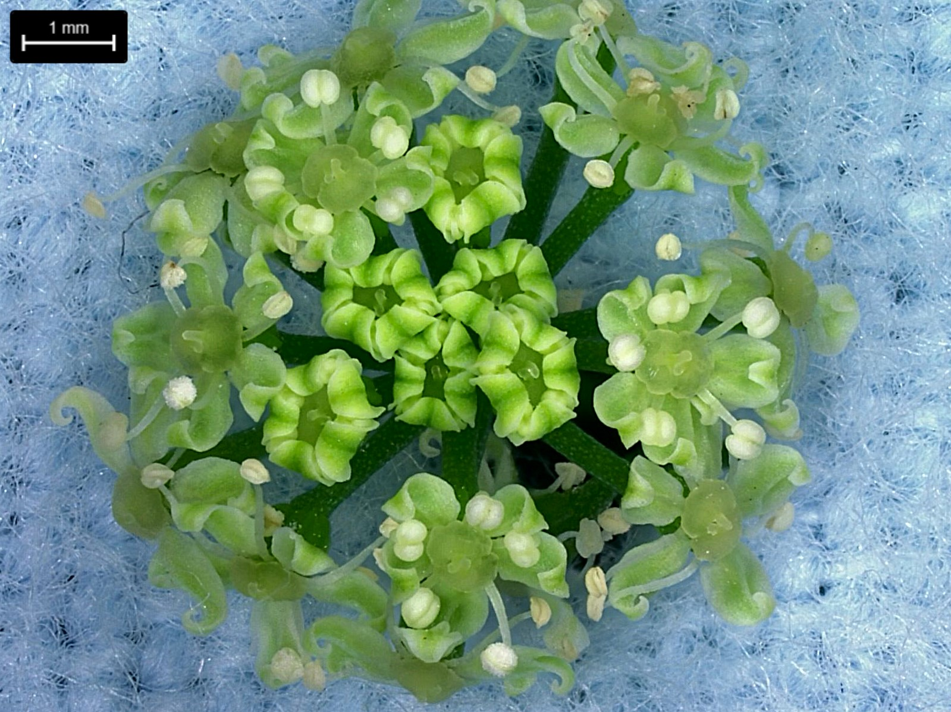
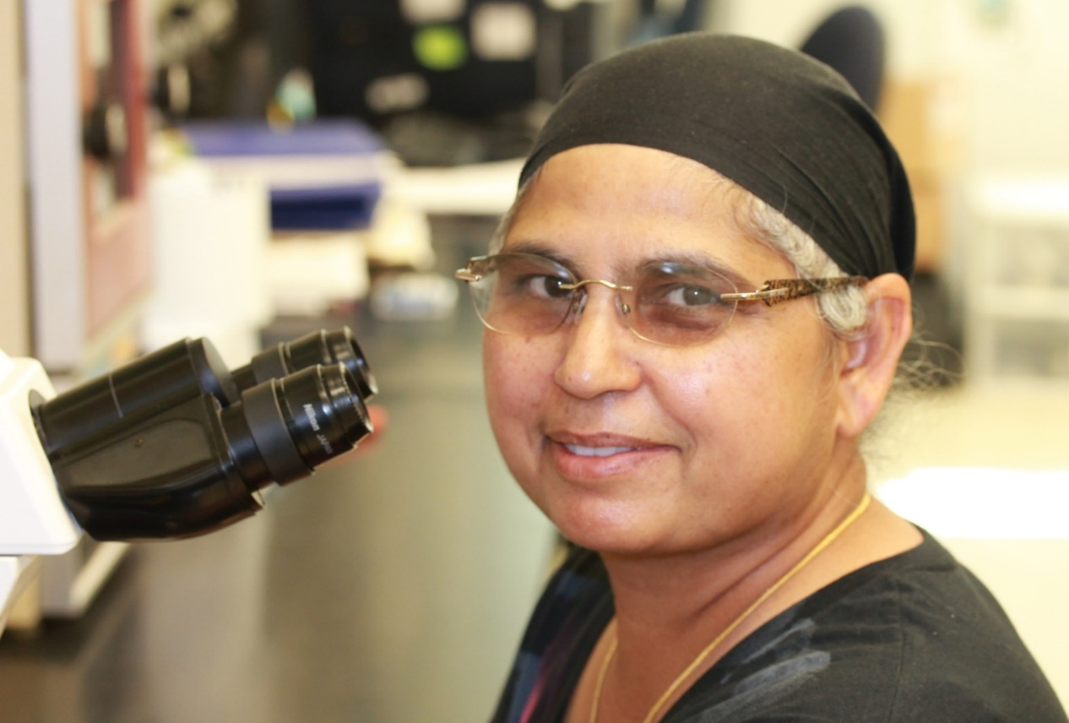
Dr. Sukhwinder Kaur
Development of resistant germplasm to Foa race 4
Notes:
Celery flowers are bisexual but protoandrous (pollen matures before the stigma is receptive)
Species is moderately outcrossing,
Celery diploid, 11 chromosomes

Slide 15
Our germplasm
2 parents (each presumably homozygous at every locus):
Challenger (celery-type, FoaR4^{S}, FoaR2^{R}) X
A0134 (not celery-type, FoaR4^{R}, FoaR2^{R})
F1 (assuming each parent is inbred/homozygous, then the F1 are heterozygous at every locus that differs between the two parents
An individual F1 plant that is selfed, produces a population of F1S1. We selected resistant individuals with celery type.
An individual F1S1 plant that is selfed, produces a population of F1S2. We selected resistant individuals with celery type.
An individual F1S2 plant that is selfed, produces a population of F1S3. We selected a resistant population.

Slide 16
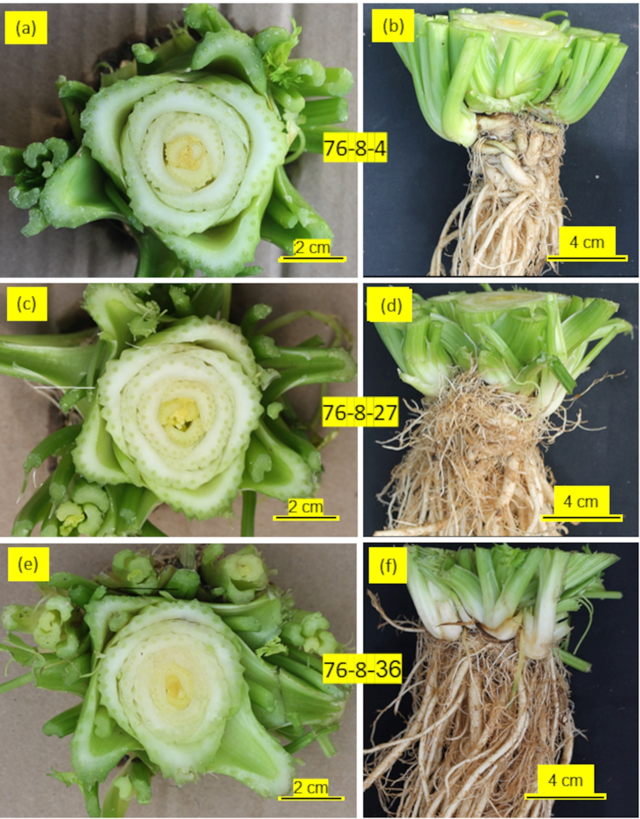
Representative plants from our field trial in

Slide 17
Results of one of two mini-trials in Foa race 4-infested soil in Camarillo in 2021
(Parent of F1) or F1S2 family that was derived from F1S1 76-8 | Fraction that died | Fraction of survivors
 |  | Asymp= tomatic above-ground | Asymptomatic below-ground | Solid petioles | Celery-type growth habit¶ | Compactly- arranged petioles
(PI 181714) | 0.00 a | 1.00 a | 1.00 a | 0.00 b | 0.00 c | 0.00 b
(Challenger) | 0.28 b | 0.49 b | 0.15 b | 1.00 a | 1.00 a | 1.00 a
F1S2 76-8-4 | 0.00 a | 1.00 a | 0.90 ab | 1.00 a | 0.96 abc | 0.96 ab
F1S2 76-8-15 | 0.00 a | 1.00 a | 0.92 ab | 1.00 a | 0.99 ab | 0.99 ab
F1S2 76-8-19 | 0.00 a | 0.98 ab | 0.86 ab | 1.00 a | 0.86 abc | 0.86 ab
F1S2 76-8-27 | 0.00 a | 1.00 a | 0.85 ab | 1.00 a | 0.85 abc | 0.85 ab
F1S2 76-8-28 | 0.01 ab | 0.95 ab | 0.83 ab | 1.00 a | 0.78 abc | 0.78 ab
F1S2 76-8-36 | 0.00 a | 1.00 a | 0.98 a | 1.00 a | 0.67 abc | 0.67 ab
F1S2 76-8-110 | 0.00 a | 1.00 a | 0.94 ab | 1.00 a | 0.14 b | 0.14 ab

Slide 18
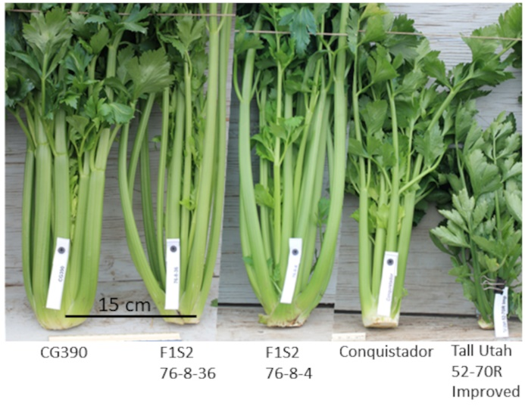
Representatives from the CCRAB field trial in Salinas, CA in 2021 in Foa race 2-infested soil
Notes:
[Field-grown plants from the CCRAB trial in Foa race 2-infested soil in Santa Maria, CA in 2021. From left to right: CG390, a Challenger-like cultivar; F1S2 76-8-36; F1S2 76-8-4; Conquistador, which is moderately Foa race 2-susceptible; and Tall Utah 52-70R Improved, which is highly Foa race 2-susceptible. As expected, our selected F1S2 lines are Foa race 2-resistant (because both of their parents are race 2-resistant). Our F1S2 are not completely “celery type.” However, because commercial breeders will have to “introgress” race 4 (and if they want race 2)-disease resistance into their commercial lines over the course of several generations, they should be able to select for recombinants with both disease resistance from our lines and celery-type from their lines, ]

Slide 19
The parents, F1S2 76-8-36 and F1S3 from nine selfed 76-8-36: vascular discoloration-based symptoms, and celery vs. celeriac type in Foa race 4-infested soil in the greenhouse
 |  | Plants in each category, % |  |  |  |  |  |  |  | Resistant, % (vd score < 2) | n
 |  | Vascular discoloration (vd)-based score from 0 (asymptomatic) to 5 (dead) |  |  |  |  |  | Celery type | Celeriac type
Generation | Plant ID | 0 | 1 | 2 | 3 | 4 | 5
Parent of F1 | A0134 | 95 | 0 | 2 | 2 | 0 | 0 | 0 | 100 | 98 | 44
F1S2 | 76-8-36 | 89 | 0 | 2 | 9 | 0 | 0 | 71 | 0 | 91 | 45
F1S3 | 76-8-36-124 | 96 | 0 | 2 | 2 | 0 | 0 | 82 | 0 | 98 | 45
F1S3 | 76-8-36-133 | 96 | 0 | 0 | 4 | 0 | 0 | 73 | 0 | 96 | 45
F1S3 | 76-8-36-151 | 84 | 0 | 2 | 14 | 0 | 0 | 93 | 0 | 86 | 44
F1S3 | 76-8-36-103 | 30 | 55 | 5 | 10 | 0 | 0 | 100 | 0 | 90 | 20
F1S3 | 76-8-36-127 | 91 | 0 | 0 | 9 | 0 | 0 | 54 | 0 | 91 | 35
F1S3 | 76-8-36-139 | 89 | 9 | 0 | 2 | 0 | 0 | 42 | 0 | 98 | 45
F1S3 | 76-8-36-146 | 95 | 5 | 0 | 0 | 0 | 0 | 35 | 0 | 100 | 20
F1S3 | 76-8-36-105 | 83 | 10 | 0 | 8 | 0 | 0 | 25 | 0 | 93 | 40
F1S3 | 76-8-36-148 | 93 | 0 | 2 | 4 | 0 | 0 | 98 | 0 | 98 | 44
Parent of F1 | Challenger | 0 | 0 | 0 | 2 | 18 | 80 | 100 | 0 | 0 | 45
Notes:
ªEach trial also had 5 uninfested plants/family; all of the uninfested plants had a vd rating of 0 (data not shown). All plants in both the uninfested and infested treatments had solid petioles, expcept for all the plants in the A. graveolens PI 181714 parent, which had non-solid petioles.
^{b}Disease scores are as follows: 0, asymptomatic; 1, some discoloration characteristic of Foa in the fine roots, but none elsewhere; 2, some characteristic discoloration in the main roots but none in the crown; 3, characteristic discoloration in the crown vasculature but on < 1/4 of the vascular ring; 4, characteristic discoloration in the crown vasculature on > 1/4 of the vascular ring; and 5, plant dead.
^{c}Except for the dead plants (vd=5) in the cv. Challenger treatment, all plants were scored as either celery-type, celeriac-type, or an intermediate type. Celery petioles are wider and fewer than celeriac petioles, which are more numerous and less wide. The number of plants in the intermediate type can be calculated.

Slide 20
The parents, F1S1 76-8, three F1S2, and F1S3 76-8-36-124: the percentage with symptoms of Fusarium wilt in Foa race 4-infested soil, and celery vs. celeriac type in a greenhouse trial.
Generation | Plant ID | Symptoms of Fusarium wilt from Foa race 4 |  |  |  |  |  |  | Plant architecture |  |  |  | n¶
 |  | Vascular discoloration-based score from 0 (asymptomatic) to 5 (dead) |  |  |  |  |  | Asymp-tomatic above-ground | All solid peti-oles | Growth habit
 |  | 0 | 1 | 2 | 3 | 4 | 5 |  |  | Celery | Mix of celery & celeriac | Celer-iac
 |  | Plants, %
F1 parent | A0134 | 94 | 0 | 0 | 4 | 2 | 0 | 100 | 0 | 0 | 0 | 100 | 47
F1 parent | cv. Challenger | 0 | 0 | 0 | 0 | 38 | 63 | 0 | 100 | 100 | 0 | 0 | 48
F1S1 | 76-8 | 54 | 3 | 1 | 15 | 21 | 6 | 64 | 19 | 53 | 44 | 3 | 80
F1S2 | 76-8-4 | 49 | 11 | 0 | 11 | 16 | 11 | 73 | 100 | 91 | 9 | 0 | 79
F1S2 | 76-8-27 | 68 | 0 | 2 | 12 | 18 | 0 | 82 | 100 | 84 | 16 | 0 | 125
F1S2 | 76-8-36 | 84 | 13 | 4 | 0 | 0 | 0 | 100 | 100 | 63 | 37 | 0 | 80
F1S3 | 76-8-36-124 | 95 | 0 | 0 | 5 | 0 | 0 | 99 | 100 | 85 | 15 | 0 | 80
Epstein & Kaur, In press

Slide 21
Conclusion: We have germplasm that is fixed for Foa race 4 (& Foa race 2) resistance
Notes:
Representative plants from a greenhouse trial 35 days after transplantation into soil that was either uninfested (left), or infested with Foa race 4 (middle) or Foa race 2 (right). The genotypes are of the two parents (celery cv. Challenger and Apium graveolens A0134), and their progeny F1S3 76-8-36-124, which is fixed/homozygous for Foa race 4 (and race 2) resistance.

Slide 22
A0134
A0134
Epstein & Kaur, In press
Technically, A0134 & F1S3-124 are at least somewhat immune to Foa race 4 (and race 2)

Slide 23
The following UC Davis (UCD) seed can be obtained [after signing a material transfer agreement (MTA) with UCD] by contacting lepstein@ucdavis.edu F1S3 76-8-36-124 F1S2 76-8-36 F1S2 76-8-27 F1S2 76-8-4 Resistant Parent USDA PI 181714 (UC A0134)
Terms of the UCD MTA:
Seeds available to anyone for research
For commercial breeding, UCD requires a
non-exclusive license with UCD
Notes:
We are releasing seed

Slide 24
What’s next?
Renee Eriksen at the USDA in Salinas is taking over the CCRAB-sponsored breeding program and the field testing
We have a team for developing DNA tools that will facilitate breeding for disease resistance to Foa
Chaehee Lee, Allen van Deynze, Grey Monroe, Lynn Epstein, Peter Henry, Renee Eriksen

Slide 25
How the DNA data could be used
-To streamline breeding for Foa race 4 and race 2 resistance
-To gain insight into the celery – Foa race 4 and celery - Foa race 2 interactions
(thanks partly to you all, we already have annotated genomes of Foa races 2 & 4)
-To see if there’s potential for “stacking” genes for race 2 resistance
-To enable efficient and productive hypothesis-driven research on a variety of stresses for California-grown celery
Notes:
Transferring the genes for resistance from our germplasm into commercial cultivars will be faster and ultimately less expensive with the DNA tools that we’re developing. In the interests of time, I’ll skip over these points for now.

Slide 26
IPM for control of Foa race 4
Include cultural controls:
EXCLUDE Foa race 4 from currently uninfested fields (make sure that equipment that’s been in an infested field doesn’t enter an uninfested field with infested soil & plant debris)
If you see an infection locus in a field, try your best to quarantine it—don’t move equipment through it
Avoid planting celery and celeriac in an infested field
If a field is infested, and you are planting celery or celeriac, don’t plant (Aug.-Sept) when the crop might experience temperatures greater than 72 ºF
Notes:
As a plant pathologist, I want to emphasize

Slide 27
https://epstein.faculty.ucdavis.edu/
PI 181714 is a source of resistance to Fusarium oxysporum f. sp. apii race 4 in celery (A. graveolens L. var. dulce). Epstein, L, Kaur, S. Plant Breeding (In Press)
The effect of temperature on disease severity and growth of Fusarium oxysporum f. sp. apii races 2 and 4 in celery. 2022. Kaur S, Barakat R, Kaur J, Epstein L. Phytopathology 112:364-372. [Supplemental file]
The emergence of Fusarium oxysporum f. sp. apii race 4 and F. oxysporum f. sp. coriandrii highlights major obstacles facing agricultural production in coastal California in a warming climate: a case study. Epstein L., Kaur S., Henry PM. 2022. Frontiers in Plant Science 13: 9211516. doi: 10.3389/fpls.2022.921516
Genomic differences between the new Fusarium oxysporum f. sp. apii (Foa) race 4 on celery, the less virulent Foa races 2 and 3, and the avirulent on celery f. sp. coriandrii. Henry P, Kaur S, Pham QAT, Barakat R, Brinker S, Haensel H, Daugovish O, Epstein L. 2020. BMC Genomics 21:730. [Supplemental files]
Races of the Celery Pathogen Fusarium oxysporum f. sp. apii are polyphyletic. Epstein L. Kaur S, Chang P, Carrasquilla-Garcia N, Lyu G, Douglas Cook D, Subbarao K, Kerry O’Donnell K. 2017. Phytopathology 107:463-473. Suppl. Fig. S1. Suppl. Table S1. Suppl. Table S2. Suppl. Table S3.
Notes:
If you’d like to know more, here’s a link to my web page, which will at least eventually have links to all of our relevant papers. Much of the work that I’ve talked about today is in this first paper that will be published shortly.

Slide 28
Lynn Epstein
Department of Plant Pathology
UC Davis
lepstein@ucdavis.edu
530-754-7916
SRA: Dr. Sukhwinder Kaur
On-going breeding: Renee Eriksen,
USDA-ARS, Salinas & colleagues
Development of molecular tools to
facilitate breeding:
UCD Plant Sciences:
Chaehee Lee, Grey Monroe, &
Allen van Deynze
USDA-ARS, Salinas:
Renee Eriksen & Peter Henry
UCD Plant Pathology: Lynn Epstein
Notes:
If you’d like to contact me, you can send me an e-mail, or leave me a message at this number, and I’ll get back to you. Renee Eriksen at the USDA-ARS in Salinas is going to take over the breeding part of program. Renee is part of a team that I’m on that will be continuing to develop DNA tools that will be useful for both the continued CCRAB breeding efrorts and for private breeders to incorporate genes for resistance to races 4 and 2 into their cultivars.

