Slide 1

Area-wide management approaches for year-round insecticide-resistant diamondback moth populations in Ventura County, CA
Maripaula Valdes-Berriz
Oleg Daugovish
Vegas Riffle
UC Cooperative Extension, Ventura County

Slide 2
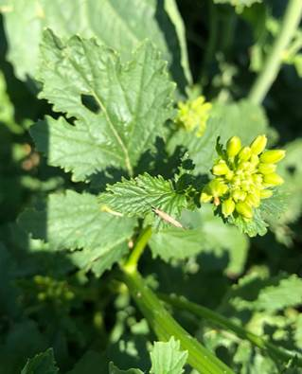
Increasingly problematic in Ventura County,
Unsustainable crop losses
Widespread resistance to most modes of actions
Climatic conditions allow survival and reproduction all year-round
  20°C (68 °F) optimal for reproduction (Saeed et al. 2009)
  Emergence still happens as low as 4 °C (39 °F) and as high as 38 °C (100 °F) (Lui et al. 2002)
Cole crop production all year

Slide 3
General Objectives
Exploring seasonal and regional trends in the counts of Plutella xylostella in Ventura County
Inform growers of counts and results through regular updates
Determine the efficacy of different tools for controlling Plutella xylostella

Slide 4
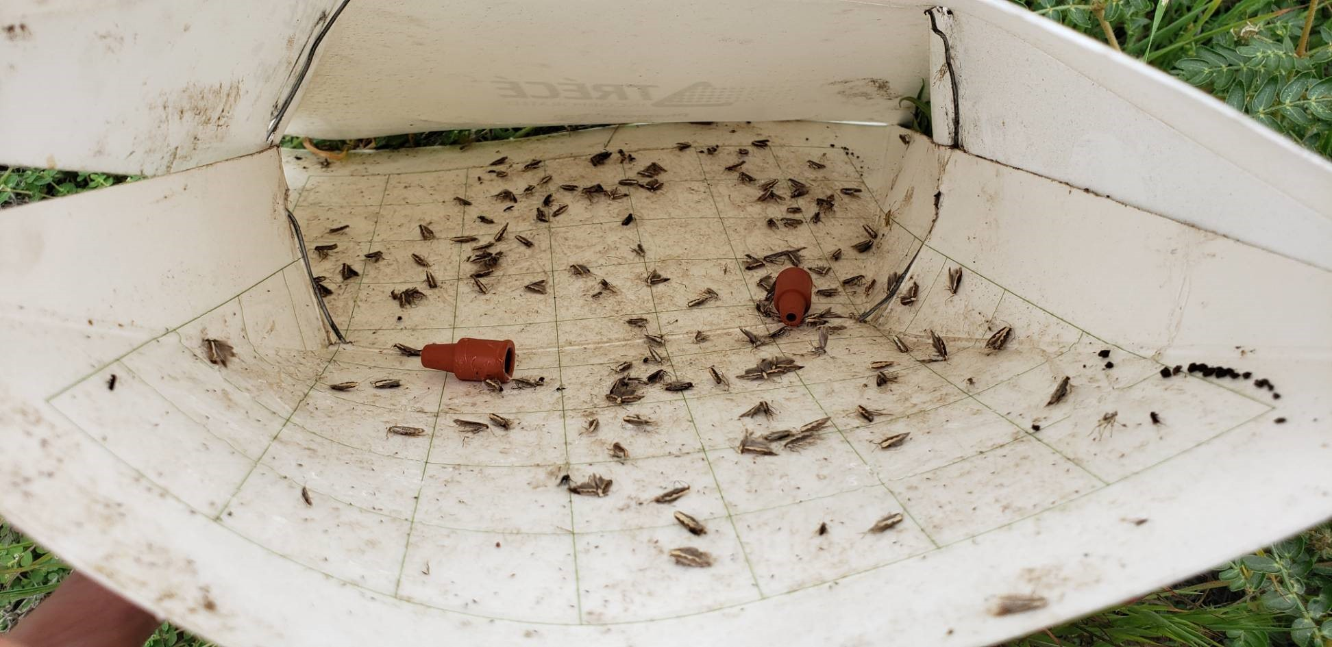
Monitoring methods
Trece traps with pheromone lures (2) at 1 meter of height
Checked weekly
Changed as needed or every 4 weeks
Some are permanent traps and some move as fields were harvested
  Permanent traps are in areas where cabbage fields are common throughout the year
Adult male counts were averaged by area/city
Weather data obtained for each city from Historical Observations from NOAA/Nat. Weather Service
  Temperature
    Average temperature for the week
    Average of daily maximum temperature for the week
  Wind speed
    Maximum wind speed for the week

Slide 5
Monitoring Counts by City
Trap counts show the number of male adults only
Some differences between cities, especially between May and August
Lower counts overall April and September
High variation within each region

Slide 6
Seasonal and regional trends

Slide 7
Seasonal and regional trends

Slide 8
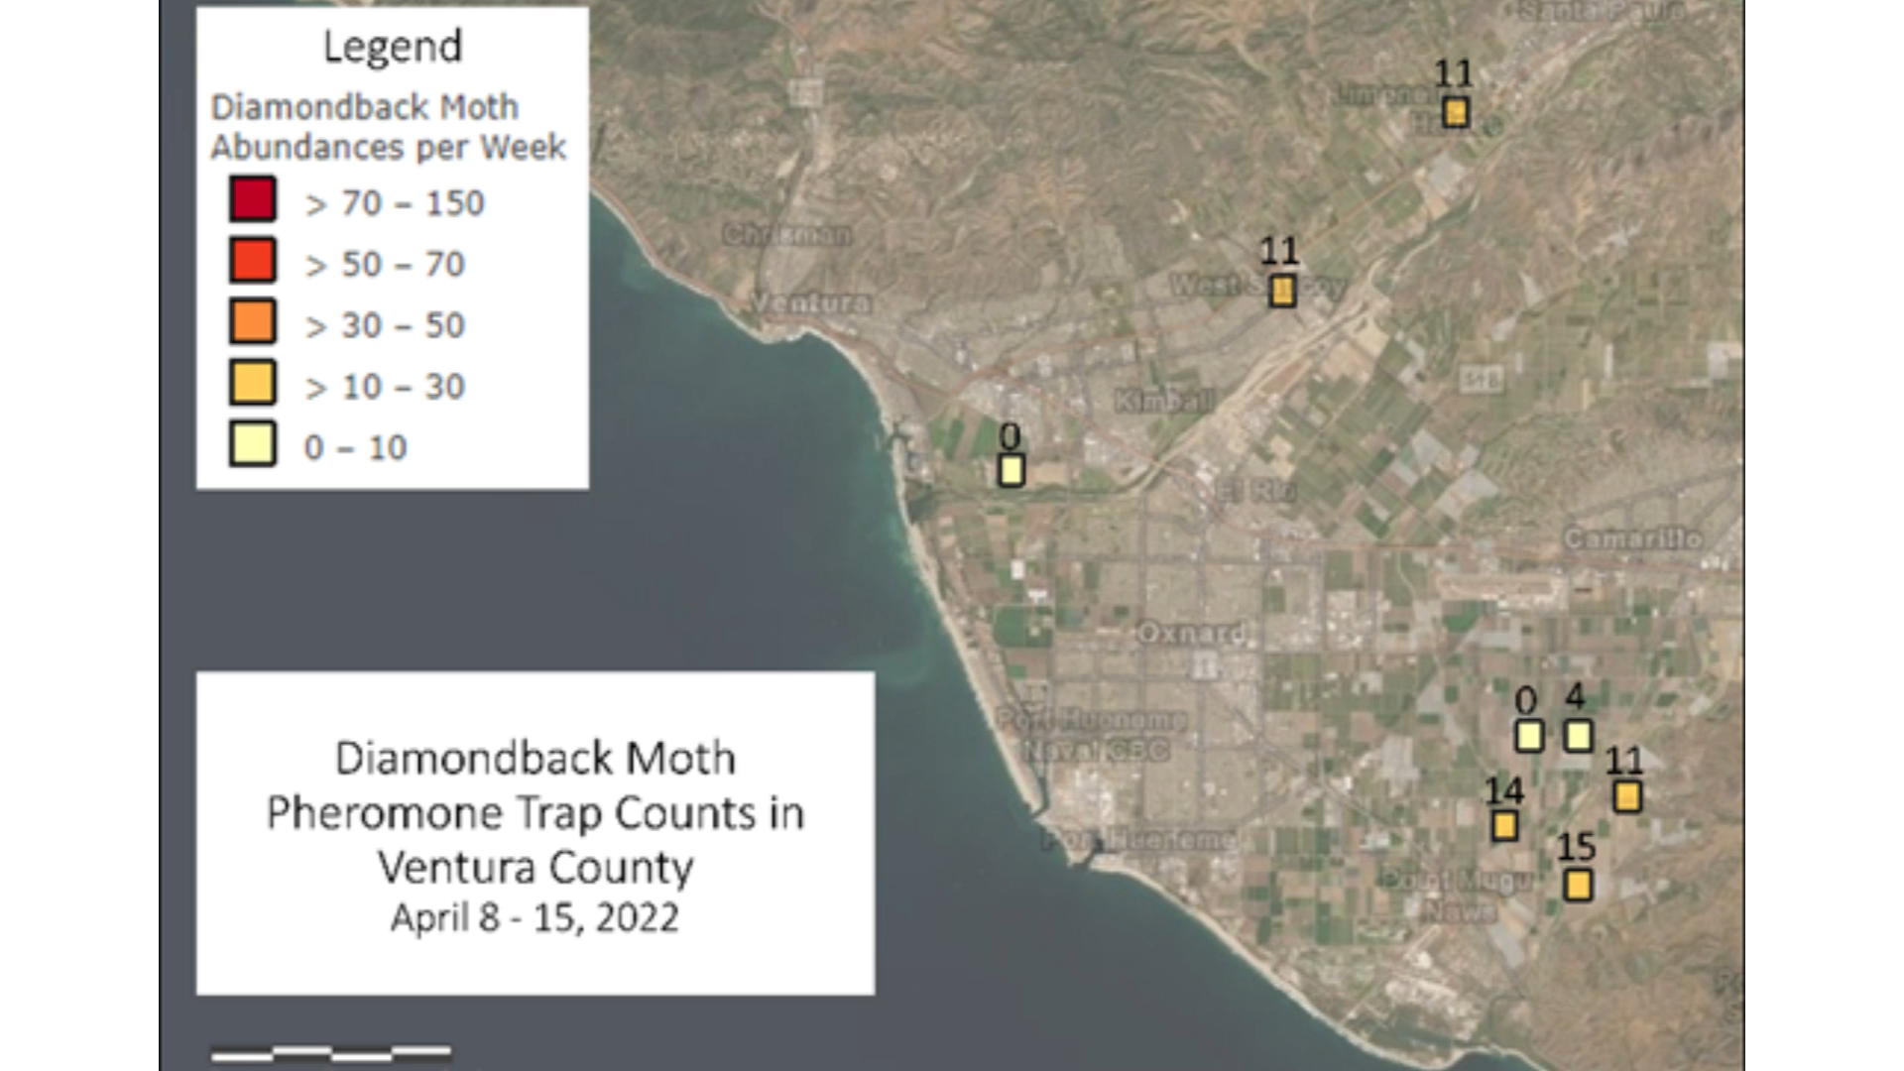
Count map shared with growers

Slide 9
Bioinsecticide trial: Methods
Oxnard
7 treatments:
  Xentari (Valent)+Surfactant
  Xentari (Valent)+Surfactant+Spearlep (Vestaron)
  DiPel (Valent)+Surfactant
  DiPel (Valent)+Surfactant +Spearlep (Vestaron)
  Senstar (Valent)
  Untreated check (Exp. 1: not sprayed with water)/(Exp. 2: water+surfactant)
  Untreated check (sprayed with water)
Treated weekly
  Experiment 1: 4 applications
  Experiment 2: 2 application (crop destroyed)

Slide 10
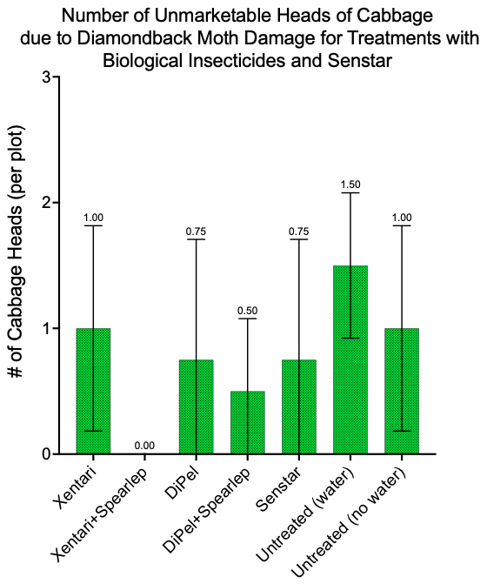
Bioinsecticide trial #1: Damage by Counts
Counts of head with damage after first harvest
Lowest larvae counts on:
  Xentari+Spearlep
  DiPel+Spearlep
  DiPel and Senstar also <1
Important: these are small plots and recolonization from adjacent field is happening

Slide 11
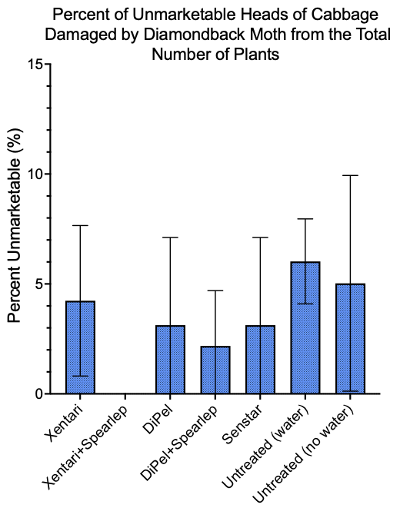
Bioinsecticide trial #1: Damage from Total
Same pattern as before

Slide 12
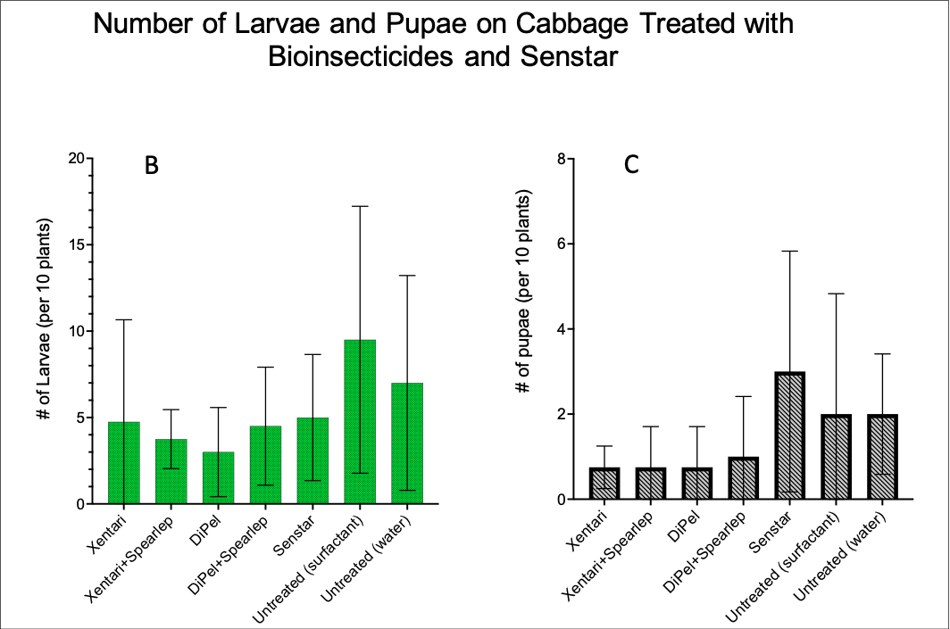
Bioinsecticide trial #2: Counts
Only differences between larvae counts were significant
Treatment was sig. (p=0.02) for larvae:
  Senstar - Untreated+Surfactant
  Xentari+Spearlep - Untreated+Surfactant
  DiPel - Untreated+Surfactant
# of holes and pupae counts were not sig. different between treatments

Slide 13
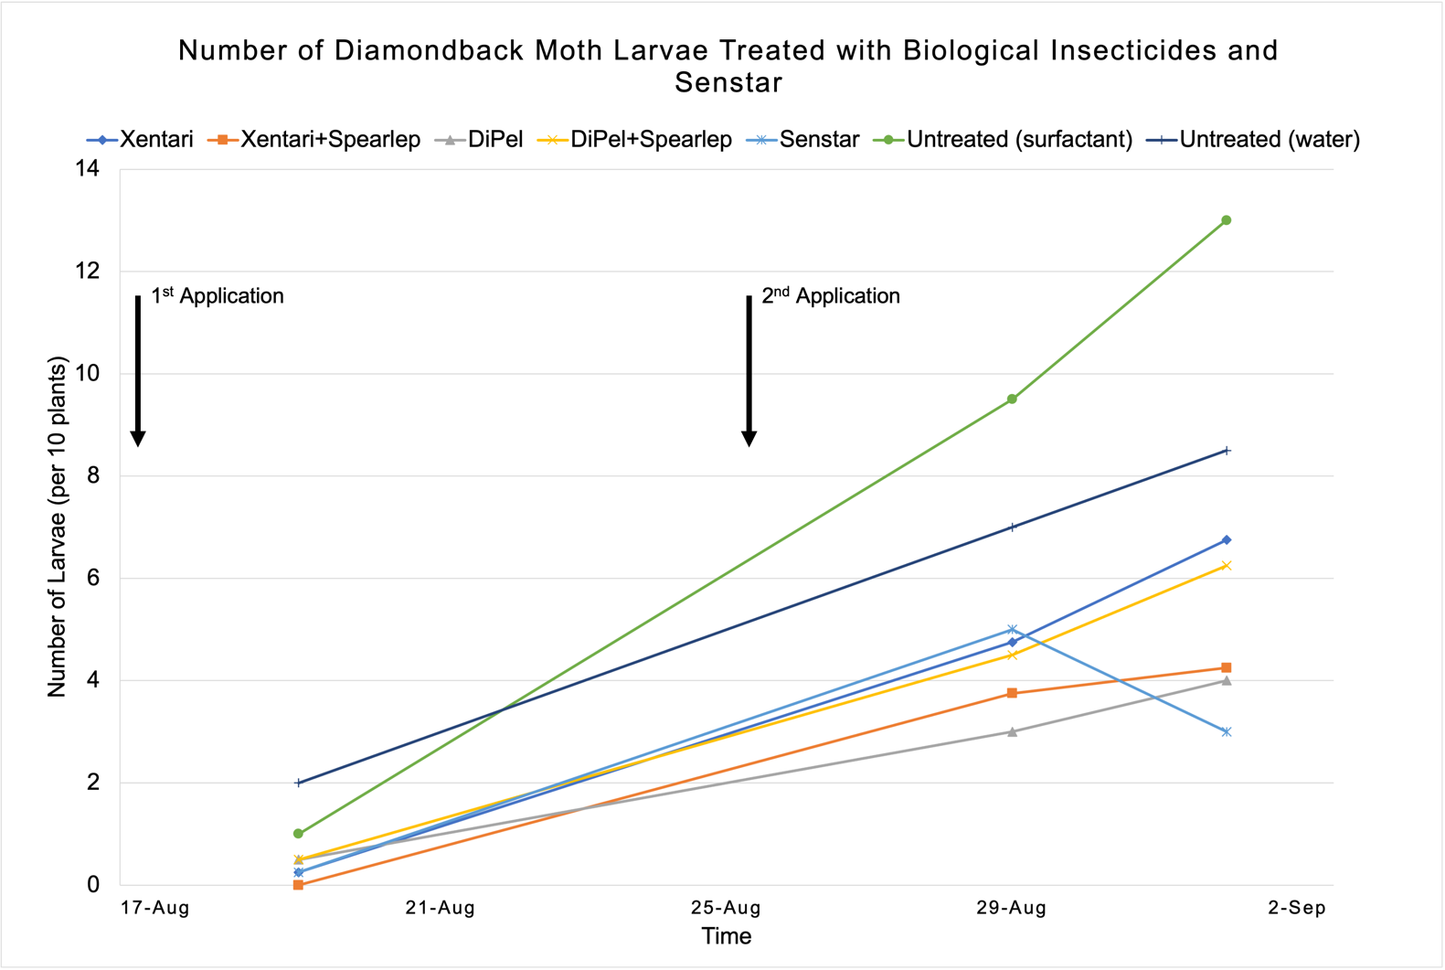
Bioinsecticide Trial #2: Larvae Counts
Both untreated checks had higher larvae counts
All treatments had lower larvae counts after two treatments
Lowest counts:
  Xentari+Spearlep
  DiPel
  Senstar

Slide 14
Cultivar trials: Methods
2 sites: Camarillo and Santa Paula/HAREC
  Camarillo/ Beardsley was conventional
  Hansen: not sprayed with cover crop around it
27 and 17 cultivars, resp.
Eggs and larvae not found on nursey plants
Different pest pressure at each site

Slide 15
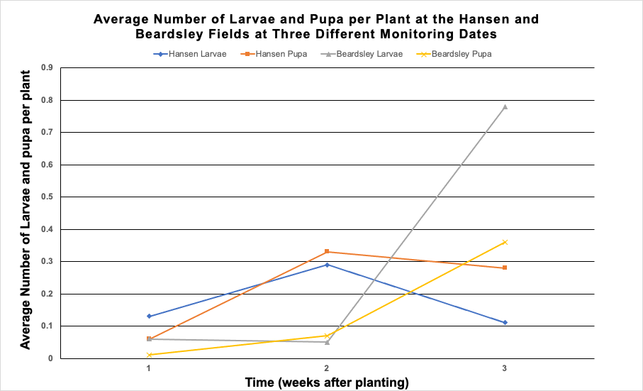
Cultivar Trials: Larvae and Pupae Counts
Different pest pressure at each site:
  High at Beardsley, lower initially
  Medium at Hansen, drops after the third week
Larvae and pupae counts dropped at Hansen after 2nd week
Plants from the same source/nursery
High level of parasitism and mortality at Hansen was observed

Slide 16
Cultivar trial at Hansen: Yield

Slide 17
Cultivar Trials: Results
Not all cultivars were represented
  56 was not represented at Hansen
Cultivar performance did not match between sites
  6075 did not do well
Large numbers of predators (spiders) and Diadegma parasitism was observed at Hansen
Low levels of parasitism at Beardsley

Slide 18
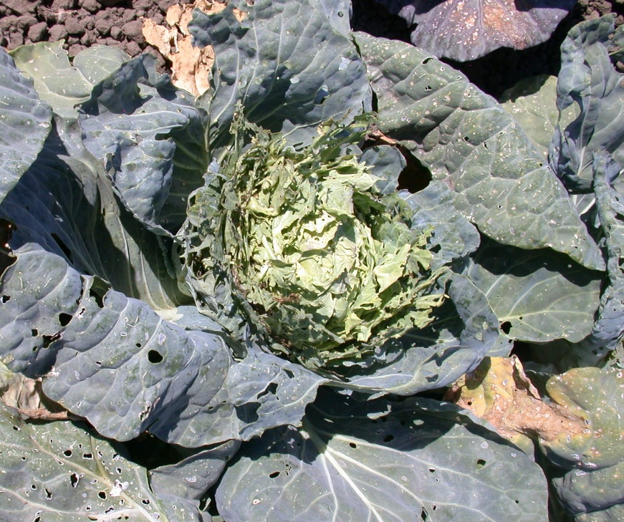
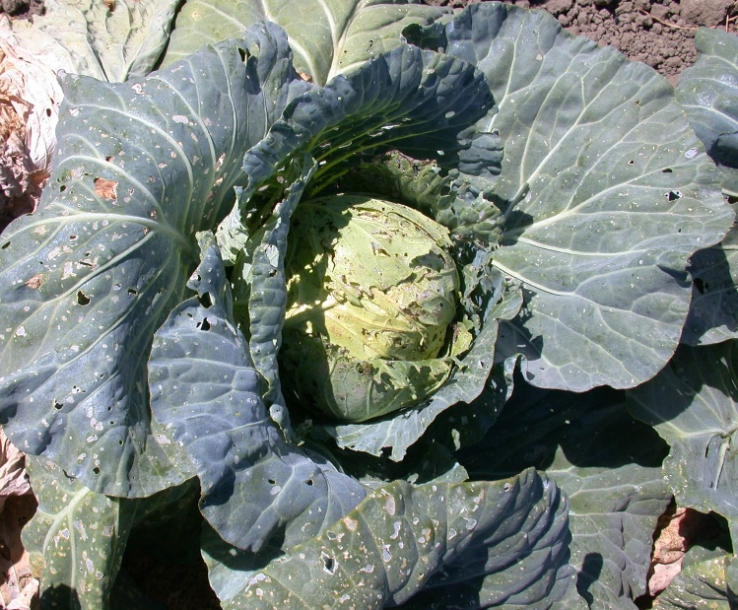
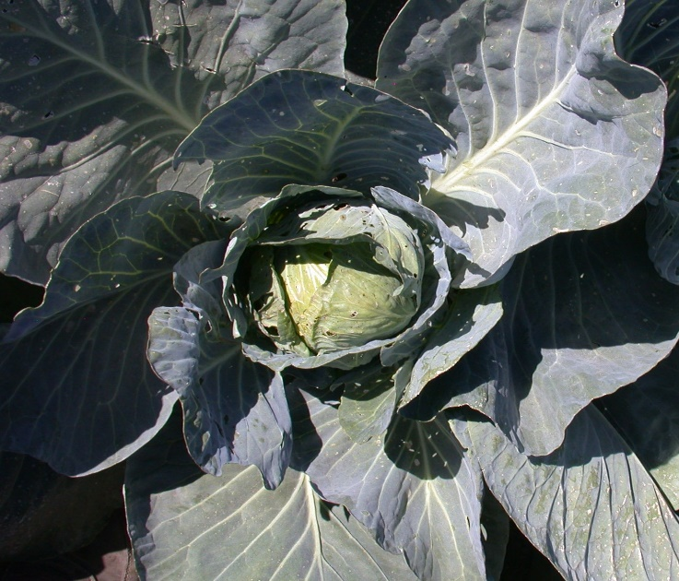
Cultivar Trials: Results
There were clear diff. in the level of damage between cultivars
The marketable yield did not reflect these differences
Should be explored further as some cultivar might have potential
Other observations/ issues:
  Diff. maturity levels for cultivars made assessment more difficult
  Presence of other pests such as the cabbage moth at Hansen

Slide 19
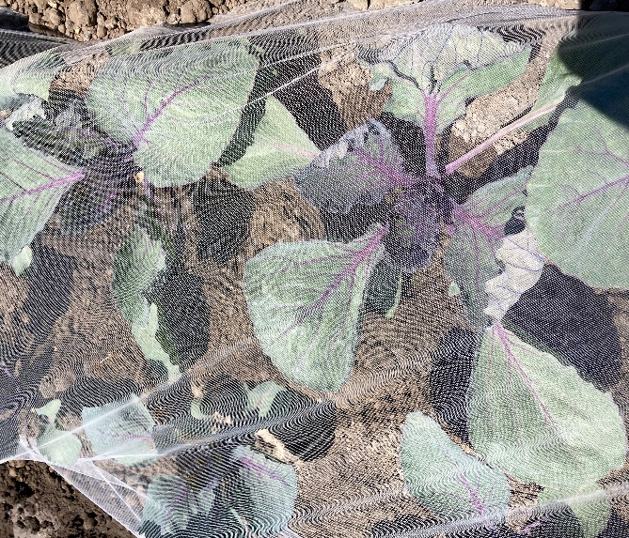
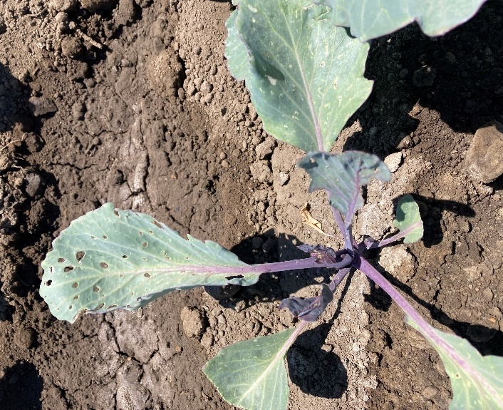
Insect netting

Slide 20
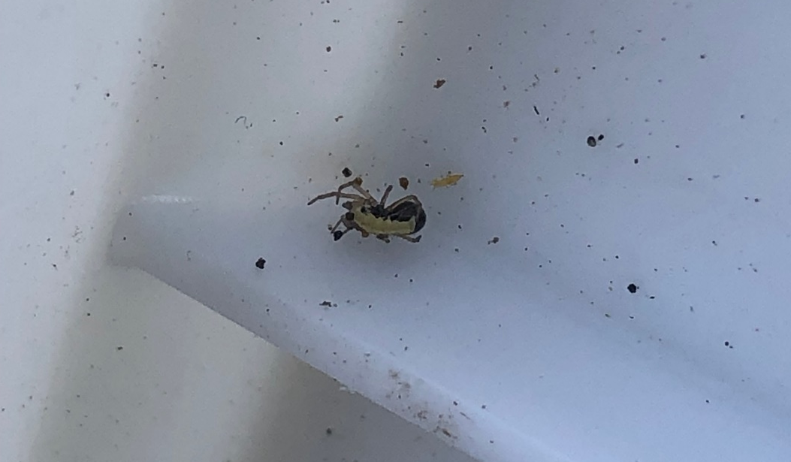
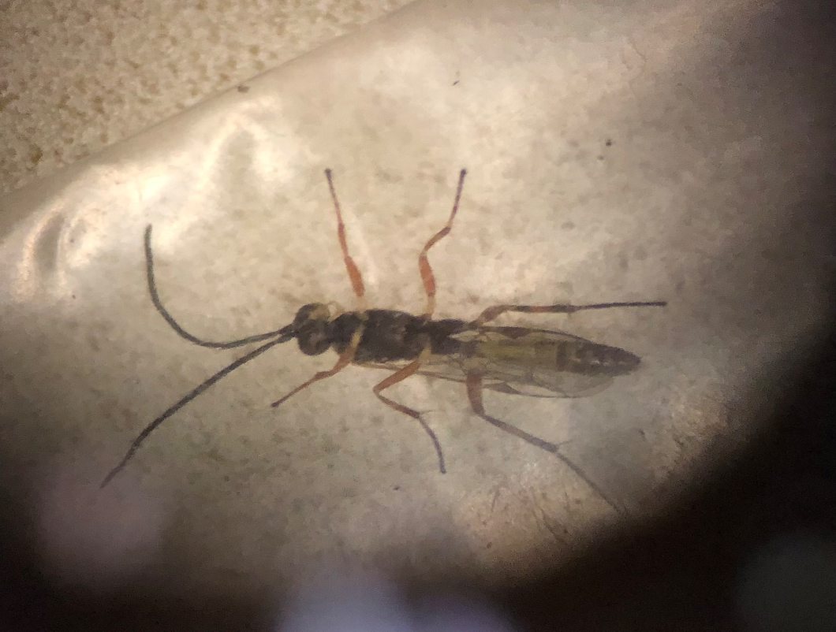
Conclusions
Factors other than temperature and wind are affecting regional abundance of diamondback moth
  Area cultivated with cole crops
  Surrounding vegetation (at both smaller and larger scales) and topography?
  Presence and abundance of predators and parasitoids
Methods such as more resistant cultivars and bioinsecticides could provides additional protection under low and medium pest pressure
Enhancing the effect of predators and parasitoids could be additive to other management practices

Slide 21

Thank you!
Acknowledgements:
Gina Ferrari
Growers
PCAs

