Slide 1
Celery Cultivar Evaluation: F. oxysporum f. sp. apii , races 2 and 4.
Acknowledgements:
CCRAB, Jake Azavedo and Danny Pereira, Plantel nuresry
Renee Eriksen and Peter Henry (USDA), Lynn Epstein (UCD), Alex Putman (UCR), Chris Greer and Oleg Daugovish (UCCE)

Slide 2
2022 Field trials
Continued at the same infested field sites (as in previous years)
Race 2 (S. Maria, 39 sections) and race 4 (Camarillo, 42 selections)
Took soil samples for pathogen density from each of 4 replicates (at planting and at harvest)
Measured soil temperature at 2 depths
Assessed Fusarium infection rate and agronomic traits

Slide 3
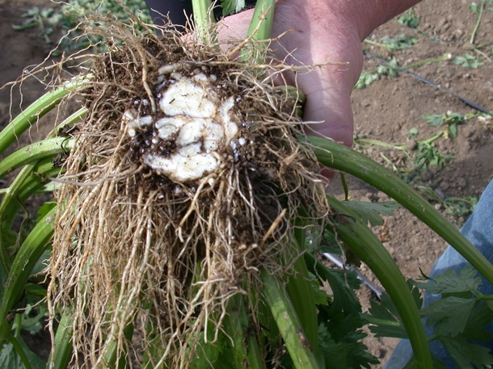
Fusarium infection ratings 0 - 5
Rating: 0
Rating: 1-2
Rating: 3-4
Rating: 5
0 = No browning
1 = Browning visible, particularly in feeder roots
2 = Browning visible, particularly in primary roots
3 = Browning visible, particularly around the crown
4 = Browning in and/or around the crown
5 = Extensive browning in crown

Slide 4
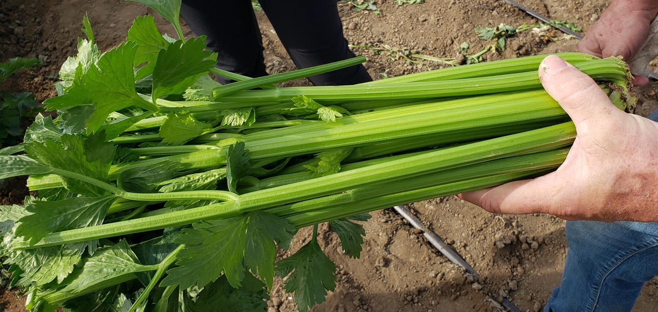
Agronomic characteristics: Petiole length, greenness and cracking. Stalk weight, bolting, pithiness, ribbiness and suckering
Ribbiness of 4.
Pithiness of 4.

Slide 5
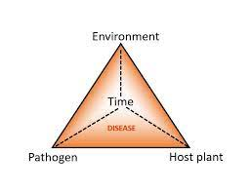

Slide 6
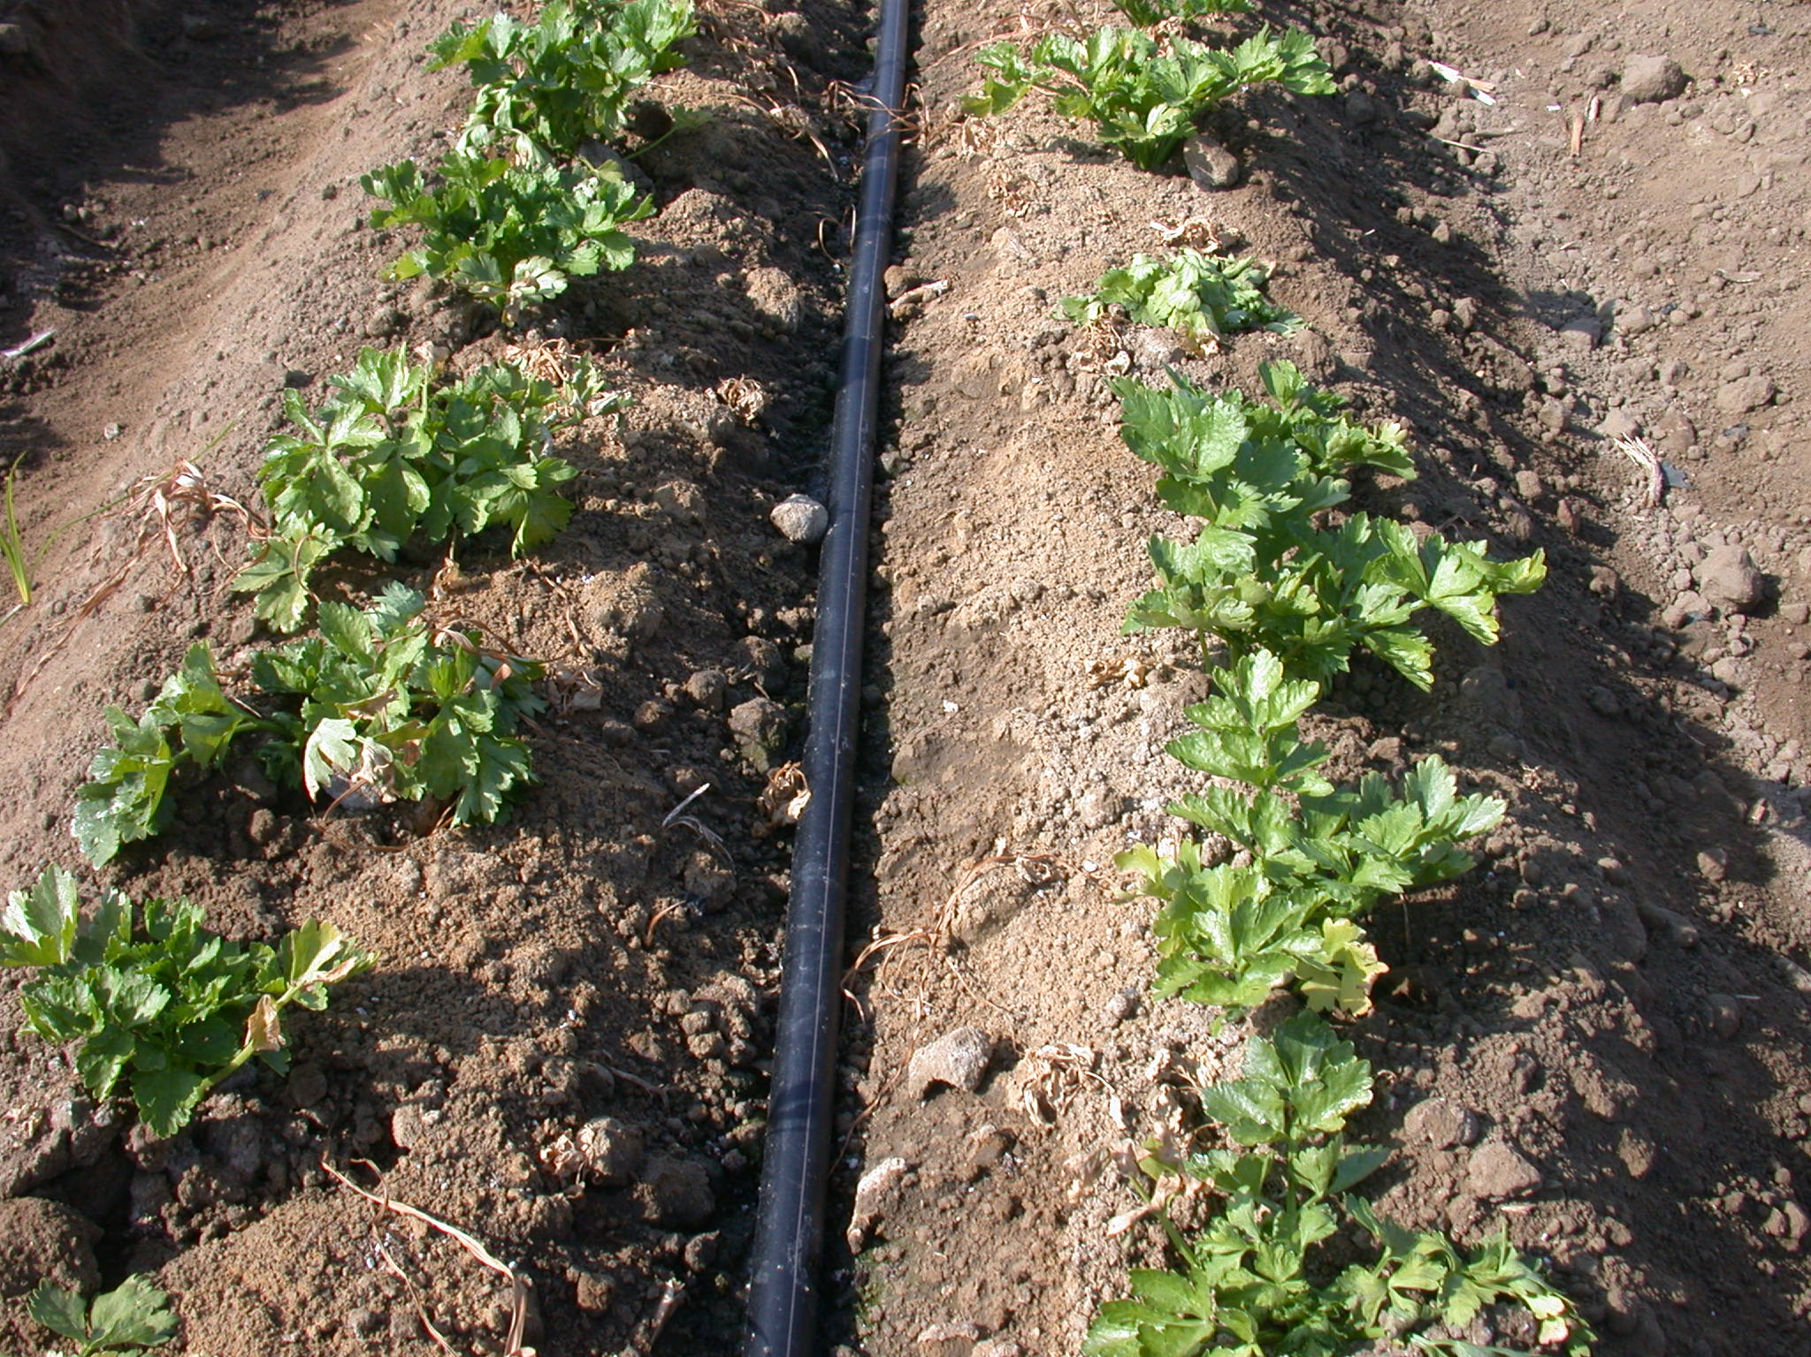
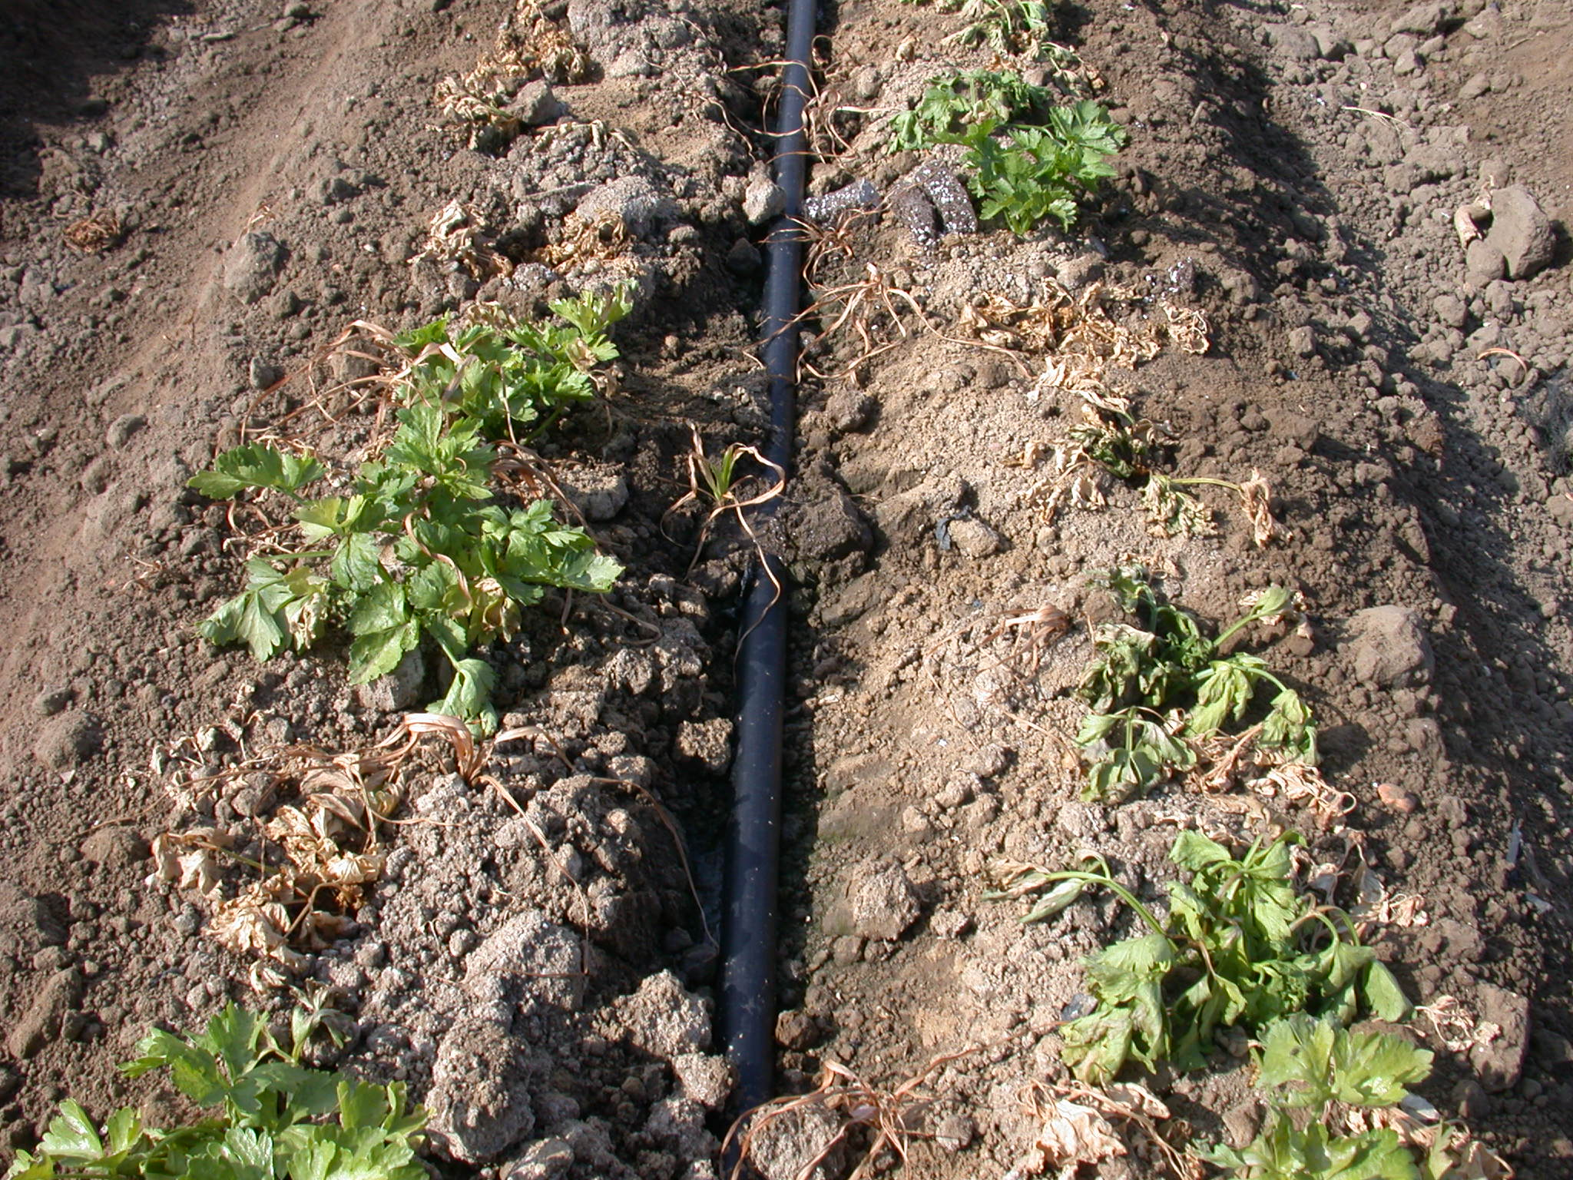
Mortality at Camarillo, 3 WAP, race 4
‘Bachata’ in Block 4
‘Bachata’ in Block 1

Slide 7
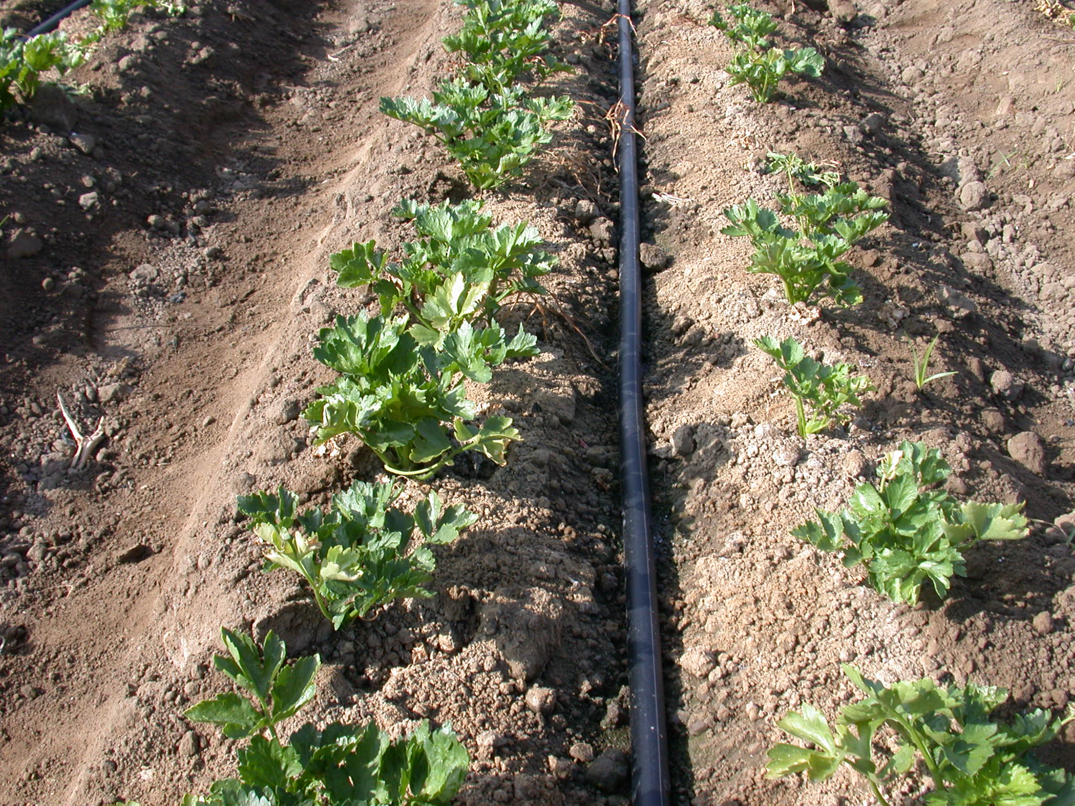
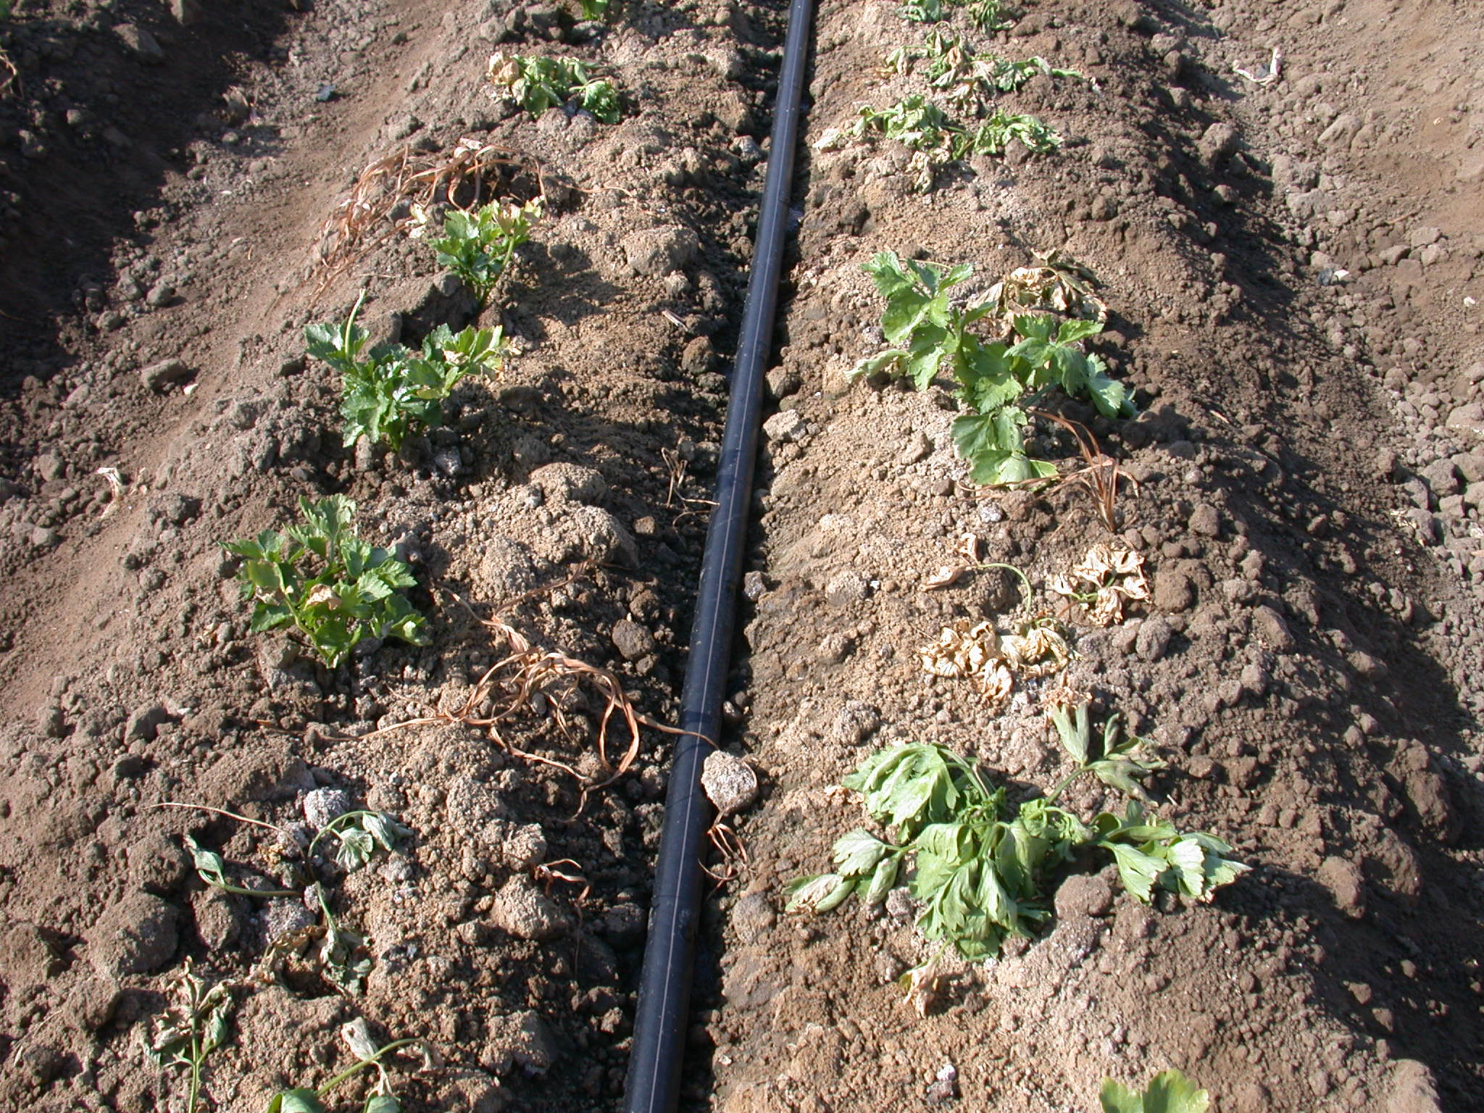
Mortality at Camarillo, 3 WAP, race 4
‘RZ 4001’ in Block 4
‘RZ 4001’ in Block 1

Slide 8
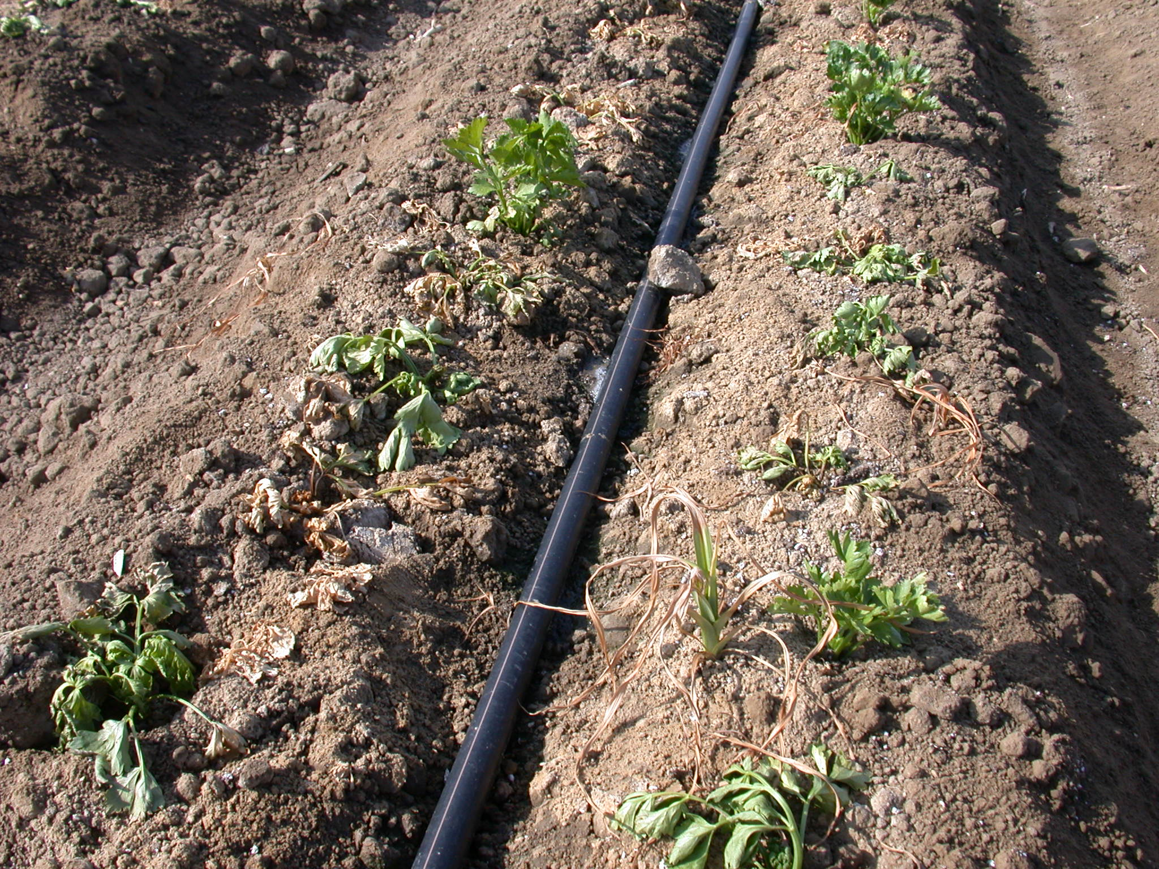
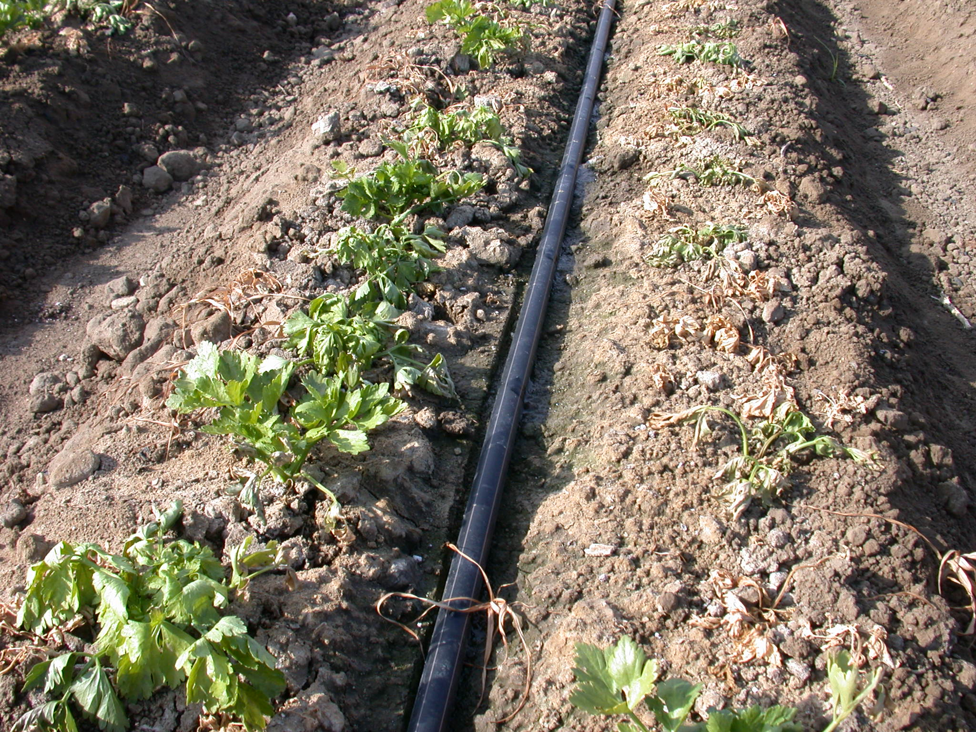
Mortality at Camarillo, 3 WAP, race 4
‘Challenger’
‘Command’

Slide 9
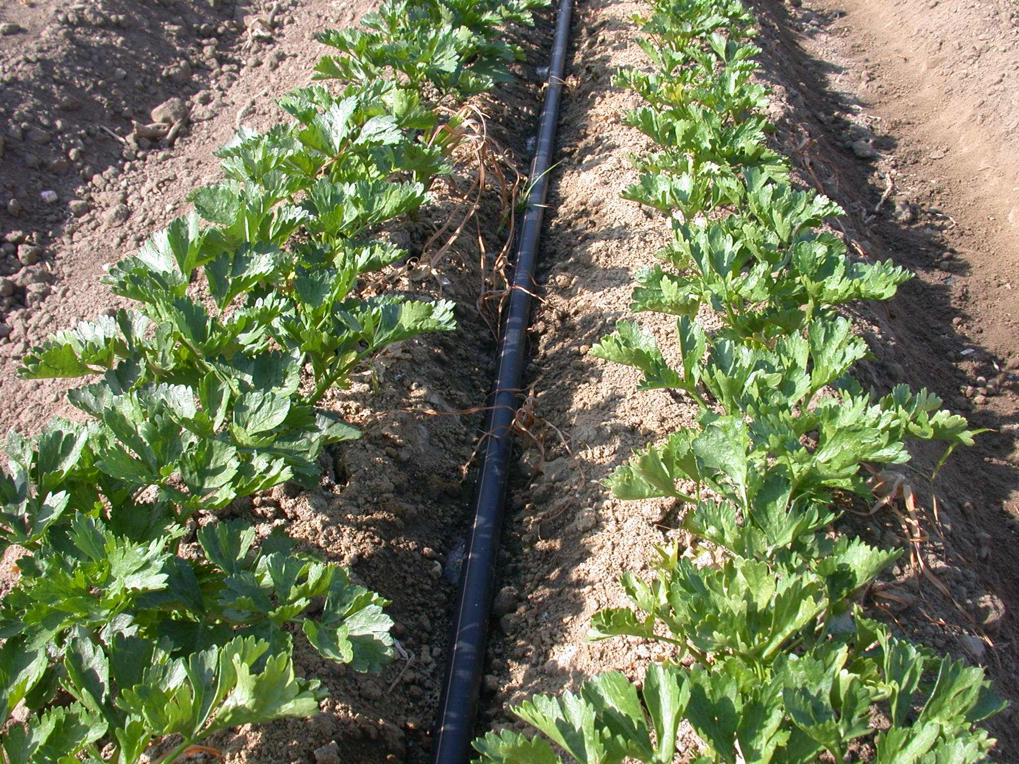
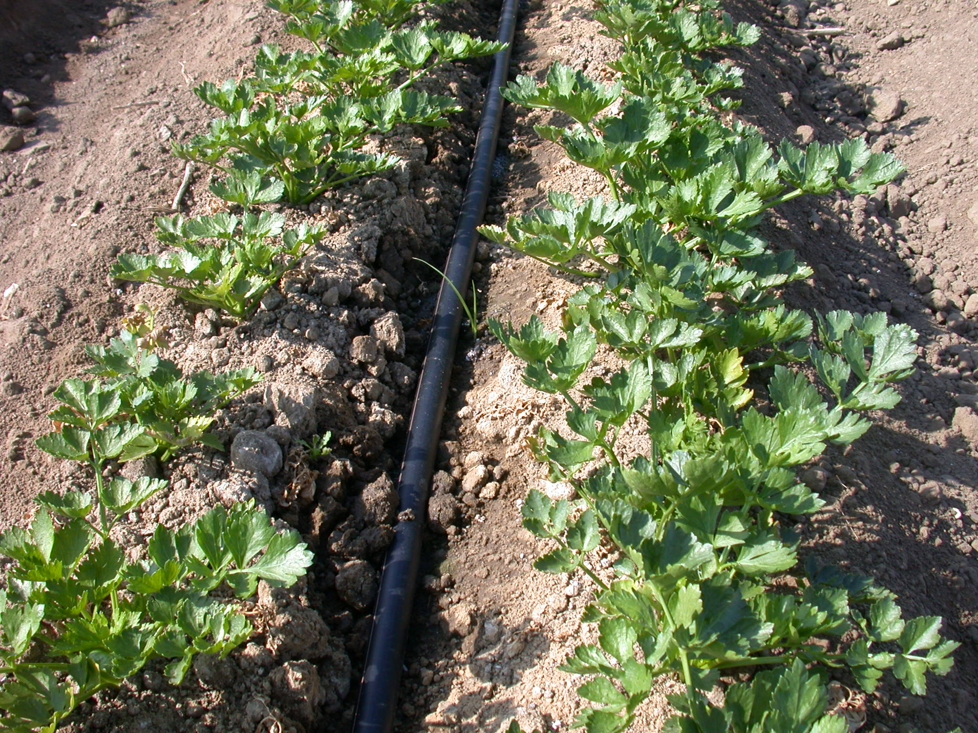
Mortality at Camarillo, 3 WAP, race 4
‘RZ 4006’
‘TZ 4’

Slide 10
Mortality of plants
100% line

Slide 12
Mortality (avg over all cultivars)

Slide 13
Fusarium infection score (avg over all cultivars)

Slide 14
Fusarium infection score (for the ones survived till harvest)

Slide 15
Stalk weight , avg. (for the ones survived till harvest)

Slide 16
Petiole length, avg. (for the ones survived till harvest)

Slide 17
 | Survivorship (least mortality) | Fusarium score (lowest) | Stalk weight (heaviest) | Petiole length (longest)
1 | TZ 5 | RZ 4007 | BJF 8 | RZ 4005
2 | RZ 4005 | RZ 4001 | RZ 4002 | RZ 4001
3 | French Dinant | RZ 4009 | BJF 12 | RZ 4010
4 | BJF 10 | TZ 4 | RZ 4005 | French Dinant
5 | BJF 11 | RZ 4006 | RZ 4001 | RZ 4002
6 | RZ 4009 | RZ 4002 | RZ 4006 | RZ 4007
7 | RZ 4007 | RZ 4005 | TZ 1 | BJF 12
8 | RZ 4001 | BJF 12 | RZ 4008 | BJF 10
9 | TZ 2 | French Dinant | TZ 4 | RZ 4004
10 | TZ 3 | BJF 13 | BJF 9 | TZ 4
 |  | TZ 5

Slide 18
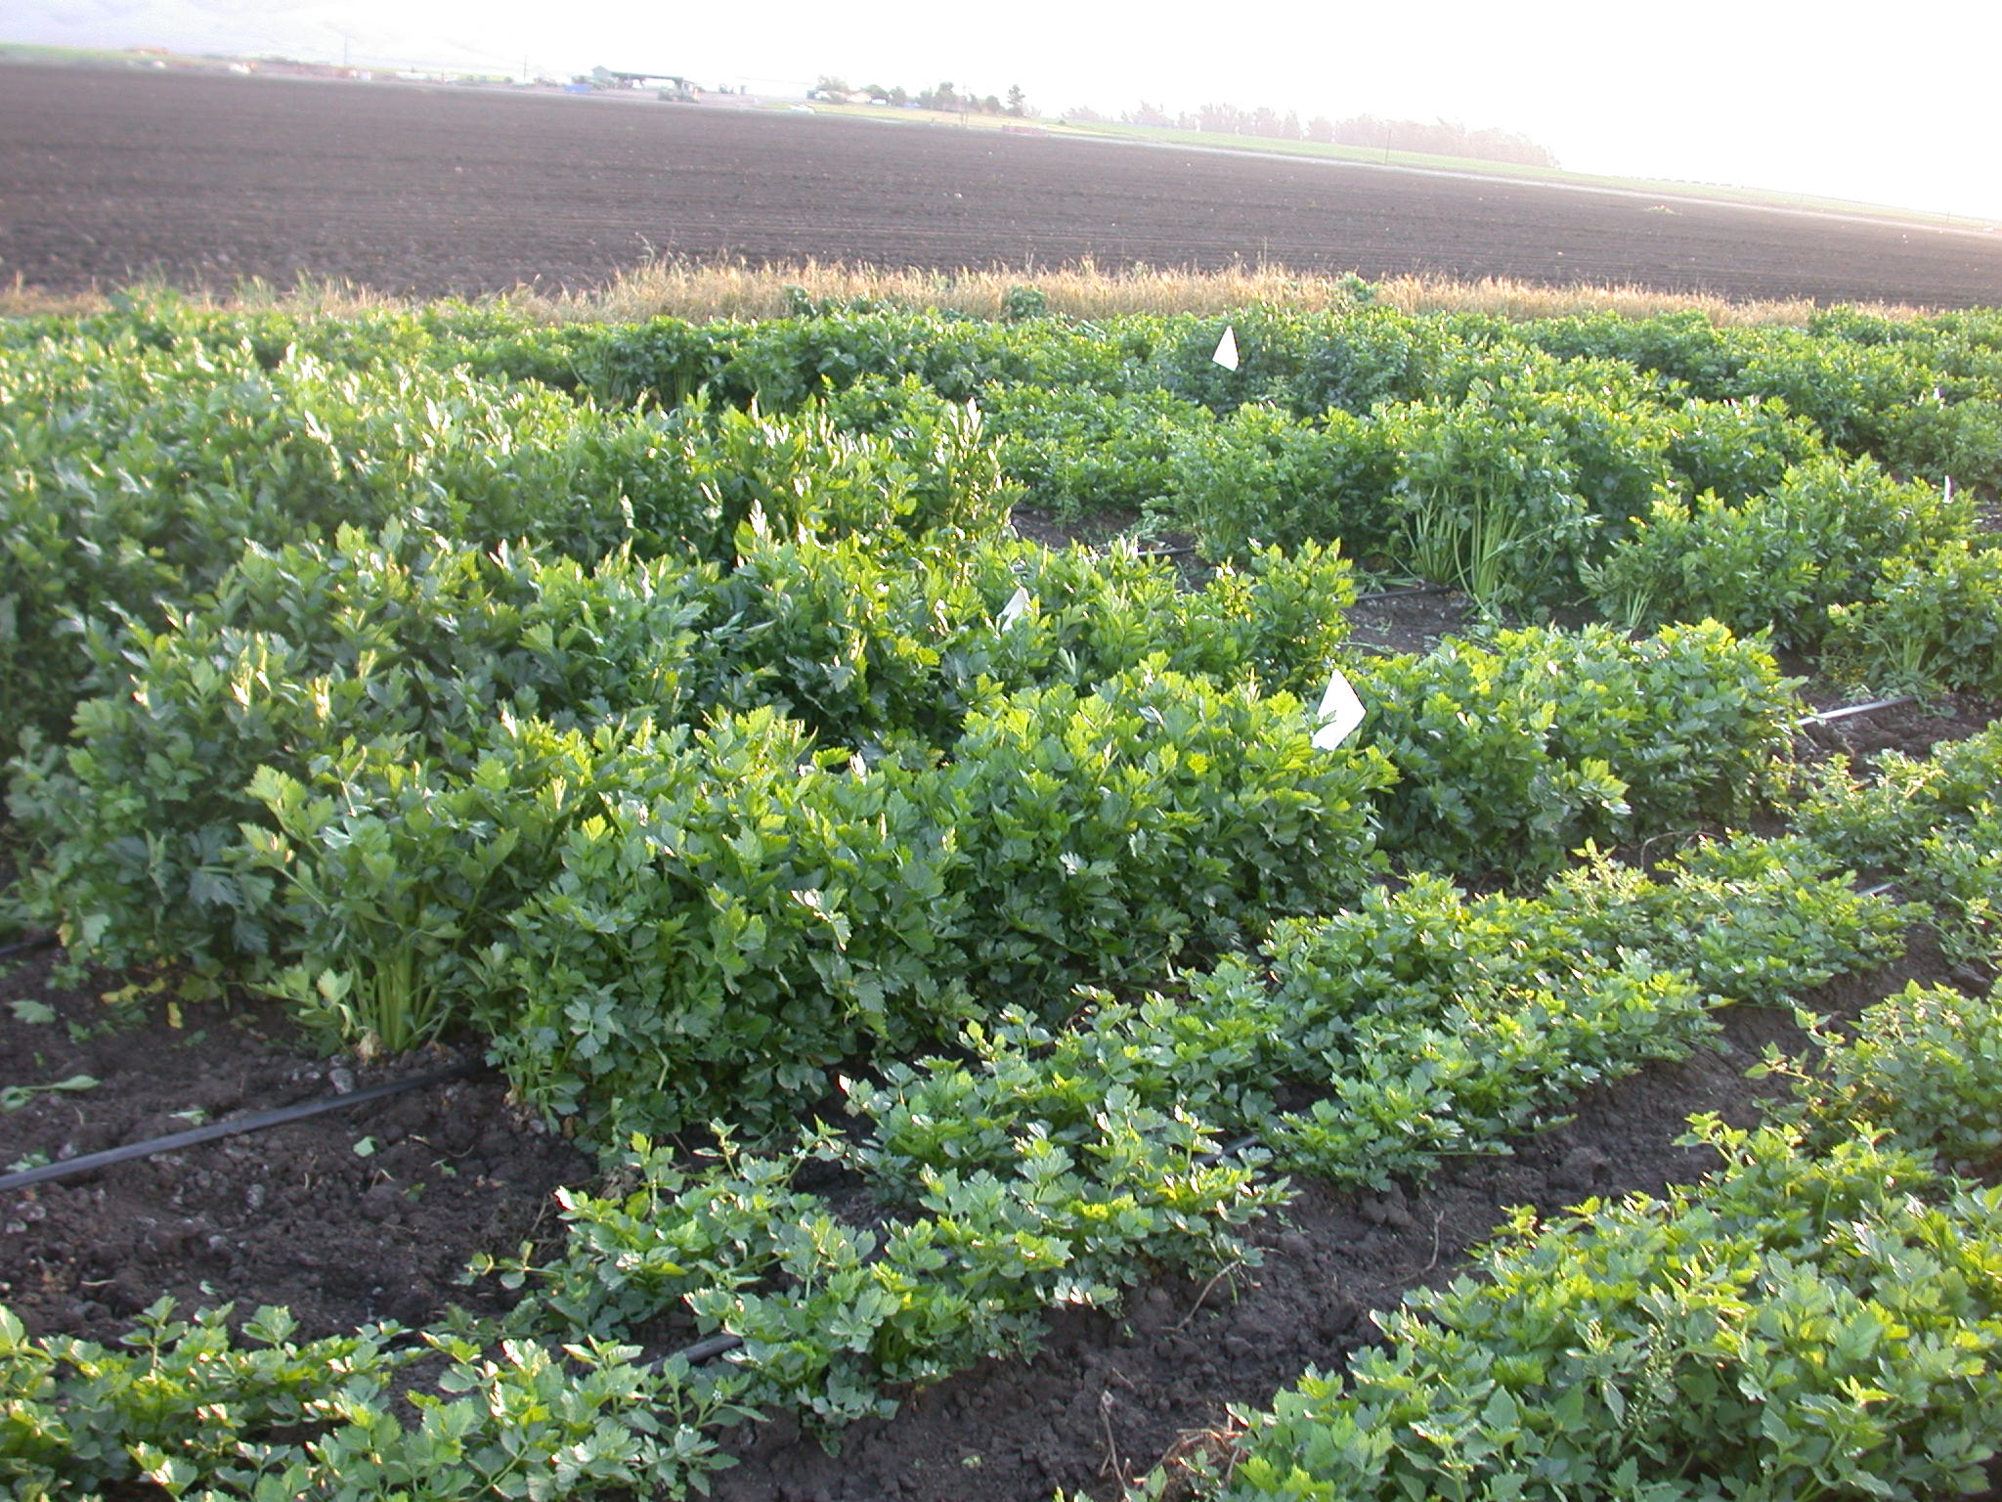
Santa Maria,
F. ox. apii
race 2

Slide 19
Fusarium infection score
Santa Maria,
F. ox. apii
race 2

Slide 20
Santa Maria,
F. ox. apii
race 2

Slide 21
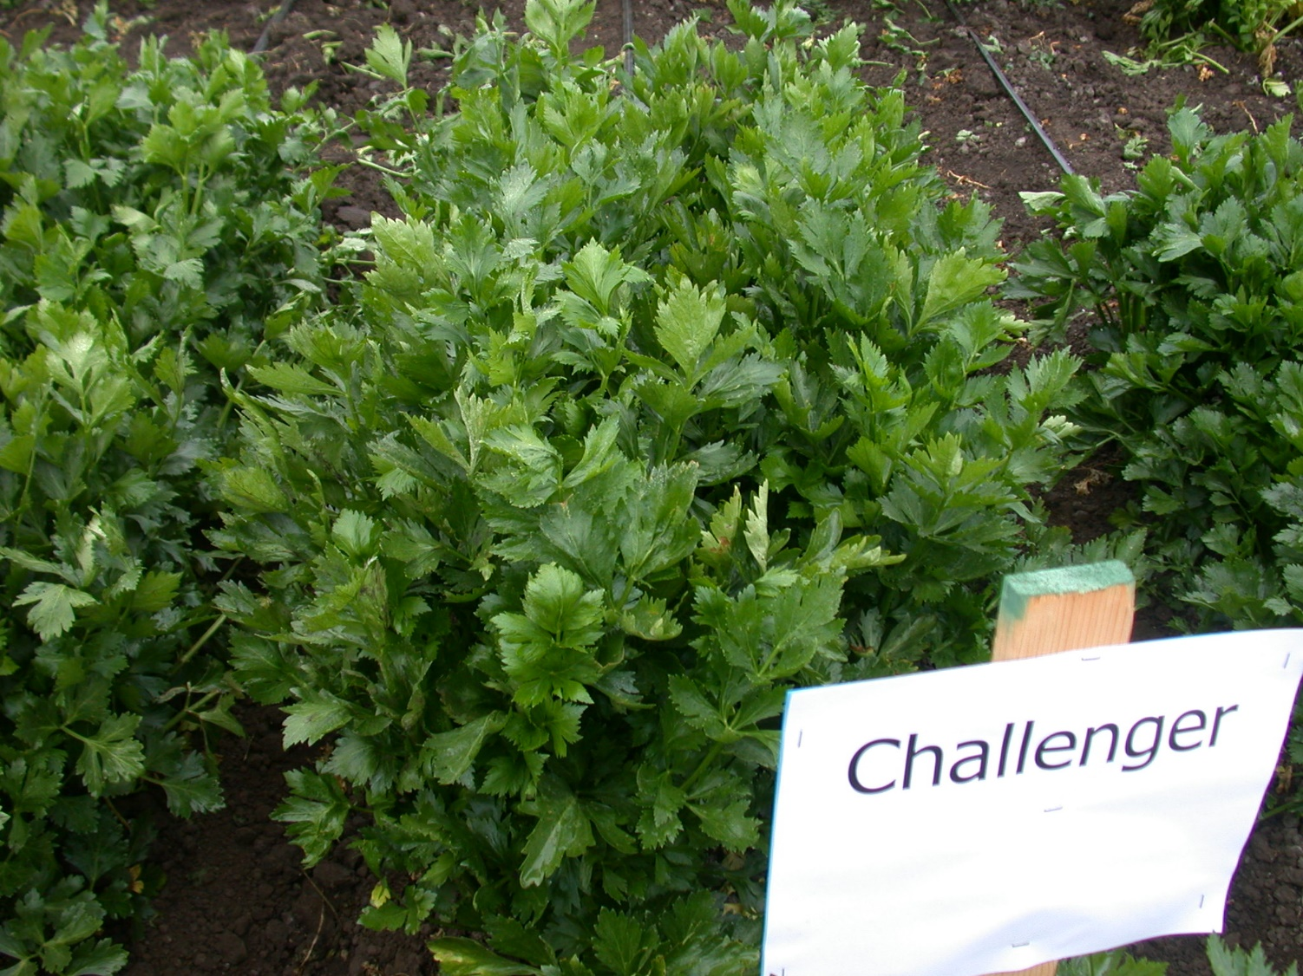
Santa Maria,
F. ox. apii
race 2

Slide 22
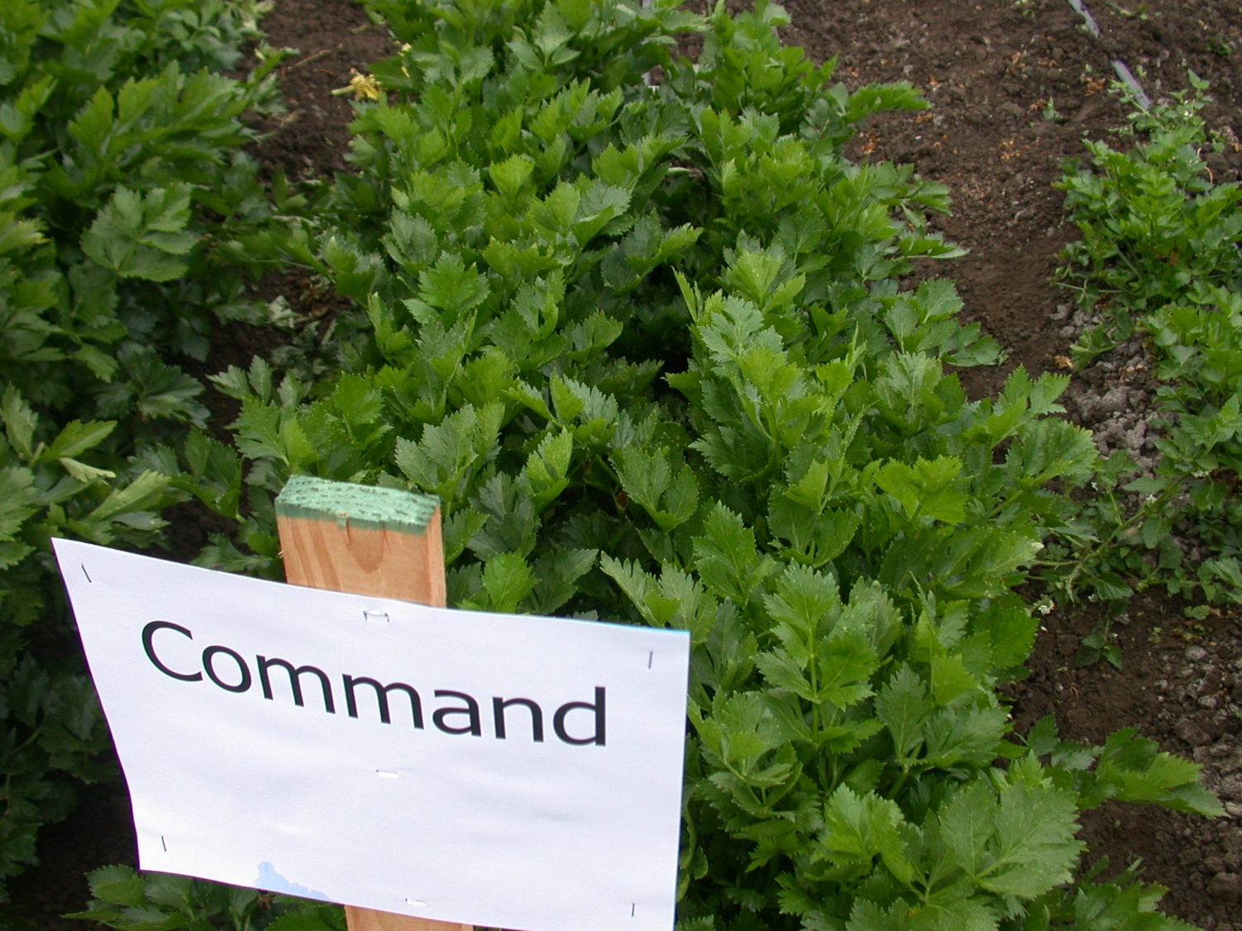
Santa Maria,
F. ox. apii
race 2

Slide 23
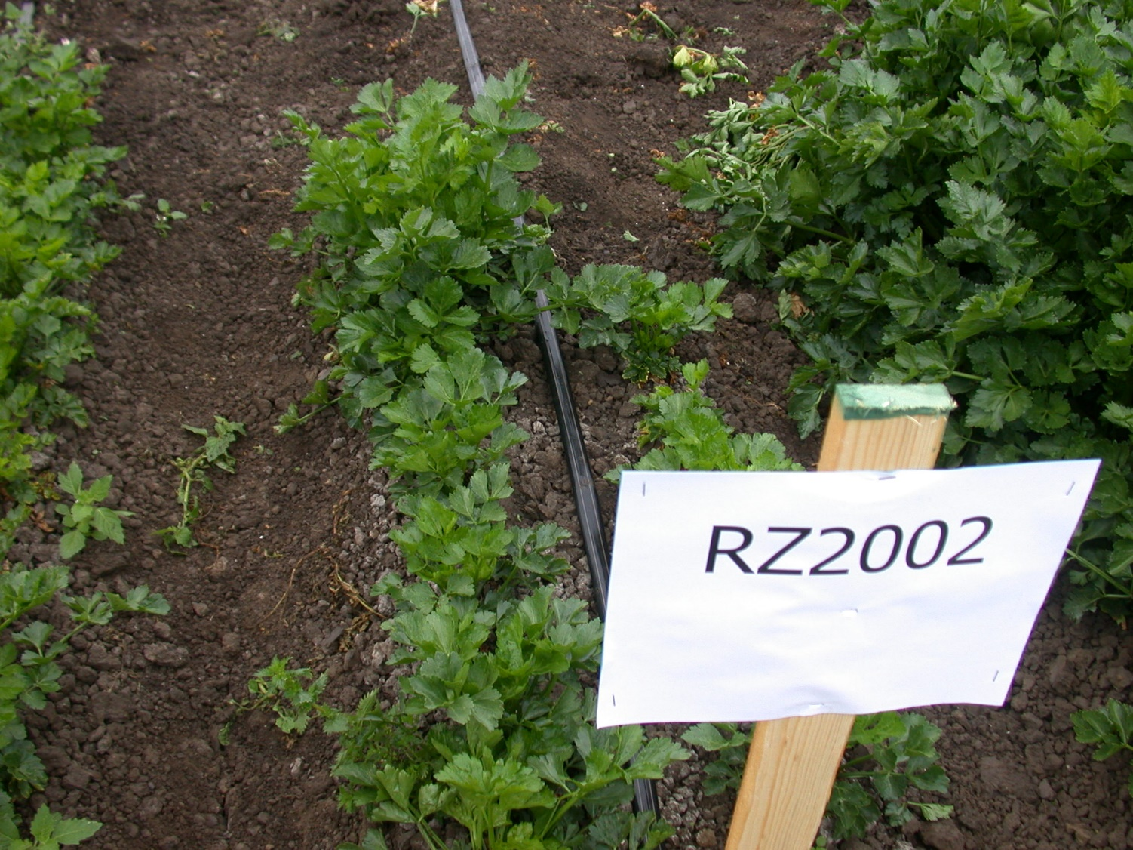
Santa Maria,
F. ox. apii
race 2

Slide 24
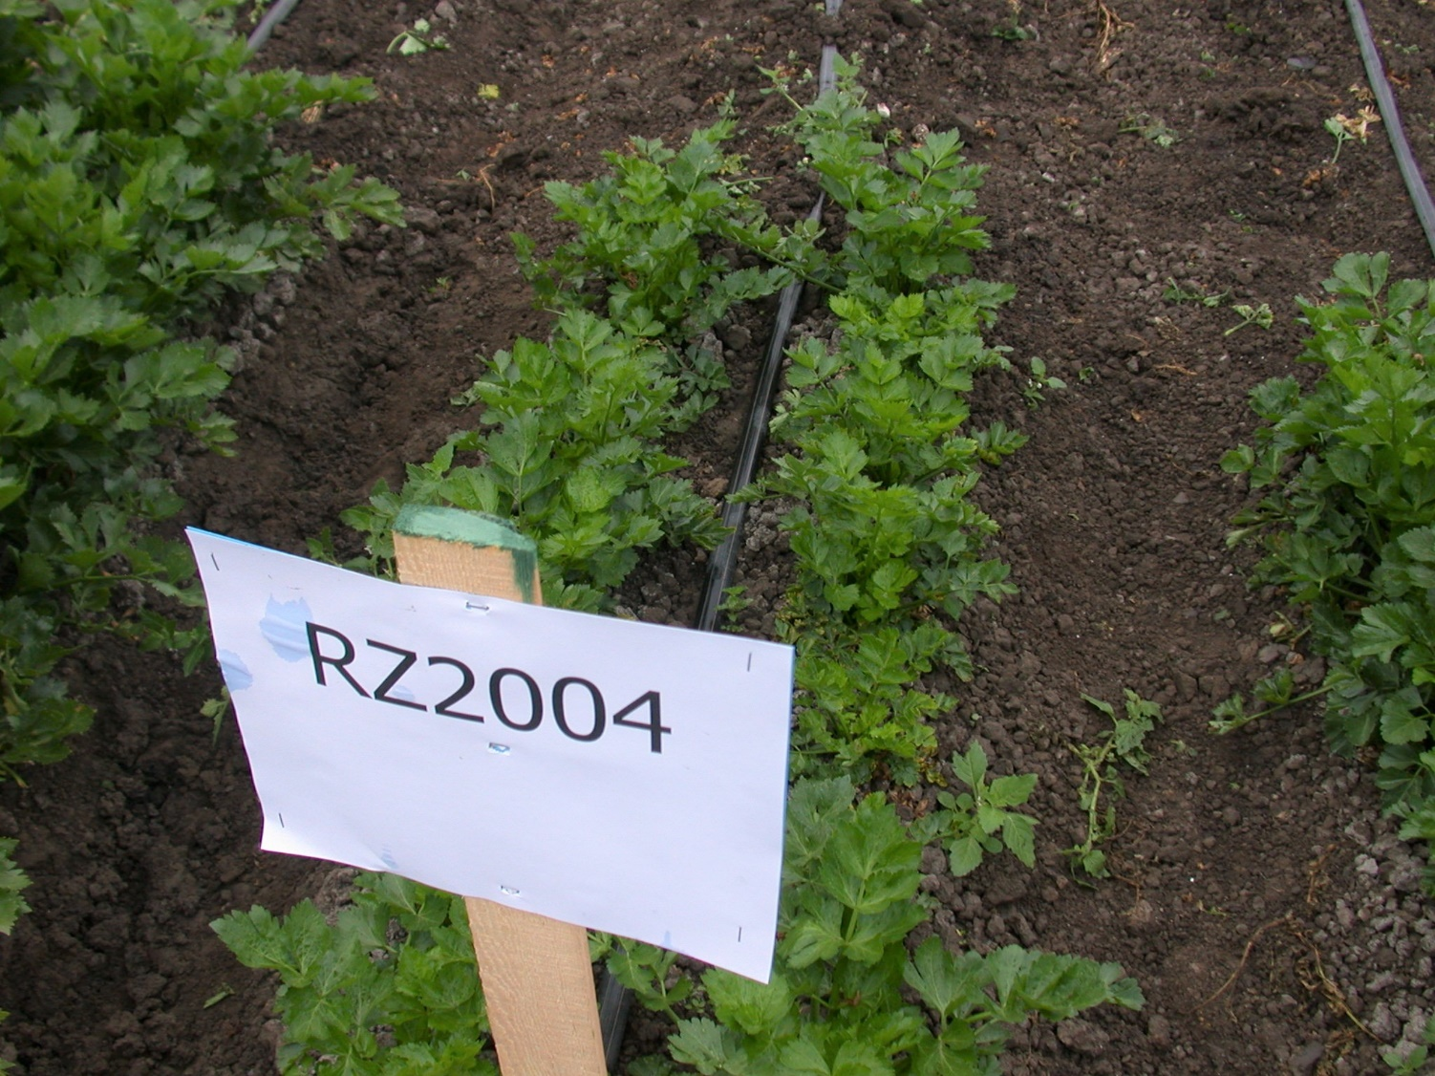
Santa Maria,
F. ox. apii
race 2

Slide 25
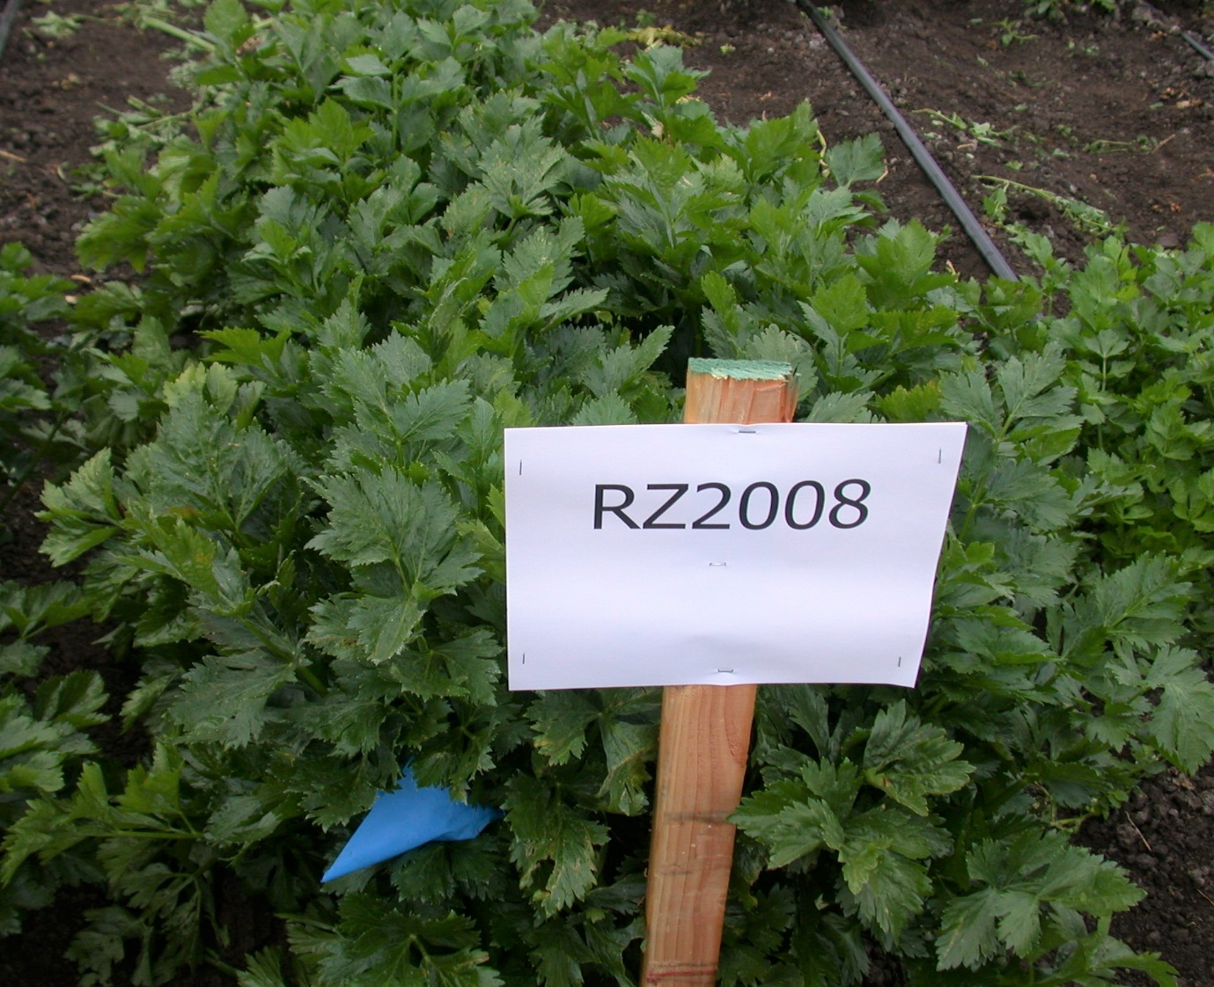
Santa Maria,
F. ox. apii
race 2

Slide 26
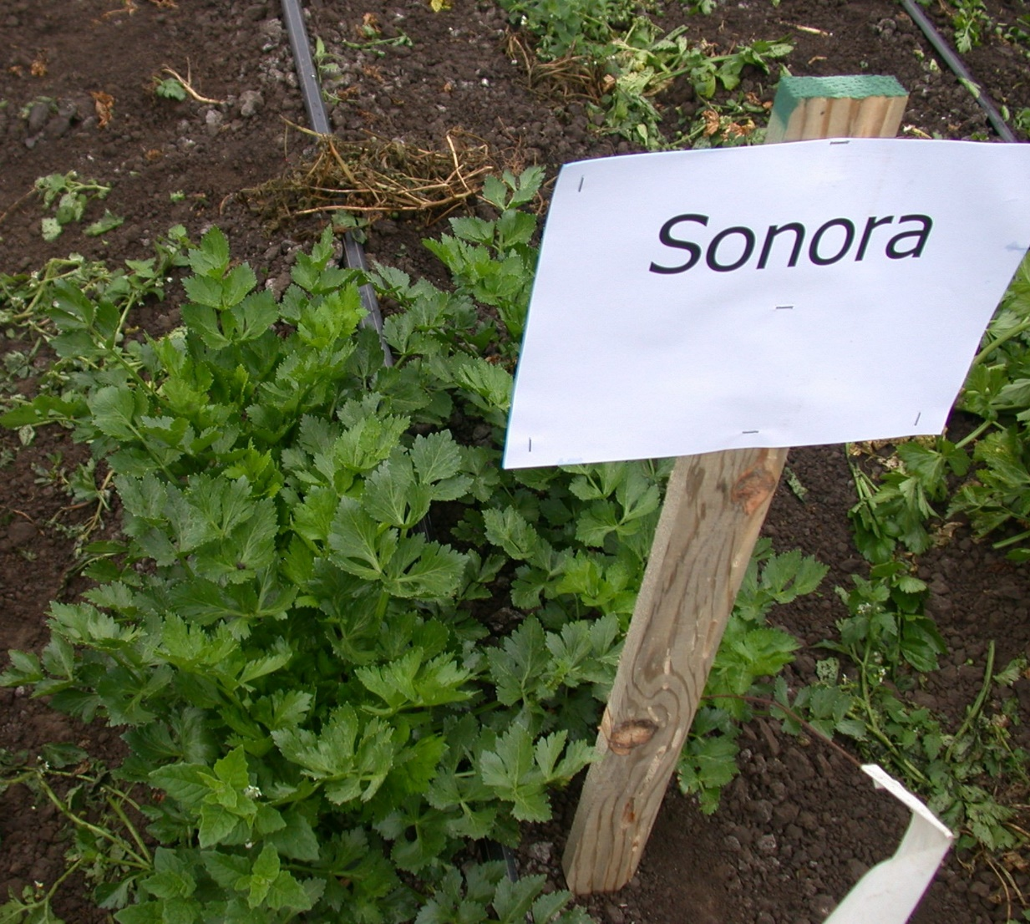
Santa Maria,
F. ox. apii
race 2

Slide 27
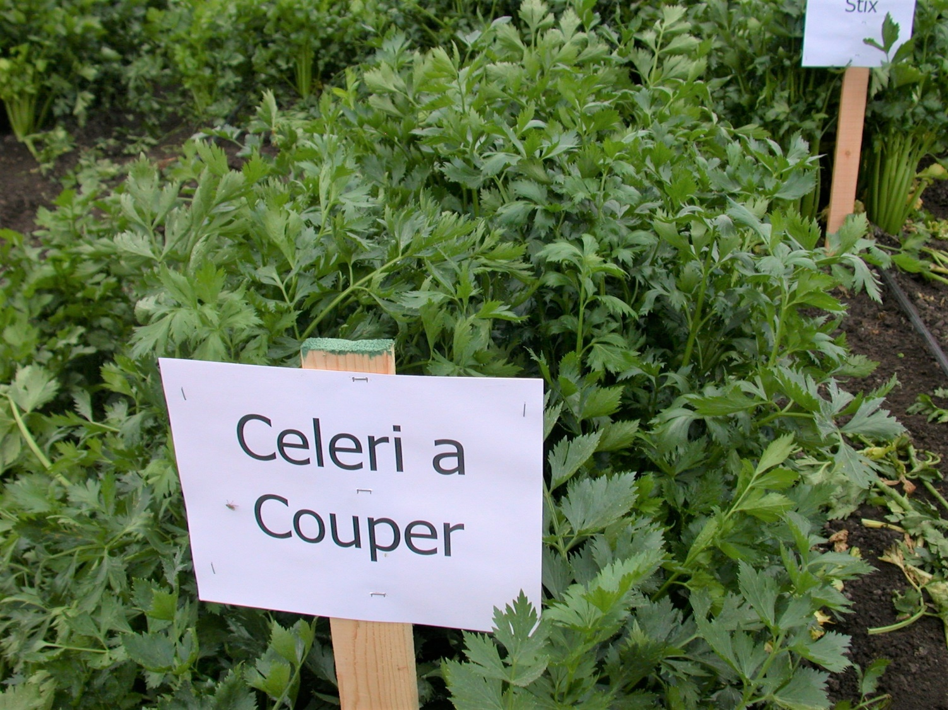

Slide 28
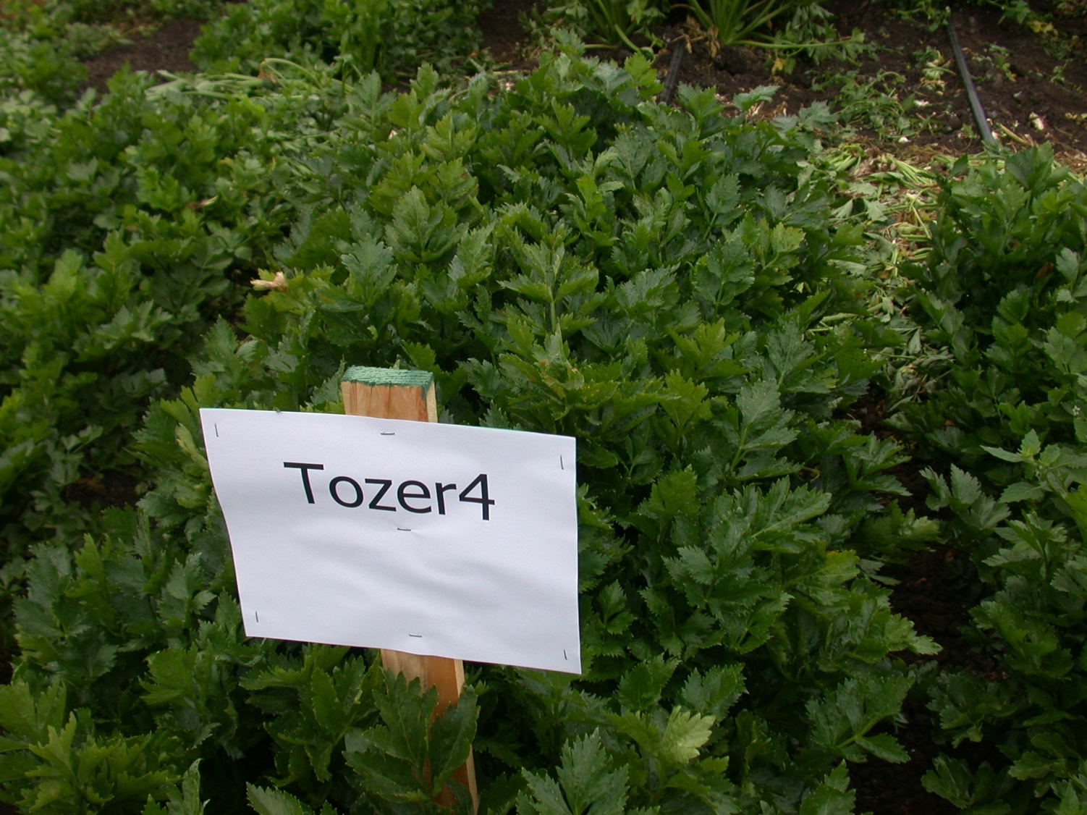
Santa Maria,
F. ox. apii
race 2

Slide 29
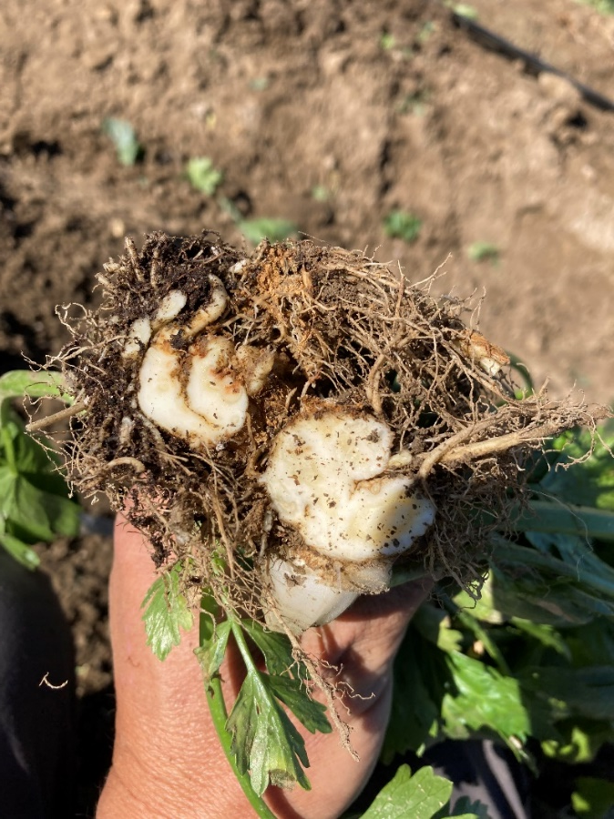
Germplasm with resistance
Valuable parent material
Do not ‘control’ the pathogen in soil
New races of Fusarium:
susceptibility of previously resistant cultivars
Slow to mutate? F.ox. apii doesn’t have a regular sexual cycle,
and apparently never has complete meiosis.

Slide 30
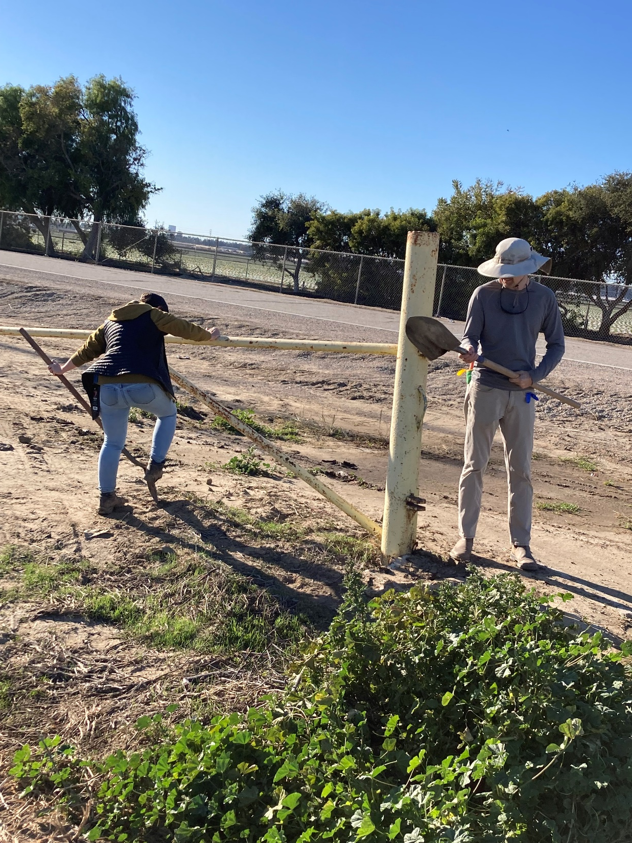
Remove infested soil before leaving
Repeat the race 4 trial :
- Same location but in winter-spring
Record soil Temp
Quantify pathogen level in soil
Compare to summer-fall trial

