Slide 1
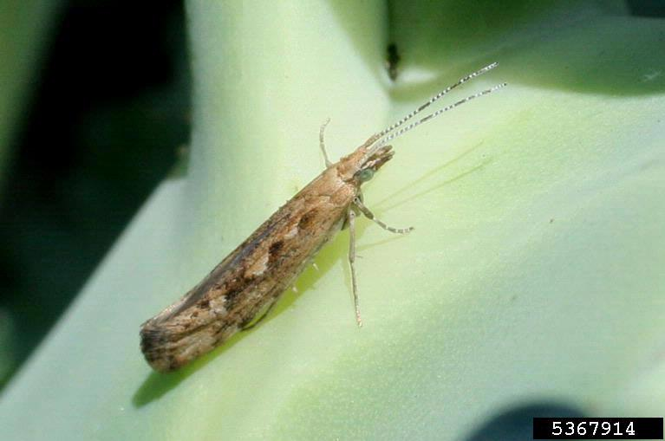
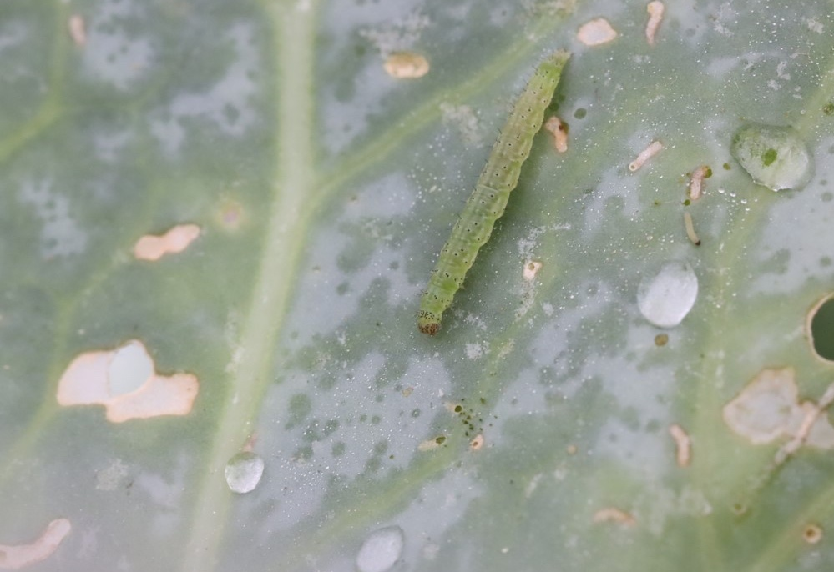
Update: Classical Biological of Diamondback Moth (Plutella xylostella)
Credit: Russ Ottens, University of Georgia, Bugwood.org
Credit: Ian Grettenberger, UCD
Credit: Ian Grettenberger, UCD
Ricky Lara, Ph.D.
Senior Environmental Scientist, Specialist
CDFA Biological Control Program
December 13, 2022

Slide 2
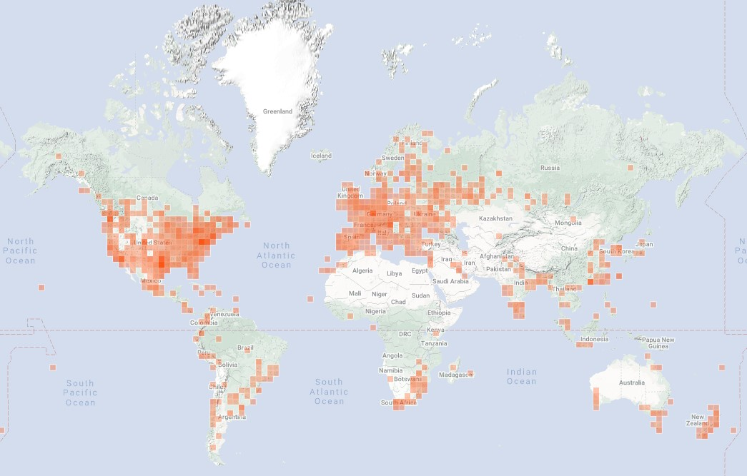
Brief DBM History
Not native to US. 1854, Illinois 1st detection.
Believed to originate from Mediterranean region or South Africa.
Worldwide pest of crucifer crops, e.g., cabbage, broccoli, cauliflower
$4-5 billion/yr in global management costs.
Multivoltine
Notes:
Arrival in California unclear but moth was already present in California and reported as a cole crop pest by UC in the 1960s.

Slide 3
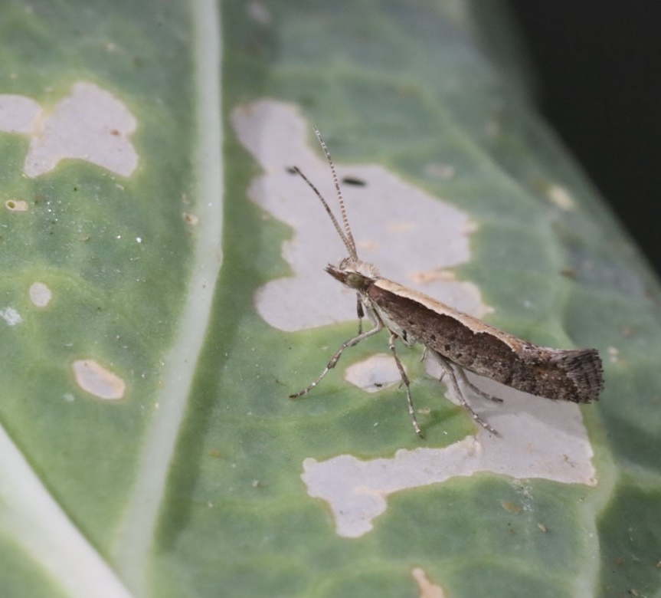
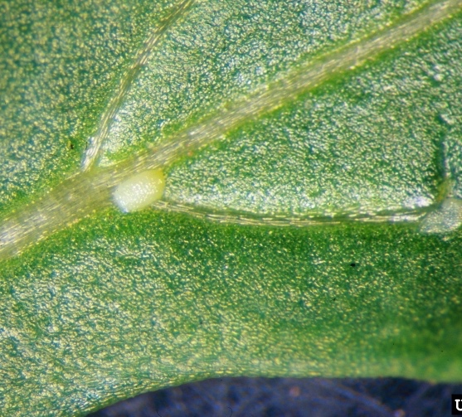
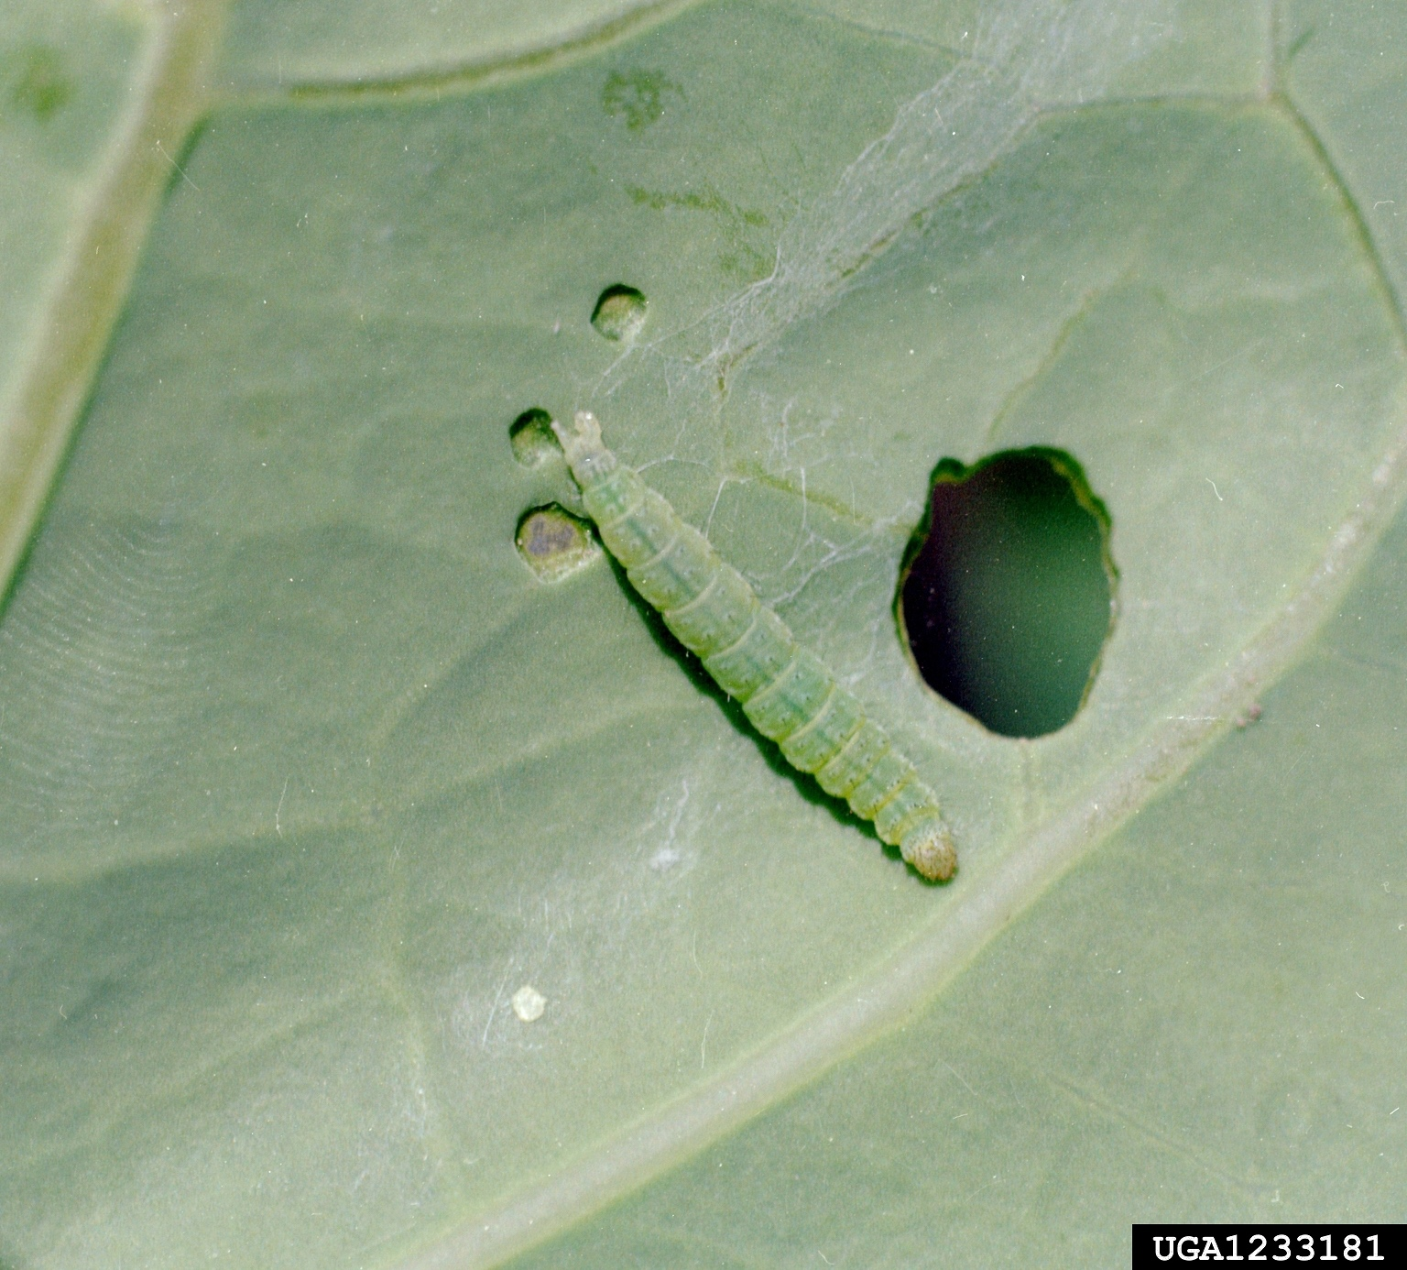
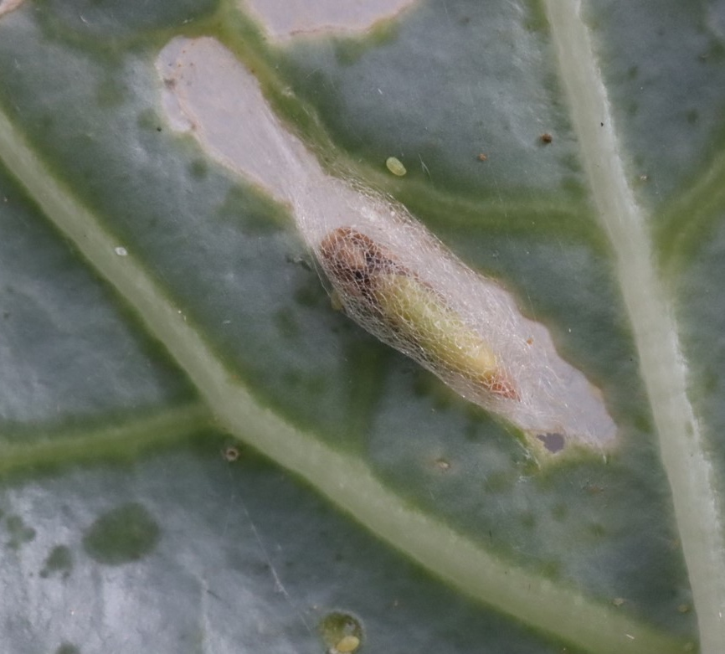
DBM Life Stages
Adult
Egg
Egg-Adult development 17-51 days (env. factors)
Adults 0.3-0.4 in length, longevity ~2 weeks. Weak fliers but aided by wind dispersal
~150 yellow-white eggs, singly or groups generally on upper leaf surfaces, along veins
4 larval instars that cause direct feeding damage. Will also wriggle when disturbed
Pupation in silk cocoon
Credit: Ian Grettenberger, UCD
Whitney Cranshaw, Colorado State University, Bugwood.org
Credit: Ian Grettenberger, UCD
Larva
Pupa
Clemson University - USDA Cooperative Extension Slide Series , Bugwood.org
Credit: Ian Grettenberger, UCD
Notes:
https://www.canolacouncil.org/canola-encyclopedia/insects/diamondback-moth/
https://entnemdept.ufl.edu/creatures/veg/leaf/diamondback_moth.htm

Slide 4
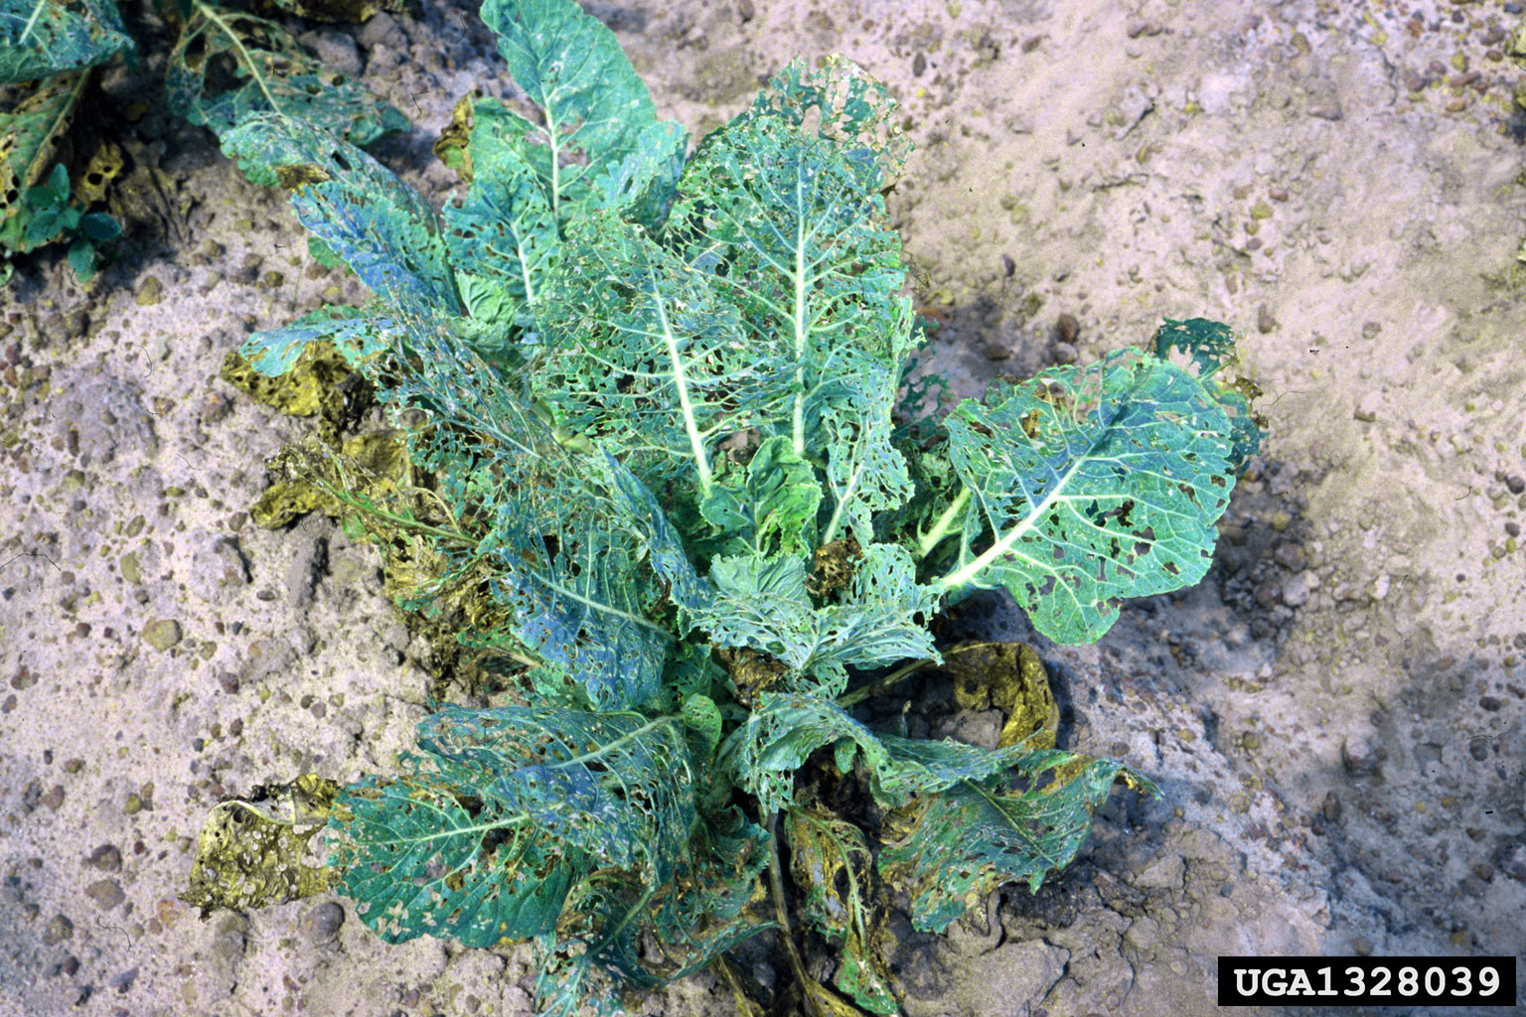
Feeding Damage

Slide 5
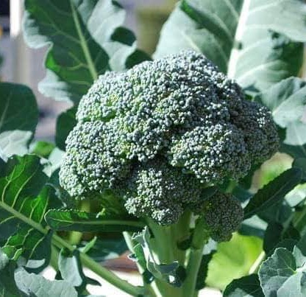
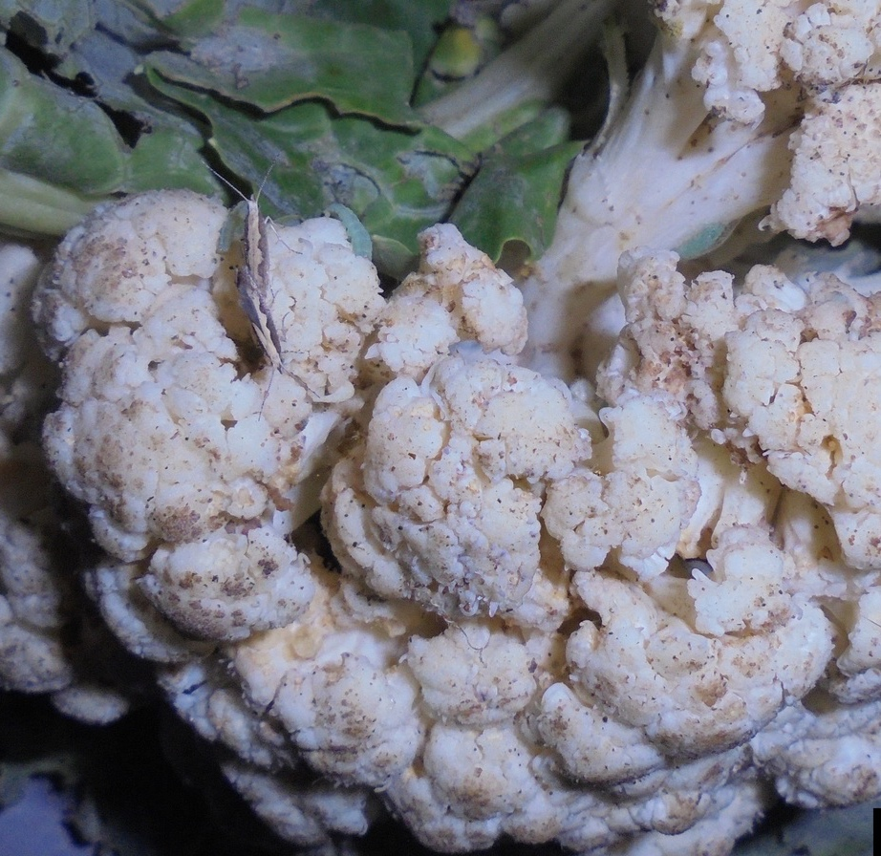
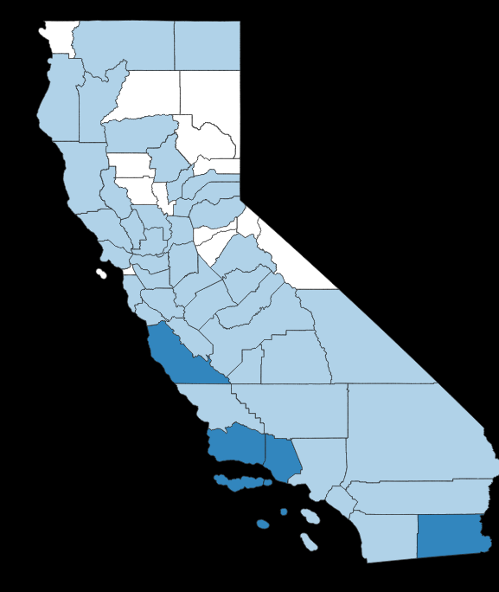
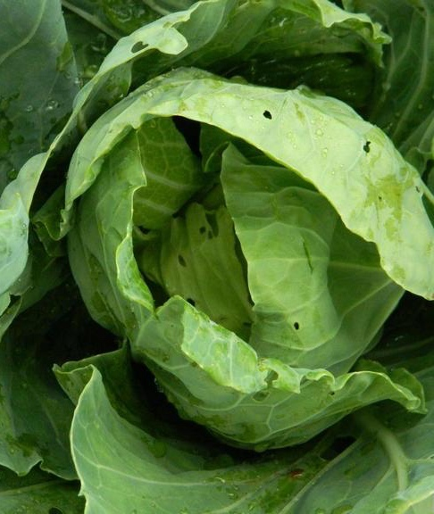
California Cole Crop Production
Broccoli
Cauliflower
800+ Farms: 150,000+ acres
#19 Broccoli, $612 million: Monterey, Santa Barbara, Imperial
#24 Cauliflower, $401 million: MY, SB, IM
#46 Cabbage, $128 million: MY, Ventura, SB
Cabbage
Monterey
Santa Barbara
Ventura
Imperial
Notes:
Cauliflower https://www.ipmimages.org/browse/detail.cfm?imgnum=5566244
Cabbage https://www.insectimages.org/browse/detail.cfm?imgnum=5475840

Slide 6
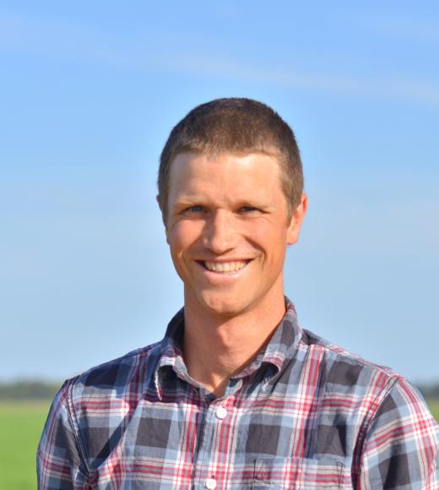
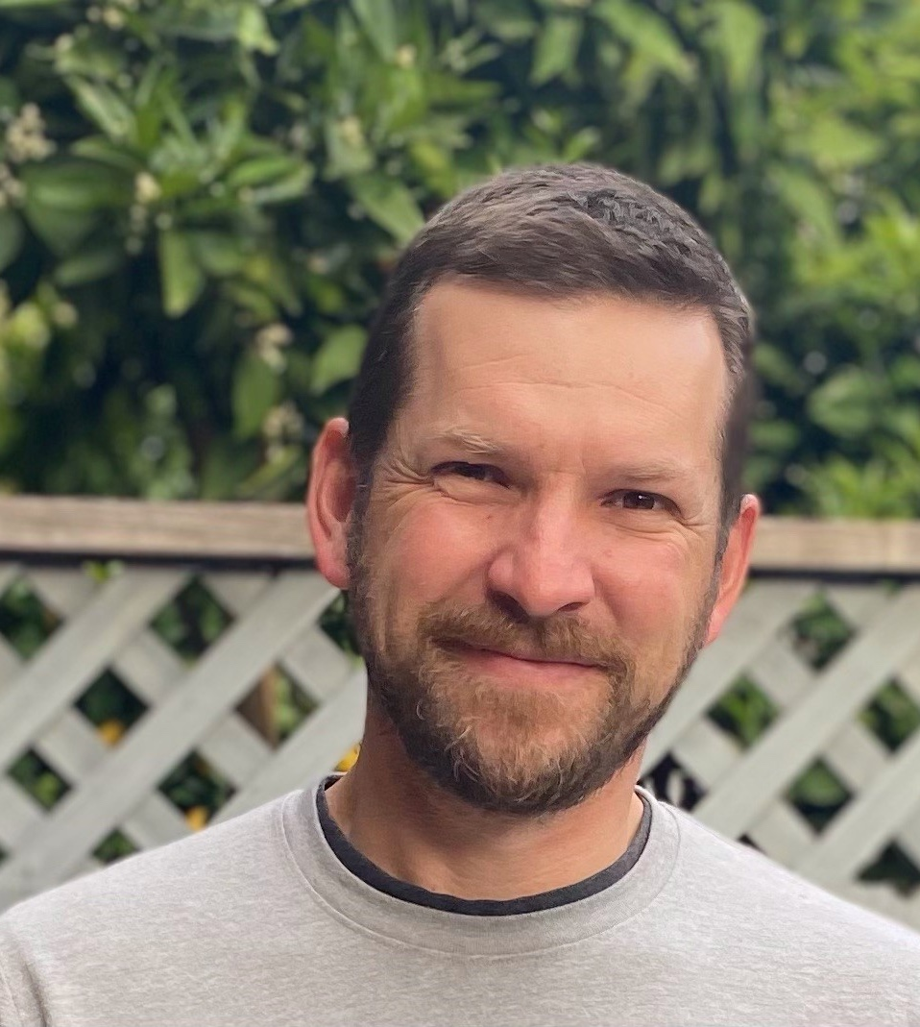
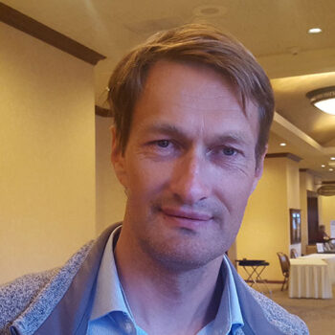
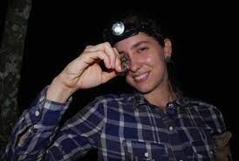
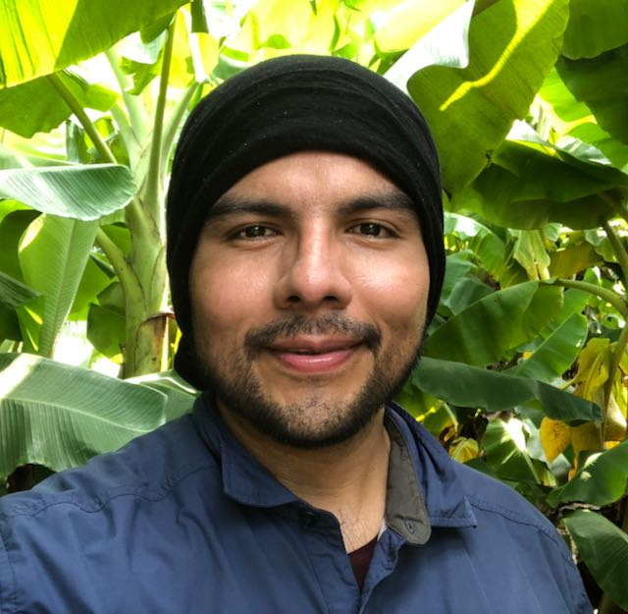
Improve DBM IPM in California
Ian Grettenber, UCD
Diego Nieto, Driscoll’s
Daniel Hasegawa, USDA-ARS
Paul Rugman-Jones, UCR
Oleg Daugovish, Ventura UCCE
Maripaula Valdes-Berriz, Ventura UCCE
Ricky Lara, CDFA

Slide 7
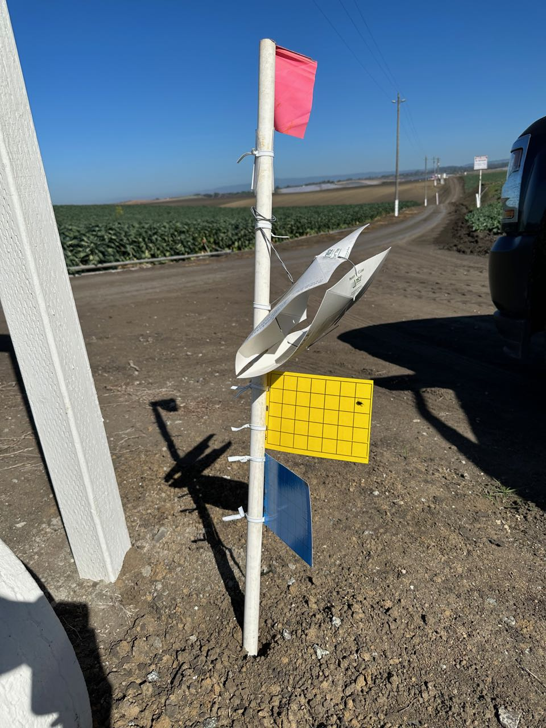
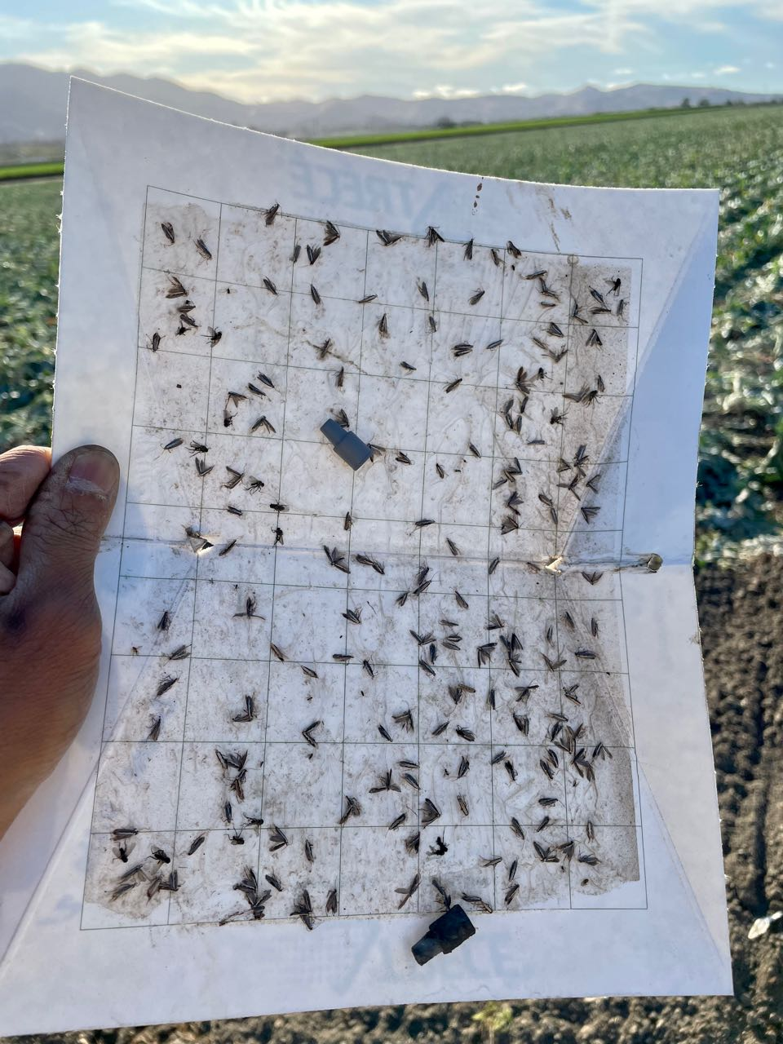
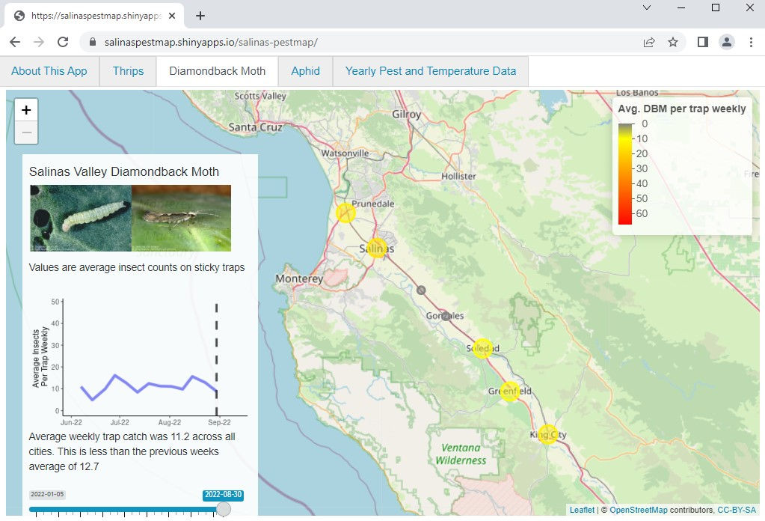
Monitoring
A
B
C
Establishing a pheromone-based trapping network in the Salinas Valley for the benefit of growers to view current pest trends. Work led by Daniel Hasegawa (USDA), Ben Lee (UCD), Ian Grettenberger (UCD).

Slide 8
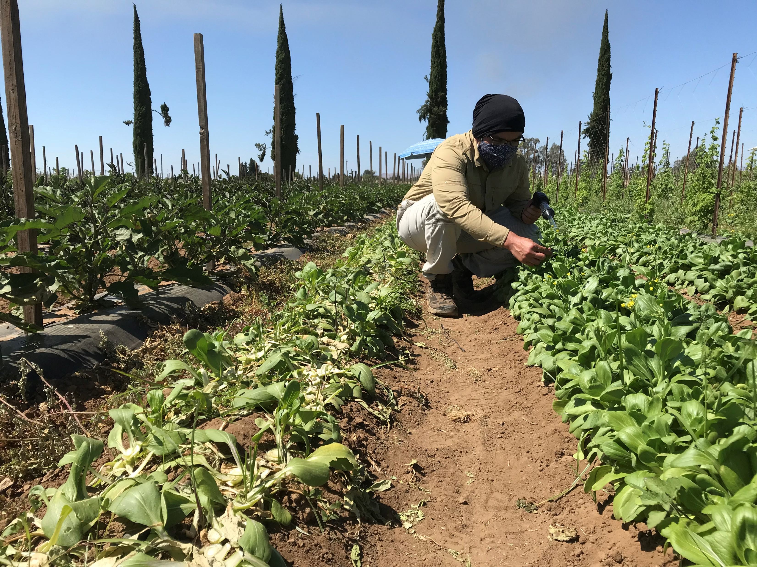
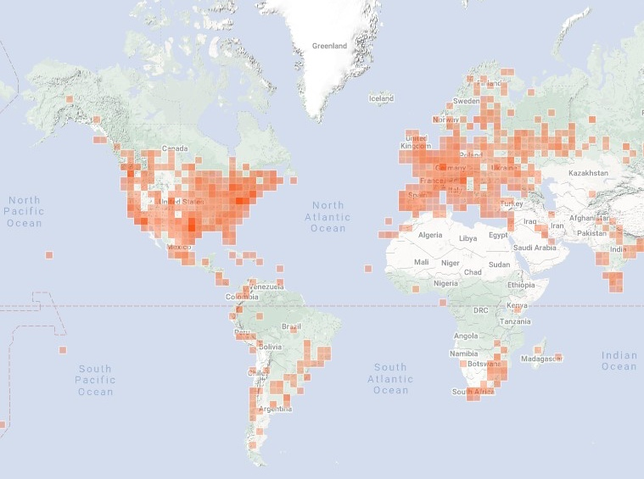
Starting Classical Biological Control
Going to the field!
Sampling DBM
to determine origin of invasive populations based on DNA signature
Collection of Natural Enemies from regions that are climate-adapted to CA

Slide 9
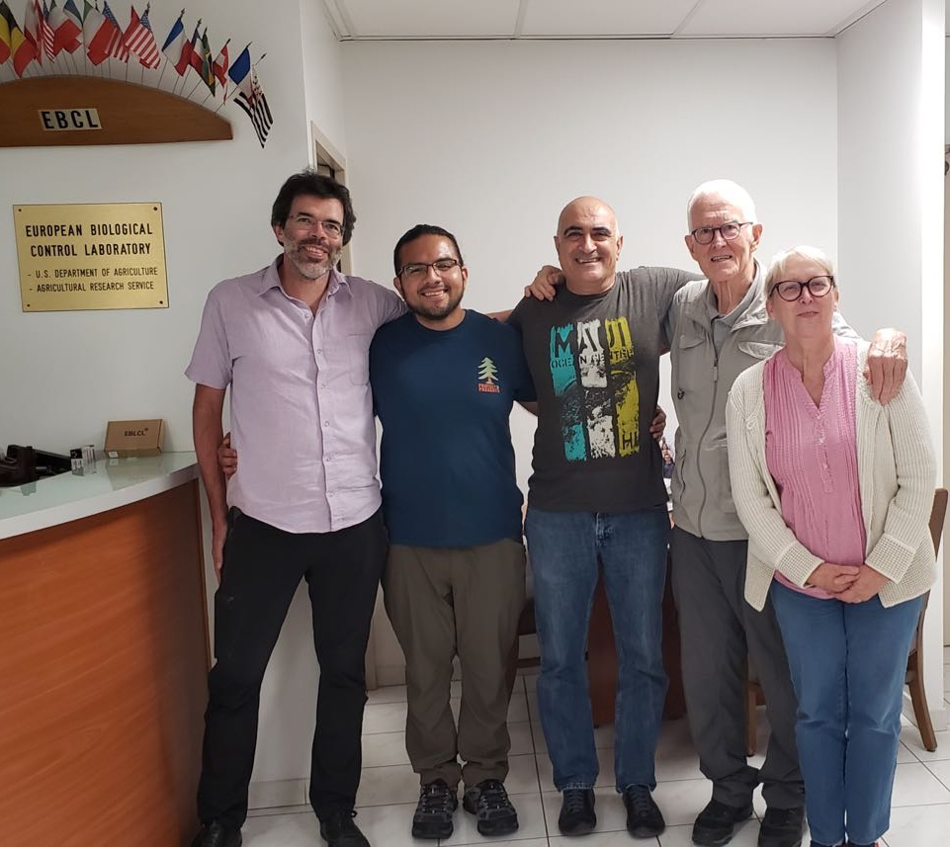
EBCL DBM Team
Gaylord
Javid
Alan Kirk
Marie Claude
Javid Kashefi: Foreign exploration
Marie Claude Bon: Parasitoid DNA work
Gaylord Desurmont: Establish, rear parasitoids and conduct quarantine studies

Slide 10
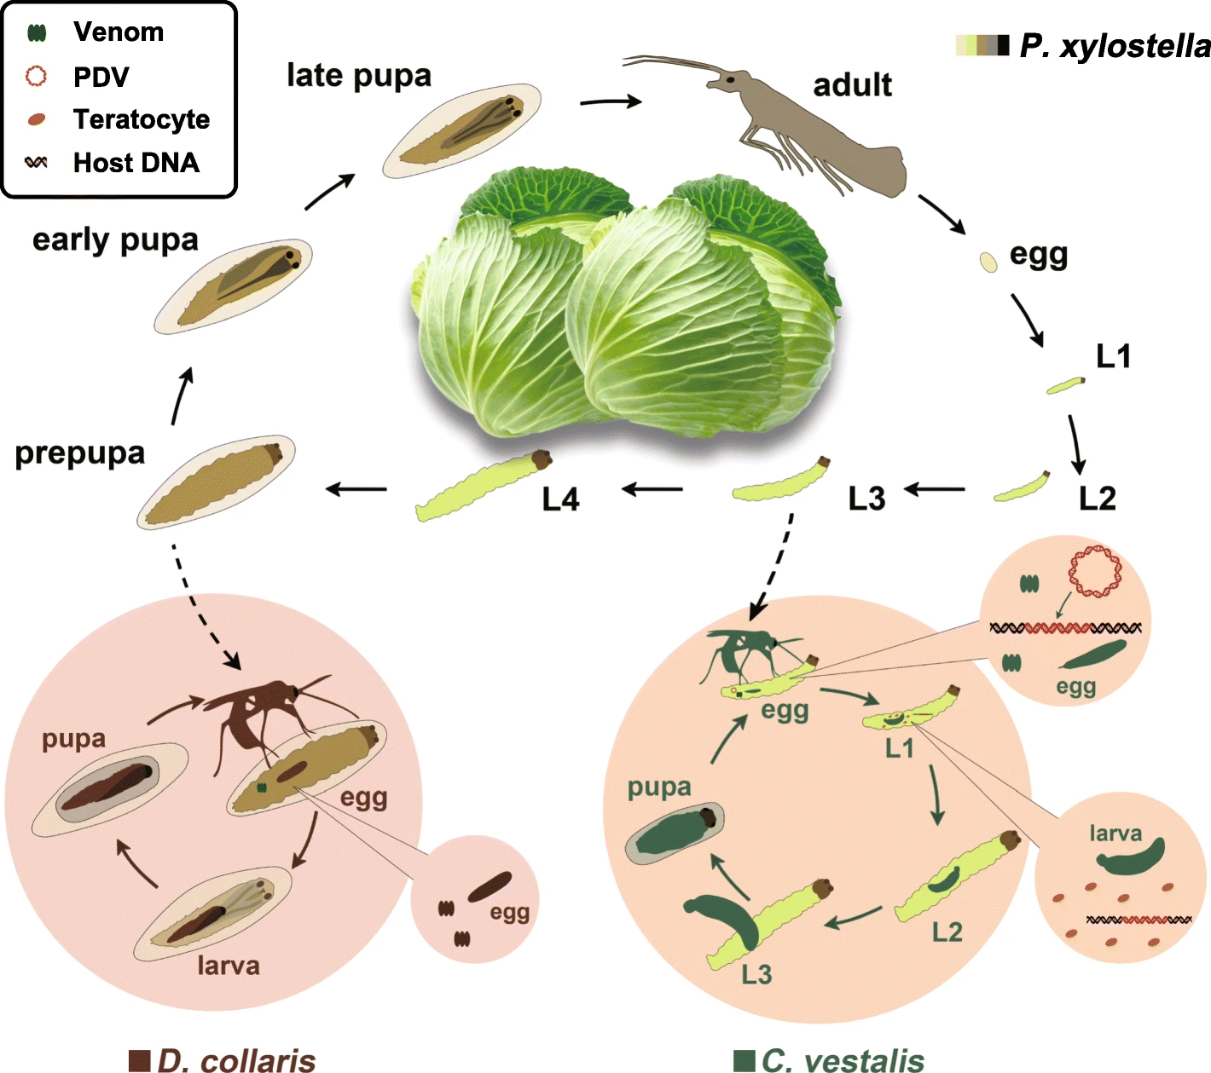
Types of DBM Parasitoids Agents
150+ of hymenopteran parasitoids recorded in the world.
Egg: Trichogramma parasitoids. Not entirely host specific to just DBM. Inundative biological control.
Larval parasitoid: Diadegma semiclausum
Pupal parasitoid: Diadromus collaris
The life history of C. vestalis and D. collaris. C. vestalis preferentially parasitizes second and third instar P. xylostella larvae (L2 and L3); and D. collaris parasitizes pupal stage hosts. Shi et al. 2019.
Notes:
https://entnemdept.ufl.edu/creatures/misc/wasps/diadegma_insulare.htm

Slide 11
Cotesia sp. parasitizing DBM larvae
J. Holopainen

Slide 12
Diadegma insulare parasitizing DBM

Slide 13
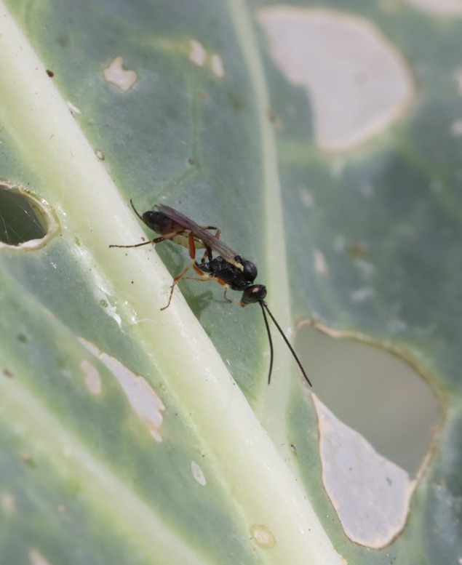
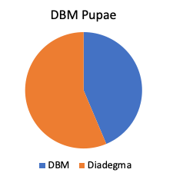
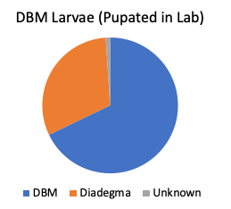
Snapshot of DBM Sampling (Oct 23)
Parasitism: 56%
Parasitism: 31%
N=71
N=190
Salinas Valley

Slide 14
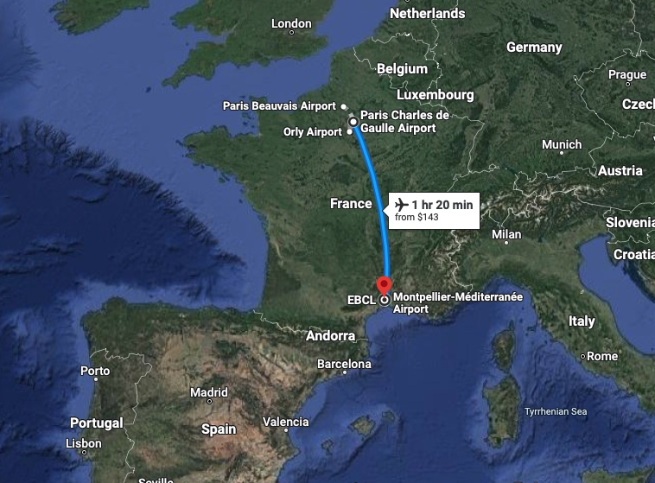
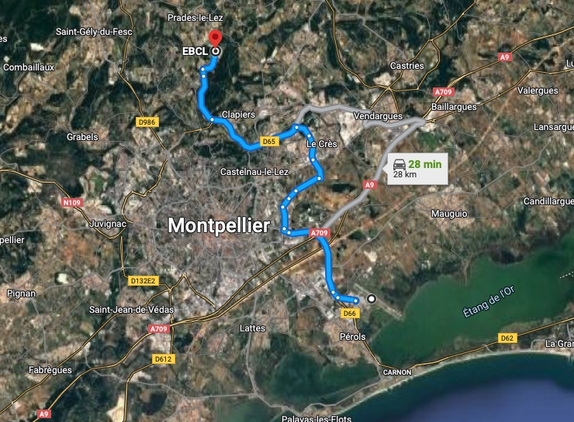
1
2
3

Slide 15
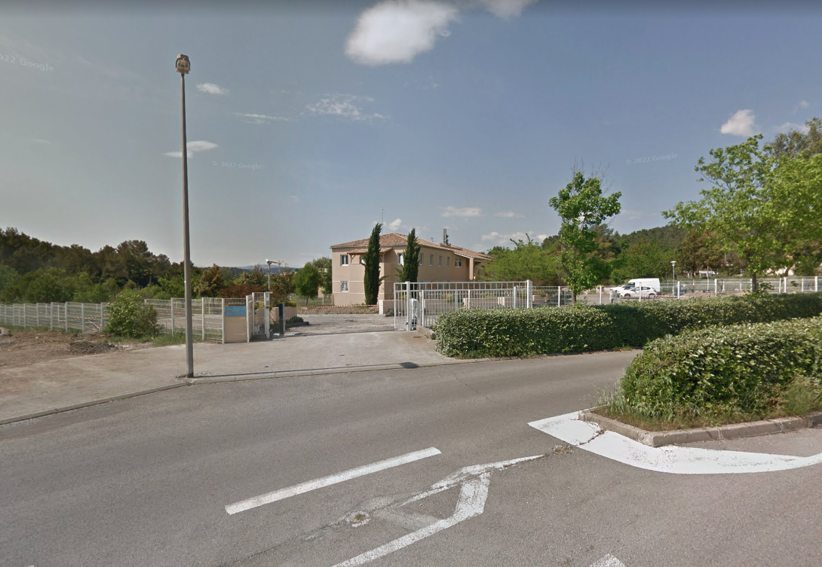
A
B
Quarantine Facility
Staff Offices/Lab Space

Slide 16
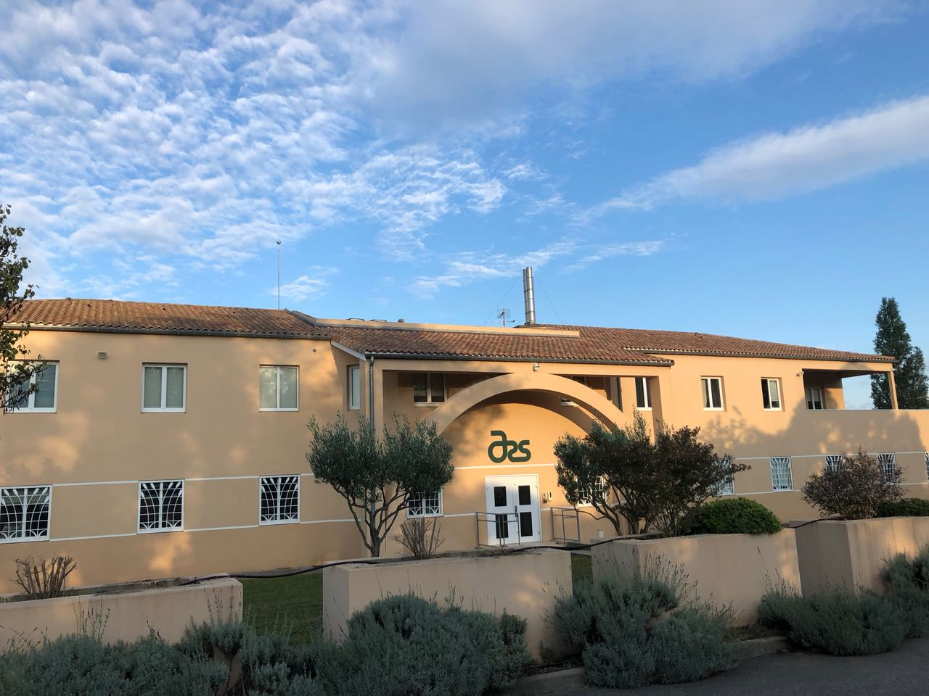
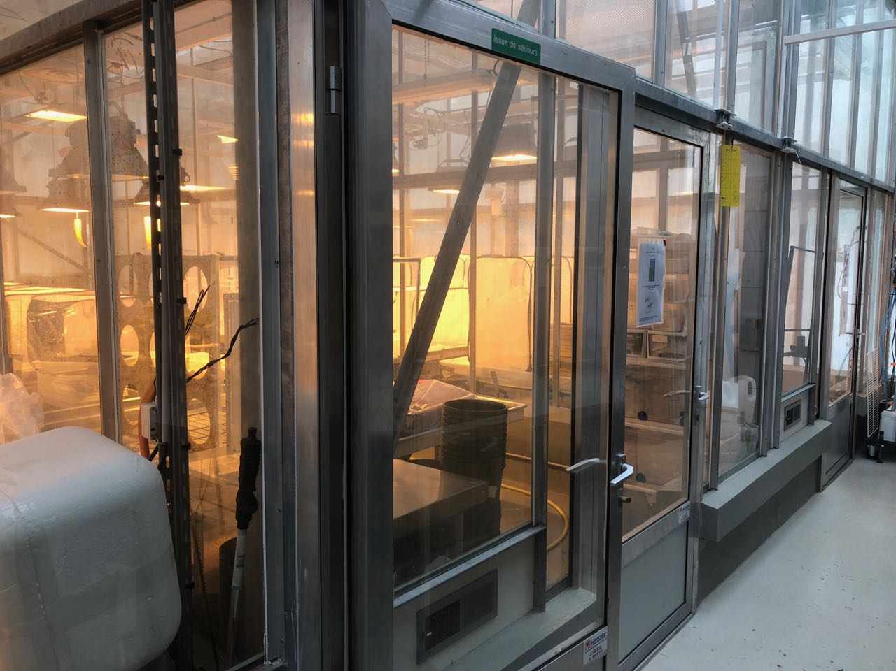
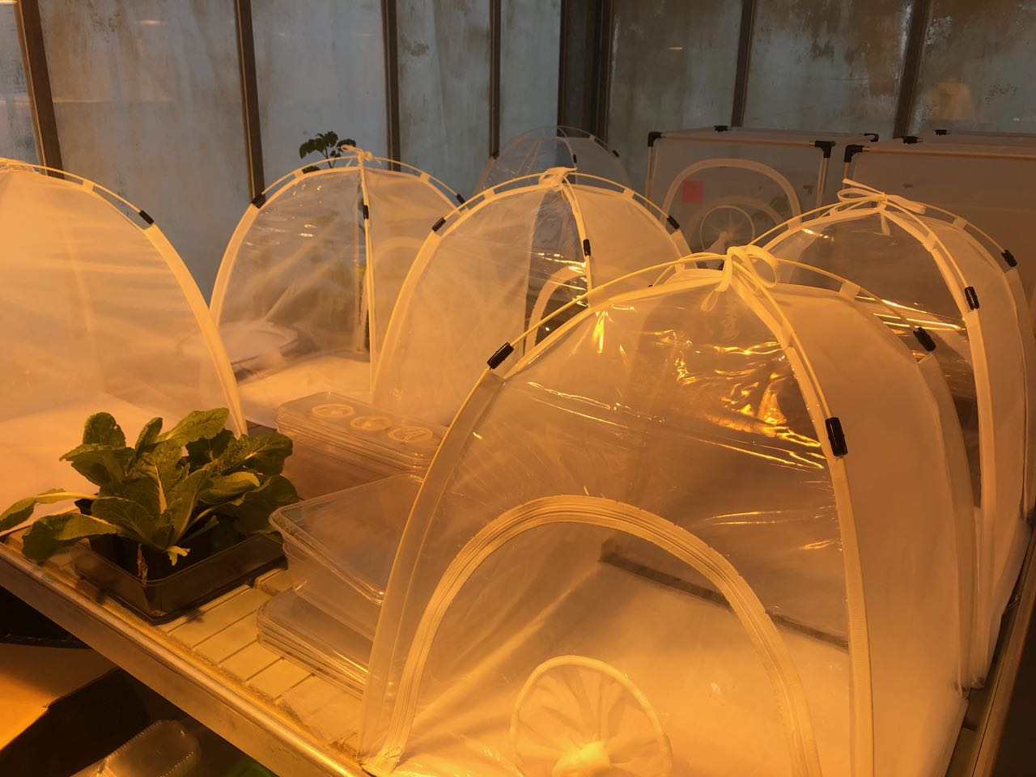
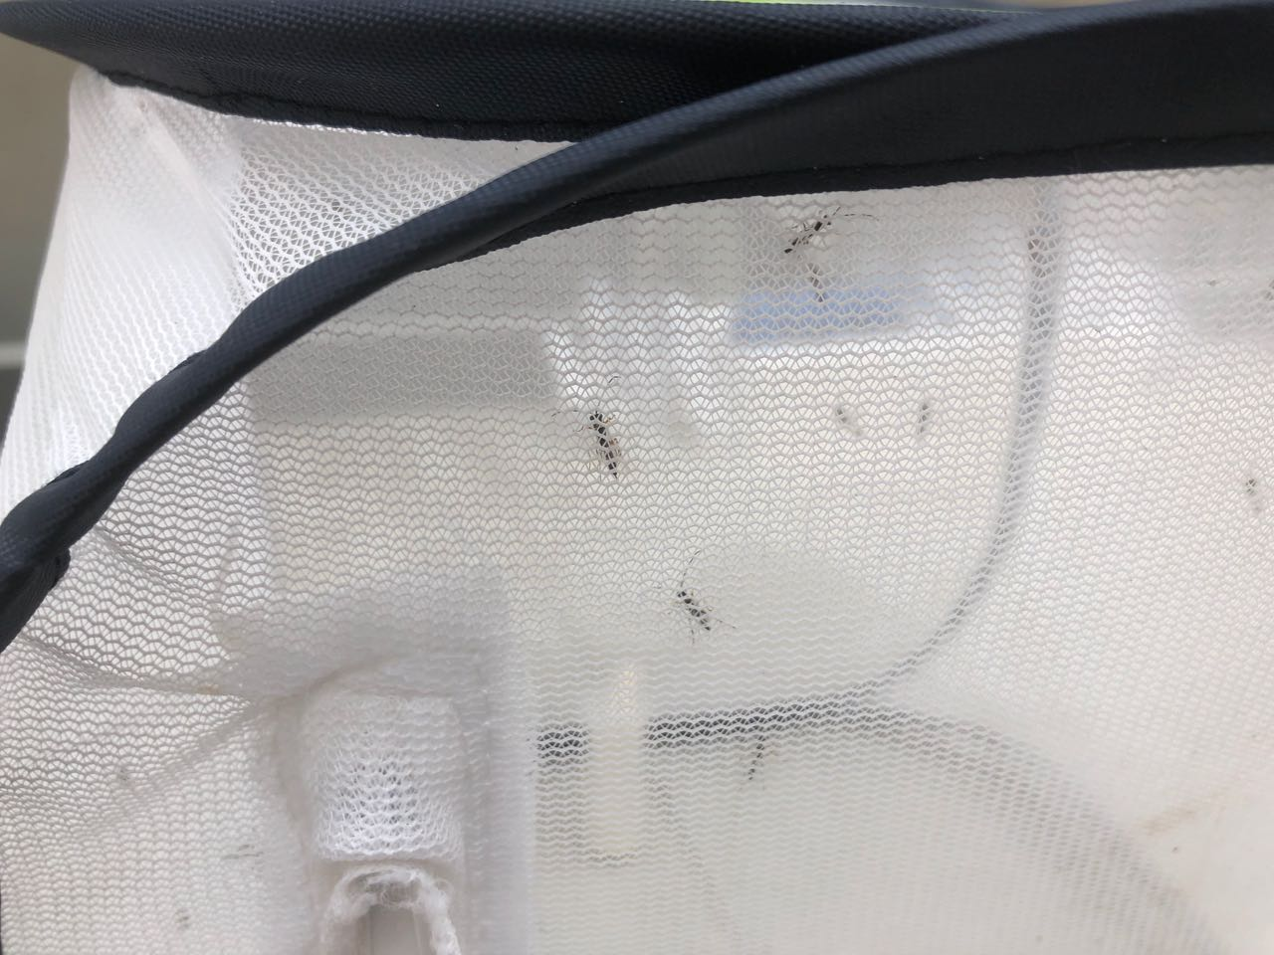
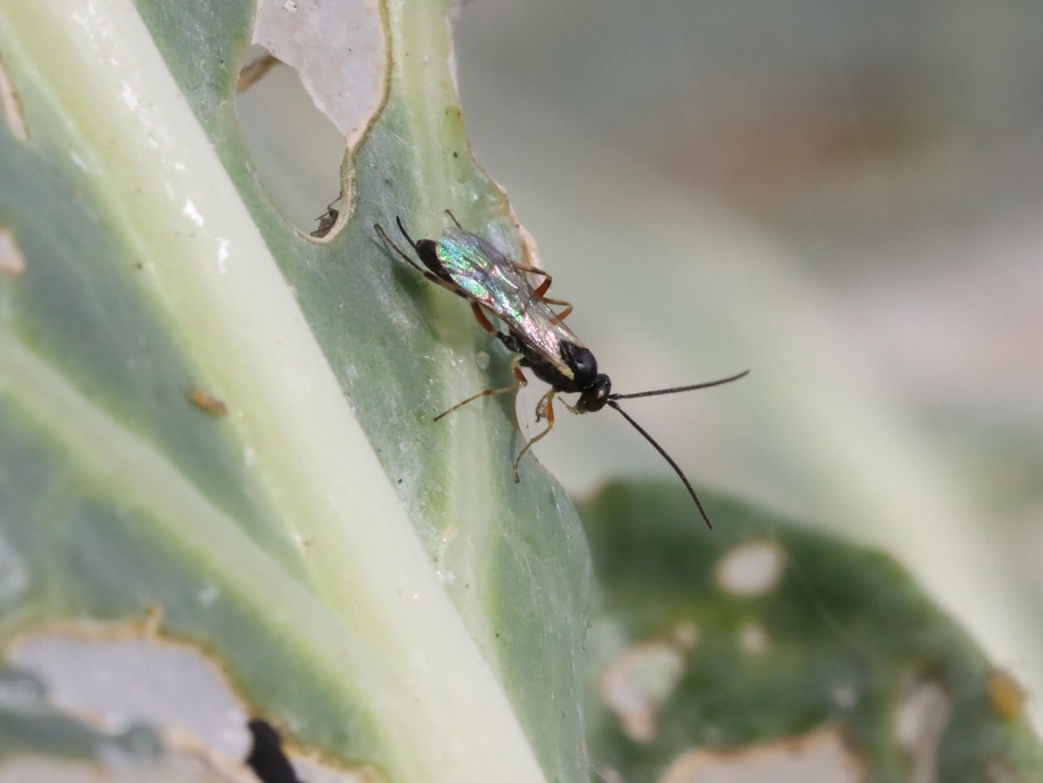
A
B
C
D
E
F

Slide 17
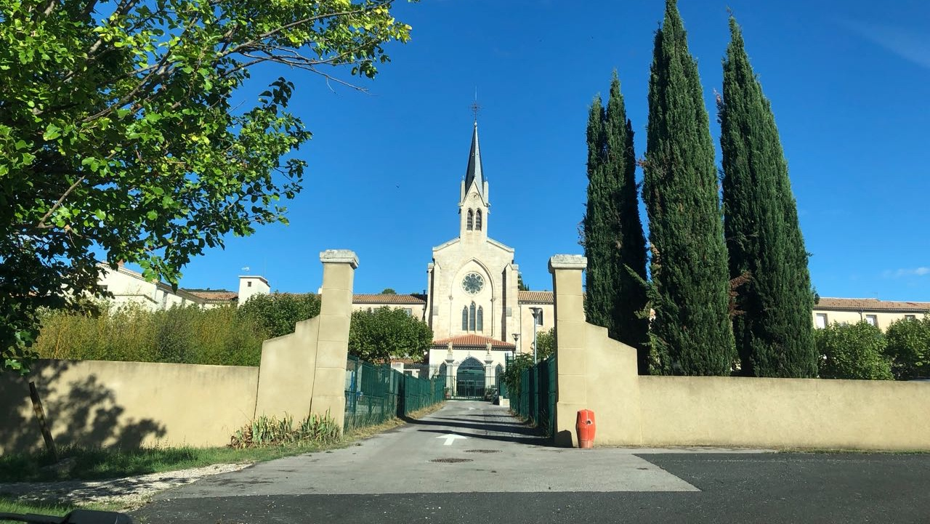
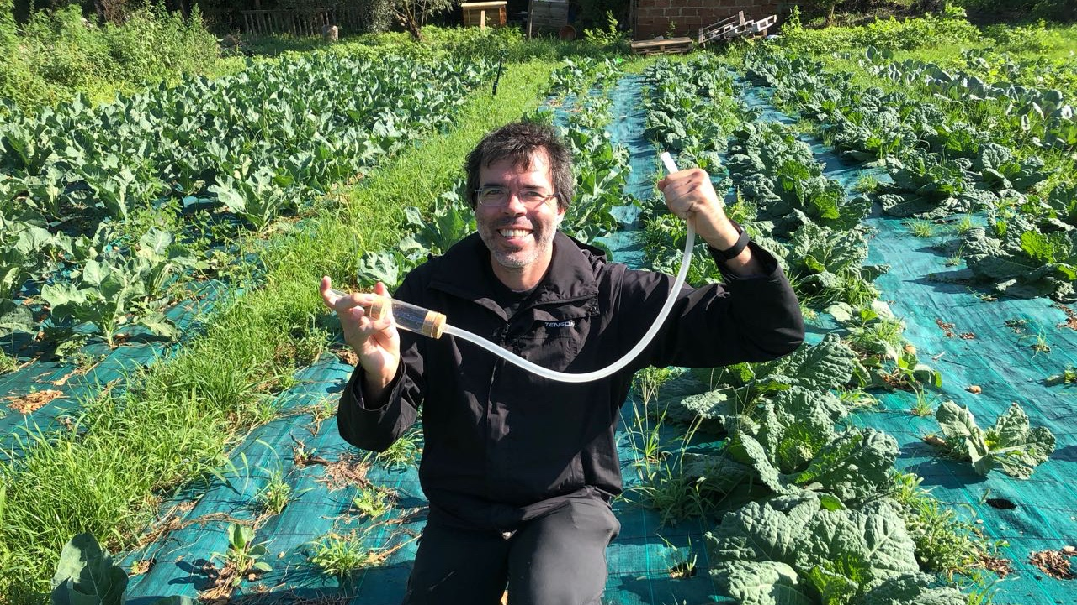
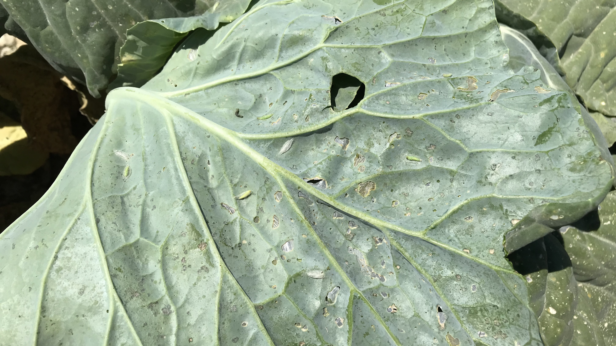
A
B
C
D

Slide 18
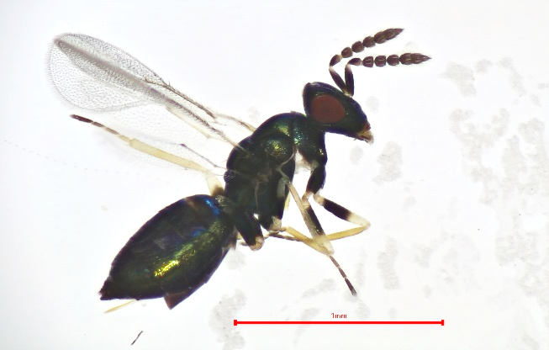
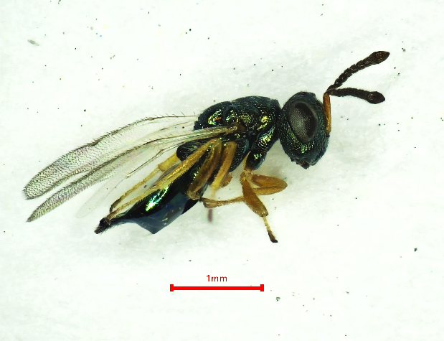
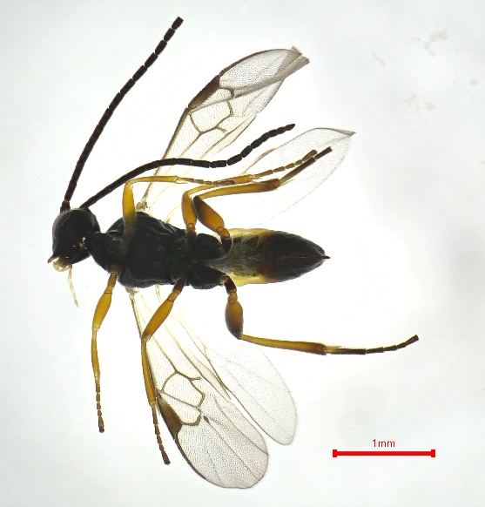
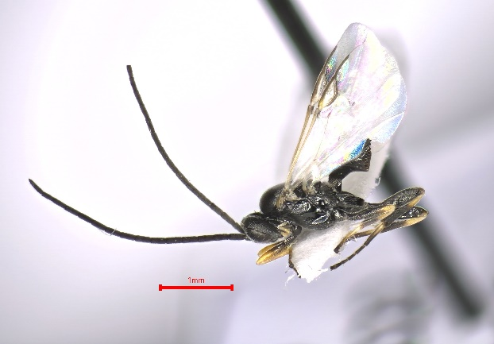
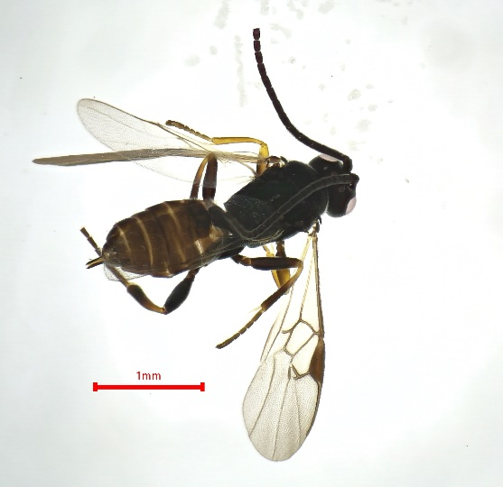
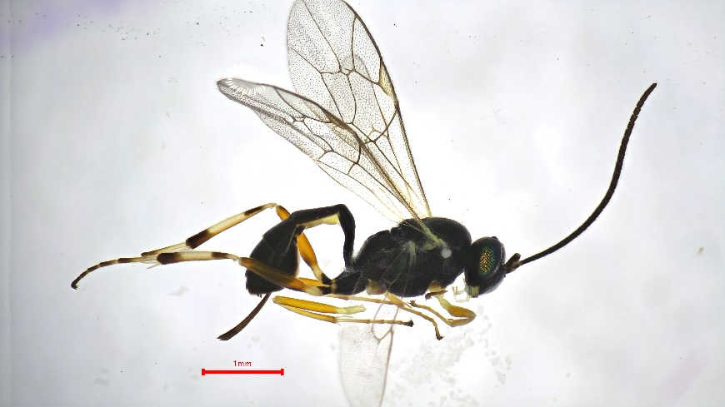
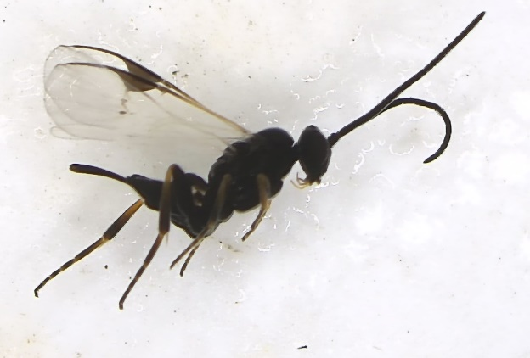
Diadromus collaris
Oomyzus sokolowski
Pteromalus chrysos
(Hyperparasitoid)
Cotesia vestalis
Diadegma fenestrale
Dolichogenidea appelator
Diadegma semiclausum
Diolcogaster claritibia
Mesochorinae sp.
(Hyperparasitoid)
Dolichogenidea sicaria
JG. Desurmont

Slide 19
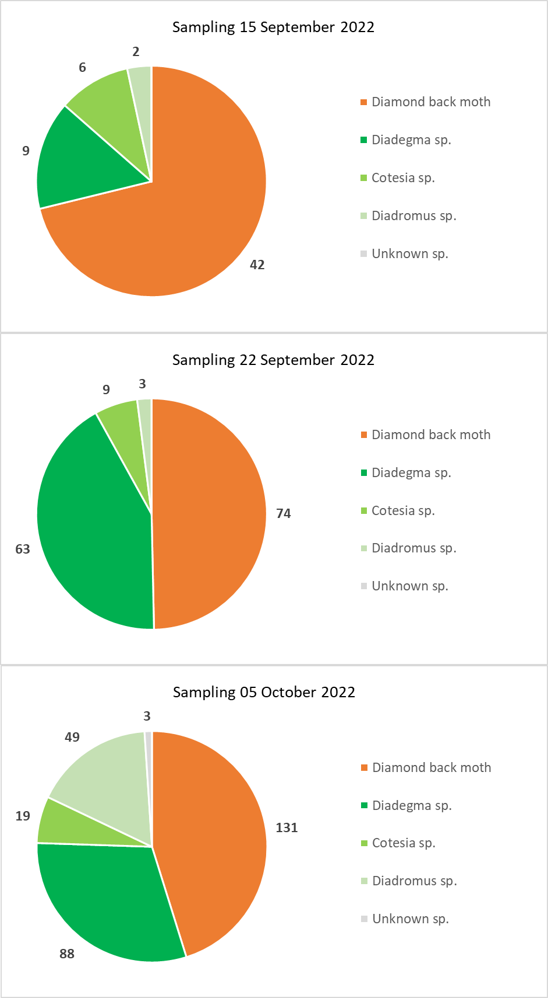
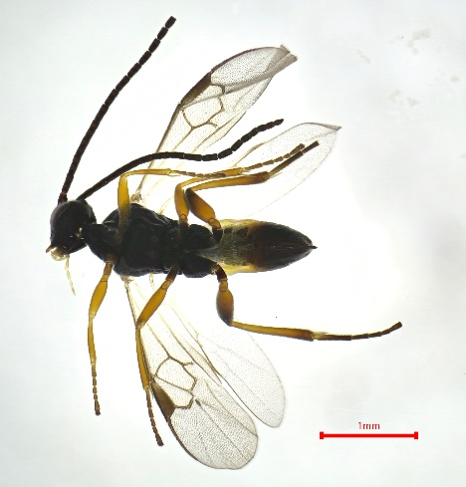
Diadromus collaris
Parasitism rate : 28.8%
Cotesia vestalis
Parasitism rate : 50.3%
Diadegma fenestrale
Parasitism rate : 54.8%
G. Desurmont

Slide 20
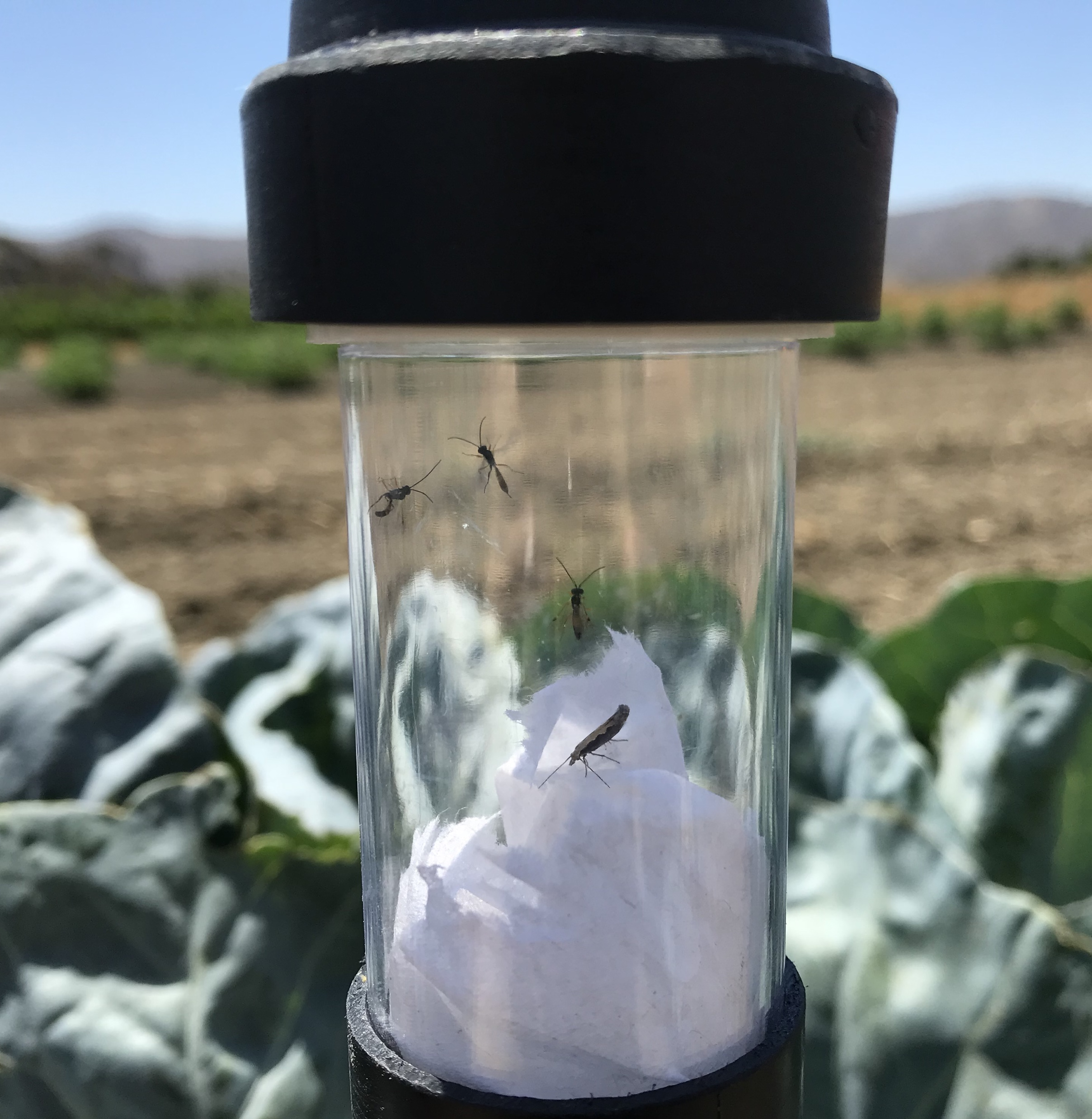
Future Directions
Foreign exploration in Africa (Kenya, South Africa)
Establish lines of parasitoids
Send EBCL a California DBM strain for parasitoid screening
Run studies under simulated California conditions

Slide 21
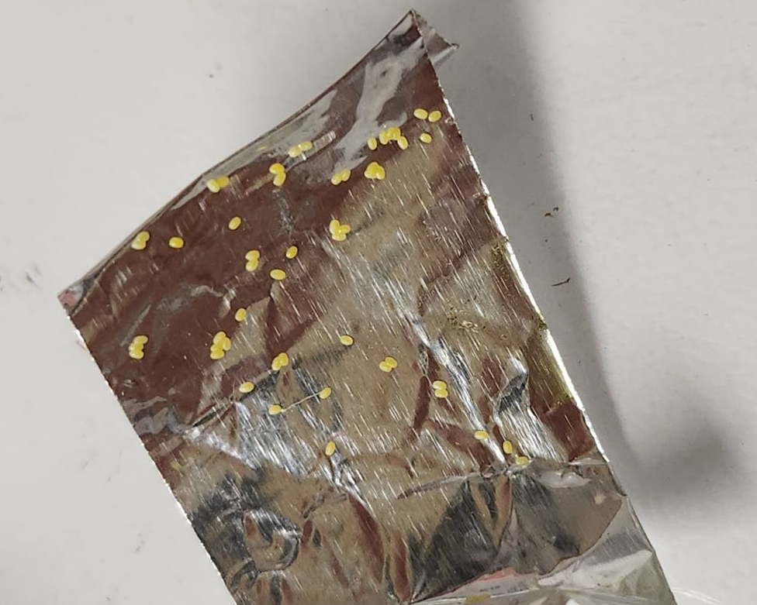
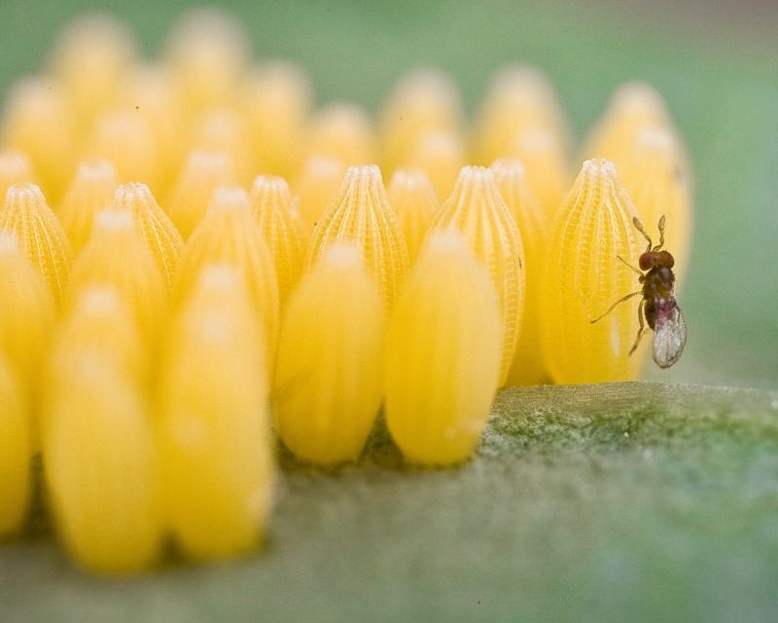
What about DBM egg parasitoids?
A
B
C
DBM Eggs (hard to find)
Sentinel Egg Cards
Commercial Trichogramma
Inundative BioControl

Slide 22
Thank you!

