Slide 1
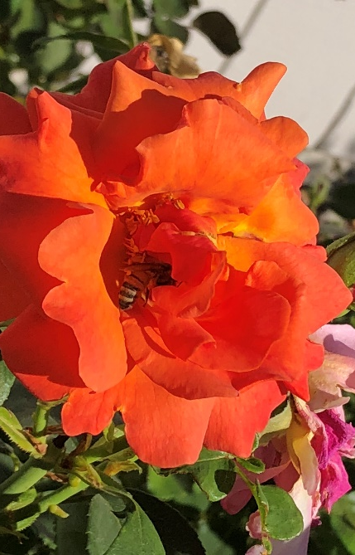
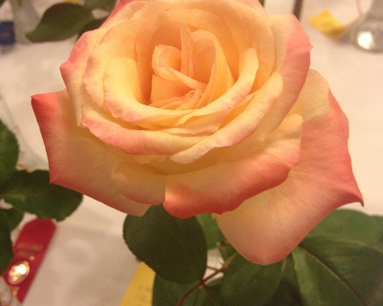
Roses
Varieties, Cultural Care & IPM
Notes:
Origin & Updates: Adapted from Roses by Master Gardeners Mary Lou Meredith and Ann Beinhorn, 2010. Revised X 5 by Ann Beinhorn, 2016, 2017, 2018, 2019, 2021. Again in 2023 by Ann Beinhorn, Placer County MG and Consulting Rosarian for the American Rose Society.
Publicity: Hardy, beautiful roses grow well in many places throughout the country. With this presentation, you’ll learn about some of the origins of roses in America. You’ll become acquainted with the categories of roses for your landscape, and learn that roses don’t have to be labor-intensive plants. You’ll learn to recognize some common pests and diseases associated with roses, and how you can safely manage them during different seasons of the year.

Slide 2
Who Are Master Gardeners?
Master Gardeners of Placer County
  Extend research-based, sustainable gardening and composting information
  Present accurate, impartial information to home gardeners
  Encourage public to make informed gardening decisions

Slide 3
Who Are Master Gardeners?
Where to find us…
Online, in the Media, and Special Publications
  Hotline: Call (530) 889-7388 or submit your questions online
  Website: pcmg.ucanr.edu
  Facebook, Instagram, X, You Tube
  Gold Country Media monthly column
  Curious Gardener quarterly newsletter on our website
  Gardening Guide and Calendar

Slide 4
Who Are Master Gardeners?
Where to find us…
Presentations, Fairs and Festivals, and Special Events
  Speakers by Request
  Workshops (various venues, check website)
  Farmers’ Markets (seasonal: Auburn, Roseville)
  Fairs and Festivals Booths (varies)
  Garden Faire (April)
  Mother’s Day Garden Tour (May)

Slide 5
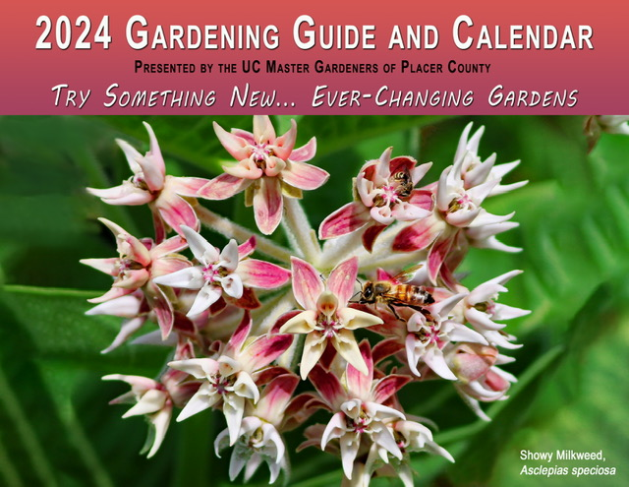
Who Are Master Gardeners?
Notes:
Master Gardeners of Placer County’s Gardening Guide and Calendar for 2024 is available for sale at various Placer & Nevada County nurseries. Check our website for nursery names and phone numbers.

Slide 6
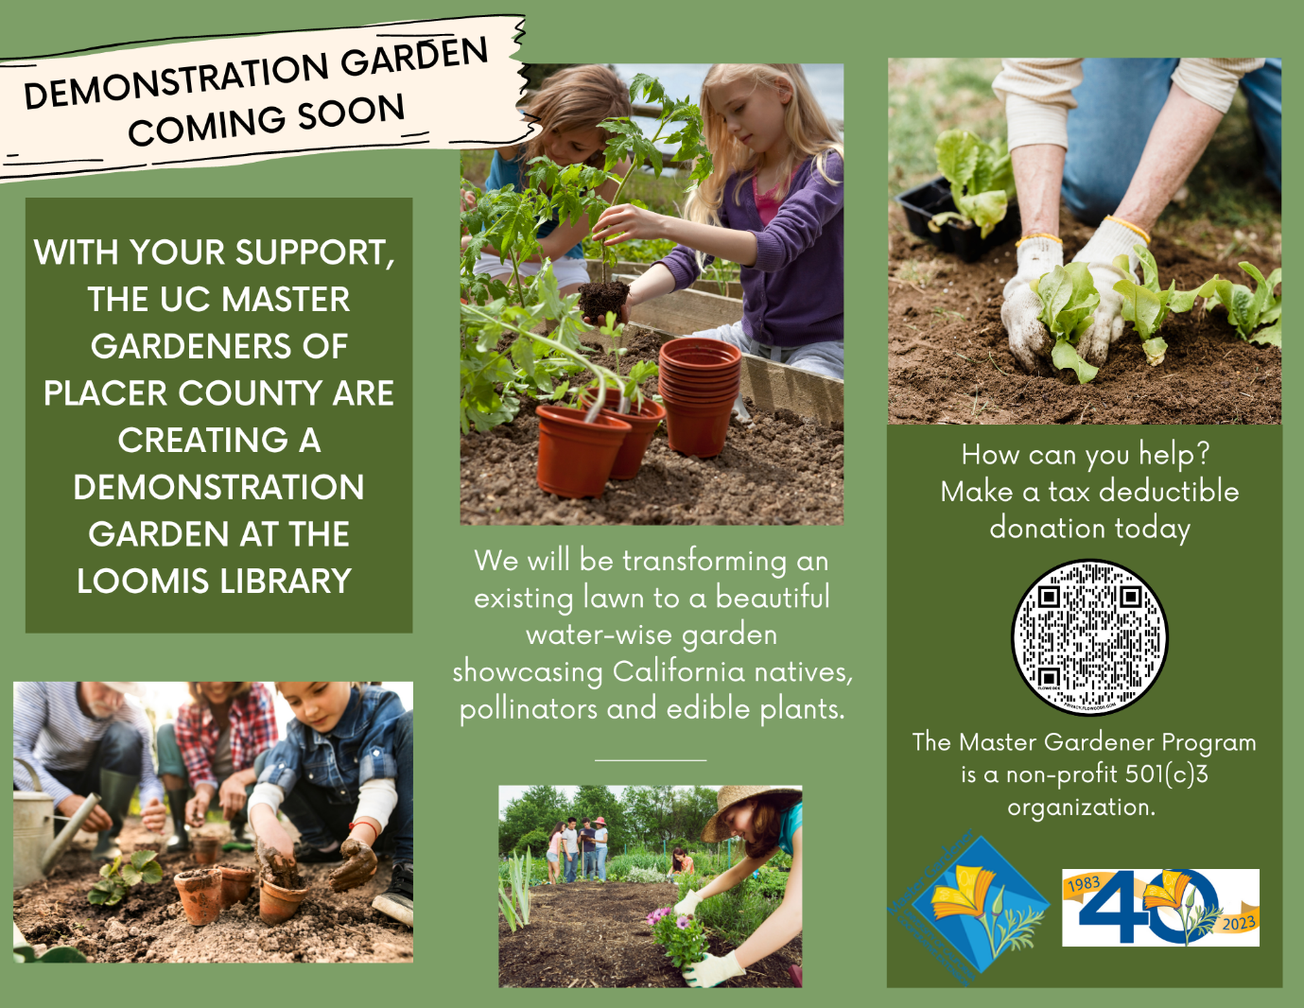
Who Are Master Gardeners?
Notes:
Have you heard the news? The Placer County Master Gardeners are creating a demonstration garden at the Loomis Library and Community Learning Center. It’s located just off highway 80 at the Horseshoe Bar Exit in Loomis.

Slide 7

Agenda
  A Brief History
  Rose Varieties for the Home Garden
  Cultural practices
    Planting
    Watering
    Fertilizing
    Pruning
  Propagation
  Pest Control

Slide 8
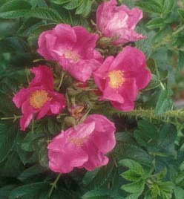
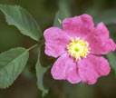
History: Early Roses in California
Rosa rugosa
Asian native shrub
Used hedges around farmlands
Now used at seashores & roadsides
Very cold-hardy
Rosa californica
“Thicket-forming”
Grows by streambeds
Found lower than 1,600 ft. elev.
Native from So. Oregon to Baja California
Notes:
Roses were commonly used as a symbol of prestige and celebration in Roman times. Western Europe inherited the traditions. Rugosa (“ruffled “leaves) brought into US in 1800’s, Native to Asia & Russia, Hybr. <1846. Tolerates -30 degr. Gets invasive. R californica prefers moister settings(but is also in Central Valley), gets 8’-10’ high x 8’. Hybr. 1878

Slide 9

Rose Varieties
(Select the disease-resistant varieties)
Two main categories:
  Garden (“modern”: after 1867) Roses -valued for their flowers
    hybrid teas (most common)
    English roses, floribundas, grandifloras, and climbers
  “Own-Root Roses”
    English roses, old garden roses
    Landscape roses – shrub roses and groundcover roses
    -low maintenance, easy care
Notes:
You can get information from the nurseries who ship roses and the American Rose Society about rose disease resistance.
This list of rose varieties is not all-inclusive: Ramblers, Polyanthas, Miniatures and Minifloras are some others. Garden Roses require specific techniques to prune for desired results (as covered under “Why Prune”). “Own root” roses don’t have suckers & resist freezing temperatures. The older varieties tend to be fragrant.
An “own root” rose is never grafted onto root stock. If you like roses but don’t want to spends a lot of time grooming them, landscape roses can be a success in the right place with basic care.

Slide 10
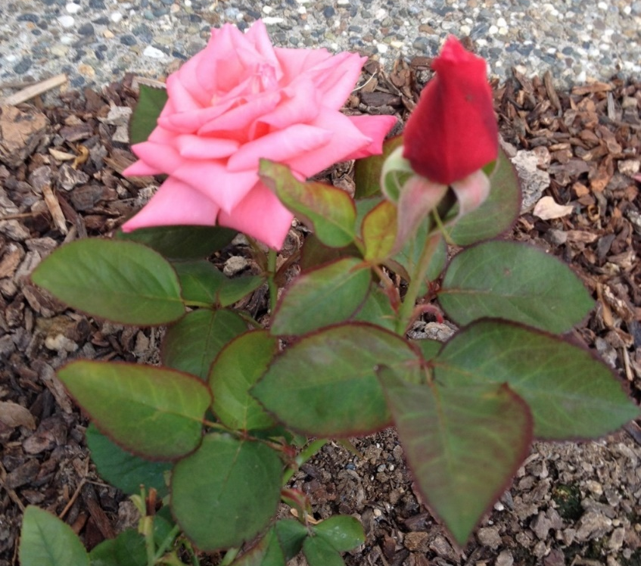
Garden Roses
Miniflora
Miniature
Miniature
Notes:
Miniatures’ blooms can be ¼”-2” Miniflora blooms are 2-3”

Slide 11
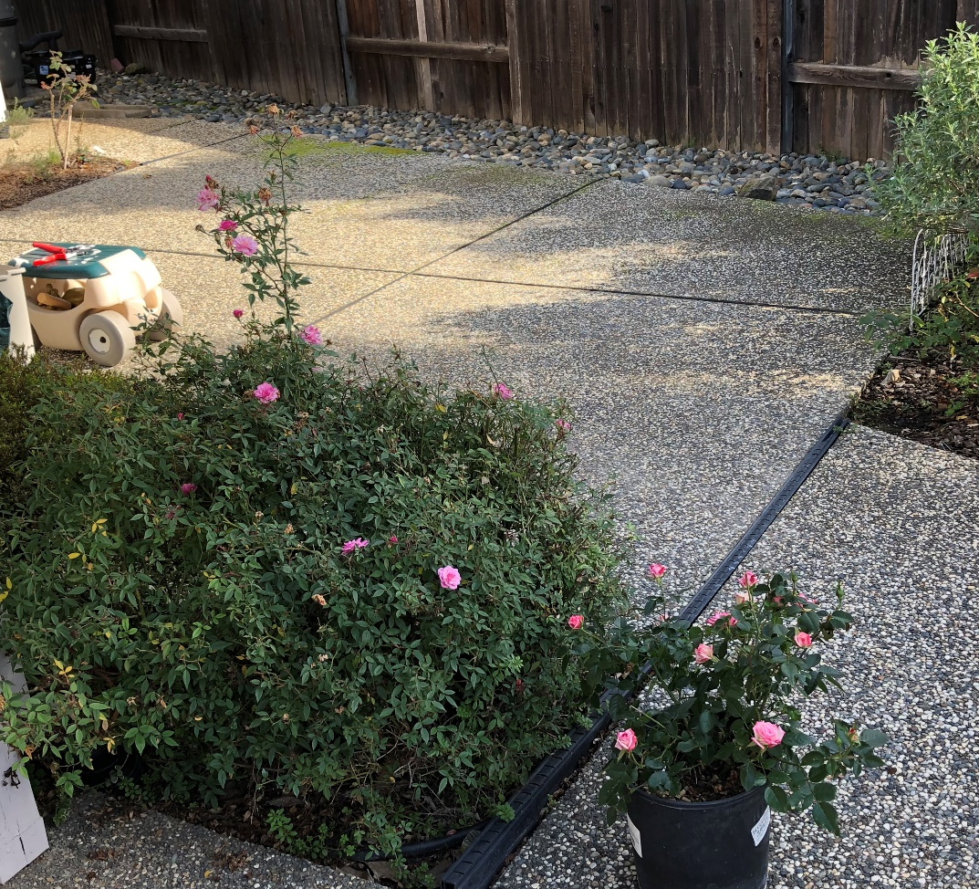
Mature and new Miniature Roses
Notes:
Compare the established miniature rose’s size to a new potted plant.

Slide 12
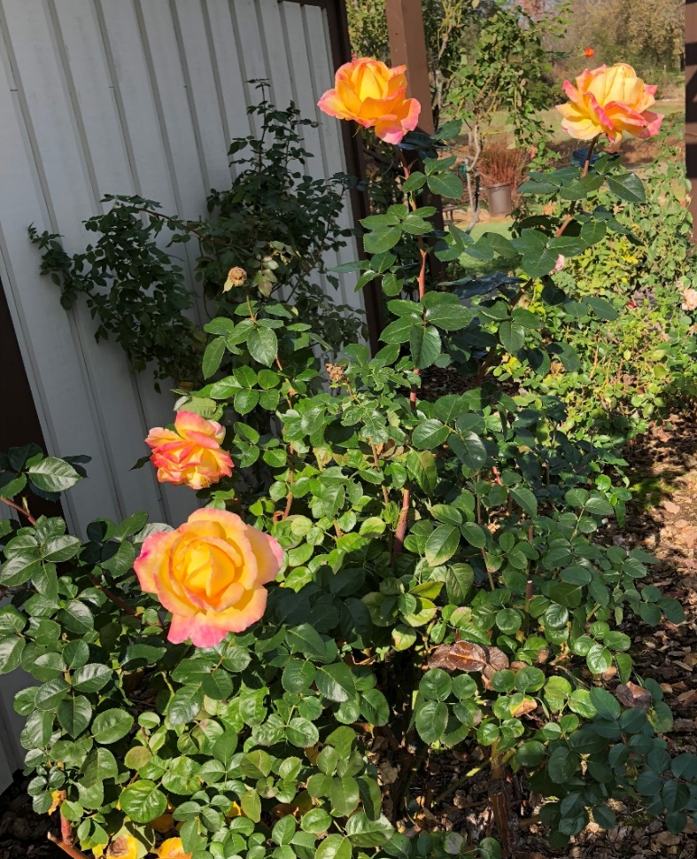
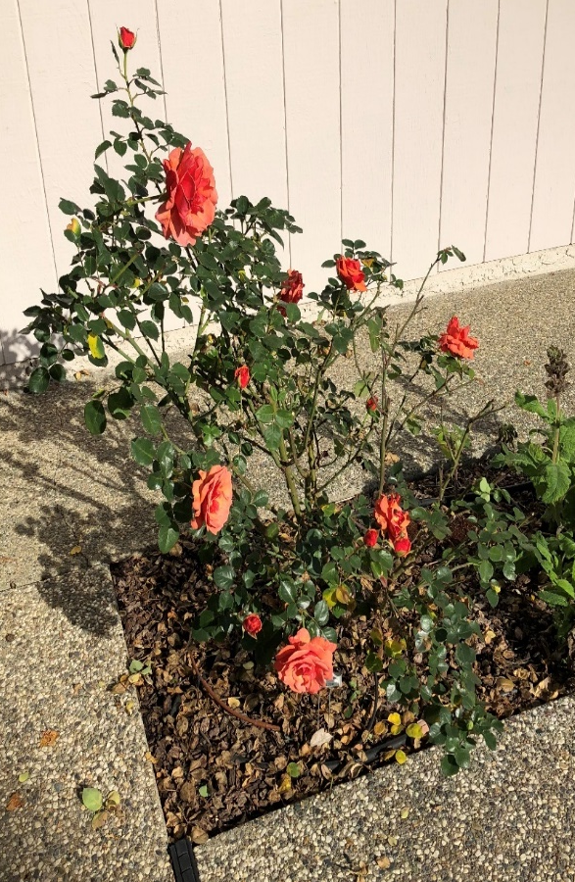
Garden Roses
Hybrid Tea
Floribunda
Notes:
Left: Floribundas are rounded and 3-4’ high, and often bloom in together in “sprays” (q. 6-8 wks) . Easiest to fit in a garden., usually in bloom.
Right: Hybrid teas are up to 6’ high and bloom usually as solitary flowers. (Traditional cutting rose) Takes 6-7 wks to rebloom.

Slide 13
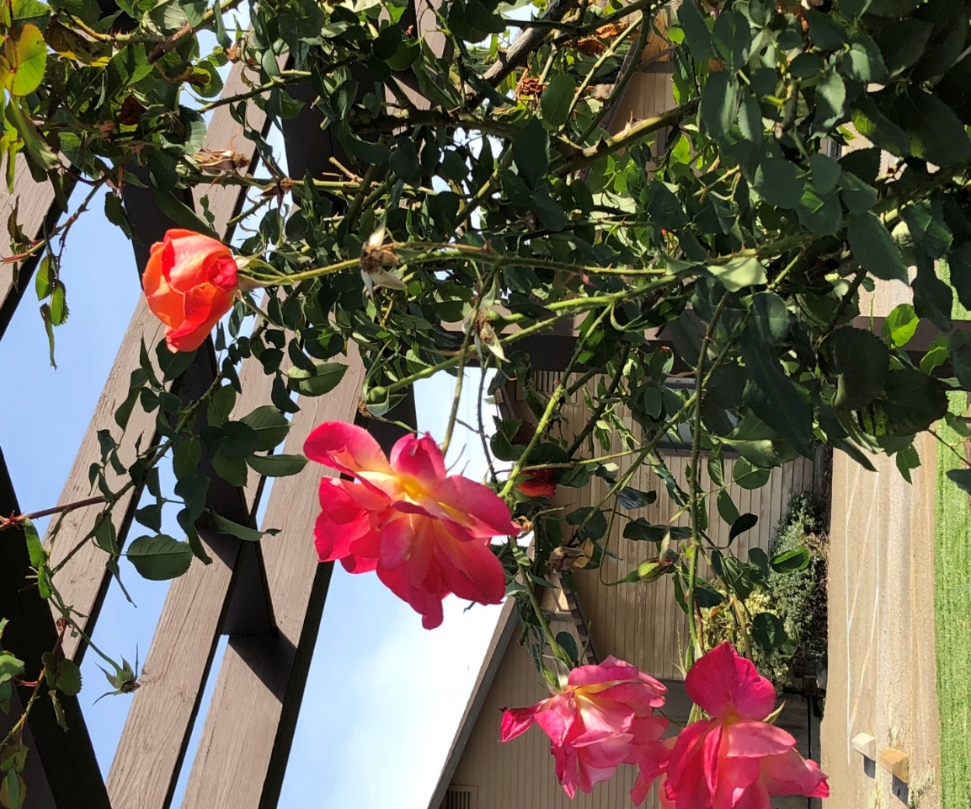
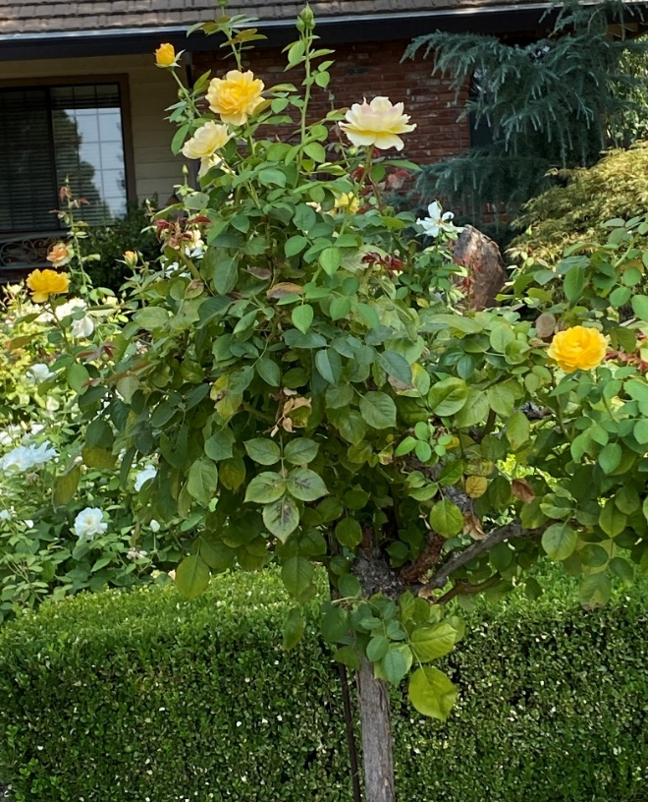
Garden Roses
Climbers
Tree Roses
Notes:
Tree roses have been grafted onto a plant of the same genus. About any modern rose can be used for a tree rose.
Climbing roses are great to line fences or around an arbor. They are pruned to bear abundant flowers on lateral stems. 6’-12’.

Slide 14
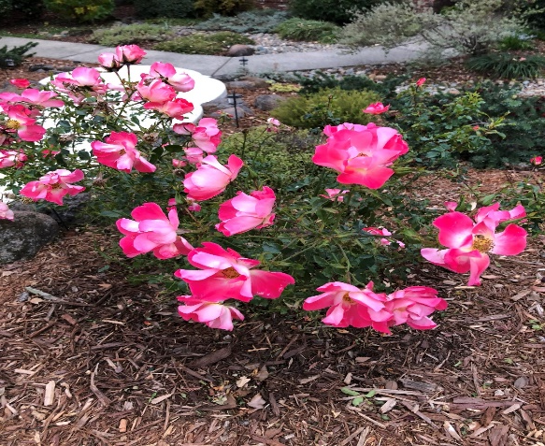
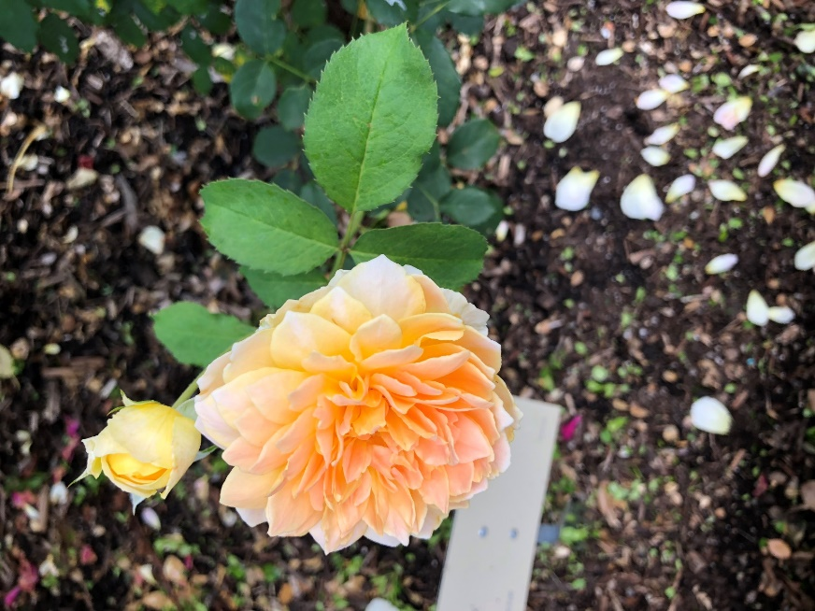
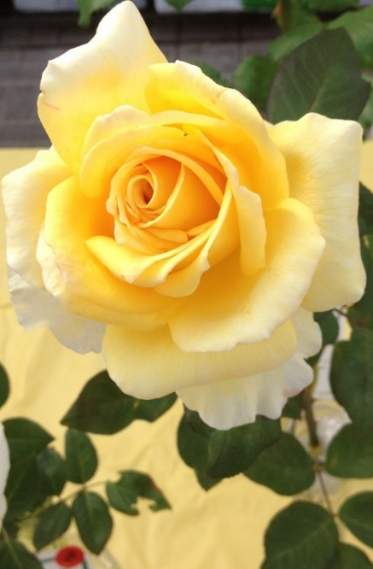
Garden Roses: Flower Forms
Hybrid Tea English Rose Single
Notes:
All these are being hybridized. Left: The perfect hybrid tea form. Middle: English rose (cup form) Right: “Single” roses, attractive to pollinators.

Slide 15
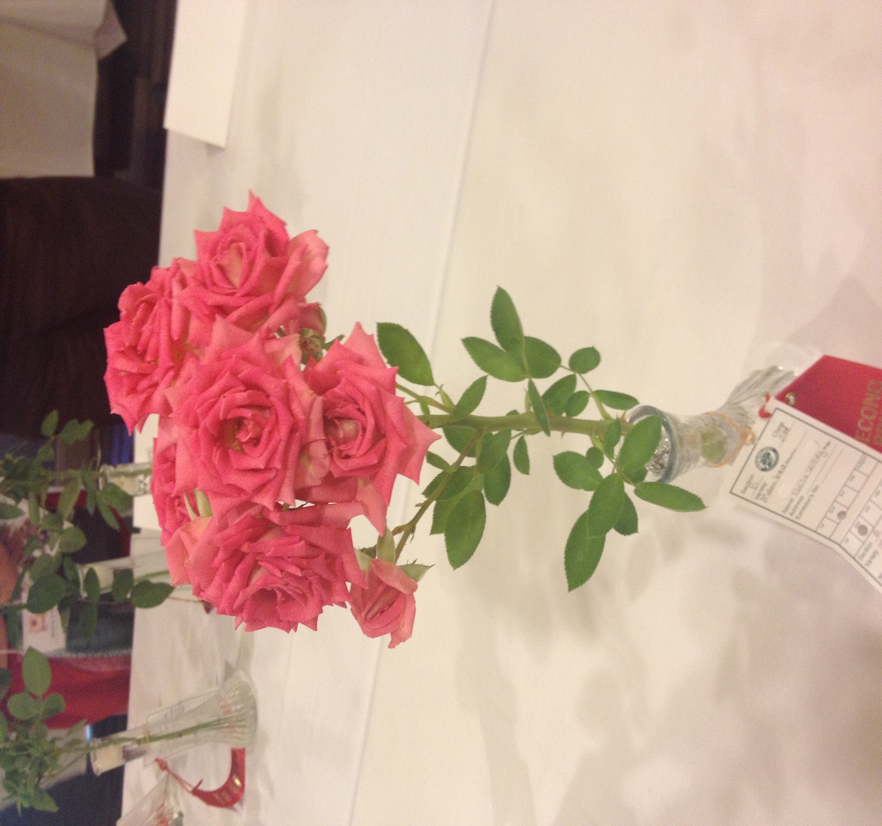

Garden Roses: Bloom Forms spray
solitary
Notes:
Hybrid teas bloom as solitary flowers, but other garden roses can also bloom in clusters too. The pointed center of hybrid teas is admired as a good bouquet or show rose.

Slide 16
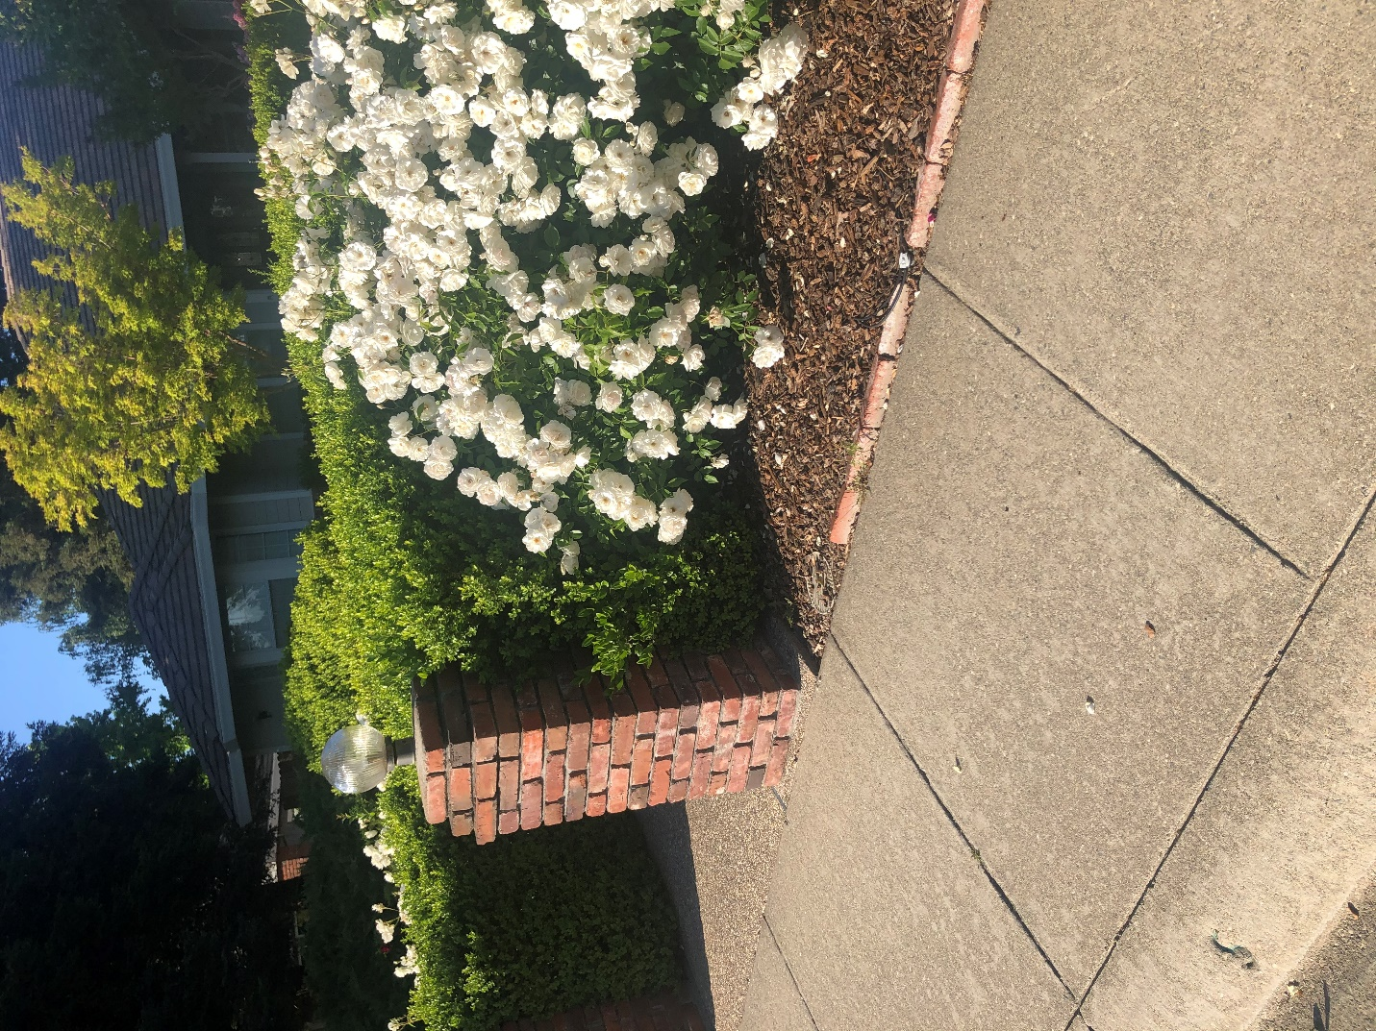
Landscape Roses
Arboretum All Star
Rosa Korbin ‘iceberg’
floribunda
upright, mounding, or
groundcover
Very good disease resistance
Notes:
Groundcover, Mounding of upright forms for landscape roses often grown in groups. On right is Iceberg, bred in 1958., still a highly-ranked rose in the world.

Slide 17
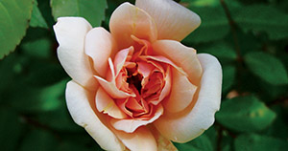
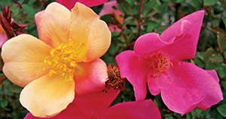
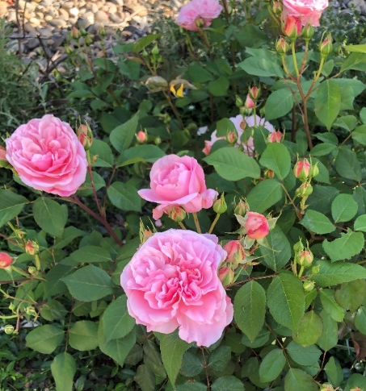
UC Davis Arboretum “All Star” Roses
R. ‘Perle de Or’
Rosa ‘Mutabilis’; ‘butterfly rose’
R. ‘Pink Gruss an Aachen’
Notes:
Mutabilis: shrub Mutabilis: China rose, 1884 Repeat bloomer. 4-6’. Gruus an Aachen: Floribunda 1909. 18”-3’ Perle de Or: Polyantha 1875
All Stars are easy care, usually drought tolerant, & attract wildlife.

Slide 18
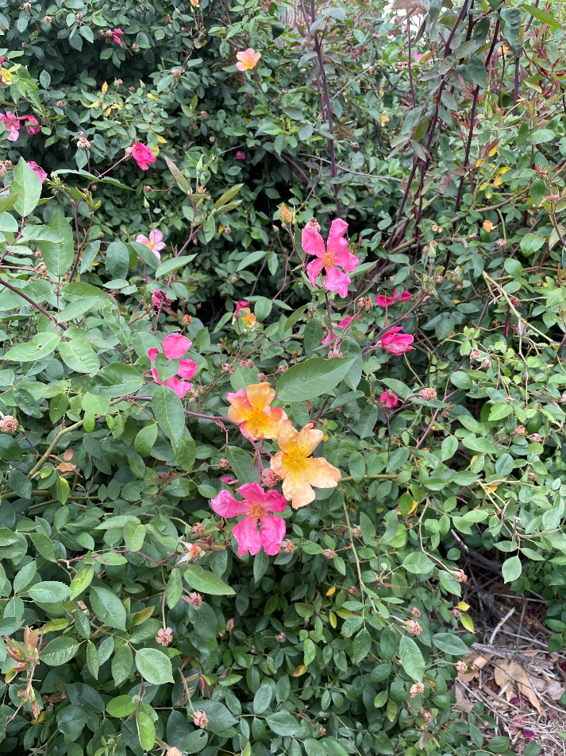
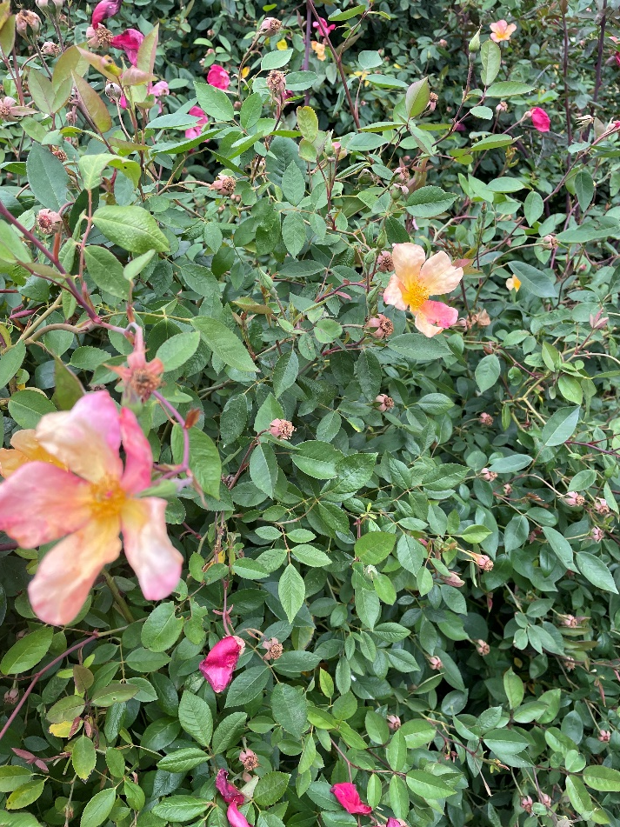
Arboretum All Stars
Mutabilis
Notes:
Observed in Davis at a “Pollinator Garden” near Putah Creek.

Slide 19
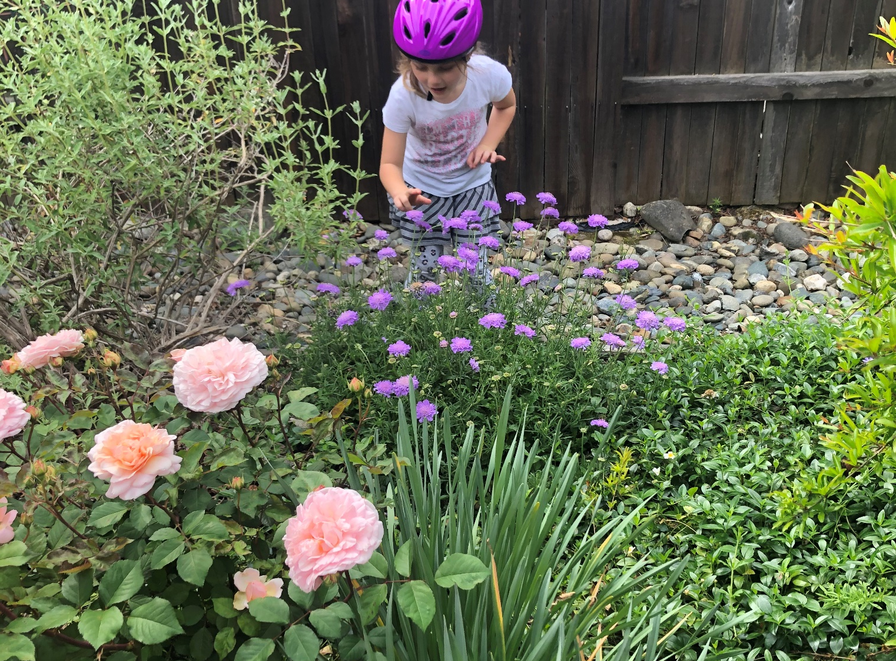
Rosa ‘Pink Gruss an Aachen’
Notes:
Floribunda in foreground. Gruss an Aachen name also is used for a climber or hybrid tea, and in different colors.

Slide 20
Poll Question:
What year was the rose declared the national flower of the United States?
(Write down your answer).
  1 1867
  2 1909
  3 1958
  4 1986
Notes:
In 1986, the rose was named national flower of the US by President Ronald Reagan.

Slide 21
Cultural Practices: Planting
Optimal soil: pH above 6.5, best at 7.0, well-drained
with organic amendments
Sun Exposure: at least 6 hours
Position: graft above soil level, or if ungrafted, same level as in pot
Separate plants several feet apart for garden roses
Bare-root plants: keep moist & cool, plant soon; form a soil “cone” support, fill in
Notes:
Do a soil test of your property before planting roses. Most of local soils are in the neutral range. You should be able to see the top of the graft in a mild climate setting
(no heavy snows). Very light-flowered roses might be more tolerant of partial shade in our climate. Easier to start bare-root roses in pots.

Slide 22
Cultural Practices: Ongoing
Watering
“moderate” water
drip Irrigation around dripline
-streamers
-tubing with 6” emitter spacing
Fertilizing
after pruning and each bloom cycle
organic
Notes:
Watering should follow evapotranspiration rate (seasonal). Don’t leave completely dry in summer. Sometimes a spray of water in a.m. while hot helps.
Fertilize with slow-release fertilizers coving all over the root crown, under the dripline. Don’t allow water on leaves to linger after dark.

Slide 23
Cultural Practices: Pruning
Why Prune in winter? (For repeat bloomers)
  ** to keep the plant healthy (removal of diseased, dead
  or dying wood, and crossing branches)
  ** to open up the plant for air circulation
  ** to influence the flowering periods
  ** to shape the plant and decrease prickly branch hazard
  Same principles apply to one-time seasonal bloomers.
Notes:
. The first two points are most important for the health of the plant. You may make a shorter plant to yield bigger fewer flowers; a taller plant may have smaller but more bloomsPrickly (thorny) branches are a hazard for pathways.
Prune one-time bloomers after bloom. You can also prune in summer to clean up. One-time bloomers need the routine pruning after bloom.

Slide 24
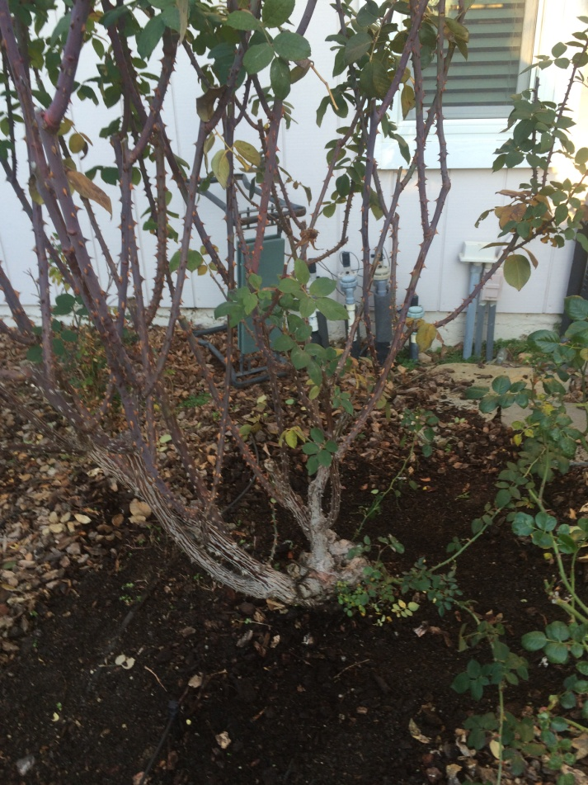
Where do I start???
Notes:
Have the branches grown together so you can’t even see the ground?

Slide 25
Prepare to Prune a Rose Plant
    Identify the graft if applicable
    Identify the wood health, leaf
    condition and branch condition
    Select preferred canes
    Start from the top height –or-
    from the bottom up
    Decide how tall your finished plant should be
    Use sharp, *clean tools
    Remove old mulch & leaves
    Follow general guidelines
Notes:
Old canes yield few if any blossoms. Suckers are from root stock, and can overwhelm the grafted hybrid. Remove dead, diseased & dying branches.
Throw all discards in the trash.

Slide 26
How to Prune
General Guidelines
  Remove dead, unproductive or diseased wood
  Remove crossing branches & twiggy growth
  Shape the plant
    Increase air circulation; open center, 3-6 canes
    Create room to get around the plant
  Remove 1/3 to 1/2 of the healthy wood
    Encourage growth of flowering wood
  Top-dress with compost & replace mulch

Slide 27
Steps to pruning: Select Canes
Old canes are rough and rough or split; prickles are gray or white
New canes are green and smooth; prickles are brownish
Dead branches
Crossing branches
Cluttered center
Look for suckers Know the bud union
Notes:
Old canes yield few if any blossoms. Suckers are from root stock, and can overwhelm the grafted hybrid.

Slide 28
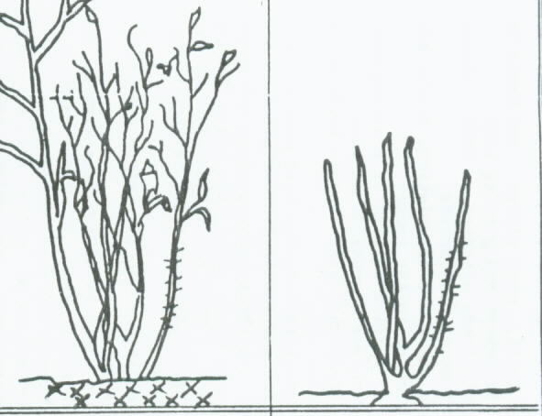
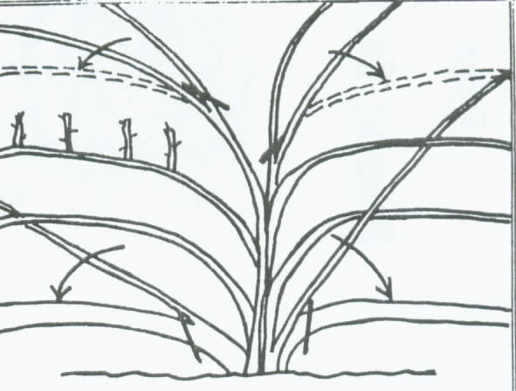
Prune by Variety
Standard garden rose Climber
Notes:
Look at the finished picture for each: count canes, note spacing, and see where branching and flowering will take place. Climber canes are more pliable for securing in winter.

Slide 29
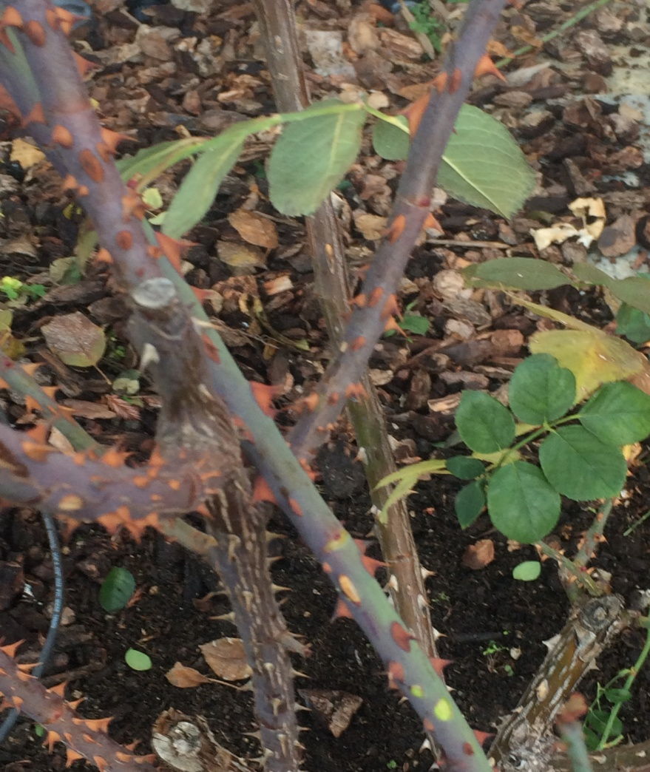
Steps to Pruning: Cuts
New & old canes
Cut about 1/2” diagonally above out-facing bud.
3-6 canes (generally): modern hybrid roses
Don’t retain twigs under pencil-size
Notes:
Explain what a bud is.

Slide 30
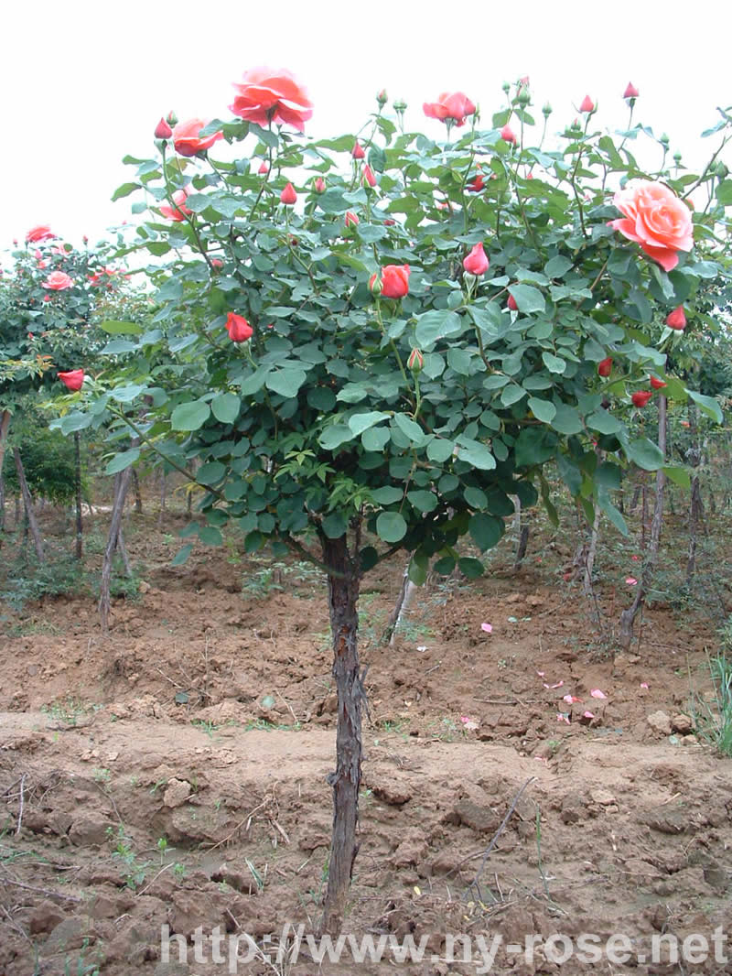
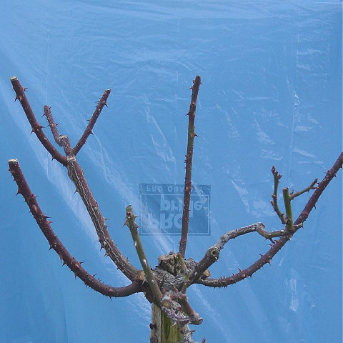
Guidelines: Tree Roses
Select about 6 canes
Open center, vase shape

Slide 31
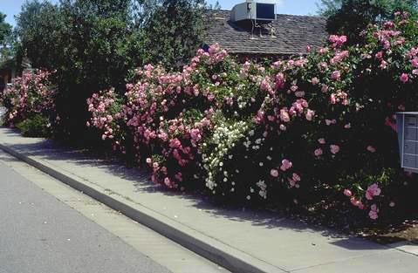
Pruning: General Guidelines
Landscape Roses
  Leave unpruned or do “rejuvenation” pruning
  Miniatures can be “headed”
Notes:
Explain what heading is.

Slide 32
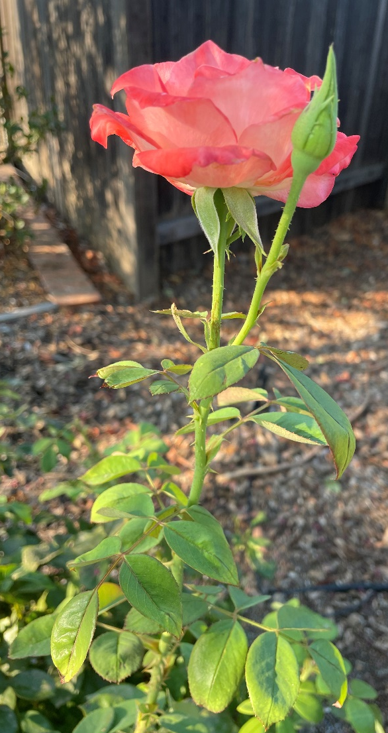
Growth Season Pruning
Deadheading
=Prune ¼” above-outward-facing bud
-Reduces disease; use clean tools
-Improves air circulation
-Promotes more flowering
Notes:
Point out 3-leaflet leaves and 5-leaflet leaves. Cut just above a 5-leaflet leaf. Sample flower: Gemini.

Slide 33
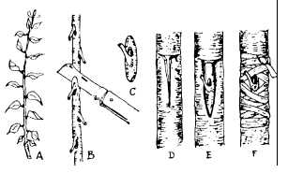
Propagation
Stem cuttings
Patent-expired samples (20-year patent)
Semi-hardwood stage preferred ( September- October)
Hardwood (November-January)
Results in less vigorous plants than grafted
T-budding
Hardy rootstock
(Rosa ‘Fortuniana’ or
R. ‘Dr. Huey’)
Healthy scion
Notes:
You can take stem cuttings during any time of year, but it’s optimal during the early greenwood stage. 6” cutting with two sets of leaves retained above soil level.
Keep moist with plastic cover or frequent spraying of water in a protected shady spot. T-budding for roses: Choose healthy, hydrated plants, You can grow your own rootstock.
For explanation: https://www.youtube.com/watch?v=siKRJSGT4sY

Slide 34
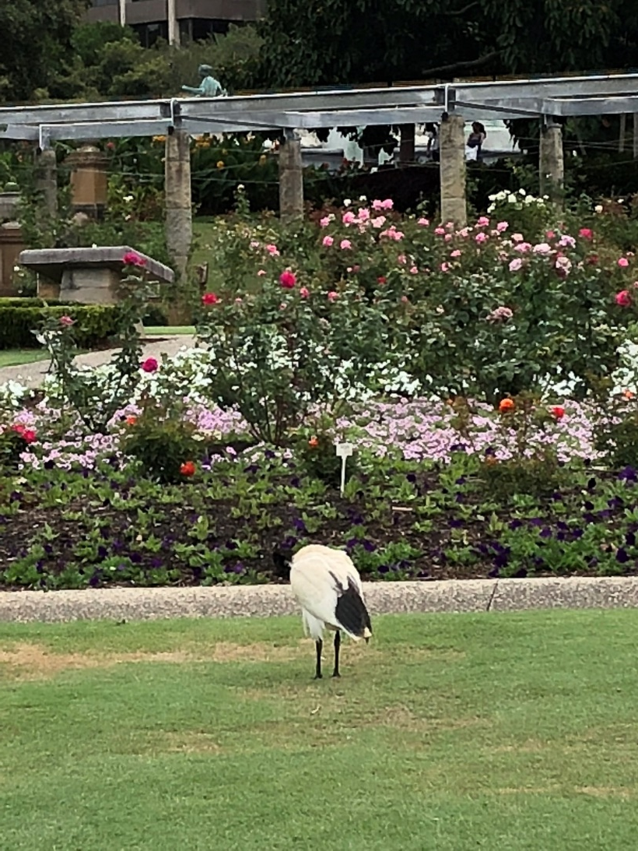
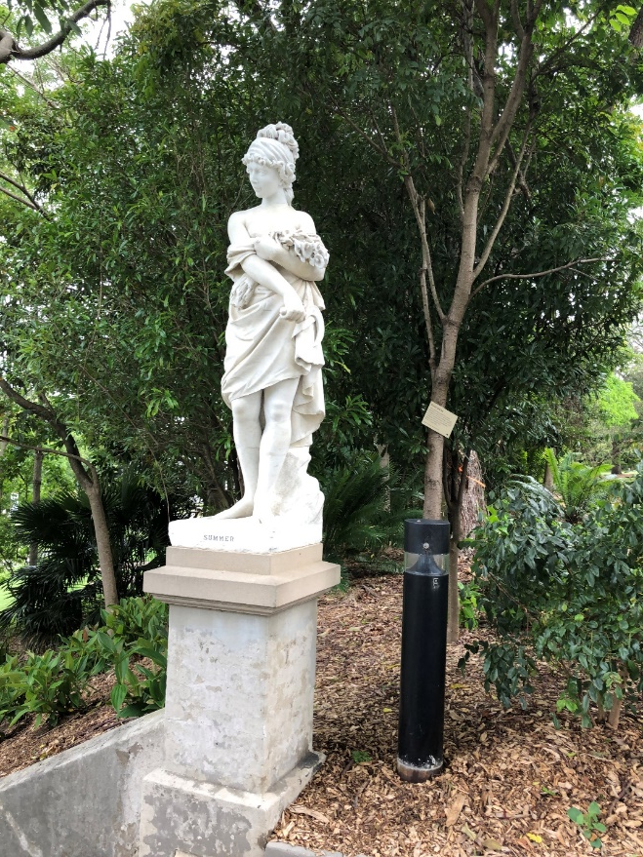
Sydney Australia’s Botanic Garden
Notes:
Garden created at Sydney’s seaside for a World’s Fair. Historic structures remain..
Ibis bird with roses arranged on hill.

Slide 35
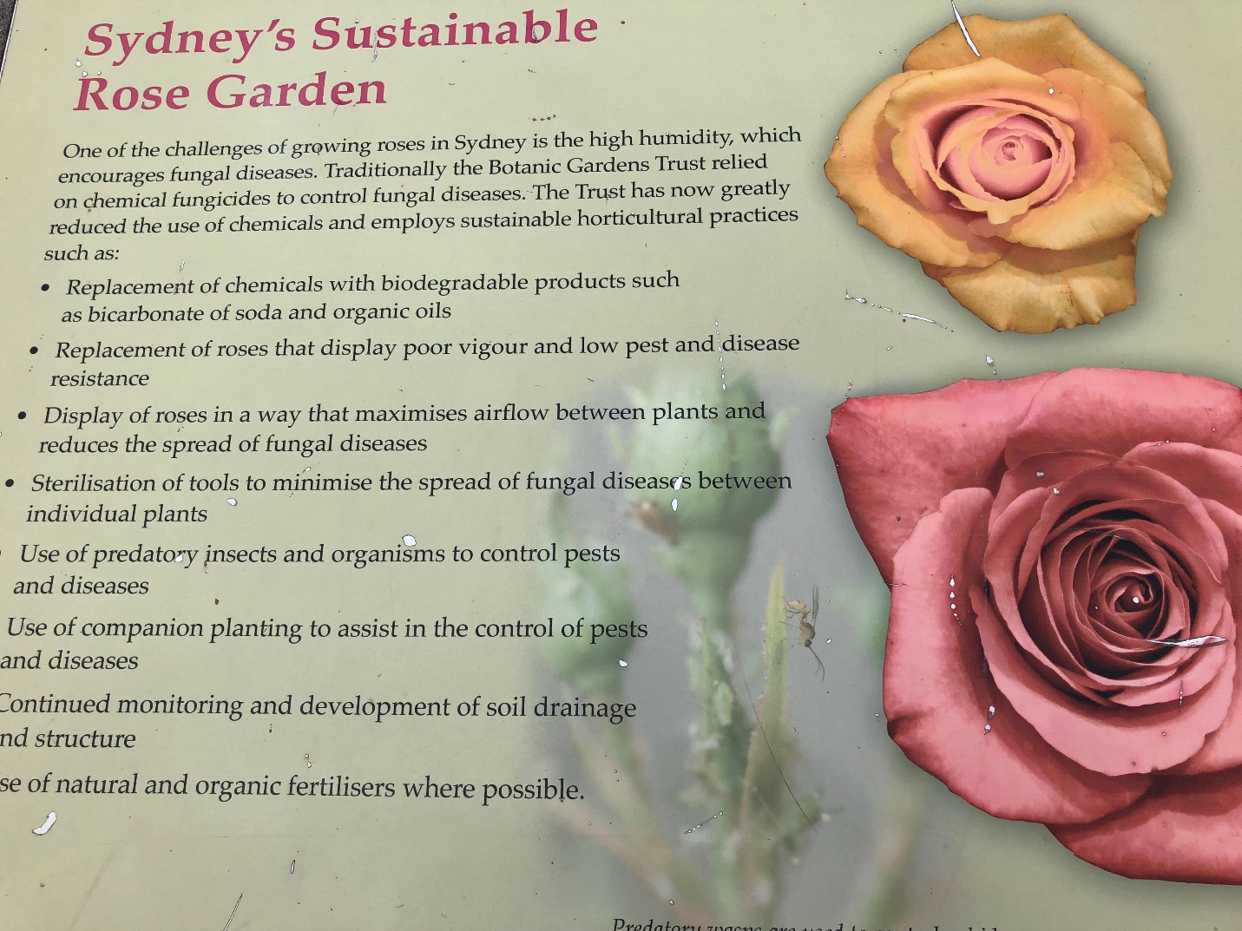
Notes:
This sign was in the historic Sydney Botanical Garden.
Note the reminder for rose culture: Reduce chemical pesticides. Use biodegradables, plant pest and disease-resistant plants, increase airflow by spacing, sterilize tools, use predatory beneficials and attract them with companion plants, monitor soil drainage and structure, natural and organic fertilizers where possible.

Slide 36
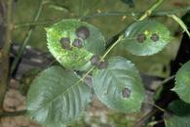
IPM Pest: Black Spot
Spots appear on upper surfaces of leaves & succulent stems, surrounded by yellow margins
-Leaves may drop
Controls:
-Leaves should be wet no more
than 7 hours
-Keep good air circulation
-prune out affected stems
-baking soda solution
(4 t. baking soda +
1 T. horticultural oil +
1 gallon water)
-Neem oil or fungicides (after rain)
Notes:
This disease can overwinter easily in the soil. So practice ground “sanitation”. Common fungus in many varieties.
http://ipm.ucanr.edu/PMG/PESTNOTES/pn7463.html

Slide 37
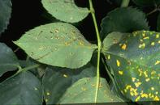
Pest: Rust
Appears in cool, moist weather
-orange pustules on underside of leaves
-discolored upper side of leaves
Controls:
-Avoid overhead watering
-Prune back severely affected
canes
-Winter leaf sanitation
-Treat with neem oil
-Preventive applications of
fungicide
Notes:
This disease can overwinter easily in the soil. So practice ground “sanitation”. Elimination requires extra effort.
http://ipm.ucanr.edu/PMG/PESTNOTES/pn7463.html

Slide 38
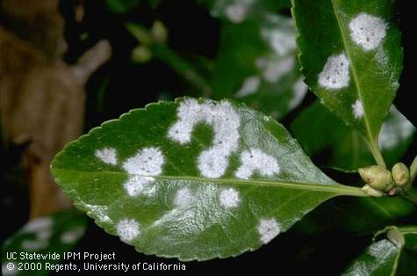
Pest: Powdery Mildew
Appears in spring on leaves. Affects new growth.
Controls:
-Prune to prevent shading & congestion
-Management
*Blast of water
*Horticultural oils
*4 tsp.baking soda per gallon
with 1% solution of
horticultural oil
*Serenade
*Sulfur fungicide
Notes:
This disease can overwinter easily in the soil. So practice ground “sanitation”.
http://ipm.ucanr.edu/PMG/PESTNOTES/pn7463.html

Slide 39
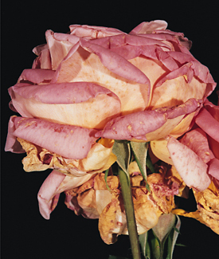
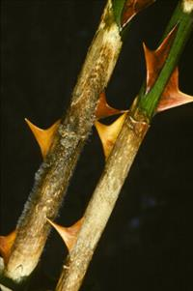
Pest: Botrytis Blight
Occurs during wet conditions at branch tips & flowers
Controls:
-Avoid crowding plants
-Prune out susceptible flowers
-Prune out branches that may harbor the fungus
(Prevention) Spray with sulfur-based
fungicide after annual pruning
Notes:
This disease can overwinter easily in the soil. So practice ground “sanitation”.
http://ipm.ucanr.edu/PMG/PESTNOTES/pn7463.html

Slide 40
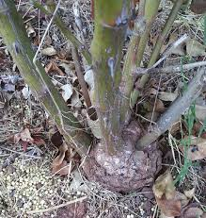
Pest: Crown Gall
Bacterial infection
Controls:
-To prevent, avoid injuring the crown
when cultivating around the rose
-Cut well below the infected growth
to remove gall
-Remove entire plant if crown is infested
Notes:
This disease can overwinter easily in the soil. So practice ground “sanitation”.
http://ipm.ucanr.edu/PMG/PESTNOTES/pn7463.html

Slide 41
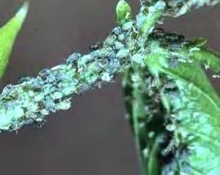
Pest: Aphids
Red, green, yellow, or black
soft-bodied insects
Black color on leaves; honeydew and sooty mold if heavy
Controls:
*Strong stream of water in a.m.
- Control ants
Insecticidal soaps
Oils (if temps < 90 degrees) at least 24 hrs. before rain)
Biological Controls:
Natural predators: lady beetles; soldier beetles; syrphid flies
Notes:
Explain why these controls are non-toxic to the environment. You usually only need to do the water spray for sufficient control.

Slide 42
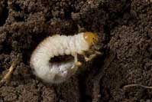
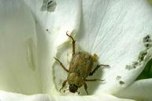
Pest: Hoplia Beetle
One generation per year
Adults feed on light colored blossoms
Controls:
Do regular hand-picking
Discard in a bucket of soapy water
Beetles are attracted to these buckets left in the garden
Biological Controls:
Natural predators: lady beetles; soldier beetles; syrphid flies
Notes:
Adults fly from egg-laying sites to rose gardens. Explain why these controls are non-toxic to the environment. Hoplia beetles are only 1/4” long. They appear between late Mar-May

Slide 43
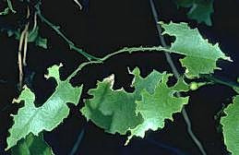
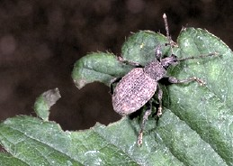
Pest: Fuller Rose Beetle
Wingless weevil, night-feeder
Adults feed on leaves or new blossoms of roses
Controls:
Use proper cultural care; don’t allow other plants’ branches to touch other branches or ground.
Apply Tanglefoot
Pick off adults
Sharp notches on leaves
S
Notes:
These beetles are 3/8” long. Explain what Tanglefoot does & refer to IPM site. Should be painted onto landscape fabric or tape.

Slide 44
Suggested Resources
Books
UC ANR Publication: California Master Gardener Handbook
UCANR Publication #21589: Healthy Roses
Online
Integrated Pest Management of Roses. Cornell University Coperative Extension
http://www.gardening.cornell.edu/factsheets/ecogardening/ipmrose.html
Roses: Diseases and Disorders: Integrated Pest Management for Home Gardeners and landscape Professionals. July, 2019. UCANR Publication 7463. http://ipm.ucanr.edu/PMG/PESTNOTES/pn7463.html
Roses in the Garden and Landscape: Cultural Practices and Weed Control.
February, 2020. UCANR Publication7465. https://ucanr.edu/sites/sjcoeh/files/309219.pdf
More
Rapp, Larry. How to Bud Roses. University of Utah Cooperative Extension. September , 2014.https://www.youtube.com/watch?v=siKRJSGT4sY

Slide 45
Poll Question:
What year was the rose declared the national flower of the United States?
  Answer: 1986
  President Ronald Reagan declared the rose as the national flower stating “We hold the rose dear as a symbol of life, love, and a dimension of beauty and eternity.”

Slide 46
Thank You!
Any Questions?
Master Gardener Hotline: (530) 889-7388
Master Gardener Website: pcmg.ucanr.edu
Evaluations, please!

