Slide 1

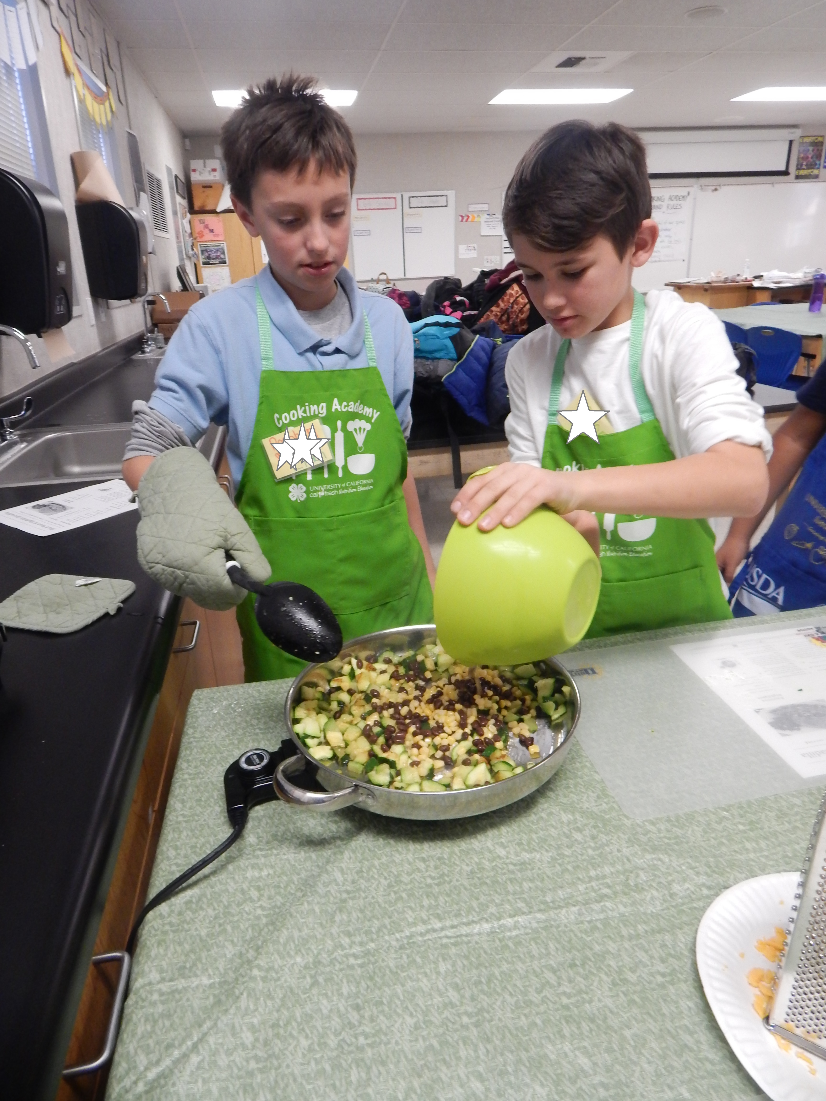




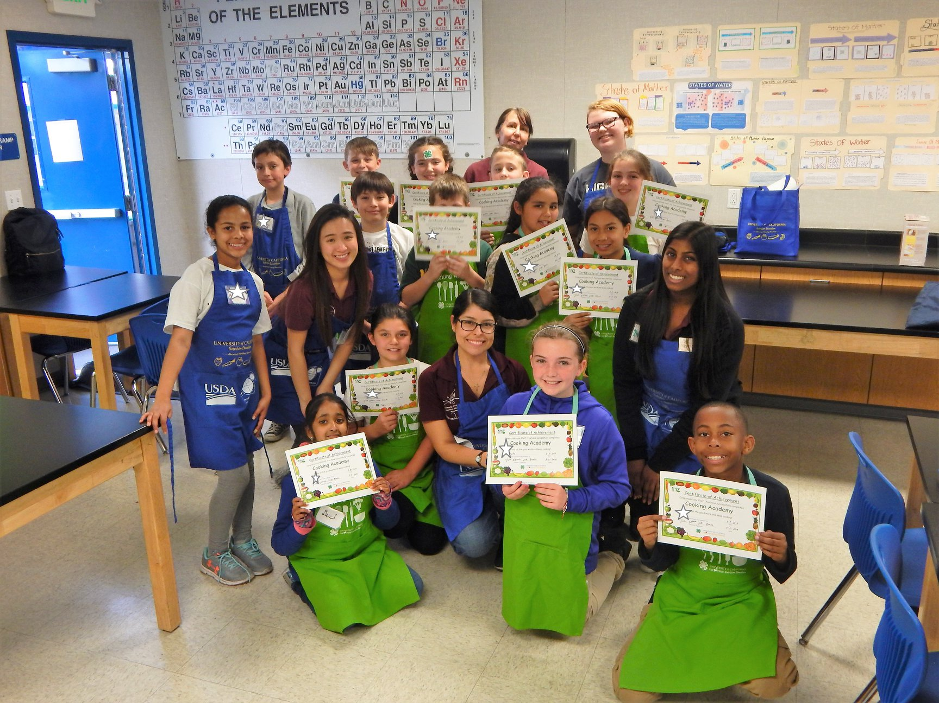
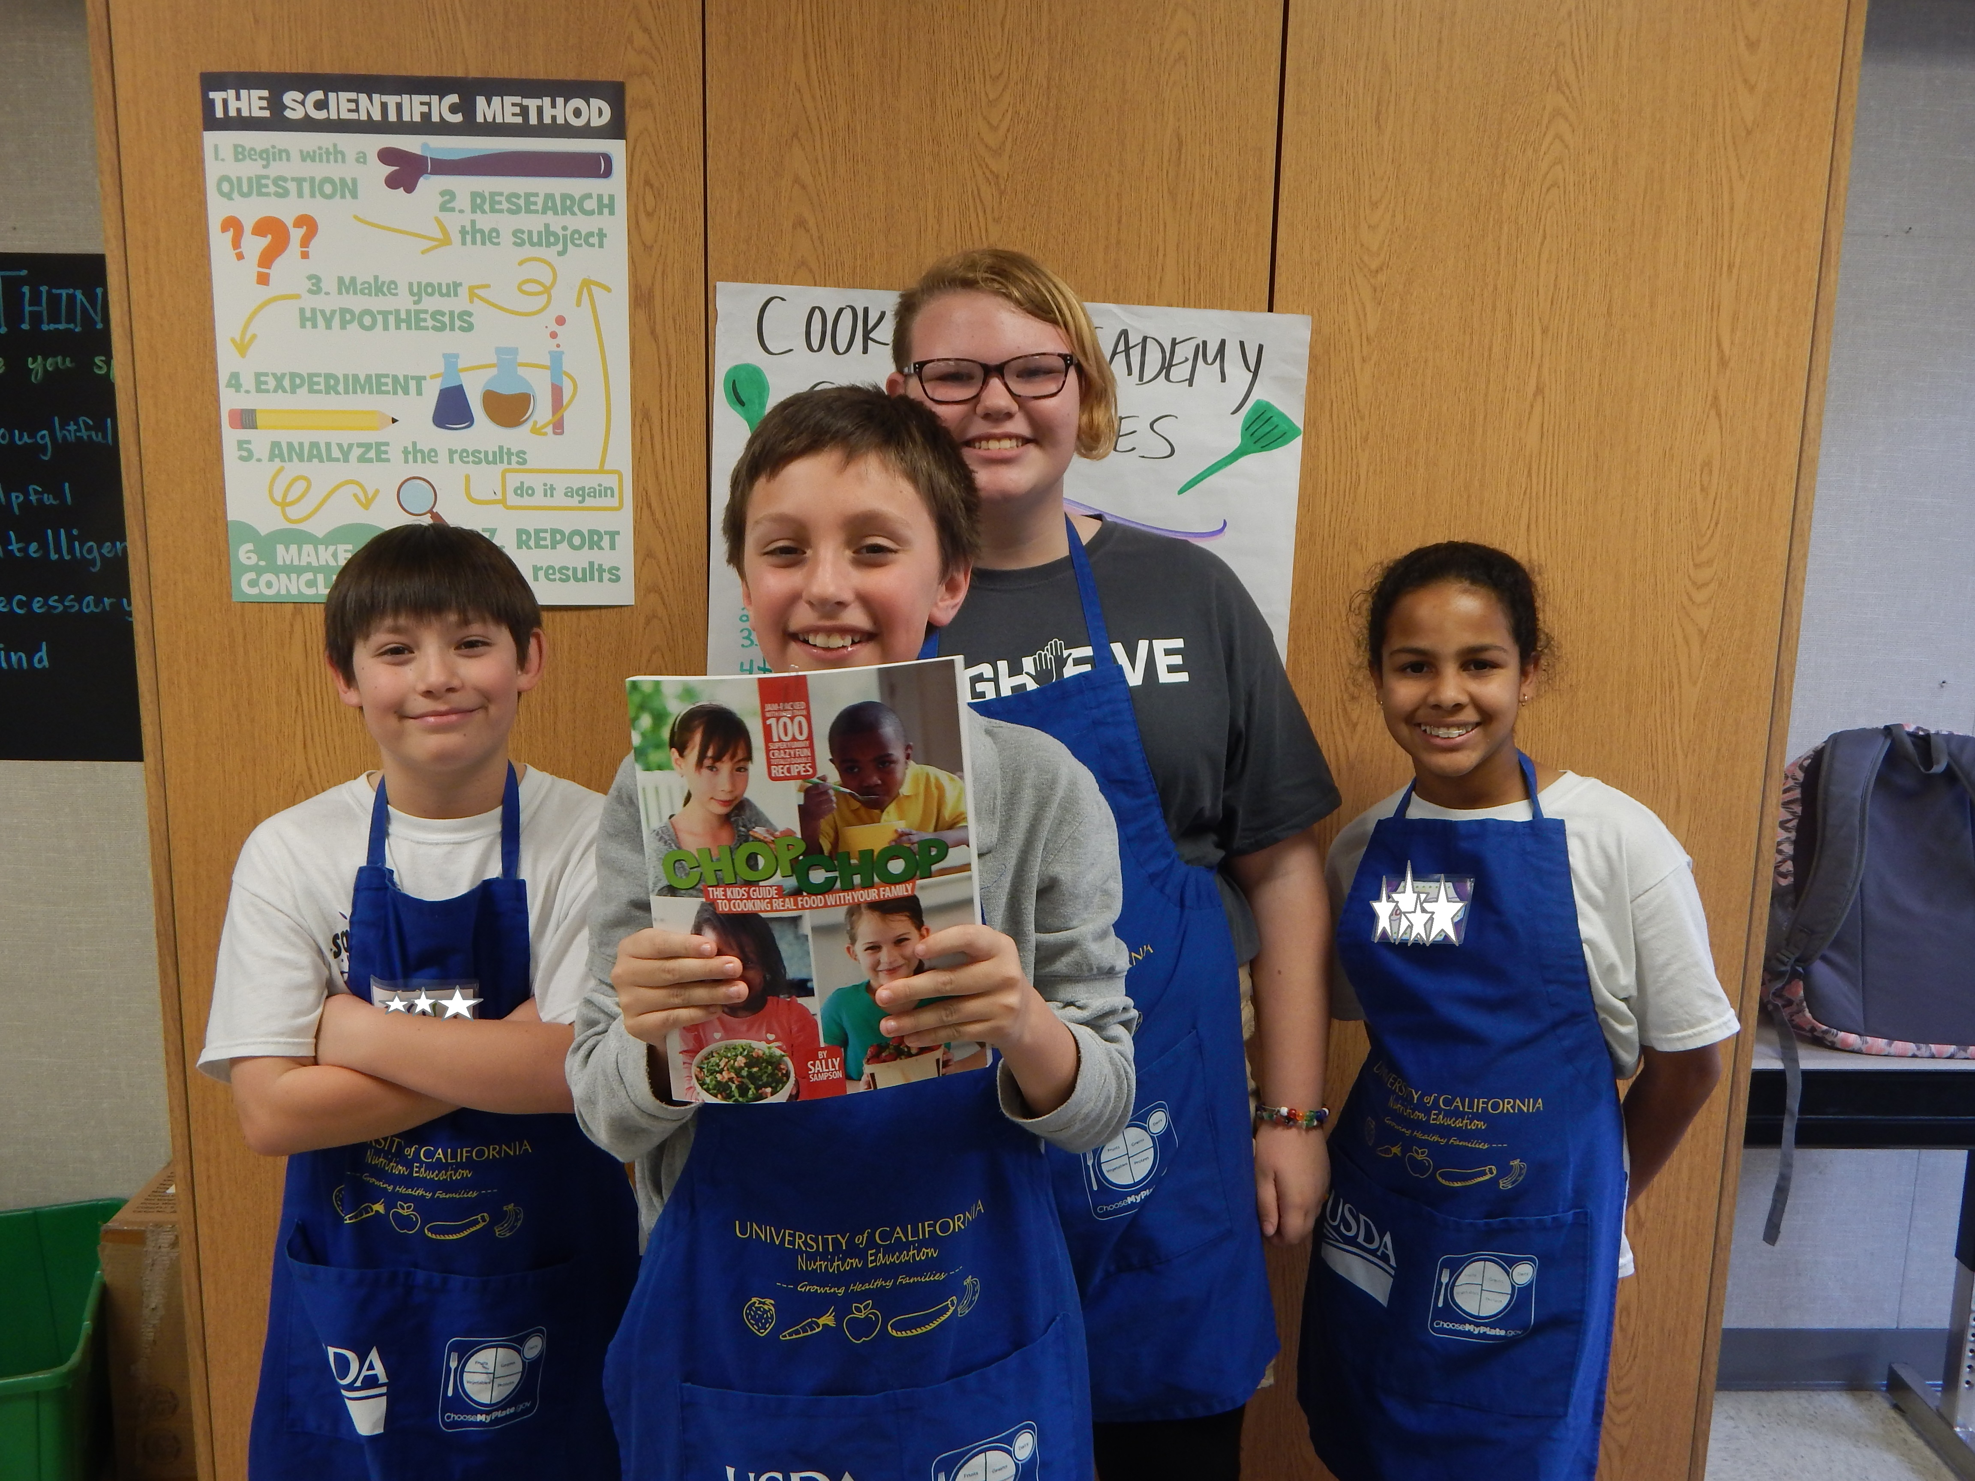
The Impact of Partnering with the 4-H Youth Development Program
to Teach Cooking in a UC-CalFresh Afterschool Program
The Need
The Work
Leadership opportunities for low-income, high risk, middle school and high school youth are few in Yolo County. Fostering youth development and leadership skills in teens helps to increase their competence, confidence, connection to their community, and their growth and development into healthy, productive adolescents and adults. Research indicates that youth that practice leadership skills report more community engagement and a stronger sense of purpose and meaning. Furthermore, teaching youth life skills like cooking and food preparation safeguards their health and well-being.
4-H & UC-CalFresh Nutrition Education Programs in Yolo County partner to implement Cooking Academy; a Teens-As-Teachers (TAT) program aimed to move from serving youth to engaging them. This TAT program leads youth through a 7 week afterschool program of nutrition education, food preparation, cooking skills, and techniques. The TAT model provides middle school youth extended learning opportunities to shadow college interns and UC CalFresh staff during lessons. Youth progressively move into teaching their peers how to successfully complete healthy recipes and hands-on nutrition education activities.
The Impact
The Future
To date, 19 Teen leaders (including middle school-age youth & young college interns) have received training to teach nutrition education, food preparation, and cooking lessons to 5th & 6th grade student chefs at several intervention sites. After training and completing the program, 100% of teen leaders felt they could successfully work with younger youth. In addition, 39% of chef participants stated that teamwork and cooperation were the best parts of the program. Further, 44% of chef participants stated they learned about healthy food choices, and 89% indicated improvement in cooking self-efficacy. Currently, 284 chefs have graduated from the program.
The strong collaboration between 4-H, UC-CalFresh, and one local implementing school has led to continued and expanded youth engagement opportunities through the formation of a Student Nutrition Advisory Council (SNAC), and created more demand for continued Cooking Academy programming. In addition, Smarter Lunchroom initiatives are being investigated at this site. Moreover, since its inception and success in Yolo County, Cooking Academy programming is now being implemented in 9 counties across the state, which continues to expand the reach, scope, and impact of the 4-H and UC-CalFresh programs.
UC-CalFresh Nutrition Education Program| Angela Asch, MA | alasch@ucanr.edu
UCCE | Marcel Horowitz, MS, CHES| mhorowitz@ucanr.edu
The mission of the California Supplemental Nutrition Assistance Program Education (SNAP-Ed) is to inspire and empower underserved Californians by promoting awareness, education and community change through diverse partnerships to result in healthy eating and active living.
California SNAP-Ed is administered by the California Department of Social Services in partnership with the California Department of Public Health, UC CalFresh Nutrition Education Program
the California Department of Aging, and Catholic Charities of California, Inc. *Funded by USDA SNAP-Ed, an equal opportunity provider and employer.

