Slide 1
Face to Face with the Authors of the Needs Assessment KIT: Challenging Questions (with a twist) and Hopefully Meaningful Answers - A Panel
American Evaluation Association
November, 2010
San Antonio, Texas
Facilitator/Panelist : James Altschuld, Ohio State University
Panelists: Jean King, University of Minnesota
Laurie Stevahn, Seattle University
Jeffry White, University of Louisiana at Lafayette
Discussants: Hsin-Ling Hung, University of North Dakota
Yi-Fang Lee, National Chi Nan University

Slide 2
Objectives/Nature of Panel
Objectives
-Learn rationale behind the Kit from those who wrote it
-Understand decisions for content/structure of book
-Question directly the authors (not vicariously)
-Interact with the them
-Challenge all of our thought processes
-Share comments/ideas with the authors/others
Structure (20-22 minutes)
-The Twist, questions from the web
-Intro of panel
-Kit editor overview
-Model underlying kit
-About books 1-3 (Editor)
-Book 4 (White)
-Book 5 (Stevahn/King)
Discussants/Facilitators (50+ minutes)
-Hung/Lee

Slide 3
The Twist - Questions sent to TIG and for you to think about
Why a Kit, why not a duck?
Content excluded or included – why?
Why aren’t there more examples of full-blown NAs?
What might be the best or good ways to use the KIT?
What stands out as new in NA?
What might be missing?
NA and asset/capacity building relationships, overlaps, differences, etc?
What are a few highlight features?
Who would be the prime and secondary users of the Kit?
Why is a NAC, Needs Assessment Committee, so prominent?
What about shortcuts to doing an assessment?
A host of other questions from your creativity/imagination

Slide 4
The Kit and Participants
Needs Assessment Kit (Ed., J. W. Altschuld) SAGE is the 2010 publisher of the 5 volume Kit.
Books in Order
1. An Overview J. W. Altschuld (The Ohio State University) & D. D. Kumar (Florida Atlantic University)
2. Phase 1: Getting Started J. W. Altschuld & J. N. Eastmond, Jr. (Utah State University)
3. Phase 2: Collecting Data J. W. Altschuld
4. Analysis and Prioritization J. W. Altschuld & J. L. White (University of Louisiana at Lafayette)
5. Phase 3: Taking Action for Change Laurie Stevahn (Seattle University) & Jean King (University of Minnesota)
Discussants Hsin-Ling Hung (University of North Dakota)
Yi-Fang Lee (National Chi Nan University)
Note: Some needs related work by Hung & Lee are prominently cited in the books in the Kit.

Slide 5
Definitions & Issues
Need: the measurable discrepancy between “what is” or the present state of affairs in regard to the group and situation of interest and the “what should be” or desired state of affairs (Witkin & Altschuld, 1995).
Issues: measurable discrepancy is the key
-needs not solutions (premature closure on solutions)
-verb vs. noun concept (misuse of the word)
-‘desired’, ‘likely to occur’, ‘ought to occur’, etc.
-wish and want lists
-many types of needs

Slide 6
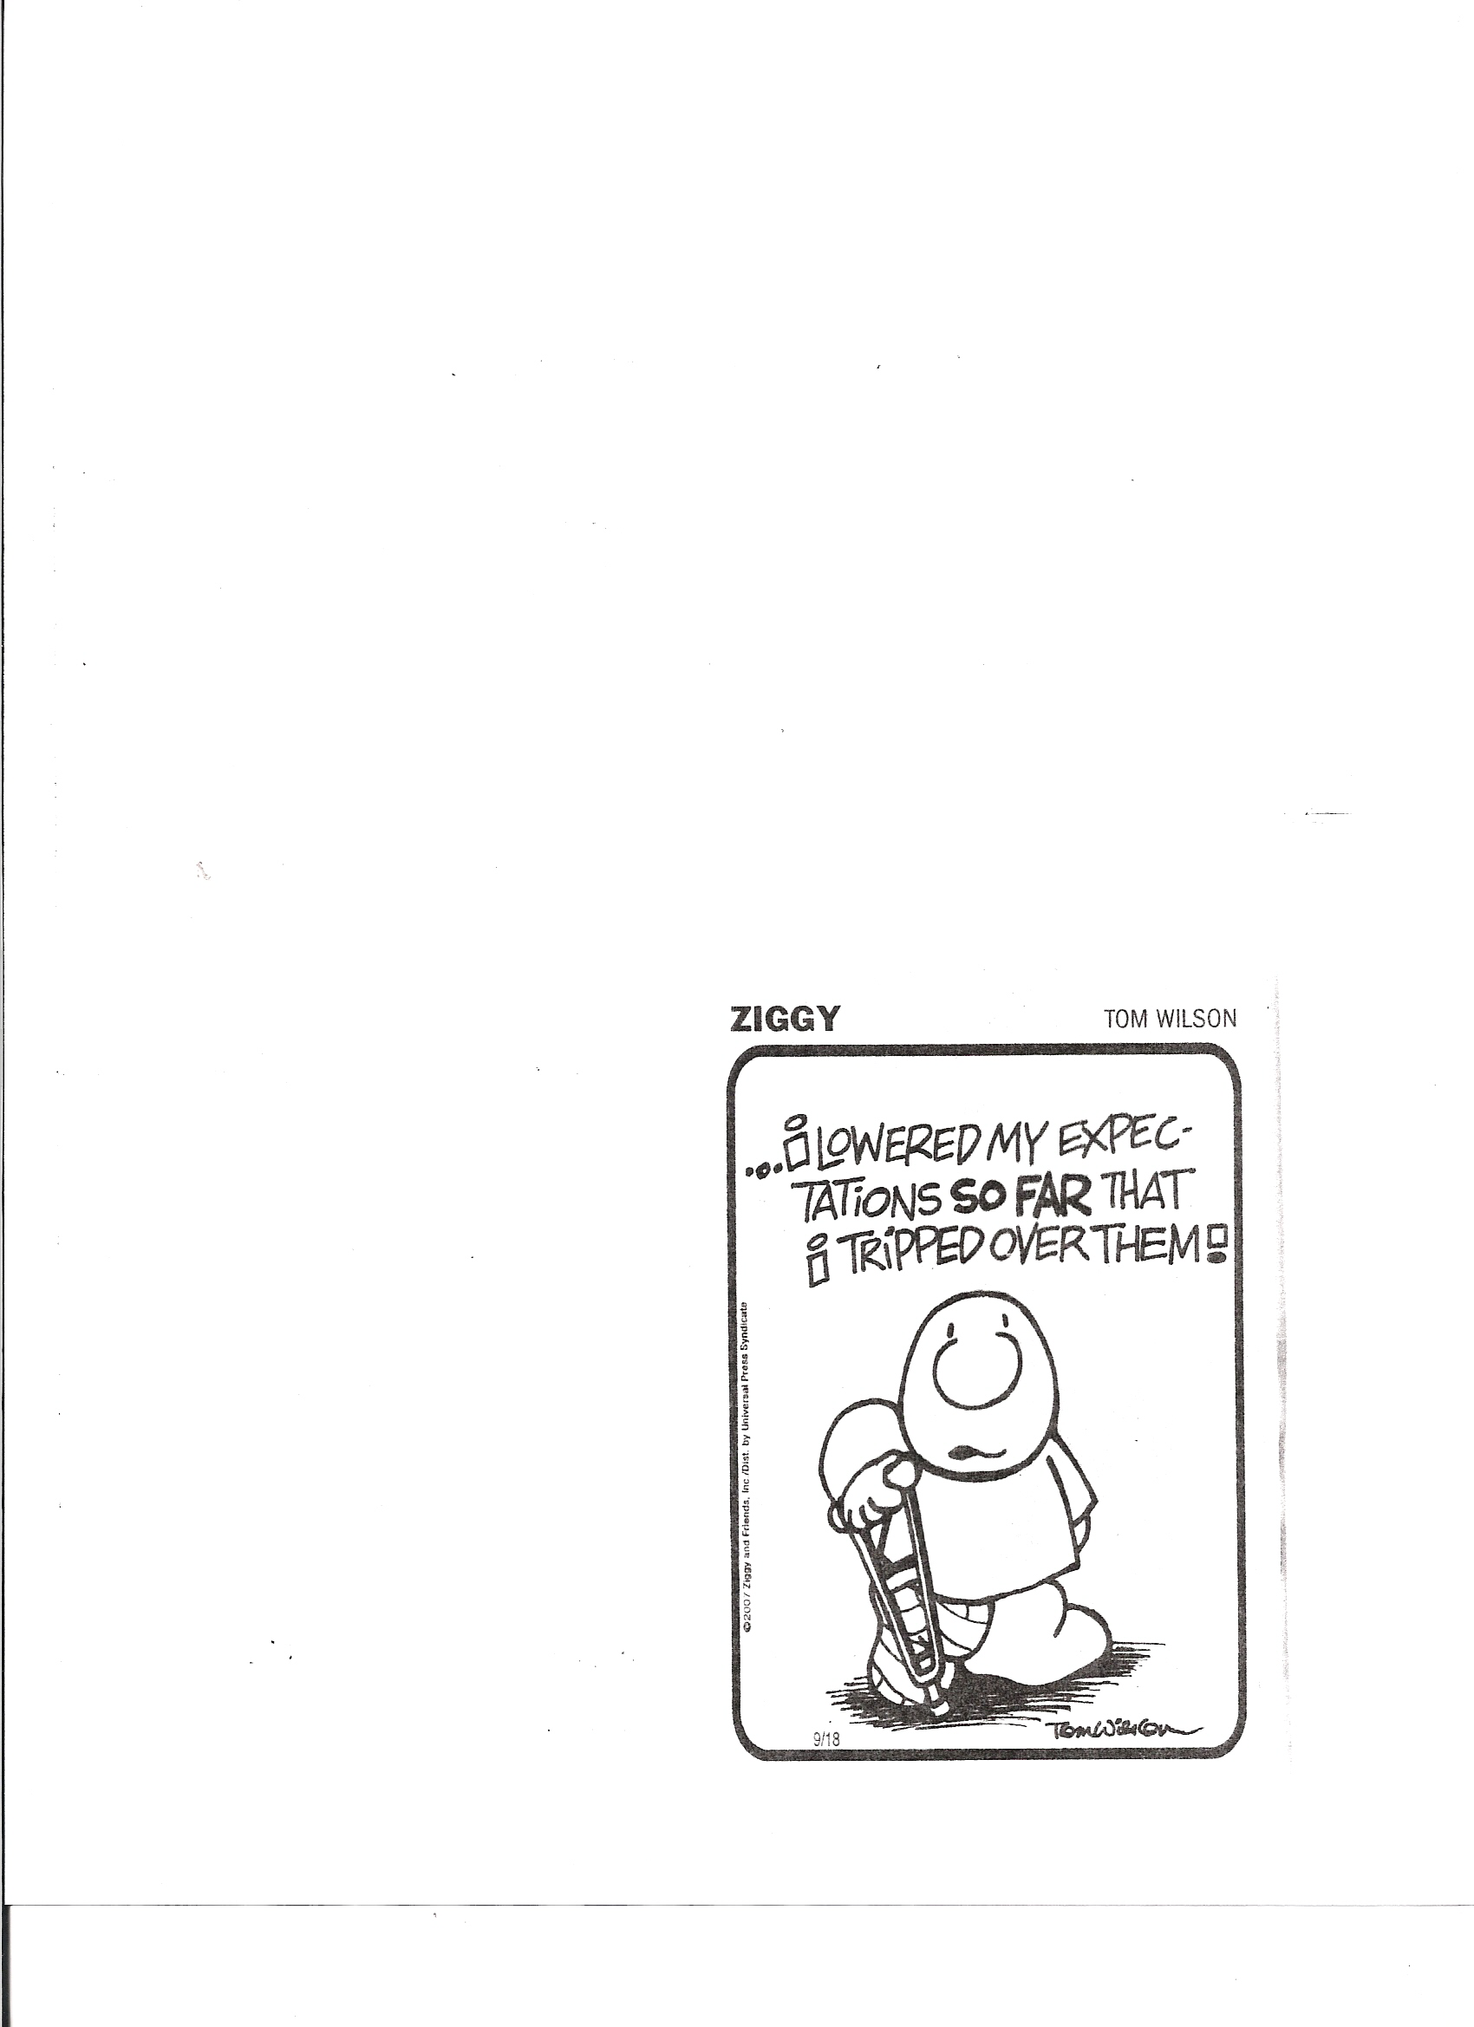
More Terms and Concepts
NA is a systematic set of procedures undertaken for the purpose of setting needs-based priorities and making decisions about organizational improvement and allocation of resources (Witkin & Altschuld, 1995).
Issues
-context for the NA
-readiness for an assessment
-NA is an organizational activity
-political aspects to the activity
-systems concept and how to think about it
Lots of subtle aspects of need and NA
Examples
Types

Slide 7
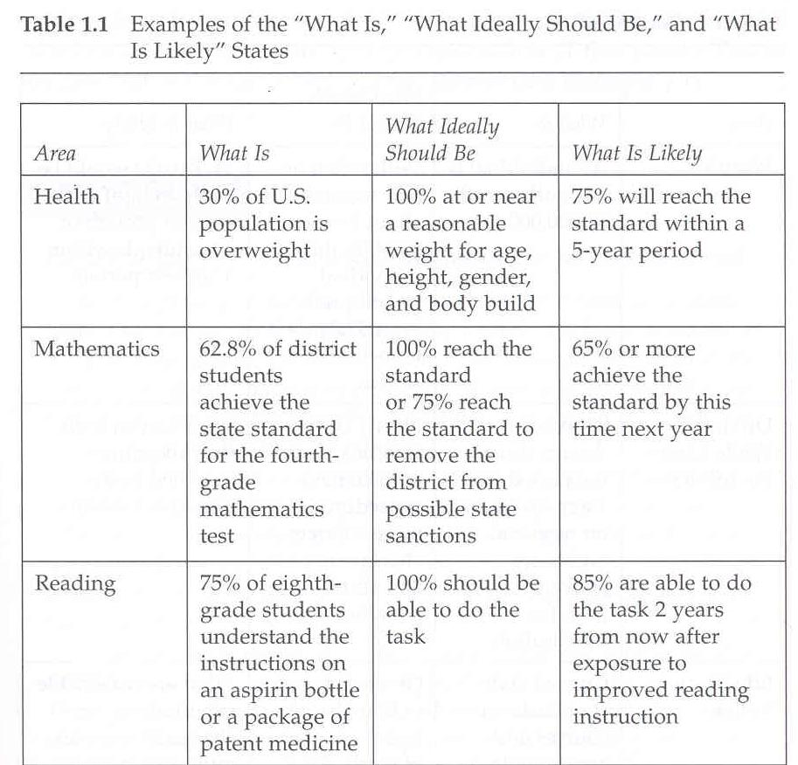

Slide 8

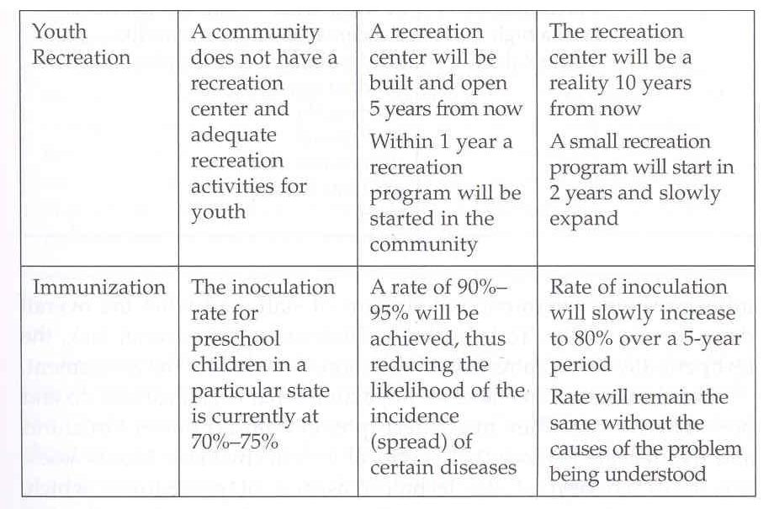

Slide 9
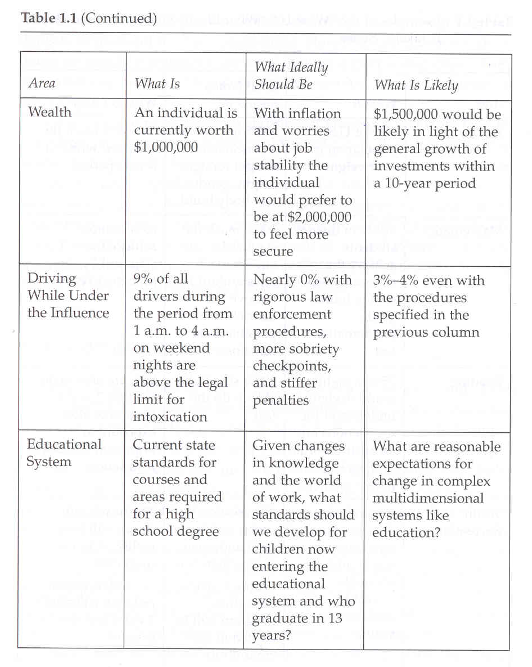
Source: from Needs assessment kit 1, by J. W. Altschuld & D. D. Kumar , 2010, Thousand Oaks, CA: Sage.

Slide 10
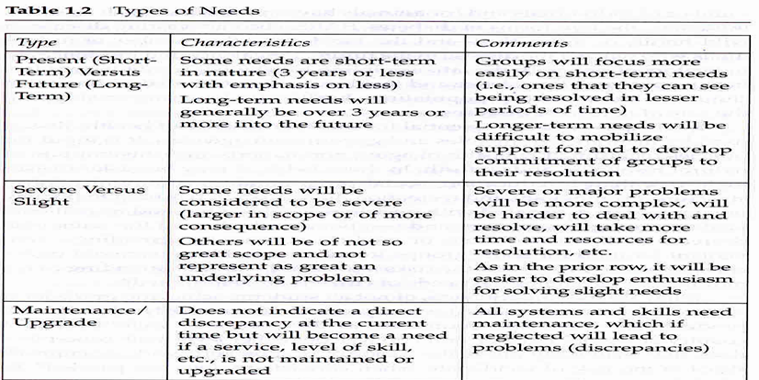

Slide 11
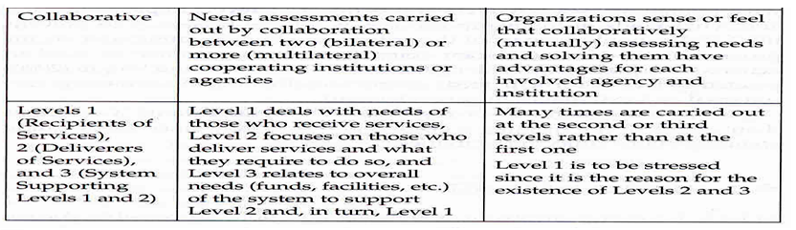

Slide 12
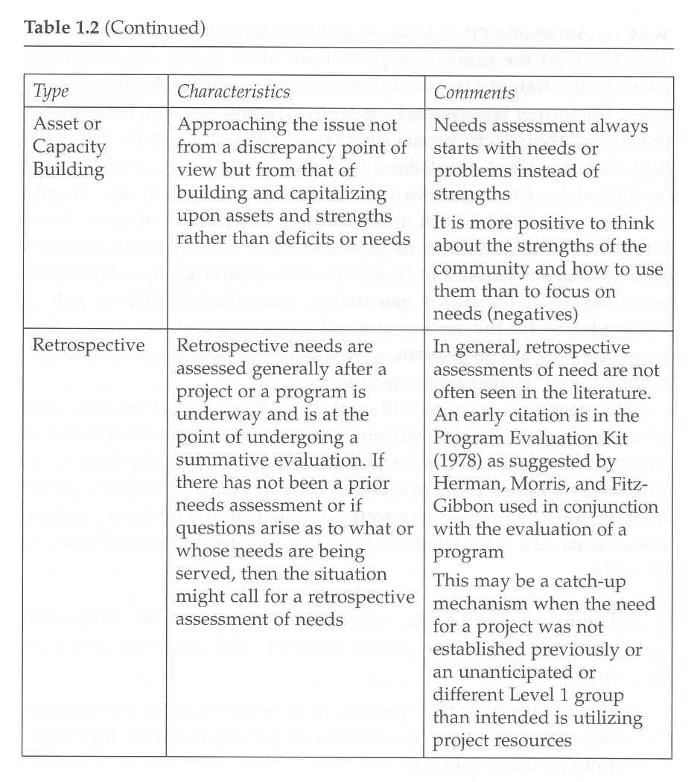
Source: from Needs assessment kit 1, by J. W. Altschuld & D. D. Kumar , 2010, Thousand Oaks, CA: Sage.

Slide 13
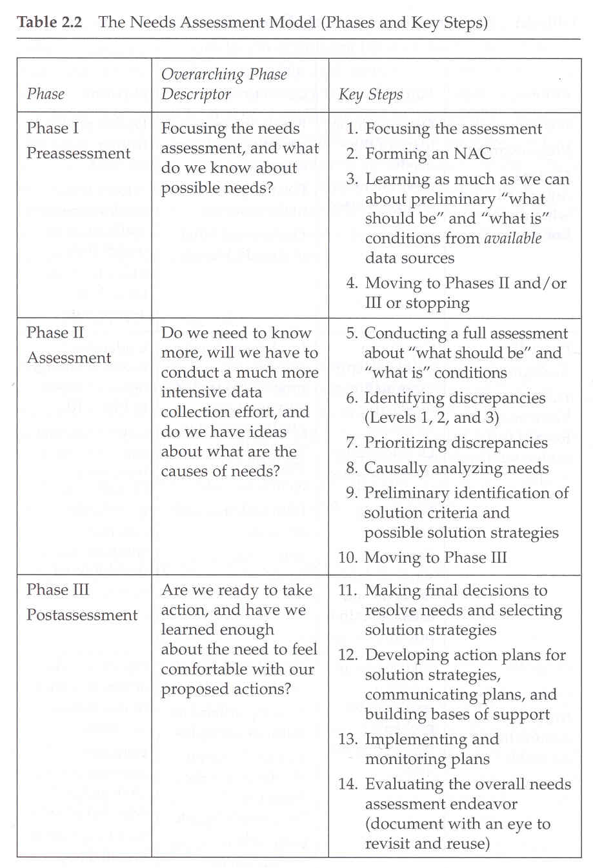
Source: from Needs assessment kit 1, by J. W. Altschuld & D. D. Kumar , 2010, Thousand Oaks, CA: Sage.

Slide 14

Putting it Together in the Kit
Book 1 – Definitions, terms, description of steps/Phases 1, 2, 3
Book 2 – Phase 1, getting started from vague beginnings, sources, collaborative NAs, etc
Book 3 – Phase 2, collecting data (emphasis on 5 key methods)
Book 4, Phase 2, analyzing and prioritizing mixed methods data (the data puzzle)
Book 5, Phase 3, transforming the NA into organizational action (making it happen)
“Like in music, expansion of and variations on a theme.”

Slide 15
Book 4 Outline
Chapter 1: The Data and Prioritization Mess: What Are You Getting Into?
The data side of the equation
How complicated can it get?
Priority setting: The other side of things.
Orientation to analysis & prioritization
Data analysis & prioritization approaches
Chapter 2: Dealing with Qualitative Needs Data
Features of qualitative data that guide analysis
Structuring in data analysis
After analyzing the data, now what?
Chapter 3: Coping with Quantitative Needs Data
Survey data analysis
Pre-analysis data checks
Data analysis questions
Descriptive statistics
Psychometrics
Inferential statistics
Discrepancy data
Correlation & regression in NA data
Other quantitative data
Conclusions from numerical data

Slide 16
Book 4 cont.
Chapter 4: Getting the results together for prioritization
First considerations
Weighing responses for prioritization
Portraying the data
Short summaries per source
Samples of short summaries
Collated summary across sources
Chapter 5: Prioritizing identified needs
Steps in prioritization
#1: Make sure formal prioritizing procedure desirable course
#2: Determine criteria for prioritizing needs
#3: Choosing a prioritizing method
#4: Prioritizing
  4a: A simple approach
  4b: Using multiple criteria a little more complex
  4c: Linking prioritization to strategic planning
Chapter 6: Some nagging after-thoughts & caveats
Why this chapter?
Problems in needs assessment data and sources
In light of these problems what can the needs assessor do?
Reiterating a role for needs assessors

Slide 17
The Needs Assessment
Jigsaw Data Puzzle
Current Condition
Need
Desired Condition
Discrepancy

Slide 18
Summarizing Data & Needs Funneling into Priorities
Initial thinking about focus of NA
Start with broad set of needs Phase I
Collect/sort through what is most available data
& information about beginning set of needs
Examine data & come to a decision to
more fully explore selected set of needs
Collect new data about smaller
set of potential needs (Phase II)
Analyze/collate data into coherent picture
of needs for Level 1, 2, & 3 as applicable
Causal analyze needs (if needed) &
determine tentative priorities of
smaller subset of needs
More formally prioritize a now
smaller set of needs (Phase 3)
Develop action plans for
prioritized needs
Develop core set of prioritized
needs & action plans

Slide 19
Guidelines for Treating Needs Data from Multiple Sources
Guideline | Principle | Discussion
Data fits together | Data from all sources is in agreement regarding a need | Best of all situations – the data provides corroboration
Data mostly fits | Data from key sources is in agreement with no contradictory evidence | Fairly good situation especially since there is no contradictory evidence
Data points to different needs | Either different methods or constituencies are indicating diverse needs but not ones necessarily in opposition to each other | Not as desirable as above but not necessarily bad if there are logical reasons for differences or one source is better implemented than another
Data in opposition | Data are contradictory to a need e.g., parents and teachers radically disagreeing on emphases in science textbooks | Worst case especially if the collection methods are all well implemented – probably will require obtaining more data or more investigation

Slide 20
Ways of Presenting Needs Data from Multiple Sources
Features | Goal Attainment Scaling (GAS) | Short Summaries per Source | Collated Summary across Sources
Outcome | One page table that is very good for decision-making | Set of short (1-2 page) sheets per each major source of data or in some instances per subgroup/constituency | A large somewhat complex table generated from the one page summaries
Ease of construction | Relatively easy | Relatively easy although more interpretation and write-up of the data is required | A little more difficult but still fairly easy but table will take some time to prepare
Abstraction from original data | Large degree of abstraction | Closest to original source, preserves much of the meaning in and sense of the data | Some abstraction but a degree of the original data is maintained but not as much as in the short summaries
Ease of use | Very good in this regard - information is available at a glance | Generally good but takes more reading and interpretation especially if there are contradictory indications for a need | In between GAS table and the use of short summaries
Cautions | While some respects GAS best way to go, much detail and feel for context of the data will disappear by going to a common metric | The best set of information but this approach is confounded by the fact that more and more detail can make decision-making somewhat harder to accomplish | Although this is a collation of the short summaries, it can lead to a fairly heavy one or two page table with perhaps some difficulty in use for decision-making
Overall comments | The loss of the context and meaning of especially the qualitative data may be too great, it all depends on the decisions to be made and the nature of the organizational milieu | It may be wise at times to deal with more of the subtleties in the data for important budget and action choices will have to be made | In some respects the best option because a portion of the flavor of the data is retained Remember the table may be more difficult to construct

Slide 21

Book 5
NA Phase III: Taking Action for Change
________________________________________________________________________________________________________________________________________
It’s a journey . . .
Chapter 1: Mapping the Road Less Traveled
Chapter 2: Gearing Up / Nuts and Bolts
Chapter 3: Collaborating / Action Plan
Chapter 4: Weathering Storms / Conflict
Chapter 5: Responding to Roadblocks
Chapter 6: Learning from the Expedition

Slide 22
Chapter 1: The Map – Needs Assessment Phase III
Purposes | Steps | Decisions | Questions
Prioritize solution strategies derived from identified needs | 11. Make final decisions on resolving needs and selecting solution strategies | Determining needs-based priorities | Should we take action (at all)?
 |  | Identifying criteria and standards | How will we know which solution strategies are the best?
 |  | Considering alternative solution strategies | What action choices are possible?
Create and implement an action plan
 | 12. Create and communicate an action plan; build commitment/support for the plan | Developing the action plan | Who needs to be involved? What’s the best plan of action?
 |  | Communicating the action plan | Who needs to know? When? In what format?
 |  | Building support for the action plan | How can we increase commitment to the action plan?
 | 13. Implement and monitor the plan | Implementing the action plan | What tasks must be completed to implement the action plan? Who will do them? When?
Document the implementation and evaluate the entire NA |  | Documenting the implementation | What are we doing? How are we keeping track of what is happening? Are people doing what they said they would?
 |  | Monitoring the implementation | What progress are we making on the action plan?
 | 14. Evaluate and document the entire NA for future endeavors | Evaluating the NA (formative) | How are we doing (as the process unfolds)?
 |  | Evaluating the NA (summative) | How did we do (once the process is completed)?
 |  | Learning from the NA experience | What did we learn?

Slide 23
Chapter 2: Nuts and Bolts – Make Transition Decisions . . .
with change in mind!
  g Involvement
  g Logistics
  g Communication
  g Information Management

Slide 24
Chapter 3: Collaborating for Change
A “double dozen” procedures to . . .
A. Promote positive interpersonal relations
B. Develop shared understandings
C. Prioritize and finalize decisions
D. Assess progress
Purpose Procedure | A. | B. | C. | D.
#1–#9 | X |  |  | X
#10–#17 |  | X |  | X
#18–#24 |  |  | X | X

Slide 25
Chapter 4: Conflict – Weathering Interpersonal Storms
Dual Concerns Theory
High RELATIONSHIPS | Smoothing (Appease) |  |  | Cooperative Problem Solving (Mutually Resolve)
 |  | Compromising ( 50-50)
 | Withdrawing (Avoid) |  |  | Forcing (Conquer)
Low High GOALS © 1975 David W. Johnson

Slide 26
Chapter 5: Roadblocks – Individual and Organizational
_____________________________________________________________________________________________________________
Individual Attitude/Aptitude Matrix
© 2004 Jean A. King
Aptitude Attitude |  | Able to do the work?
 |  | Yes | No
Willing to do the work? | Yes | Willing and able | Willing but unable
 | No | Unwilling but able | Unwilling and unable

Slide 27
Chapter 6: Learning – Evaluating the Entire NA
________________________________________________________________________________________________________________
Summary of Overarching Questions
© 1995 Jean A. King
Question | Time in the NA Process | Evaluative Terms
How are we doing? | During, throughout (Pre, NA, and Post) | Monitoring, Formative
How did we do? | After, at the end (Post) | Summative
What did we learn? | Throughout, but especially at the end (Pre, NA, and Post) | Reflective

Slide 28

Epilogue
Stevahn’s Tips
for Traveling
_______________________________________________________
■Pack light
■Carry the right currency
■Stay alert
■Make friends
King’s Rules
for Living
_______________________________________________________
■Never panic
■Solve the problem
■Keep the big picture in mind
■Be nice

