Slide 1

  What should be measured to
  demonstrate the value of UC ANR programs?
EIPD SI Conference, April 27, 2012
Katherine Webb-Martinez
& Kim Rodrigues

Slide 2
  Using Science to Find Solutions
  Performance Measures
Activities:
# Research
Projects,
Workshops,
Field days,
Presentations,
Interviews,
etc.
Outputs/Products:
# New fundamental
or applied
knowledge,
Patents,
Publications,
Extension
Newsletters,
Websites,
Videos,
Manuals,
etc.
Outcomes:
Clientele
Changes in
Knowledge,
Attitude,
Skill,
Behavior,
&
Economic,
Environmental,
Social/Health
Condition Changes

Slide 3
Why We Measure Outcomes
To ensure accountability
To secure funding
To improve programs
To influence policy
To promote the program
“I think we owe this [accountability] to parents, students, legislators, taxpayers”
– UC President Mark Yudof at UC ANR Statewide Conference 2009

Slide 4
How ANR Uses Outcomes
Government
  Advocacy materials
  County reports
  Federal Annual Report & Plan of Work
  Ad hoc UC reports
General public
  Media stories

Slide 5
“Measure what you value and others will value what you measure”
– John Bare, The Arthur M. Blank Family foundation

Slide 6
How You Use Outcomes
Merit and promotion process
Reporting requirements
UC Delivers & other advocacy
Other?

Slide 7
What to measure?
  What effect did your publications have?
  Was your work adapted and extended by others?
  What did participants learn?
  What attitudes changed?
  What skills were increased?
  What practices/behavior changed?
  How many people changed?
  Were policies changed as a result?
  How much money was saved?
  What were the final outcomes?
What private value to individuals turns into public value?
What demonstrates public value?
Notes:
7
7

Slide 8
Outcome Criteria
Important
  Does the outcome present meaningful change?
  Is this improvement valued by key stakeholders, including you, program participants, and the public?
Reasonable
  Is the outcome connected to the program activities?
  Is the outcome achievable given the resources, the situation?
Realistic
  Can we realistically measure it?

Slide 9
Challenges Measuring Outcomes
For Individual Academics:
Accountability trends
Lack of resources for evaluation (time, training, etc.)
Deciding what and how to measure
Multiple, different reporting requirements and formats
For ANR:
Accountability trends
Data issues
Diverse training needs
Communicating our statewide value

Slide 10
Individual Advisor EIPD Outcomes (DANRIS-X)
112 horticultural crop producers implement at least three low impact pest management practices
500 artichoke growers in Castroville, CA area incorporated fencing to exclude voles from artichoke fields based on our suggestion and initial study findings. This should greatly reduce rodenticide applications.
4 growers and consultants are now using management plans in a few areas for control of white rot in fields known to be infested with success. Previously, the management strategy was to avoid planting onions or garlic on infested soil, but with the spread of this disease to a large percentage of some growers property, options for garlic or onions is limited.

Slide 11
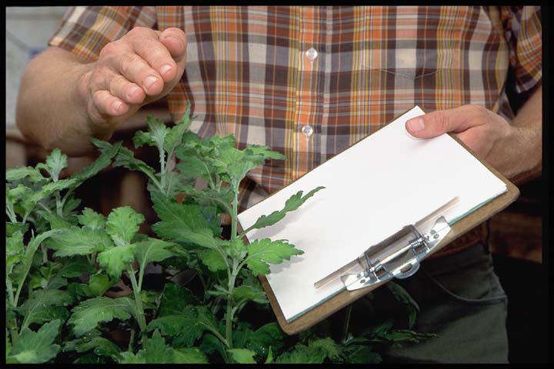
EIPD Federal Planned Program
Aggregated Statewide Outcome 10 1
5738 Farm owner/operators and managers, and Pest Control Advisors and other allied industry professionals, participating in pest management education programs, adopted recommended integrated pest management practices.

Slide 12

Outcomes Evaluation Opportunity:
Be more efficient and effective
Proposal
Define and agree upon
UC ANR programmatic outcomes and indicators
for our main program areas.

Slide 13
Rationale for Developing Statewide Outcomes
  Promote statewide, big picture Strategic Initiative thinking
  Focus Program Team effort
  Streamline academic reporting
  Improve outcomes data collected
Address changing federal reporting requirements

Slide 14
Theme: Invasive Species Prevention & Control
Yellow Star Thistle Program & Multistate Invasive Species Research Project
Issue
Invasive species causing loss of rangeland and ecosystem damage
Intermediate Outcomes
Ranchers and managers gain knowledge of control yellow star
Ranchers and mangers adopt recommended control practices
Condition Outcomes
Ranchers gain improved return for intermountain alfalfa
Outputs/
Products
New techniques for control of yellow star thistle
Research pubs and newsletter on prevention and control methods for 3 invasive species
Activity
Develop workshops for ranchers and managers on yellow star thistle control
Research on prevention and control for 3 invasive species
Improved health of ecosystem and native species

Slide 15
EIPD Condition Change Outcomes
WHO | WHAT
Farm and nursery owner/operators, participating in pest and disease management education programs, | used recommended pest and disease management practices, which resulted in reduced crop losses and thus more economic gain.

Slide 16
EIPD Learning Outcomes –
Knowledge Change
WHAT
gained knowledge of Integrated Pest Management strategies and techniques.
gained knowledge of pesticide and pharmaceutical efficacy and optimal use.
gained knowledge of prevention, detection and treatment practices for invasive species.
gained knowledge on how to recognize and identify pests and diseases.

Slide 17
EIPD Learning Outcomes –
Attitude & Skill Change
WHAT
were more likely to try out or adopt recommended strategies and techniques for invasive species and pest management.
gained boat inspection skills to identify invasive species to reduce risks of transporting invasive species on boat hulls.

Slide 18
EIPD Behavior Change Outcomes
WHAT
adopted recommended integrated pest management practices.
adopted treatment practices for invasive species.
adopted pesticide and pharmaceutical efficacy and optimal use practices.

Slide 19
NIFA National Outcome and Indicators
OUTCOME: More sustainable, diverse, and resilient food systems across scales.
Number of new diagnostic systems analyzing plant and animal pests and diseases.
[Diagnostic systems refer to, among other things: labs, networks, procedures, access points. We have used the term “available” because maintaining capacity is just as important as developing and deploying new capacity. So, this indicator and the next one refer to both existing and recently deployed diagnostics.]
2. Number of new diagnostic technologies available for plant and animal pests and diseases.
The intent here is not to count individual pieces of equipment or devices, but to enumerate technologies that add to the diagnostic capacity.]
3. Number of first detectors trained in early detection and rapid response of plant pests, animal pests and diseases.

Slide 20
Proposed Process
Work with Program Teams
Determine interested members to be part of committee
During Strategic Initiative Conferences and/or Program Teams meetings

Slide 21
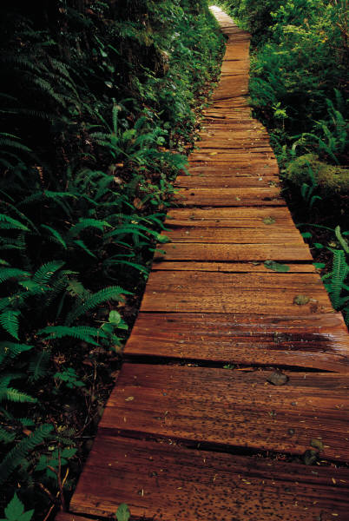
Your input on next steps….
Do you agree that statewide outcomes would be useful? For more than federal reporting?
Are Program Teams the right mechanism? If not, then what?

Slide 22
Table group activity
What should we measure to demonstrate the value of EIPD outcomes statewide?
EIPD Priority Areas:
Exclusion of pests & pathogens
Emerging & re-emerging pests and diseases
Integrated management

Slide 23
Session Wrap-up
Interested? Talk to us.
New resource: www.ucanr.org/sites/CEprogramevaluation
Thank you!

