Slide 1
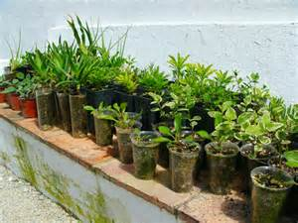
PROPAGATING PLANTS WITH STEM CUTTINGS
Mariposa Master Gardener
Helen Willoughby-Peck

Slide 2
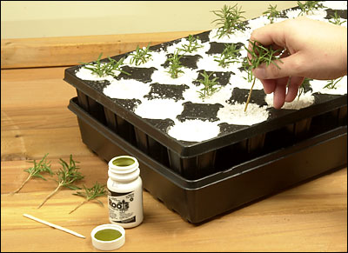
Cloning or Asexual
After seeds, stem cuttings are the most widely used form of plant propagation

Slide 3
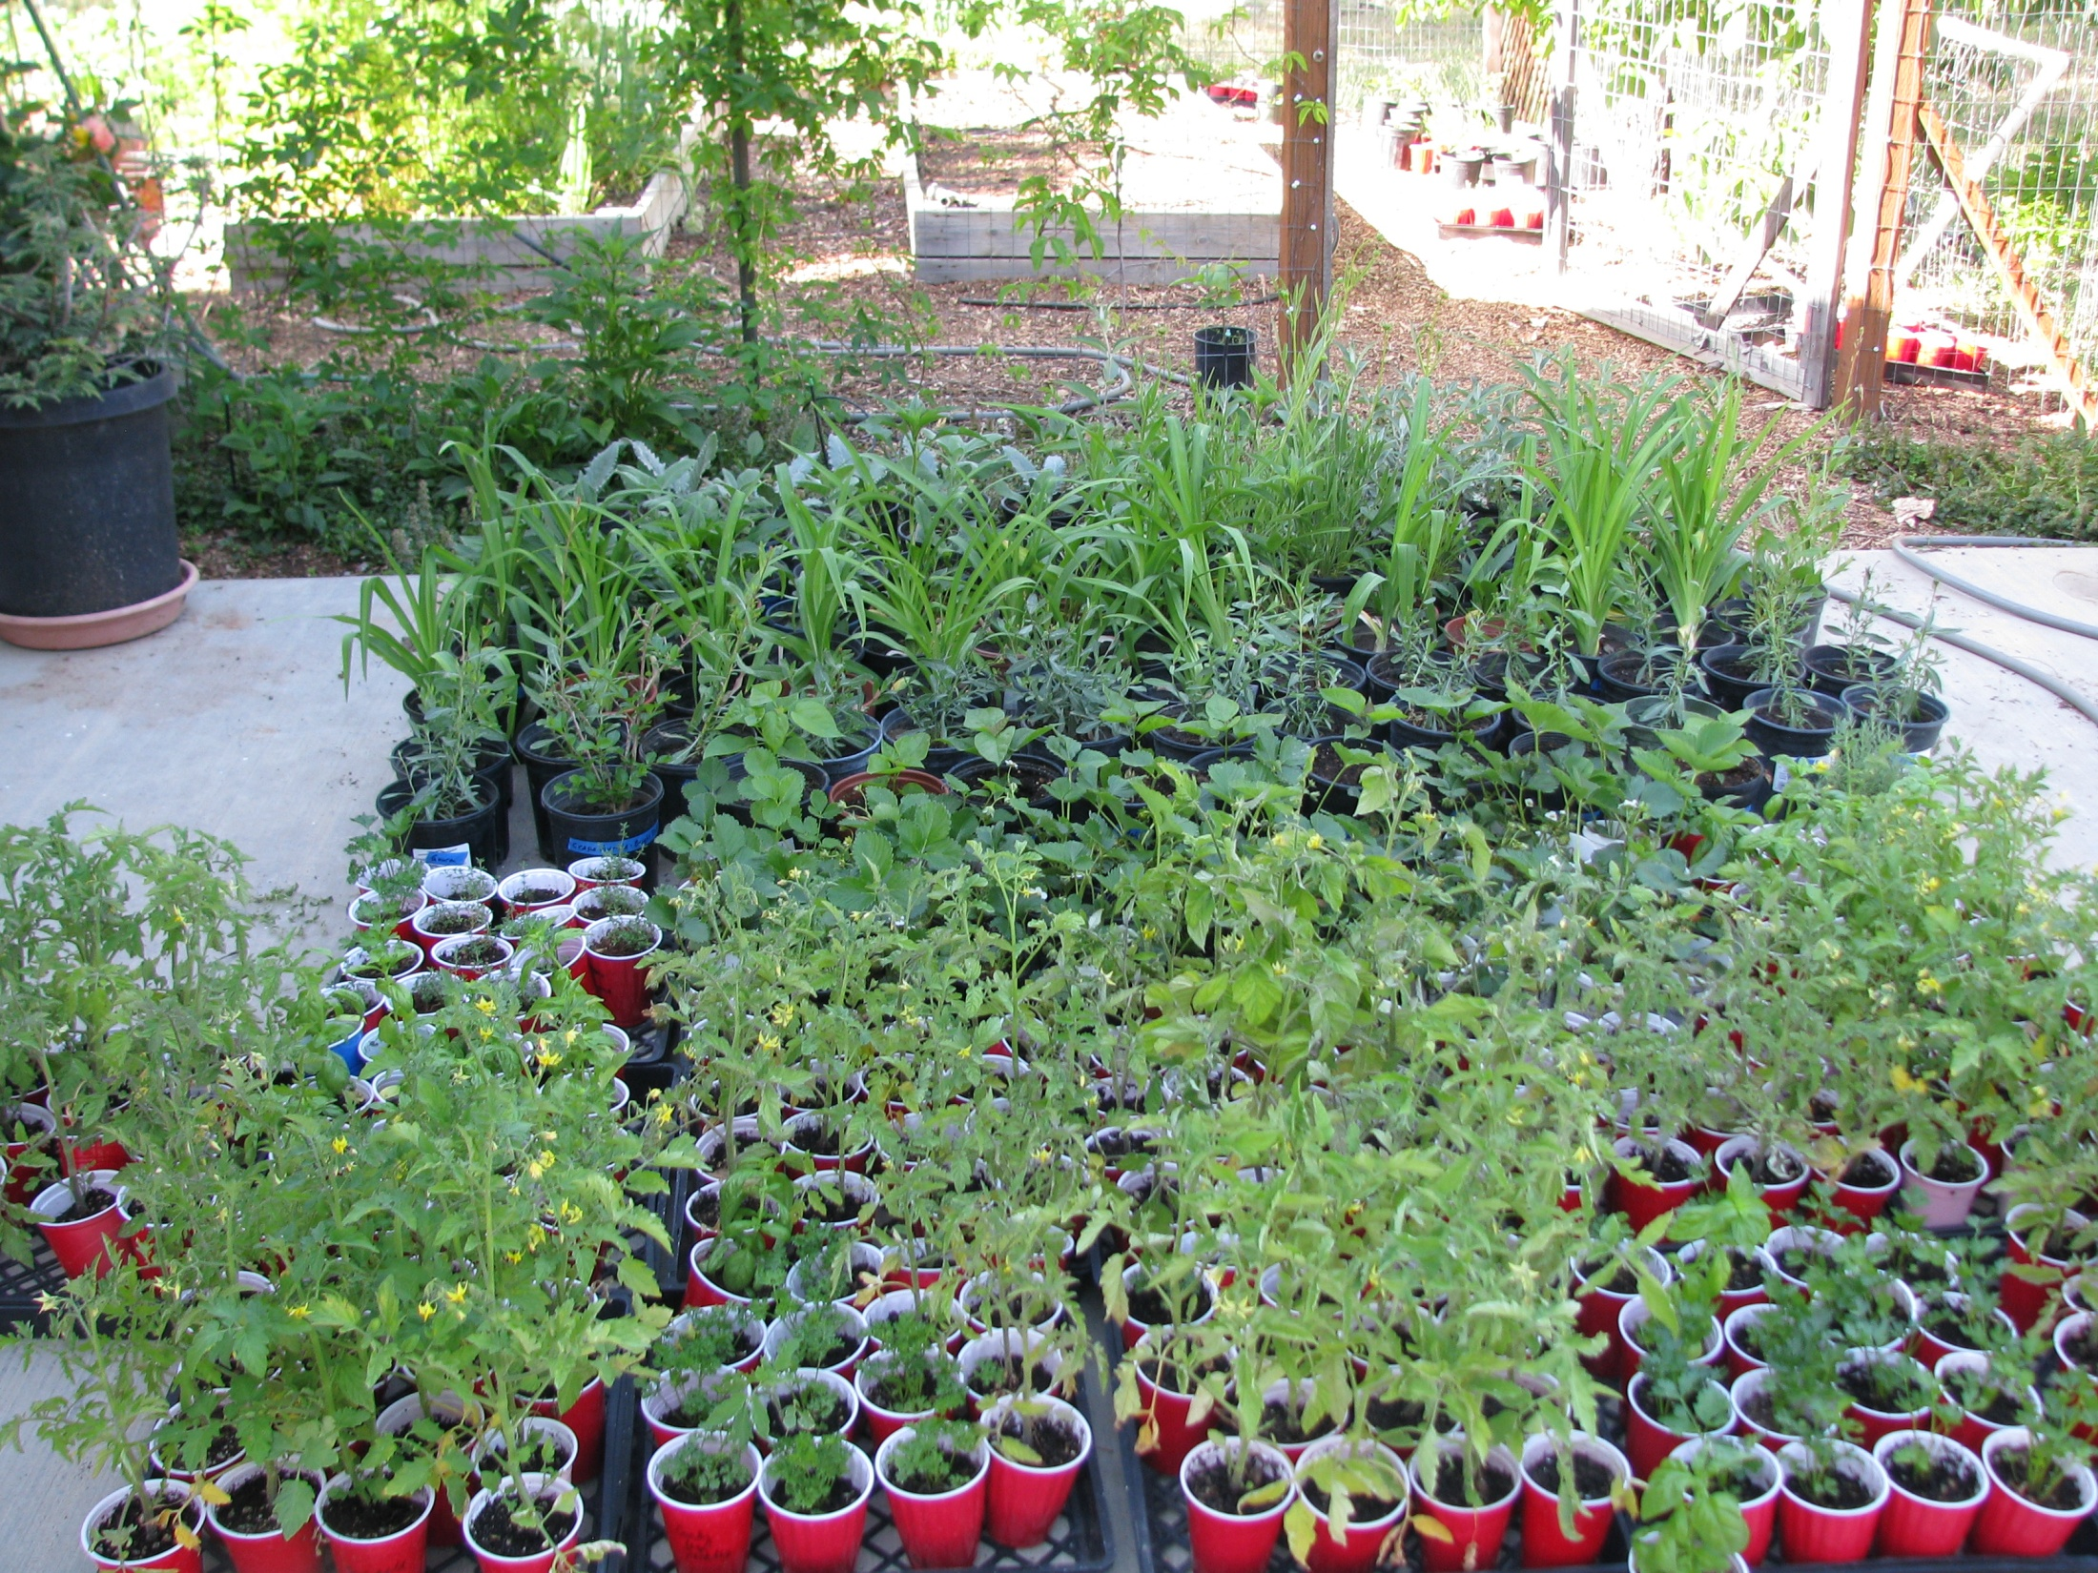

Slide 4
Today’s Agenda
Types of cuttings
Choosing plant material
Environmental factors that affect success
Step- by step / Hands on

Slide 5
Why Propagate Using Cuttings?
Free or close to free
Identical to parent plant
A better idea of what the mature plant will look like
More volume for mass plantings
Satisfaction factor

Slide 6
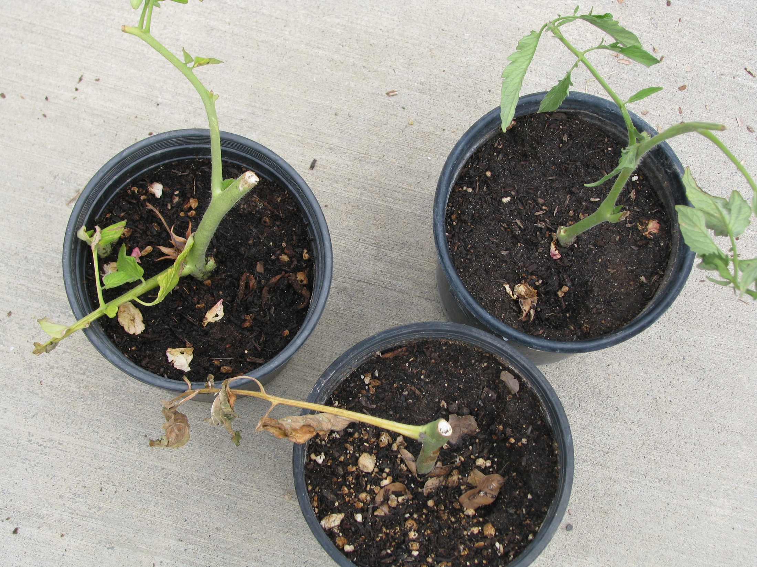

Slide 7
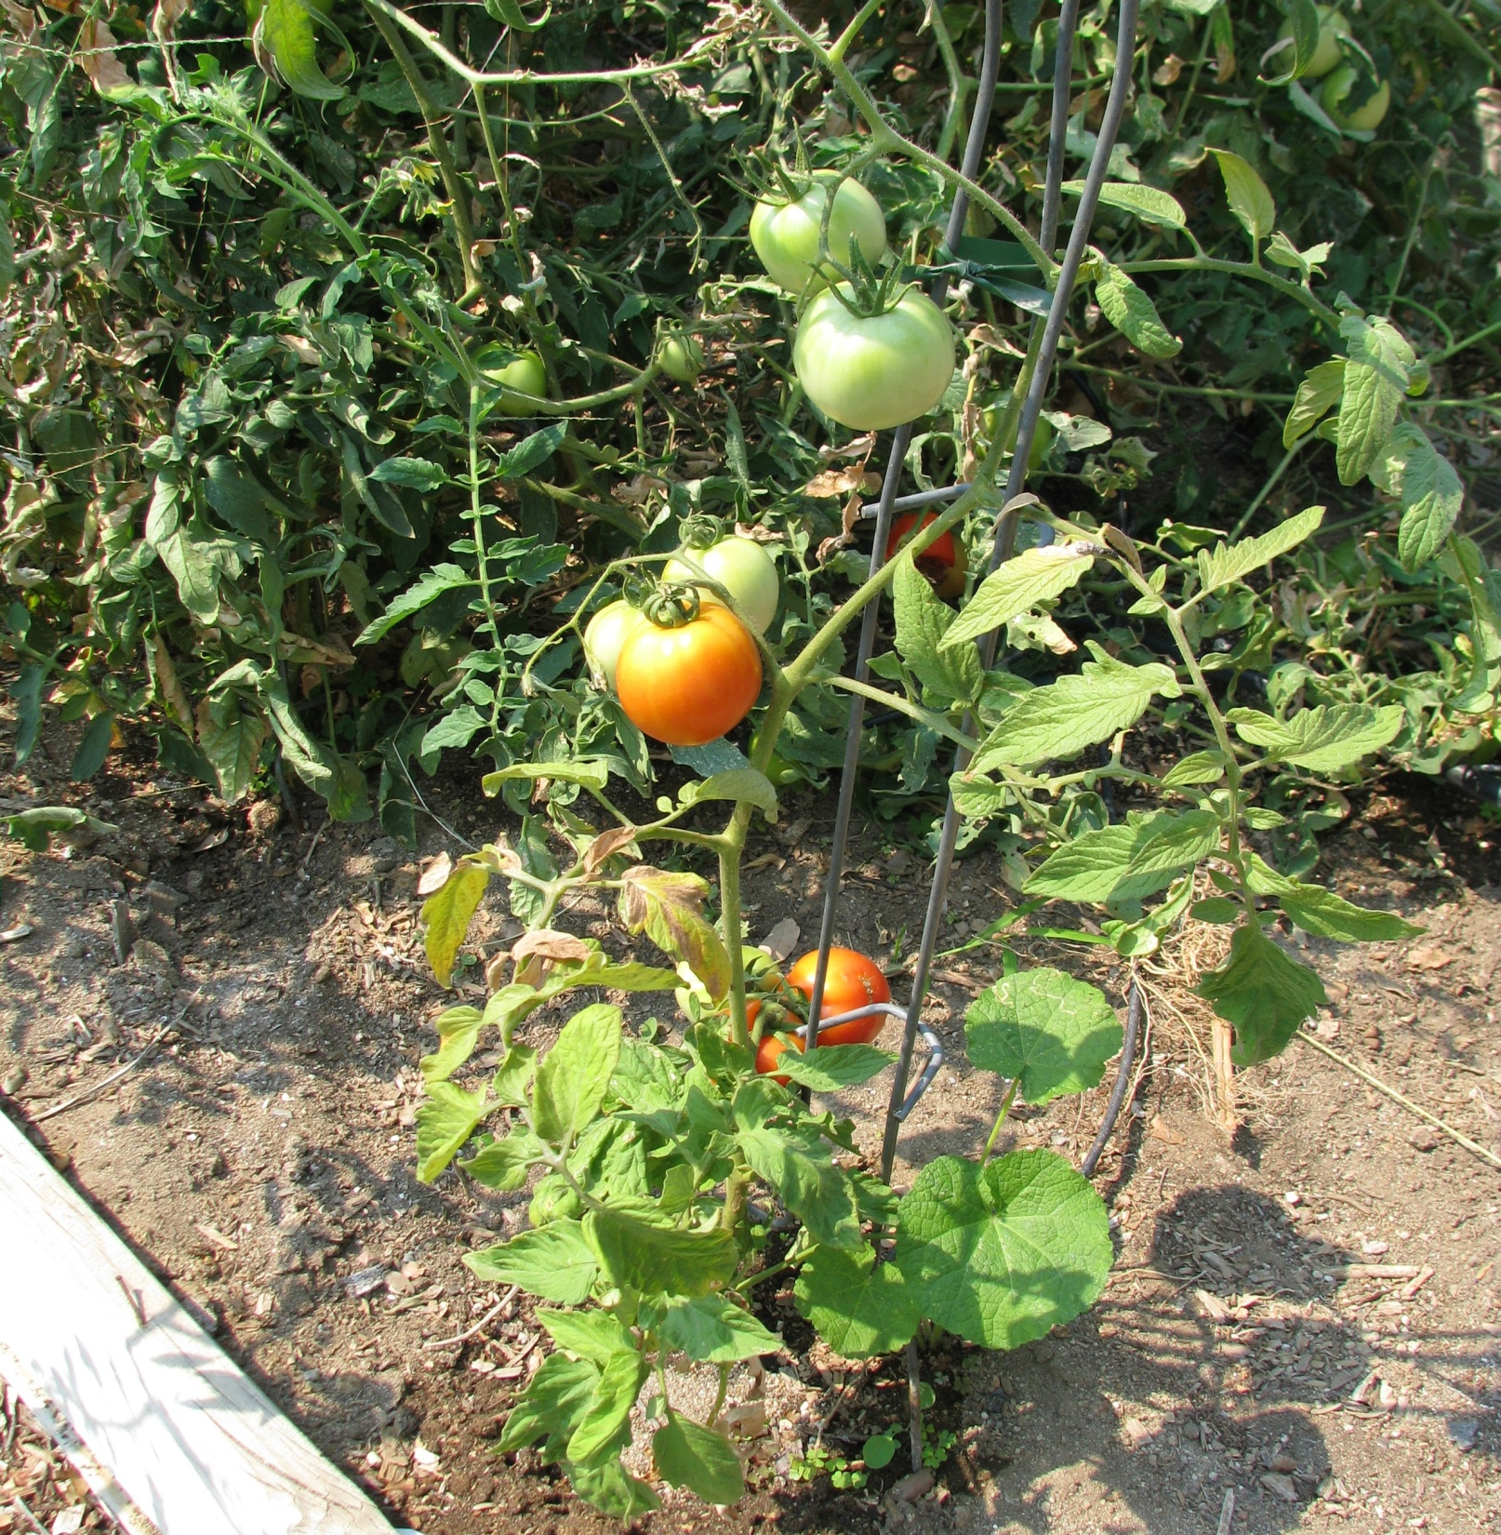

Slide 8
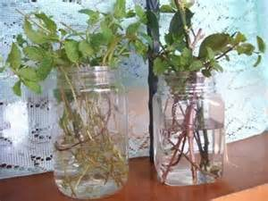
Rooting in Water

Slide 9
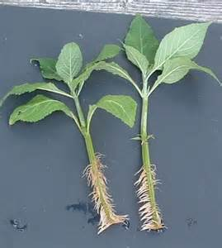
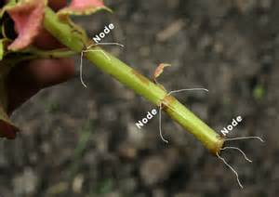
Root Development

Slide 10
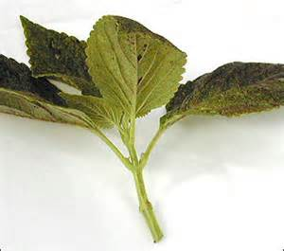
Spring Softwood (Tip) Cuttings lush tender new growth
Advantages
quick root development
faster leaf out and growth
Disadvantages
tender/easy bruised
quickly dry out so require more attention to their environment

Slide 11
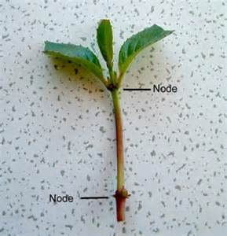
  Fall/Early Winter Semi Hardwood Cuttings
  Partially matured wood from current season’s growth taken in late summer to early winter
Advantages
Stems are hardier and better suited to handling and some neglect
Disadvantages
Slower to root
Often don’t show new growth until following spring

Slide 12
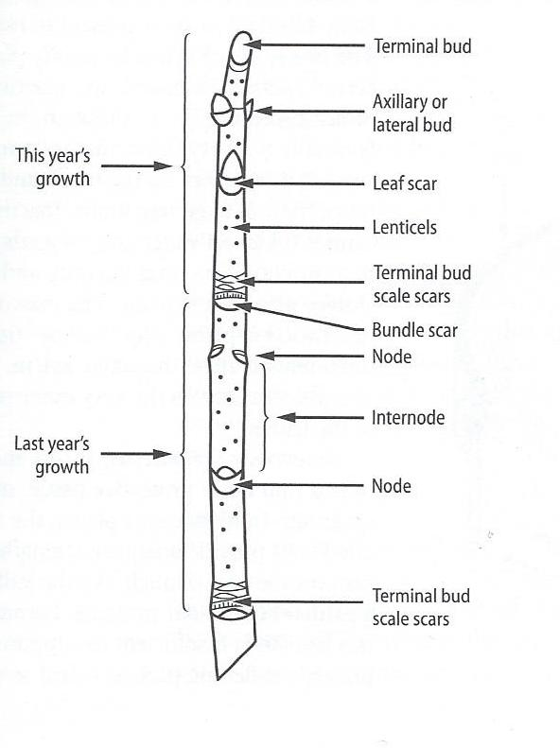

Slide 13
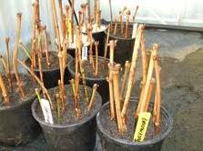
  Late Fall/Winter Hardwood Cuttings dormant woody stems taken in late fall, winter, early spring after leaves have fallen off
Advantages
Requires little environmental control
Disadvantages
Usually not a productive plant until 1 year later

Slide 14
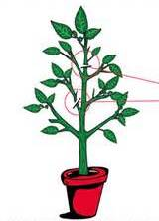
Choosing Plant Materials
Healthy – pest & disease free
Younger plants work better
Lateral shoots work better than terminal shoots
Taken in the early morning
Well hydrated
Keep cool, hydrated and out of direct light if not planting immediately (refrigerate if storage is necessary)
Terminal
Lateral

Slide 15


Environmental Factors for successful rooting
Sanitation
1 part bleach to 9 parts water

Slide 16
Planting Medium
    Peat
    Vermiculite
    Perlite
    Sand
    Potting mix
Notes:
Sterile, well drained, good aeration, able to hold moisture (moistening in advance helps), low fertility? Warmth aids rooting

Slide 17
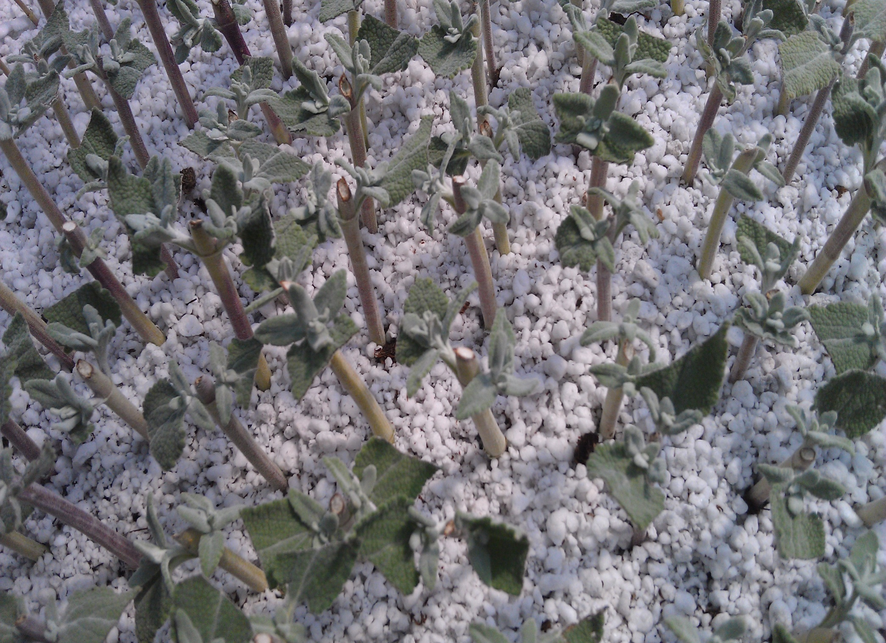

Slide 18
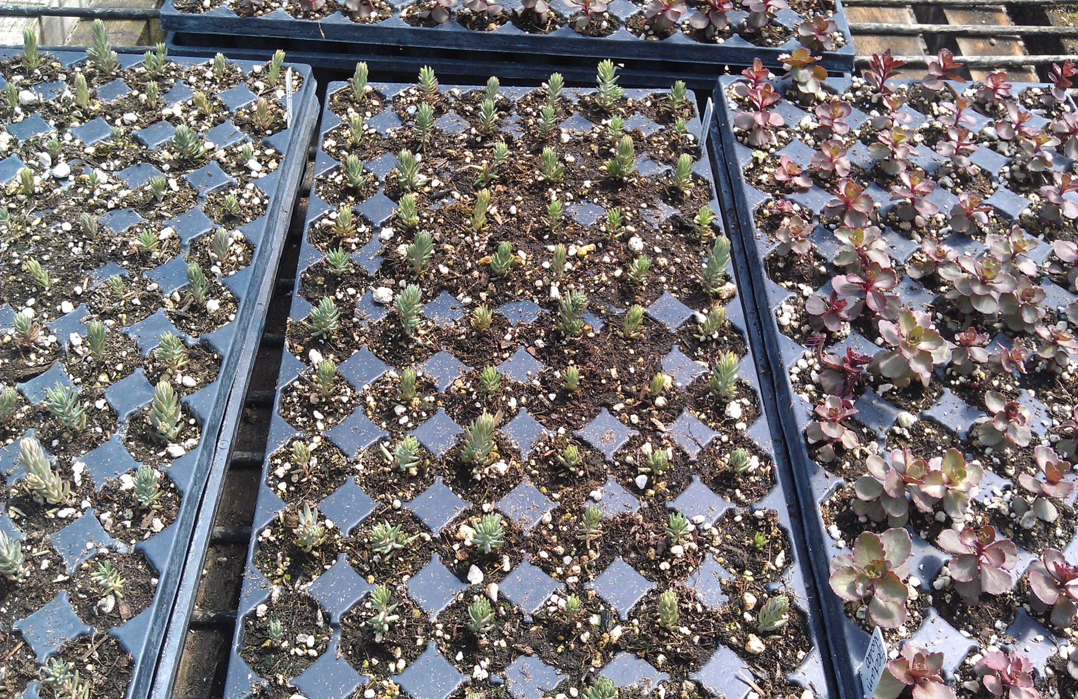

Slide 19
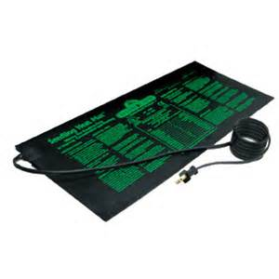


Air
Temperature should remain around 65-75

Slide 20
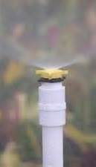

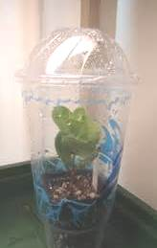
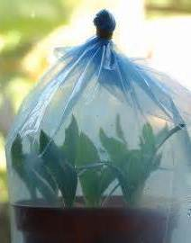
Humidity

Slide 21


Slide 22
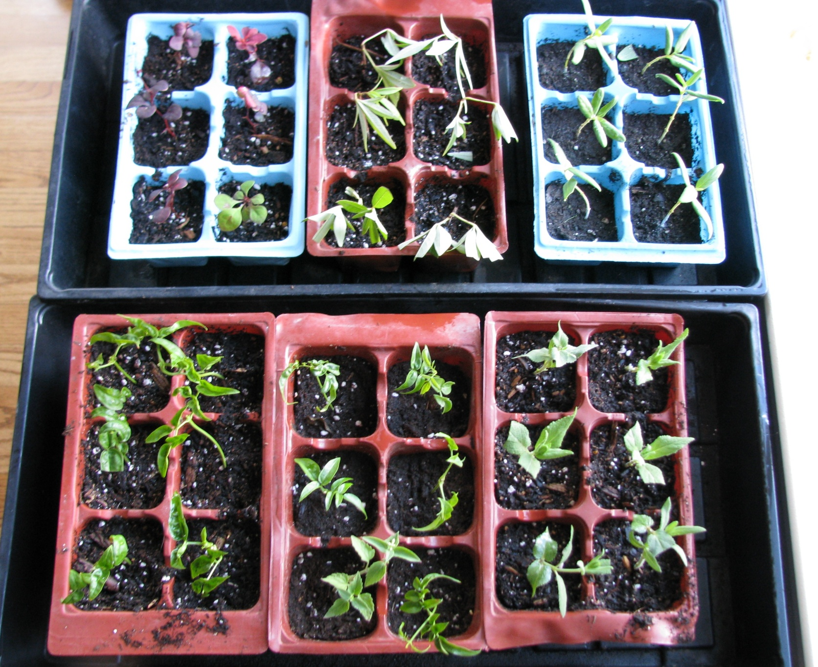
Bright But Indirect Light

Slide 23
Hardwood Cuttings
Deciduous plants that have lost the leaves
Last season’s growth
Stems cut from 6 to 20 inches long
Central or basal (bottom) cuttings

Slide 24
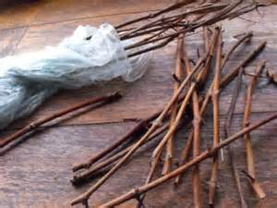
Bundling in Sawdust

Slide 25
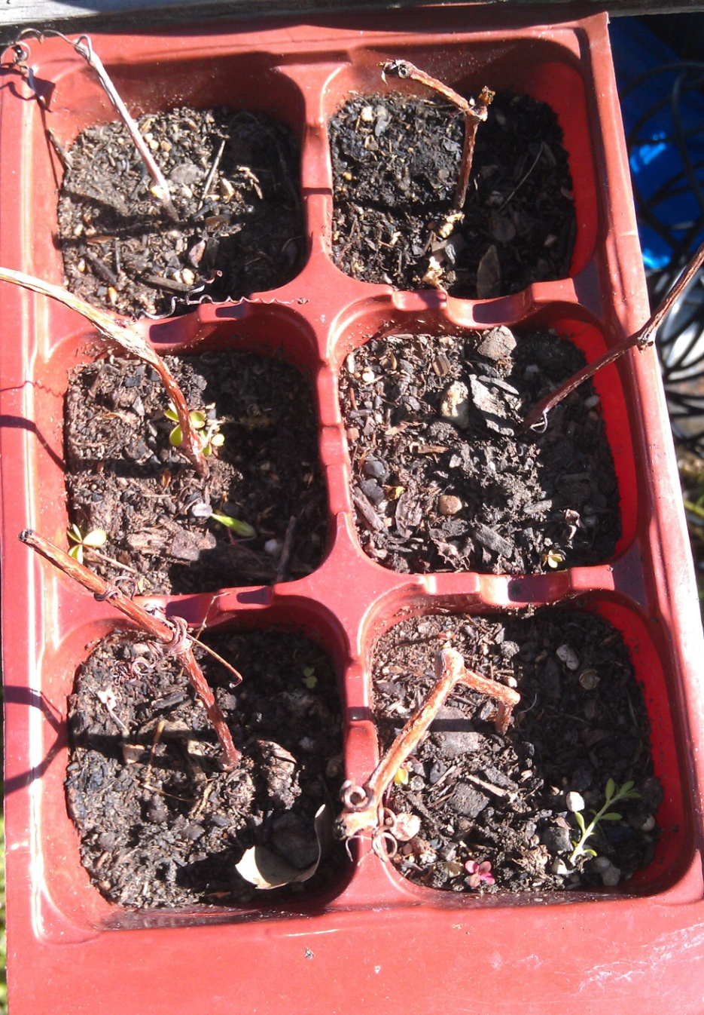
Rooting Outdoors

Slide 26
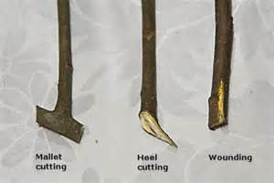
Cuts for Difficult to Root Plants

Slide 27
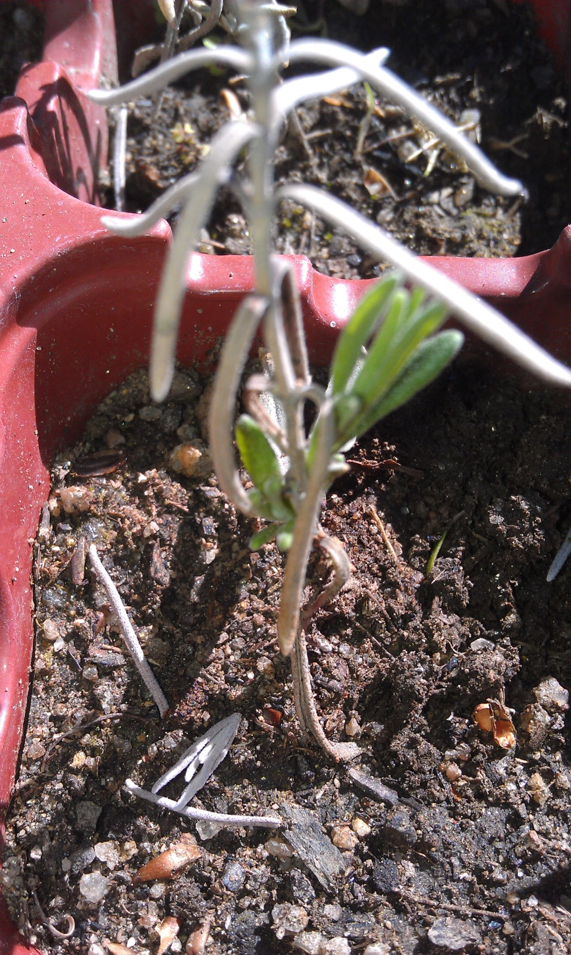
Don’t Give Up Too Soon!

