Slide 1




Pruning Deciduous Fruit Trees
Carol Constantine
Joseph Salib

Slide 2
“There are many ways to train and prune deciduous fruit trees, and no single method is right for all situations and needs.”
- UC ANR

Slide 3
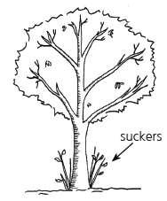
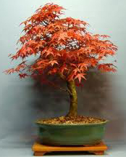
Beginning Steps
Remove all the grass and weeds growing around the tree to the drip line.
Prune suckers back to the point at which they begin growing.
      For suckers growing directly off the roots, remove the soil until the point of growth on the root and remove. Cutting the tops of suckers causes them to grow many new suckers from the cut end.

Slide 4
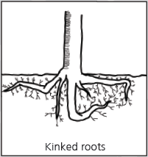
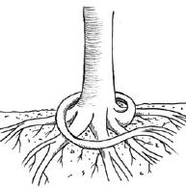
Beginning Steps
Circling or girdling roots
  Prune back to the point before it starts to circle.
  If the circling root is wrapped tightly around the trunk or other roots, use a small chisel to remove it.
  Do not prune roots that are 1/3 the diameter of the trunk or larger.

Slide 5
Prune Out the 4 D’s
Diseased
  Cut 6”-12” below the infection to remove disease that has started to spread.
Dead
  A dead branch prevents the tree from sealing off the area from the outside.

Slide 6
Prune Out the 4 D’s
Damaged
  Prune with a proper clean cut.
  Ragged cuts or rips prevent the tree from sealing over the wound sufficiently.

Slide 7
Prune Out the 4 D’s
Deranged
  Remove branches that grow towards the center of the tree, or are crossing and rubbing against another branch, the trunk or a structure.

Slide 8
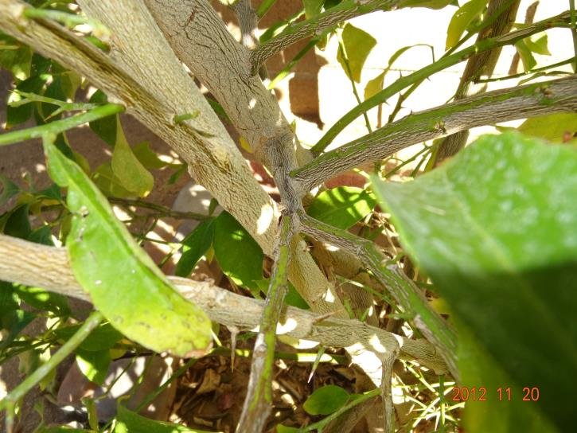
Prune Out the 4 D’s
Deranged

Slide 9
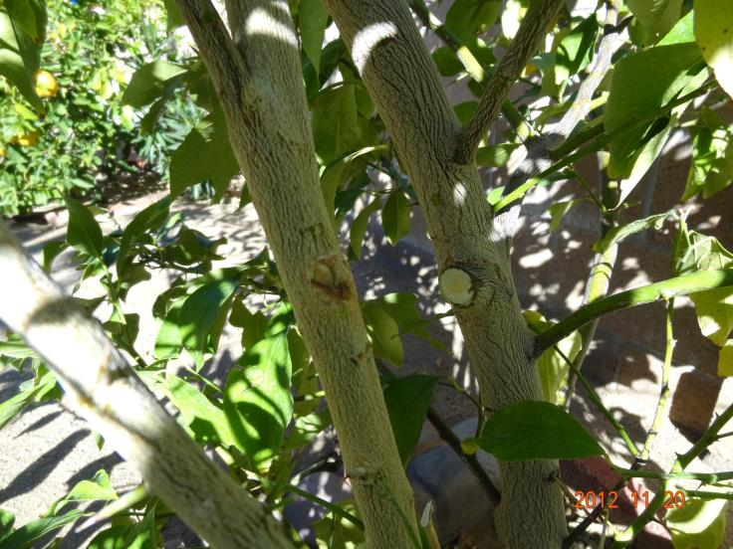
Prune Out the 4 D’s
Deranged

Slide 10
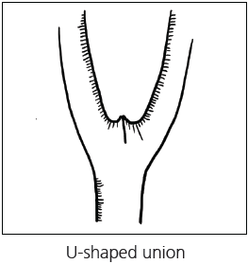
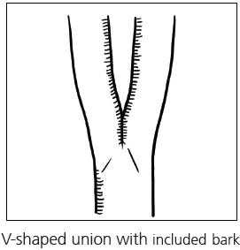
Remove Codominant Stems
This poor branch attachment is a weak spot that can break under stress caused by wind, rain, or just the weight of the branch.

Slide 11
Remove Codominant Stems
Remove the weaker/smaller stem or shorten it to allow the lead branch to grow larger in diameter.
If removing the branch results in too much of the canopy being removed, it will need to be a multi-year process.
  Shorten the branch using a reduction cut and wait a year to either shorten the branch further or remove the remainder.

Slide 12
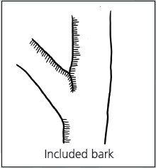
Remove Branches with Included Bark
It is only a matter of time before the branch will push away from the trunk, break off and split away, ripping bark off the trunk as it falls.
For good branch attachment, the juncture of branch and trunk will look like a “U”, with a more or less rounded crotch.

Slide 13
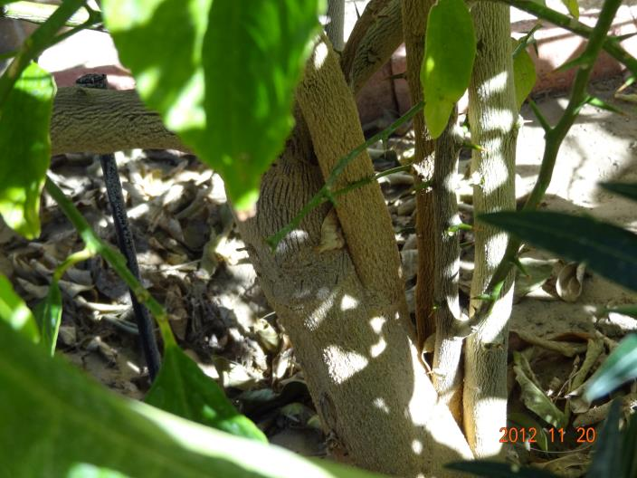
Remove Branches with Included Bark

Slide 14
Types of Training Techniques
Open Center
Fruiting Bush
Central Leader

Slide 15
Types of Training Techniques
Open Center
  Center is kept free of large branches and upright shoots in order to allow sunlight to reach the lower fruiting wood.
  Almond, apricot, cherry, fig, nectarine, peach, plum, pistachio, and prune.

Slide 16
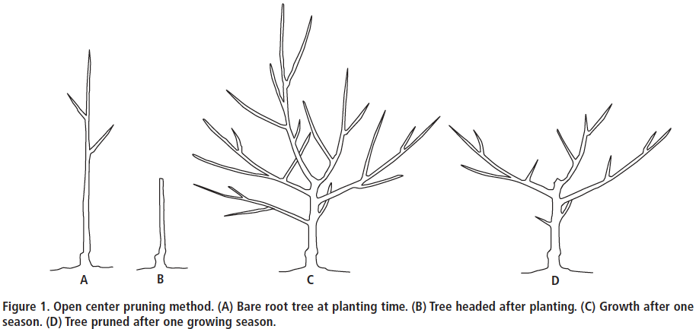
Types of Training Techniques
Open Center

Slide 17
Types of Training Techniques
Fruiting Bush
  Done through periodic summer pruning
  Works for nearly all fruit species
  Begin in late April/early May of first growing season: cut all new growth in half
  Late June: cut subsequent new growth in half again aiming for uniform, bushy appearance
  Continue cutting new growth in this manner until tree reaches desired height

Slide 18
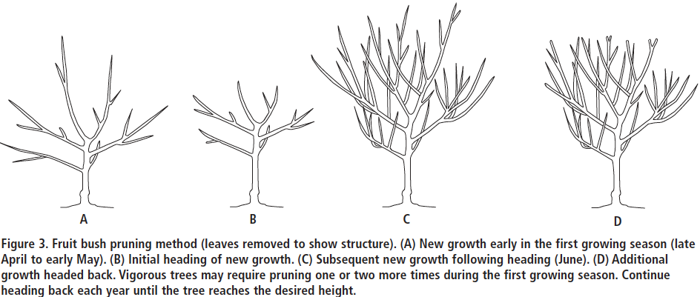
Types of Training Techniques
Fruiting Bush

Slide 19
Types of Training Techniques
Central Leader
  Like a Christmas tree.
  One central leader, with lateral branches arranged in separate layers, with branches in lower layers wider than those in upper ones.
  4 tiers of lateral branches with 4 branches per tier
  Done in Spring and Summer
  Apple, pear, Asian pear, pecan, and quince.

Slide 20
Types of Training Techniques
Central Leader
  Create the 1st tier by tying or staking branches outward at an angle just above horizontal after they have grown 2-3 ft.
  When central leader has reached 2.5-3 ft past first tier, head it just below this point and train a 2nd tier.
  Avoid training one branch directly over another branch in a lower tier.
  Keep lower branches longer than upper branches.

Slide 21
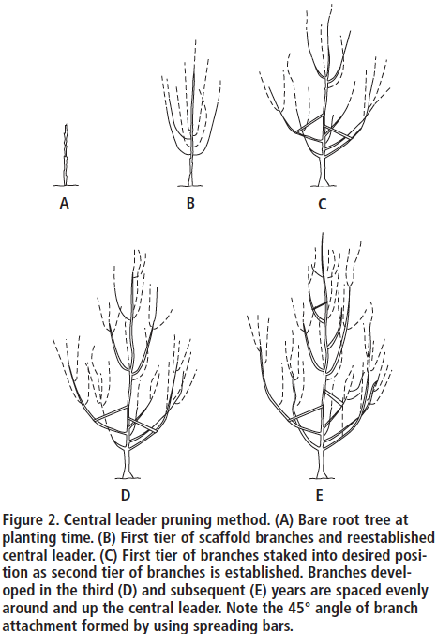
Central Leader

Slide 22
Summer vs. Dormant Pruning
  Do some pruning in Spring and Summer to train young trees and shorten time to fruit production.
  Bend and stake shoots of young trees during the spring and summer so they will grow in desired direction; this way you do not have to head them to develop the scafolding structure.
  On mature trees, prune vigorous upright shoots in the summer and thin other shoots to control tree height.

Slide 23
Pruning Cuts & Tools
  2 types of pruning shears: bypass (blades pass each other) and anvil (one blade cuts down against a flat surface)
  Bypass shears for small shoots
  Anvil shears for larger shoots and branches
  Make cuts at 45º angle across branch, downward away from horizontal.
  Never cut into a branch collar.
  Do not apply emulsions, paint, or other materials to a pruning cut as they can trap moisture.

Slide 24
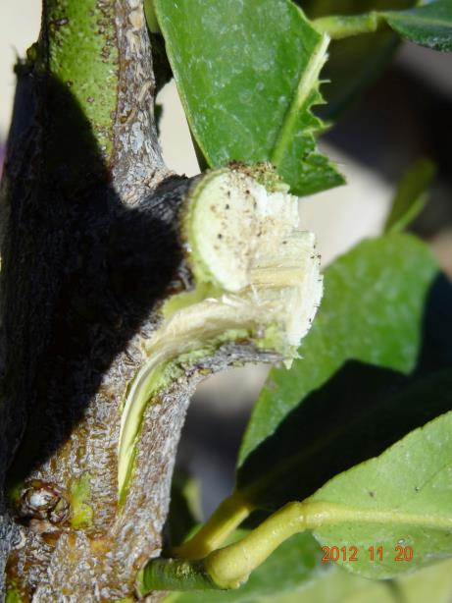
Pruning Cuts & Tools

Slide 25
References
  Ingels, C., Geisel, P. M., & Unruh, C. L. (2002). Fruit trees: Training and pruning deciduous trees. UCANR, Publication 8057.
  Ingels, C., Geisel, P. M., & Unruh, C. L. (2002). Fruit trees: Pruning overgrown deciduous trees. UCANR, Publication 8058.
  TreePeople (2012). Citizen arborist guide. TreePeople Citizen Forestry Program.

