Slide 1

Master Gardener Program of
San Bernardino County
Creating a Pet-Safe Garden

Slide 2

Mission Statement
Master Gardener Volunteers are trained by the UCCE Advisors, Specialists and other qualified instructors to provide the gardeners of San Bernardino County with research-based information to promote environmentally responsible and sustainable horticultural practices.

Slide 3
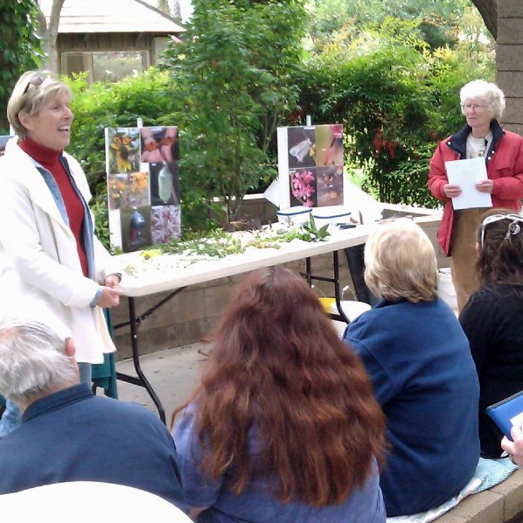

Who We are
Master Gardeners participate in this program entirely on a volunteer basis.
Master Gardeners are trained by the University of California Cooperative Extension to provide the gardeners of San Bernardino County with research-based information.
All of San Bernardino County’s currently certified Master Gardeners have been finger-printed and have passed background screening.

Slide 4
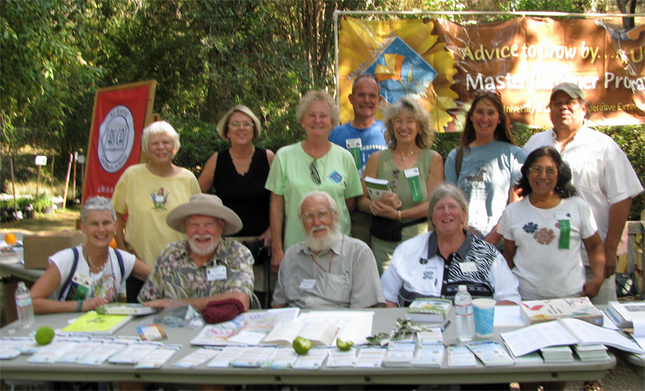
Master Gardeners of
San Bernardino County
Our ultimate goal is to improve the quality of life for San Bernardino County residents by assisting individuals and groups in identifying garden related issues and resolving garden questions.

Slide 5
Creating a
Pet-Safe Garden

Slide 6
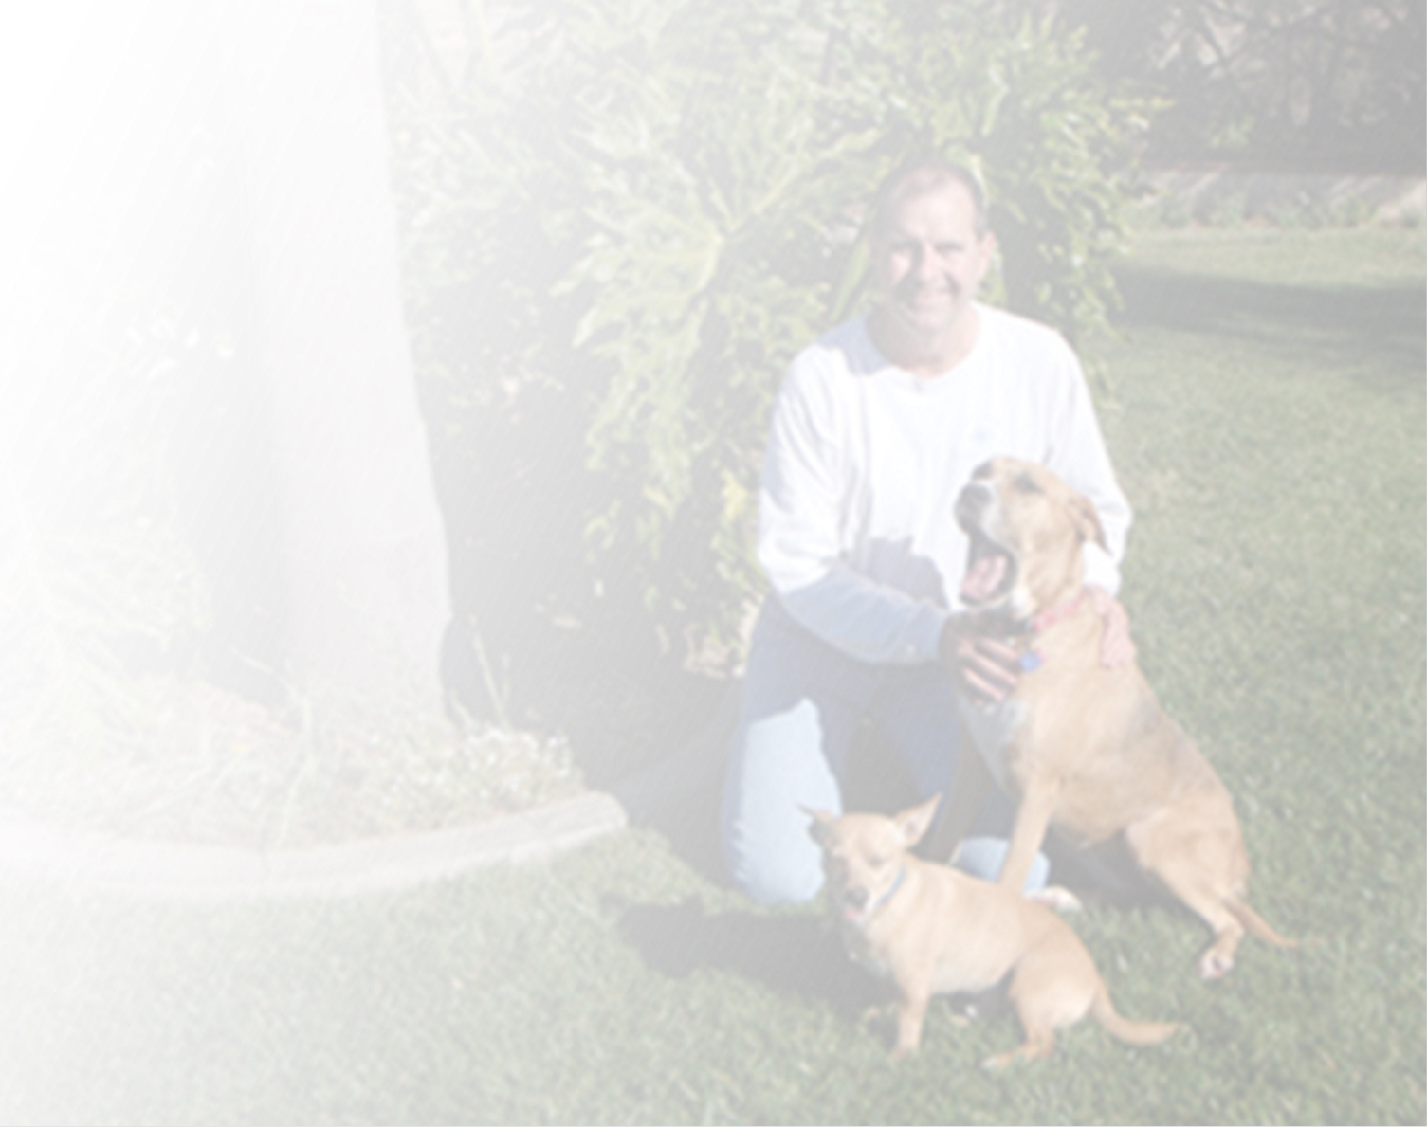
Your yard should be safe for everyone
You
Your kids
Your pets
  Dogs
  Cats
  Tortoises
  Ducks
  Emus
  Llamas
And ????
  Neighbor kid that wanders in
  Meter reader

Slide 7
“Tour” Your Yard
Look for hazards
Ask a friend or neighbor
  They might see things you don’t notice
Remove or fence off hazards
Keep a list of plants poisonous to your specific pets handy
Have phone numbers handy
  Doctor
  Vet or Emergency Animal hospital
  Poison control
Pet Poison Help -- iPhone app

Slide 8
Toxic Chemicals
Dangerous during application
Improper storage, disposal
Run off can poison ponds, groundwater
Drifting aerosol
Sprayed leaves become toxic
Systemic insecticides create toxic plants
Use least toxic alternative
Follow manufacturer’s directions

Slide 10
Toxic Chemical, cont.
All the “cides” – cide means kill
  Insecticides, miticides, fungicides, bactericides, herbicides
Ant/roach bait stations
  Old stations → arsenic based insecticide → high toxicity
  Current stations have small amount of insecticide at low concentration
    Boric acid, Avermectin, Hydramethylnon, Fipronil
    Intestinal obstruction due to eating plastic trap more likely than poisoning
Rat/ground squirrel/gopher poison
  Dead animal is poisonous
  Can bait box be dug up?
  Bleeding, seizures, paralysis, kidney failure, often fatal
  Symptoms may appear 3-5 days after ingestion

Slide 11
Toxic Chemical, cont.
Snail baits
  Metaldehyde -- toxic
  Iron phosphate – “non-toxic”
    Unlike metaldehyde baits, does not taste nasty
    If pet consumes whole bag, can get iron toxicity
  Diatomaceous earth
    dust is irritating (lungs, skin)
    if pet got into bag
Fertilizers
  Plain fertilizers minimally toxic
  Combo food/insecticide/fungicide are toxic

Slide 12
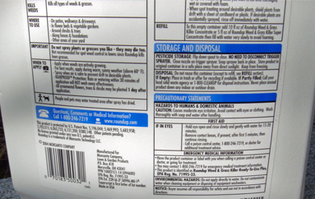
Follow Manufacturer’s Instructions

Slide 13
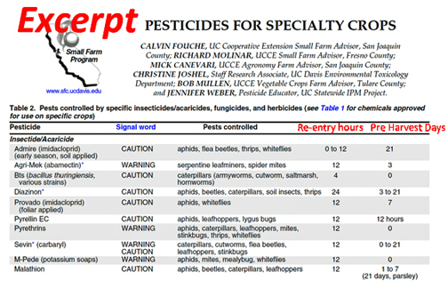
Be aware of Re-entry hours and Days until Harvest

Slide 14
“Non-Toxic” Doesn’t Mean Safe
Bone meal
  Highly attractive for dogs
  Can cement itself together in the stomach and cause obstruction
Blood meal
  Vomiting, diarrhea, pancreatitis, and possibly iron toxicity
Iron
Bleach

Slide 15
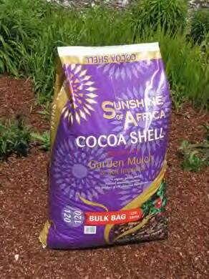
Cocoa bean mulch
  Cocoa bean hulls
Fragrance attractive to dogs
May contain theobromine and caffeine
Symptoms
  Dose dependent
  Vomiting, diarrhea, hyperactivity, tremors, tachycardia, tachypnea, seizures

Slide 16
Piles, Bags, etc
Compost piles and worm bins
  Decaying matter may produce mycotoxins
  Cause intestinal distress or nervous system problems
Trash piles and wood bins
  May attract rats, snakes, other critters
Tortoise suffocated in a bag of potting soil

Slide 17
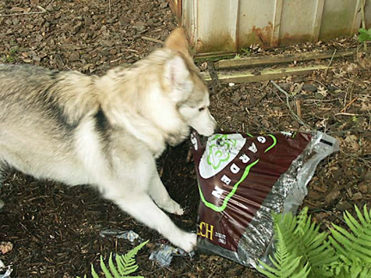
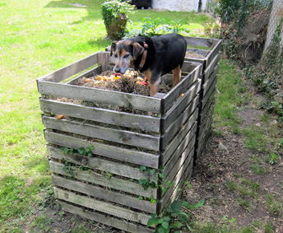

Slide 18
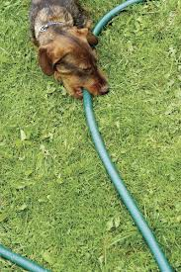
Garden Tool Safety
Are tools lying around?
  Can they fall or blow over
  Fall on people or pets
Are they something your animal would chew on?
Lawn mowers & line trimmers can throw rocks, sticks
  Make sure pets are out of the way

Slide 19
Fencing
Tall enough
  Pets can’t crawl over or climb through
  Dig under, chew through
Strong enough
Locks on gates
  Neighborhood kids/dogs can’t wander in
  Gates actually closed

Slide 20
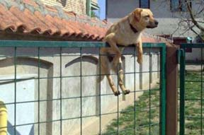
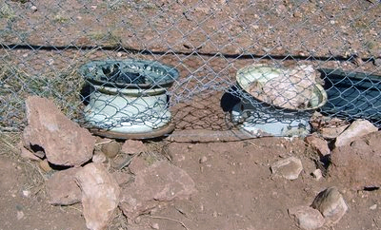

Slide 21
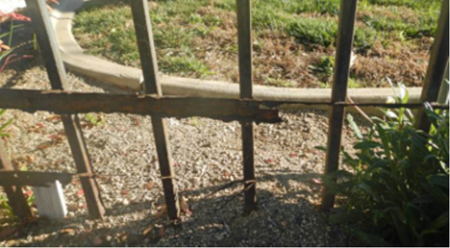

Slide 22
Assorted Hazards
Gas from mowers, etc
Propane tanks, gas lines, charcoal, barbeque grease bucket
Electric outlets/wires/extension cords
Paths with sharp gravel
Hot cement or artificial turf
Make sure plant stakes are not at a height that animals can run their eyes into them

Slide 23
More Potential Hazards
Pool or pond
  Tortoises swim like rocks
  Pool chemicals
Wasp nests, bees, black widows
Wild animals
Citronella candles
Mesh from lawn sod
Bird netting

Slide 24
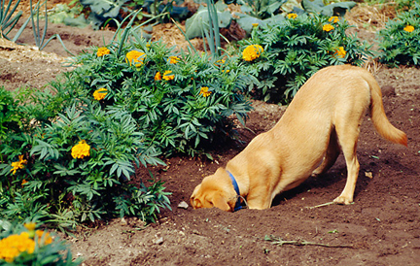
Know your animal

Slide 25
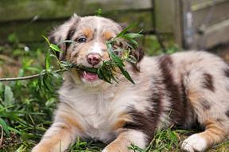

Slide 26
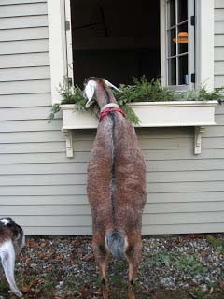

Slide 27
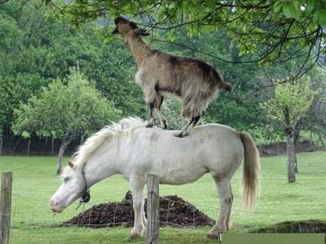

Slide 28
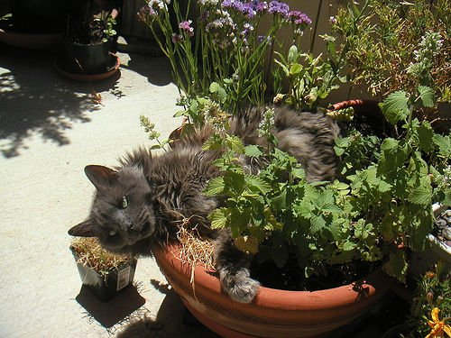

Slide 29
Dangerous Plants
Plants that poke or scratch
  Thorns, spines
  Puncture wounds cause infection
Plants that cause skin reactions
  Rashes, dermatitis, allergic reactions
Stinging nettles, poison oak
Unstable tree limbs
Large falling palm fronds, pine cones

Slide 30
Toxic plants
Dangerous when eaten
Toxicity can vary
  Only part of plant may be toxic
  Individual plant may be more/less toxic at different times of year, drought stressed, etc.
  Amount ingested/victim size
  Very young, or frail more susceptible
  Symptoms may be delayed or only if ingested over an extended period

Slide 31
Toxic Plants, cont.
Dog/horse/tortoise may eat plants you would never even think of
May be toxic for some species, not others
Get a list specific for your animal
Many plants taste nasty → ingestion limited
Inadvertent ingestion
  Oleander leaves mixed in with feed

Slide 32
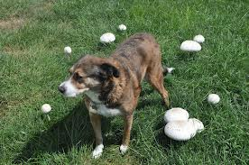
“Seasonal” Toxic Plants
Mushrooms
Weeds
Fruit/nut/seedpod drop
  Apple seeds
  Peach pits can cause intestinal obstruction
  Fruits from queen palms

Slide 33
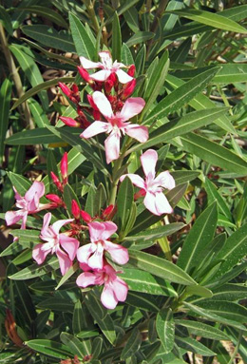
Oleander (Nerium oleander)
All parts poisonous, including dried leaves & smoke from burning bushes
Symptoms range from GI distress to seizures, coma, and rarely, death
All mammals appear to be susceptible
Rodents and birds may be not be affected
Norco city ordinance forbids planting them – public nuisance

Slide 34
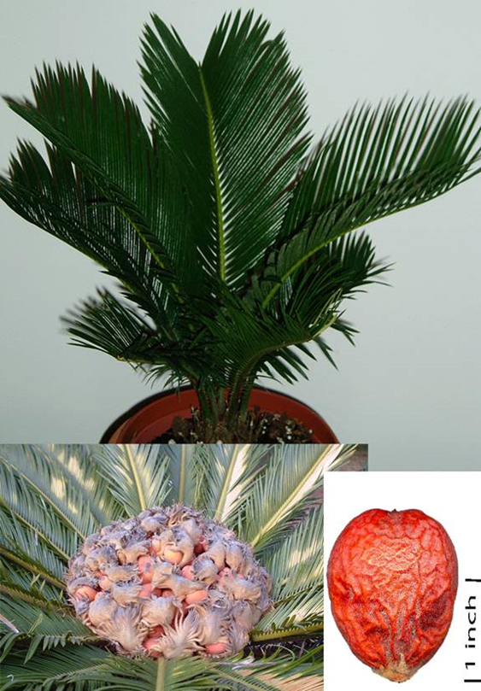
Cycads and Zamias
Sago and Cardboard “Palms”
All parts very toxic, especially seeds
Many dogs like to chew on Sago (why?)
Toxin causes GI symptoms and liver failure
Once a dog shows signs of liver failure, the mortality rate is 30%

Slide 35
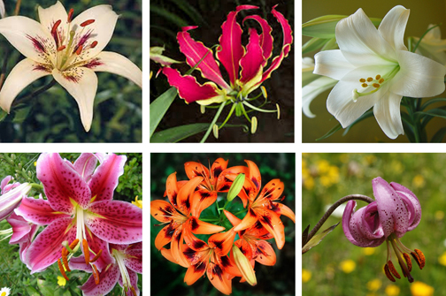
Lilies
Asiatic, Oriental, tiger, Easter, gloriosa lilies
Cats develop kidney failure, nearly always fatal
Dogs develop vomiting and diarrhea, rarely die

Slide 36
Other “lilies”
Scilla spp. – Cuban lily or squill – eating bulb may be fatal
Alstroemeria spp. - Peruvian lily - severe skin irritation and blisters from sap contact
Crinium, Hymenocallis, Lycoris – “spider” lily and others – ingesting bulb → vomiting and diarrhea
Spathiphyllum - Peace lily – burning of lips and throat
Zantedeschia – Calla lily – burning of lips, vomiting, very large ingestions can be fatal
Agapanthus (lily of the Nile) and Hemerocallis (daylily)
  may or may not be poisonous to cats?
  Some lists say yes, some say no

Slide 37
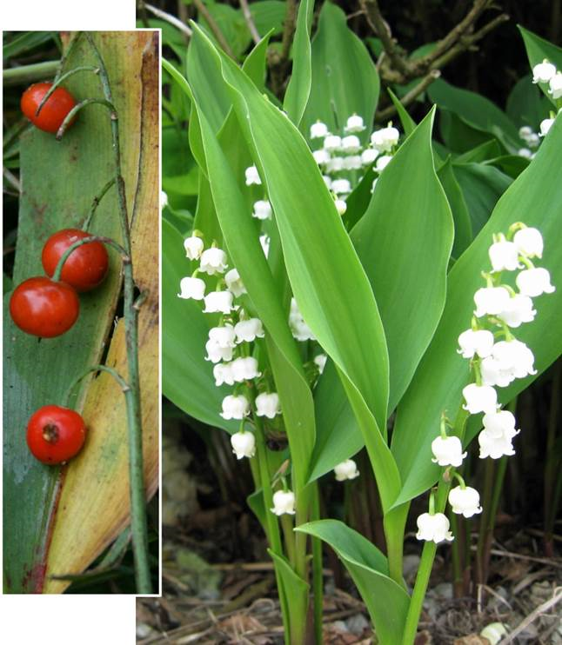
Convallaria majalis
Lily of the Valley
All parts toxic
Berries esp. attractive
Cardiotoxin - lowers heart rate
Large ingestions may be fatal

Slide 38
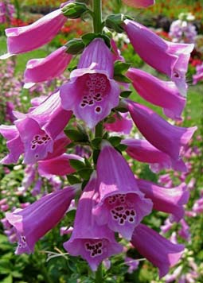
Foxglove (Digitalis purpurea)
All parts toxic, including seeds, dried leaves and roots
Causes cardiac arrhythmia, heart rate depression
Digoxin - heart medication made from plant extract
Children may suck on flowers

Slide 39
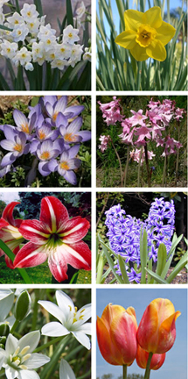
Very Toxic Bulbs
Narcissus (daffodils, paperwhites)
Colchicum (autumn crocus)
Amaryllis belladona (Naked Lady)
Somewhat Toxic Bulbs
Hippeastrum (amaryllis)
Hyacinthus
Ornithogalum (star of Bethlehem)
Tulipa
Underground parts are especially toxic
Dogs may dig them up and eat them
corm(glad), rhizome (iris), tuber(begonia)

Slide 40
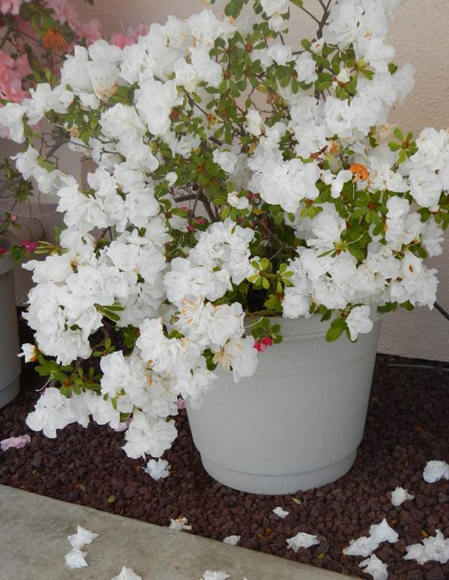
Azalea (Rhododendron spp.)
All parts toxic, especially leaves
Horses and goats esp effected
Fatal if significant volume ingested
Toxins cause GI symptoms, paralysis, difficulty breathing & cardiac problems
Symptoms may be delayed

Slide 41
Plants in your Vegetable Garden and Orchard
Rhubarb – leaves
Tomato – leaves and stems
Potato – leaves and stems
Onions, garlic – all parts
Grapes – leaves and fruit may cause kidney failure, esp in dogs
Apricot, cherry, peach – pits
Apple - seeds
Walnuts
Avocado -- leaves, fruit, seeds and bark may be toxic for rabbits and some large animals, including horses, but probably of little problem for cats, dogs, or tortoises

Slide 42
Other toxic plants
Aloe vera – sap is somewhat toxic
Chrysthanamum – leaves and flowers – mostly irritating
Cyclamen – especially the roots
Hosta – all parts cause stomach ache, possible “bloat”
Ivy – leaves mostly irritating
Milkweed – great for butterflies, but not dogs or cats.
  Causes vomiting, spasms if large quantity eaten.
Morning glory – seeds especially may cause hallucinations

Slide 43
More toxic plants
Nicotiana – flowering tobacco – very toxic
Poinsettia – really not very toxic
Sweet Pea – toxic if eaten in large quantity
Solanum –nightshade, potato vine, etc – all are toxic or very toxic
Vinca rosea – periwinkle – source of cancer drug vincristine
Yew – cancer drug taxol was derived from bark – horses are especially sensitive

Slide 44
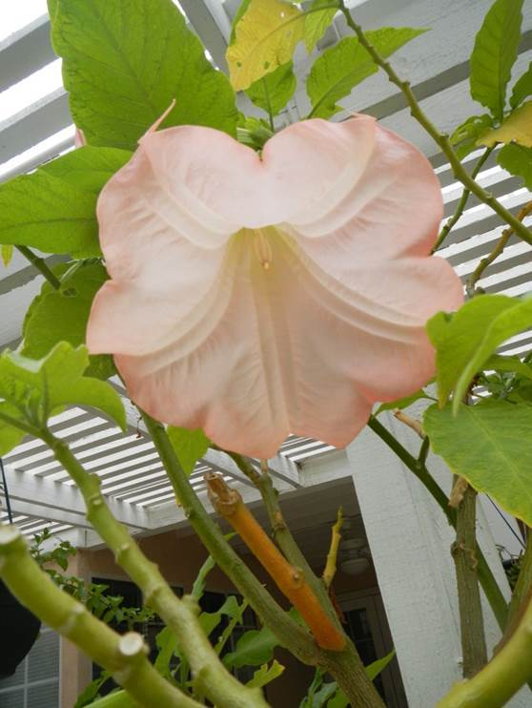
Angel's trumpet (Brugmansia arborea)
All parts toxic
Ingestion of seeds may be fatal
Related to Datura (Jimsonweed)
  Hallucinogenic

Slide 45
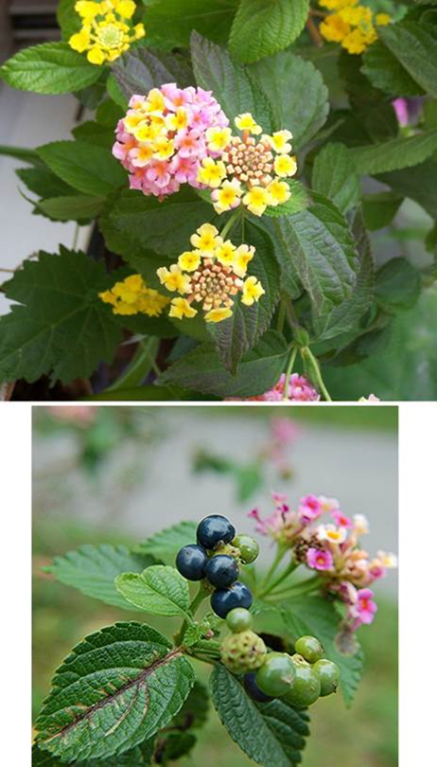
Lantana (Lantana camara)
All parts of plant toxic
Most animals won’t willingly consume enough leaves to be poisoned due to nasty taste
Ingestion of large dose of unripe berries can be fatal
Skin irritant

Slide 46
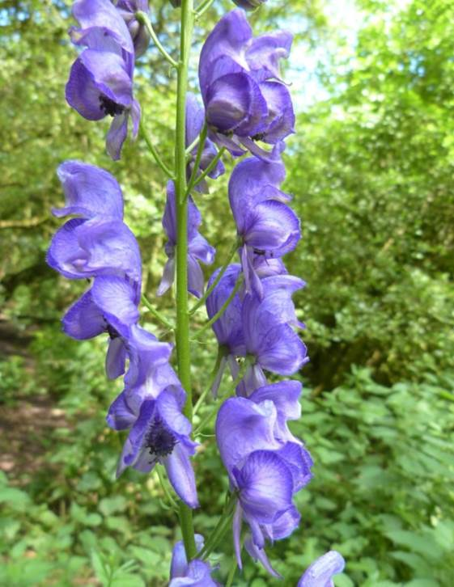
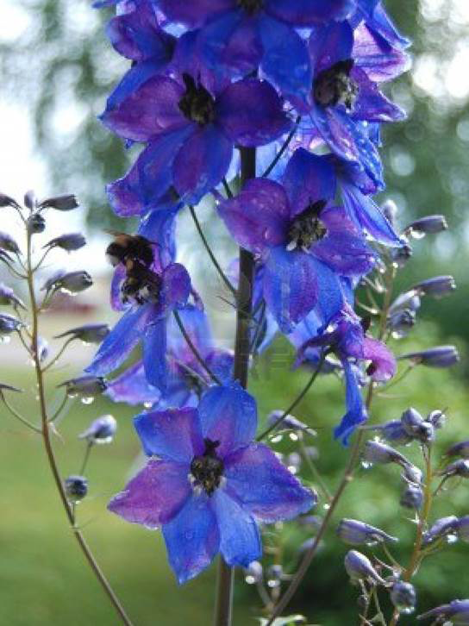
Monkshood (Aconitum spp.)
All parts are toxic. Ingestion of small amount can be fatal.
Larkspur (Delphinium spp.)
Ingestion of seeds and young leaves cause severe vomiting, respiratory paralysis and, possibly, death.

Slide 47
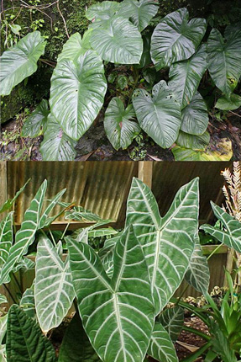
Elephant’s Ear
Many plants with common name – different genera
Alocasia spp.
Very toxic – GI symptoms, delerium, possibly fatal
Colocasia spp.
Unlike to be fatal unless swelling of mouth/throat causes choking

Slide 48
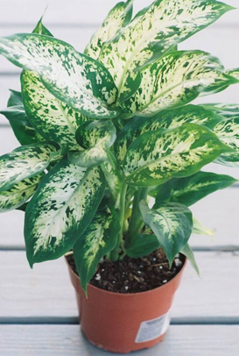
Dieffenbachia spp.
Dumbcane
Toxin in stems and leaves
Paralyzes vocal chords (dumbness)
Swelling of throat & tongue, if severe causes choking
Caladium & Philodendron species have similar toxin and effects if eaten in large quantities

Slide 49
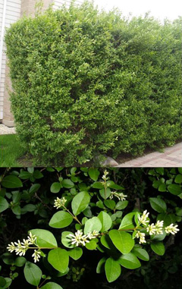
Ligustrum spp.
Privet
Leaves and berries toxic
Gastrointestianl upset, incoordination, increased heart rate, death (rare)

Slide 50
Very toxic, rarely cultivated by SoCal homeowners
Abrus precatorius - rosary pea
Acokanthera spp. - bushman’s poison
Aesculus spp. – buckeye, horse chestnut trees
Amsinckia intermedia - fiddleneck
Atropa belladonna –deadly nightshade
Daphne spp.
Ricinus communis - castor bean
Zigadenus spp. – death camas

Slide 51
No list can cover all potentially poisonous plants.
If you suspect your pet has consumed a poisonous plant or is sick, call your vet to be safe.

Slide 52
In 2012, the ASPCA Animal Poison Control Center in Urbana, Illinois, handled more than 180,000 cases about pets exposed to possibly poisonous substances.
2% fertilizers and garden products
4% plants
4% rat poison
11% insecticides (almost all regarding cats)
Remainder were medications, household products or people food

Slide 53


Gardening Questions?
Call or email
UCCE Master Gardeners of
San Bernardino County
San Bernardino MG Website:
Telephone Helpline:
Email Helpline:
http://ucanr.org/sites/sbmg
909-387-2182
mgsanber@ucdavis.edu

Slide 54
References
ASPCA -- toxic and non-toxic plants lists for dogs, cats, and horses – good photos
http://www.aspca.org/pet-care/animal-poison-control/toxic-and-non-toxic-plants?
Pet Poison Hotline Website – includes plants as well as chemicals
http://www.petpoisonhelpline.com/poisons/
California Desert Tortoise Poisonous plant list
http://tortoise.org/general/poisonp.html
Reptile Edible and Harmful plants
http://www.anapsid.org/resources/plants.html
CA poison control system
http://www.calpoison.com/public/plants-toxic.html
UCANR poisonous plants
http://ucanr.edu/sites/poisonous_safe_plants/Toxic_Plants_by_Scientific_Name_685/
Cornell Univ. Dept. Animal Science
http://www.ansci.cornell.edu/plants/index.html
http://www.ansci.cornell.edu/plants/anispecies.html
N. Carolina Poisonous plants
http://www.ces.ncsu.edu/depts/hort/consumer/poison/poison.htm
University of California Integrated Pest Management website regarding pesticides
http://www.ipm.ucdavis.edu/GENERAL/pesticides_urban.html
National Pesticide Information Center
1-800-858-7378
http://npic.orst.edu/index.html
Pesticides for Specialty Products
http://anrcatalog.ucdavis.edu/pdf/7253.pdf
Riverside Poison Control Center 1-800-876-4766
California Poison Control 1-800-222-1222
Pet Poison Control Centers:
ASPCA Animal Poison Control Center - 1-888-426-4435 ($65.00 credit card fee)
Pet Poison Helpline - 1-800-213-6680 ($39.00 credit card fee)

