Slide 1
Combining Form & Function
Dona Jenkins, Master Gardener

Slide 2
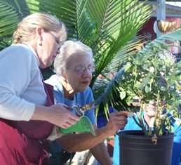
What is a
Master Gardener?
Volunteer Gardeners
Trained and certified to volunteer for San Bernardino County
Utilize UCCE and MG peer-reviewed materials

Slide 3
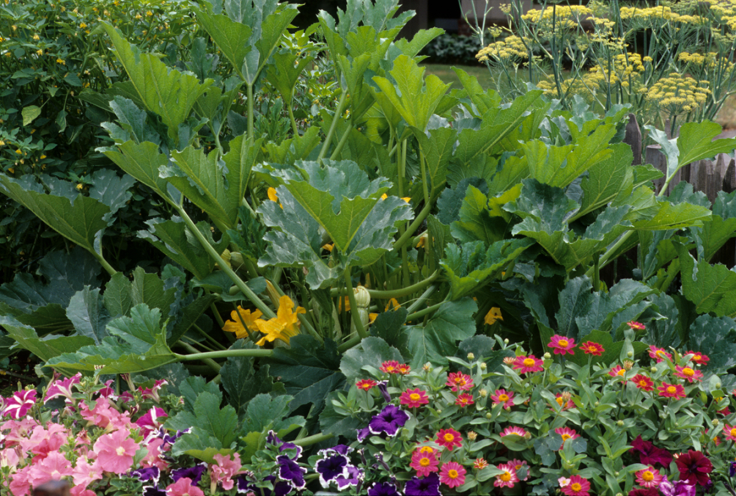
Overview of Edible Landscaping
Definition:
Edible landscaping is the use of
food plants as design features in
a landscape. These plants are
used both for aesthetic value as
well as consumption.
Important Note:
Edible landscapes encompass a variety of garden types and scales but do not include food items produced for sale.
Notes:
Edible landscaping combines FORM and FUNCTION within the same landscape.

Slide 4
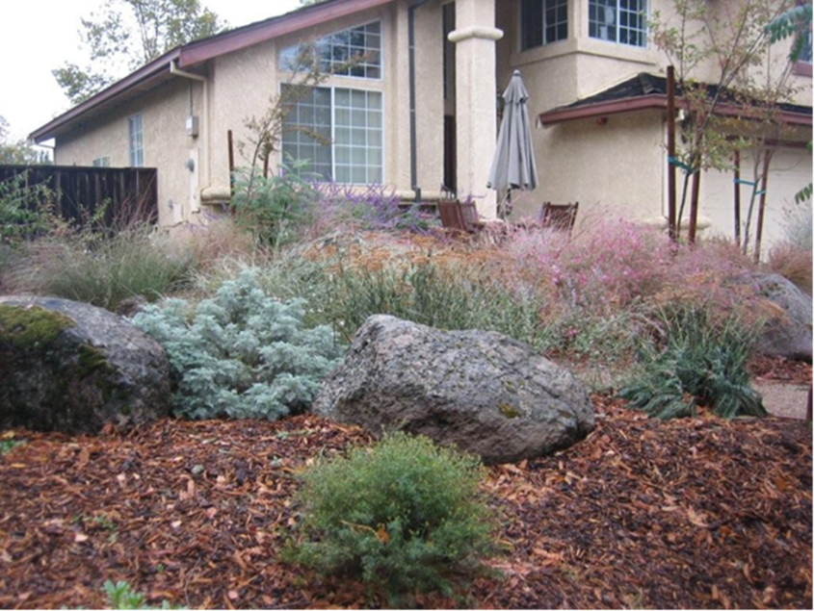
Edible Landscape vs. Traditional Landscape
The Pros
Environment – decreased food
miles, reduced reliance on fossil
fuel supported calories
Health - food security, horticulture
therapy, healthy food choices
In general, edible landscaping promotes sustainable gardening practices that maximize water efficiency, support wildlife and reduce the use of chemicals in the landscape.

Slide 5
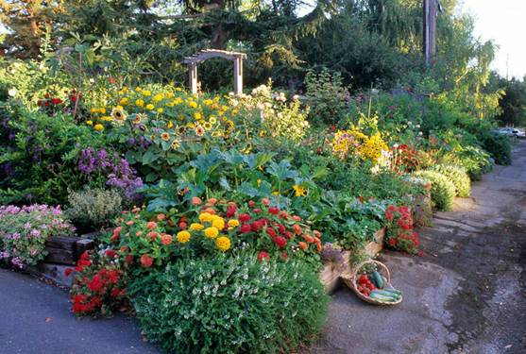
Edible Landscape vs. Traditional Landscape
The Cons
Time – increased maintenance
requirements, seasonal planting,
regular garden planning
Inputs – increased water needs
Practices - increased plant waste
typically requires healthy compost pile
Notes:
The maintenance of an edible landscape must be matched to an individual’s gardening preferences. Consider the commitment before diving in.

Slide 6
Planning & Design

Slide 7
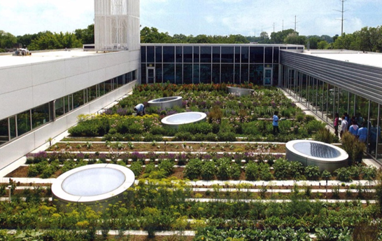
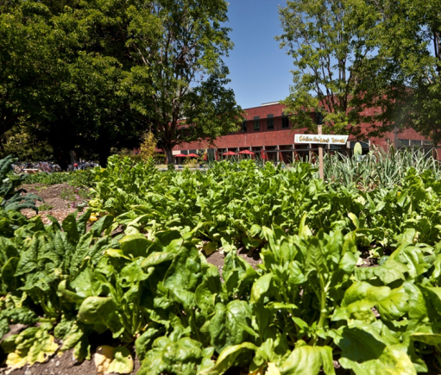
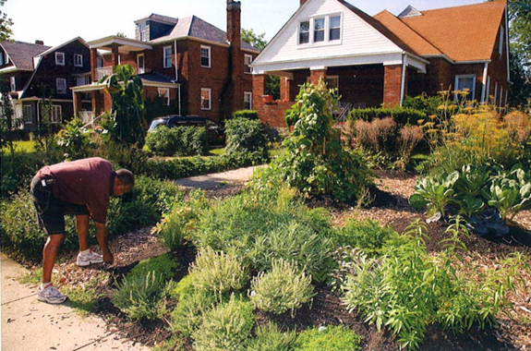
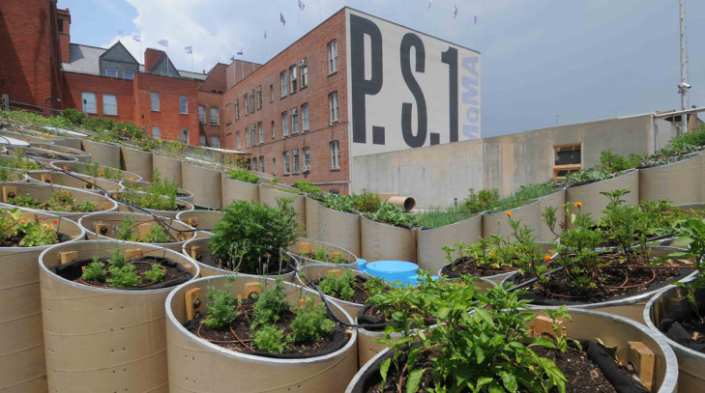
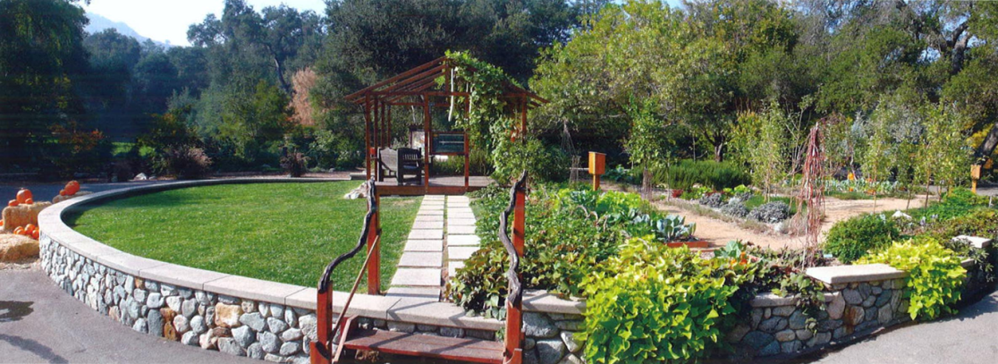
Edible Landscapes Defined:
  The use of food plants as design features in a landscape. These plants are used both for aesthetic value as well as consumption.
  It is the integration of the function of food-growing within a landscape with alternative forms & functions, including aesthetic, recreational, and other landscape functions; often requires balancing these approaches.
  It does not include food items produced for sale.
Image Sources: “Carrot City” by M. Gorgolewski, SWA Group, & C. Napawan
Notes:
It includes a range of private and public examples, from the large to the small scale. Pictured here, clockwise from top left: Edible Rooftop at the Gary Comer Youth Center in Chicago; Edible Schoolyard at the Sacred Heart School in Atherton, CA; Edible Private Residence in Baltimore, MD; Edible Art Installation in New York City; Edible Public Park in Descano, CA.

Slide 8
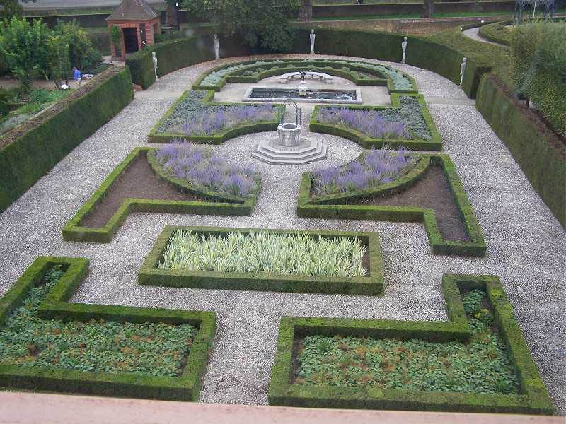
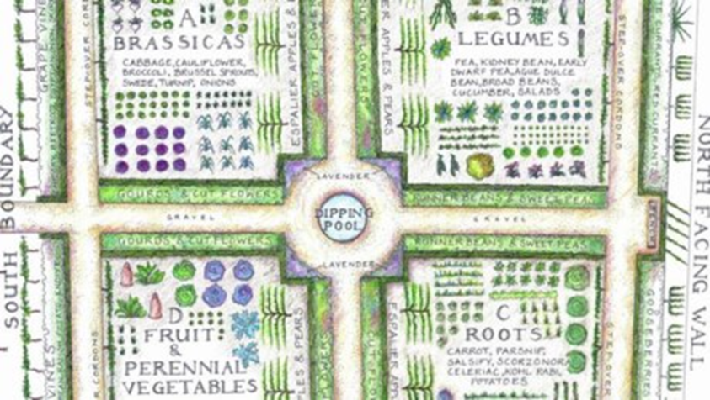
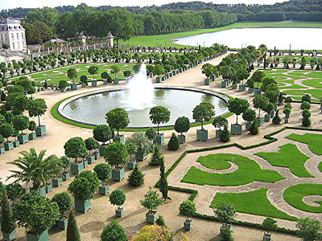
History of Edible Landscaping:
  Precedents for the integration of food-growing with alternative landscape uses exist in examining victory and community gardening in the US
  Three most influential landscape styles from Europe have their roots in food-production: Italian Renaissance gardens, French Baroque gardens, and English Picturesque landscapes.
  Most significantly, the Ferme Ornee, or ornamental farm, represents a period of popular landscape design that sought to balance food-producing with ornamental planting techniques.
Image Sources: www.nationaltrust.org/uk/
Notes:
Edible Landscaping is not a new concept, as evidenced by precedents from around the world and since the beginning of landscape & garden history.
Precedents for the integration of food-growing with alternative landscape uses exist in examining victory and community gardening in the US.
Three most influential landscape styles from Europe have their roots in food-production: Italian Renaissance gardens, French Baroque gardens, and English Picturesque landscapes. Both the landscape forms and the horticultural techniques employed draw from food-growing activities. Parterres were early means of organizing companion plants using a low, clipped-hedge; edibles were eventually replaced by ornamentals. Topiary, espalier, and pollarding techniques were pruning techniques to help in fruit-tree cultivation, but also evolved to be ornamental techniques. Left is an image of edible parterre planted at the Kew Gardens in London, center is a historic edible parterre planting plan, right is the orange topiary at the Palace of Versailles.
The Ferme Ornee, or ornamental farm, represented the period of garden design mid-way through the evolution of food-producing and ornamental landscape design, and thus is a precedent for the balance of food-producing and ornamental plants; one of the first examples of edible landscapes.

Slide 9
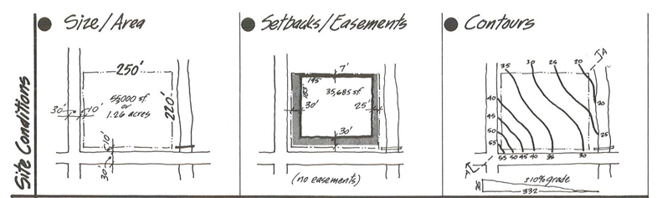
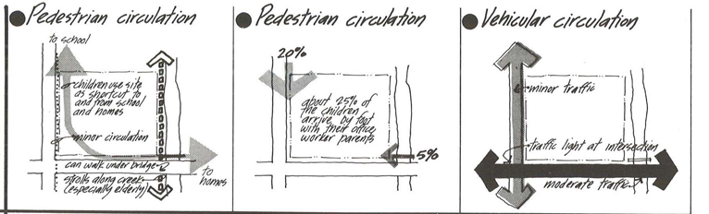
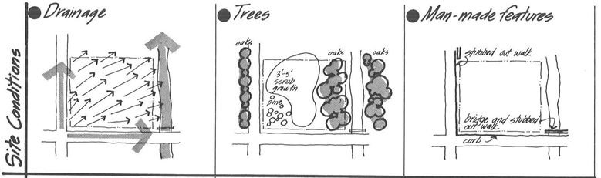
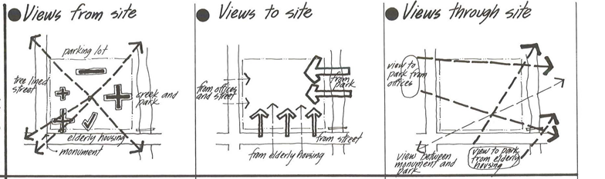
Design & Planning of Edible Landscapes
  Site Assessment includes analyzing physical attributes such as site location & adjacencies; growing region, climate, & microclimate; and resource availability such as water, soil, and solar energy.
  Client/User(s) Assessment includes understanding the needs/desires, the existing or intended patterns of use, and the maintenance capabilities of the client/users.
  Programmatic (or functional use) Assessment includes recognizing the functions attributed to the landscape other than food-growing.
Image Source: “Site Analysis” by E. T. White
Notes:
Design & Planning of any landscape is a process of synthesis. Successful design & planning of Edible Landscapes requires a thorough analysis of the intended site, client/user(s) of the site, and program (or functional use) of the site, and synthesizing these considerations into a design solution.

Slide 10
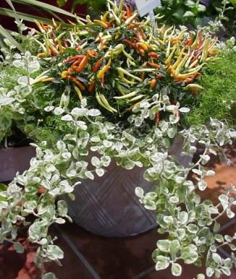
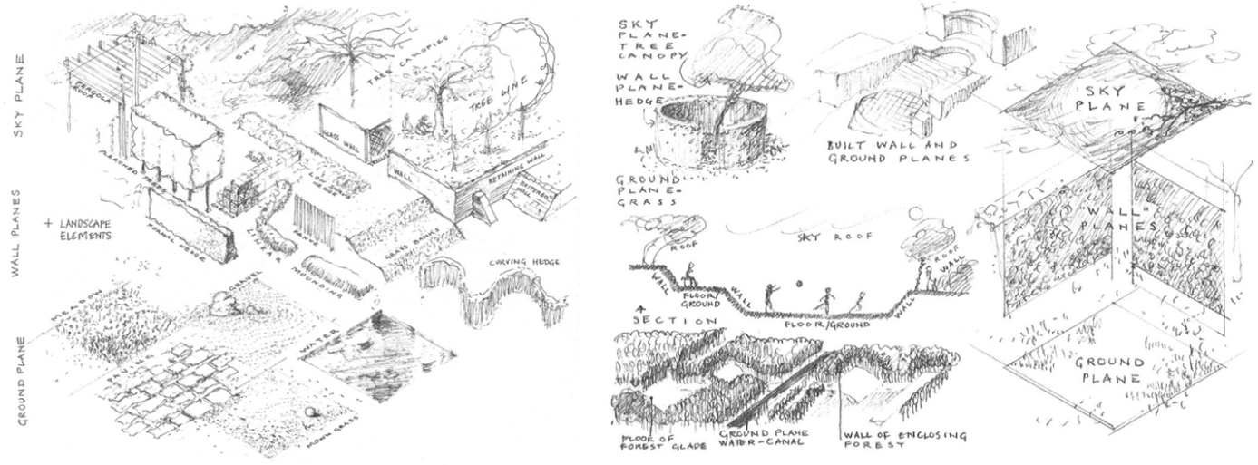
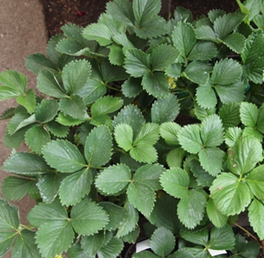
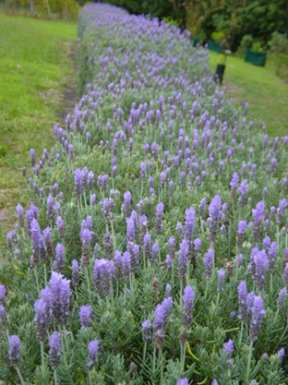
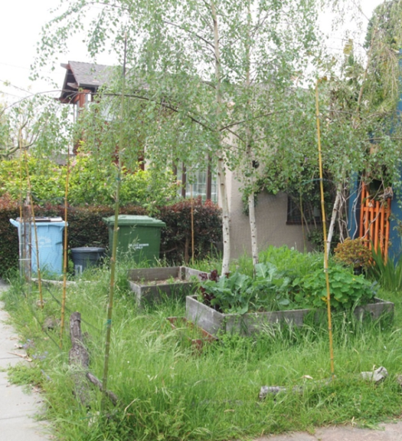
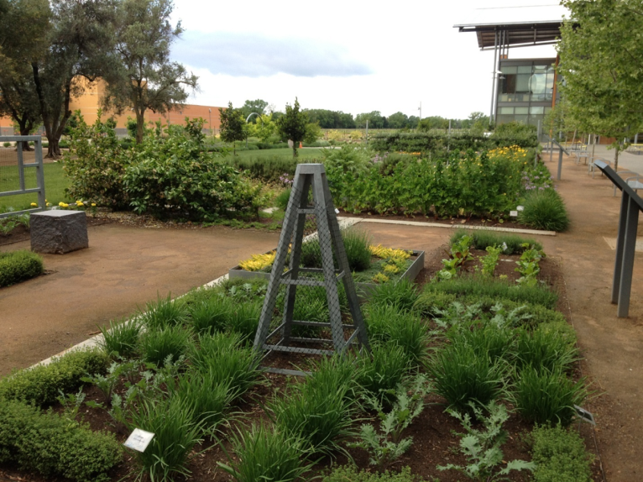
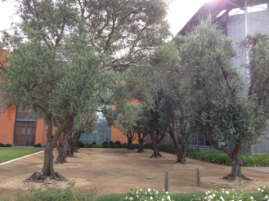
Designing for Form as well as Function:
Containers
Because a landscape loved is a landscape likely to endure.
Carpets
vs.
Hedges/Walls
Image sources: “Form & Fabric in Landscape Architecture,” by C. Dee; & C. Napawan
Canopies/Columns
Notes:
Plants take forms that help to define space through creating ground planes (carpet), vertical planes (walls, columns, objects, and containers), and overhead/sky planes (canopies). These spatial elements help define a sense of place. Choreographing these forms can help to define many kinds and sizes of spaces, from small intimate gathering places to large, grand multi-use amphitheatres. Edibles are capable of taking these plant forms as well, and together with ornamental plants, hardscape and other architectural forms (trellis, site furnishings, etc.), a well-loved edible landscape can be designed to endure.

Slide 11
Planting & Maintenance

Slide 12
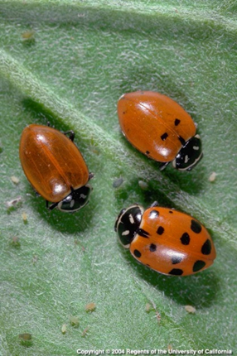
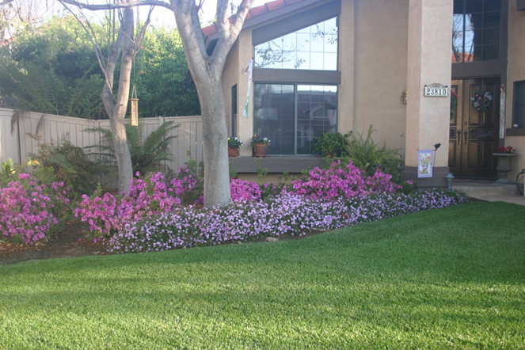
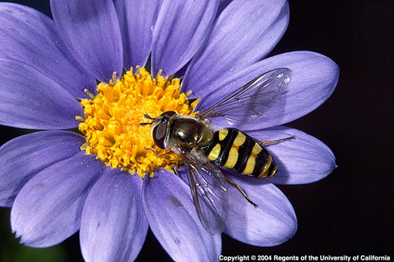
Diverse & Complex Plant Systems
Increases diversity
Eliminates monoculture
Creates habitat for beneficial organisms
Crops selected for yield and aesthetics
Notes:
Edible landscapes provide opportunities for more diverse and complex plantings than vegetable, fruit, or ornamental gardens provide individually, which eliminate crop monocultures and can increase habitats for desirable organisms. At right, larvae of syrphid fly and lady beetles are beneficial garden insects.

Slide 13
Sun and Shade Effects
Affects performance and yield of food crops
  Need at least 6 hours of sun per day
Plan for seasonal variation in shade and sun angle
Notes:
Garden shade is important to consider. Crop plants generally perform and yield best with at least 6 hours of full sun per day, which can be a challenge in many sites or within a site. Also, plan for changes in shade patterns within the landscape as the sun’ angle changes through the seasons.

Slide 14
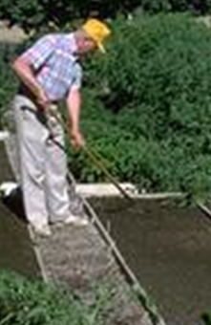
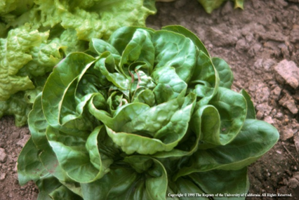
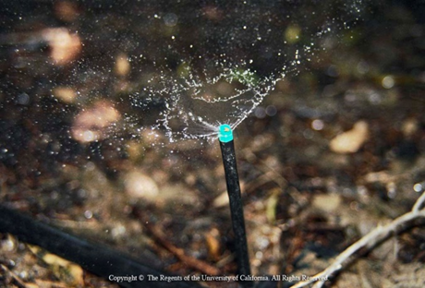
Inputs Required
Time and labor
  Attention, training, maintenance
Fertilizer
  Frequency and nitrogen
  Organic vs. synthetic
Water
  Amount
  Variation in application methods
Notes:
Edible Landscapes, versus traditional ornamental landscapes, usually require somewhat more time and labor because the management needed to assure aesthetic and yield is more intense. More fertilizer may be needed for certain edibles, particularly leafy greens. Edibles also perform best when well-watered while many ornamentals preform adequately with less than optimum water amounts. Water application methods may need to vary within landscape plantings to assure proper watering of edibles vs. ornamental components.

Slide 15
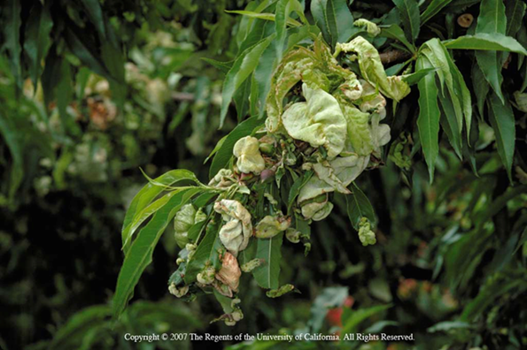
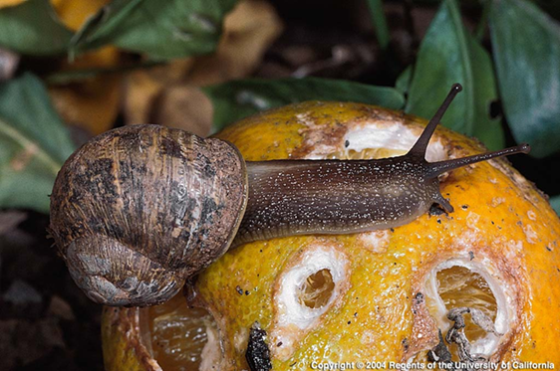
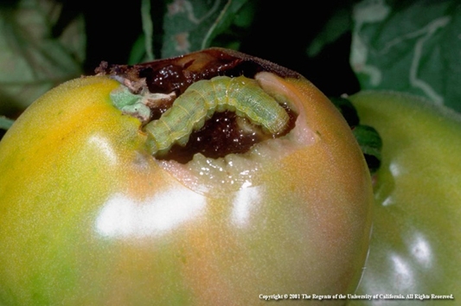
Pests and Weeds
Pest management often more demanding with edibles
IPM more complex
Notes:
Mixing edibles and ornamentals can increase the number and variety of pest problems and make pest management more complex. Pesticide use may be less needed or may need to be reduced or eliminated in edible landscapes Tolerance of pest damage may be less in edible crops thereby increasing the demand for pest management vs. traditional landscapes.

Slide 16
Soil Management Considerations in Edible Landscaping
Routine replanting annual crops
  Dedicate bed space if possible and amend with OM or perlite before planting.
Inter-planting edible crops into existing landscape areas
  Cultivation and root disturbance of permanent plants pose problems.
Notes:
Four general concepts define “What’s different about soil management in edible landscapes?”

Slide 17
Soil Management in the Edible Landscape
Fertilizer management for edibles vs. ornamentals
  Edibles often require more fertilizer, especially N
  Consider using slow-release N
Container growing
  Avoids soil management issues
  Requires good drainage and must leach potting media before planting
Notes:
Four general concepts define “What’s different about soil management in edible landscapes?”

Slide 18
Water Use in the Edible Landscape
Crops are not in uniform rows
  Consider hydrozoning and schedule irrigations based on plant needs
  Drip irrigation is a good way to conserve water
Higher planting density = greater water requirement
  Use soil amendments and mulches effectively to help with soil water retention

Slide 19
Compost
How to Amend Soil with Compost
Amend entire planting site or bed when possible, adding at least 30% compost (by volume) to original soil
Thoroughly mix compost 6 inches to 2 feet deep (depending on depth of expected root zone)
Seed edibles directly into garden soil amended with compost or transplant seedlings/container plants into amended soil at same depth they were in their containers
Irrigate immediately and maintain a moist root zone through establishment

Slide 20
Mulch
How to Amend Soil with Mulch
Apply 2.5-3.5 inches of mulch on top of the soil
Carefully spread compost around the base of plants using a shovel or rake
Avoid applications around tree trunks
Apply outward toward dripline of trees

Slide 21
Fertilizing the Edible Landscape
Chemical vs. Organic Fertilizers
Plants take up nutrients from organic and chemical sources (no preference)
Organic fertilizers feed soil microbes and require them for breakdown (“Feed the soil”)
Microbes convert nutrients from organic form into a plant-available (soluble) form

Slide 22
Chemical vs. Organic Fertilization
Chemical fertilizers:
  Provide precise nutrient amounts quickly and simply at low cost
  But they are made from nonrenewable fossil fuels, they may not promote soil health, and it’s easy to overfertilize
Organic fertilizers:
  They are renewable and biodegradable, they may improve soil structure, slow release of nutrients so it’s not easy to overfertilize, and they can utilize waste
  But nutrient content is often lower so they’re bulkier, correcting deficiencies may be slow, the nutrient content of manures and compost is often unknown, and they are often more expensive
The goal should be to improve soil nutrition with products that are natural, renewable, and not-too-distant at the lowest cost and effort.

Slide 23
Organic Fertilizer Categories
Animal-based
  Animal killed (blood, bone, & feather meals and fish products)
  Animals not killed (bat guano, manures)
Plant-based
  Alfalfa, cottonseed, and soybean meals, kelp/seaweed
Compost
  Usually considered a soil amendment, not fertilizer
Mined organic fertilizers
  Phosphorus: Soft rock phosphate
  Potassium: Muriate of potash, sulfate of potash, greensand

Slide 24
Vegetables

Slide 25
Incorporating Vegetables into your Landscape…
Make a list of edibles you like and that grow well in your climate (table 2.3 & 3.5)
Identify the cultural needs of each
  Sun vs. shade
  Soil ph
  Water requirements
  Nutrient requirements
Realize that some plants may not be compatible with certain areas or existing plants
Be aware of overall form
  Size, shape, color, flowers, fruit
Identify any pests/diseases that are common
Notes:
Whether you are staring from scratch or looking at incorporating some fruits and vegetables into an existing landscape, the first step is to make a list of edibles you like and that grow well in your climate. As you take note of them, keep in mind their cultural needs like sun versus shade, soil pH, irrigation requirements, and nutrient requirements. In doing this you may realize that some plants may not be compatible with certain areas of your landscape and/or with existing plants. You will also want to be aware of the overall form of the plantings, keeping in mind the overall size, shape, color, flowers and fruits that the plant will produce. Lastly, keep in mind that some plants are prone to more pests and diseases, so be aware of them up front and come up with a plan to deal with them

Slide 26
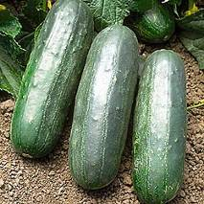
Choosing Varieties That Best Suit your Needs
Some plants have varieties / cultivars that are better suited in your landscape
  Drought tolerance
  Salt tolerance
  Disease resistance
  Pest resistance
  Striking or more profound colors
http://gurneys.com
Notes:
Once you have your list and have identified your cultural needs and potential pests and or diseases on each, look to see if varieties or cultivars are available that may make growing your edibles easier with less care or inputs. Plant breeders are becoming much more aware of edible landscaping and are adding new varieties that may make growing them easier or more attractive.
The picture is an example of a cucumber variety (Eureka) that is resistant to the following: angular leaf spot, downy mildew, papaya ring spot, scab, watermelon mosaic virus, zucchini mosaic virus, anthracnose race 1 & 2, cucumber mosaic virus, and powdery mildew

Slide 27
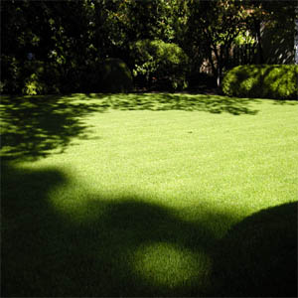
Site Selection
Vegetable crops perform best when well irrigated and receive at least 6-8 hours of sunlight
Vegetables can be used as
  Ground covers
  Annual low border bedding plants
  Visual screens
  Trellis vines
  Hanging baskets/containers
Notes:
Vegetable crops can be used and placed as edible ornamental annual plantings among or adjacent to perennial ornamental landscape plantings that perform well when well irrigated and receive at least 6-8 hours of sun per day. Specific sites and crops will be further dictated by the aesthetic functions and type of vegetables desired. Vegetable crops can serve as annual low border bedding plants, visual screens, trellis vines, and hanging basket or container plants.

Slide 28
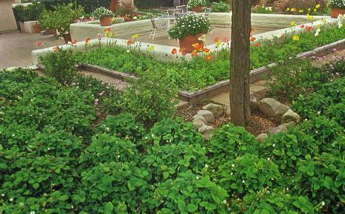
Edible Ground Covers
Alpine strawberry
Blueberry (lowbush)
Chamomile
Cranberry
Cucumber
Lingonberry
Mint (creeping)
Natal plum (dwarf)
Oca
Peanut (temporary cover)
Rosemary (trailing)
Sweet potato (temporary)
Sweet woodruff
Thyme
Wintergreen
© Rosalind Creasy
Notes:
Ground covers are low growing plants that are used to cover an area. Ground covers can be used on slopes, in raised beds, along borders, or as a lawn substitute. Some like alpine strawberry, creeping mint, oca, sweet woodruff, and wintergreen can tolerate partial shade. Only chamomile can tolerate foot traffic.
In the picture; alpine strawberry is used as a ground cover in a raised border planting.

Slide 29
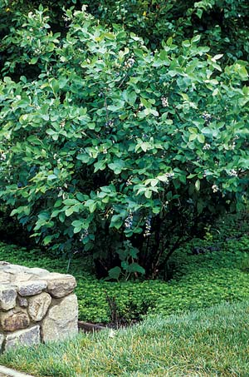
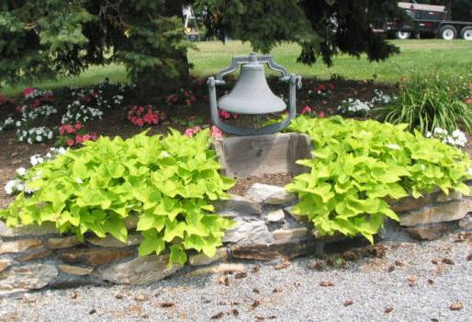
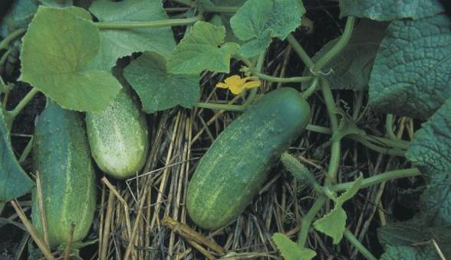
© Rosalind Creasy
© Rosalind Creasy
http://organicgardening.com
Notes:
In this picture, sweet woodruff makes an ideal groundcover below a highbush blueberry plant. Sweet woodruff thrives in partial shade and acid soils.
Sweet potato and cucumber also make a great sprawling ground cover. Choose cucumber varieties that are short to prevent misshapen fruit.

Slide 30
Edible Herbaceous Borders
Alpine strawberry
Angelica
Anise hyssop
Artichoke
Arugula (perennial)
Asparagus
Basil
Beet
Borage
Broccoli
Cabbage
Cantaloupe (bush)
Celery
Chard
Chives
Collards
Corn
Cucumber (bush or trellis)
Edible flowers
Eggplant
Endive
Kale
Lavender
Lettuce
Licorice
Lovage
Marjoram
Mitsuba
Mizuna
Nasturium
Okra
Orach
Oregano
Parsley
Pea
Peanut
Pepper
Poppy (breadseed)
Rhubarb
Rosemary
Safflower
Sage
Scented geranium
Sea kale
Shallot
Squash (summer)
Tarragon
Tomato (determinate)
Notes:
Edible herbaceous border plants can be perennial or annual and can be intermixed amongst many ornamentals both flowering and foliage plants. These plants work especially well next to walks, driveways, walls, patios, or other areas you can appreciate the plants up close. These plants also work well for breaking up large lawns or other large expanses in ground cover.

Slide 31
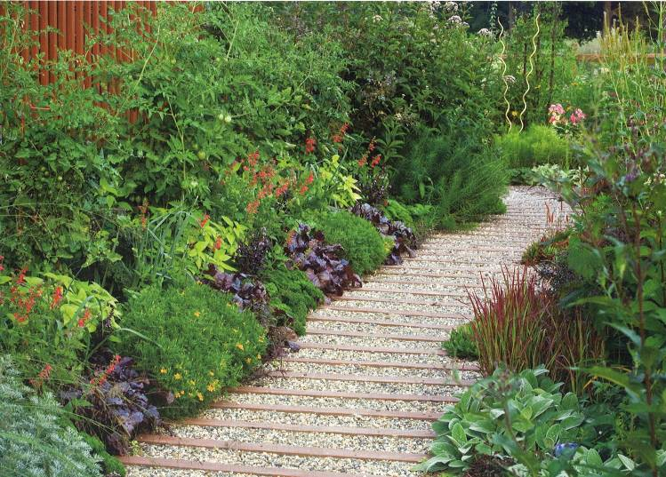
Edible Herbaceous Borders
© Rosalind Creasy
Notes:
In this example, two colorful beds combine edibles with traditional ornamentals. The repeating patterns of ‘Bull’s Blood’ beet, curly parsley, and Lemon Gem marigold give rhythm to the space. Also featured are ‘Gold Delicious’ pineapple sage as well as ‘Yellow Pear’ and ‘Sweet 100’ tomatoes

Slide 32
Edible Flowers
Anise hyssop
Apple
Arugula
Basil
Bee Balm
Borage
Broccoli
Calendula
Chamomile
Chervil
Chicory
Chives
Chrysanthemum
Citrus
Daylily
Dianthus
Dill
Elderberry
Hibiscus
Hollyhock
Johnny-jump-up
Lavender
Lemon verbena
Lilac
Marigold
Mint
Nasturtium
Okra
Passion flower
Pineapple guava
Redbud
Rose
Rosemary
Sage
Scented geranium
Squash
Sunflower
Sweet woodruff
Thyme
Tulip
Violet
Notes:
Flowering plants, with their showy displays, are often used as interest plants. Flowers have traditionally been used in many types of cooking: European, Asian, East Indian, Victorian English, and Middle Eastern. Early American settlers also used flowers as food. Today, there is a renewed interest in edible flowers for their taste, color, and fragrance. Edible flowers can be used fresh as a garnish or as an integral part of a dish, such as a salad. Squash flowers can be fried in light batter or cornmeal. Some flowers can be stuffed or used in stir-fry dishes. Edible flowers can be candied; frozen in ice cubes and added to beverages; made into jellies and jams; used to make teas or wines; minced and added to cheese spreads, herbal butters, pancakes, crepes, and waffles. Many flowers can be used to make vinegars for cooking, marinades, or dressings for salad.

Slide 33
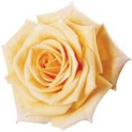
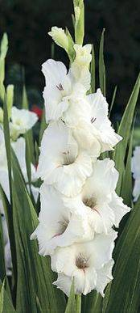
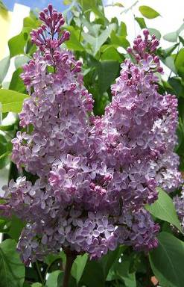
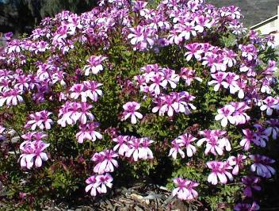
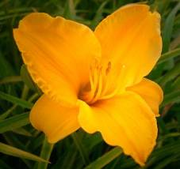
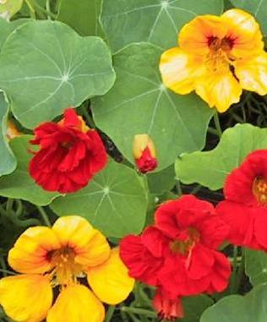
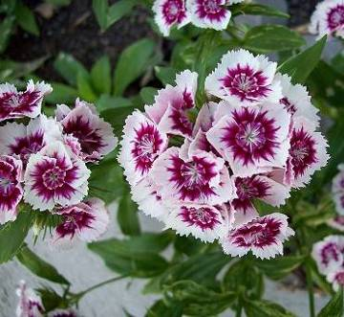
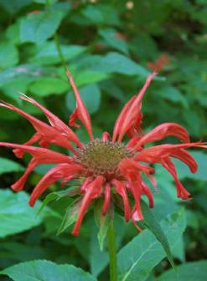
Edible Flowers
Notes:
From Left to right
Top Row: Rose, gladiolus, lilac, scented geranium
Middle row: Daylily
Bottom row: dianthus, bee balm, nasturiums

Slide 34
Planting Your Edible Landscape
Seasonal temperatures are very important
  Warm season crops germinate best when soils is between 65 to 80⁰F
  Cool season crops germinate best when soil is between 60 to 60⁰F
Plants can be direct seeded, transplants, or self seeding
  Use direct seeding for large seeded plants: corn, melons, squash, beans and peas; and for root crops: carrots, radish, beets, turnips, and parsnips
  Use transplants for crops that you want to get an early start by growing them in the house, a cold frame or greenhouse
    Follow Table 3.5 in the Edible Landscape Handbook
Notes:
Keep in mind that for many of our annual fruits and vegetable there are cool season and warm season plants. Warm season plants like melons and okra may grow slow in the early spring but will explode is size with warmer summer days and nights. Cool-season plants like lettuce thrive during the cooler months of spring and fall, when they can be direct sown for quick harvest.
Plants can be direct seeded, transplants, or self seeding
Use direct seeding for large seeded plants: corn, melons, squash, beans and peas; and for root crops: carrots, radish, beets, turnips, and parsnips
Use transplants for crops that you want to get an early start by growing them in the house, a cold frame or greenhouse
Follow Table 14.2 in the CA Master Gardener Handbook

Slide 35
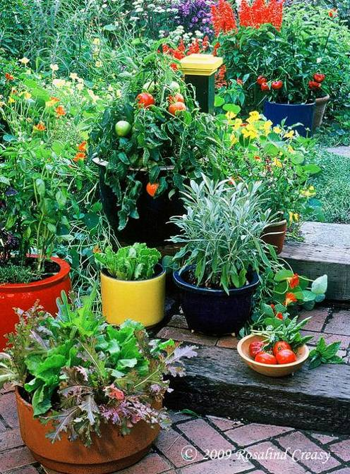
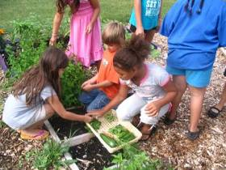
http://miyouthandfood.msu.edu/projects/index.html
Best of both worlds – edible & ornamental
Inter-planting reduces pests
New textures, forms, colors
Grow what you like best
Fun for everyone
Great conversation piece

Slide 36
Fruit Trees

Slide 37
Fruit Tree Considerations in
Edible Landscapes
Allow enough room to prune, thin, & harvest
Roots will spread 2-3 times the width of the canopy
Consider effects of sprays on adjacent plants
Consider clustering fruit trees and keeping them small
  Similar irrigation, bird netting, mulching, pollination

Slide 38
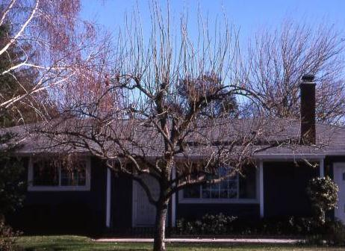
Low-Maintenance Fruit Species
Cane berries & blueberries
Citrus (for now)
Figs
Jujubes
Persimmons
Plums & pluots
Pomegranates
Notes:
These trees are not without problems, but they can often have few or no insect or disease pests.

Slide 39

Serious Problems with Some Fruit Trees
Apples & pears – Fire blight, codling moth
Apricots – Brown rot, bacterial canker
Cherries – Spotted-wing Drosophila
Citrus – Asian citrus psyllid, citrus
greening, scale insects, frost
Peach/nectarines – Peach leaf curl
Grapes – Powdery mildew
Practical solutions to several of
these pests have been developed
Notes:
If you can’t control key pests with natural controls or products available from retail stores, some trees just shouldn’t be grown or recommended.

Slide 40

Site Selection
6-8+ hours of full sun
Shelter from high winds
Some trees may benefit from warm south wall
Avoid planting where fruit falls on walks or driveway
Soil should be at least 2-3 ft. deep
Crop Specific Information
Selected planting and training methods are discussed

Slide 41
Policy

Slide 42
Your Local Community
Local Regulations or Policies
  Water Use
  Land Use
  Food Safety
Notes:
Outlines regulations or policies in place in your community that affect edible landscapes, including water use, land use and food safety.

Slide 43
Water Use
Policies related to water use may address:
  Budget
  Allocation and Pricing
  Water Capture and Conservation
  Rainwater collection systems
  Greywater systems

Slide 44
MWELO
Model Water Efficient Landscape Ordinance (MWELO)
Requires a permit for new or rehabilitated landscapes larger than
  5,000 sq.ft. for homeowner-installed projects
  2,500 sq.ft. for developer-installed projects
Permit requires calculating an estimation of annual landscape water use
Notes:
MWELO was developed in response to Assembly Bill (AB) 1881, the Water Conservation in Landscaping Act of 2006 (Laird).
Go to the Department of Water Resources website for assistance.
http://www.water.ca.gov/wateruseefficiency/landscapeordinance/
They provide a spreadsheet to assist in calculating landscape water use.

Slide 45
Information about MWELO
Local ordinances may exist in place of or in addition to MWELO
  Water provider
  City or county water resources department
  Department of Water Resources website
    http://www.water.ca.gov/
  CalRecycle
    http://www.calrecycle.ca.gov/
  Professional organizations (e.g., CLCA, APLD)
Notes:
Department of Water Resources Website http://www.water.ca.gov/
CLCA – California Landscape Contractors Association
APLD – Association of Professional Landscape Designers

Slide 46
Land Use
Private policies/restrictions
  Focus on community gardens rather than residential landscapes
Home Owner Association
  Restrictive Covenants
  Covenants, Conditions, Restrictions (CCR)
  Maintenance and aesthetics are key!
AB 1061, Lieu 2009
  This act provides that the architectural guidelines of a common interest development shall not prohibit or include conditions that have the effect of prohibiting the use of low water-using plants as a group.
Notes:
From Gardening Within the Lines: Edible Gardening Honoring Subdivision Deed Restrictions. Jane Grey January 2012. http://www.fbmg.com/Edu/ediblegardening.pdf
A restrictive covenant includes any form of declaration of covenants, conditions, and restrictions (CCR) or similar non-governmental mechanisms for controlling land use on private property, including rules regulations, or guidelines implemented under the authority of restrictive covenants.

Slide 47
Food Safety Policy
Donating produce (e.g., to food banks)
  Organization or Institution policy
    Check with target organization
    Clean containers, sound product with minimum 3-day shelf life (typical)
  Government policy
    May be local guidance
      Department of Environmental Health
    Non-food safety policy may apply to preventing spread of pests (e.g., Light Brown Apple Moth, Asian Citrus Psyllid)
      Donations may be restricted to county in which product was grown and may need to be defect free (caterpillar damage)
Notes:
Food safety –
Check with the local organization for their policy
Keep food safety in mind (next section). Starts with site selection and continues to containers used to transport product.
Sometimes recipients are very vulnerable to foodborne illness: elderly (e.g., Senior Centers), children, immune compromised
Village Harvest: www.villageharvest.org May be able to harvest product for you.

Slide 48
Harvest & Storage

Slide 49

General Rules of Harvest
Each crop has an optimum harvest period
and method.
  Varies based on:
    Individual taste preferences
    Physiological characteristics of the fruit
    Planned use of the crop

Slide 50

Stages of Ripening
Fully Ripe-Tree Ripe
  Full maturity and ready to eat at harvest.
  Best for fresh eating, drying
  Firm ripe is better for canning and freezing

Slide 51



Stages of Ripening
Physiologically Mature
Fruit may or may not continue to ripen after harvest

Slide 52

Sanitation and Harvest
Use only clean, sanitized buckets and bins
Wash hands prior to harvest
Wear clean cotton gloves to reduce contaminants on fruit
Do not stack bins/buckets
Notes:
Avoid stacking bins and buckets on top of each other to avoid introducing contaminants from the bottoms of the containers.

Slide 53

Twist Up!
Notes:
Most fruit such as peaches, nectarines, plums, cherries, apricots, pears and apples are harvest by gently twisting and pulling up on the fruit. Avoid damaging the fruit spurs. If the fruit resists separating from the spur, it is likely not quite ready to harvest.

Slide 54

Key Storage Requirements
Depends on Product:
Most ripe fruit (apples, stone fruits, fig and berries)
  Harvest in a.m.
  Place in refrigerator at 32-35F ASAP
  Get fruit cold after harvest and keep cold
  until use

Slide 55

http://ucce.ucdavis.edu/files/datastore/234-1920.pdf
Notes:
This chart is a synopsis of how to store many types of fruits and vegetables.

Slide 56


What about Storing Vegetables? http://ucanr.org/sites/gardenweb/files/29040.pdf
Notes:
This website has an excerpt from the Master Gardener Handbook, which can be a very useful guide for harvest and storage of vegetables.

Slide 57
Food Safety

Slide 58




Key points
Fruits and vegetables are a very
important part of a healthy diet
Fruits and vegetables can be a
source of foodborne illness
Common sources of foodborne pathogens (microorganisms that cause illness) in produce include:
  Water
  Animals: wild and domestic
  Soil amendments (especially animal-based)
  People
Preventing contamination is key
  Evaluate and mitigate risks from pre-plant
  to harvest of the of the edible landscape.
Notes:
Strawberries: Used under Creative Commons Attribution license, USDA
ChooseMyPlate: USDA
E. coli: NIAID
Deer: Used under Creative Commons Attribution-No Derivative works license, USDA
Snap pea and pansy photo by Sheryl Yamamoto

Slide 59

Good Agricultural Practices
Focus is on RISK REDUCTION
  Prevent contamination where possible
4 main sources of foodborne pathogens
  Water
  Wildlife or domestic animals
  Soil amendments
    especially those derived from animals
  People
Notes:
As a result of the recent history of outbreaks and several high impact outbreaks, the use of Good Agricultural Practices has become an essential component of doing business on commercial farms. The guidelines focus on risk factors and have a strong emphasis on preventing food safety-related issues from the planning stage of the farm through distribution of the produce. Prevention is KEY. It is generally accepted that once the produce is contaminated, it is exceptionally difficult to remove or kill the pathogens present on the fruit or vegetable if that product is eaten fresh. Knowing the risks and mitigating those risks up front is the most effective method for being able to enjoy safe produce.
What are the risks of contamination? Foodborne pathogens are excreted in the feces of animals and humans. Therefore, there are 4 main source of foodborne pathogens in the garden: water (when contaminated), animals, soil amendments, and people. Good agricultural practices take these sources into consideration and work to reduce risk. We will address these in more detail later in the presentation.

Slide 60




Microbiological Safety of the Edible Landscape
Growth(PreHarvest)
  Water
  Soil Amendments and Supplements
  Animal access
Planning
  Site Selection
  Water Source
  Facilities: toilets and handwashing
Harvest
  Personal Hygiene and Handwashing
  Cleaning and Sanitation
Post Harvest
  Washing Produce
  Food Storage and Preservation
Notes:
Here is an illustration of the GAP-based approach to edible landscape safety. We will discuss points to consider during each phase from planning the garden through post-harvest.
Planning Photo: Used under Creative Commons Attribution license by USDA, Lance Cheung
People’s Garden photo used under Creative Commons Attribution-No Derivative Works license by USDA, Lance Cheung
Tomato Seedlings photo used under Creative Commons Attribution license by USDA, Lance Cheung
Washing photo used under Creative Commons Attribution license by USDA, Lance Cheung

Slide 61

Site Selection
(community gardens)
Know the history of the land
  Risk assessment of prior use
Consider the neighbors
  Zoning in surrounding areas
  Present/Future use
Existing structures/equipment
  Septic tanks
  Plumbing
  Toilets
Notes:
When choosing a site for any type of edible landscape, it is important to know the history of the land. This is particularly important for community gardens but may also be an issue in the home garden. Was there prior land use that could have left chemical, physical, or microbiological hazards lingering on the site? Were cattle or foul previously farmed on the land? Did chemicals unintentionally contaminate the site?
Particularly for community gardens: Who are your neighbors? What are they doing now and how do they plan to use the land in the future? What type of zoning exists? What will they build next to the property line next year?
Take a look at the integrity of the existing structures on the property. Where are the sewage line? Is there a septic system and where is it located? How will you be delivering water to the landscape? Are the waterlines clean? These are some of the issues to be considered before deciding on a site for your edible garden.
Photo used under Creative Commons Attribution license by Rick Bradley. Derivative work by S. Yamamoto

Slide 62



Method of Water Application
Foliar application (spray)
  Water in contact with edible parts
  Use water from a safe source
Soil application (trickle, drip)
  May lower risk if properly maintained
Water used to mix solutions or chemicals that contact the edible plant must be potable!
Notes:
The greatest risk for foodborne illness occurs when the edible portion of the crop is contaminated close to the harvest date. This includes plants that yield fruit with peels that may not be consumed (melons, citrus).
Gardeners have two general methods for delivering water to their plants: foliar application (spray) and soil application (trickle or drip).
Lower your risk by irrigating with potable water where the contact is direct and close to harvest. Use drip or trickle methods of irrigation when water quality is unknown or of lower quality (e.g., surface water, rainwater, or greywater) but make sure these systems are maintained – that they do not leak or cause water to pool. Water that is known to be microbiologically safe (such as clean municipal or tested well water) is not likely to introduce microbiological contamination to the plant. However, dirty pipes or hoses, may result in contamination of water that is clean leaving the tap.
Water on Leaf: Photo from Wikimedia by Kkong
Garden Water: Photo used under Creative Commons Attribution-NoDerivs license by USDA
Drip system: Photo used under Creative Commons Attribution-Share Alike license by JISL

Slide 63

Soil Amendments
Compost
  Animal sources (manure)
    Potential source of high levels of pathogens
    Properly composted or heat treated
    Manure from pigs, dogs, and cats must not be used
      parasites may remain viable after composing
  Vegetative matter (no manure)
Green manures
  Plant matter grown and chopped and incorporated into soil
Notes:
Use of properly composted manures is strongly recommended over the use of raw manures. Animal manure as well as human sewage must be properly composted. Manure from pigs, dogs, and cats must not be used as parasites may remain viable after composting.
Domestic green manure is made from plant matter that is grown and chopped before applying to the soil. It does not contain animal manure and does not need to be composted to be used safely.
Photo by S. Yamamoto

Slide 64

Equipment and
Personal Protective Items
Check that all are clean and well maintained
Consider designating tools/gear for
certain tasks
  Chemical use/Compost
  Harvesting
Wash and sanitize harvest tools
(e.g., clippers, knives) and gloves
  As you would kitchen utensils
Keep workspace clean
Notes:
Consider designating tools or protective equipment to either “clean” or “dirty” jobs in the garden to prevent cross-contamination of microbial and chemical hazards to edible plants. For example, one set of tools can be used for working with or applying compost while another can be used for working around edible plants. Designate one pair of gloves for pesticide application while another pair can be designated for pruning or harvesting edible plants. Alternatively, disposable latex or nitrile gloves may be used for working with compost or chemicals and simply discarded when the work is finished. If the disposable gloves are worn under normal gardening gloves, be sure to launder the gardening gloves.
Tools and protective items used during harvest such as clippers, buckets, or gloves should be cleaned and sanitized before use. Clippers can be placed in the dishwasher while fabric gloves and other protective clothing can be laundered. Clean surfaces directly in contact with food including tabletops, workbenches, containers and bins by first washing with warm soapy water and then rinsing with a sanitizing solution such as bleach (1 tablespoon household bleach per gallon of water).
Exclude and discourage vectors (insects, rodents, birds, etc) from the workspace or storage area. Discard old/damaged fruit and clean surfaces of food residue.
Workbench: Used under Creative Commons Attribution license by Andrea44

Slide 65

Dry produce with paper towels before storage.
Transfer to a sanitary container.
Wash hands, sanitize brushes, work surfaces, cutting boards and knives.
Scrub or rub fruits and vegetables with a brush or hands under running water.
How to Wash Produce
Notes:
To wash produce, begin with sanitary hands, tools and work surfaces. Unwashed produce should not be stored on the sanitized cutting surface, but rather in a clean bag or container. Begin by washing produce under clean running water and when possible use a scrub brush or rub the item with your hands to remove visible and non-visible soil. Dry the fruits or vegetables with disposable paper towels.
Washing in batches can result in one contaminated item spreading microorganisms to other items in the batch. When washing produce, dish soaps and detergents are not recommended because they are not designed for this use and chemical residues may remain on the fruits and vegetables. The safety of these residues has not been evaluated. Commercially available fruit and vegetable wash solution may remove some dirt on some types of produce, however, the ability of these solutions to reduce microbial populations has not been standardized.
Certain produce items require different washing methods due to their physical qualities or history of contamination. Removing the outer green leaves from items like lettuce is recommended before washing. Hulls or stems from items like tomatoes, strawberries, and peppers are best removed after washing. In the case of canteloupe, cut off the stem end of the clean dried melon (about ¾ to 1 inch), peel, cut in half, remove seeds, and cut into slices.
Additional information on washing, preparing and storing fruits and vegetables can be found at http://ucfoodsafety.ucdavis.edu/UC_Publications/UC_Home_Preservation_and_Storage_Publications/ under “Home Preservation and Storage - by Specific Food”
Grape washing: Photo used under Creative Commons Attribution license by Dan4th Nicolas

Slide 66




Storage
Short term storage
  Cut fruit: Refrigerate within 2 hours (1 h if >90°C))
  Whole fruit: Refer to storage chart by Postharvest Technology Research and Information Center
Several methods of home preservation
  Freezing
  Drying
  Fermentation
UC Home Preservation and Storage Publications
  www.ucfoodsafety.ucdavis.edu
  Pickling
  Canning
  Jams and Jellies
Notes:
Washed produce should be consumed soon after washing. Washed and CUT produce should be consumed immediately or refrigerated within 2 hours. For more information about safely serving fruits and produce, refer to http://www.fda.gov/food/resourcesforyou/consumers/ucm114299
If the produce is not immediately consumed following washing it will need to be stored. Some fruits and vegetables are best stored at room temperature to preserve the quality of the item while the quality of others is best preserved at refrigerated temperatures. This chart produced by Postharvest Technology Research and Information Center shows proper storage of a variety of fruits, melons, and vegetables and is available on the ucfoodsafety website (or as a handout in this course)
Fruits and vegetables can be stored for long periods of time if frozen, dried, fermented, or canned. The UC Davis food safety website contains links to brochures describing the post harvest handling on a variety of fruits and vegetables.
An important additional resource is the National Center for Home Food Preservation: Link from this page: http://ucfoodsafety.ucdavis.edu/Home_Food_Preservation/
There are several UC publications: http://ucfoodsafety.ucdavis.edu/UC_Publications/UC_Home_Preservation_and_Storage_Publications/
Canning Safe Methods of Canning Vegetables (PDF 355 KB)
Fermentation http://nchfp.uga.edu/how/can6a_ferment.html
Photos by:

Slide 67


Gardening Questions?
Call or email the
UCCE Master Gardeners of
San Bernardino County
Telephone Hotline | 909-387-2182
Email Hotline | mgsanber@ucdavis.edu
MG Website | http://ucanr.edu/sites/sbmg

