Slide 1

Less Toxic Pesticides for Gardens and Landscapes
Master Gardener Program of San Bernardino County

Slide 2
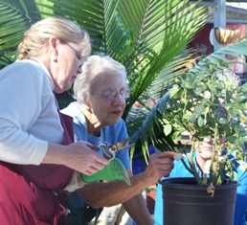
Who We are
Master Gardeners participate in this program entirely on a volunteer basis.
Master Gardeners are trained by the University of California Cooperative Extension to provide the gardeners of San Bernardino County with research-based information.

Slide 3
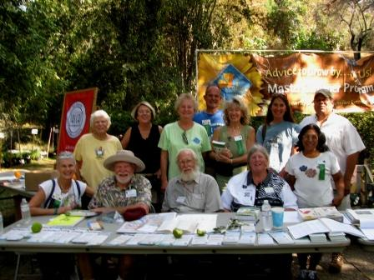
Master Gardeners of san Bernardino County
Our ultimate goal is to improve the quality of life for Riverside County residents by assisting individuals and groups in identifying garden related issues and resolving garden questions.

Slide 4
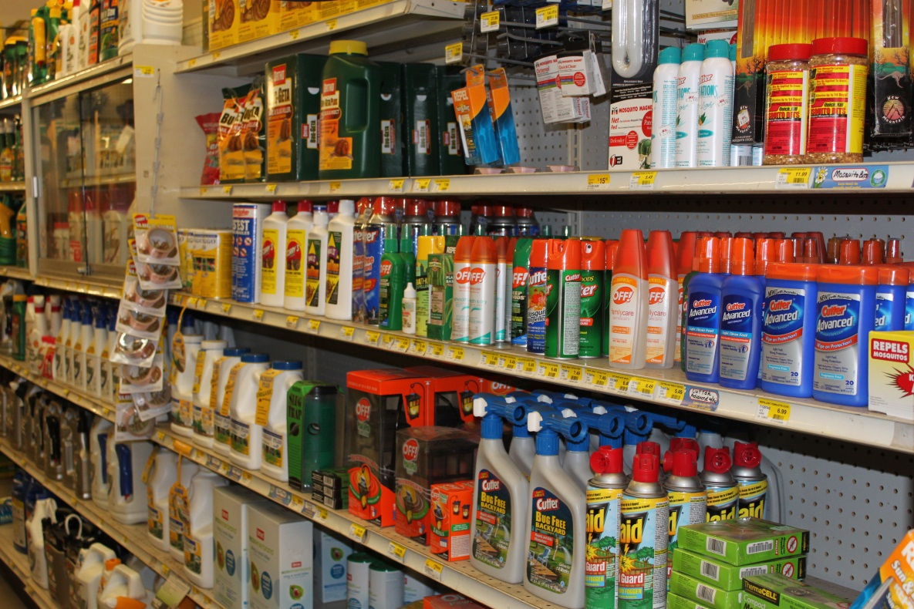
Less Toxic Pesticides for Gardens and Landscapes
Prepared by the UC Statewide Integrated Pest Management Program
Notes:
DB notes:
This is the slide that we should use to introduce the Presenter(s) and Coordinator(s). Credit goes to our friends at the IPC for presenting this material. Announce that questions should be held off until the end of the Power Point, to make sure there is enough time to cover the material.
The Power Point should take around 30 minutes, with a little less than 1 minute per slide.
We still need to work in the “Name that Pesticide” exercise and the audience quiz.

Slide 5
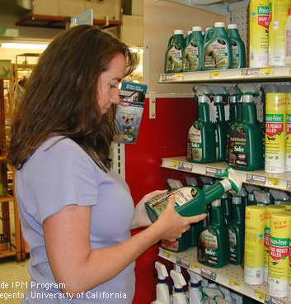
Topics covered in this presentation
Types of pesticides and active ingredients
Pesticide toxicity and impacts
The pesticide label
Less toxic and organic pesticides
Resources for information
Notes:
In this presentation you’ll get a brief overview of
types of pesticides,
pesticide toxicity and impacts,
and key information on the pesticide label.
You’ll also learn about some
less toxic pesticides
and where to go for more information
for home and garden pesticide information
.

Slide 6
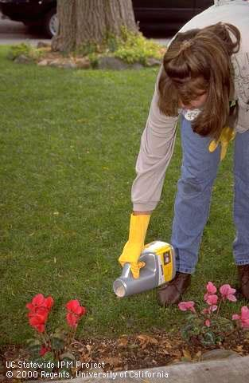
What are Pesticides?
Substances that control, suppress, prevent or repel pests
What is a pest?
Notes:
Pesticides are substances that
control,
prevent
or repel
pests.
The term pesticide applies to a range of products that control different types of pests. These include
herbicides,
insecticides,
fungicides
and rodenticides.

Slide 7
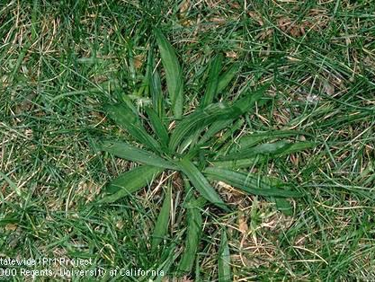
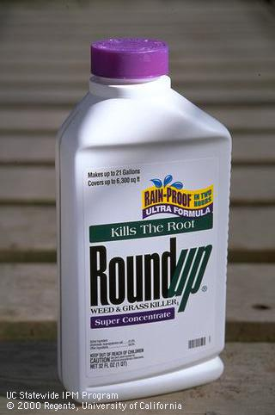
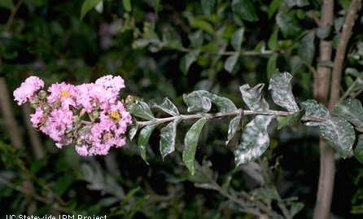
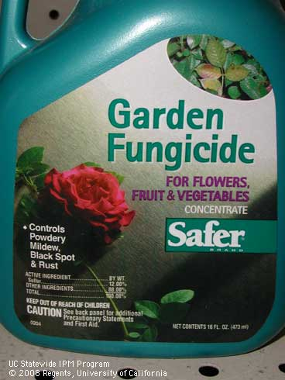
Pesticide Types by Pest
Examples:
Glyphosate
2,4-D
Benefin
Trifluralin
WEEDS
HERBICIDES
Examples:
Sulfur
Copper
Chlorothalonil
Oils
Soaps
FUNGI/PLANT PATHOGENS
FUNGICIDES
Notes:
Herbicides
Pesticides used to control weeds are called Herbicides (also know as weed killers).
Active ingredient examples include
glyphosate,
2,4-D,
benefin
and trifluralin.
Fungicides
Pesticides used to control fungi and other plant pathogens are called Fungicides.
Examples include
sulfur,
copper,
chlorothalonil,
and certain fungicidal soaps and oils.

Slide 8
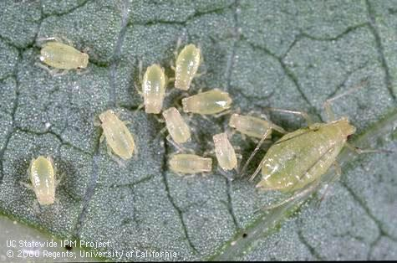
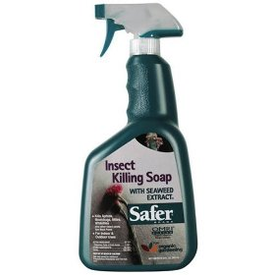
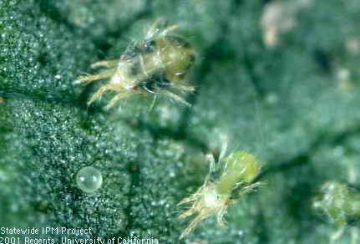
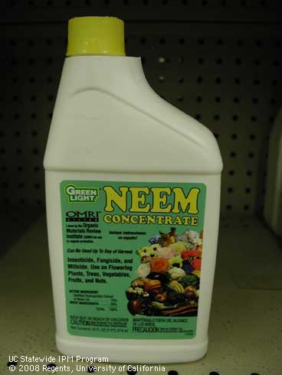
Pesticide Types by Pest
Examples:
Imidacloprid
Carbaryl
Malathion
Pyrethrin
Permethrin
Bifenthrin
Oils
Soaps
INSECTS
INSECTICIDES
Examples:
Oils
Soaps
Some insecticides
control mites
MITES (spider mites)
ACARICIDES or
MITICIDES
Notes:
INSECTICIDES
Pesticides applied to control insects are called INSECTICIDES. There are many insecticides available for use in landscapes.
Some of the most common active ingredients are listed here including
imidacloprid,
carbaryl,
malathion,
pyrethrin,
permethrin,
bifenthrin,
and insecticidal oils and soaps.
Many insecticides also control mites but pesticides specially formulated to manage mites are called acaricides or miticides.

Slide 9
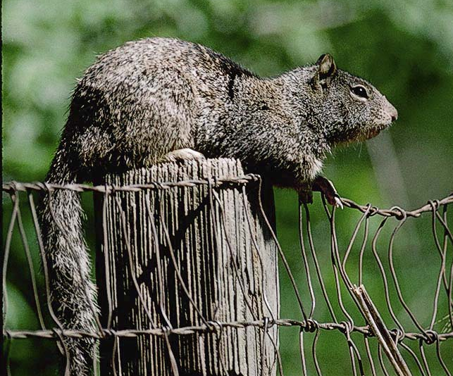
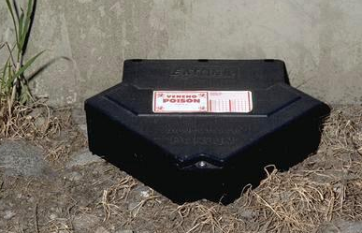
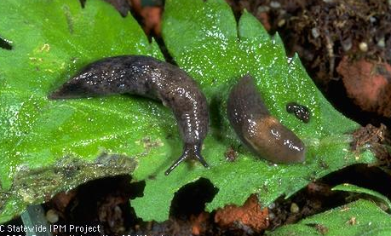
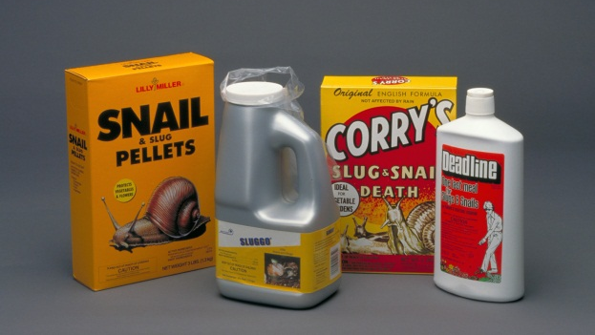
Pesticide Types by Pest
Examples:
Strychnine
Warfarin
Diphacinone
Chlorophacinone
Zinc phosphide
VERTEBRATE PESTS
RODENTICIDES
Examples:
Metaldehyde
Iron phosphate
SLUGS AND SNAILS
MOLLUSCICIDES
Notes:
Rodenticides
Pesticides applied to manage rats, mice, ground squirrels, gophers or other rodents are called Rodenticides.
Many of these products are quite toxic to pets or wildlife and should be placed in bait boxes or out of reach.
Examples include
strychnine,
warfarin,
diphancinonene,
chlorophacinone
and zinc phosphate.
Molluscicides
Pesticides applied to control slugs and nails are called Molluscicides
Metaldehyde
and iron phosphate
are common active ingredients in molluscicide products.

Slide 10
Pesticide toxicity
TOXICITY is the ability of a pesticide to injure a living organism.
ALL pesticides are toxic to some organisms.
DOSE: More toxic pesticides cause harm at lower doses than less toxic pesticides.
Notes:
Toxicity is the ability of a pesticide to injure a living organism. Exposure to pesticides may be through several routes: skin (dermal), mouth (oral), lungs (inhalation), and eyes.
All pesticides are toxic to some organisms.
More toxic pesticides cause injury at lower doses than less toxic pesticides.

Slide 11
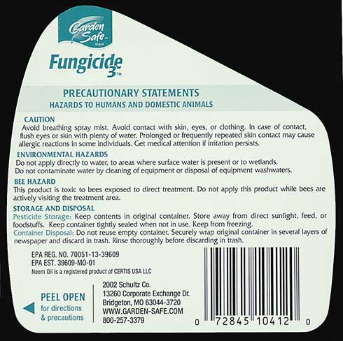
Read the Pesticide Label!!
Product and brand identification
Active ingredients
Directions for use
Precautionary statements
  Hazards to Humans, Domestic animals and the Environment
First aid instructions
Note to physicians
Storage and Disposal
Notes:
The pesticide label includes important information. This is your main source of information in the store. Learn how to locate this important information on the label. Labels from different manufacturers present the information in different ways, but most contain the information listed here: (Read off bullets)

Slide 12
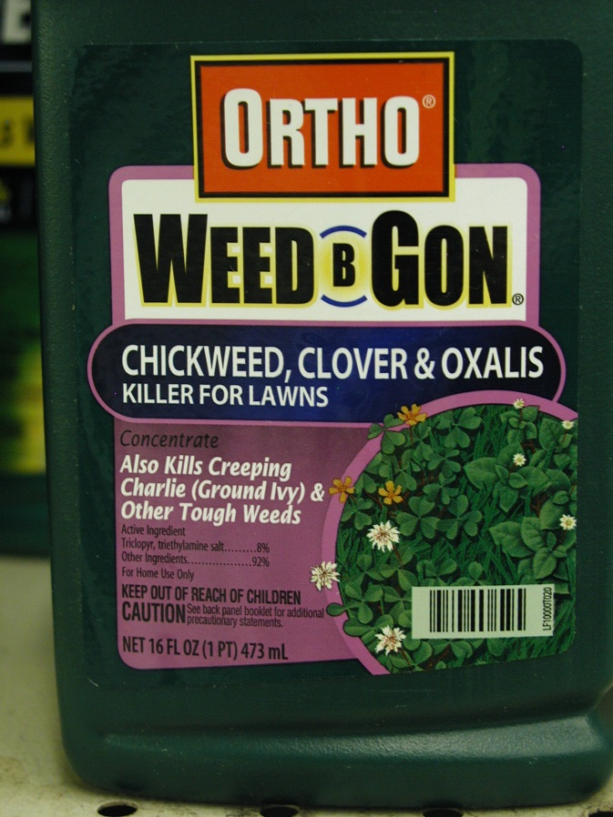
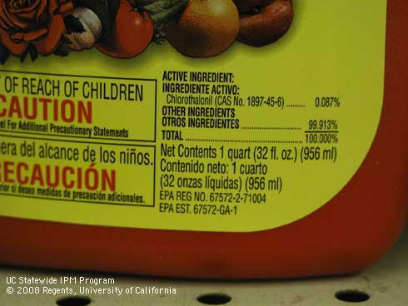
Don’t confuse the trade name and the active ingredient name
Look closely for
Active ingredients
Signal word
EPA registration number
Notes:
The most prominent name on the pesticide label is the trade or brand name. Don’t confuse it with the active ingredient.
active ingredient
The active ingredient is the toxic chemical that controls the pest. It is very important that you know what the active ingredient is in the pesticide you are considering using.
There are usually multiple products (and trade names) for an active ingredient. Sometimes very similar trade names are used for different active ingredients. It is difficult to keep up with products because manufacturers come with new products every year, change the formulation or active ingredients in existing products, discontinue products, and change packaging.
Also look on the label for the EPA Registration number. EPA stands for the United States Environmental Protection Agency. The EPA Registration number is specific to each product. It is also useful if you are trying to look up information about a product. (More on EPA and registration on a later slide)
signal word
The signal word gives an indication of the acute toxicity of the product as shown in the next slide.

Slide 13
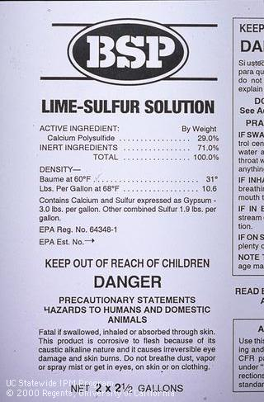
Signal Words indicate acute toxicity
SIGNAL WORD | Toxicity | Approx Human lethal dosage
DANGER-POISON | Highly toxic | Taste to a teaspoon
DANGER | Highly hazardous | Pesticide-specific
WARNING | Moderately toxic | 1 teaspoon-1 oz
CAUTION | Low toxicity | 1 oz to relatively nontoxic
Notes:
signal word
Signal words apply primarily to human health and indicate acute or immediate toxicity.
Signal words do not provide information related to cancer or other long term effects.
Most nonrestricted products used around homes and landscapes have the signal word “caution” or “warning”. but a few products with “danger” signal words are still on the shelves.
Direct your customers to the safest effective products.
Pesticides with CAUTION present the least hazard. However, there is still a great variation in the hazard of these relatively safer products with some being essentially nontoxic and others toxic if, for instance, substantial quantities are swallowed.
Many pesticides with caution signal words may be very toxic to fish, honeybees, desirable plants or beneficial organisms.

Slide 14
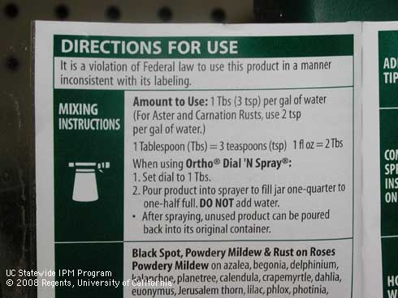
Directions for use
How to mix up product (if applicable)
What plants or sites you can use it on
What pests it controls
Special restrictions
Notes:
The Directions for Use portion of the label tells how to mix up (if a concentrate) and apply the product.
Make sure you have the proper tools to measure the product accurately as well as the recommended application equipment and safety equipment. It’s important to know this information before leaving the store in case you need to purchase these items.
The directions for use also specifies what pests will be controlled and what plants and sites you can use the product on.
This is very important– if you target pest or plant is not listed, you should not use the product. Using a product that is not appropriate for your pest or situation may be ineffective and wasteful.

Slide 15
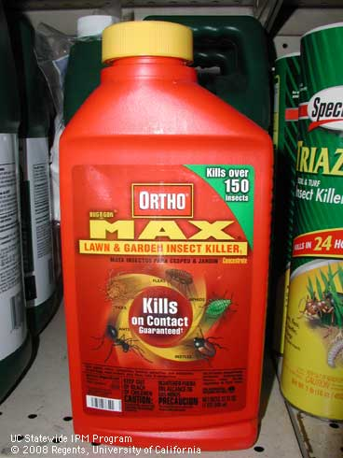
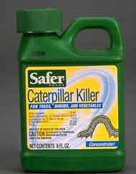
Pesticide Selectivity— Insecticides
A broad-spectrum pesticide kills a wide range of organisms
A selective pesticide kills only organisms in
a related group.
Bifenthrin kills all types of insects including ants, grubs, aphids, caterpillars, bees as well as fish and nontargets.
Bacillus thuringiensis (Bt.k) kills only caterpillars feeding on leaves or buds of sprayed plants. Beneficials, bees and wildlife not affected.
Notes:
Pesticide selectivity indicates the range of organisms or plants and animals killed or injured by the pesticide.
A broad-spectrum pesticide kills a wide range of organisms. For instance, the insecticide bifenthrin kills all types of insect pests including ants, grubs, aphids, and caterpillars but also kills many beneficial insects such as honeybees and natural enemies. Bifenthrin is also very toxic to fish and other aquatic animals and moderately toxic to birds and mammals.
A selective pesticide kills only organisms in a related group. A good example is the insecticide BT or Bacillus thuringiensis, which is only toxic to caterpillars. It is not toxic to other types of insects including other pests such as aphids or beneficials such as honeybees or natural enemies. It is nontoxic to fish, other wildlife and people.
Broad spectrum pesticides are much more likely to cause environmental or health problems. Where possible, choose a selective pesticide to manage your pest.

Slide 16
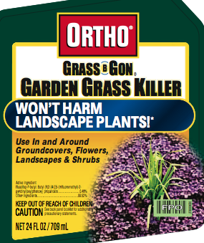
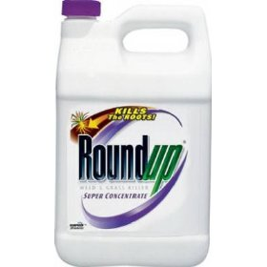
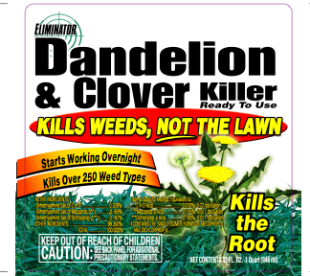
Pesticide selectivity– Herbicides
Selective
Non-Selective
FLUAZIFOP:
Kills grasses but not broadleaves.
2,4-D, MCPP:
Kill broadleaves not grass.
Glyphosate:
Kills broadleaves AND grasses.
Notes:
Selectivity is very important when choosing herbicides. Herbicides are plant killers and have the potential to injure or kill ornamental plants or lawns as well as weeds if not used properly.
You need to choose a herbicide that will not injure desirable plants in the landscape.
Certain herbicides are toxic to grasses but not broadleaved plants. These herbicides, such as fluazifop, are the best choice when you are trying to kill bermudagrass or other grasses growing in beds with broadleaved shrubs.
Other herbicides are toxic to broadleaf weeds such as dandelion and clover, but do not kill grasses. These herbicides such as 2,4-D are good choices when trying to kill broadleaf weeds in lawns.
Non-selective herbicides will kill or injure plants indiscriminately.

Slide 17
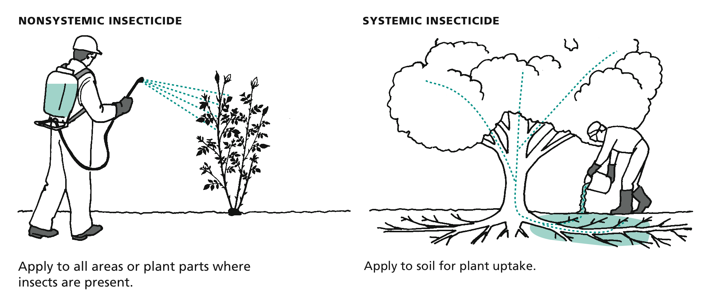
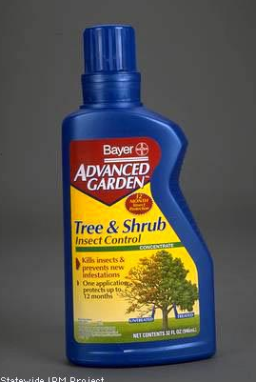
Contact (nonsystemic) vs Systemic Insecticides
Example: Most insecticides
Example: Imidacloprid
Notes:
The terms systemic and nonsystemic are also applied to insecticides.
Contact insecticides only kill insects on the parts of the plant that are covered with the spray.
Most insecticides used in landscapes are contact insecticides.
Systemic insecticides are taken up by the plant—usually through the roots, but sometimes through trunks or leaves—and moved to leaves and shoots.
This is a very effective way of getting insecticide to leaves in tall trees and other areas that are difficult to cover with a spray.
Some systemics may remain active in the tree, controlling insects for many months after application.
Imidacloprid is the most common systemic insecticide used in landscapes.

Slide 18
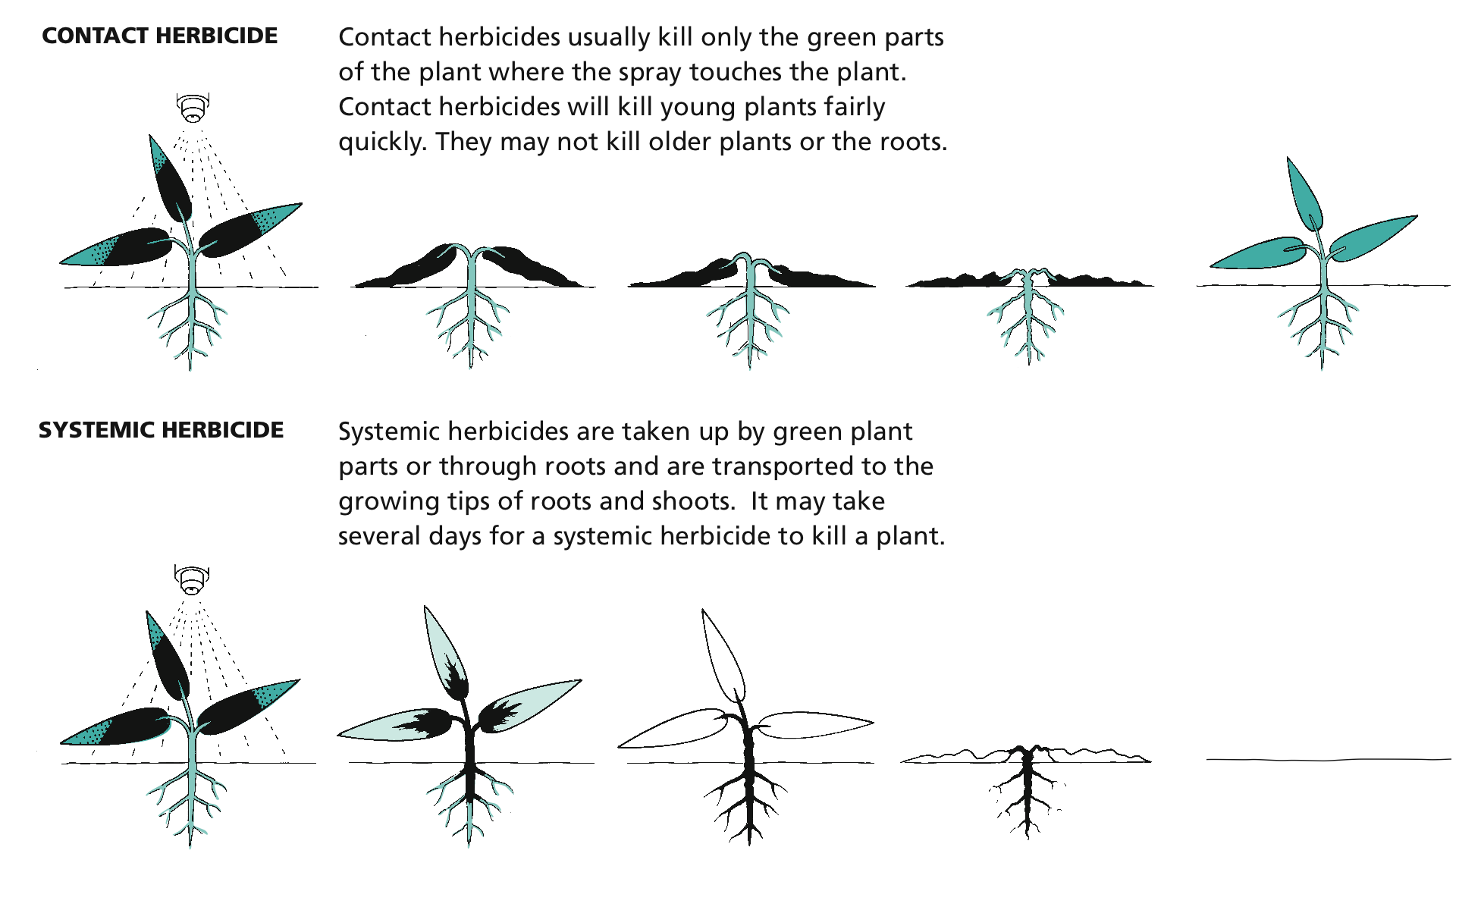
Contact vs. Systemic Herbicides
(postemergent only)
Contact examples: pelargonic acid (Scythe),
Clove oil (Burnout)
Systemic examples:
Glyphosate (Roundup), 2-4-D, fluazifop
Notes:
Postemergent herbicides can be further classified as contact or systemic herbicides.
Contact herbicides usually kill only the green parts of the plant where the spray touches the plant. Therefore you need to cover the whole plant with spray to get good control.
Contact herbicides are most effective on young plants.
They don’t kill older plants or roots and are not very effective against perennial weeds.
Systemic herbicides are taken up by the plant and transported to growing tips of roots and shoots.
It may take several days for a systemic herbicide to kill a plant.
However, systemics will kill older plants, including perennials, and the whole plant does not need to be sprayed to get good control.
Glyphosate or Roundup and 2,4-D are examples of systemic herbicides.

Slide 19
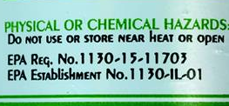

Registrations and terminology
Most pesticides are registered by the U.S. EPA and CA Department of Pesticide Regulation.
Some food or natural oil products are exempt from registration (“25b” products). They don’t carry EPA registration numbers.
Organically acceptable pesticides are derived from natural products such as plants or minerals (including petroleum oil), are not chemically processed. Some but not all have the OMRI logo.
Less Toxic Pesticides: (not an official term)—have less negative impact on people and nontargets
Notes:
Most pesticides are registered by the US Environmental Protection Agency and carry EPA registration numbers. They must also be registered by the CA Department of Pesticide Regulation to be sold in California. (Some pesticides sold online, for instance, are not registered for use in California.)
There are a number of pesticide products derived from food products or natural oils on the market. Because these products are considered safe, they have been exempted from registration by the US EPA and the California Department of Pesticide Regulation. They are sometimes called “25b” products after the section of FIFRA (Federal Insecticide, Fungicide, and Rodenticide Act) that describes them. They do not carry EPA registration numbers but often have signal words and precautionary statements such as KEEP OUT OF REACH OF CHILDREN on their labels.
Organically acceptable pesticides are derived from natural products such as plants or minerals (including petroleum oil), and are not chemically processed. Some but not all have the OMRI label. OMRI stands for the Organic Materials Review Institute. Pesticide manufacturers must pay OMRI to be certified to carry the logo. An organic designation does not mean harmless. A product with acetic acid/20% vinegar is organic, but carries a DANGER signal word.
Less Toxic pesticides is not an official term but is used widely to designate pesticides that have less negative impact on people and nontargets.
Organic pesticides are not always less toxic and less toxic pesticides are not always organic. The two terms are not interchangeable.

Slide 20
OMRI.ORG

Slide 21
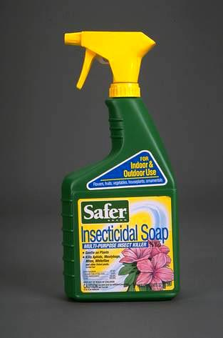
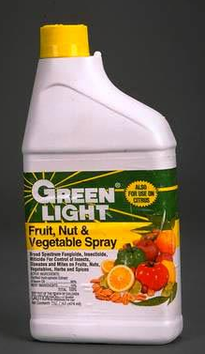
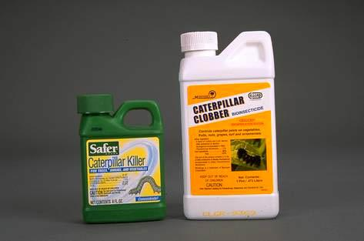
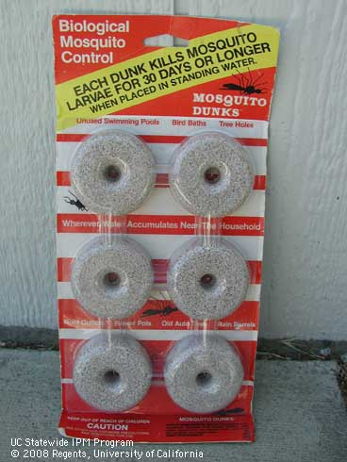
What are some less toxic insecticides?
Insecticidal soaps
Petroleum oils
Neem and other plant based oils
Microbials
For aphids, whiteflies and other soft bodied insects
B.t. k--For caterpillars; B.t. i--mosquitoes
Notes:
The pesticides shown on this screen are harmless to people, pets and wildlife and have zero to little negative impact on honeybees, other pollinators and natural enemies of insect pests.
Soaps and oils are effective against aphids, whiteflies, scale insects, spider mites and other soft bodied insects and mites. Oils may either be petroleum based or they may be derived from plant sources such as neem, jojoba, canola, or cottonseed.
Bacillus thuringiensis (often called “BT) is a bacterial disease of insects. BT variety kurstaki (BTk) kills caterpillars that eat it. BT isrealensis (Bti) kills larvae of certain flies including mosquitoes and fungus gnats. These BT products pose no threats to other insects, wildlife or people.

Slide 22
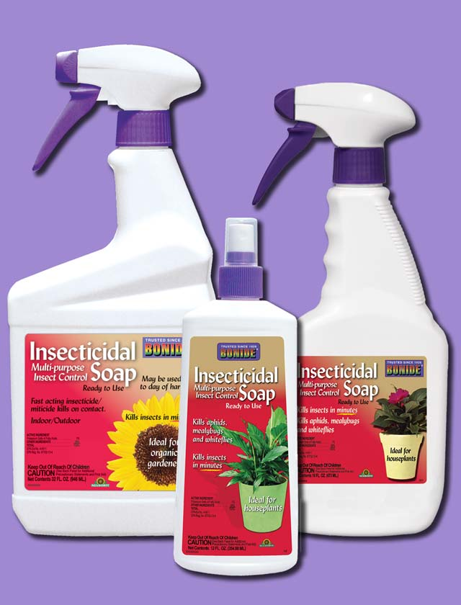
Soaps vs Oils
Smother pests/disrupt gas exchange—good coverage essential
Soaps used primarily for herbaceous plants or small shrubs
Oils used for woody plants
Oils somewhat more effective, especially on scales
Oils frequently used as dormant treatments
Notes:
Insecticidal soaps and oils are organically acceptable and less toxic pesticides.
Soaps and oils are contact insecticides that work by smothering the pest and disrupting the insect’s gas exchange. For this reason good coverage is essential.
Soaps are used primarily for herbaceous plants or small shrubs, whereas oils are used more for woody plants.
Oils are somewhat more effective, especially on scales.
Oils are frequently used as dormant treatments.

Slide 23
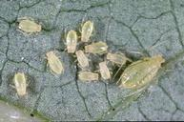
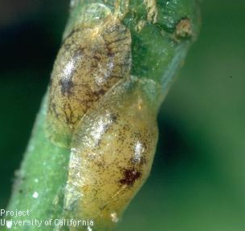
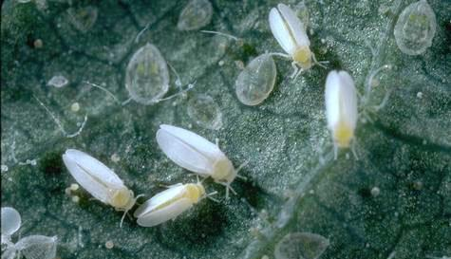
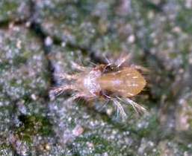
Soaps and Oils
Aphids
Immature Scales
Immature whiteflies
Thrips
Lacebugs
Psyllids
Spider mites
Some foliar diseases
Notes:
Insecticidal soaps and oils are effective on a variety of soft-bodied insects and mites such as (read list) as well as some foliar diseases, but are easy on beneficials.

Slide 24
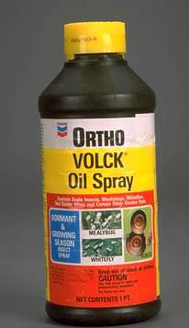
Petroleum versus plant derived oils
Petroleum: superior oil, supreme oil, narrow range oil, horticultural oil
Plant-based: neem oil, jojoba oil, canola oil, cottonseed and others
Notes:
Petroleum oils and plant-based oils are also organic and less toxic.
Petroleum oils are often called superior oil, supreme oil, narrow range oil, and horticultural oil.
Plant-based oils include neem, jojoba, canola, cottonseed and others.

Slide 25
Plant essential oils and other “25b” products
Most are derived from food plants
Considered nontoxic to people
Don’t require federal or state registration
Can be effective on soft-bodied insects and mites. Some have fungicidal activity
Act as other oils do, but may also have other modes of action
Some act as repellents
Very short residual
Examples
  Cinnamon
  Citric acid
  Citronella
  Clove
  Cottonseed
  Garlic
  Lauryl sulfate
  Lemongrass
  Mint
  Peppermint
  Rosemary
  Sesame
  Thyme

Slide 26
http://www.epa.gov/oppbppd1/biopesticides/regtools/
25b_list.htm#activeingredients

Slide 27
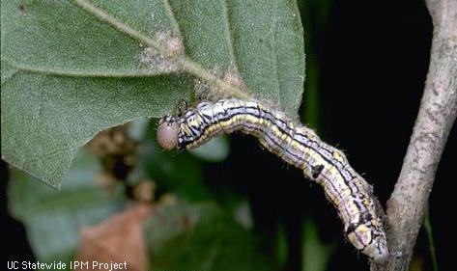
Bt: Bacillus thuringiensis kurstaki
Microbial Insecticides—
derived from insect pathogens
For control of leaf or bud-feeding caterpillars (Lepidoptera only)
Caterpillar must eat material–excellent coverage essential
Small caterpillars most effectively controlled
Breaks down rapidly. May need to reapply
Non toxic to beneficials, humans and wildlife
Another microbial, Cydia pomonella granulovirus (Cyd-X), is a virus disease of codling moth
B.t. israelensis is effective against mosquitoes & fungus gnats

Slide 28
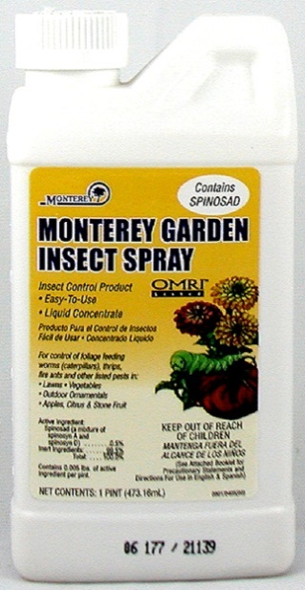
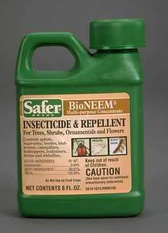
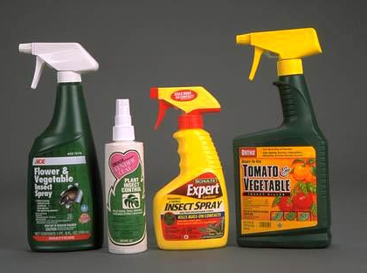
Other lower toxicity insecticides
Spinosad– chewing insects and thrips. A natural fermentation product.
Botanical or plant-derived insecticides—pyrethrin and azadirachtin (neem extract)
Boric acid or borate for ant control.
All these materials are generally organically acceptable, breakdown rapidly in the environment and have less impact on beneficials, people and wildlife than conventional insecticides.
Notes:
Several other pesticides have low toxicity to people and most wildlife. These include spinosad, a natural soil fermentation product that kills thrips, caterpillars and other chewing insects. This product is effective against codling moth.
Botanical insecticides are derived from plants. The two botanical insecticides currently found on shelves are pyrethrin, from chrysanthemum (also know as pyrethrum daisy) plants and azadirachtin from the neem tree.
Borate or boric acid for ant control is another low toxicity insecticide.
All these materials breakdown rapidly in the environment and have less impact on beneficials, people and wildlife than conventional insecticides, although they may have short term negative impacts on beneficial insects.

Slide 29
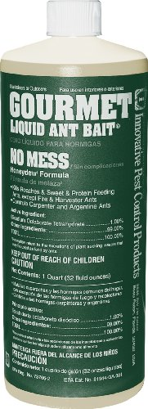
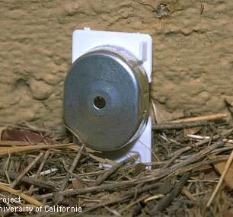
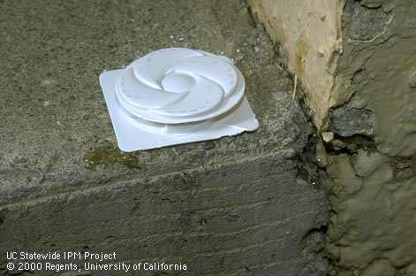
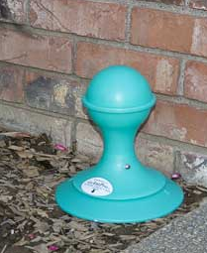
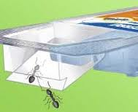
Ant baits: borate-based products, fipronil, hydromethylnon, sulfluramid
Only borate products are organic/less toxic
Bait stations reduce risks of more toxic a.i.s
1% liquid borate bait in refillable dispensers best for tough ant problems
Ant management requires an integrated program including sealing up entryways and removing food sources
Notes:
Even more toxic pesticides can be made safer for the environment by putting them in sealed bait stations or dispensers. Many of these products are available for ants.
The most effective bait for Argentine ant is 1% borate in sucrose solutions such as the Gourmet Liquid Ant Bait sold in only a few stores. It can be placed in the refillable KM AntPro dispensers shown here (mainly available online).
Keep in mind that successful management of a serious ant problem cannot be achieved with pesticides alone. You need to seal up entryways and remove food sources as well.

Slide 30

Common home use insecticide products NOT qualifying as less toxic
Organophosphates (malathion, acephate, disulfoton)
Carbaryl (Sevin)
Pyrethroids (bifenthrin, permethrin, cyfluthrin, cypermethrin, lambda-cyhalothrin)
Imidacloprid
Notes:
Some common home use insecticides are associated with environmental problems that some customers may want to avoid. For most uses of these insecticides, less toxic products are available to control the pest. All the insecticides and insecticide groups listed here can be quite toxic to honeybees, other pollinators and beneficial insects.
The pyrethroids have been identified as posing a special threat to water quality when they are washed off of treated surfaces with rain or irrigation water.
Pyrethroids (examples such as bifenthrin, cypermethrin, and other listed here) are synthetic versions of the organic compound pyrethrin. Be careful not to confuse them.

Slide 31


Iron phosphate snail & slug bait
Breaks down into harmless materials
Nontoxic to pets, humans and wildlife
Avoid metaldehyde to protect pets, people & the environment
Some products now adding spinosad for earwigs
Notes:
Iron phosphate is a low toxicity pesticide for management on snails and slugs. It is nontoxic to pets, humans and wildlife and breaks down into harmless materials in the environment.
The other common molluscicide, metaldehyde, is associated with dog poisoning and negative impacts on wildlife.

Slide 32
Herbicides Used in Organic Systems
Plant-based oils (clove, eugenol, lemongrass, rosemary)
Pelargonic acid
Herbicidal soap
20% Vinegar/Acetic Acid (Weed Pharm)
These products are effective only on young plants, primarily broadleaves.
Not effective on perennials or plants with substantial roots
Nonselective—can damage desirable plants
Useful for cracks and crevices, edges.
Acetic acid can be dangerous
Corn gluten meal: used as preemergent—UC research does not back up efficacy
Notes:
The 4 herbicides listed at left are organically acceptable products that can burn back annual weeds. They are effective only on young plants, primarily broadleaves and not effective on perennials or plants with substantial roots
All these products are nonselective and thus can damage desirable plants
However, these products can be useful for burning back weeds in cracks and crevices, edges.
Please note that acetic acid can be dangerous.
Corn gluten meal is an organically acceptable material for pre-emergent weed control, but University of California researchers have not found it effective in research trials.

Slide 33

Fungicides: powdery mildew & other foliar diseases
Sulfur formulated with soap (NOT DUST)
Biologicals: Bacillus subtilis
Neem and other oils*
Potassium bicarbonate
Copper fungicides are organic; used primarily in the dormant season
*Oils are the most effective against foliar diseases and are the only ones that have eradicant activity.
Notes:
Sulfur products have been used to manage powdery mildew on grapes and other crops for centuries but are only effective when applied before disease symptoms appear. The best sulfur products to use for powdery mildew control in gardens are wettable sulfurs that are specially formulated with surfactants similar to those in dishwashing detergent (such as Safer Garden Fungicide).
Biological fungicides are commercially available beneficial microorganisms formulated into a product that, when sprayed on the plant, inhibit or destroy fungal pathogens. The active ingredient in the product Serenade is a bacterium, Bacillus subtilis, that helps prevent the powdery mildew from infecting the plant. While this product functions to kill the powdery mildew organism and is nontoxic to people, pets, and beneficial insects, it has not proven to be as effective as the oils or sulfur in controlling this disease.
Horticultural oils and plant-based oils such as neem oil and jojoba oil can be used. Oils act as both a protectant and an eradicant, for the early season sprays provides the best control.
Potassium bicarbonate is not as effective as other products, may leave a residue, and can injure the plant, so use with caution.
Protectant fungicides must be applied to plants before disease develops. Once mildew growth is mild to moderate, it is generally too late for protective fungicides to effectively control powdery mildew except for on new plant growth. Good coverage of all susceptible plant parts is essential. As plants grow and produce new tissue, additional applications may be necessary.

Slide 34

Information on Toxicity
UC IPM Pest Notes

Slide 35

UC IPM Home > Homes, Gardens, Landscapes, and Turf > Pesticides

Slide 36

Notes:
… which lists the pesticide active ingredients registered for that pest in California.
The table illustrates the potential hazard of each AI to the category listed: Water quality and aquatic wildlife, beneficials, honeybees, and people/mammals, to help you determine which product best matches your situation.
Clicking on the name of the AI (for instance, horticultural oil)…

Slide 37

Notes:
…will take you to a page that gives additional information on that AI, pests for which this AI is mentioned in the Pest Notes, and examples of trade names of pesticide products (not shown here).

Slide 38



http://www.ipm.ucdavis.edu/NATURAL/index.html

Slide 39
Sources of Pesticide Environmental and Health Impact Information on the Web
National Pesticide Information Center:
http://npic.orst.edu
UC IPM Web site, pesticide active ingredients database
http://www.ipm.ucdavis.edu
Pesticide Action Pesticide Database: http://www.pesticideinfo.org/
For information on how to manage specific home and garden pests, visit the UC IPM Web site: www.ipm.ucdavis.edu/homegarden
Notes:
Here are some web sites that provide information on pesticide toxicity and risks.
For information on what pesticides to use against specific pests, go to the UC IPM home and garden web site.

Slide 40


Gardening Questions?
Call or email the UCCE Master Gardeners
of San Bernardino County
Website: http://ucanr.edu/sites/SBMG/
Telephone: 909-387-2182
Email mgsanber@ucdavis.edu

