Slide 1

Seedlings – Start Yours Today!
Forest Falls Garden Club
June 17, 2014
Master Gardener Program
of San Bernardino County

Slide 2
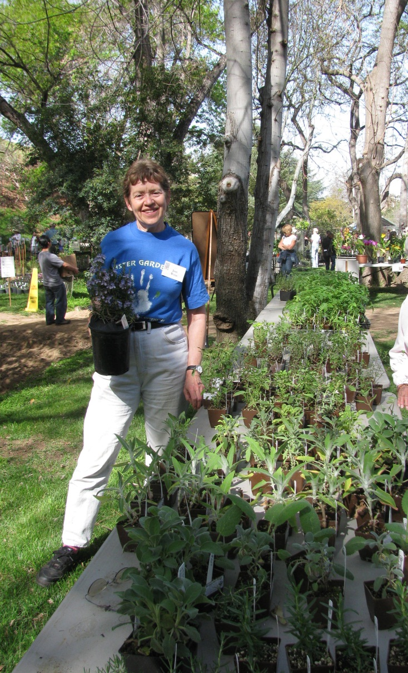
Who We Are…
Volunteer Gardeners
Utilize University of California Cooperative Extension (UCCE) and Master Gardener
peer-reviewed materials

Slide 3
Resources
http://cagardenweb.ucanr.edu
http://cagardenweb.ucanr.edu/Glossary/#GlossC
http://cagardenweb.ucanr.edu/Glossary__N-Z/#GlossS
http://www.ghorganics.com/page15.html#Seedlings:%20Damping%20off%20disease

