Slide 1
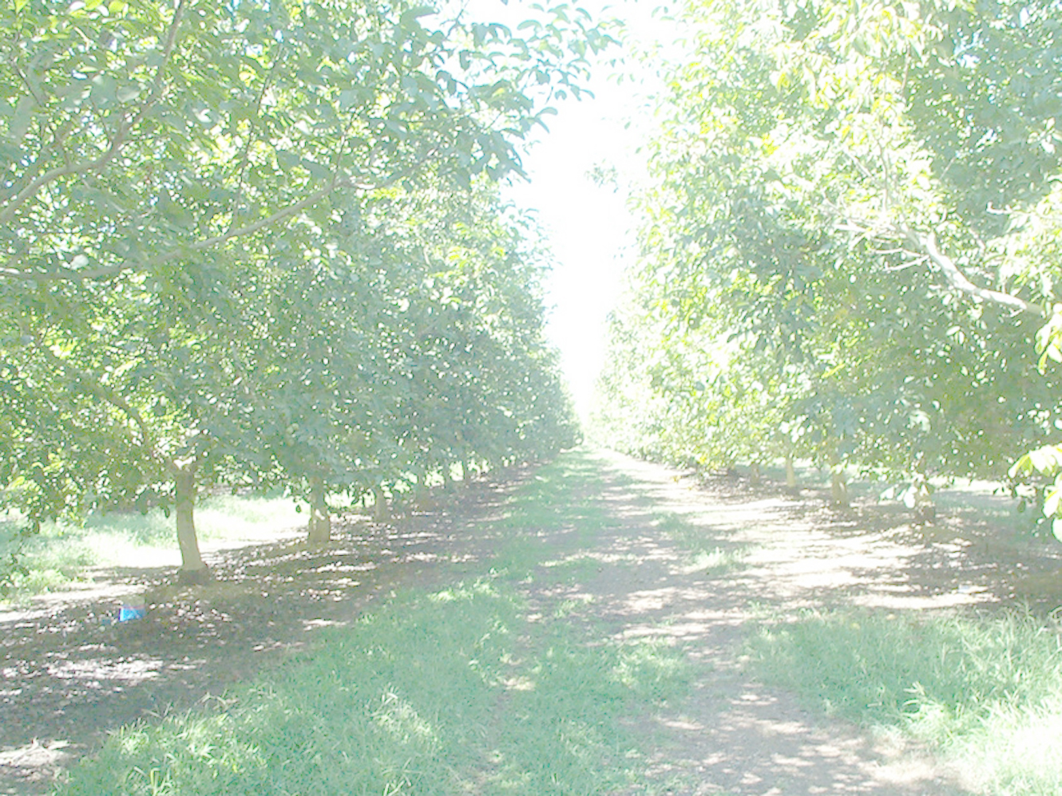
Walnut History and Production in California
Richard P. Buchner
UCCE Farm Advisor
Tehama County, California
and Terri A. Buchner

Slide 2
Historical accounts of walnuts in California mention the hard-shelled walnuts brought in from South America by the mission fathers in the 1770’s
Smith et al. 1912, Webber and Goodspeed 1919, Batchelor 1924, Batchelor et al. 1945

Slide 3
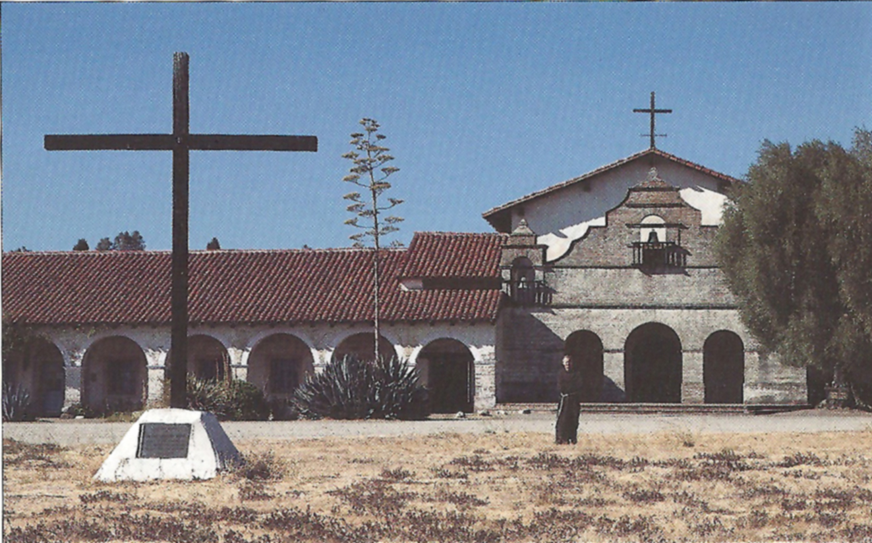
Notes:
San Antonio de Padua mission

Slide 4
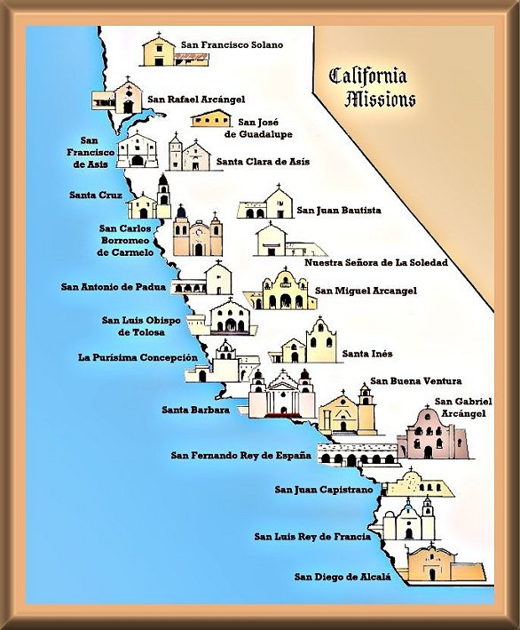

Slide 5
In 1869 Joseph Sexton purchased a large sack of walnuts at the dock in San Francisco and planted a thousand trees at his ranch in Goleta, California. The origin of these nuts is uncertain, perhaps Chile or China

Slide 6
About 1870 Felix Gillet, a nurseryman in Nevada City, California, was importing scion wood and nursery stock from France. He is credited with introducing the French cultivars Franquette, Mayette, Chaberle, Meylan, Parisienne, Proparturiens and Cluster.

Slide 7
As a result of the introduction by Sexton and Gillet, California walnut growers found superior open-pollinated seedlings that led to the cultivars Eureka, Placentia, Concord, Payne, Hartley and others.

Slide 8
All of the early walnut cultivars were obtained by selecting seedlings that occurred by chance.
1879 to 1885 Luther Burbank walnut breeding: j. hindsii x j. regia è paradox j. hindsii x j nigra è royal

Slide 9
Historical Acres
By 1914, 34,138 acres of walnuts in California
By 1933, 110,700 bearing acres
By 1940 walnut planting moved north

Slide 10
Decline in Southern California acreage
Increased land values
Competition with citrus
Northern orchards were superior in yield and quality
Water quality problems
Lack of chilling
Post WW2 housing demands (urbanization)

Slide 11
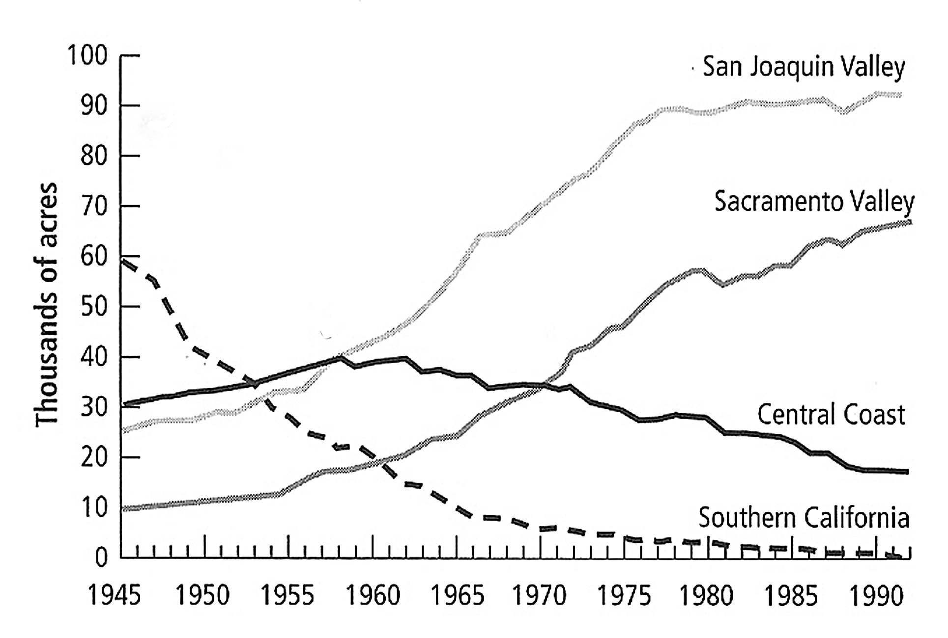

Slide 12
As the walnut industry expanded in California, growers soon experienced marketing problems
First local cooperative in 1887
Walnut growers of Southern California 1896
Walnut growers Association in 1912
Walnut Control Board in 1933
Diamond Walnut Growers in 1956

Slide 13
The Walnut Marketing Board 1962
(California Walnut Board)
Implement the federal marketing order
  Orderly marketing
  Quality control
  Product promotion
  Market development
  Prohibition of unfair trade practices
  Financing production and industry research

Slide 14
California Walnut Commission 1987
Promote the export of California walnuts
Inshell Exports to Hong Kong, China, Turkey, Vietnam, Italy and Spain
Shelled Exports to Japan, Germany, Korea, Canada, Spain and Australia

Slide 15
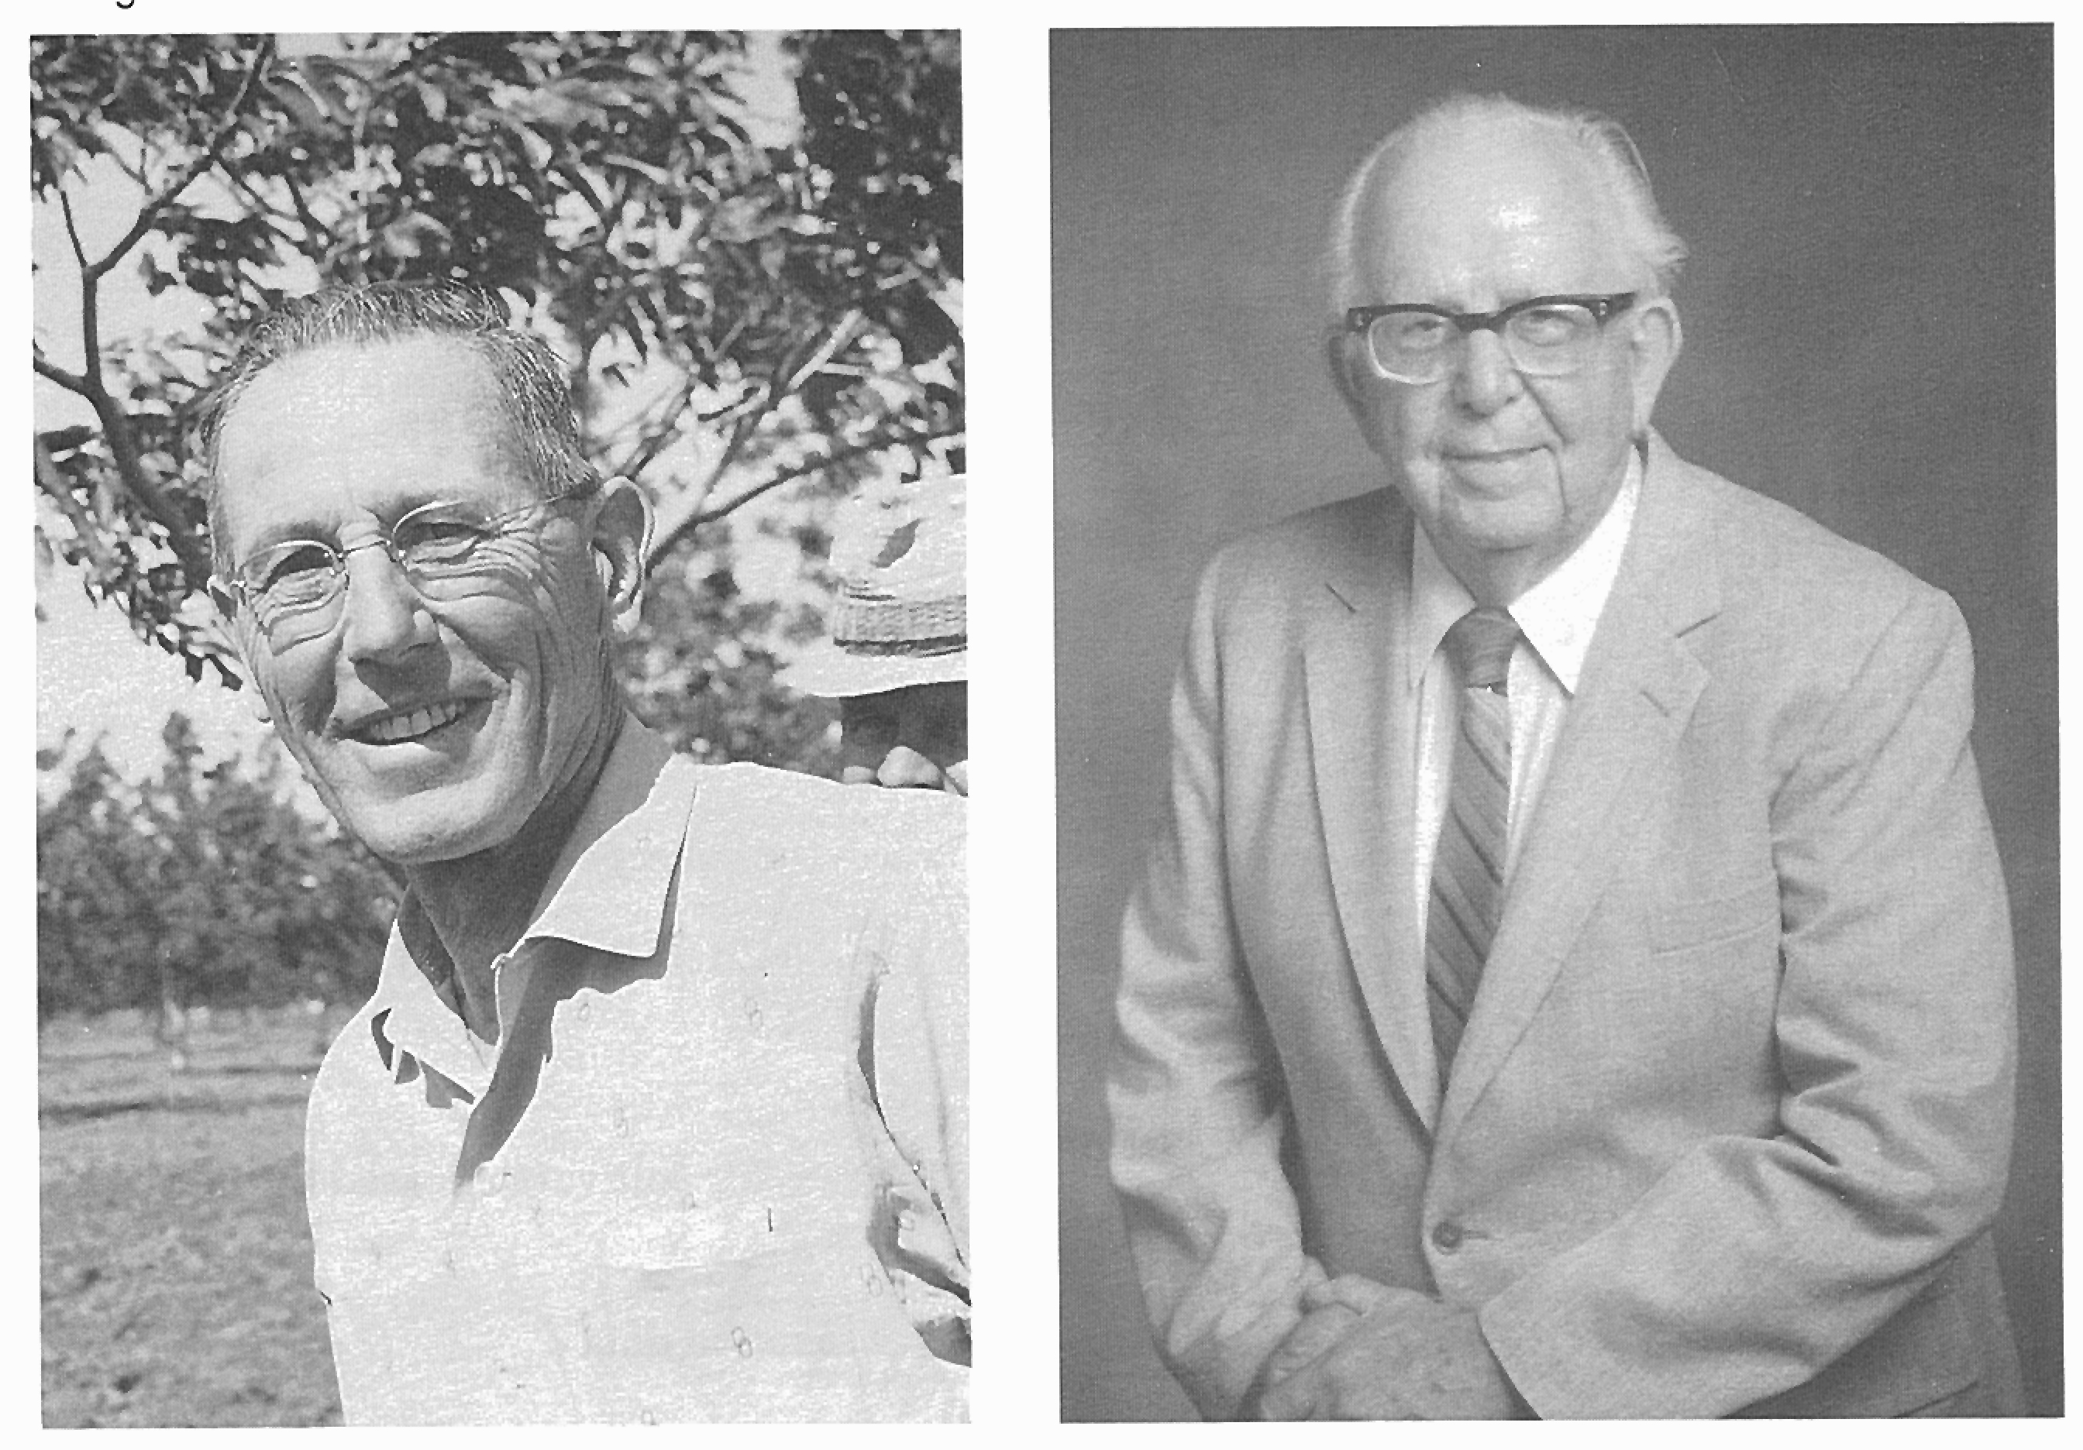
UC Davis walnut breeding program 1948-1978
Eugene F. Serr
Harold I. Forde

Slide 16
By 1956 Serr and Forde clearly identified objectives of their breeding program:
Two or more flowers per pistillate bud
50% or more lateral fruitfulness
Nut size 38 to 42 mm length
Kernels of 8 to 10 gms dry weight
Pollen shedding coordinated with flowering

Slide 17
Late leafing
Late nut maturity
Kernel 50 to 60% of the net weight
Light kernel color with good flavor
Smooth shell with a strong seal
Tree vigor and strength

Slide 18
By 1956 Serr and Forde had made:
39 different crosses
pollinated 15,691 pistillate flowers in controlled crosses
derived 833 seedling progeny to be evaluated and selected for desirable characters

Slide 19
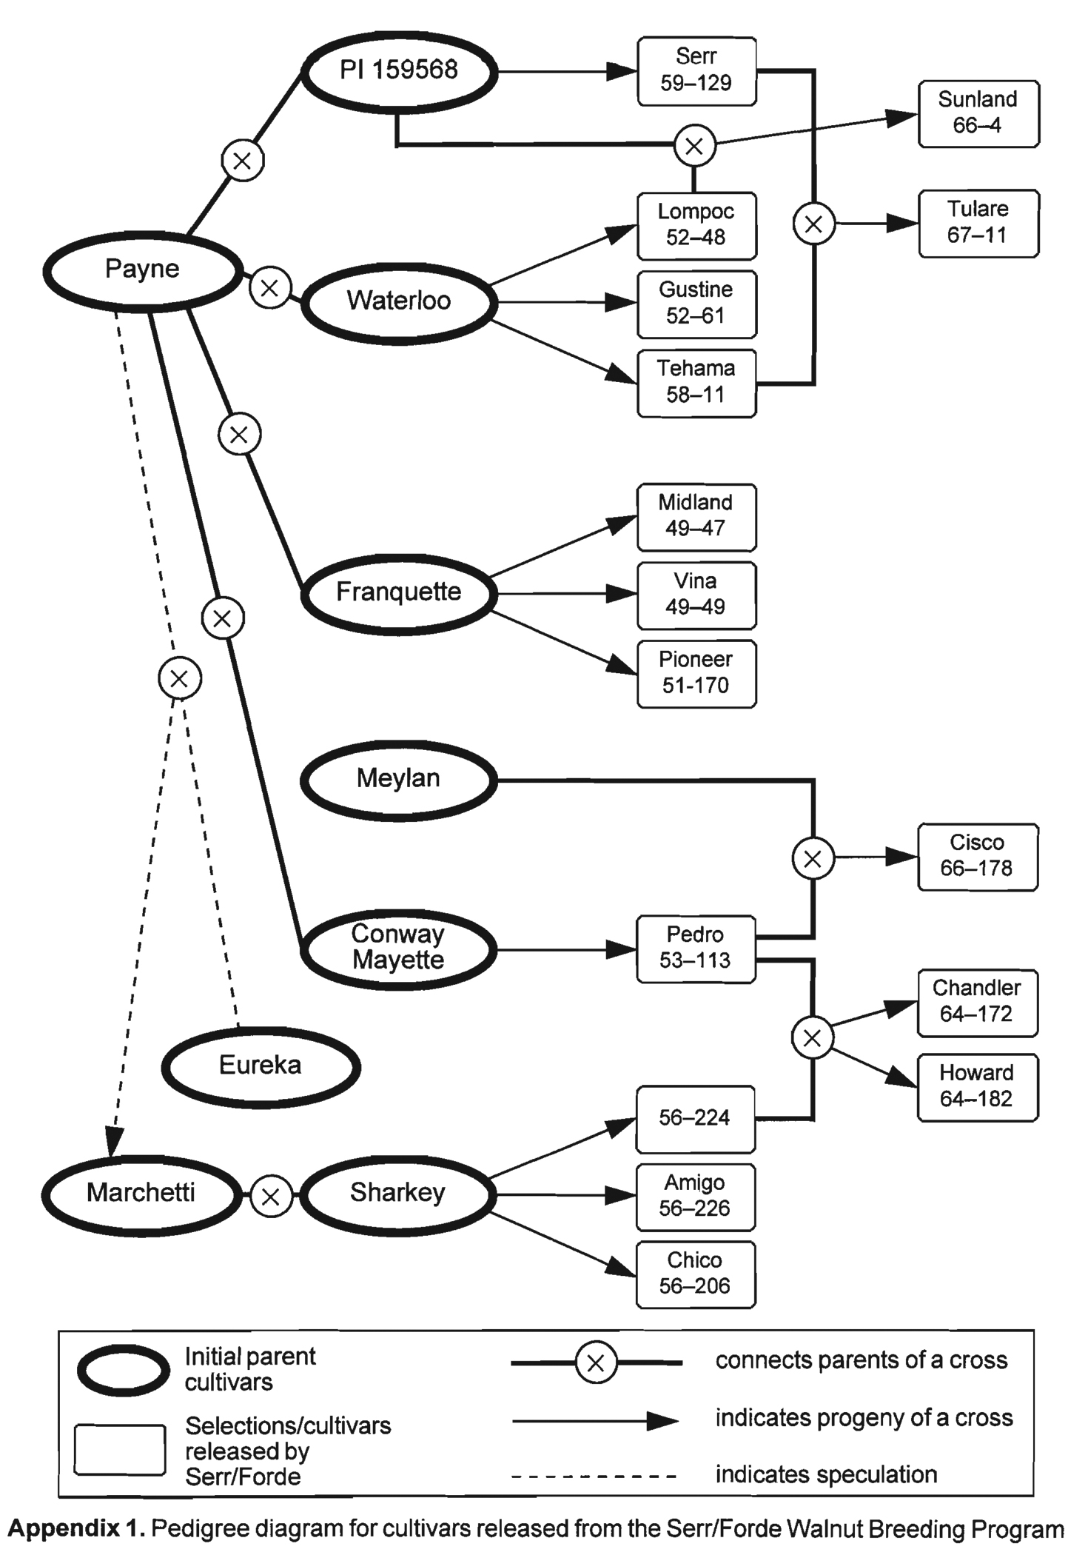

Slide 20
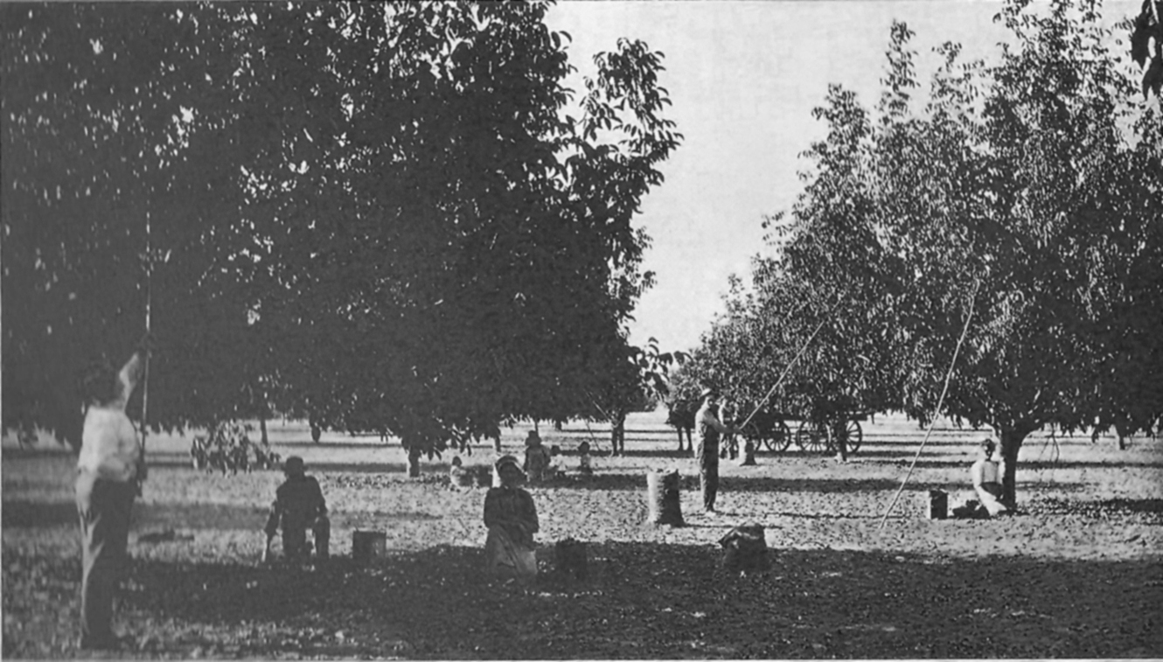
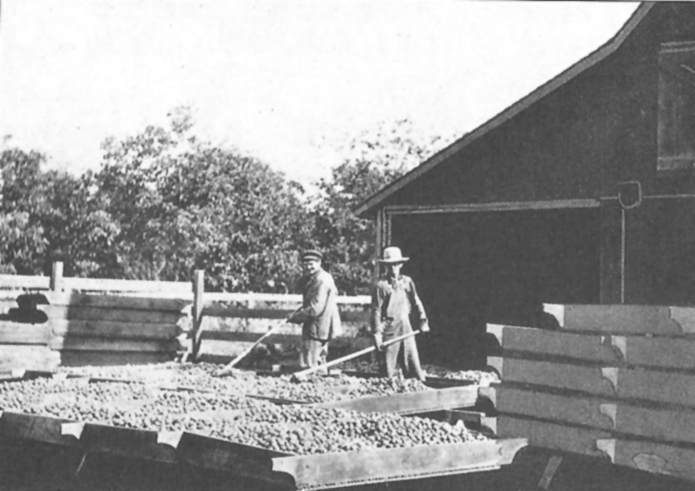
Harvest by Hand

Slide 21
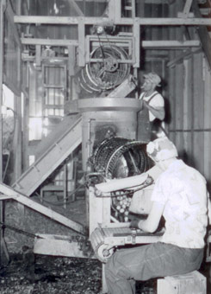

Slide 22
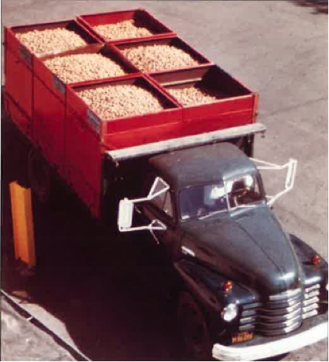

Slide 23
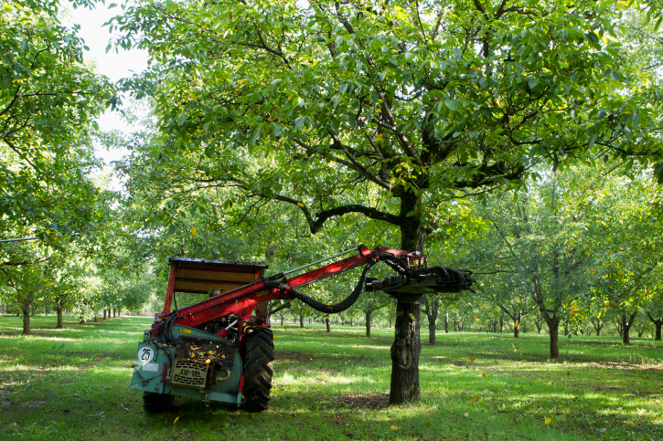
Mechanization of the California Walnut Industry
Notes:
Getty nut harvest

Slide 24
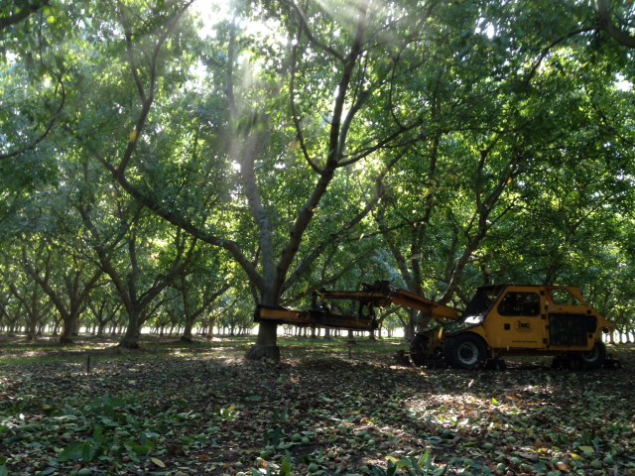

Slide 25
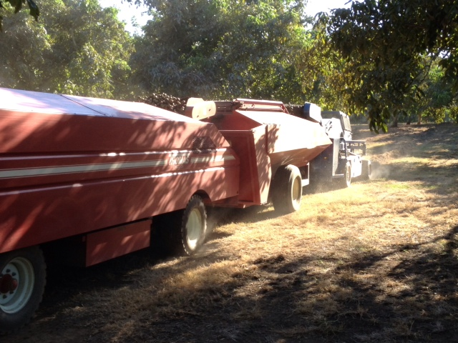

Slide 26
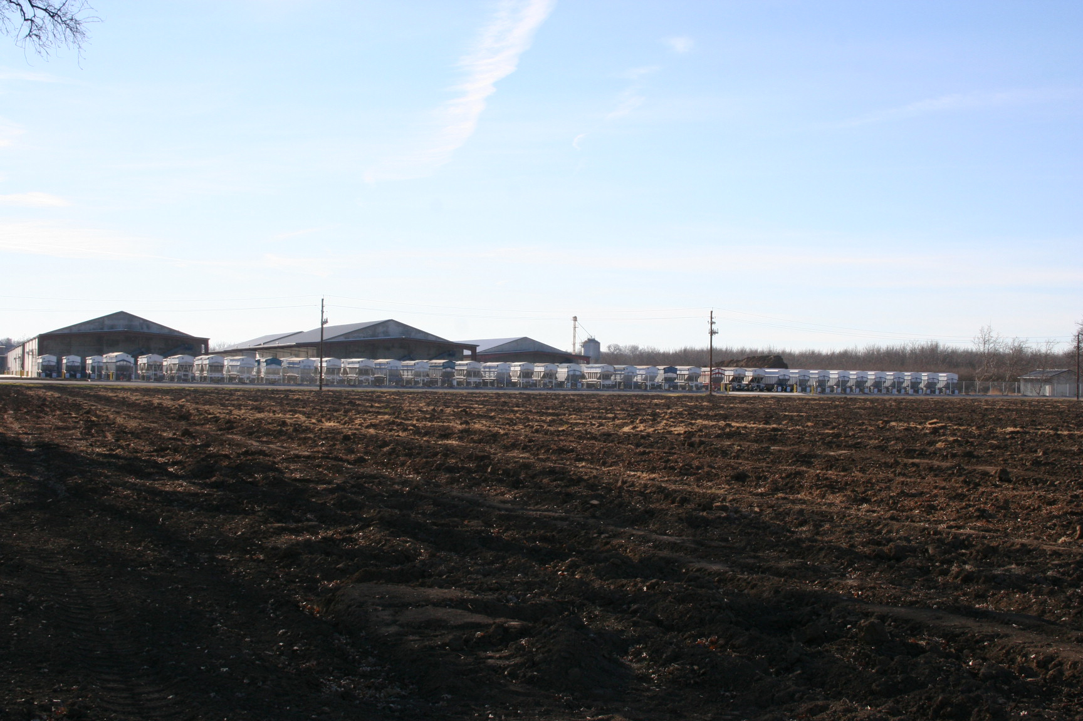

Slide 27
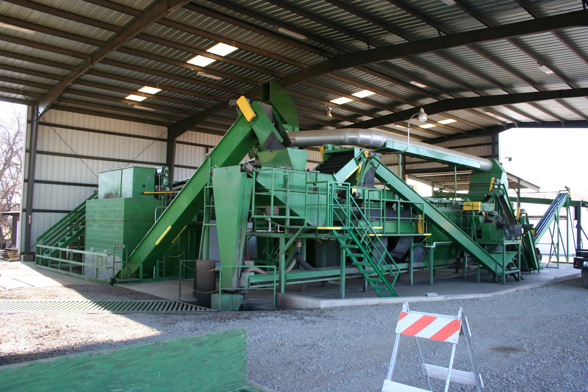

Slide 28
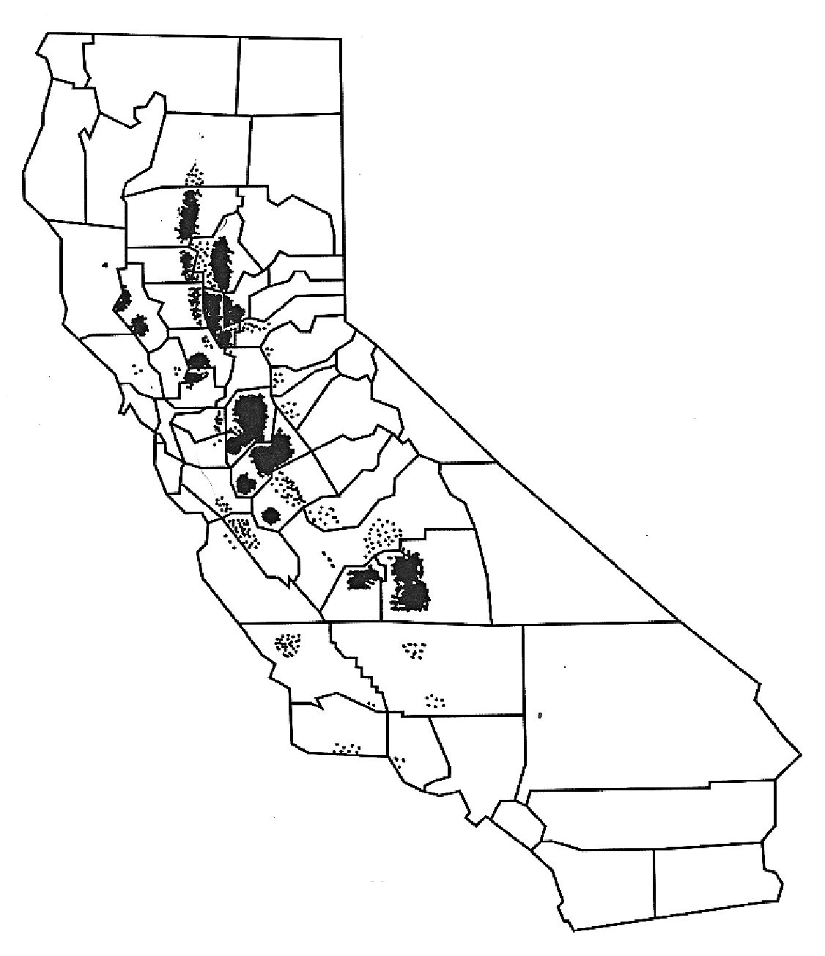
Almost all USA walnuts are grown in California

Slide 29
California Walnut Board
Inventory Report
Year Ending August 31
Crop Year | USDA Final Crop Size (tons)
2007/08 | 325,000
2008/09 | 436,000
2009/10 | 437,000
2010/11 | 503,000
2011/12 | 461,000
2012/13 | 497,000

Slide 30
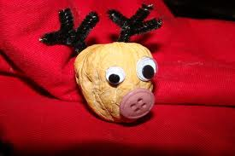
Questions

