Slide 1
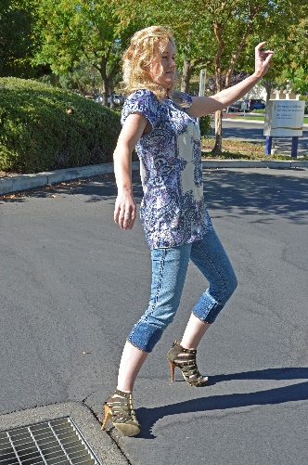
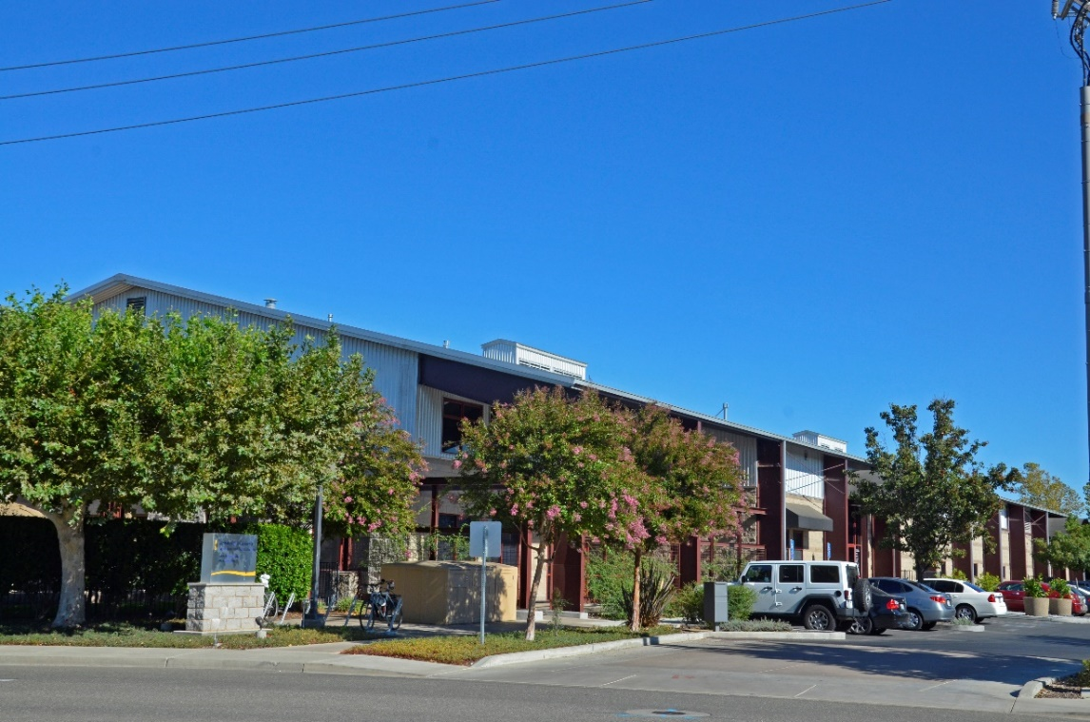
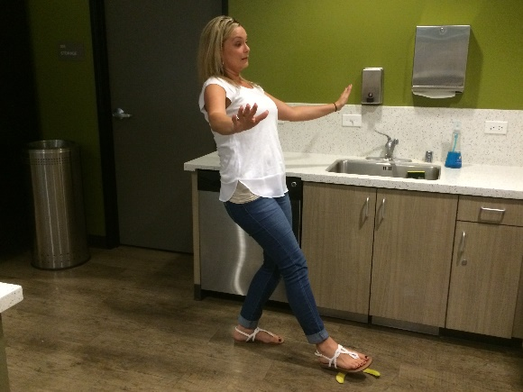
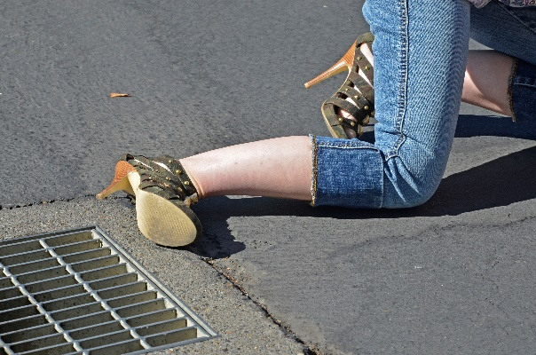
SLIP, TRIP and FALLS
Navigating the ANR Building
Notes:
The goal of this presentation is to be aware of slip, trip and fall hazards in your work environment
and try to convince some of you to stop wearing flip flops.

Slide 2
STATISTICS and CODES
(the boring stuff)
  An average of 3.8 million slip, trip, and fall, work injuries occur every year.
  Resulting in a 15 to 20 percent of all workers’ compensation costs.
  The average disabling claims costs is $22,000 per worker.
  Slip, trip, and falls account for 20 percent of non-fatal accidents and 15 percent of all work related deaths.
  Cal-OSHA requires all floors to be free of dangerous projections or obstructions, maintained in good repair, and reasonable free of oil, grease, or water.
Notes:
Slip, trip and fall injuries are very common in all work environments due to the fact that almost everyone walks where they work.
Only driving causes more fatalities then slip, trip and falls.
Cal-OSHA also requires all aisle ways, entrances, and storage areas to be free of obstructions.
We covered this in the material storage safety presentation

Slide 3
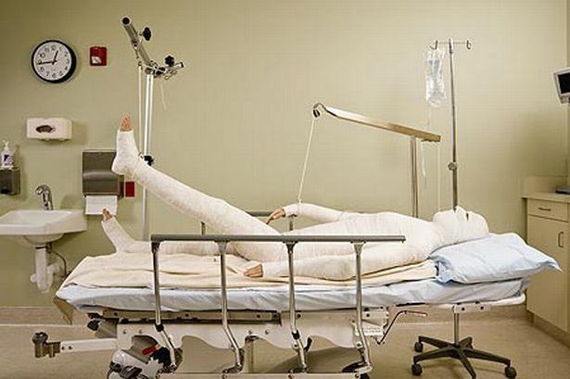
TYPES OF INJURIES
SPRAINS
FRACTURES
STRAINS
ABRASIONS
BRUISES
LACERATIONS
CONTUSIONS
COMA
DEATH
Notes:
The types of injuries from slip, trip and falls are endless. From no injury to death.
Sprains & Strains
Bruises & Contusions
Bone fractures
Abrasions & Lacerations
Brain damage
Coma

Slide 4

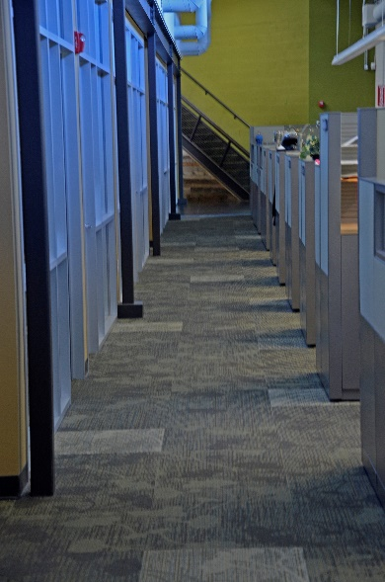
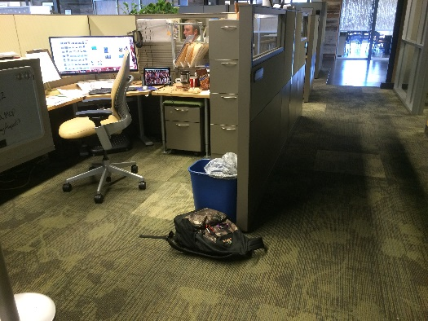
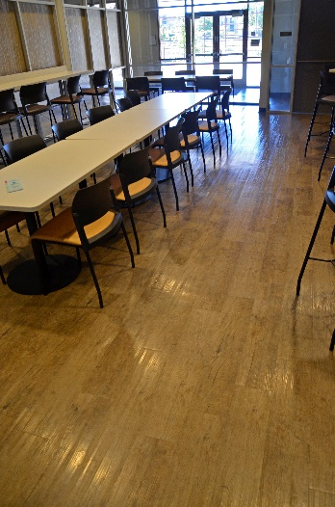
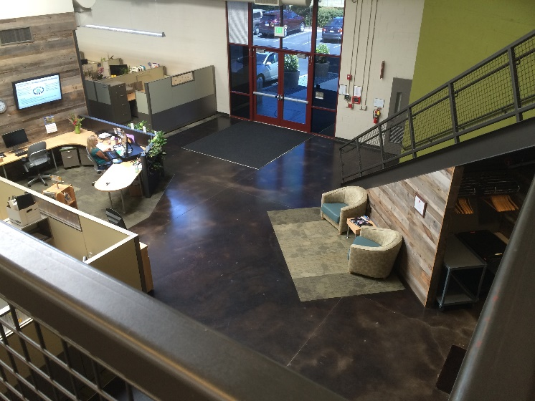
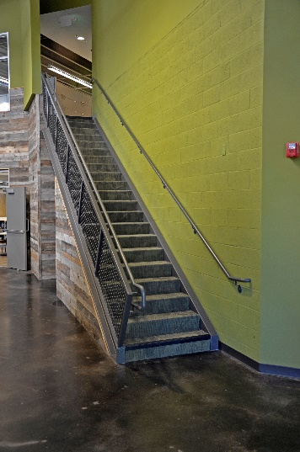
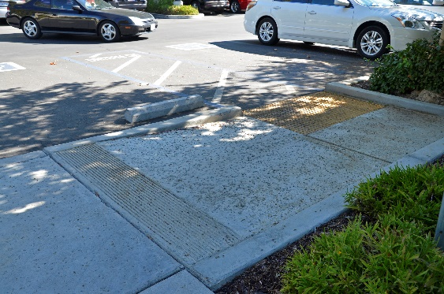
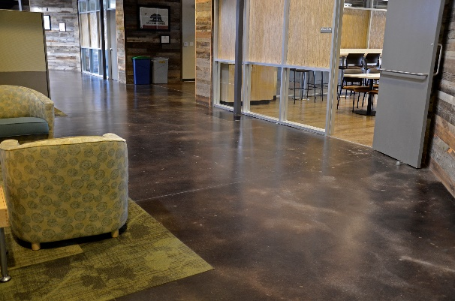
SLIP, TRIP AND FALLS ARE EVERYWHERE!!!
  Add photos
Notes:
So, where are the slip, trip and fall hazards? EVERYWHERE!
Stairs, floors, carpets, fie drawers, slick surfaces, work stations, furniture, uneven surfaces, curbs.
Changing surfaces, unsafe shoes, blind corners, protruding objects, spilled materials, and on and on.

Slide 5
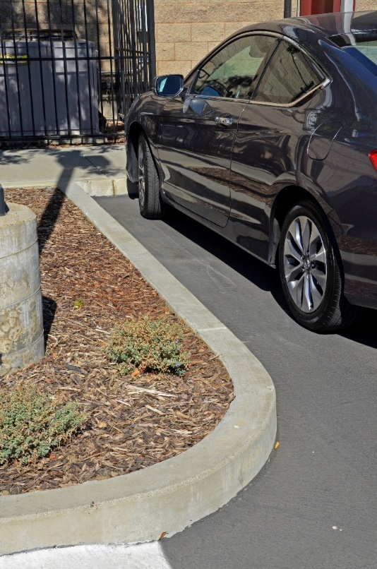
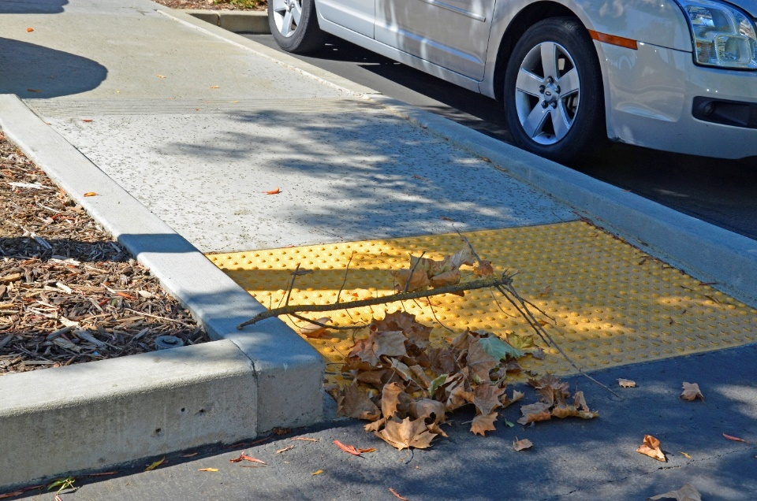
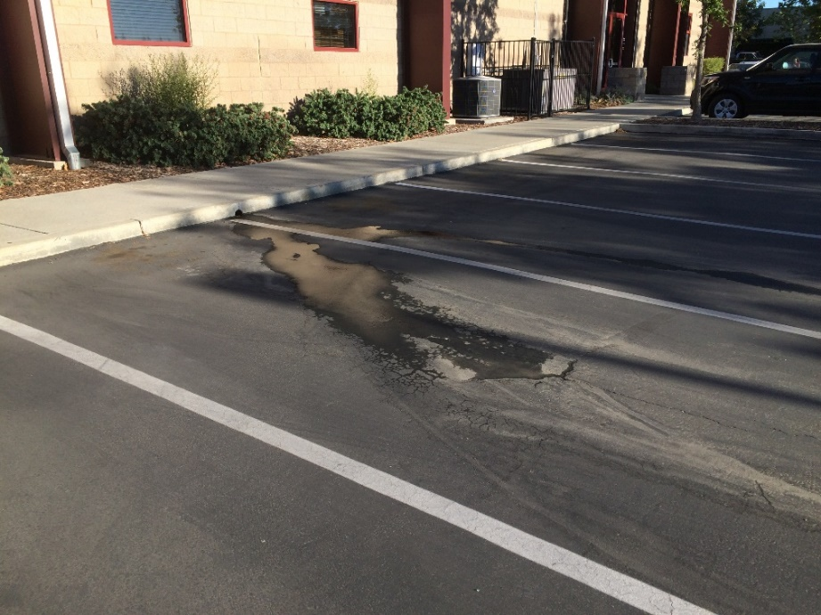
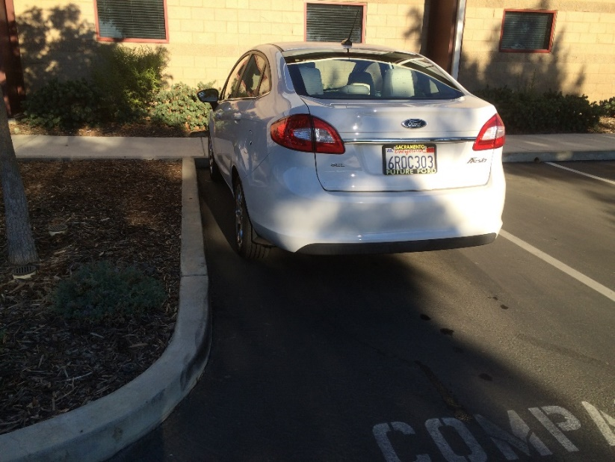
PARKING LOT
(where the hazards begin)
Notes:
Leaves, fallen branches, and other types of debris can be a slip, trip and fall hazard
Water and oil
If you are parked next to a curb, you don’t have much room to maneuver
If you are carrying items, your balance is further off trying to maneuver

Slide 6
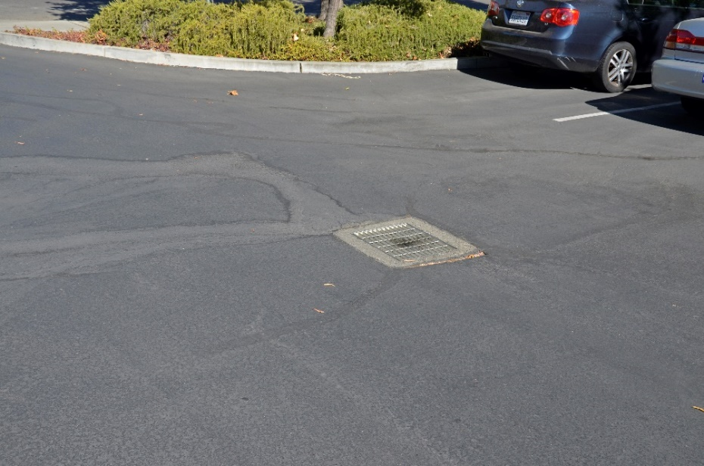
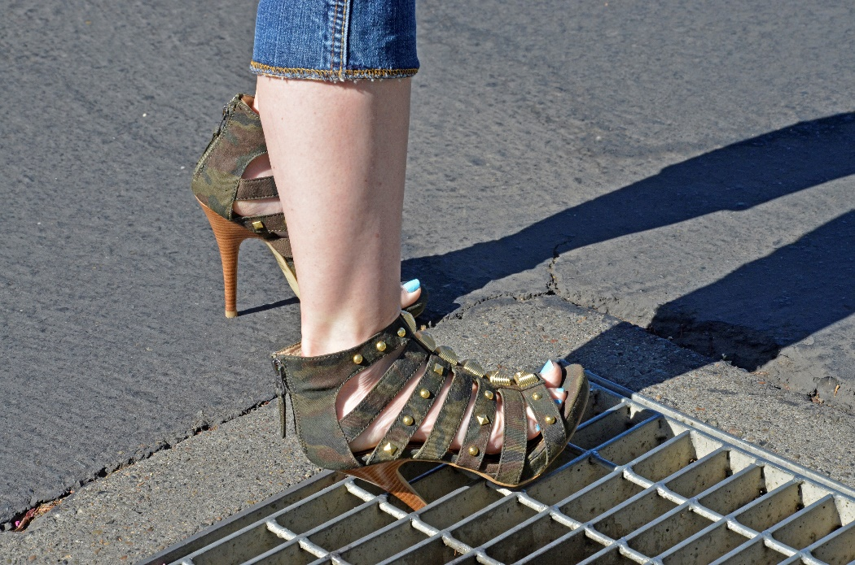
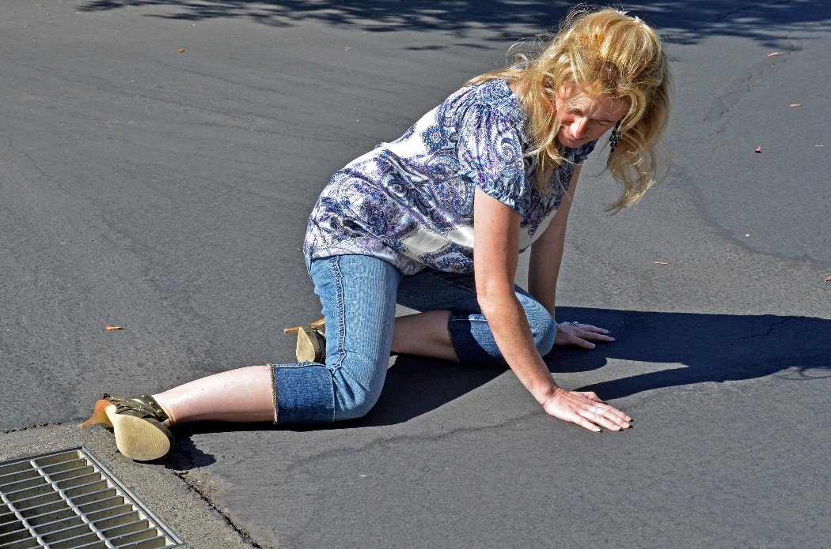
PARKING LOT
Notes:
Storm drains can be a fall and injury hazard if wearing small heels or not walking carefully
Injuries from this can be:
Twisted/broken ankle
Knee and hand wrist injuries
Back and head injuries

Slide 7
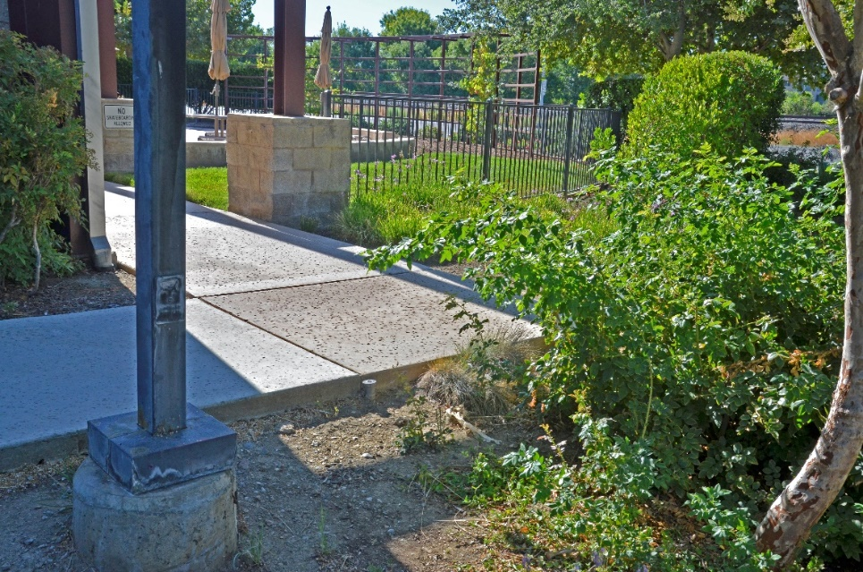
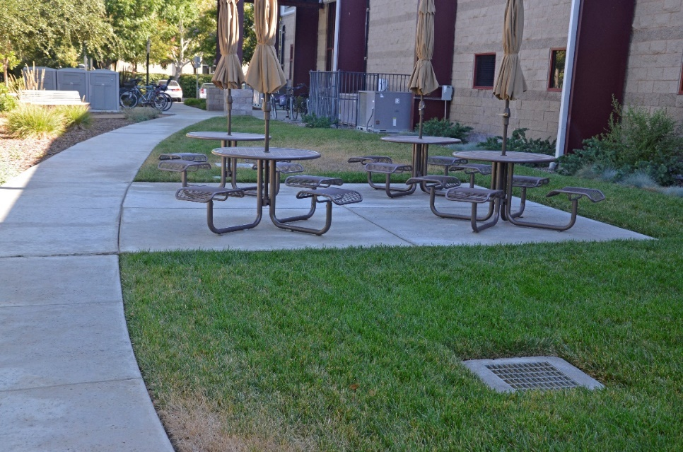
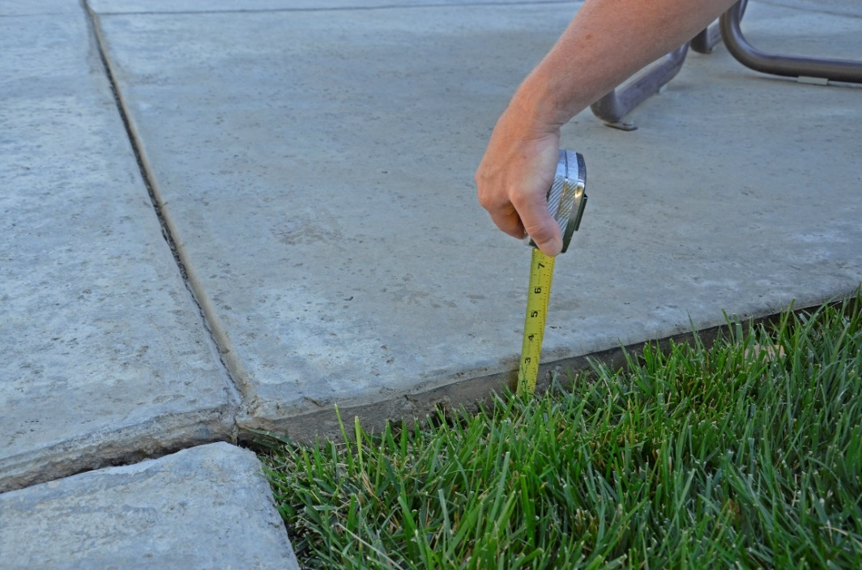
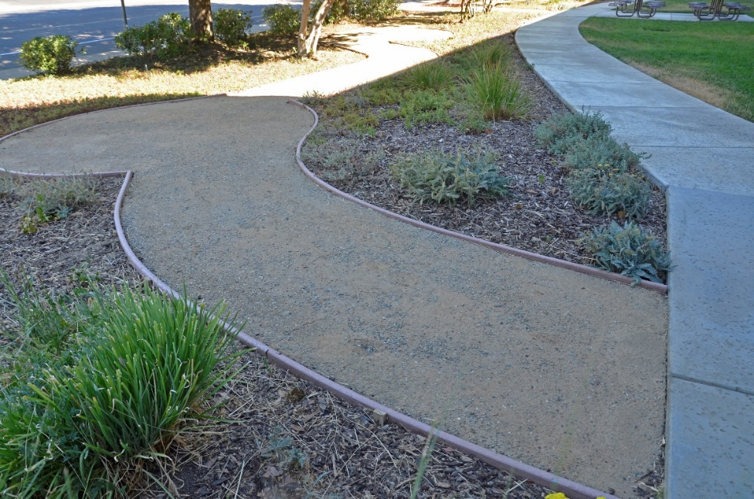
SIDEWALKS, PATHS AND GROUNDS
Notes:
Uneven pavement 1 and a half inch
Drop off edges 3 inches or more
Hard pack dirt paths which gets slippery and muddy when wet
Raised edge boards
Storm drains

Slide 8
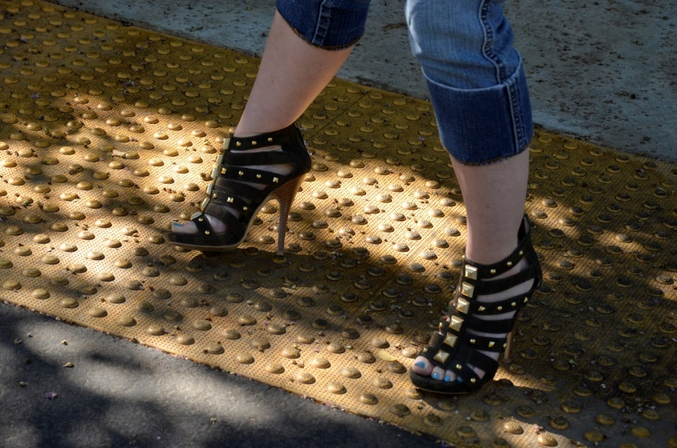
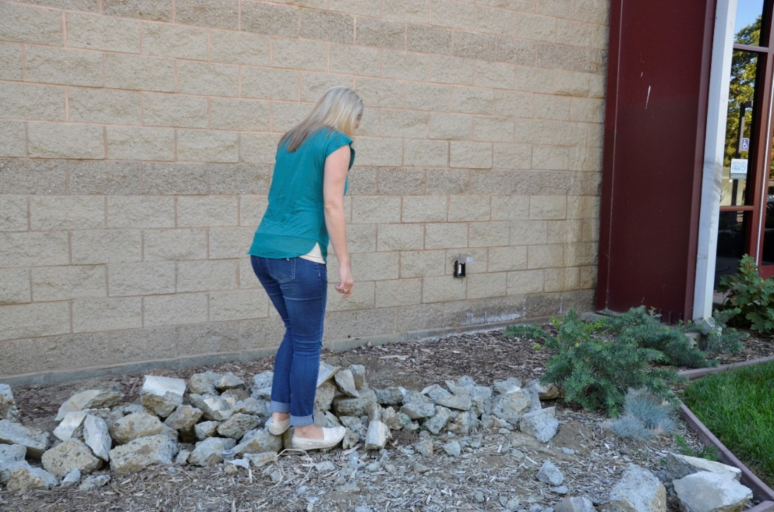
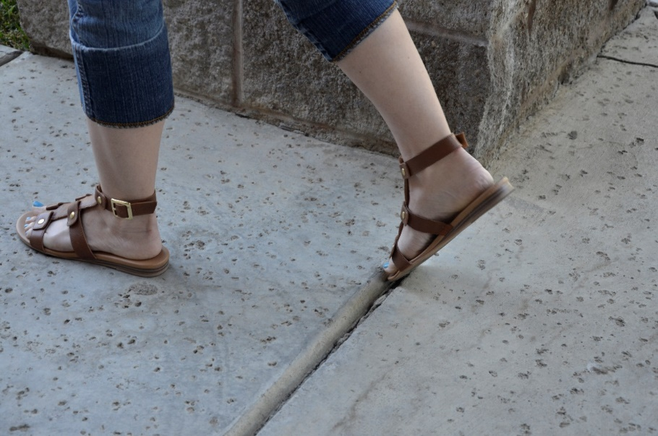
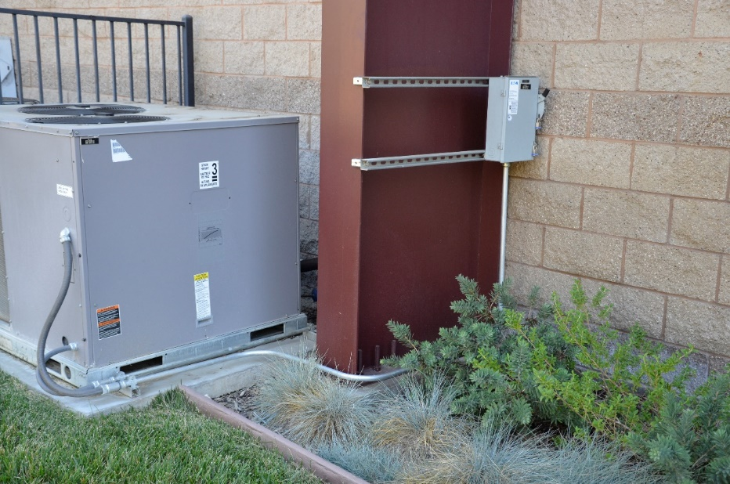
SIDEWALKS, PATHS AND GROUNDS
Notes:
Wide gaps between concrete slabs can be a toe stub with open shoes
The bumps from truncated dome surfaces can be a walking hazard especially with high heels
(Invented in Japan in 1960 and introduced to America Year 2000
Navigating through broken concrete to reach an outlet
No path available to the power box

Slide 9
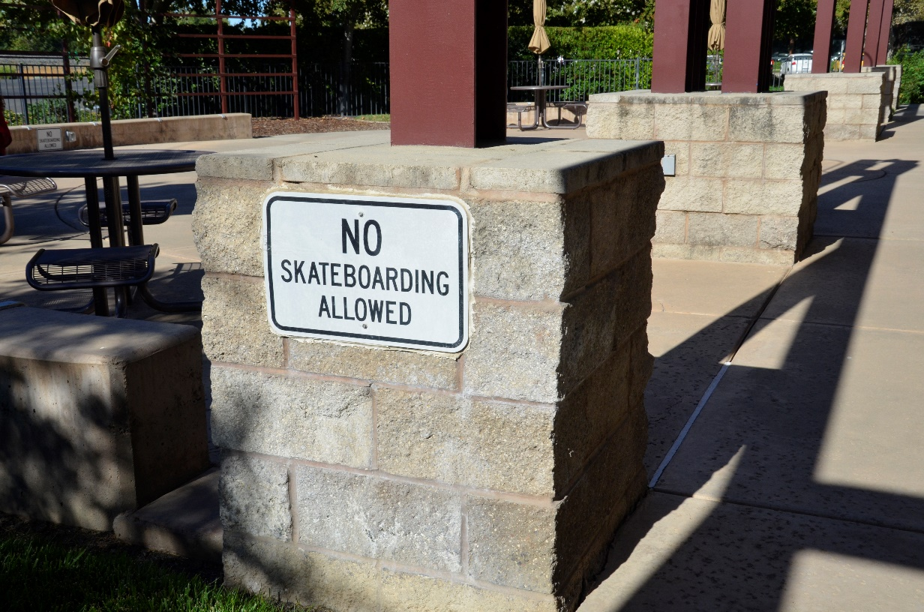
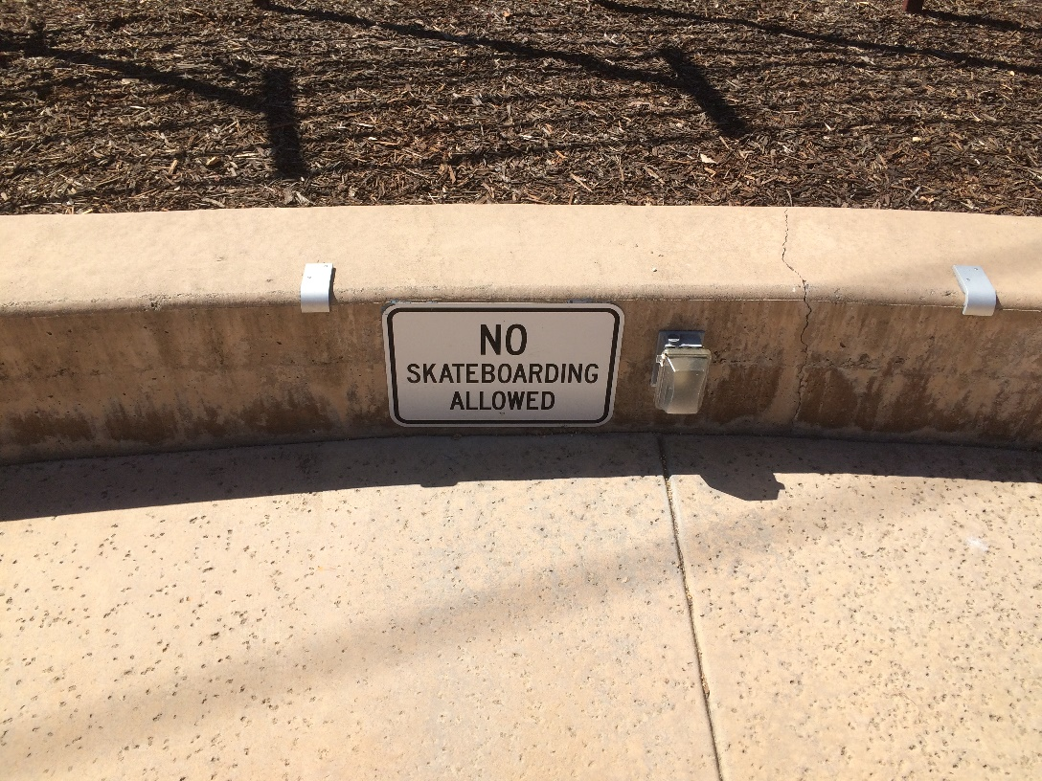
PATIO
Photos
Notes:
The only place with warning signs is the patio
So why only No Skateboarding???
Shouldn’t Running, Skipping, Hopping, Jumping be included??
It would be a large sign, so I had an idea……………………………

Slide 10
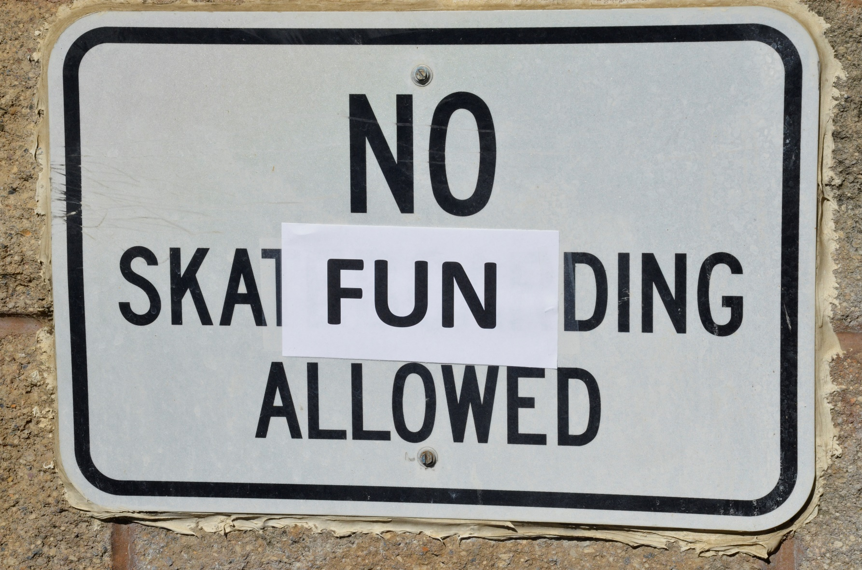
PATIO
Notes:
And I fixed it!

Slide 11
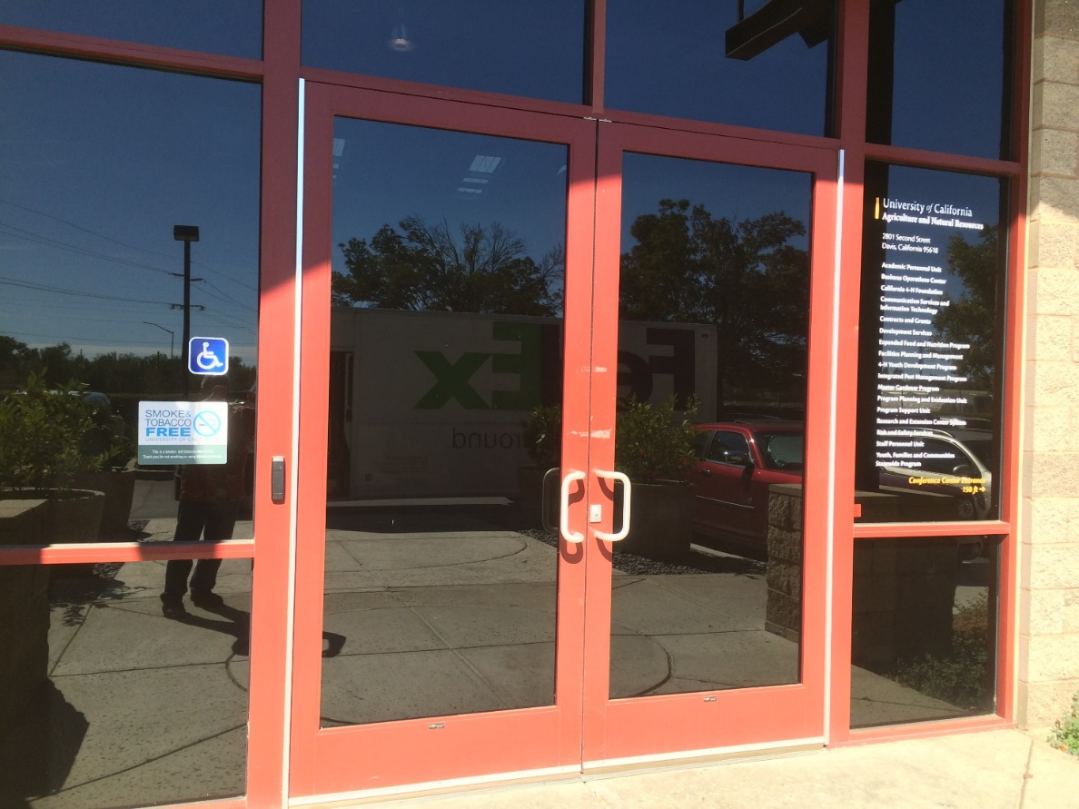
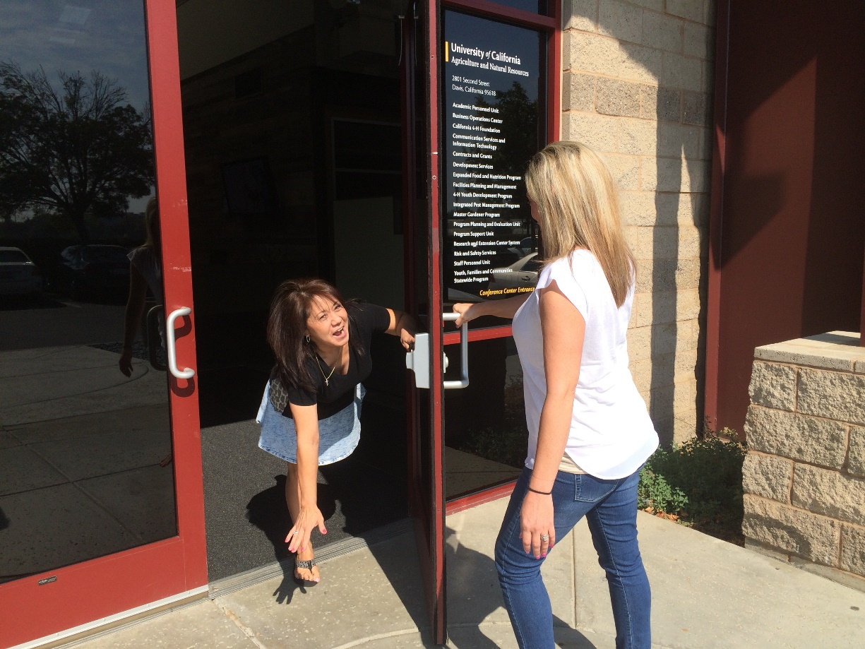
ENTRANCES
Notes:
So now that only half of us are still alive to enter the building…
We have a hazard just entering.
The tinted glass prevents people entering the building from seeing anyone inside who might be exiting the door.
So be careful and open the doors slowly
Potential collision and fall hazard

Slide 12
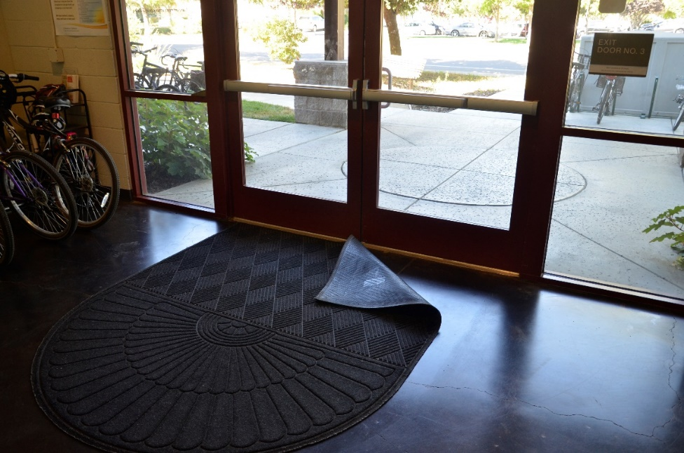
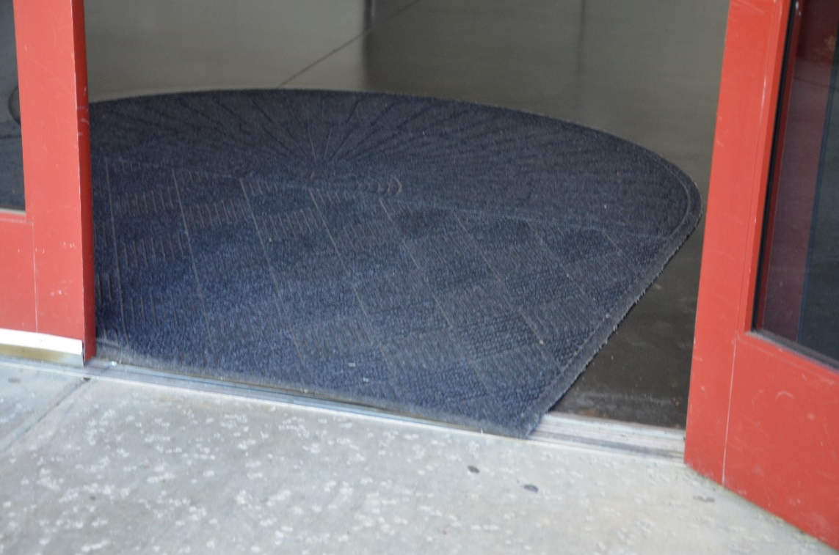
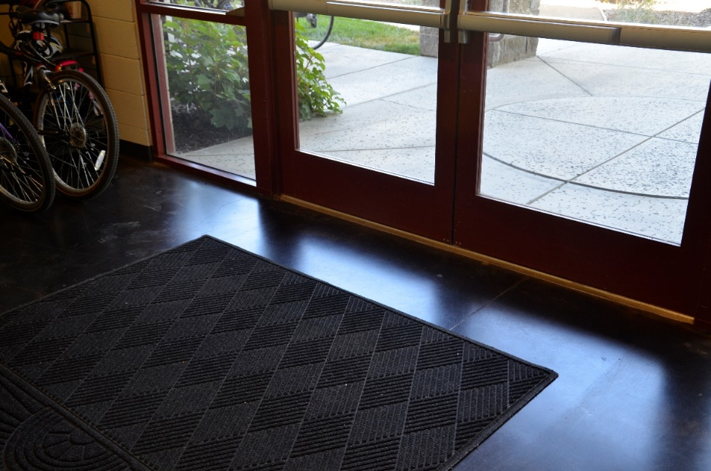
ENTRANCES
Notes:
Floor mat with raised edge and lapping over the entrance
So not having the floor mat up against the door entry can in result in a slip hazard
Especially if shoes are wet or muddy.
Trip hazard from loose, unanchored carpet and mats

Slide 13
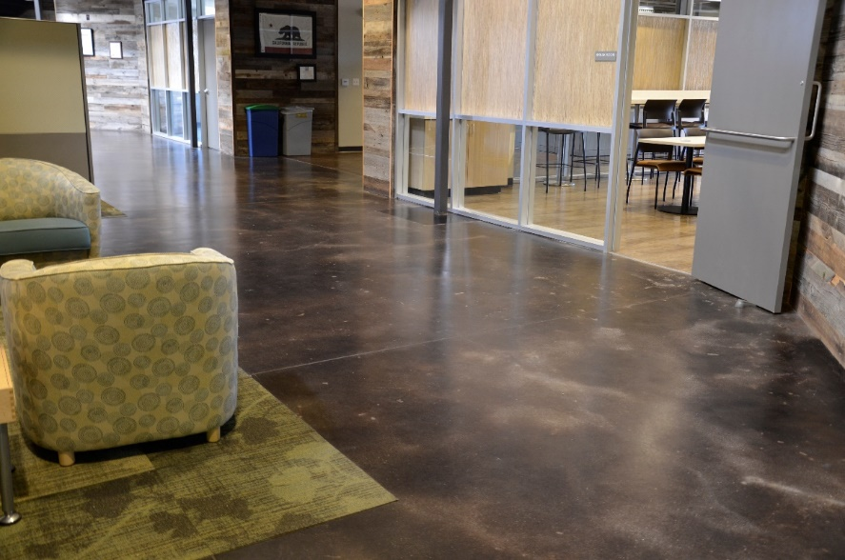
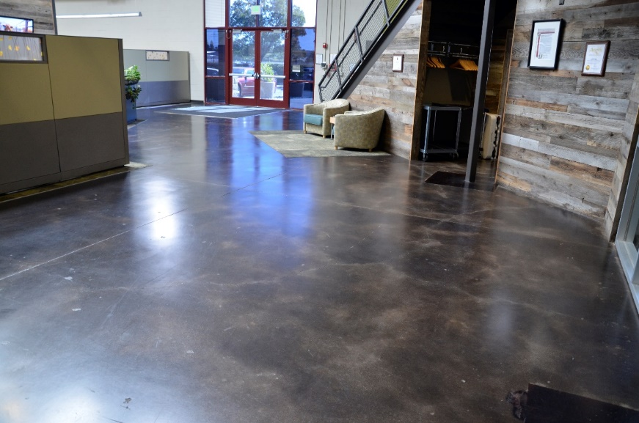
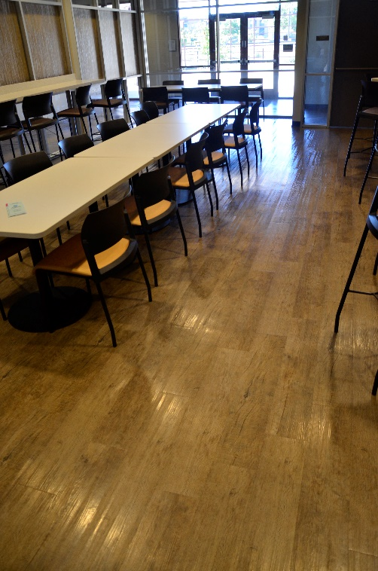
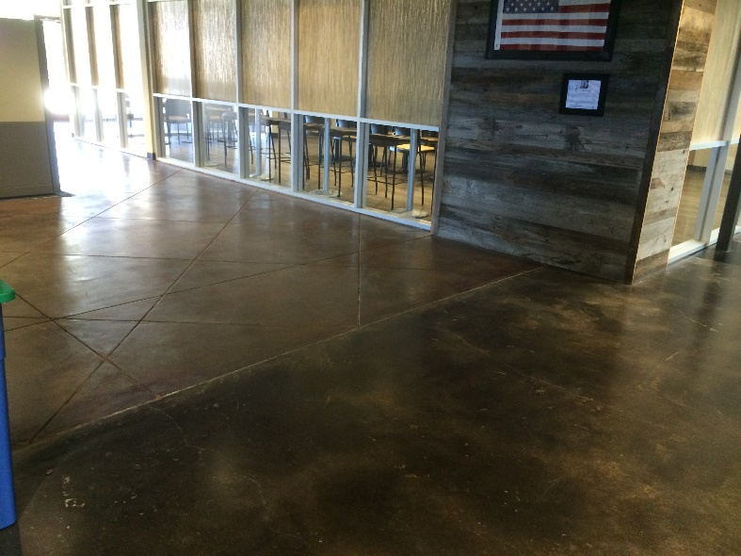
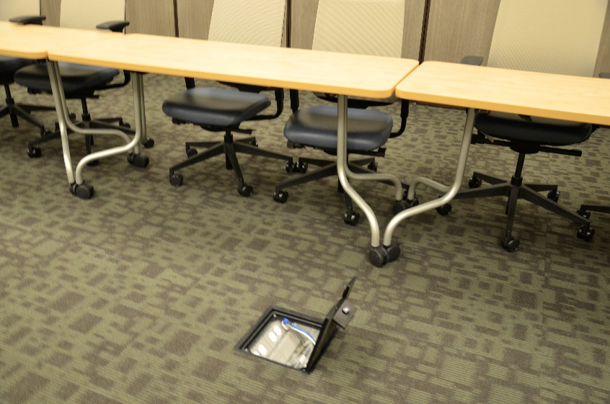
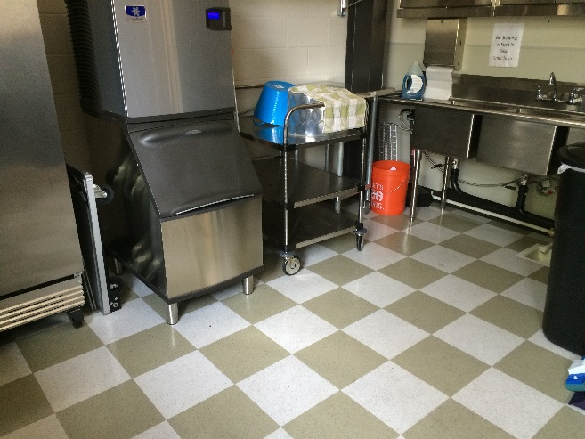
FLOORS
Notes:
There are several different types of floor surfaces.
Some are slip resistant and others are not.
Smooth floors can be a slip hazard especially when wet and for shoes without slip resistant soles
Transitioning from different surfaces such as a slip resistant surface to a smooth surface
Highly polished floors
Freshly waxed surfaces
Floor openings

Slide 14
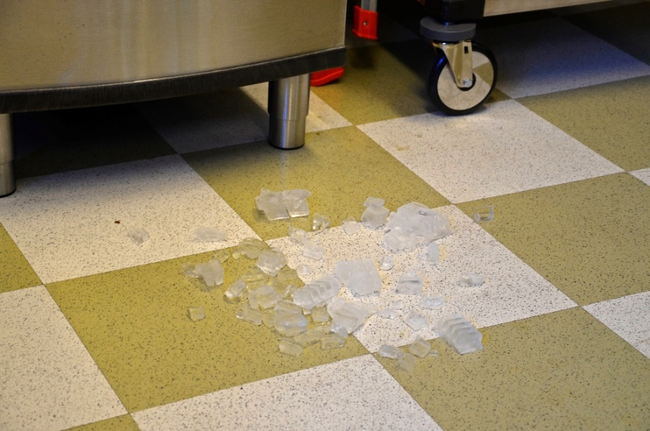
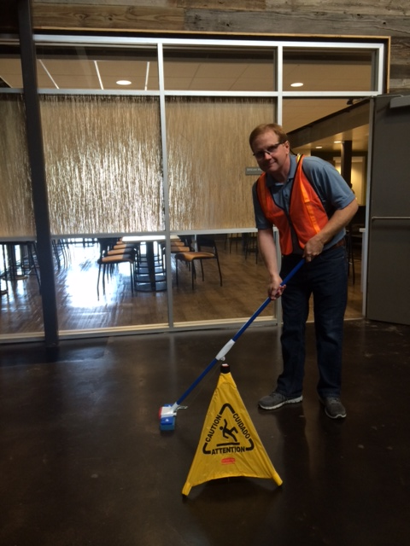
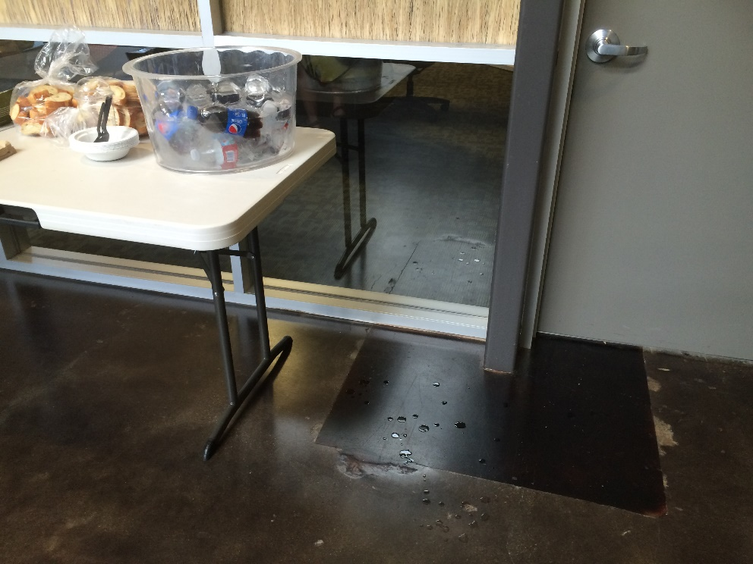
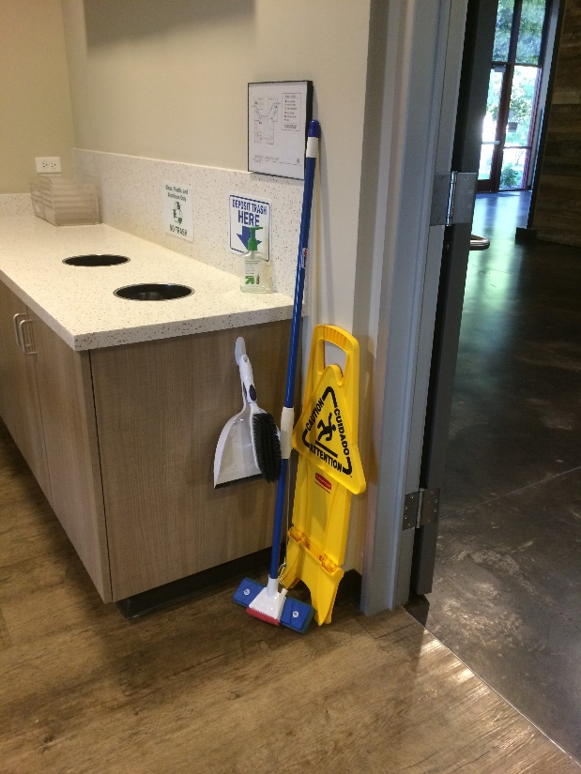
SPILLS
Notes:
Number one slip and fall issue in the building is,
Spilled water on floor from people filling water bottles and transporting tea pots (you tea party people know who you are)
Ice machines
Catering tables
Water fountains
If you spill water or anything else, please clean it up!! (show mop, sign and brush/broom)

Slide 15
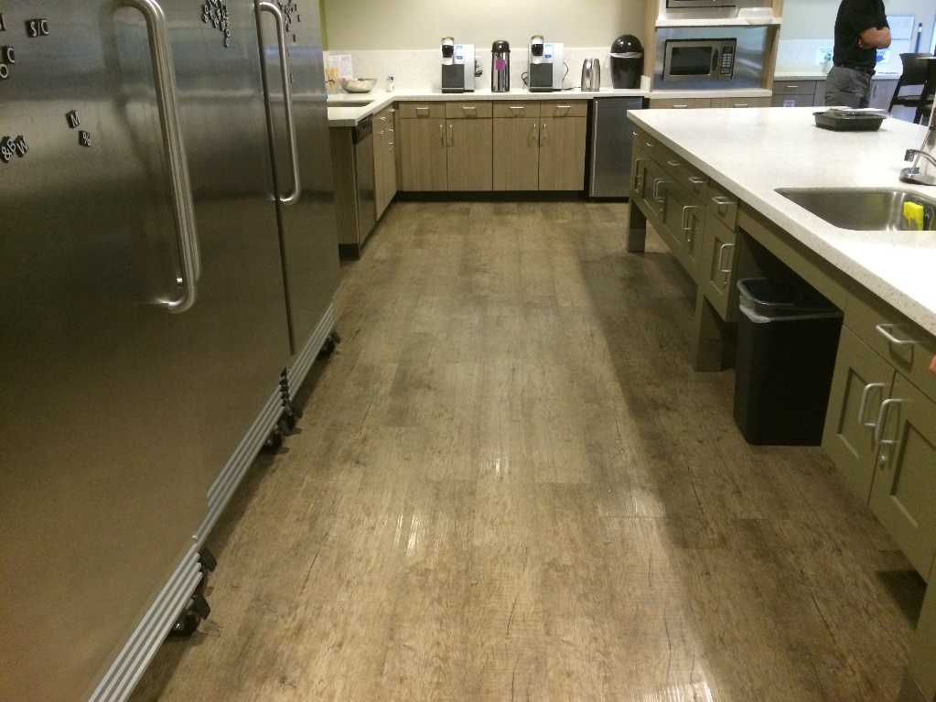

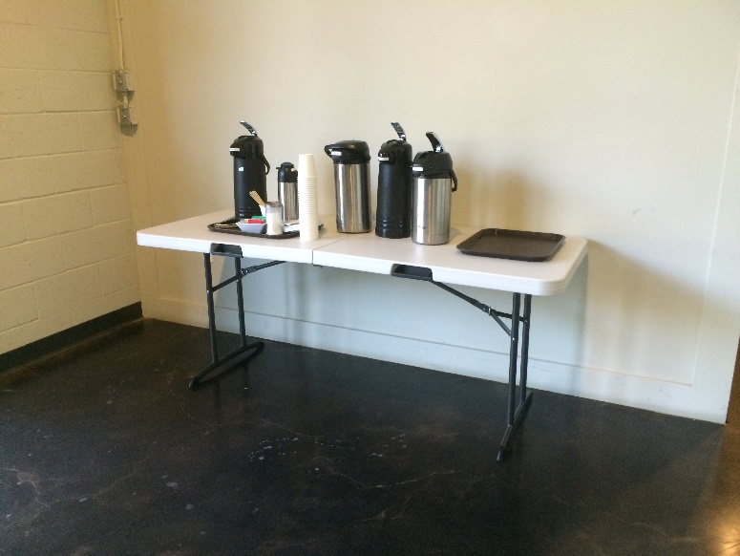
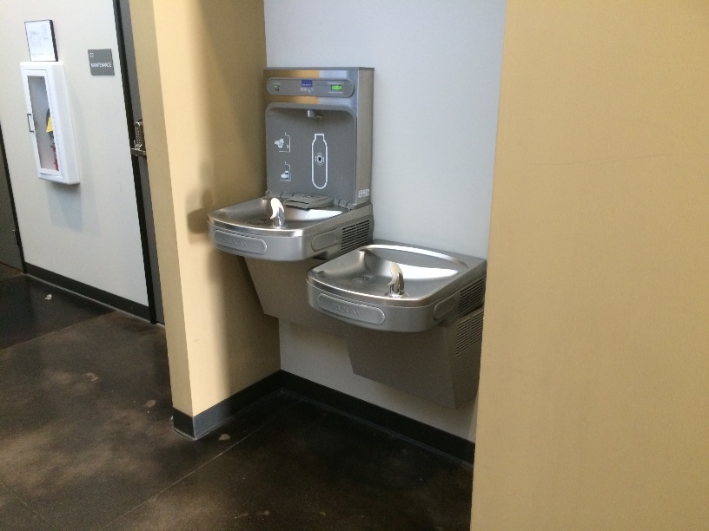
HIGH RISK SPILL AREAS
Notes:
There have been some slips and falls in the break room spilled water.
So be alert and aware when in the break room, at the ice machines, refrigerators and drinking fountains
The areas around catering tables are another high risk area

Slide 16
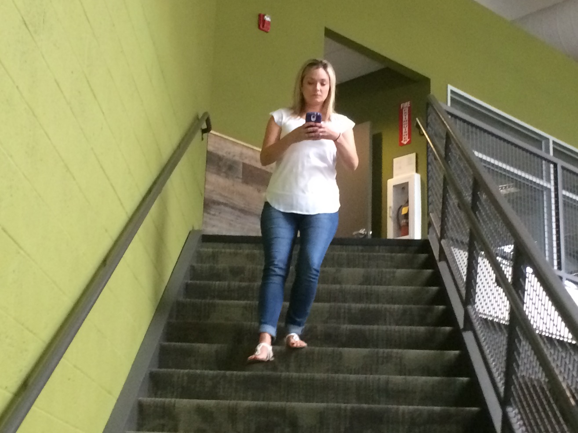
STAIRS
Notes:
We have 4 stairways to heaven in the building
Hazards are:
Not holding on to the banister.
Distracted using a phone or other device.
Running on the stairs
Skipping over steps
Carrying to many items

Slide 17
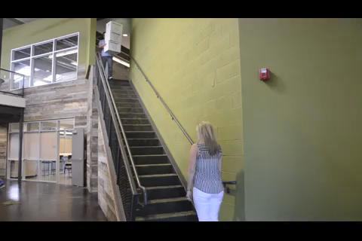
STAIRS
Notes:
Carrying too many items and not watching where you are going

Slide 18

STAIRS
Notes:
No horseplay!!
David caught students doing this

Slide 19

GOOFING OFF
Notes:
No horseplay!!

Slide 20


BLIND SPOTS
Notes:
Rounding blind corners to fast, distracted

Slide 21



WORKSTATIONS
Notes:
Bags and other items on floor
Electrical and data cords
Housekeeping

Slide 22



ASILEWAYS AND FILE AREAS
Notes:
Load bearing beams and footings along the asileways
Cords sticking out of cubicles
File drawers left opened

Slide 23





RANDOM BEAMS
Those silly building designers
Notes:
Load bearing beams are a potential collision hazard
Be aware of your surroundings
Many people have told me they have collided it to them.

Slide 24

BATHROOMS AND SHOWERS
Notes:
According to the Centers for Disease Control and Prevention,
Approximately 235 thousand people annually go to the emergency room due to injuries in the bathroom
More than a third are from showers or bath tubs

Slide 25

WHAT YOU CAN DO
Be alert!! Pay attention to your surroundings!
Notes:
Don’t be distracted while walking
Keep an eye out for other people, items on the floor and spills
Poor can increase risk

Slide 26

WHAT YOU CAN DO
Get plenty of rest!
Notes:
Preferably before you come to work.
Try to get plenty of sleep the night before.
Being sick increases risk

Slide 27

WHAT YOU CAN DO
Try to manage your stress!
Notes:
Being stressed out can cause all kinds of unsafe practices.
Chill out in a quiet room, take a break to calm down
Exercise can reduce stress and being fit can decreases your risk

Slide 28

WHAT YOU CAN DO
Keep the party at home
Notes:
Avoid alcohol and drug use
Prescription medications can increase risk of a slip, trip and fall
Many slip, trip and fall accidents in the workplace are contributed from intoxication or over medication

Slide 29







FOOTWear
BECAUSE YOU CAN NEVER HAVE TO MANY SHOES
Notes:
Their are shoes design for different work environments and tasks including the office.
You want to wear shoes that provide good support and have slip resistant soles

Slide 30


Do not recommend these type of shoes for the office
Notes:
It’s easy to figure why the high heel shoe can be a slip, trip and fall hazard.
Shoe has very little surface contact and not slip resistant
The heel is unstable
The foot is in an un-natural position
Fatigue sets in quickly
You couldn’t create a more hazardous shoe

Slide 31

THE FLIP FLOP
Notes:
The flip flop may look innocent but it is a dangerous shoe
According to the UK National Health Services, there were approximately 200 thousand flip flop related injuries in 2010
With a cost of $64 million dollars.
Flip flops are mostly design to protect the soles from hot surfaces and from catching athlete’s foot from public showers
They were not design to wear all day as a walking or working shoe.
Flip flops do not offer:
Heel support
Arch support
Sole cushioning
Ankle support
Shock absorption
Sun protection
Skin protection
Toe protection
They can fall off easily resulting in an slip, trip and fall hazard

Slide 32



GOING BAREFOOT
Notes:
Walking around the office barefoot is a bad idea for several reasons
No foot protection from sharp materials, hot surfaces, floor edges, dropped items
Being barefoot is a slip hazard
And in the event of an earthquake, fire, or other emergency, your feet can be injured
Resulting in a failed evacuation

Slide 33



WORN OUT SHOES
Notes:
Worn out shoes can contribute to slip, trip and falls.
They fall apart, don’t provide support
Can cause poor posture
Soles worn out not providing slip resistance

Slide 34


REPLACEMENT FOR FLIP FLOPS
Notes:
Instead of flip flops, wear sandals that provide good:
Arch support
Heal support
Ankle support
Secure fit
And slip resistant

Slide 35






RECOMMENDED SHOES
Notes:
Examples of shoes from the Shoes For Crews company that provide good support and are slip resistant

Slide 36






RECOMMENDED SHOES
Notes:
Examples of shoes from the Shoes For Crews company that provide good support and are slip resistant

Slide 37


RESOURCES
Safety Note 62 (Slip, Trips, and Falls
http://safety.ucanr.edu/files/1457.pdf
DVD E-071 (Slips, Trips, and Falls Update)
http://safety.ucanr.edu/files/1457.pdf
ANR Cord Cover Installation Video
http://safety.ucanr.edu/Training/
Notes:
Safety Note
DVD
Cord Cover video

Slide 38
THE CREW
THANKS!!!
Kimberly Rodegerdts – Shoe Consultant and Fall Specialist
Melissa Figueroa – Lizzy Borden and Stunt Woman
Mike Zwahlen – Video and Camera Wizard
David Alamillo – Stunt Man and Surfer Dude
Sueanne Johnson – Fall Specialist
Brian Oatman – Party Dude
Robin Sanchez – Psycho Woman
Malendia Maccree – Collision Specialist
Dustin Flavell – Sleeping Dude

Slide 39



Slide 40


ANR Building – 2801 Second St.
Earthquake & Evacuation Drill
October 15, 10:15 a.m.
During “The Great California ShakeOut” the entire ANR building (including all staff, guests and anyone present) will participate in an earthquake simulation and building evacuation drill.
BE READY TO SHAKEOUT!

