Slide 1
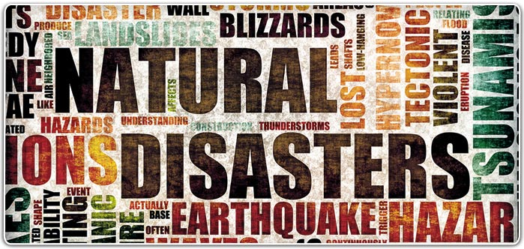
Emergency Preparedness
ANR Building, Davis
Staff Meeting
September, 2015

Slide 2

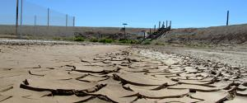
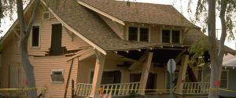

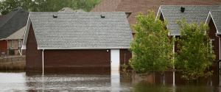
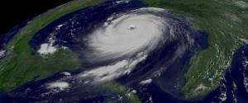
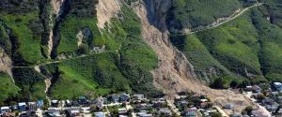
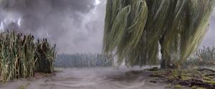

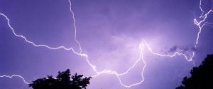
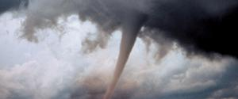
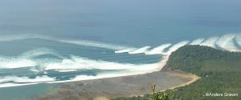
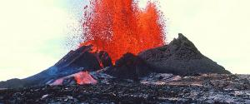
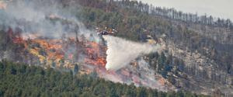
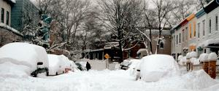
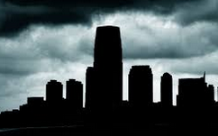

Disasters and Emergencies happen
  Drought Earthquakes Extreme Heat Floods
  Hurricanes Landslides/Debris Severe Weather Space Weather
  Thunderstorms Tornadoes Tsunamis Volcanoes
  & Lightning
  Wildfires Winter Storms Power Outages Pandemics
Notes:
Disasters and emergencies happen
They affect our employees (and their families) and our workplace locations
In recent months, ANR locations have been affected by Power Outages, Wildfires, Drought, Earthquake, Tsunami advisory, etc.
Visit Ready.gov for information on disasters that may occur in the areas you live and work

Slide 3
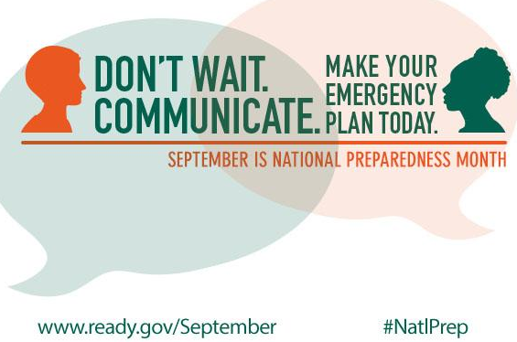

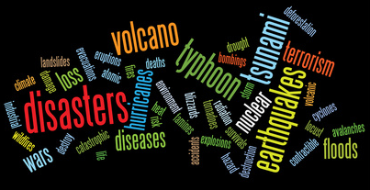

National Preparedness Month
  A nationwide initiative encouraging Americans
    to take simple steps to prepare for emergencies
    in their homes, workplace and communities.
  Get started with the universal building blocks of emergency preparedness:
    Be Informed
    Make a Plan
    Build a Kit
  Build upon this foundation by getting involved, and by encouraging co-workers, friends, family and neighbors.
  Don’t rely upon others, always prepare to be self-reliant for a minimum of 3 days (the first 72 hours).
Notes:
September is National Preparedness Month
Preparedness is a year round activity. However, September is the month for recognizing national preparedness. The Federal Emergency Management Agency (FEMA), in partnership with the Ready Campaign, will again kickoff National Preparedness Month (NPM) this September.
A nationwide initiative designed to encourage Americans to take simple steps to prepare for emergencies in their homes, workplace and communities.
Preparedness is everyone’s responsibility. The better prepared you are, the more likely you can help, or free-up First Responders for those in dire need.
This year’s NPM theme is “Don’t Wait. Communicate. Make Your Emergency Plan Today.”
Get started with the universal building blocks of emergency preparedness:
Be Informed
Make a Plan
Build a Kit
Build upon this foundation by getting involved, and by encouraging co-workers, friends, family and neighbors.
Share the message of preparedness and engage others in preparedness activities. People are more likely to hear and act on messages from people they know and trust.
Don’t rely upon others, always prepare to be self—reliant for at a minimum of 3 days (the first 72 hours).

Slide 4



Be Informed
BEFORE an emergency
  Be informed about hazards and risks in your area
    Ready.gov: http://www.ready.gov/be-informed
    CalEMA MyHazards: http://myhazards.calema.ca.gov/
  Be Trained – in First Aid and CPR, at least one member of the household
  Be Notified – Sign-up for:
          Nixle: www.nixle.com
          UC Davis WarnMe: warnme.ucdavis.edu
          Sacramento-Yolo-Placer ALERT: www.yolo-alert.org
  DURING & AFTER an emergency
  Stay alert – no matter where you are
    TV, Social Media, Radio (KFBK 1530 AM, 93.1 FM)
    Reverse 911, Emergency Alert System (ESA), Wireless Emergency Alerts (WEA), Integrated Public Alert & Warning System (IPAWS)
Notes:
UC Davis WarnMe emergency notification service provides employees and students with timely information and instructions during emergencies. WarnMe uses employee’s work contact information from the UCD online directory, students’ email addresses; AND personal contact information you voluntarily provide. Register & update at: warnme.ucdavis.edu
Sacramento-Yolo-Placer ALERT –these three counties have partnered to
Provide a community notification system to alert residents about emergency events and other important public safety information. www.yolo-alert.org

Slide 5
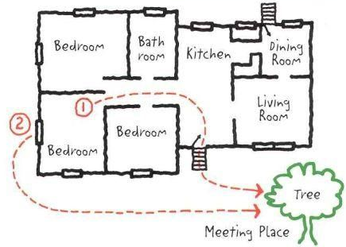
Make a Plan
  Meet with your family and discuss how to prepare and respond to emergencies
  Plan what to do if separated – choose two places to meet
  Plan what to do if evacuation is necessary – from the home, from your community
  Choose an out of the area contact
  Identify responsibilities – work as a team
  Have copies of essential documents, household inventory
  Know the location of utility shutoffs and keep tools nearby (http://www.ready.gov/utility-shut-safety)
  Try to keep your car’s tank half-full

Slide 6
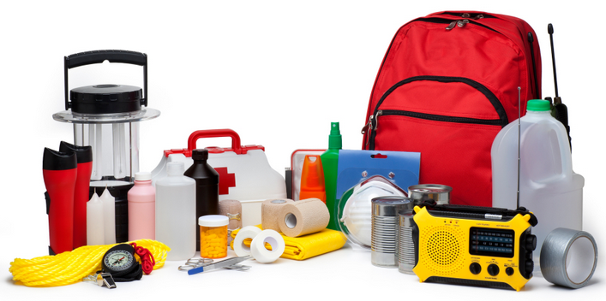
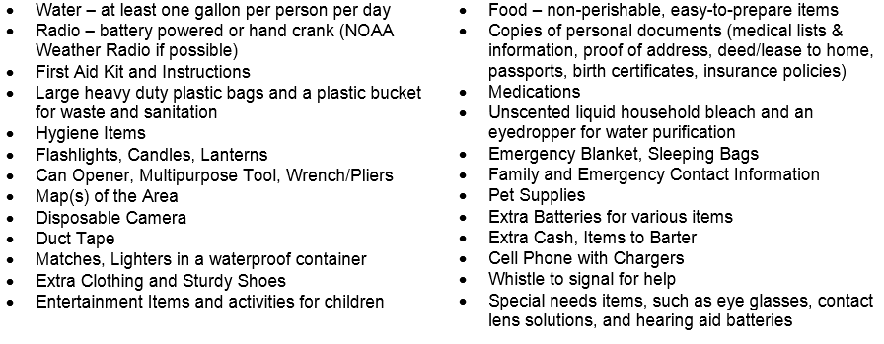

Build a Kit
  Pre-packaged or build from home
  Store in an easily accessible location
  Use a large, watertight container (e.g. large plastic garbage can with lid & wheels)
  Checklist are available from – Ready.gov, 72hours.org, Redcross, the CDC, etc.

Slide 7
Resources
    Safety Notes Series on Emergency Preparedness
  #166: Office Preparedness
    employees likely spend near 8 hours each day at the office, so the possibility of being at work during a major catastrophe is likely.
  #167: BE INFORMED
    Be Informed about the potential hazards and risks in your area and learn the appropriate ways to respond to them.
  #168: MAKE A PLAN
    Make a Plan with your family or household members to discuss how to prepare and respond to emergencies that are most likely to happen where you live, learn, work and play.
  #169: BUILD A KIT
    Build a Kit full of disaster supplies and basic items your household may need in the event of an emergency - be prepared to be self-sufficient for at least three days.
Notes:
This series of Safety Notes provides tips for personal emergency preparedness. Each UC ANR work place should also have site specific emergency plans. See safety.ucanr.org or your location’s Safety Coordinator for more information about your workplace emergency plans.
1. Be informed about the different types of emergencies that can happen in your area and their appropriate
responses.
Learn about the hazards that may strike your community, the risks you face from these hazards and your
community’s plans for warning and evacuation. You can obtain this information by visiting
http://www.ready.gov/be-informed.
2. Create a family emergency plan
Your family may not be together when an emergency happens, so it is important to plan in advance. Think about
how you will contact one another, how you will get back together, and what you will do in different situations.
You can download a family emergency plan template from by visiting http://www.ready.gov/make-a-plan.
3. Put together an emergency supply kit
You may need to survive on your own after an emergency. This means having your own food, water and other
supplies in sufficient quantity to last for at least three days. Local officials and relief workers will be on the scene
after a disaster, but they cannot reach everyone immediately. You could get help in hours, or it might take days. In
addition, basic services such as electricity, gas, water, sewage treatment, and telephones may be cut off for days,
or even a week or longer. To find a complete checklist of the supplies your household may need in the event of an
emergency, visit http://www.ready.gov/build-a-kit.

Slide 8
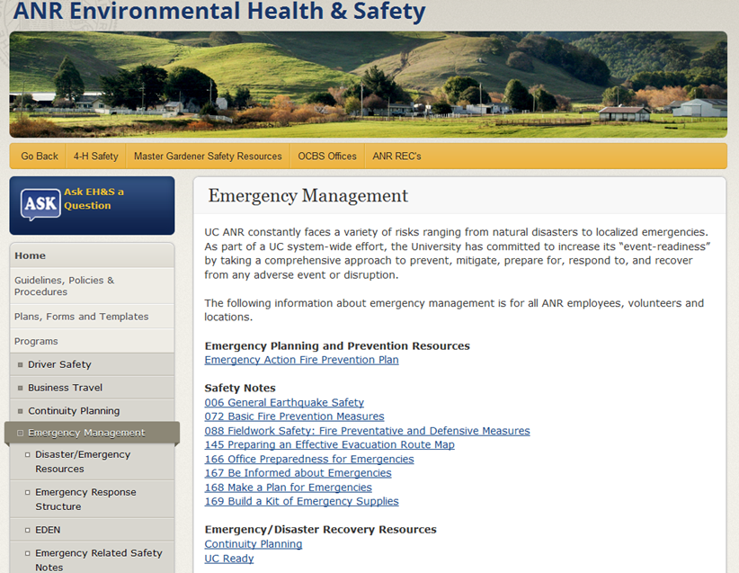
Resources
    ANR EH&S website
      http://safety.ucanr.org/Programs/emergency/
Notes:
Resources available on the ANR EH&S website include:
Emergency Management Program
Planning and Prevention Resources
Safety Notes in emergency preparedness
Recovery resources
Continuity Planning (UC Ready)
The structure/system used for response: SEMS/NIMS/ICS

Slide 9
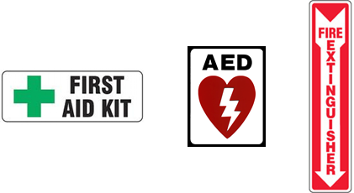
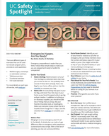
Resources
    Emergency Action and Fire Prevention Plan
    Located in the EH&S library and on the building website
    Identifies the steps to take in an emergency
  Emergency notifications/alarms
  Location of emergency equipment
    Fire extinguishers
    First aid kits
    Automated External Defibrillator (AED)
  Evacuation routes and assembly area
    Plan ahead, know the exits around you
Safety Spotlight Newsletter
UC monthly newsletter focusing on Safety
September’s topic is Preparedness
  http://ucanr.edu/sites/ucehs/Safety_Spotlight/

Slide 10

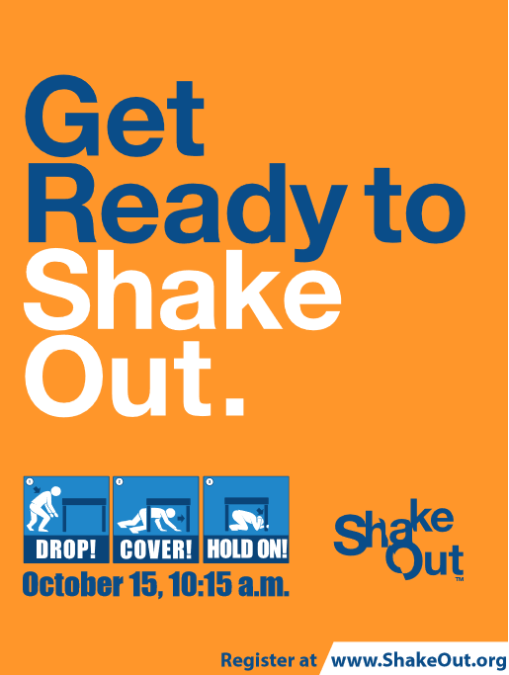

Slide 11


Why ShakeOut?
The Great California ShakeOut is an annual opportunity to practice how to be safer during earthquakes, and to improve preparedness
Over 10 million Californians participate annually, and over 25 million nation-wide
The occasion is also used as an opportunity to:
  rehearse Drop, Cover, & Hold On
  secure our space to prevent damage & injuries
  review & update our emergency plans & supplies
  discuss emergency preparedness & response
  hold a fire drill / building evacuation exercise
What we do now will determine our quality of life after our
  next big earthquake. Are you prepared to survive and recover?

Slide 12

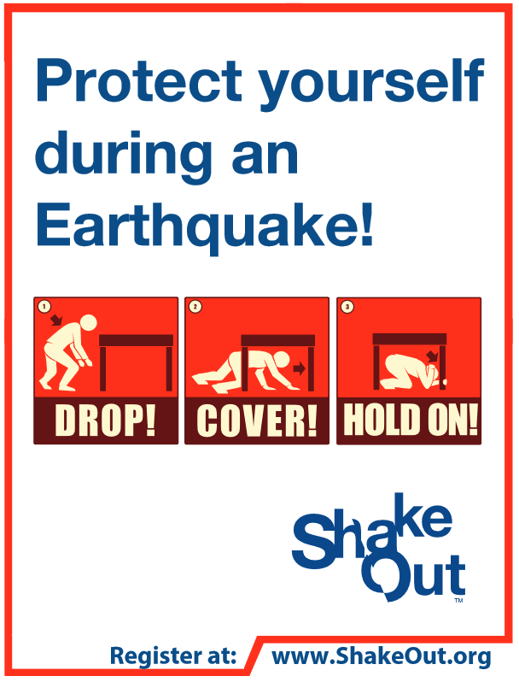
ANR Building – 2801 Second St.
Earthquake & Evacuation Drill
October 15, 10:15 a.m.
During “The Great California ShakeOut” the entire ANR building (including all staff, guests and anyone present) will participate in an earthquake simulation and building evacuation drill.
BE READY TO SHAKEOUT!

Slide 13
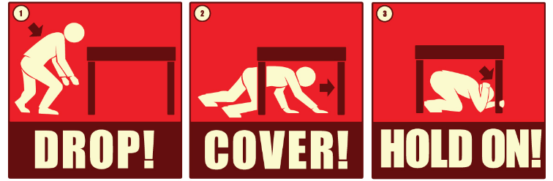
DROP! COVER! HOLD ON!
Preparedness organizations and experts all agree: “Drop, Cover, and Hold On” is the appropriate action to reduce injury during earthquakes
  DROP to the ground (before the earthquake drops you!)
  COVER your head and neck with your arms and seek shelter by getting under a sturdy desk or table if nearby; and
  HOLD ON to your shelter and be prepared to move with it until the shaking stops

Slide 14

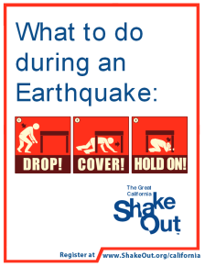
DROP! COVER! HOLD ON! continued
The main point is to not try and move, but to immediately protect yourself as best as possible where you are
If there is no table or desk near you, drop to the ground in an inside corner of the building and cover your head & neck with your hands & arms
If you must move to get away from heavy or falling/breaking items, first drop to the ground, then crawl only the shortest distance necessary
As you spend time in areas new to you, take a moment to look around:
  What is above & around you that could move or fall?
  What are your various routes of evacuation?
  Identify safe places, & use your best judgment to stay safe!

Slide 15

Earthquake & Evacuation Drill Procedures:
10:15 a.m. Thursday, October 15, you will hear 3 air horn blasts
Department Safety Contacts (DSC) in your area will announce the earthquake portion of our drill
Drop, Cover, & Hold-on, for one minute – the recommend action to take to avoid injuries during earthquakes
FIRE ALARM will be PULLED next
Please safely evacuate the building, as the fire alarm sounds, to our emergency assembly area
The assembly area is across Pena drive, within the Davis Musical Theatre Company parking lot
Cross the street safely, watch for traffic
Line up for roll-call by department, look for your DSC who will be wearing an orange safety vest and holding up a clipboard
Once the building is clear, and as departments/individuals are accounted for within our assembly area, your DSC will be given the “all clear” to have you return to work
Please do not leave our assembly area until you are specifically accounted for and released
Again, cross the street safely to return to work
We will debrief and discuss the ShakeOut/evacuation event at our All Staff Meeting

Slide 16
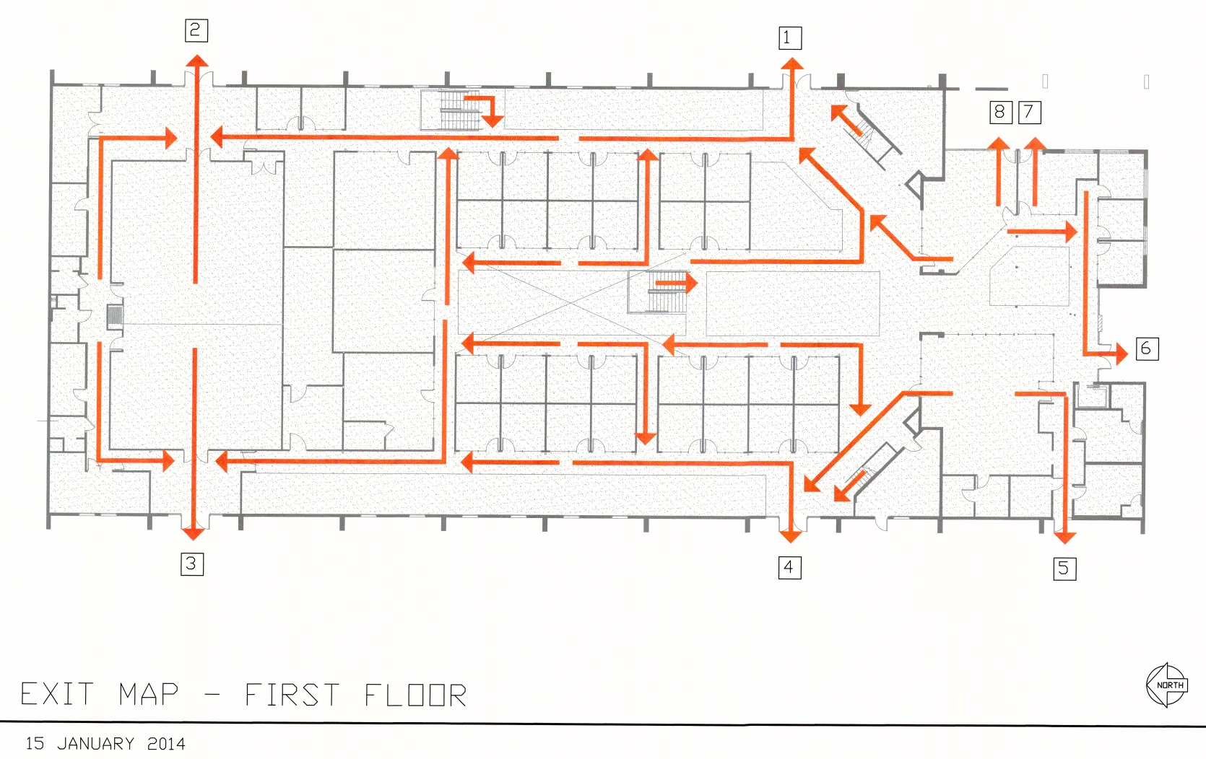
Emergency Action and Fire Prevention Plan
First Floor Evacuation
  Insert map

Slide 17
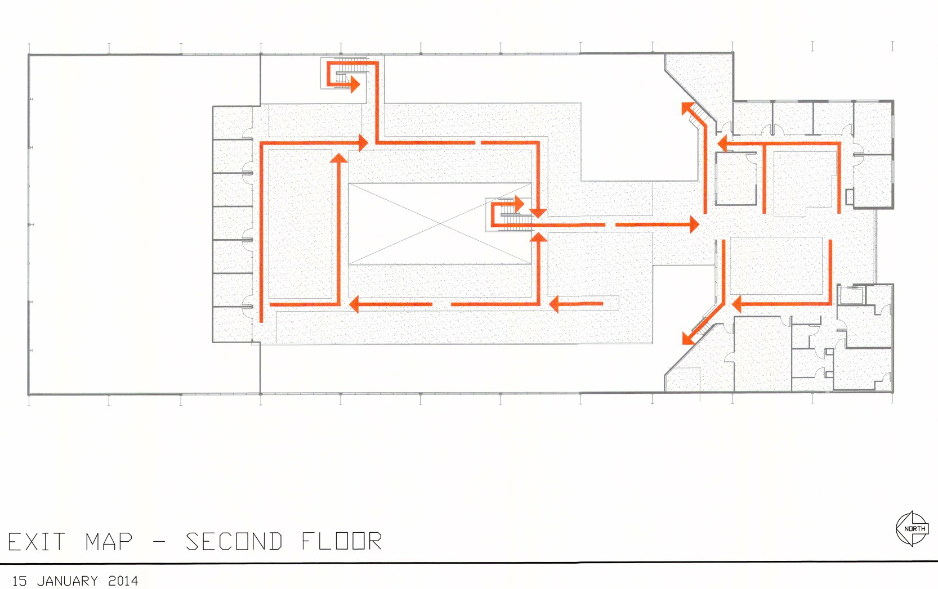
Emergency Action and Fire Prevention Plan
Second Floor Evacuation
  Insert map

Slide 18
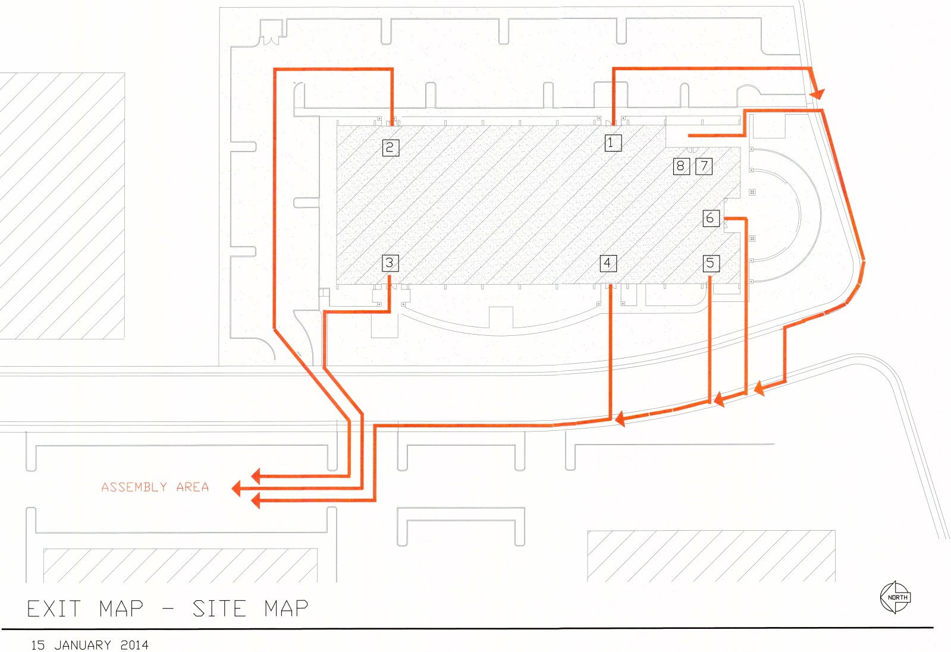
Emergency Action and Fire Prevention Plan
Building Exterior and Assembly Area
  Insert map

Slide 19
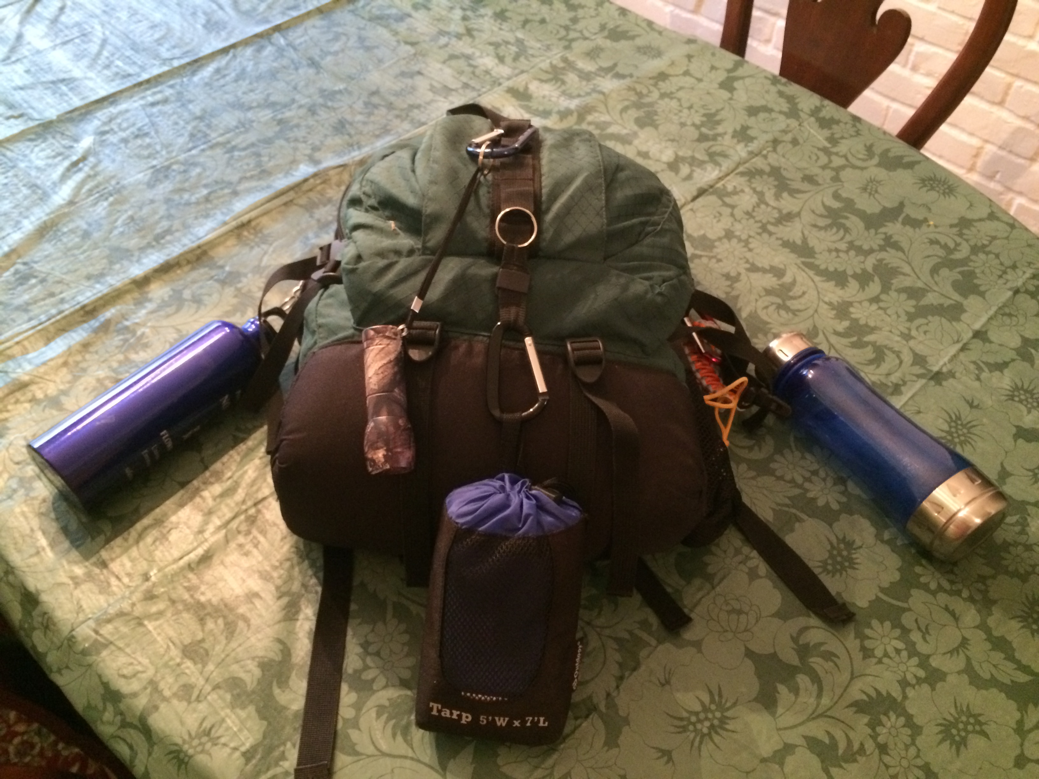
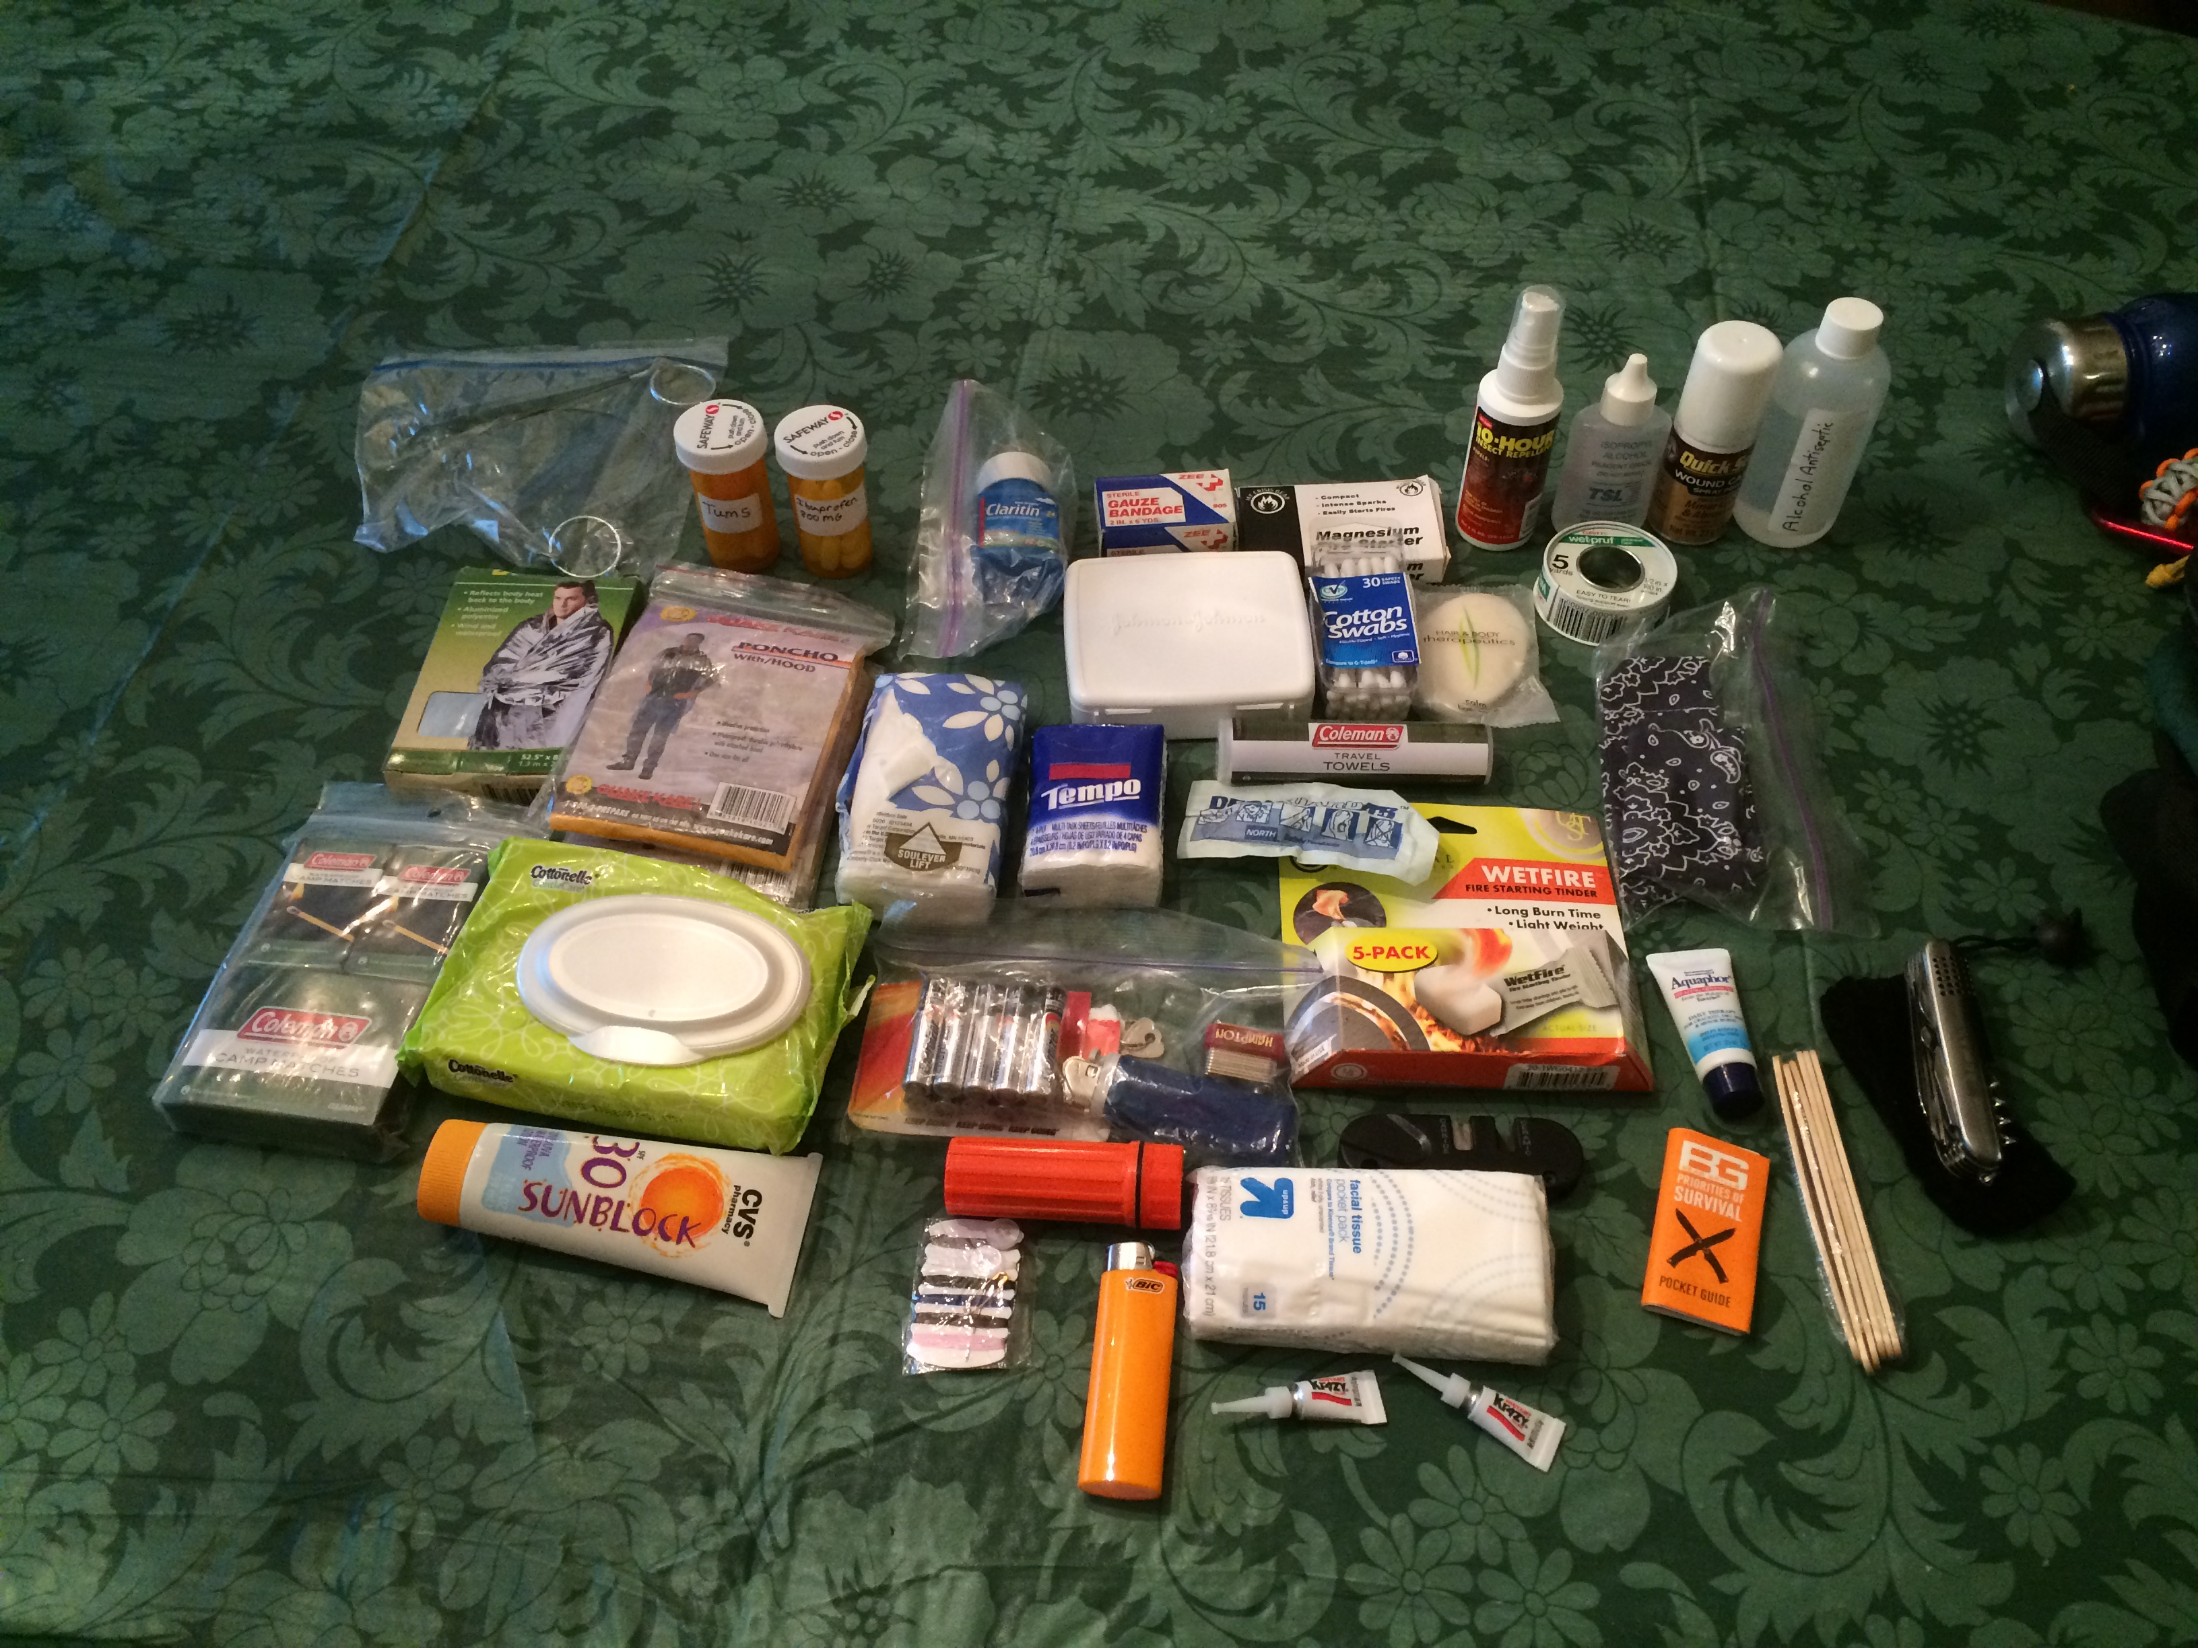
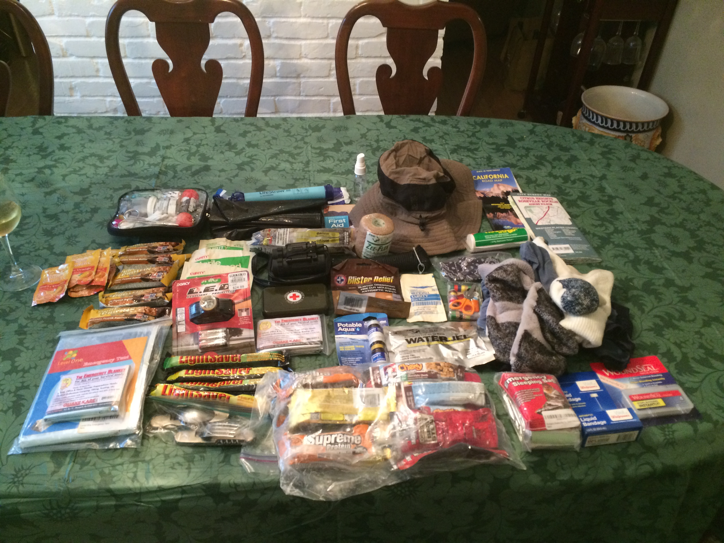
Get Home Bag
Notes:
A Get Home Bag (GHB) is an important part of your personal and home disaster preparedness plan.
It’s an up to 3 day emergency survival pack to assist getting you home safety.
Recommend you can keep it in your vehicle so you have it all the time when traveling
For those of you at Oakland, recommend keeping it at your workstation.
If an earthquake hits, you might not be able to get to your car to retrieve it.
Recommend using a boring looking, non-expensive backpack that doesn’t scream (I Have Money).
If you get a new pack, scruff it up and stain it some to not look appealing.
THE CLOTHING IN YOUR PACK SHOULD NOT BE BRAND NEW AND EXPENSIVE LOOKING
YOU DO NOT WANT TO STAND OUT AND BE A TARGET!!!!
Blend in to the environment you are in. (Going Grey)
A disaster is not the time to show off your new tactical mall ninja outfit

Slide 20
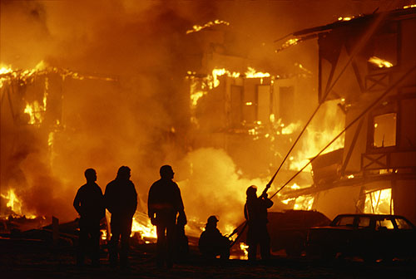
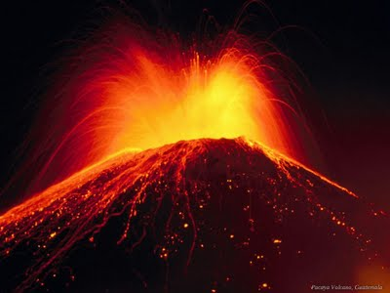
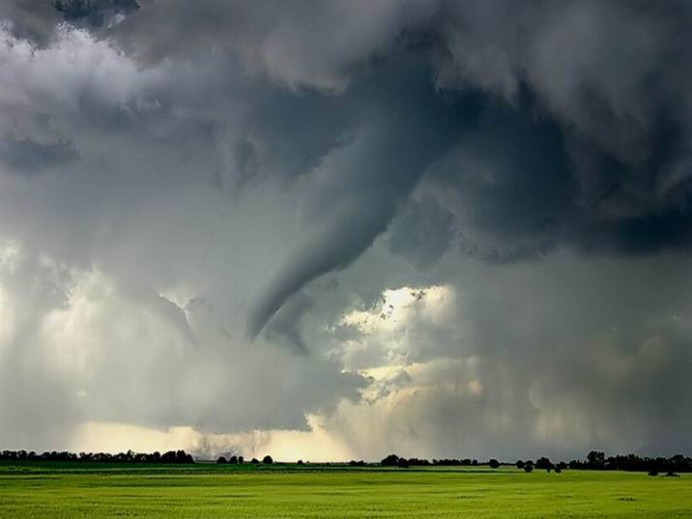
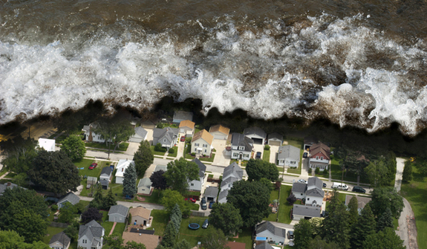
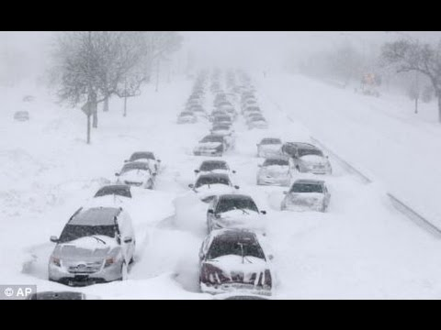
What situations might require a Get Home Bag?
Earthquakes
Floods
Fires
Hurricanes
Tornados
Volcanic eruptions
Snow storms
Land slides
Terrorist attacks
Chemical spills
Train derailments
Mass transit down
Notes:
Some natural and man made disasters can result in not being able to drive home
If any of these disasters happen, roads might be in assessable
Roads/bridges are damaged, power lines, buildings, and trees are down
Roads washed out, flooded or covered in snow and ice
City streets closed due to civil unrest or not drivable due to earthquake
The bag is also useful if your vehicle breaks down in remote country
The Get Home Bag can also be used as a Bug-In
Bag if traveling is not possible, or the
situation does not allow evacuation

Slide 21
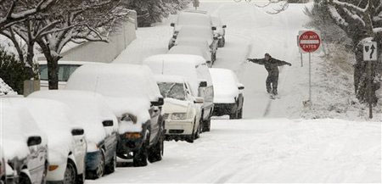
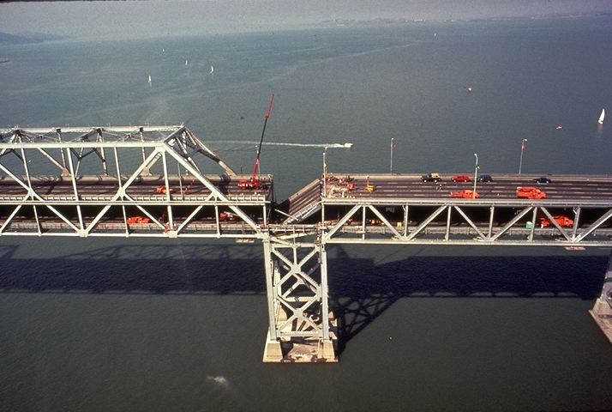
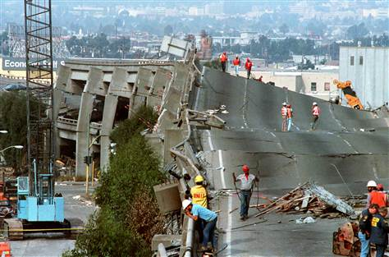
Real Life Examples:
Snow storm in Spokane Washington 2008
San Francisco/Oakland Earthquake 1989
Notes:
In Spokane, a record 20 inches of snow fell in a 24 hour period.
Creating a “Condition Red” snow emergency
Most roads were impassable due to amount of snow, collisions, and stalled cars.
People were stranded throughout the city with the only method of getting home was walking.
Many people decided to stay in place (work/school) and wait for help or conditions to change.
In the Bay Area as many of you know, the Bay Bridge shut down due to a fallen section of the upper deck.
The two-level Cypress Street corridor collapsed, crushing vehicles and people.
Other areas were hit hard rendering travel by vehicle impossible.
The north bay region was basically shut down to personal vehicles.
People lost their vehicles and had to walk home or to a shelter
Other disasters were:
Hurricane Katrina and Rita
Northridge Earthquake
Napa Earthquake last year
Butte Wildfire
Lake County Wildfire
9-11 Terrorist attacks ( people who lived out side of lower Manhattan had to walk out of the city to get home or to a shelter)

Slide 22
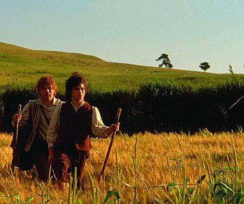
What is your distance home?
The average person can walk 3 miles an hour on flat easy ground.
36 miles in 12 hours
The average person who is not used to carrying a pack, does not exercise on a regular basis, and is traveling over varied terrain can cover 10 – 18 miles in 12 hours.
Use this as a guide to determine how long it would take to walk home.
Notes:
The size of your GHB and equipment needed depends on the distance you have to travel in order to get home.
Other situations that can slow your travel home are:
Downed roads and bridges
Extreme heat or cold temperatures
Storms
Civil unrest
If you have a one day walk, pack for 2 days.
Two day walk for three

Slide 23
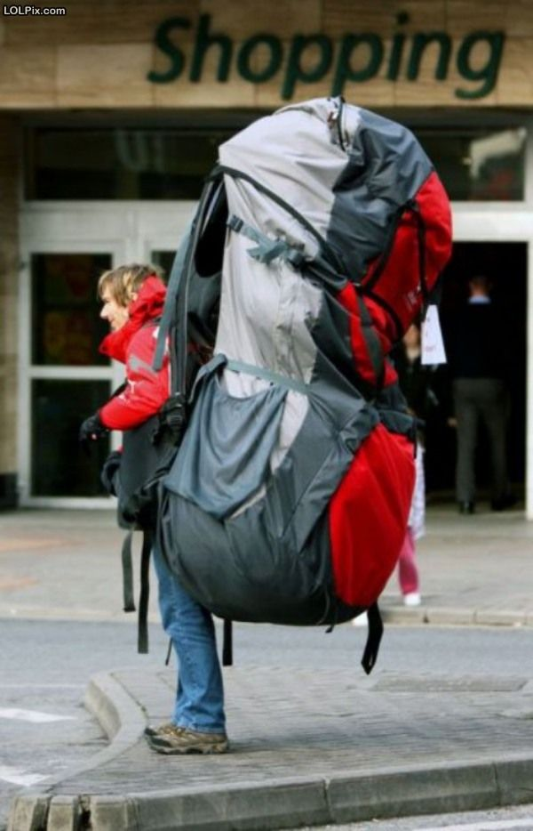
What do I put in my Get Home Bag?
FOOD – Ready to eat foods that don’t require cooking (Energy and Protein bars)
WATER – The average person needs 1 gallon a day.
SHELTER - Emergency tent, emergency sleeping bag, emergency blankets
CLOTHING – Socks, underwear, hat, long pants, shirt, hiking boots or shoes, coat, rain suit or poncho.
MEDICINE – 3 day supply of prescriptions, pain relievers, allergies, tums, etc..
FIRST AID – Mini kit, antibacterial ointment, wound seal, sunblock, gauze
LIGHT/FIRE – Lighters, waterproof matches, flash light, light sticks, flares
PERSONAL – Travel grooming kit, camp toilet paper,
foot blister kit.
9. TOOLS – Knife, multi-tool kit, cord, duct tape
Notes:
If you live here in Davis or within 10 miles, you would not need some of these items
The size of your GHB and equipment needed depends on the distance you have to travel in order to get home.
Equip your bag twice a year for summer and winter and check your food stuffs
(I use daylight savings time)
It should not cost much to put it together.
Many of the items you will need for the bag you already have at home
I have my 3 day GHB as an example for you to see.
I’m in the process of changing out the bag and updating other supplies
I have a list of items that are in my bag.

Slide 24
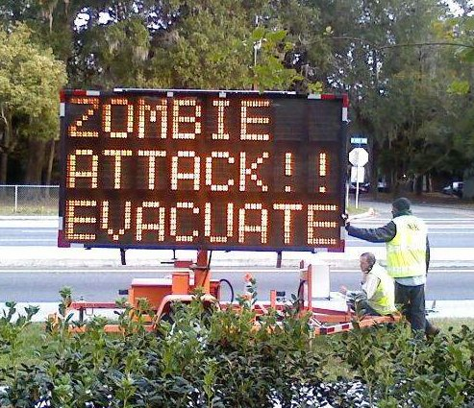
THE END
Notes:
There are pre-packaged survival bags on the market
But I don’t recommend them as they are too basic
And can cost a small fortune
Wal Mart has many survival and camping items along with:
Sportsmen's Warehouse in Rancho Cordova and Rocklin
The new Bass Pro Shop in Rocklin
And if you have money to burn and want to be in style REI is for you
Amazon is a good source as are many survival websites for supplies
I can assist you with putting a GHB if you would like.
FINAL WORD!! PRACTICE WALKING WITH YOUR BAG AND HIKING SHOES!!

Slide 25
QUESTIONS?
please remember to sign-in

