Slide 1
Office Safety
Recognizing and correcting hazards

Slide 2
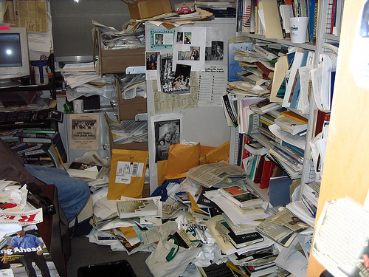
Introduction
We will cover
  Recognizing office hazards
  General Safety Tips
  Office Layout

Slide 3
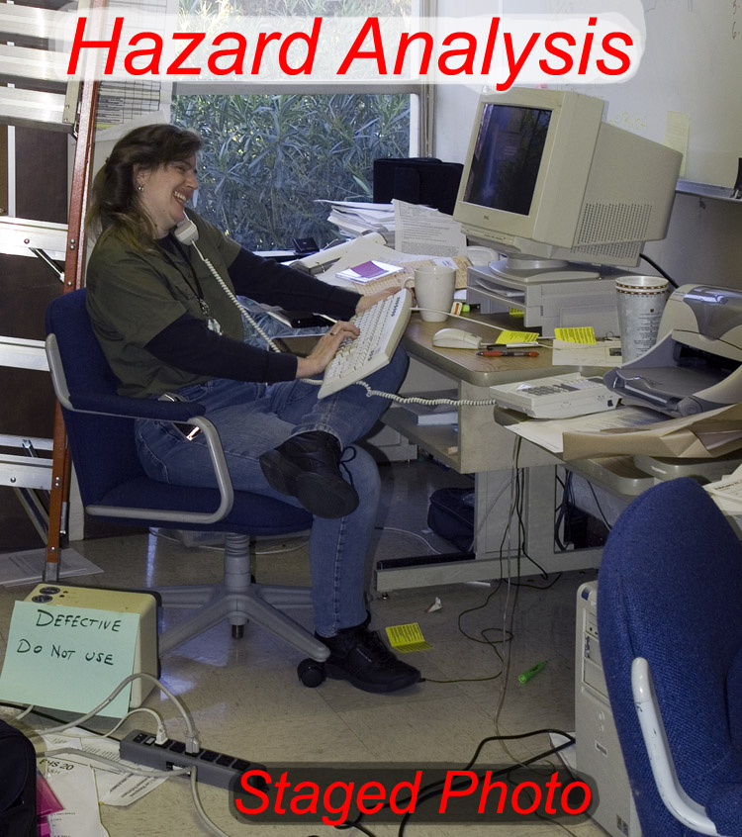
Other Hazards

Slide 4
Office Hazards
Here are a few:
  Poor housekeeping
  Trip hazard
  Daisy chained power strip
  Poor desk layout
  Poor computer location
  Bad posture and seating
  Ladder stored poorly

Slide 5
Office Hazards
Why is it bad:
  Poor housekeeping
    This also can block an emergency escape route or lead to falls
  Trip hazard
    Slips/Trips/Falls is a leading cause of injuries in ANR
  Daisy chained power strip
    Overload the circuit and/or cause one strip to over heat

Slide 6
Office Hazards
Why is it bad:
  Poor desk layout, computer location, bad posture and seating
    Can lead to pain and ergonomic-related injuries
  Ladder stored poorly
    Outdoor equipment, as with other equipment, should be stored in its proper place where it will not pose a hazard

Slide 7
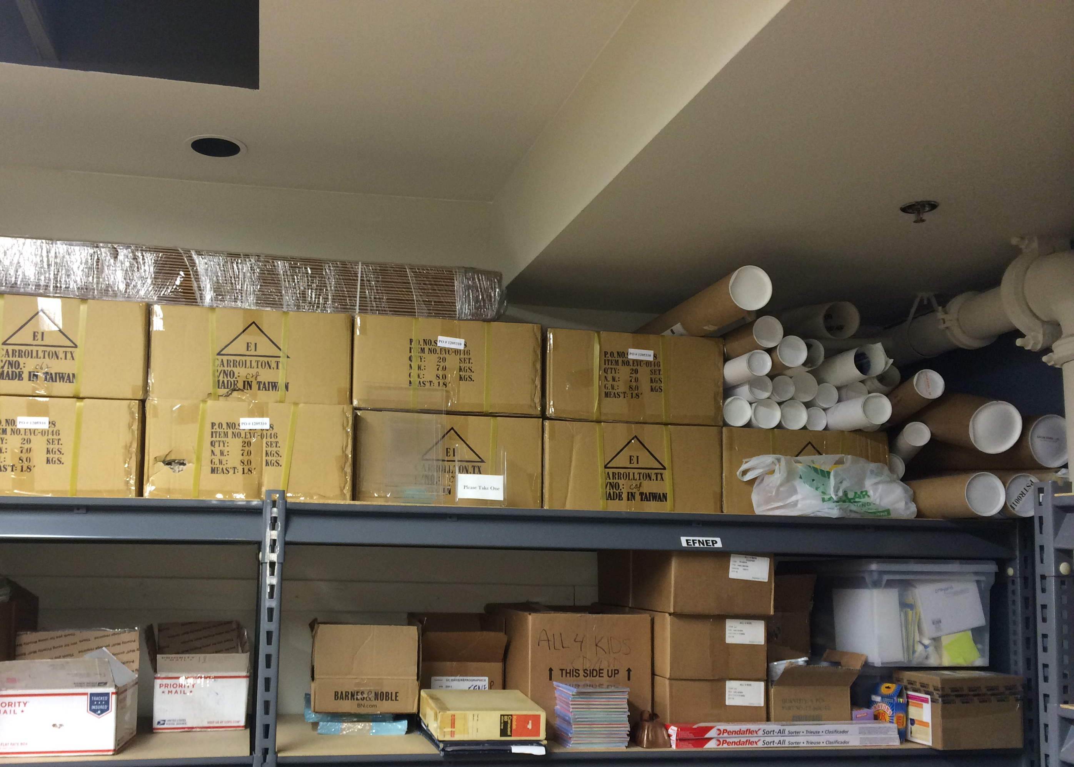
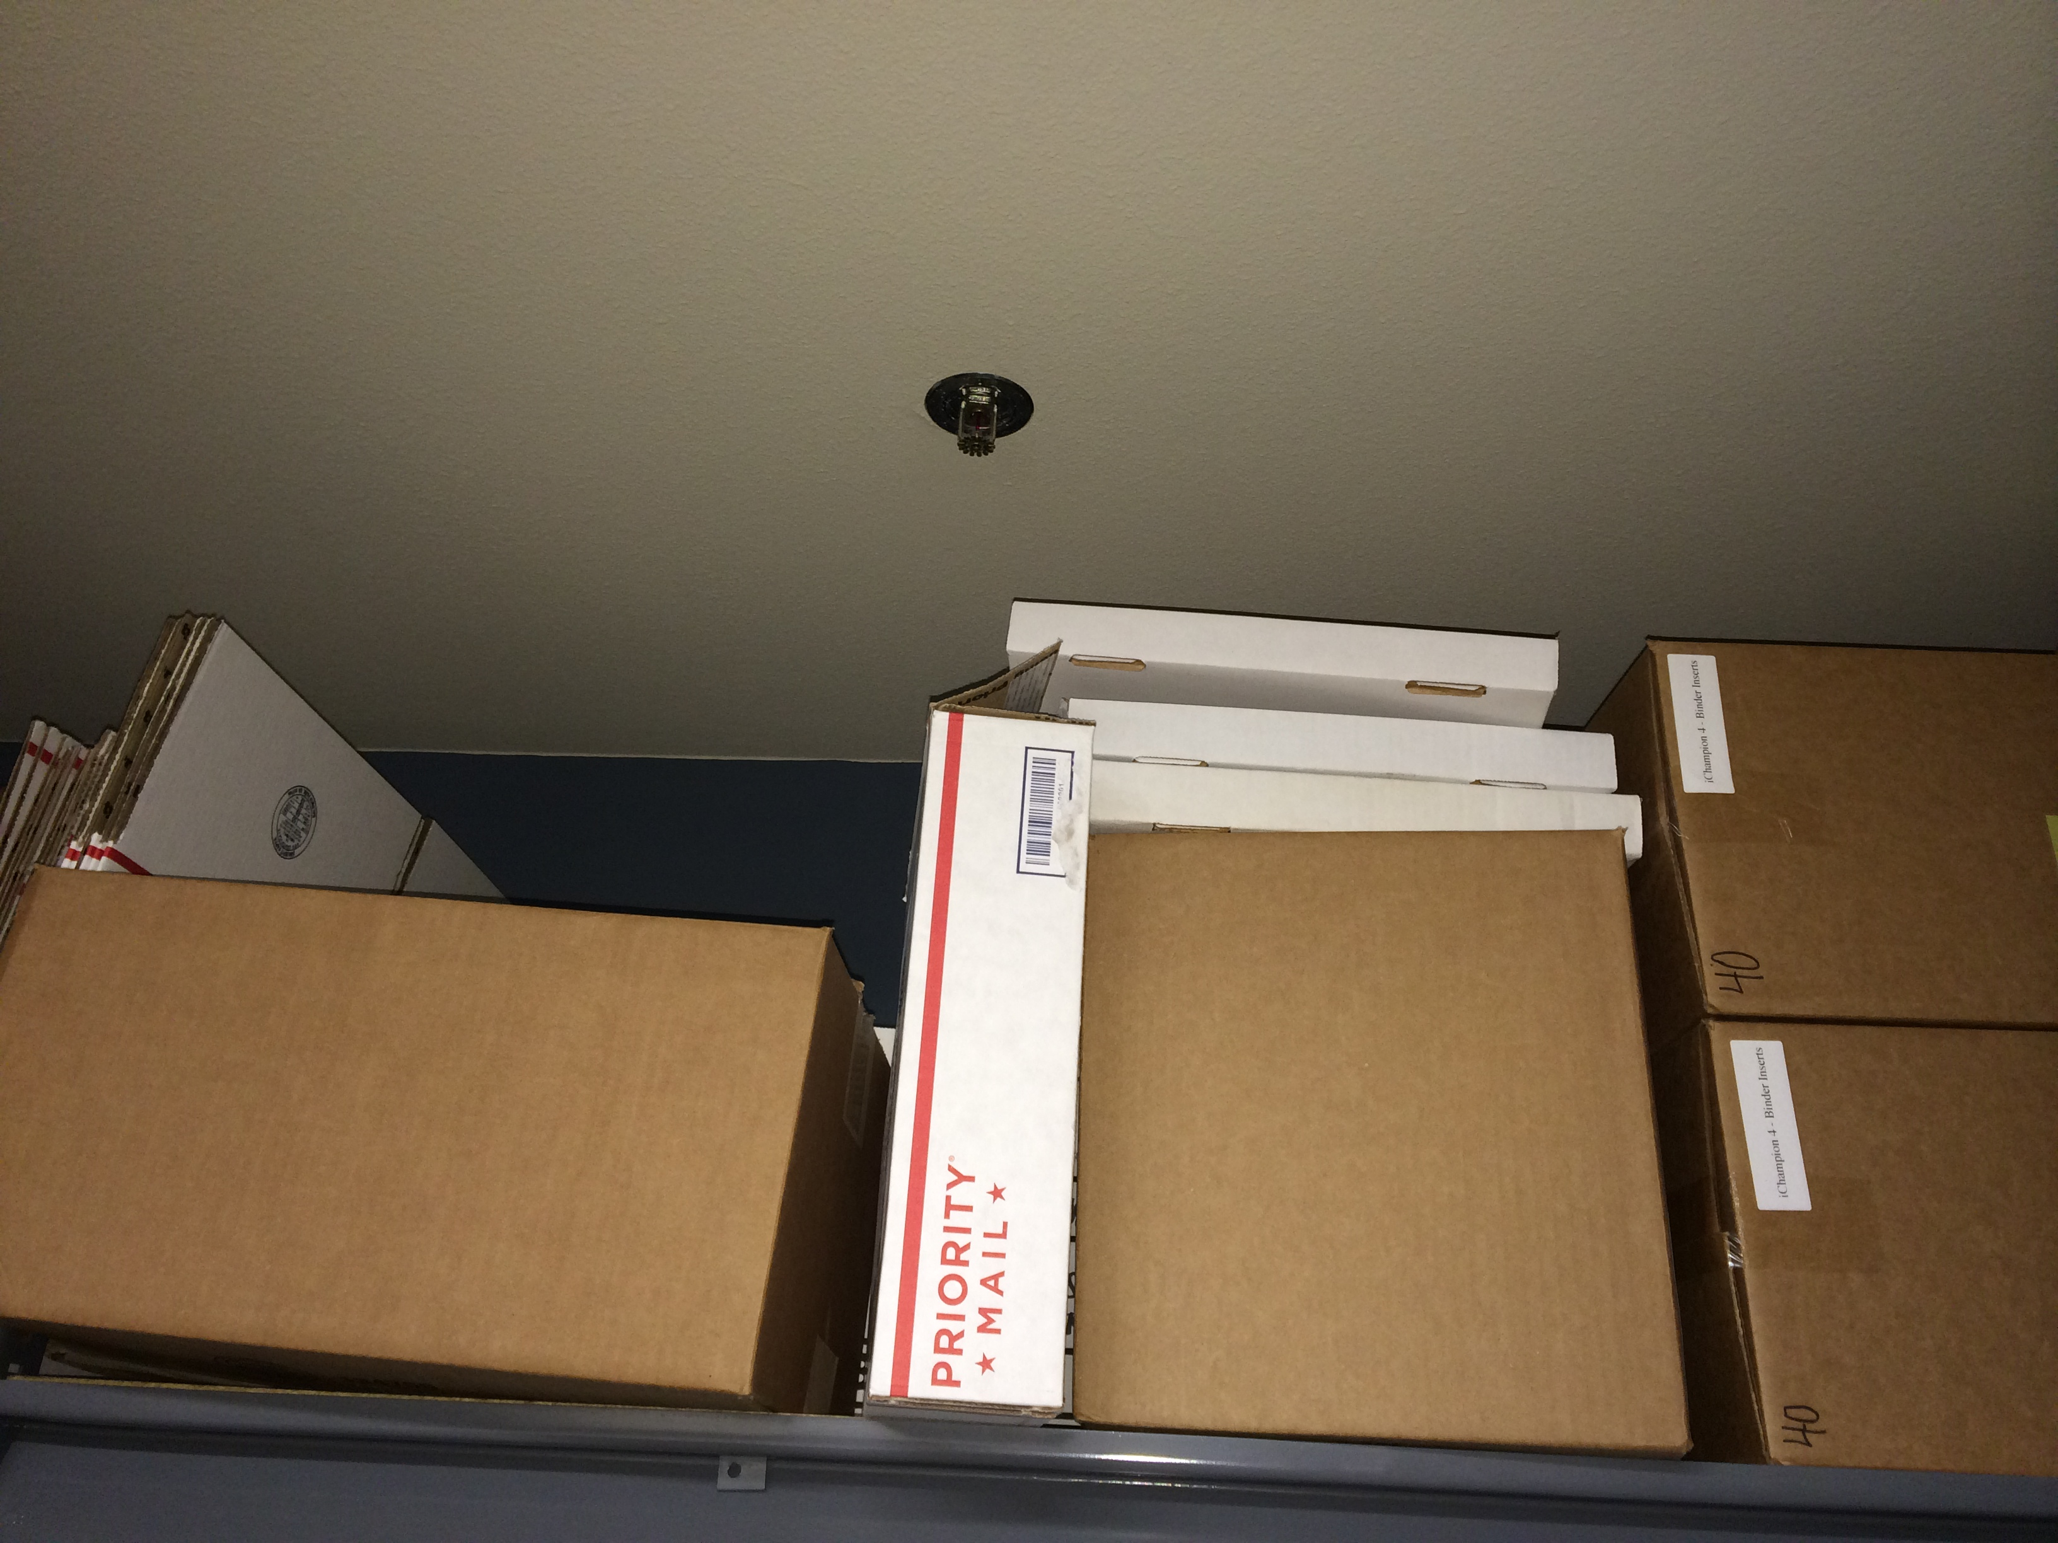
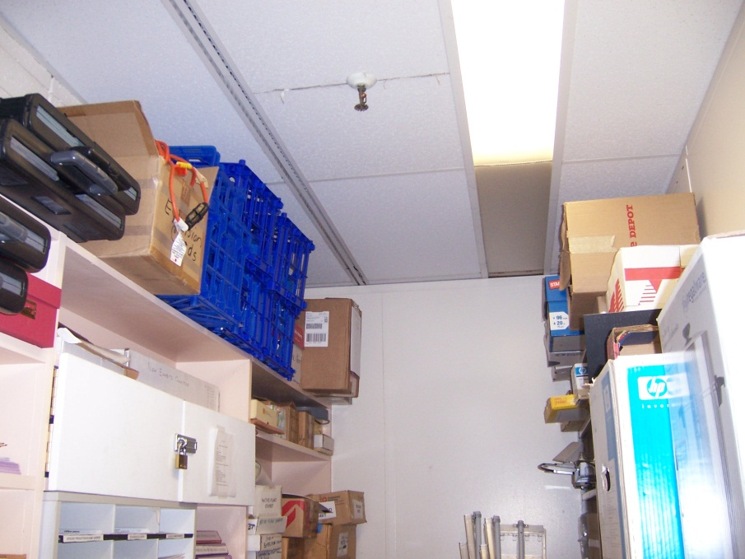
General Safety Tips
Material Storage
Always have at least 24’’ clearance for walk ways and paths
Don’t stack boxes in hallways
Items stacked over 6’ need to have at least a 1’’ guard rail
Don’t stack items all the way to the ceiling
Secure shelves to wall

Slide 8
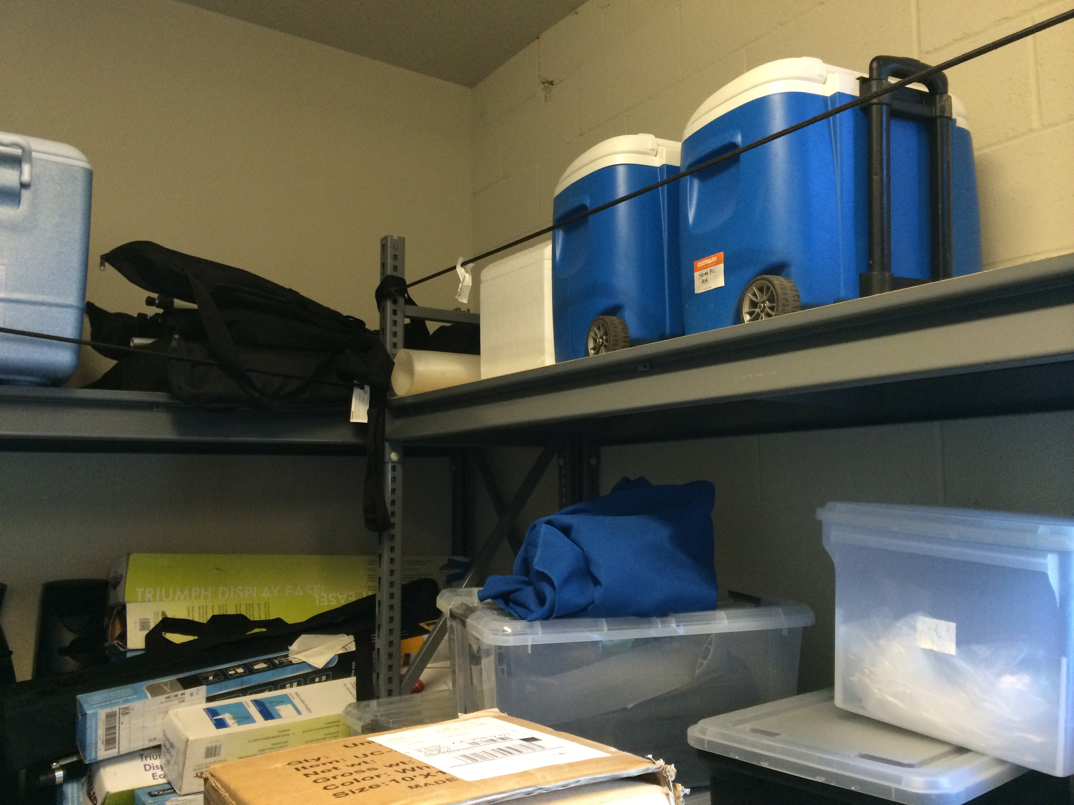
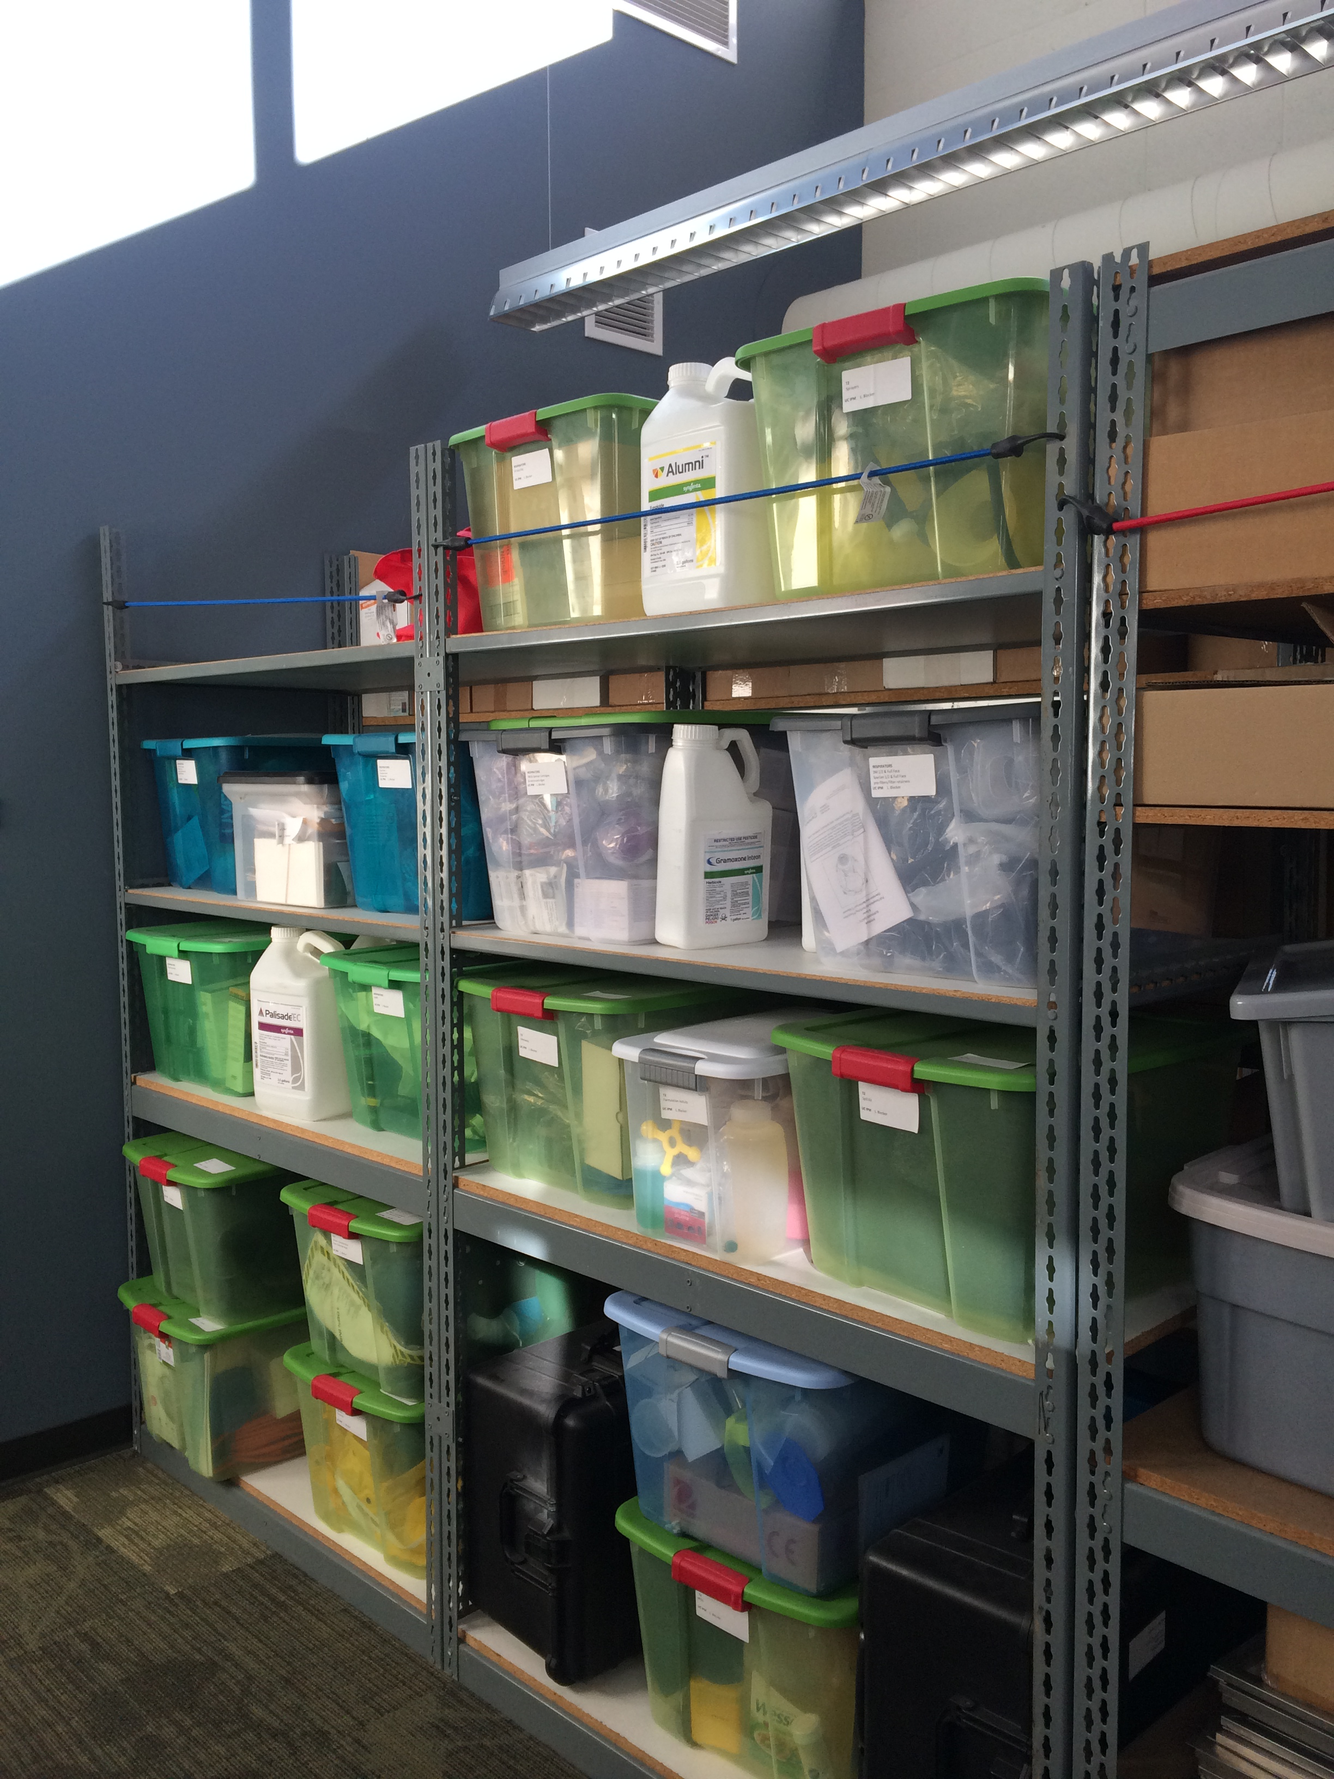
Recommended practices:
shelving above 6 ft. should have either a retaining lip of >1 inch, or a chain/bungee cord, etc. to retain the stored items
limit the overall height of stored items to <18 inches of the ceiling
store items away from ledges
For more: Safety Note #171 (Office Storage Safety)
  http://safety.ucanr.edu/files/191680.pdf

Slide 9
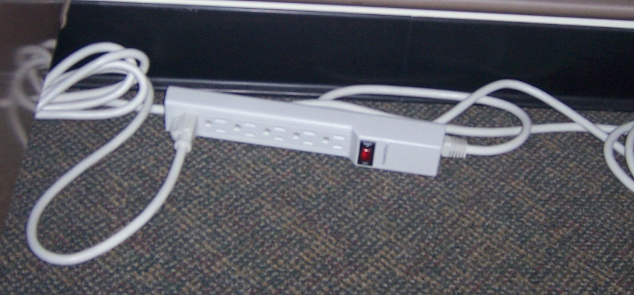
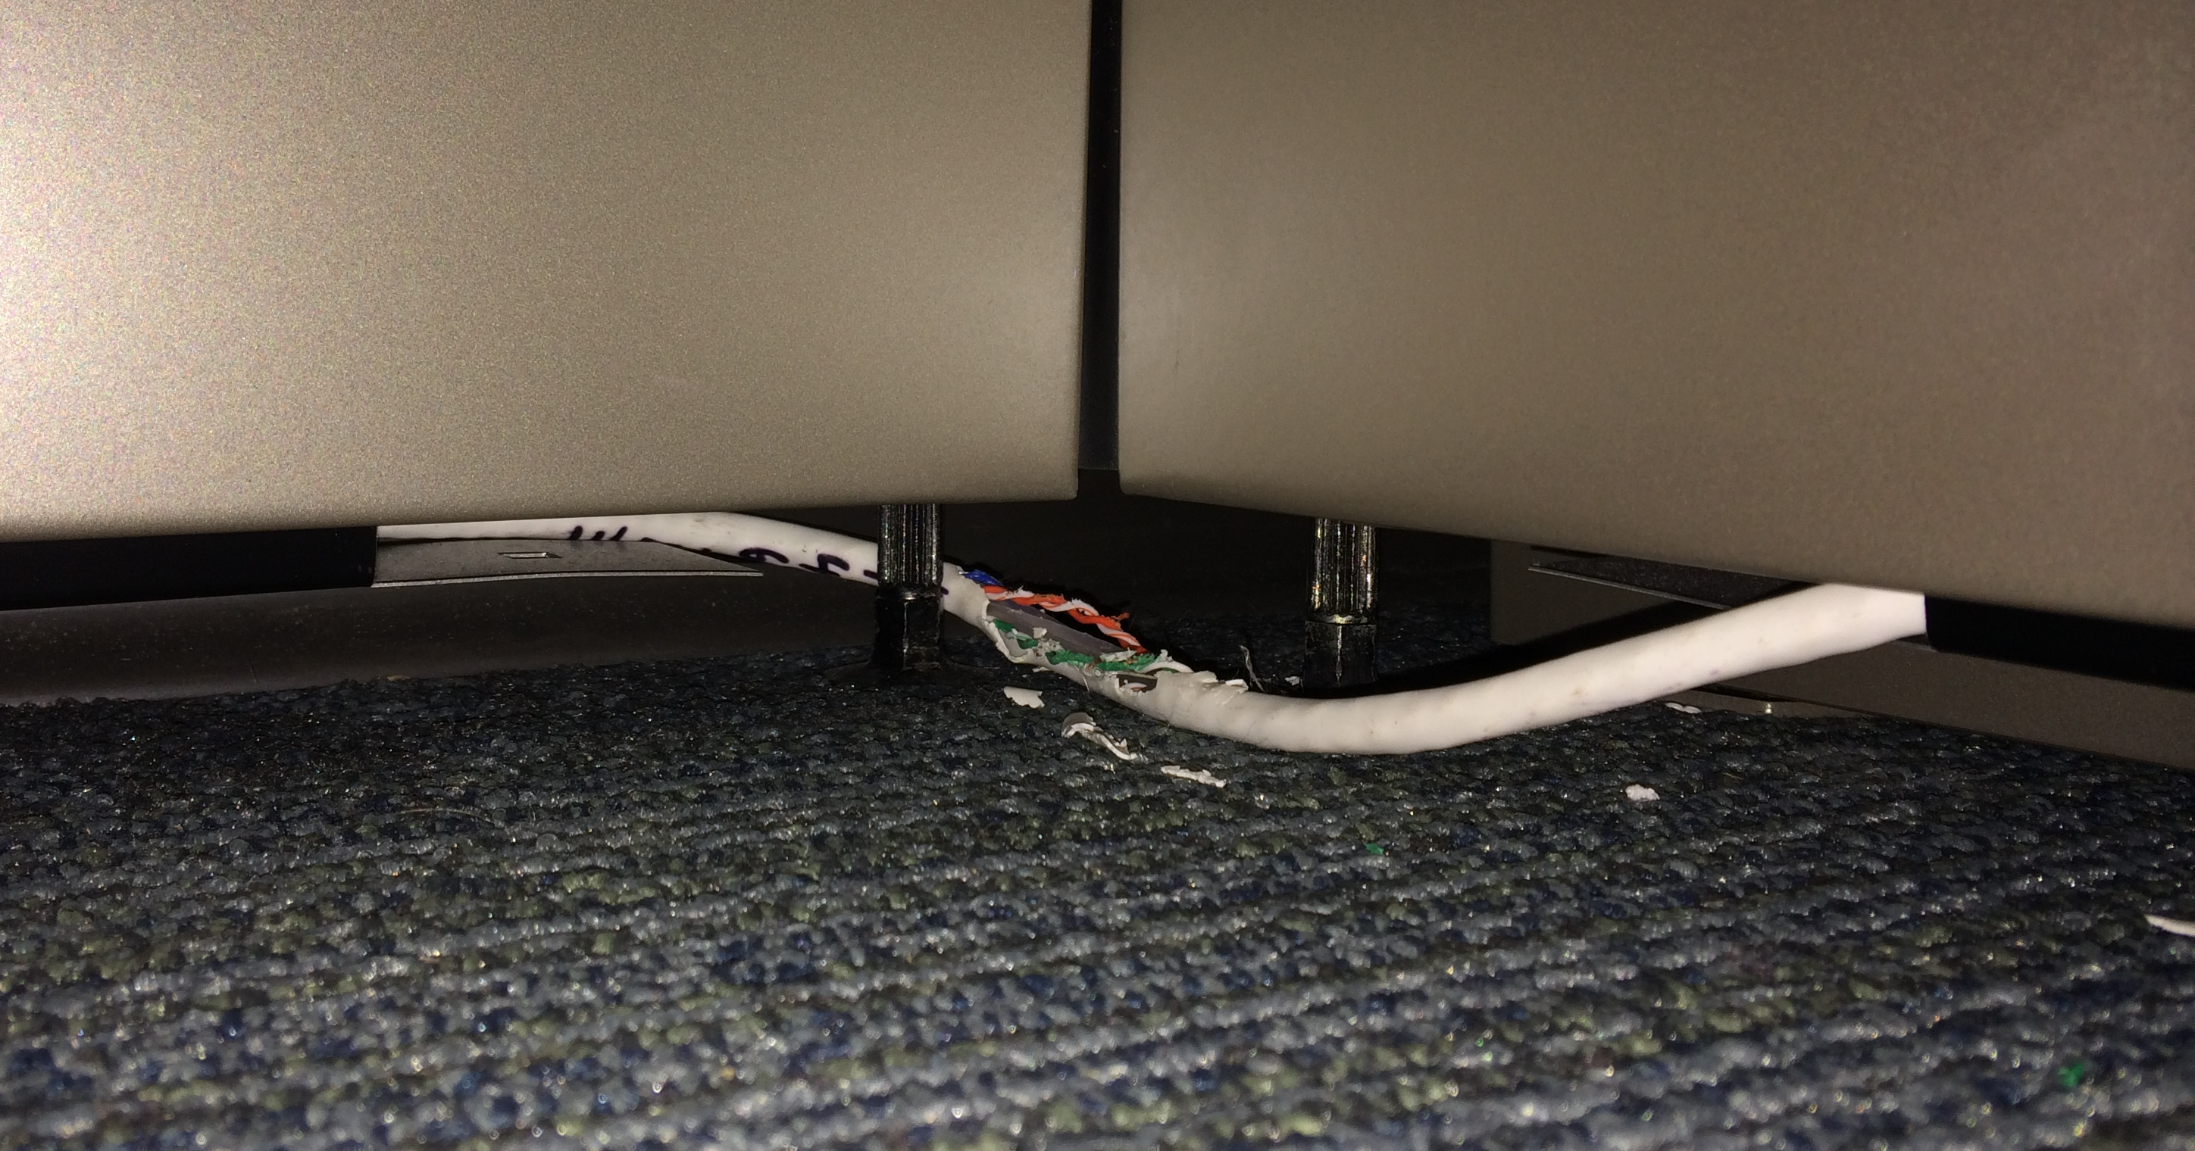
General Safety Tips
Electrical Safety
Don’t connect extension cords together (daisy-chain)
  use a longer cord if needed
Ensure that cords have the appropriate load rating for the equipment you are connecting
Replace cords that are frayed or have any exposed wires
Avoid stretching cords across aisle ways
  use a temporary cord cover if necessary
Extension cords can not be used for permanent wiring
If allowed, only use space heaters that are UL listed and have auto shut-off
See Safety Note #144 Electrical Extension Cord Safety
  http://safety.ucanr.edu/files/1392.pdf

Slide 10
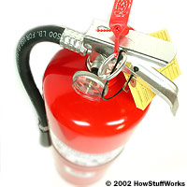
General Safety Tips
Fire Prevention
Have an Emergency Action/Fire Prevention Plan http://safety.ucanr.edu/files/2905.doc
Store flammable materials away from ignition sources
Keep fire extinguishers and electrical cabinets accessible
Inspect Fire Extinguishers monthly
  Verify that extinguisher is in assigned location
  Extinguisher is clearly visible and access is not obstructed
  Fire extinguisher is fully charged
  Nozzle is free of obstruction
  Lock pin is in place
  Service tag is attached and current
See Safety Notes #50 Portable Fire Extinguisher Basics http://safety.ucanr.edu/files/1444.pdf
  and #72 Basic Fire Prevention http://safety.ucanr.edu/files/1468.pdf

Slide 11
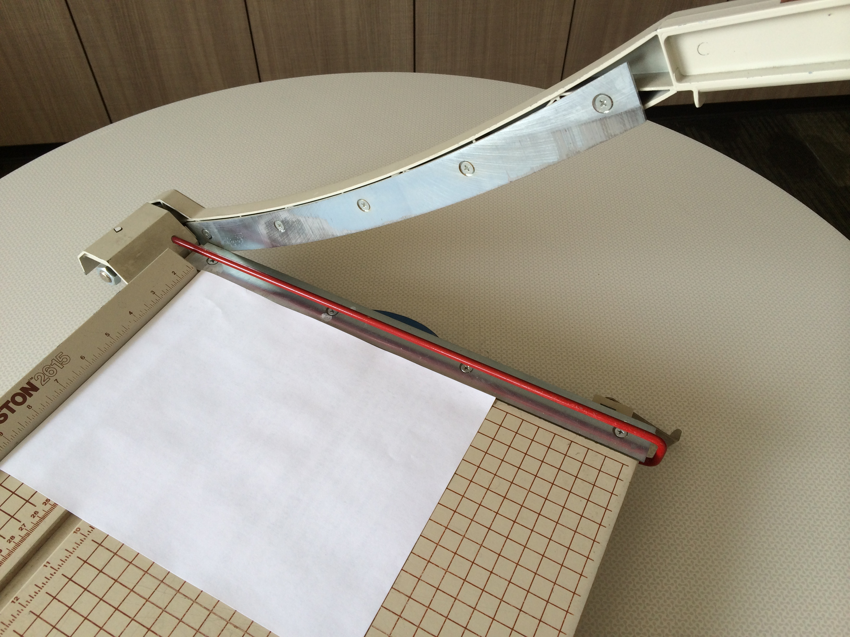
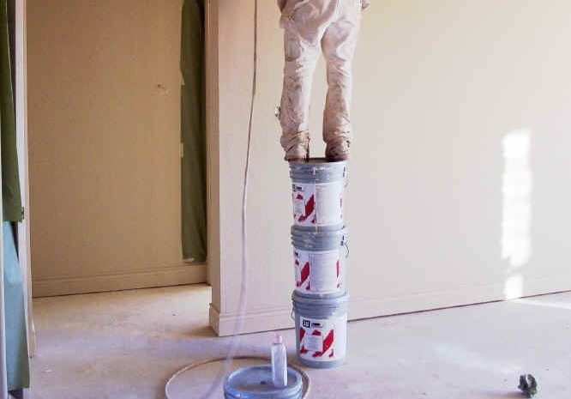
General Safety Tips
Clean up spills to prevent slips
Fix loose rugs so they don’t cause a trip hazards
Wear shoes appropriate to the task
Train employees on proper use of office equipment
  Such as paper cutters, shredders, copiers, etc.
  Maintain guards or other safety devices
Never use makeshift climbing devices
  Use a step stool

Slide 12


General Safety Tips
Know emergency procedures for your facility
  Evacuation routes and assembly area
  Exits marked and kept clear
  Perform evacuation drills
Manage hazardous materials properly
  Maintain an inventory of hazardous materials
  Keep safety data sheets for chemicals
  Store chemicals properly and manage wastes

Slide 13
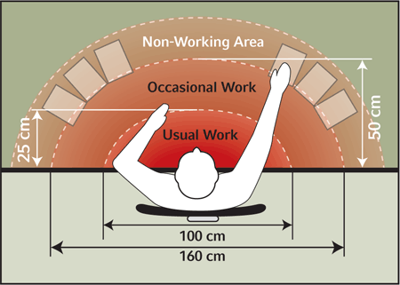
Office Layout
Set up your workspace for how you work
Consider ergonomic recommendations
  Adjust monitor, keyboard, mouse, etc.
Learn how to adjust your chair
Arrange materials and equipment by distance and frequency of use
  Usual Area: keyboard & mouse, writing area
  Occasional Area: phone, reference materials
  Non-Working: items used rarely

Slide 14
Office Layout
And for the rest of the stuff…
  If possible, place items on either side of you, try to have a balance
  Organized documents help reduce clutter, and can help in time management
  Have the area around your feet clear, give yourself some stretching room
  If you are not comfortable, change it, don’t just live with the way it was

Slide 15
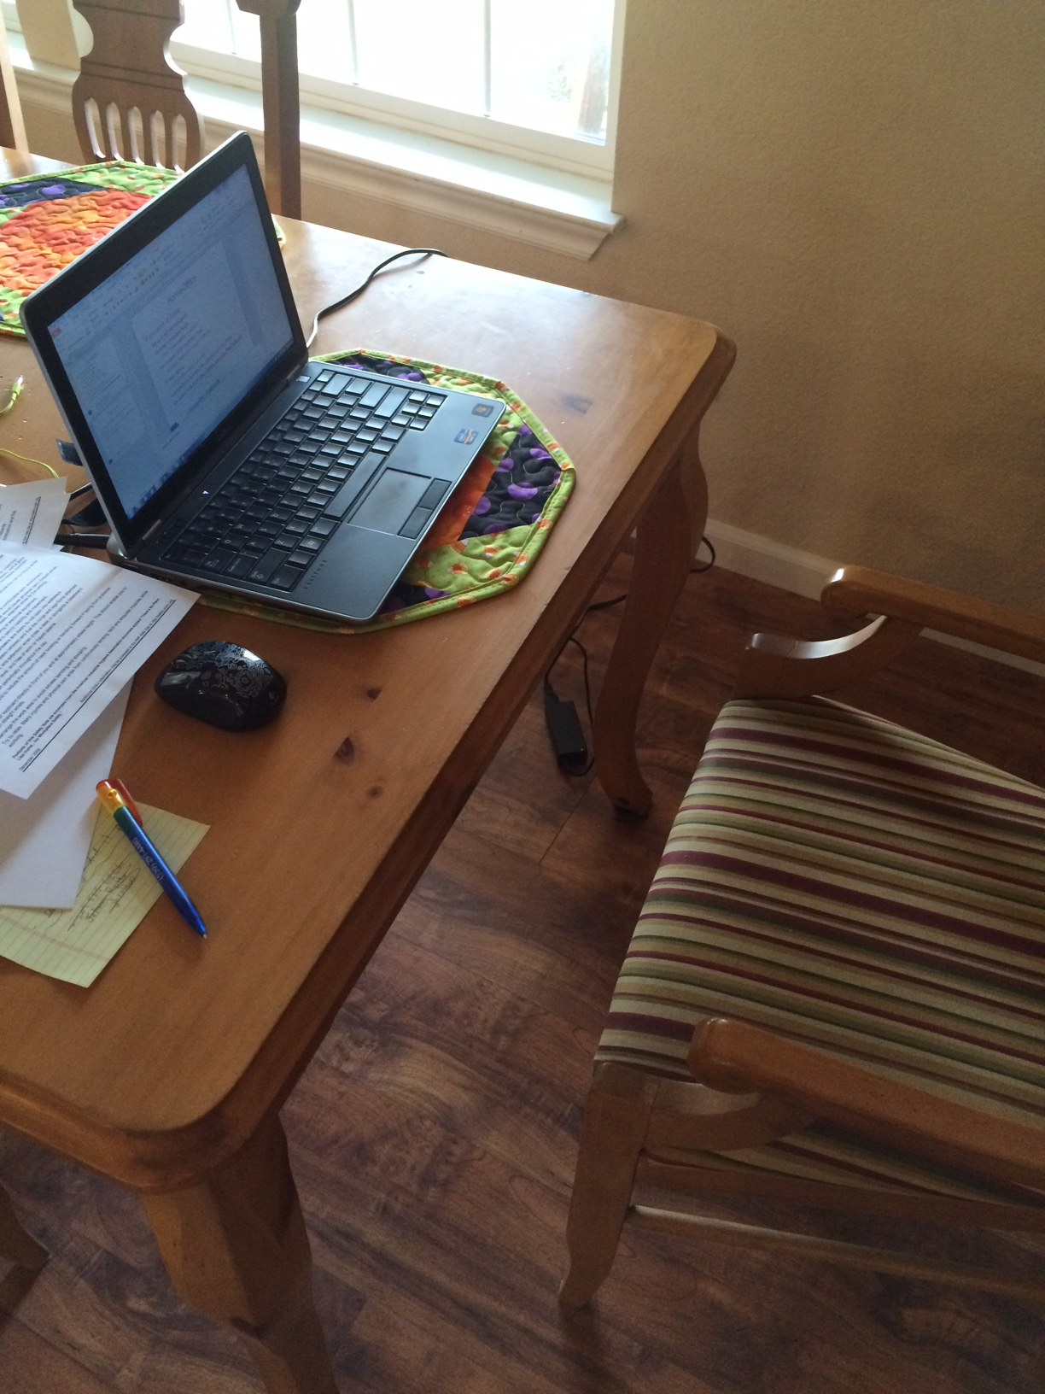
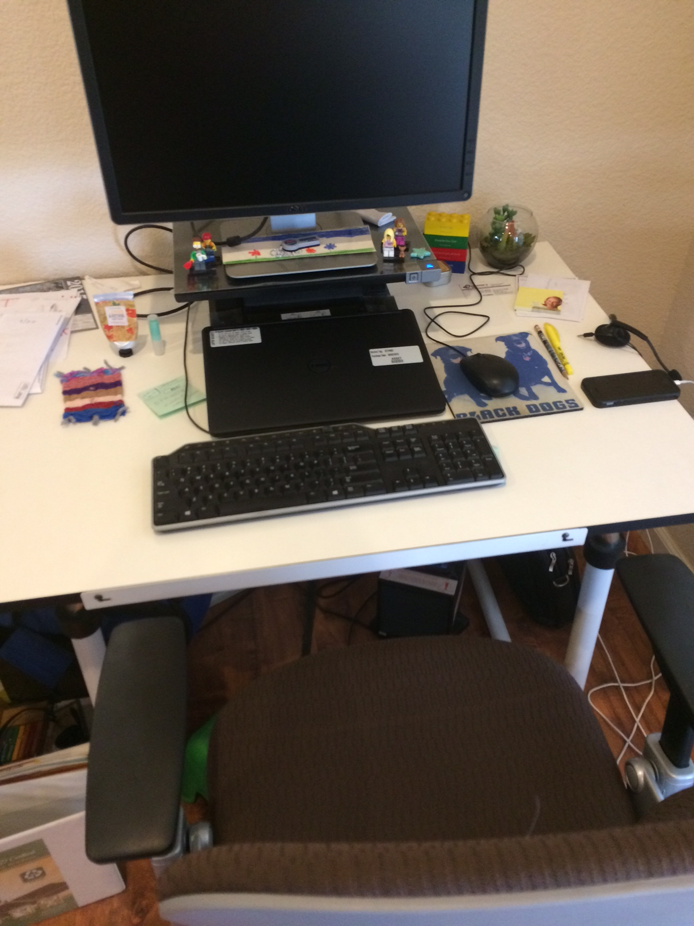
Home Office
If you work at home:
Set up a defined workspace
Consider workspace height
  Kitchen table probably not optimal
Have a good office-style desk chair
  Adjustable height, back support, stable
Proper lighting
  Sufficient for reading, avoid glare
Avoid electrical hazards (see previous slide for office)
See Safety Note #155 http://safety.ucanr.edu/files/1404.pdf
Poor set-up
Good set-up

Slide 16
Reducing Stress
  Adjust your workstation and tasks for comfort
  Get organized
  Take breaks
    move around
    do stretches at your desk
  Relax your body

Slide 17
What Can You Do?
Be aware of hazards around you in the workplace
  Fix the ones you can
  Report the hazards that need attention
Set up your space so it works for you not against you
Keep up on housekeeping
  In your space and in shared space
Notes:
Sometimes we may be more aware of hazards in the field, lab, or other sites
We can become blind to some hazards around us

