Slide 1
ANR Building CPR/AED and First Aid Training
Video Link - The Office, First Aid: click here
Notes:
Web Link to Video (The Office – First Aid): http://www.bing.com/videos/search?q=The+office+CPR+First+aid&&view=detail&mid=41B2F36014DE3EBCDA5541B2F36014DE3EBCDA55&FORM=VRDGAR

Slide 2
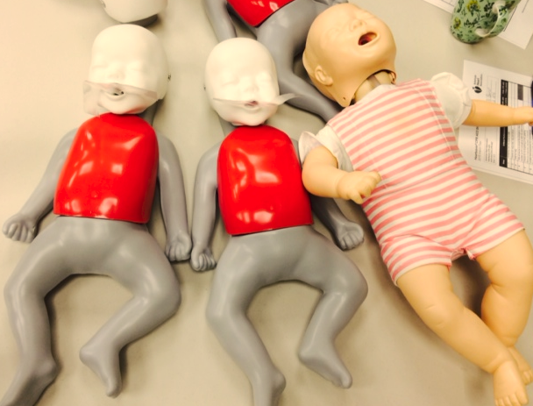

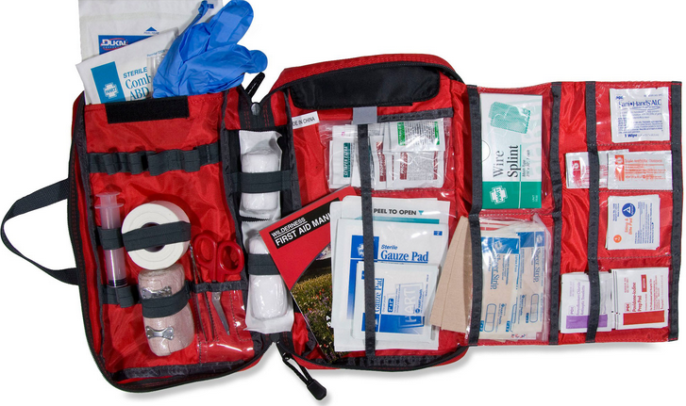
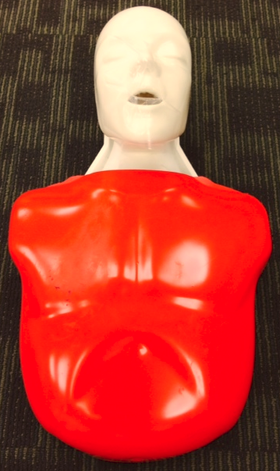
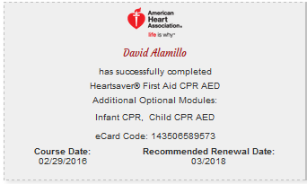
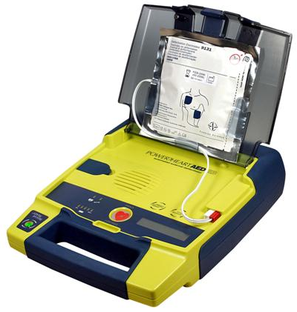
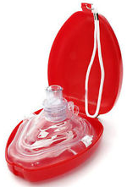
ANR Building CPR/AED and First Aid Training
19 trained in CPR/AED & First Aid
9 additional in CPR/AED only
3 additional in First Aid only
31 total trainees

Slide 3

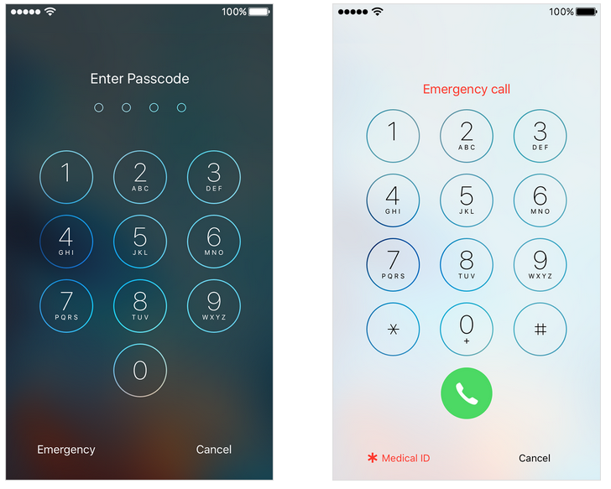


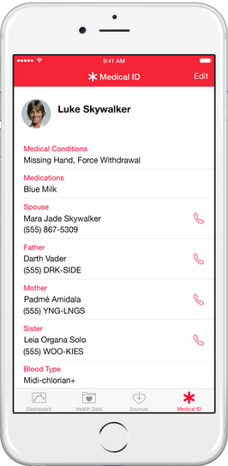
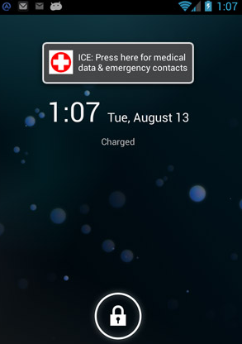

Health and First Aid Apps
      iPhone Health App, Medical ID
      access Medical info on a locked screen
Other devices
  search Medical ID, Emergency, or ICE in App Store
    or use Notes & Wallpaper
Red Cross First Aid App
  instant access on handling the
  most common first aid needs

Slide 4

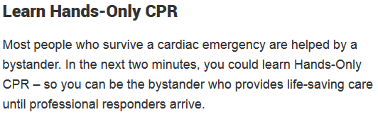



Slide 5
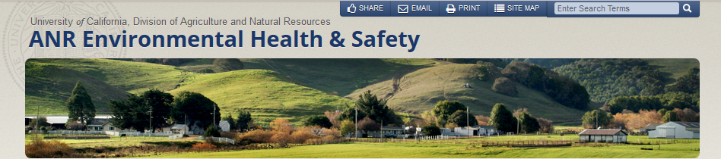
Safety Resources a Click Away
EH&S Online Resources
ANR Building, Davis
Staff Meeting
March, 2016

Slide 6
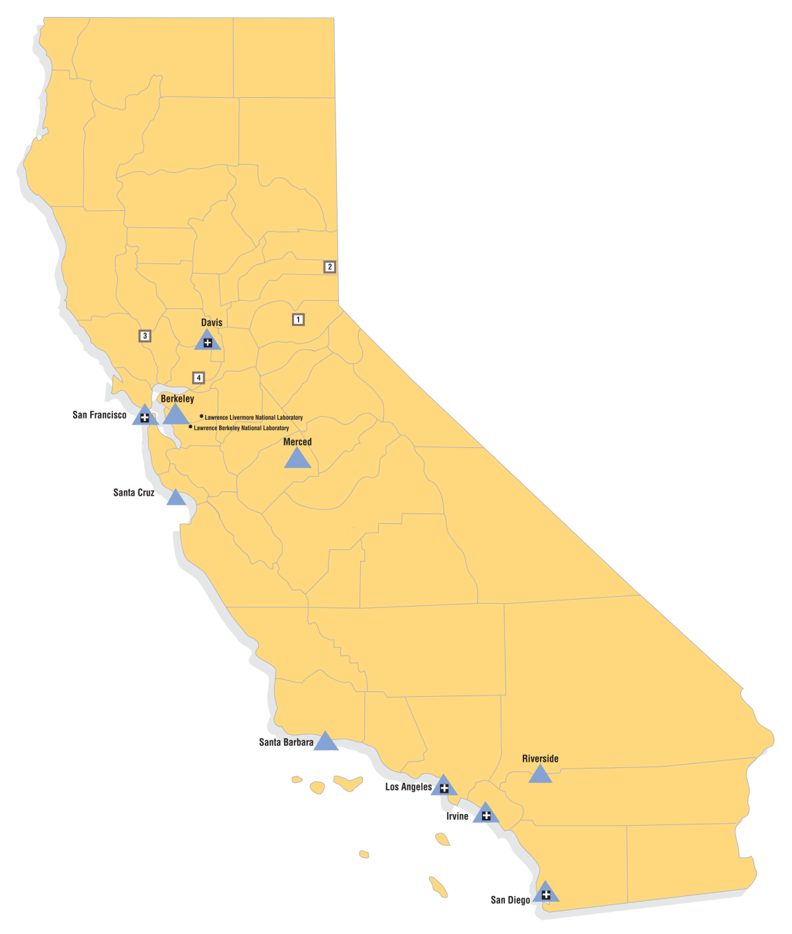
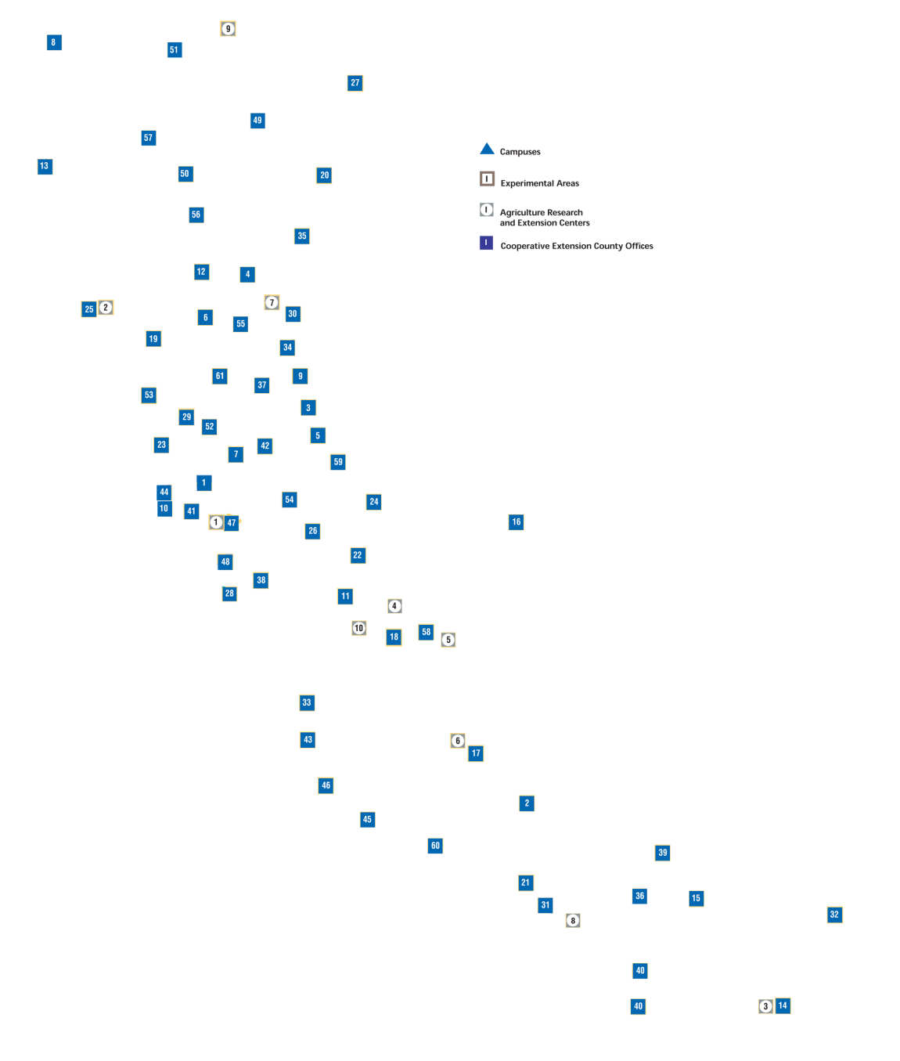
California Facts:
Population: 38 million
Area: 163,000 square miles
UC ANR Facts:
More than 60 locations, serving 57 counties
9 research centers
Academics and staff based on 3 campuses
Notes:
More than 60 locations, serving 57 counties
9 research centers
Staff based on 3 campuses – about 1000 total ANR FTE
Significant interface with the public in programming and applied research

Slide 7
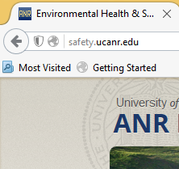
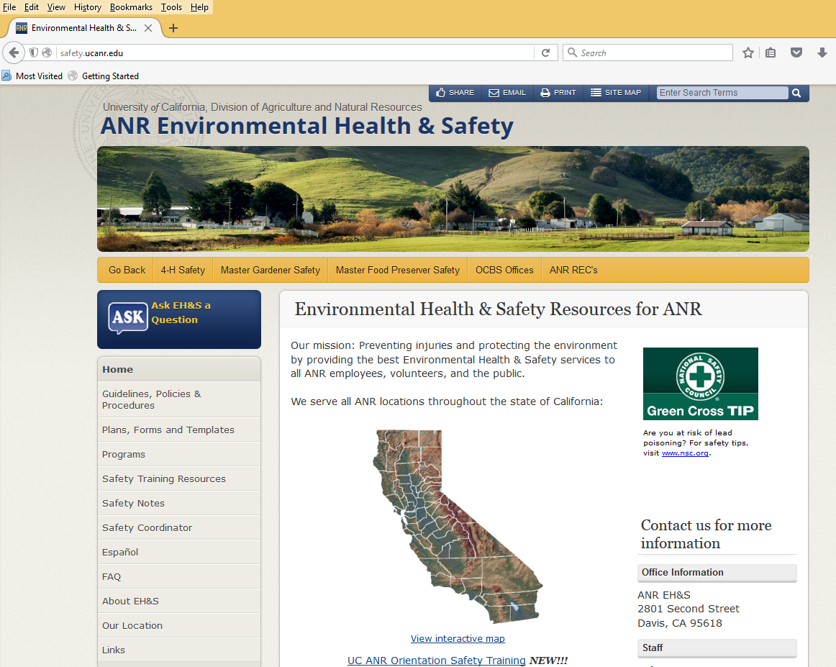


Notes:
The ANR EH&S Website is located at: http://safety.ucanr.edu
Google us: UC ANR Safety
View of our homepage

Slide 8
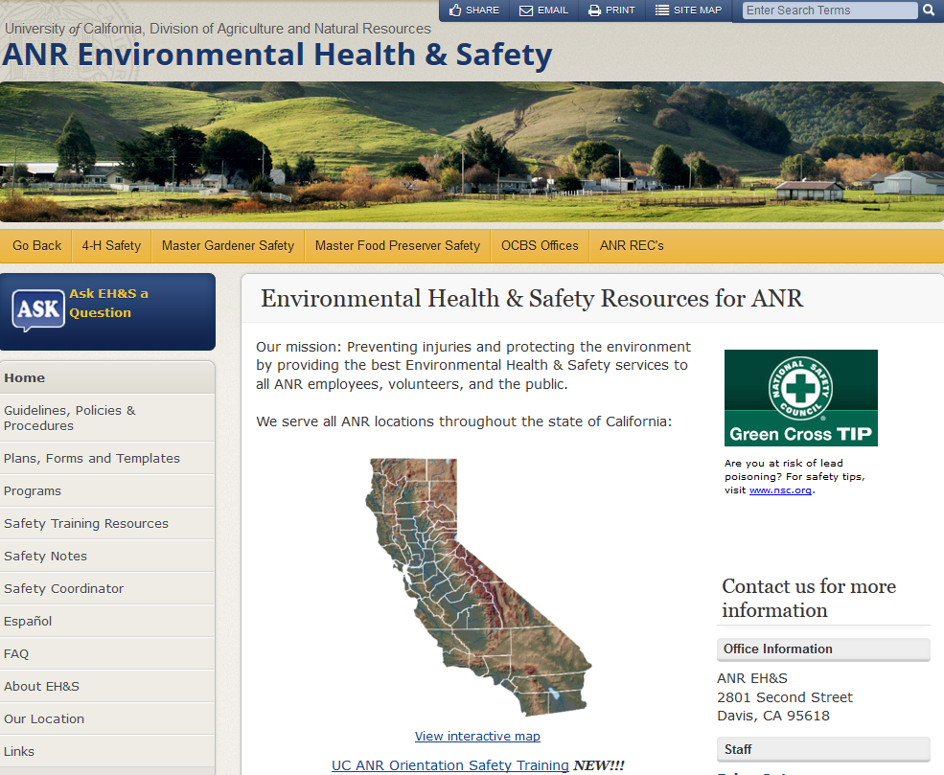


Notes:
An important resource to note is our ASK button.
Use this form to submit any question related to health, safety or the environment to EH&S staff.

Slide 9

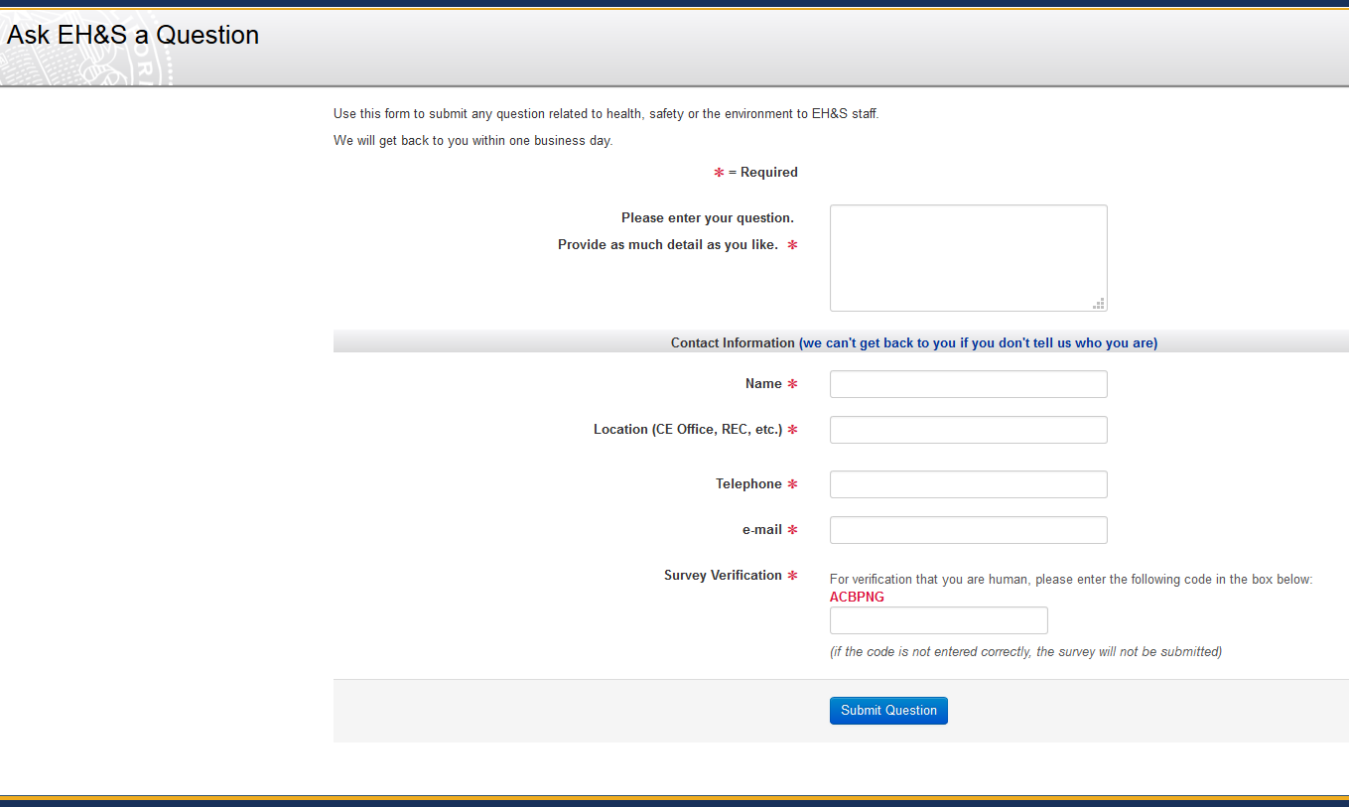
Notes:
Sample of our Ask EH&S page.
A survey allows users to enter a question or information, and provide contact information.
We will typically get back to you within one business day.

Slide 10
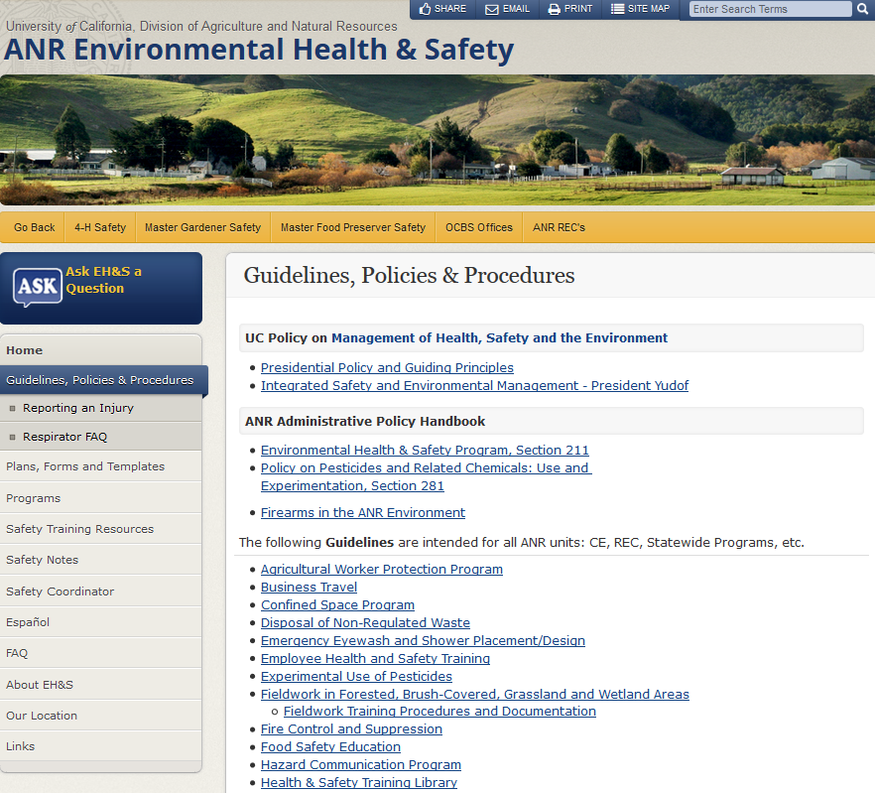


Slide 11
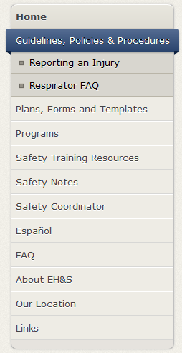

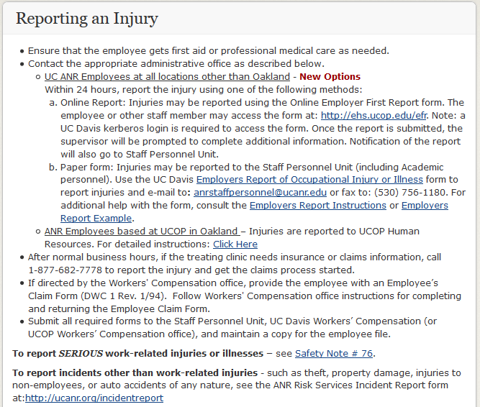

Resources to Use:
Online reporting EFR system
Paper form
Franklin building use UCOP HR
See Safety Notes
  #76
  #123
  #163

Slide 12
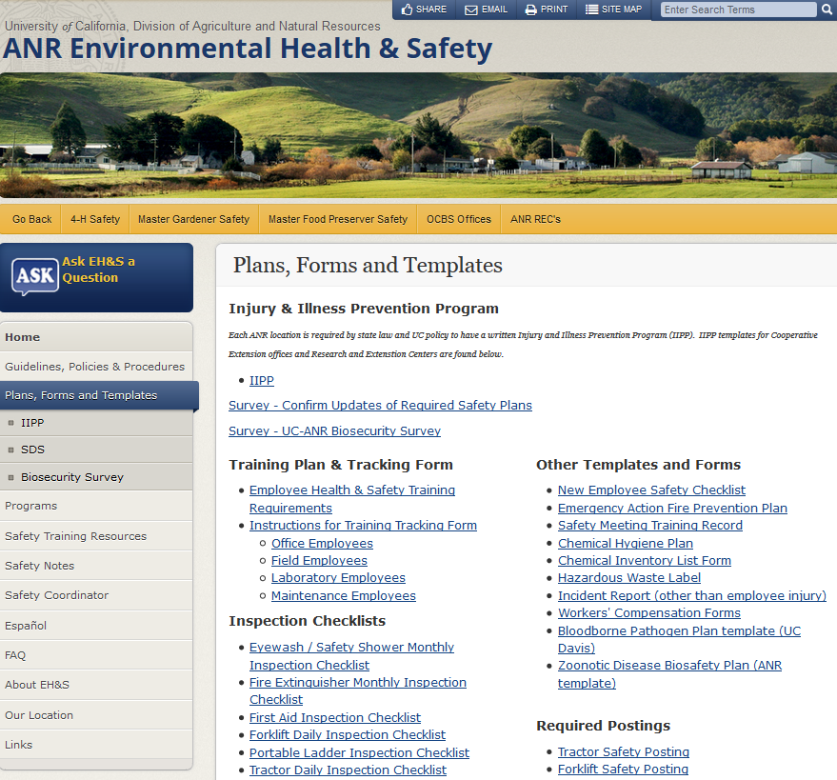


Slide 13
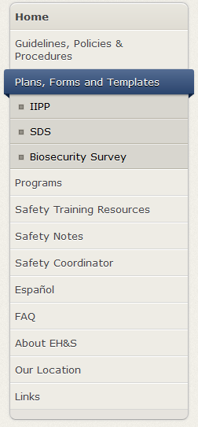
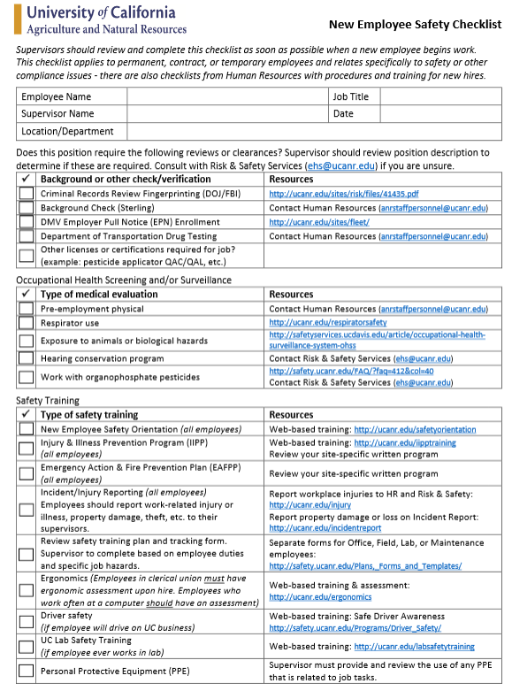

Resources to Use:
Online checklist for new hires
Relates to safety & compliance
Includes area of focus and links
  Reviews or clearances need?
  Health screening or surveillance
  Safety Training
HR also has additional checklists with procedures and training for new hires
Notes:
Supervisors should review and complete this checklist as soon as possible when a new employee begins work. This checklist applies to permanent, contract, or temporary employees and relates specifically to safety or other compliance issues - there are also checklists from Human Resources with procedures and training for new hires

Slide 14
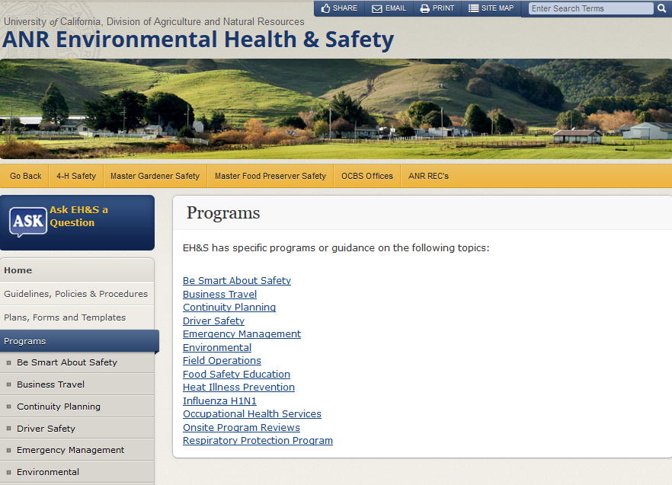


Slide 15
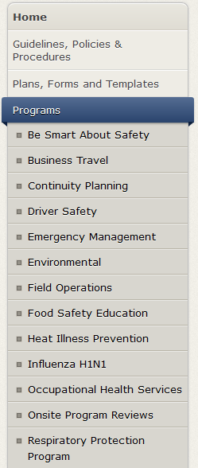

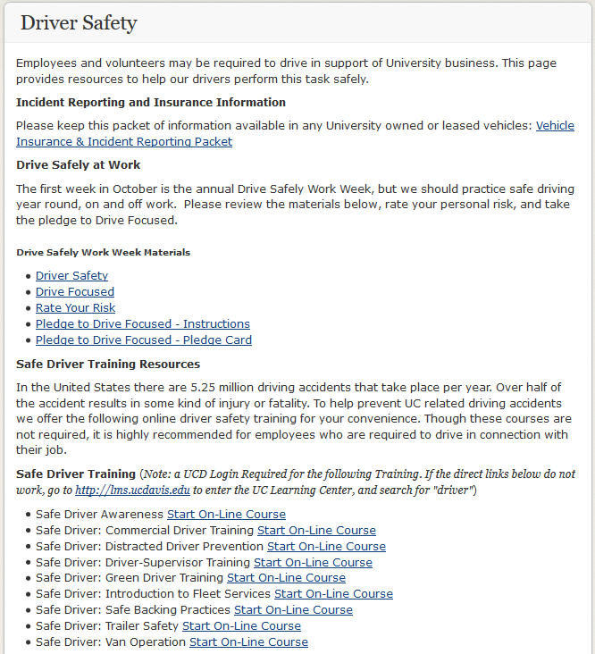
Resources to Use:
Vehicle Insurance & Incident Reporting Packet
Driver Safety Materials
Online Safe Driver Training (UCD LMS)
Videos for Loan
See Safety Notes
  #75
  #90
  #132
  #174
  #175
Notes:
Employees and volunteers may be required to drive in support of University business. This page provides resources to help our drivers perform this task safely.

Slide 16
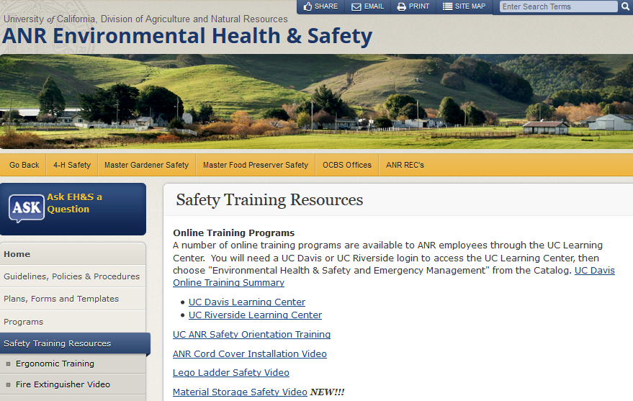

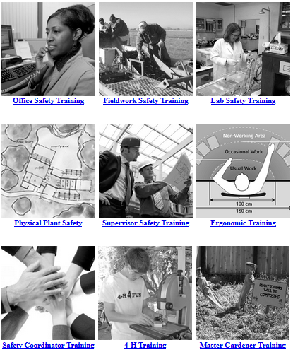
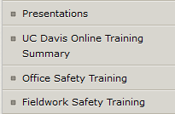

Slide 17
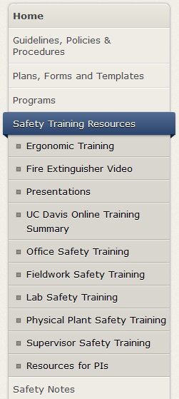
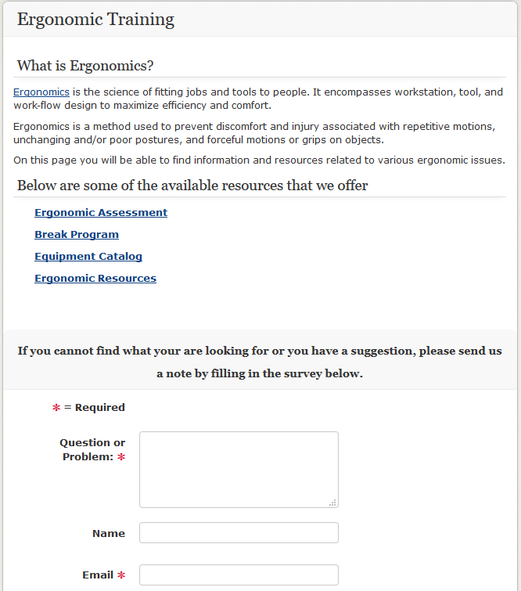
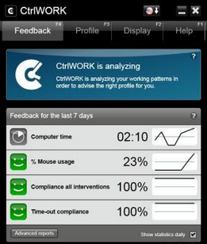
Resources to Use:
Online Ergo Assessment
Break Program
Ergo Equipment Catalog
Ergonomic Resources
See Safety Notes
  #10
  #17
  #27, #28, #29
  #41
  #46
  #96
Notes:
In an effort to help reduce ergonomic related injuries for our employees we offer a variety of ergonomic assessments.

Slide 18
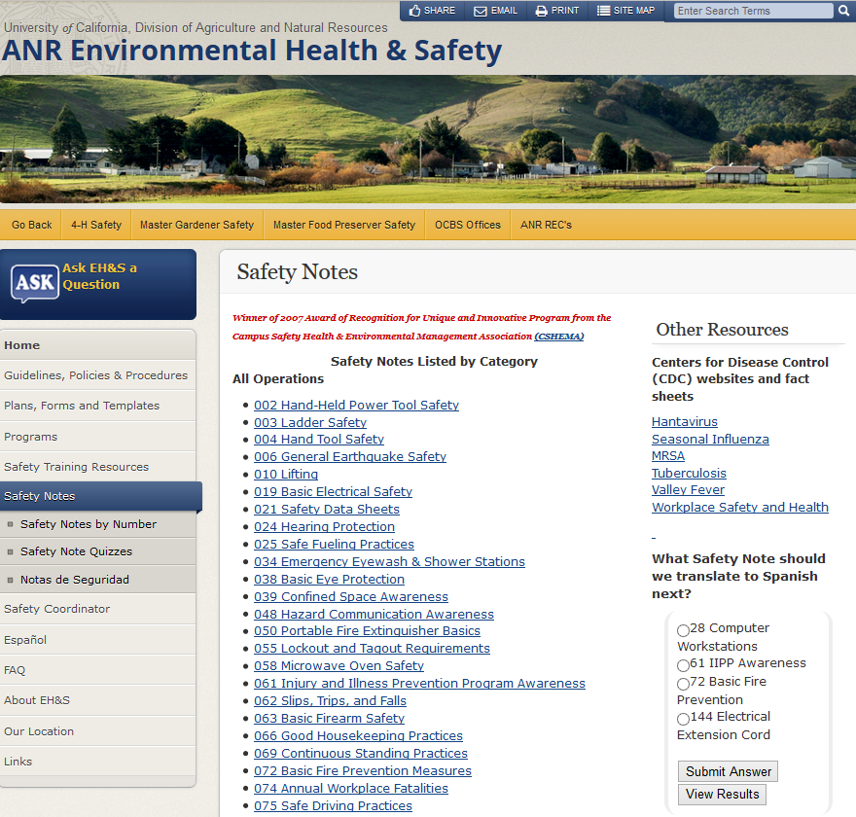

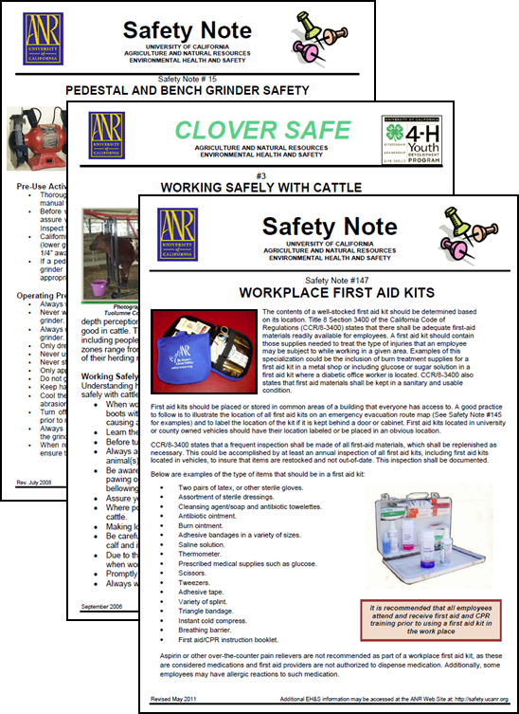

Slide 19
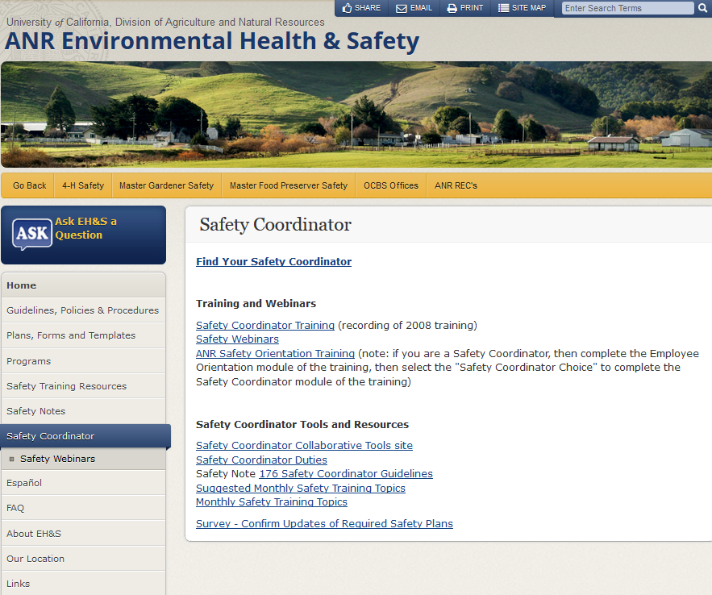


Slide 20
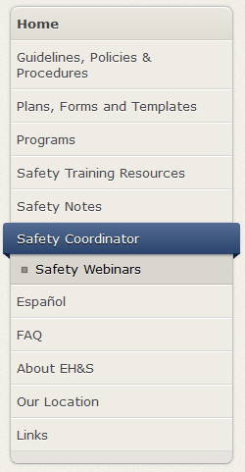

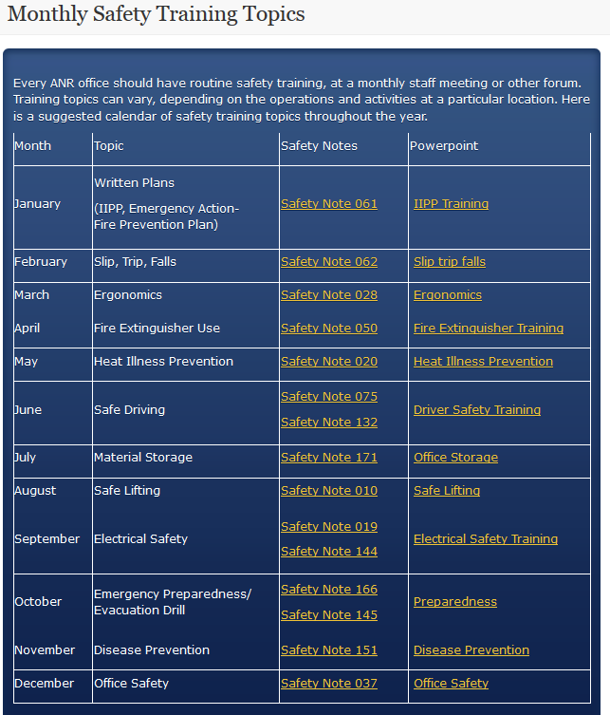
Resources to Use:
Find Your Safety Coordinator
Monthly Safety Training Topics
Safety Webinars
Safety Coordinator Collaborative Tools site
Safety Coordinator Duties
ANR Safety Orientation Training

Slide 21
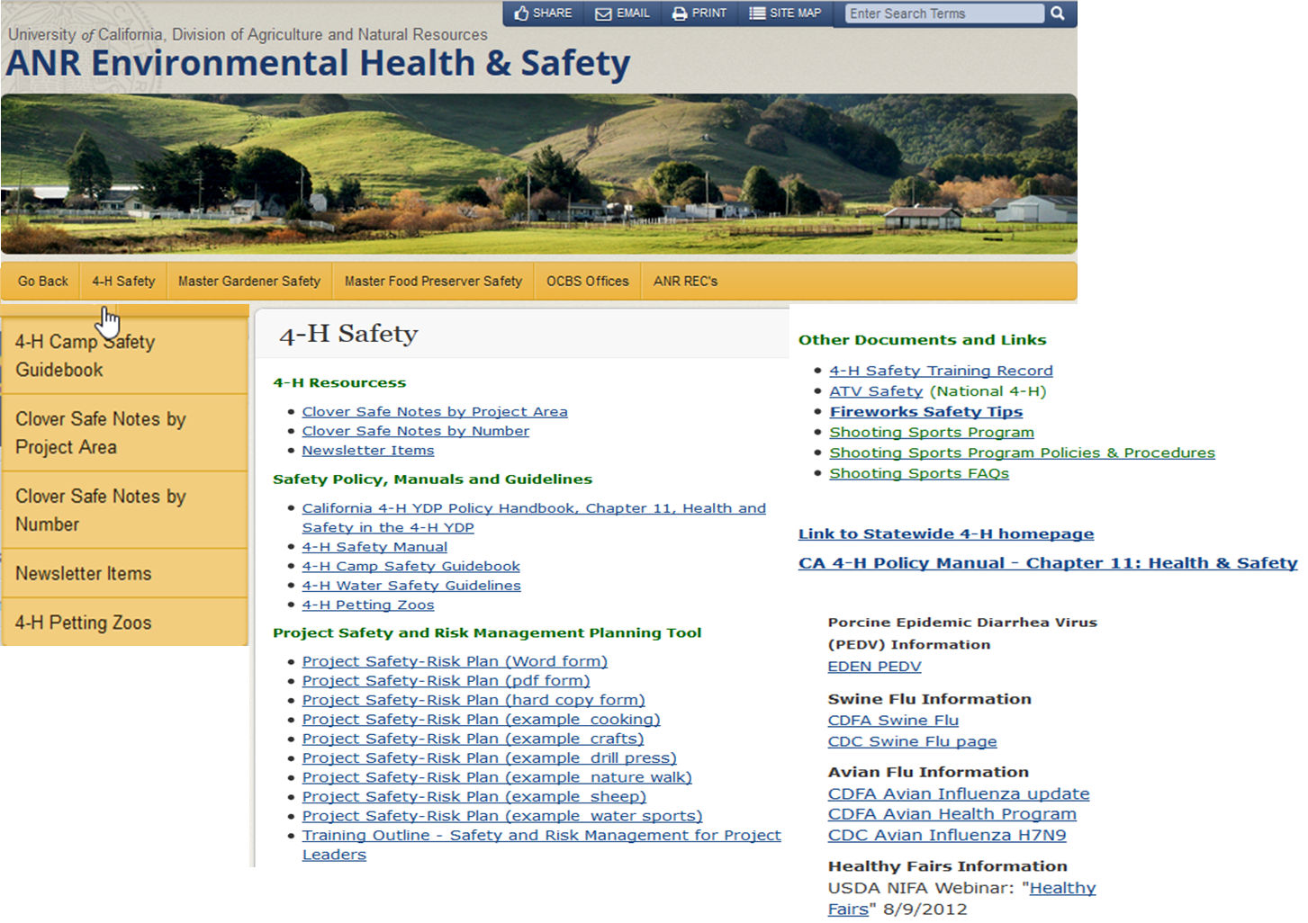


Slide 22
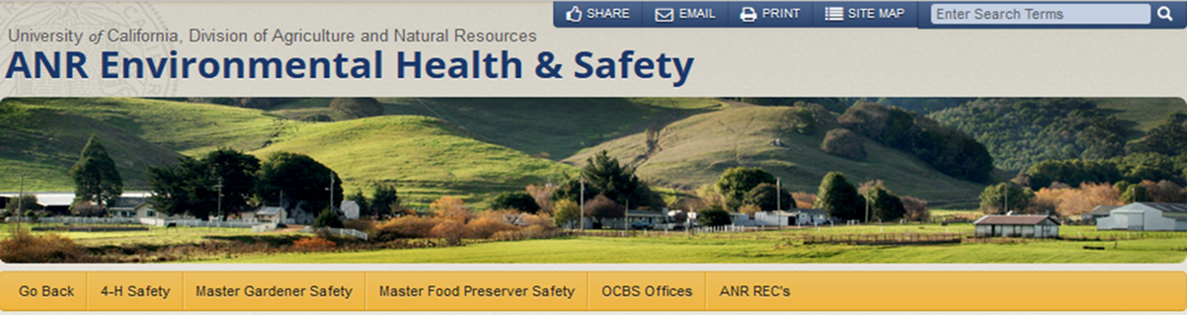
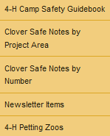
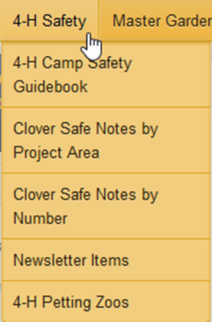
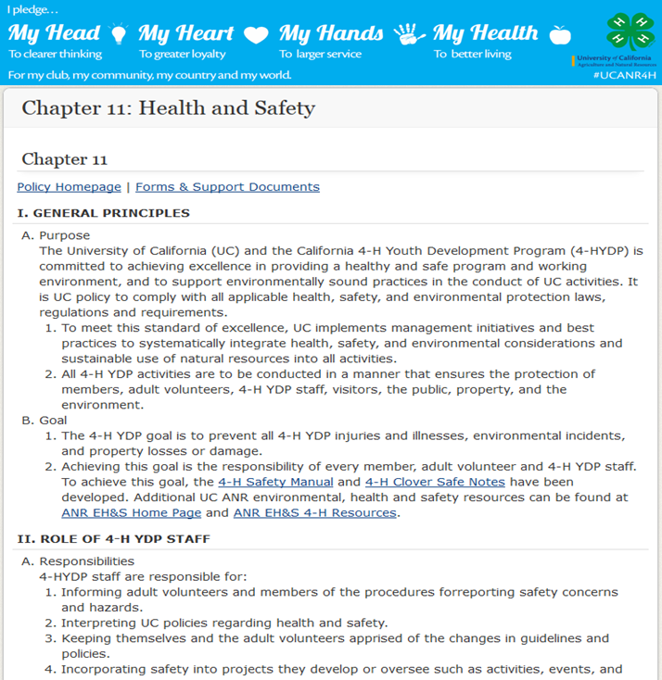
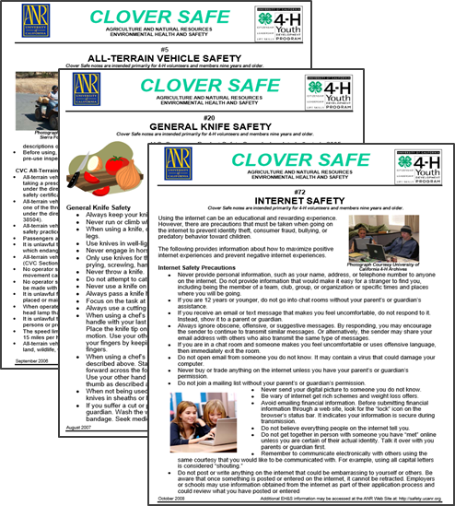



Slide 23



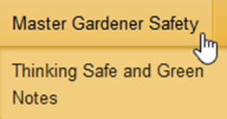
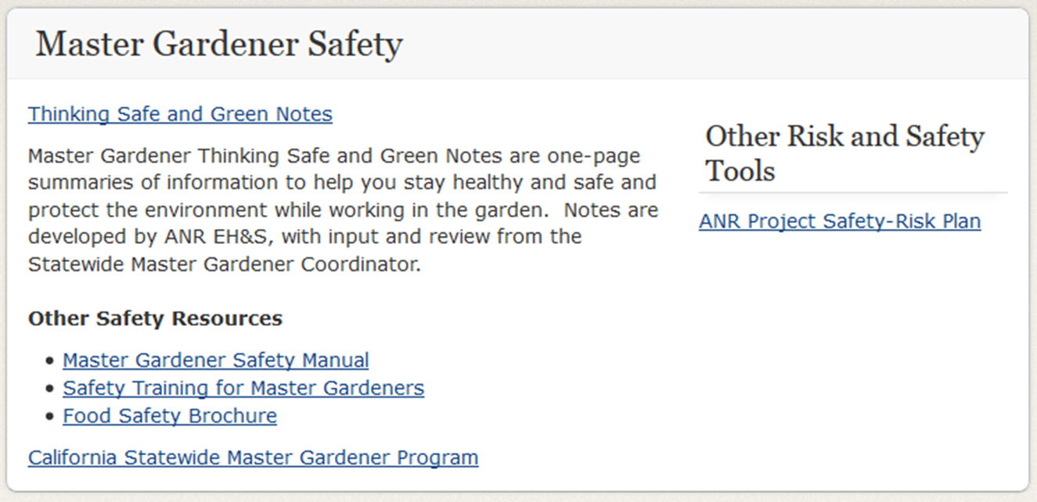


Slide 24


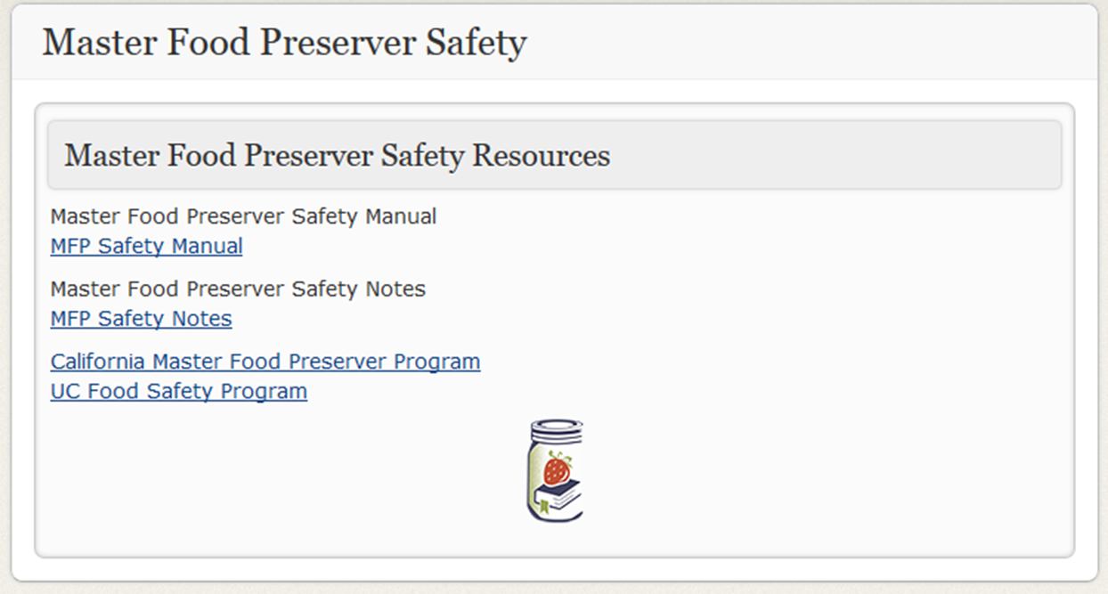
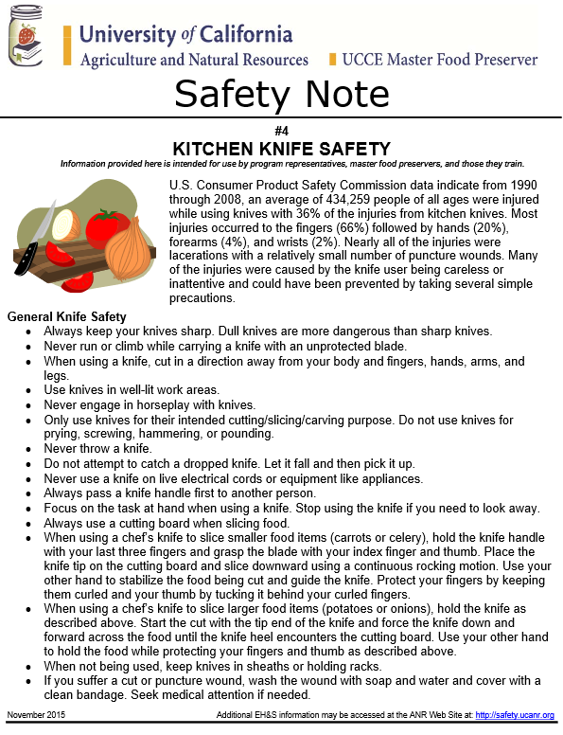

Slide 25

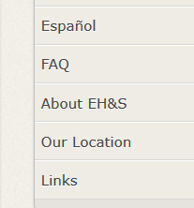

Slide 26
QUESTIONS?
please ‘sign-in’ before leaving

