Slide 1
Safety Culture
Safety culture refers to the ways that safety issues are addressed in a workplace. It often reflects "the attitudes, beliefs, perceptions and values that employees share in relation to safety."
Notes:
There has been discussion around the UC system over the past few years about creating a stronger safety culture.
At UC campuses, this has been seen through an increased focus on initiatives to improve safety in laboratories.
There have been efforts to increase inspections, develop new training and protocols, and to provide basic equipment such as lab coats and eye protection.
While these efforts on campus have focused on labs, the principles still apply to all of our work – in offices, in the field or wherever our work takes us.

Slide 2
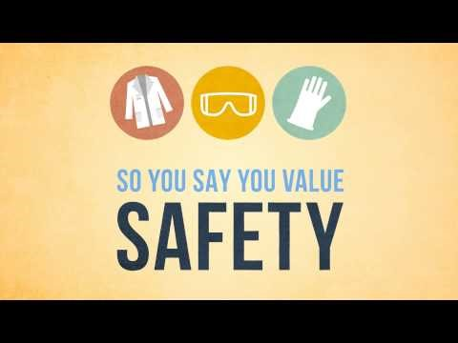
Notes:
I want to start with this video produced by UCLA

Slide 3
Values for a Culture of Safety
Safety is everyone’s responsibility.
Good science is safe science.
Safety training and safety education are essential elements of research and education.
An improved culture of safety is necessary to truly reduce risk.
Recognize that there are diverse methods and flexible approaches.
* APLU Guide to Implementing A Safety Culture
Notes:
The Association for Public and Land Grant Universities (APLU) recently released a “Guide to Implementing a Safety Culture in our Universities”
This was in response to a number of serious injuries and accidents at several universities across the country, including the tragic death of a graduate researcher in a lab accident at UCLA.
APLU’s guide presents these values that build and demonstrate an effective safety culture at universities

Slide 4
Safety is everyone’s responsibility
Ensure your individual safety
Follow safe work practices
Ask your supervisor if you do not know how to perform a task safely
Wear protective equipment when directed
Report workplace hazards
Supervisors have additional responsibilities:
  Identify and correct workplace hazards
  Assure employees receive training, have necessary equipment and follow safe practices
  Document employee training
  Consider safety in performance reviews
Notes:
Safety is everyone’s responsibility.
Each institution should commit to providing a campus environment that supports the health and safety practices of its community (faculty, students, staff, and visitors) and empowers the community to be responsible for the safety of others.
A safe campus environment is a right of employment for all categories of employees.
A safe campus learning environment is a right of all involved in education and research.

Slide 5
Good science is safe science
Safety is a critical component of scholarly excellence and responsible conduct of research.
Safety measures should be a part of written protocols or research plans.
Consider the risks, hazards, and mitigation measures before starting a new task or project.
Train and mentor others to practice safe science.
Notes:
Good science is safe science. Safety is a critical component of scholarly excellence and responsible conduct of research.

Slide 6
Safety training and education
Incorporate safety into all of our programs and activities
  Safe conduct is part of effective research or extension activities
  Instill safety into next generation (of youth, researchers, or fellow employees)
  Have a safety briefing before starting a new task or project
  Use Safety Notes
Notes:
Safety training and safety education are essential elements of research and education.
They instill a culture of safety in the next generation of researchers and future faculty,
and they are important for our students’ career development and employability.
Consider the examples for safety that we set in conducting our programs – with youth, volunteers, or the public
Our office has worked with 4-H and Master Gardener programs to make safety an integral part of our extension activities

Slide 7
A culture of safety can reduce risk
Reduce the frequency and severity of injuries
  Leads to reduced cost
Prevention instead of response
Avoid regulatory violations, fines and lawsuits
Notes:
An improved culture of safety is necessary to truly reduce risk throughout the academic enterprise.
During an inspection, locations with a strong safety culture will do better

Slide 8
Diverse methods & flexible approach
Different locations may use diverse methods and flexible approaches to develop a strong culture of safety
Safety is not “one size fits all,” but is unique to the situation or application.
Notes:
It is best to recognize that diverse methods and flexible approaches will be used by each institution to develop a strong culture of safety, unique to its situation.
We see that the culture varies from a REC to a CE office to Oakland and this office. But all of us can make safety a priority and part of that local culture.

