Slide 1

Heat Illness Prevention
ANR Building, Davis
All Staff Meeting
May, 2016
Notes:
According to the National Weather Service – each year, extreme heat kills more people than hurricanes, floods, tornadoes and lightning combined.

Slide 2
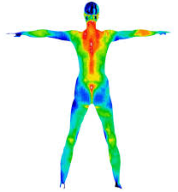
The Body’s Response to Heat
Thermoregulation – the balance between heat gain & loss
Maintaining an internal core temperature, 97.7 ~ 99.5
Hypothalamus (in the brain) is our body’s thermostat
When the internal temperature rises, the body attempts to get rid of excess heat by:
  Increasing blood flow to the skin surface
  Releasing sweat onto the skin surface
Notes:
The human body regulates temperature by keeping a tight balance between heat gain and heat loss.
Normal core temperature at rest varies between 97.7 to 99.5 °Fahrenheit.
Core temperature is regulated by the hypothalamus (in the brain), which is often called the body’s thermostat. For example, on a hot day, temperature receptors located in the skin send signals to the hypothalamus to cool the body by increasing the sweat rate.
Your body normally cools itself by sweating. During hot weather, especially with high humidity, sweating just isn't enough. Your body temperature can rise to dangerous levels and you can develop a heat illness.

Slide 3
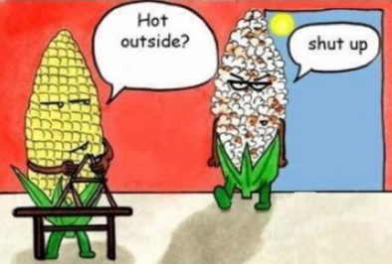
Effects of the Body’s Response
Reduced blood flow to the brain
  Reduced mental alertness and comprehension
Reduced blood flow to active muscles
  Fatigue, loss of strength
Increased Sweating
  Slippery, wet skin
Potential for a higher rate of mistakes or injury

Slide 4
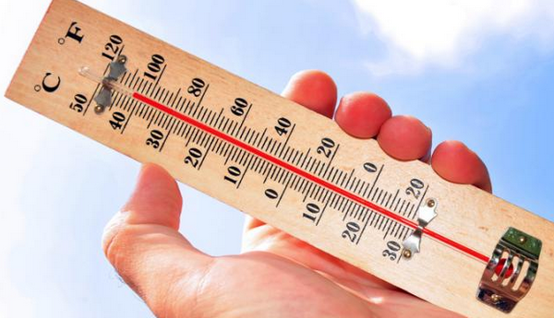
Contributing Factors
Environmental:
  Air temperature — Humidity — Air Circulation
  — Radiant Heat (sunshine) — Conductive Heat
Work-related:
  Type of work — Level of physical activity — Time spent working
  PPE — Clothing weight & color
Personal:
  Weight/fitness — Age — Low water consumption
  Use of drugs, alcohol, caffeine, medication — Prior heat-related illness

Slide 5
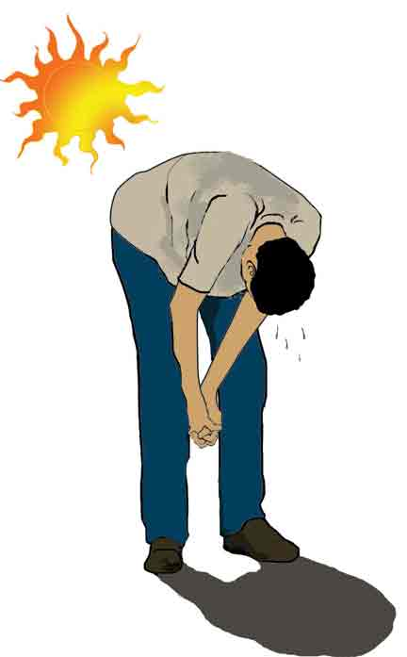
Heat Illness
Natural bodily systems fail to cool the body
Very high body temperatures can be lethal
Heat-related illnesses include:
Heat rash - skin irritation from excessive sweating
Heat cramps - muscle pains or spasms
Heat exhaustion - can precede heatstroke
Heatstroke - a life-threatening illness
Notes:
Series of medical conditions – escalating severity
Will talk about each on in more detail

Slide 6
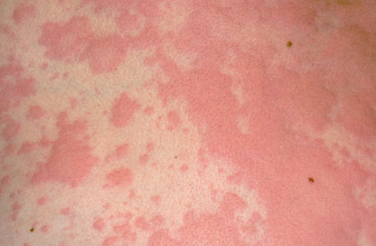
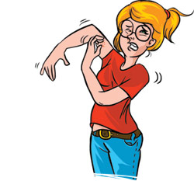
Heat Illness – Heat Rash
  Signs and symptoms:
  Clusters of red bumps on skin
  Often appears on neck, upper chest, folds of skin
  Common problem in hot work environments
What to do:
Try to work in a cooler, less humid environment when possible
Keep the affected area dry
Notes:
Also known as “prickly heat”

Slide 7
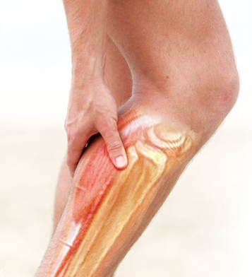
Heat Illness – Heat Cramps
  Signs and symptoms:
  Muscle spasms
  Pain
  Usually in abdomen, arms, or legs
  Can be a first sign of worsening heat-related illness
What to do:
Have worker rest in shady, cool area
Drink water or other cool beverages
Wait a few hours before allowing returning to strenuous work
Seek medical attention if cramps don't go away
Notes:
Caused by loss of salt – need to replace electrolytes

Slide 8
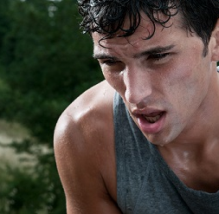
Heat Illness – Heat Exhaustion
  Signs and symptoms:
  Heavy sweating
  Weakness
  Cold, pale, and clammy skin
  Fast, weak pulse
  Nausea or vomiting
  Headache, dizziness, lightheadedness
What to do:
Move to a cooler location
Lie down and loosen clothing
Apply cool, wet cloths to as much of the body as possible
Sip water
Seek medical attention immediately for prolonged vomiting

Slide 9
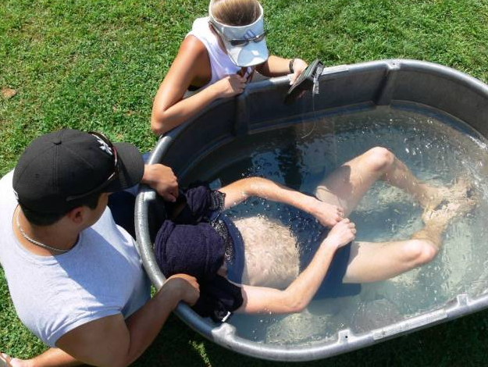
Heat Illness – Heat Stroke
Signs and Symptoms:
Very high body temperature (above 103°F)
Hot, red, dry or moist skin
Rapid and strong pulse
Possible fainting, confusion, or seizures
What to do:
Call 911 immediately — this is a medical emergency.
While waiting for emergency services:
Move the person to a cooler environment. Do NOT give fluids.
Reduce the person's body temperature with cool cloths or even a bath.
Notes:
Victim stops sweating
Victim can be more susceptible to heat illness in the future

Slide 10

Heat Illness Standard – Title 8, Section 3395
  Applies to outdoor worksites
  Must have a written plan (can be part of IIPP)
  Triggered by temperature at worksite
  Employee and Supervisor training is specified
  High heat procedures (temperature > 95F)
  Emergency response procedures
  Acclimatization procedures
Notes:
also applicable to principal investigators, students, volunteers, and activity participants.

Slide 11

Heat Illness Standard - Water
  One quart per person, per hour (2 gallons for an 8-hr shift)
  Must be “fresh, pure, suitably cool… free of charge” (potable water, not ice cold)
  As close as practicable to worksite (if not plumbed or supplied at site)
  Educate workers and actively encourage them to drink small amounts of water often (up to 4 cups/hour)

Slide 12
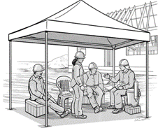
Heat Illness Standard - Shade
  Shade = blockage of direct sunlight
  Required to be available at 80F (formerly required at 85F)
  Must accommodate “the number of employees” on rest or recovery break
  Access to shade must be permitted at all times
    Must be made available upon request if <80F
    If unsafe or not feasible, define alternative procedures
Notes:
Air conditioned vehicle can be alternative, if vehicle is running and available

Slide 13
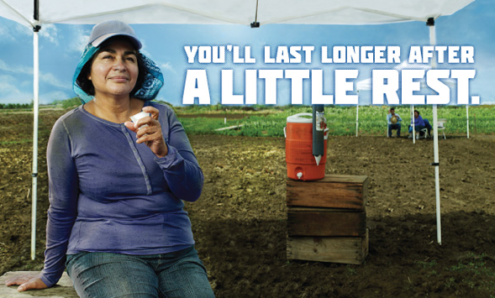
Heat Illness Standard – Cool-down Rest Periods
  Must be allowed and encouraged
  Employees shall be monitored for symptoms and signs of heat illness (observation and inquiry is sufficient)
  If symptoms or signs occur:
    First aid or emergency response is required (based on level of heat-related illness)
    Workers must not be ordered back to work, sent home, or left alone until symptoms have abated

Slide 14
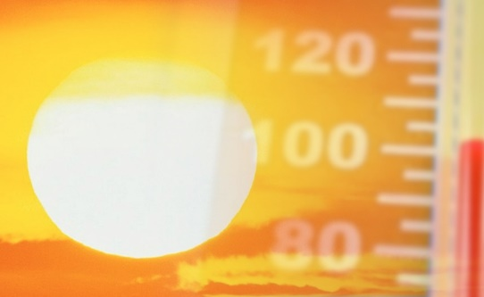
Heat Illness Standard - High Heat Procedures
  Triggered at 95F (unchanged in regulation)
  Pre-shift meeting to review high heat procedures
  Observation of employees for signs and symptoms
  Mandatory 10 minutes cool-down recovery time for each two hour period of continuous work
  Employees must be authorized and able to call for emergency service (or designate employees onsite)

Slide 15
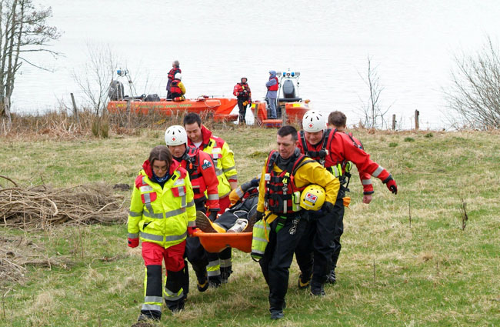
Heat Illness Standard – Emergency Response
  Ensure effective communication with employees
  First aid procedures
  Emergency medical services (how and when are they provided?)
  “Clear and precise” directions to the worksite
  Employees must be able to call for emergency service

Slide 16
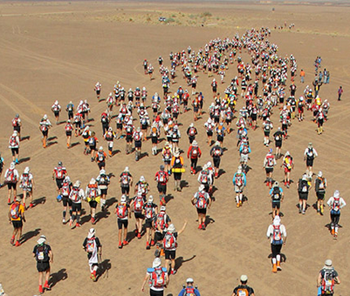
Heat Illness Standard – Acclimatization
  Include concept/definition and specific procedures in training and written plan
  Applies to new employees, heatwave events, and employees returning to work after extended absence from heat
  New employees must be observed for first 14 days
  All employees observed during heat wave events (>80F AND 10 degrees higher than average of previous 5 days)
  Procedure: define gradual increase in work hours over multi-day period or define alternative work arrangements

Slide 17

Heat Illness Standard - Training
  Employer responsibilities and worker’s rights
  Signs and symptoms of heat illness
  Personal/environmental risk factors and acclimatization
  First aid and emergency response for various levels of heat illness
  High heat procedures (pre-shift meeting required)
  Emergency response procedures
Notes:
Can use Safety Note #20
and online training – see website links at end of presentation

Slide 18

Heat Illness Standard – Written Plan
  Heat Illness Prevention Plan (English/Spanish)
  Must be available at worksite upon request
    Procedures for complying with standard (water, shade, training
    High heat procedures
    Emergency response procedures
    Acclimatization procedures
Notes:
Heat Illness Prevention Plan template
Attachment H for Injury and Illness Prevention Program (IIPP)

Slide 19
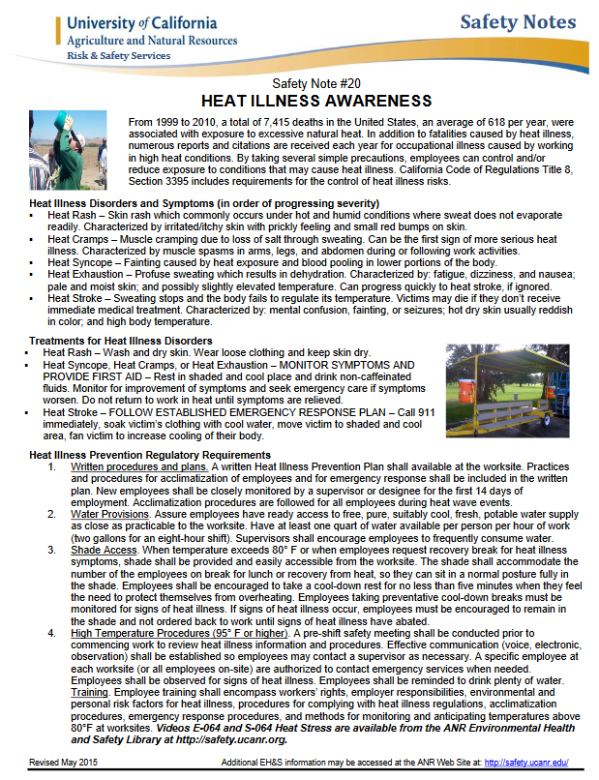
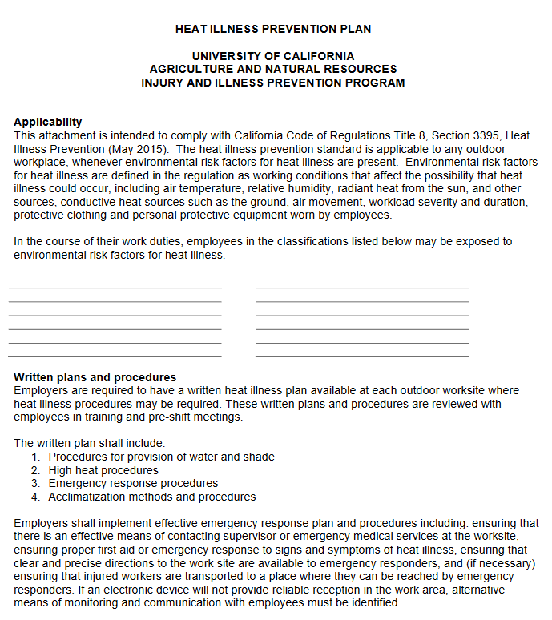
Heat Illness Standard – Helpful Resources
UC-ANR resources:
Heat Illness Prevention website: http://ucanr.edu/heatillness
Safety Note # 20: http://safety.ucanr.edu/Safety_Notes/
CalOSHA Heat Illness prevention website:
https://www.dir.ca.gov/dosh/heatillnessinfo.html

Slide 20
Heat Illness Standard – Helpful Resources
Federal government resources
OSHA picture-based pamphlet:
https://www.osha.gov/SLTC/heatillness/3422_factsheet_en.pdf
OSHA Heat Illness prevention website:
https://www.osha.gov/SLTC/heatstress/prevention.html
CDC Heat Stress website:
http://www.cdc.gov/niosh/topics/heatstress/

Slide 21
QUESTIONS?
please ‘sign-in’ before leaving

